Slide 1
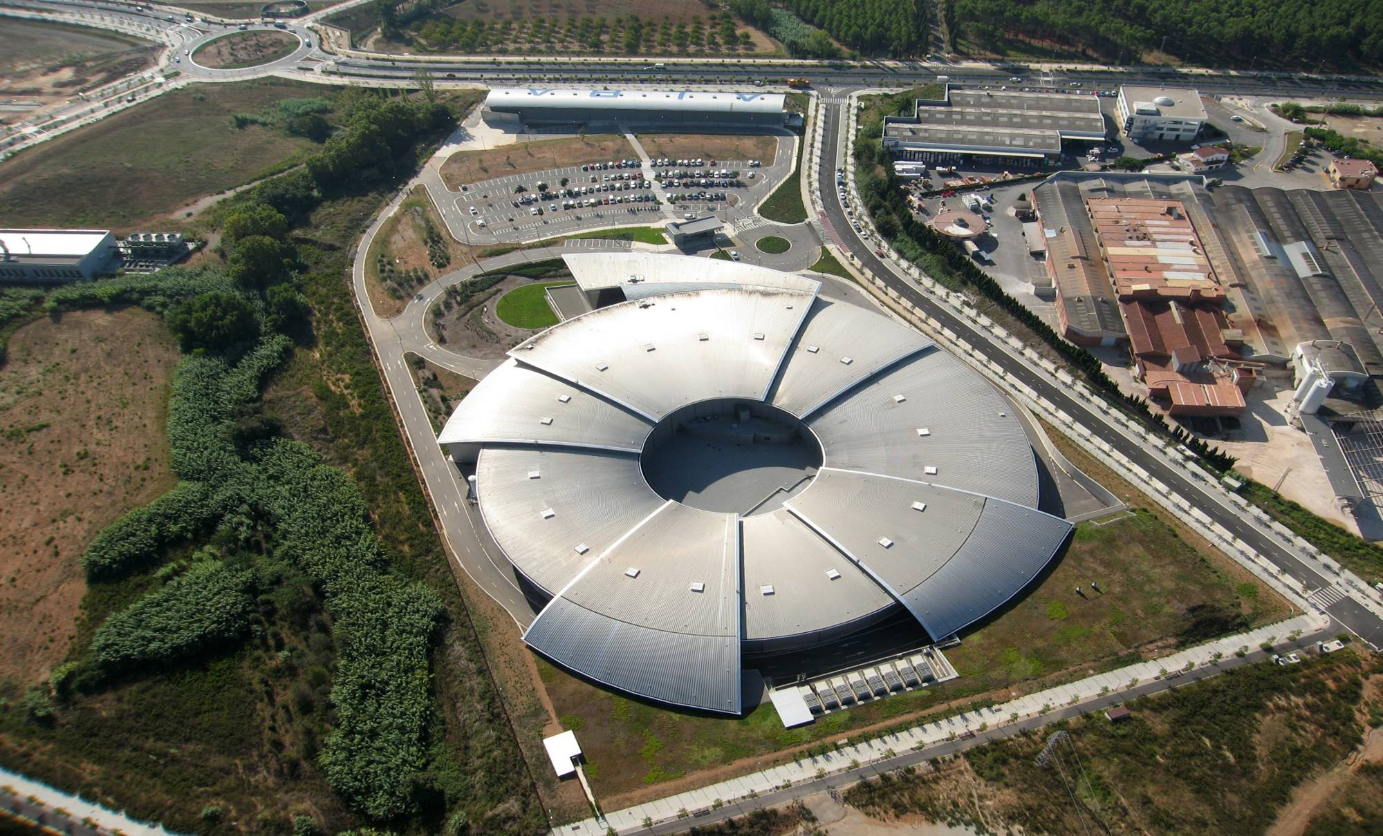
ALBA, The Spanish Synchrotron Light Source
C. Biscari

Slide 2
ALBA History
First idea of building a Synchrotron in Spain – first nineties
10 years to start + 10 years from approval to full operation
ALBA founded April 2003
ALBA 1st worker Dec 2003
Design work 2004-2005
Start construction May 2006
Start Accelerator installation Feb 2008
Start Accelerator commissioning Oct 2008
Beamlines commissioning 2011 - 2012
Start of Users Operation May 2012
Phase I Beamlines Operative February 2013

Slide 3
Organization
CELLS:
Consortium for the Construction, Equipment and Exploitation of the Synchrotron Light Laboratory
The Spanish Ministry of Economy and Competitiveness and the Catalan Ministry of Economy and Knowledge have equal share in this public body, both for construction and for exploitation.
Prof. Ramon Pascual is the President of the Consortium
ALBA – CELLS is the biggest scientific infrastructure in Spain.
65.000 mq plot of land, 18500 covered by buildings.

Slide 4
Organization
CELLS:
Consortium for the Construction, Equipment and Exploitation of the Synchrotron Light Laboratory
The Spanish Ministry of Economy and Competitiveness and the Catalan Ministry of Economy and Knowledge have equal share in this public body, both for construction and for exploitation.
Prof. Ramon Pascual is the President of the Consortium
ALBA – CELLS is the biggest scientific infrastructure in Spain.
65.000 mq plot of land, 18500 covered by buildings.

Slide 5
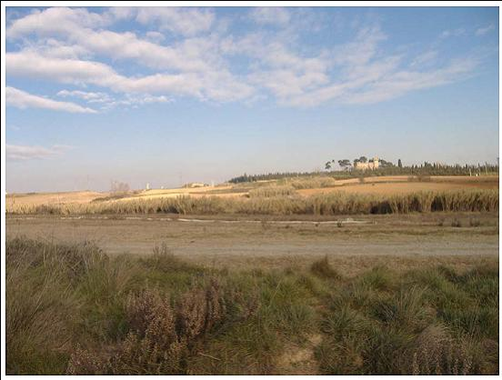
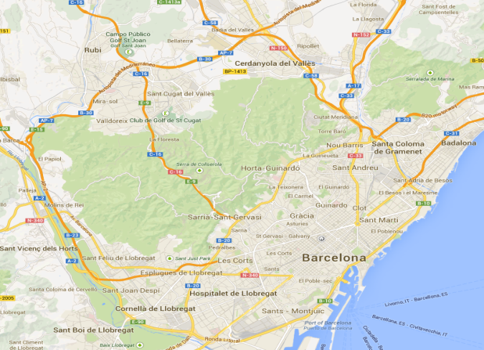
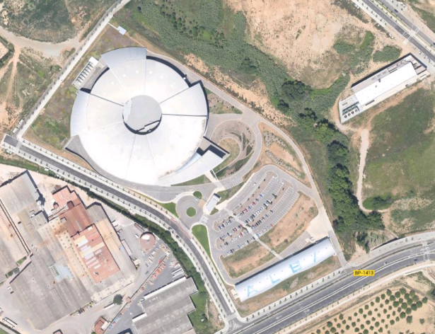
On 2006 the excavation started on a green field at ~ 15 km from Barcelona

Slide 6
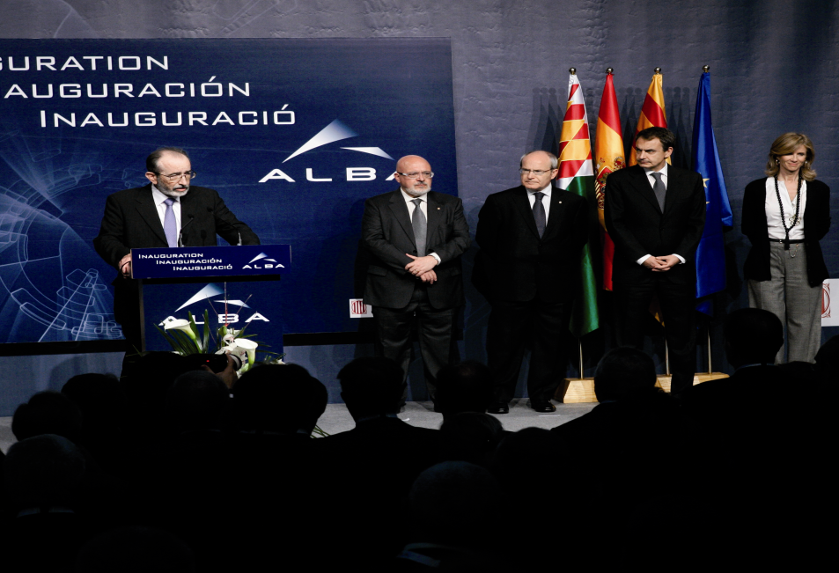
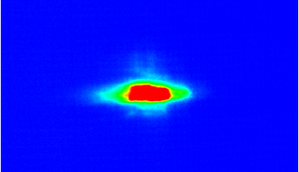
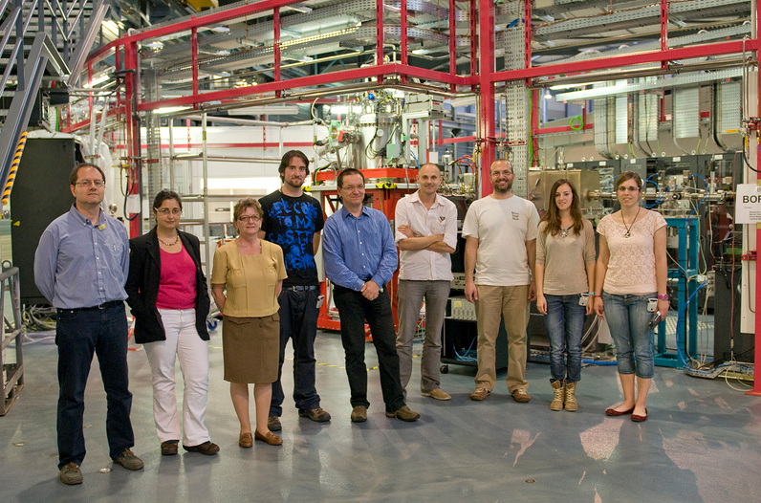
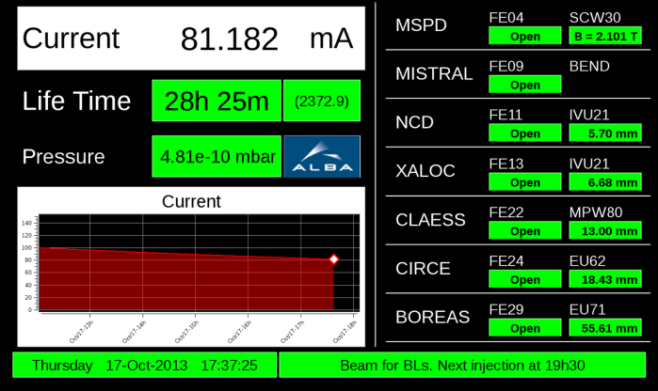
Some important dates
22 March 2010 - Inauguration
16 March 2011: First Synchrotron Light in the SR
7 May 2012 : First external user at Boreas BL
17 December 2012 : First Publication with data collected at ALBA
Since February 2013: All Phase I Beamlines operational
22-03-2010
16-03-2011
7-05-2012

Slide 7
ALBA Staff Organization
Presidency
Direction
User office
Communication
Safety
Experiments
Accelerators
C&C
Engineering
Administration
Staff ~ 160 people
International representation ~ 25%
Average age ~ 35 years

Slide 8
View from above

Slide 9
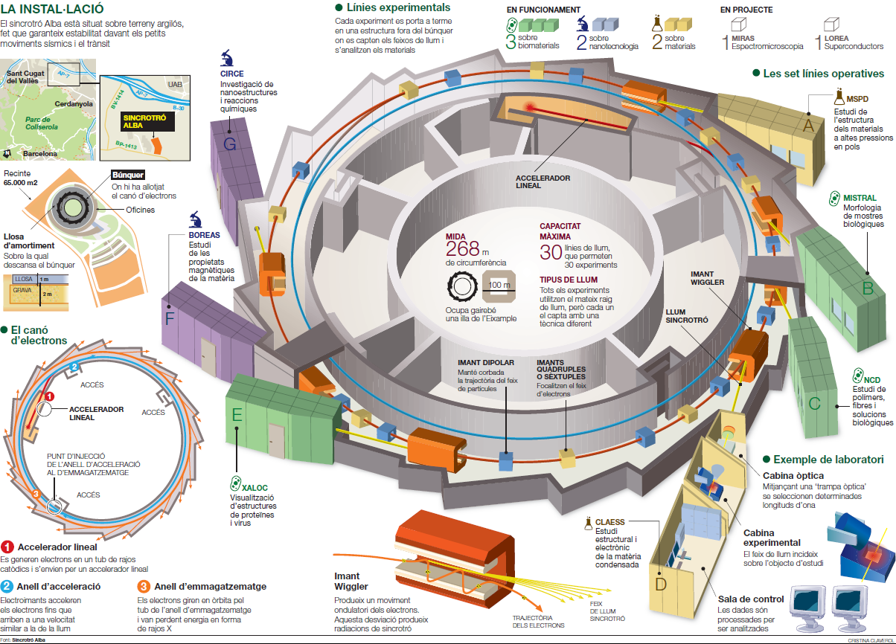
Sketch of the infrastructure
El periodico 05-05-13

Slide 10
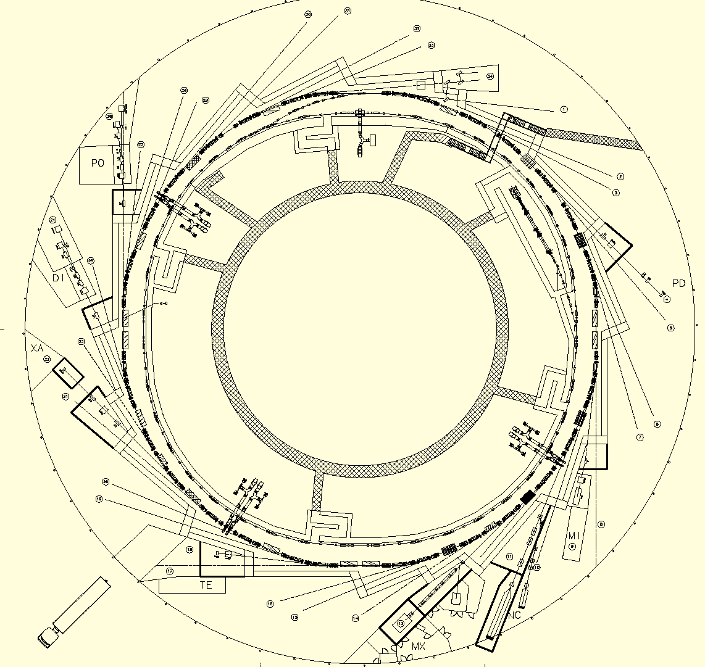
Accelerator layout
Synchrotron
Linac
Booster

Slide 11
Storage ring and Booster main parameters
 | Storage Ring | Booster Extraction
Beam Energy | 3 GeV | 3 GeV
Natural Hor Emittance | 4.6 nm*rad | 9 nm*rad
Tunes (h / v) | 18.15 / 8.36 | 12.42 / 7.38
Natural Chromaticity (h / v) | (- 40.0 / -25.6) | (-17.0 / -9.6)
Momentum Compaction Factor | 0.88 x 10⁻³ | 3.6 x 10⁻³
Energy Spread | 1.05 x 10⁻³ | 0.96 x 10⁻³
Revolution Time | 896 ns | 832 ns
Damping Times (h / v / l) | (4.6 / 8.0 / 6.4) ms | (4.6 / 8.0 / 6.4) ms
Partition Numbers (h / v / l) | (1.3 / 1.0 / 1.7) | (1.75 / 1.0 / 1.25)
Energy Loss per Turn (no IDs) | 1.2 MeV | 0.625 MeV
Harmonic Number | 448 | 416
ALBA accelerators

Slide 12
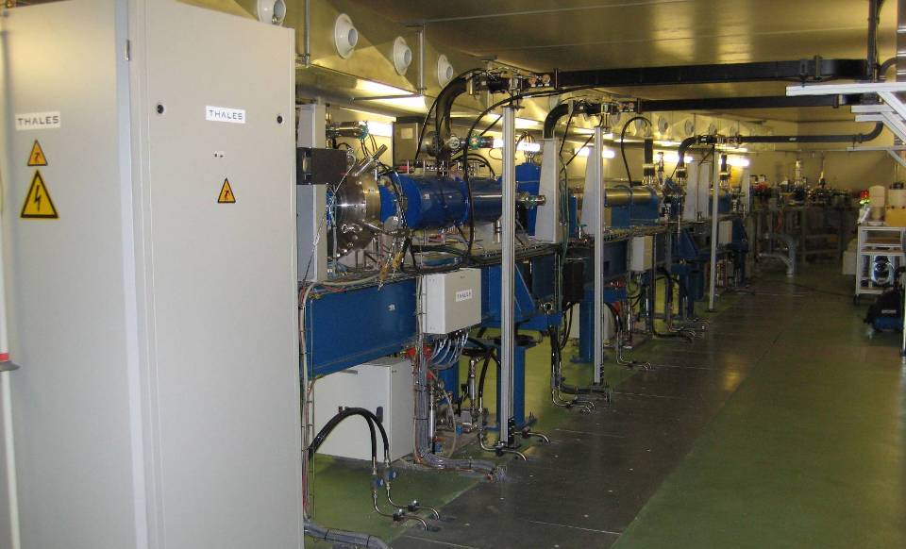
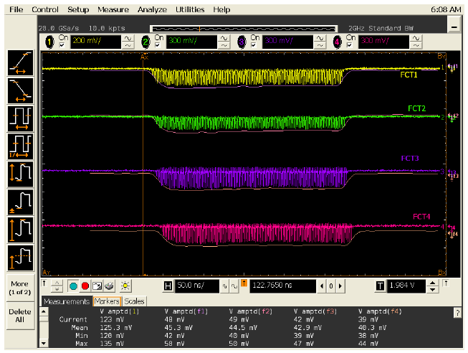
LINAC
Beam energy at gun: 90 keV
Beam energy at buncher exit: 15 MeV
Pulse length: 40 to 1000 ns
Pulse charge : 4 nC
Normalized emittance: 15 p mm mrad
Electron
Gun
Subharmonic 500 MHz prebuncher
and 3GHz prebuncher
100 MeV – 10 m long
3 GHz, 2π/3 Travelling wave
3-5 Hz rep rate
FCT signals

Slide 13
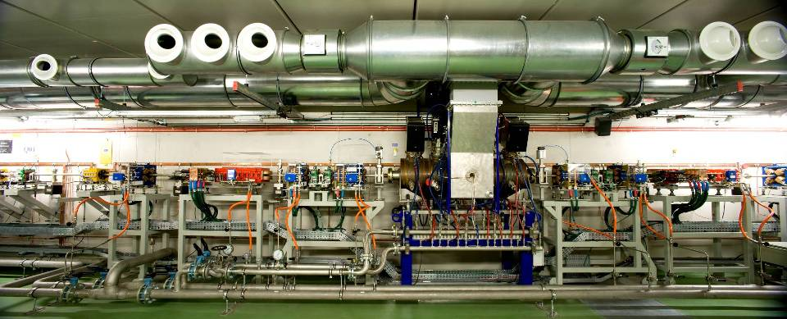
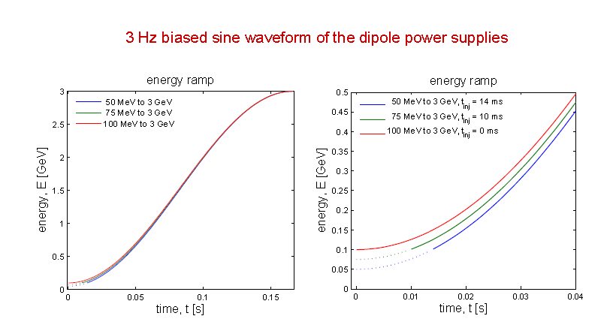
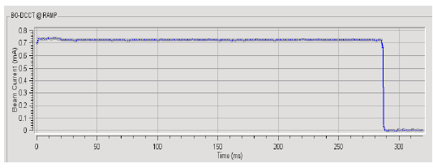
BOOSTER
Acceleration from 100 MeV to 3 GeV
in 150 msec, 3 Hz rep rate
~ Same circumference of SR, sharing same tunnel
Low emittance == better injection efficiency
Booster current

Slide 14
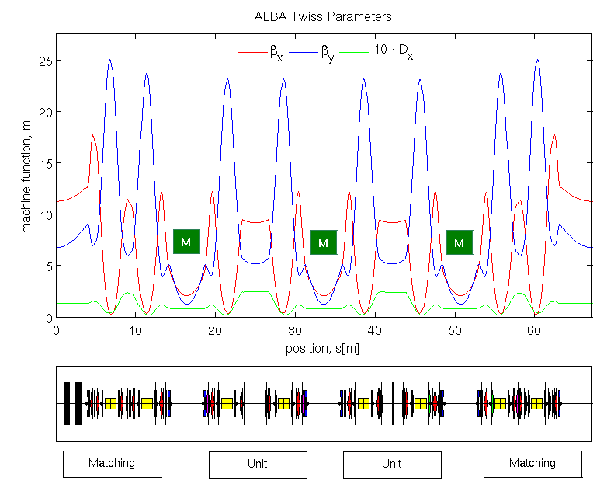
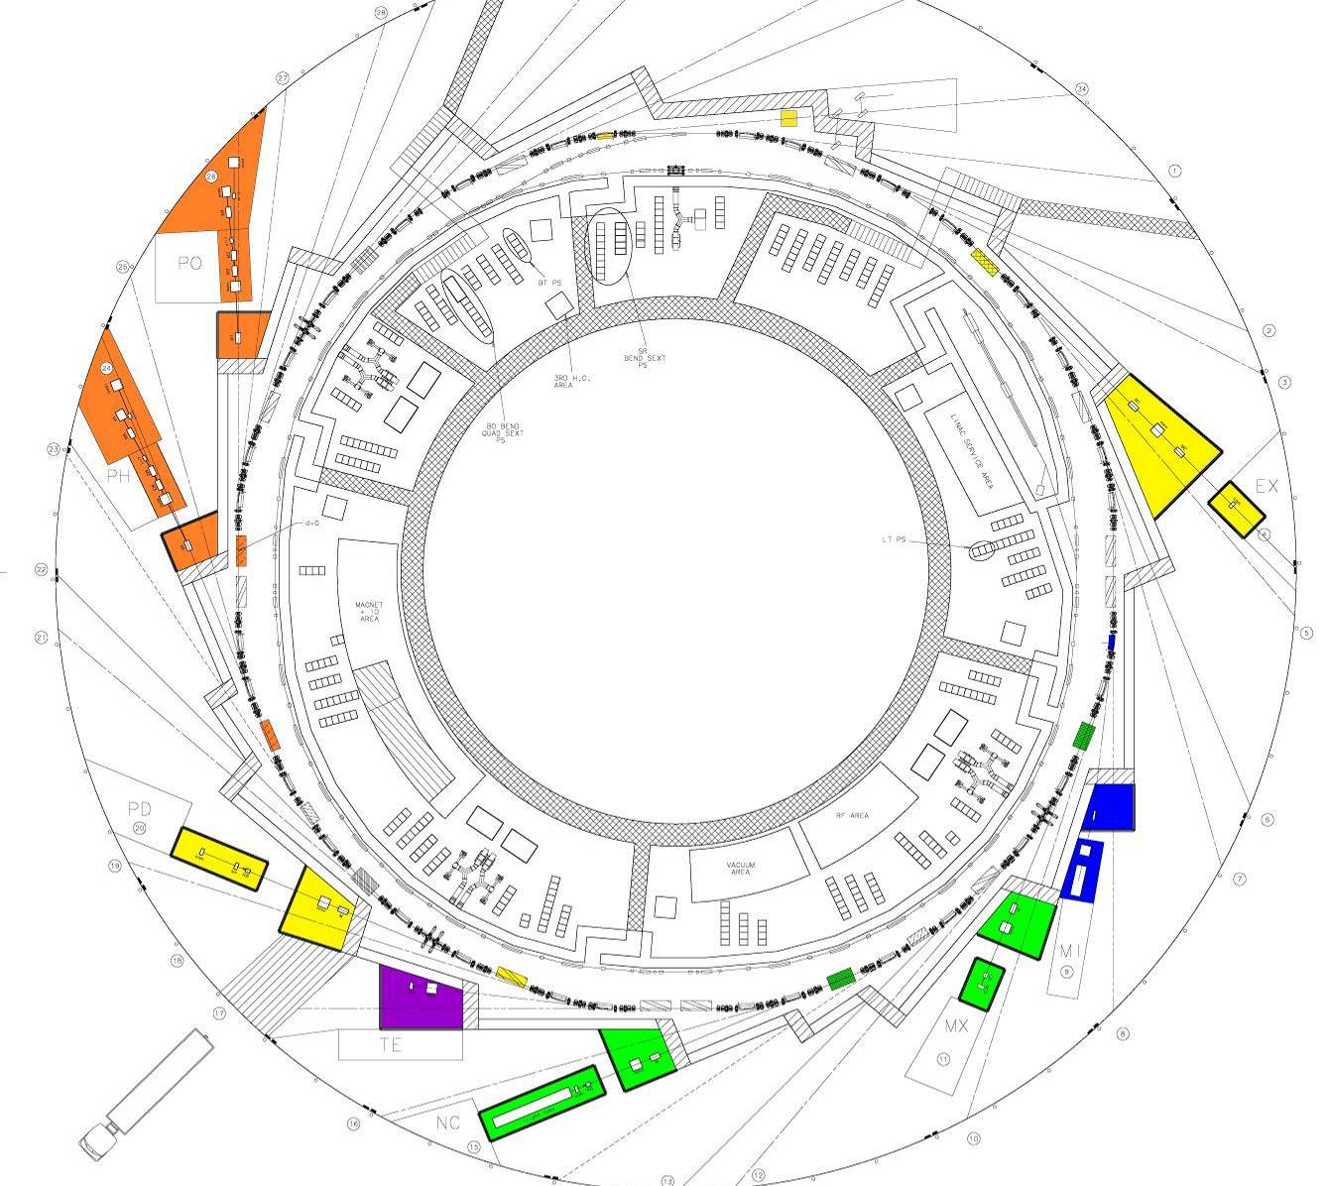
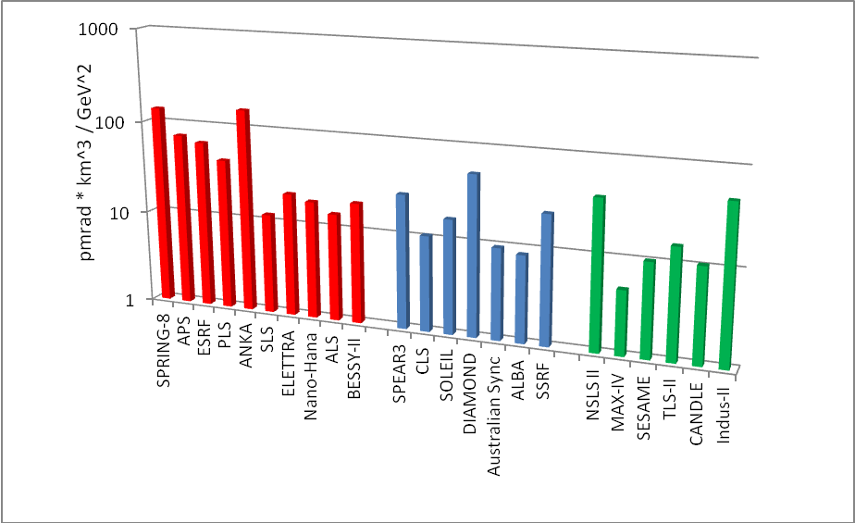

Synchrotron Ring
expanded DBA + Fourfold symmetry
Non zero dispersion in straights: low emittance
in spite of low # of dipoles
Compact lattice, combined function dipoles
Large number of straights in spite of relatively short circumference (270m)
Figure of merit, the lower the better

Slide 15
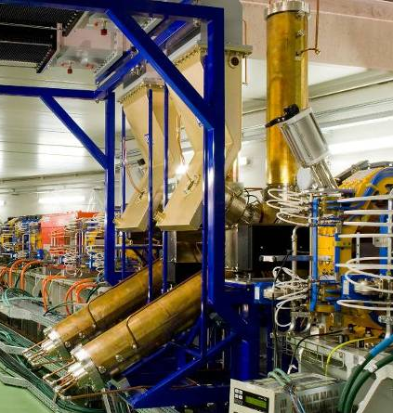
RF system
6 RF cavities (DAMPY, designed by a EU collaboration)
500 MHz
Normal conducting
nose cone
HOM damped
Designed for 500 kW beam power (400 mA)
Powered by IOTs (Inductive Output Tubes)

Slide 16
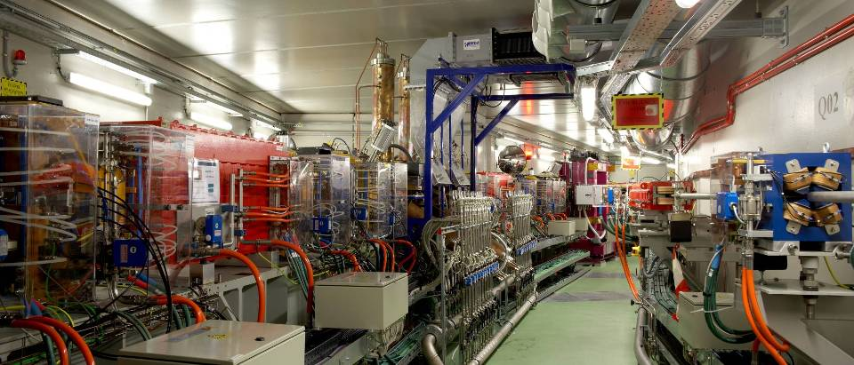
View in the tunnel
Bending
RF cavities
In vacuum undulator
SR
3 GeV
Booster
0.1 – 3 GeV

Slide 17
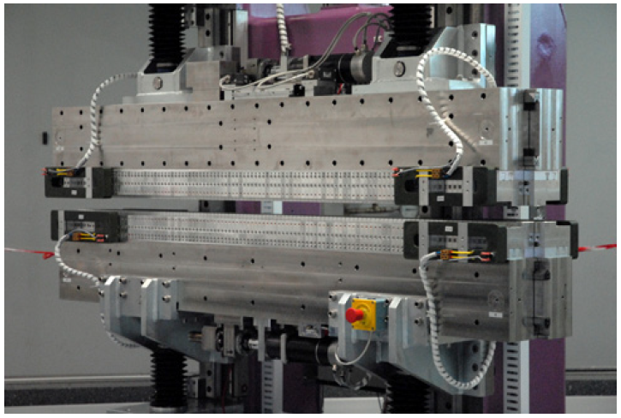
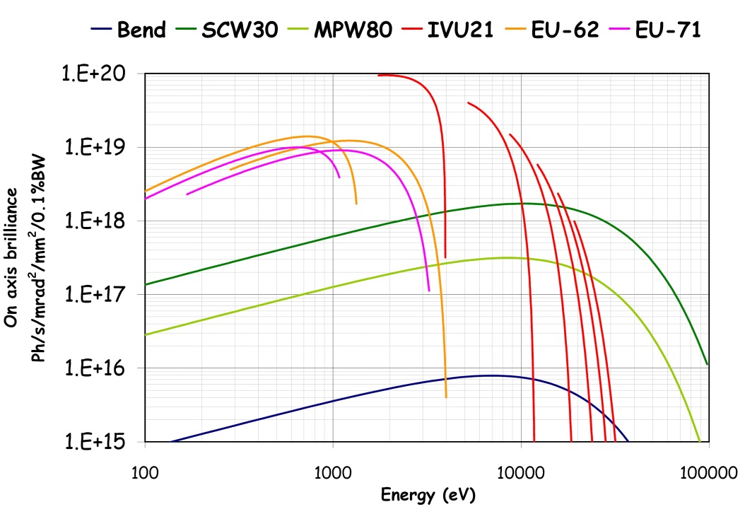
Six Insertion Devices
Beamline | Experiment | ID type | ID name | Min gap (mm) | Period (mm) | N. of periods | Magnetic Length (mm)
BL04 | Powder diffraction | Superconducting wiggler | SCW-31 | 12.4 | 30.2 | 58.5 | 1764
BL11 | Non-Crystalline Diffraction | In-vacuum undulator | IVU-21 | 5.7 | 21.6 | 92 | 1987
BL13 | Protein Crystallography | In-vacuum undulator | OVI-21 | 5.7 | 21.6 | 92 | 1987
BL22 | X-Ray Spectroscopies | Multipole wiggler | MPW-80 | 12.5 | 80.0 | 12.5 | 1000
BL24 | Photoelectron Spectroscopies | Apple-II undulator | EU-62 | 15.5 | 62.4 | 27 | 1684
BL29 | X-Ray Magnetic Circular Dicrhoism | Apple-II undulator | EU-71 | 15.5 | 71.4 | 22.25 | 1588
Spectral range: from 80eV to hard X-rays (50 keV)
17

Slide 18
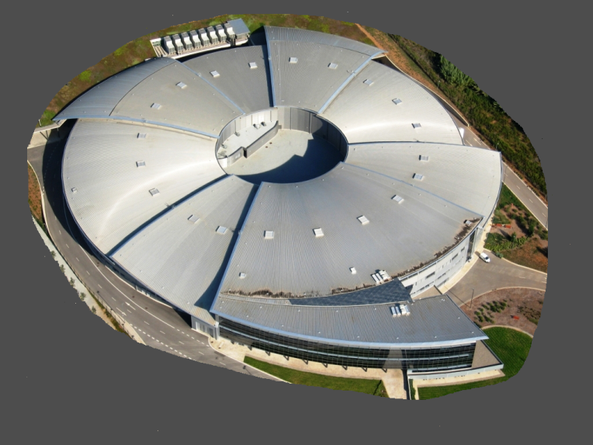
Phase I Instruments in ALBA
Photoemission
Spectroscopy and Microscopy
CIRCE: PEEM & NAPP
Resonant Absortion and Scattering
BOREAS: Hector & MARES
In commissioning
Material Science & Powder Diffraction
MSPD: HR & HP
Non cristalline
Diffraction
NCD
Core Level Absorption and Emission
Spectroscopy
CLAESS
Soft X-Ray
Microscopy
MISTRAL
Macromolecular
Cristallography
XALOC

Slide 19
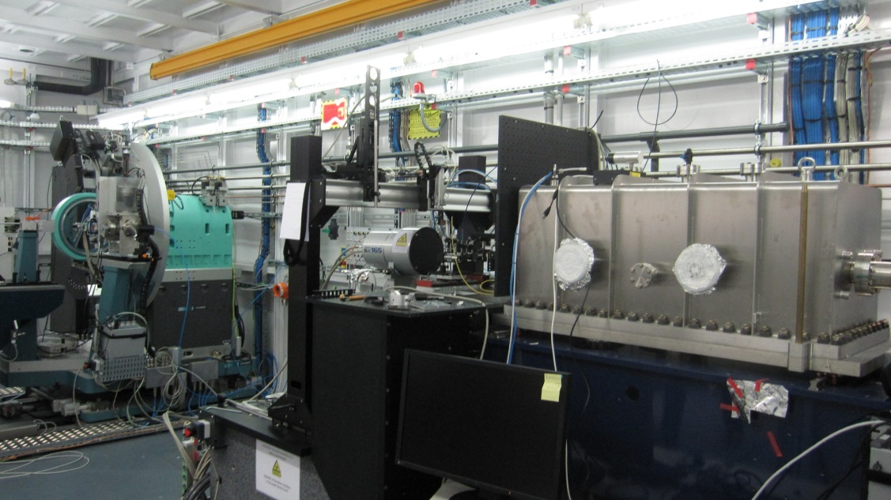
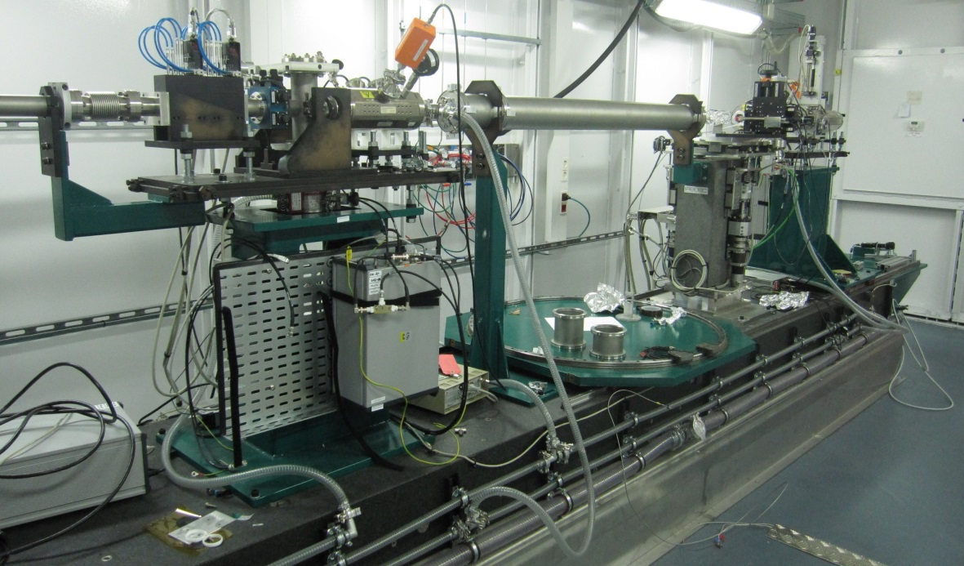
BLs dedicated to Chemistry
Material Science Powder Diffraction
Two state-of-the-art end-stations:
High resolution powder diffraction (10 μm spot size) - Mythen detector
High pressure powder diffraction - diamond anvil cells (100 μm) - Multi Analyser Detector
SC Wiggler : 8 to 50 keV
MSPD
Core Level Absorption % Emission Spectroscopies
Quick EXAFS
Hybrid wiggler: 2.4 – 65 keV
A fluorescence spectrometer, now in commissioning, will be one of the few instruments worldwide performing inelastic hard X ray scattering
CLAESS

Slide 20
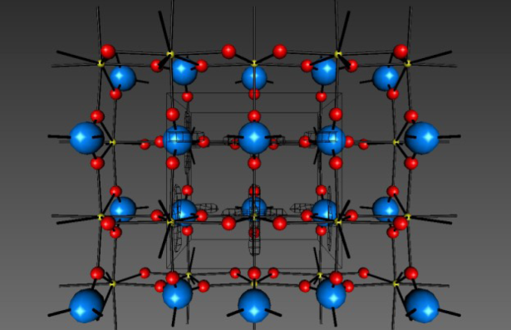
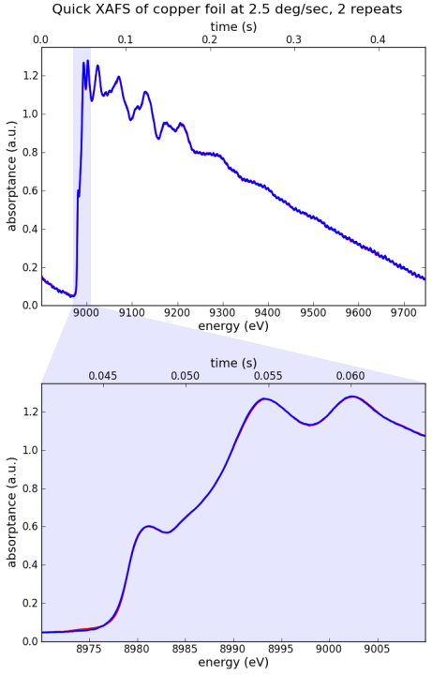
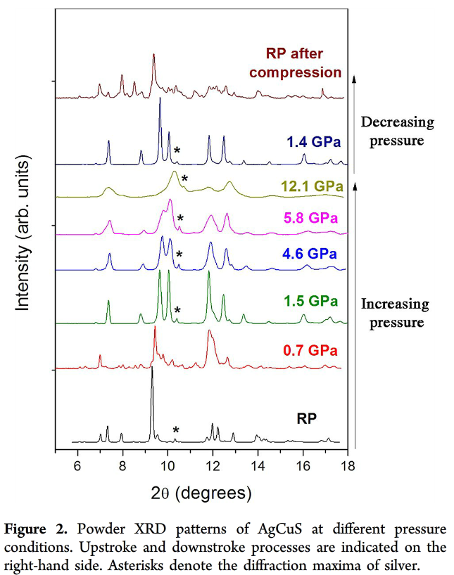
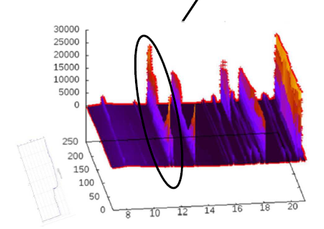
Example of experiments (MSPD & CLAESS)
Materials Structure,
Pharmaceutics.
Geological materials,
Ceramics, …
Chemical analysis,
Chemical reactions,
Environment
Catalisis
Zircon to monazite phase transition in NdVO4
25 msec
First quick XAFS at CLAESS

Slide 21
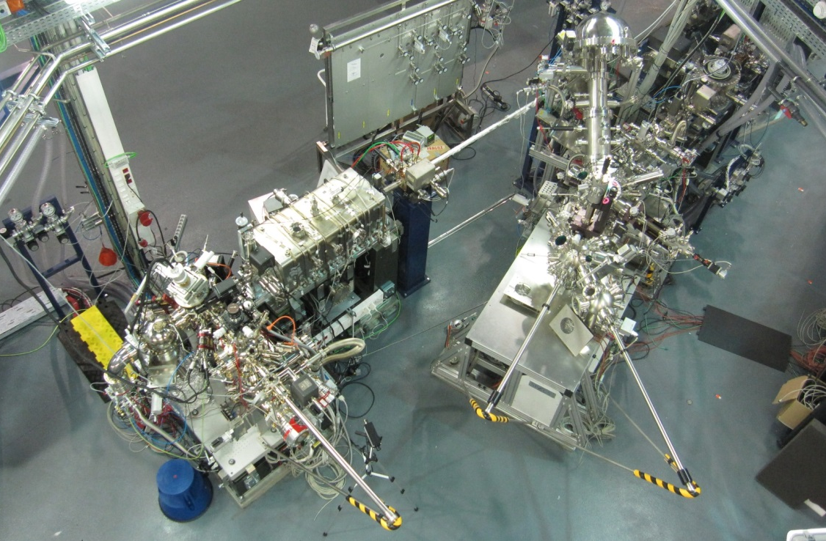
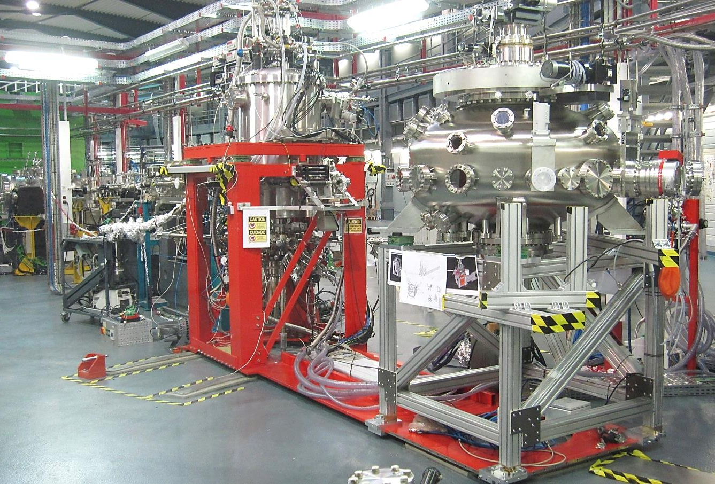
BLs dedicated to Physics - Condensed Matter - soft X rays
Variable polarization BL dedicated to advanced photoemission microscopy
and spectroscopy.
  PEEM (PhotoEmission Electron Microscopy)
  NAPP (Near Ambient Pressure Photoemission).
Apple II undulator: 100 - 2000 eV
CIRCE
Beamline fOr REsonant Absorption and Scattering
Polarization-dependent spectroscopies of advanced materials.
Two cutting edge end stations:
  HECTOR vector magnet (up to 2 / 6 Tesla) for absorption methods
  MARES UHV reflectometer for scattering and reflection measurements
PM Helical undulator: 80 to 4000 eV. Will be unique worldwide
BOREAS

Slide 22
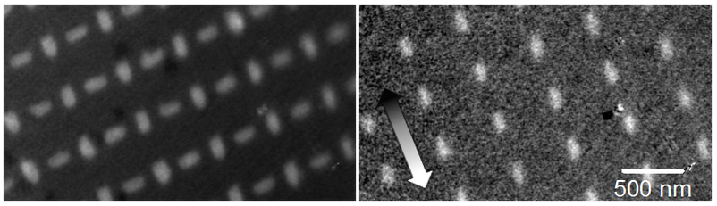
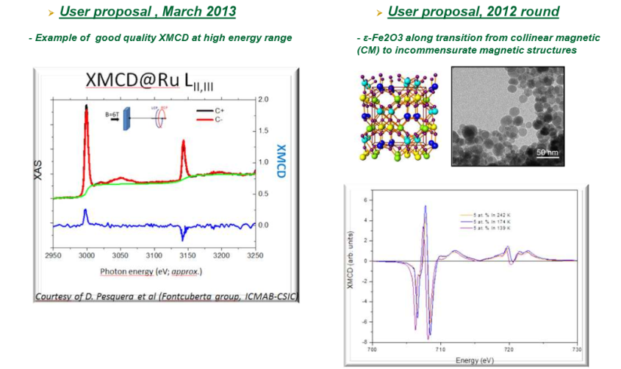
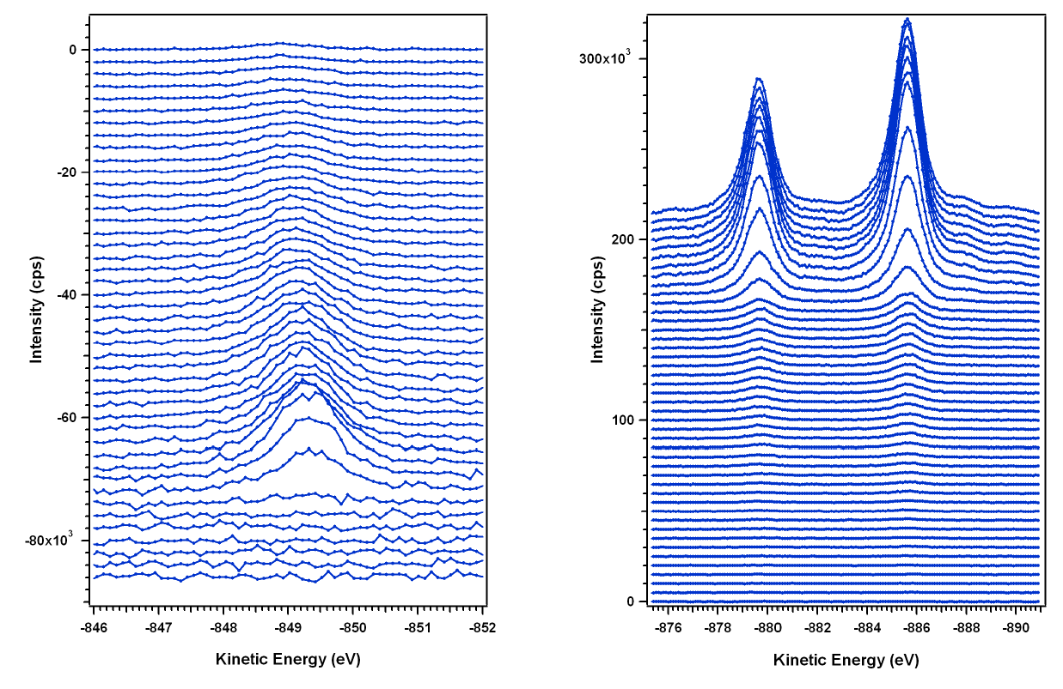
Example of experiments (CIRCE & BOREAS)
Nanomaterial, surface,thin films
Microscopy
Catalysis
Magnetism
Sample courtesy of P. López-Barberá & J. Nogués from ICN Barcelona and J. Perron & L. Heydermann from PSI Switzerland).
Permalloy (NiFe) nanostructures dimension 80nm*200nm*30nm (W*L*H) appear bright, while the Si background is dark (chemical contrast) and XMCD image
N1s
Difference in absorption of right and left handed circularly
Polarized X rays informs on the magnetic properties of the sample
NAPP XPS Ag sample/Mg Kα
From UHV (top) to 25 mbar N₂ (bottom)
Ag3d

Slide 23
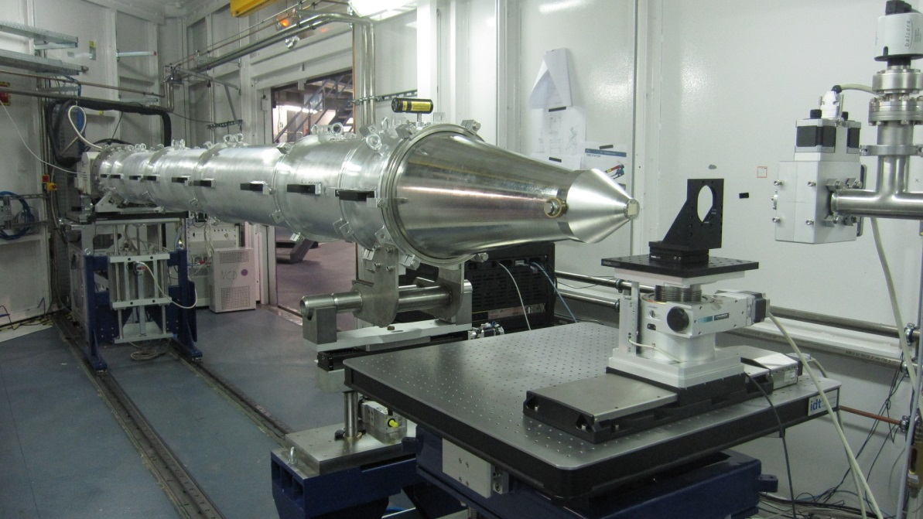
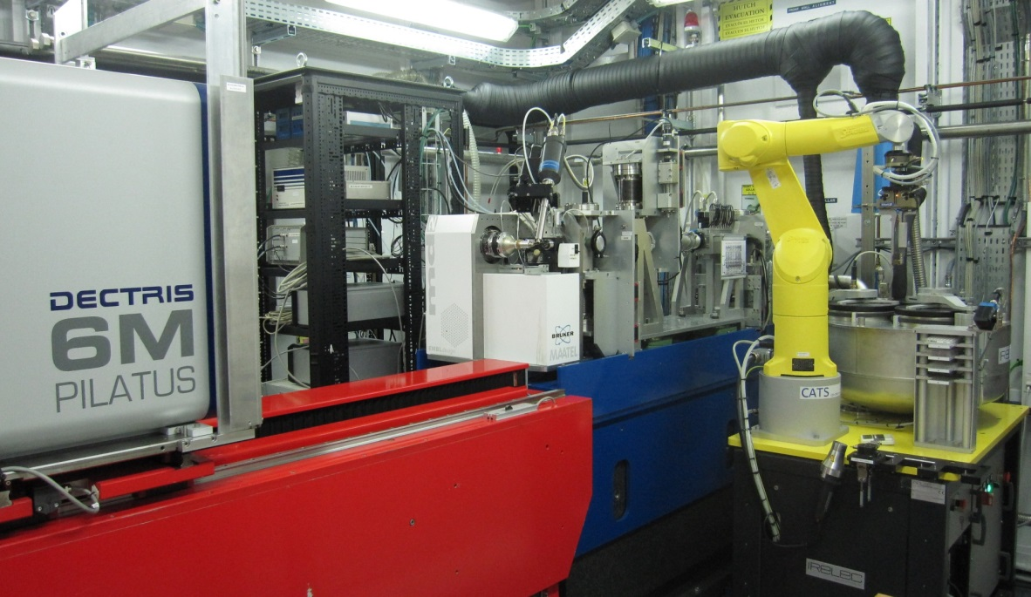
BLs dedicated to Life Sciences
Non Cristalline Diffraction
Simultaneous recordings of SAXS and WAXS for structural and functional insight at molecular level
Study of long- and short-range structures in soft condensed matter
Time resolution of milliseconds or faster – important for kinetic processes
To be installed a 2D SAXS detector, able to collect 500 frames/sec and microfocusing down to <10 μm beam size
In-vacuum undulator : 6.5 to 13 keV
NCD
Macromolecular Crystallography
Flexible and reliable for solving structures of macromolecules and complexes
MAD (multi-wavelength anomalous diffraction) based
Copes with a broad variety of crystal sizes and unit cell parameters
Allows both wavelength dependent and independent experiments
PILATUS detector
In-vacuum undulator: 5 to 22 keV
XALOC

Slide 24
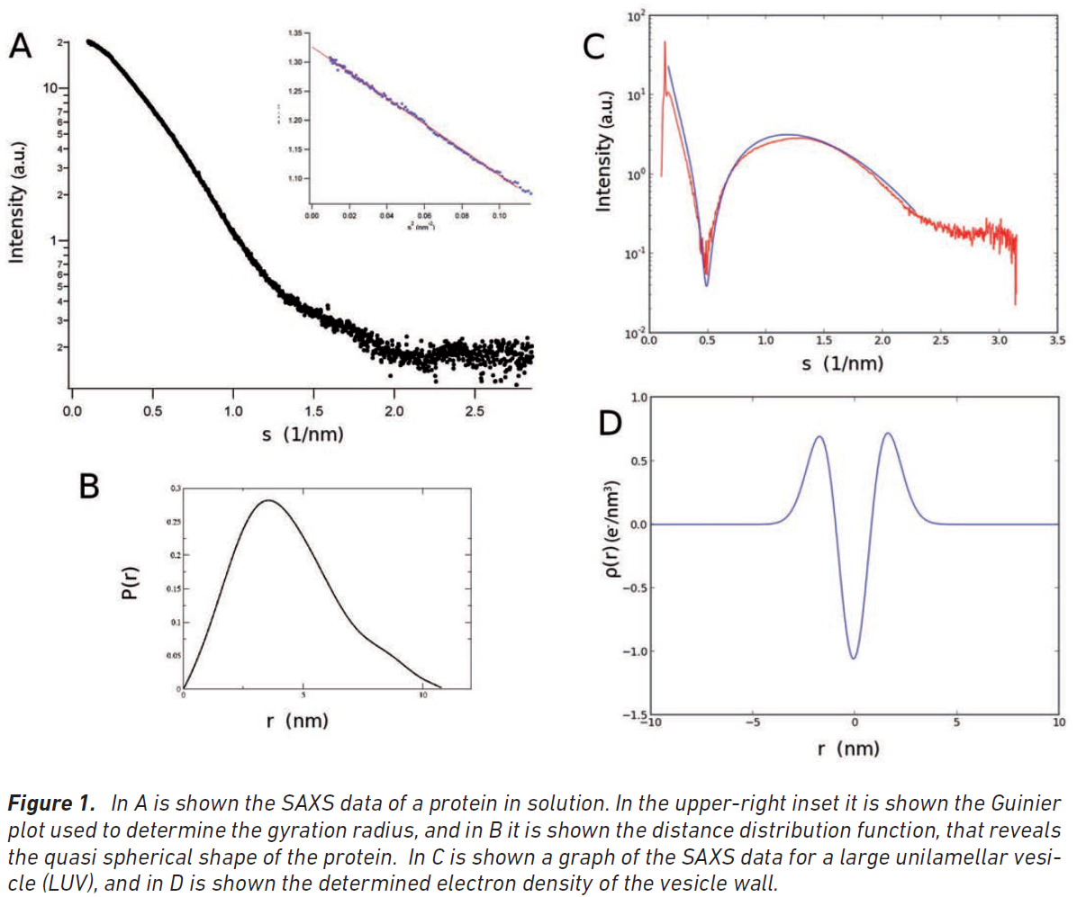
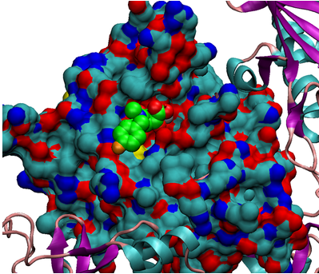
Examples of experiments (NCD & XALOC)
Fibers, Polimers,
Biological solutions
Proteins and virus structures
More than 3000 crystals analyzed since fall 2012
Protein in solution
Herpesvirus nuclease-antiviral complex
Bongarzone, S., Nadal, M. & Coll, M., IBMB

Slide 25
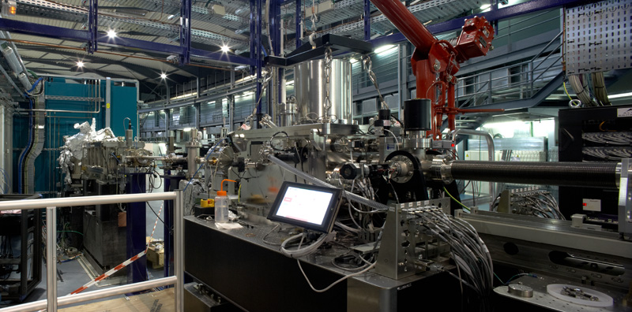
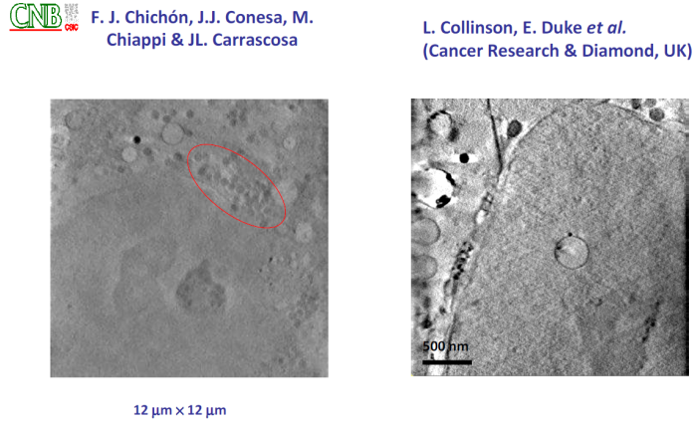
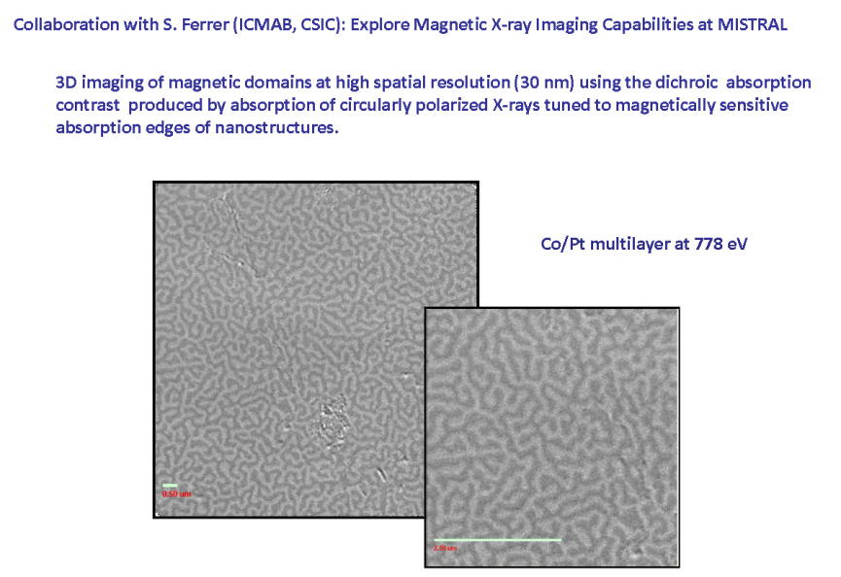
BL09 Mistral : Transmission Soft X-Ray Microscopy
Only two other similar Microscopes in the world: BESSY-II and ALS
Microscopy Beamline
Cryo nano-tomography in water window and multi-keV spectral regions for biological applications.
Spectroscopic imaging of thin films.
Present photon energy range: 270 to 1200 eV, upgradable to 2600 eV in the future.
30 nm 2D resolution

Slide 26
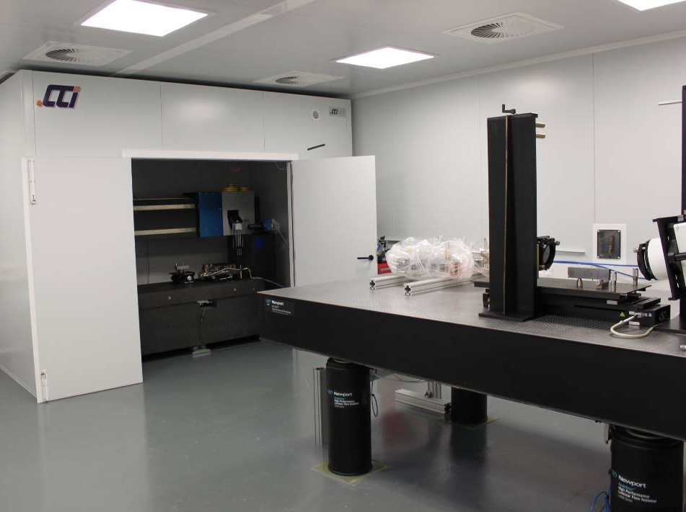
The optics metrology laboratory
FIZEAU INTERFEROMETER
Alba-NOM (LTP)
NOM enclosure
NOM: nanometer optical measuring machine

Slide 27
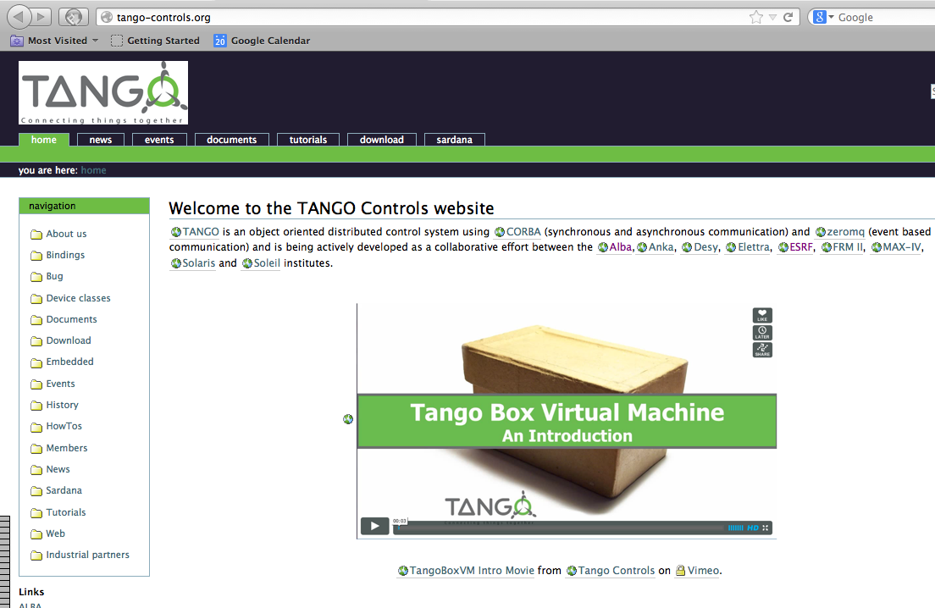
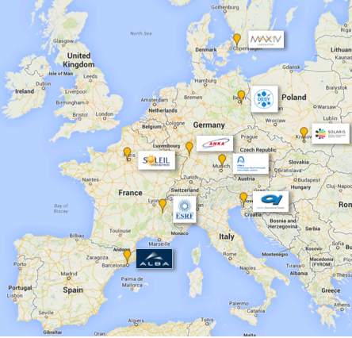

TANGO: the control system for accelerators and Beamlines
Active collaboration among nine scientific institutions in Europe.
Communication layer based on CORBA and ZMQ and implementing C++, Java and Python as programming languages.
Management and self-diagnostic tools
Code generators
Evolving into SARDANA, a generic program for control applications in large and small installations

Slide 28


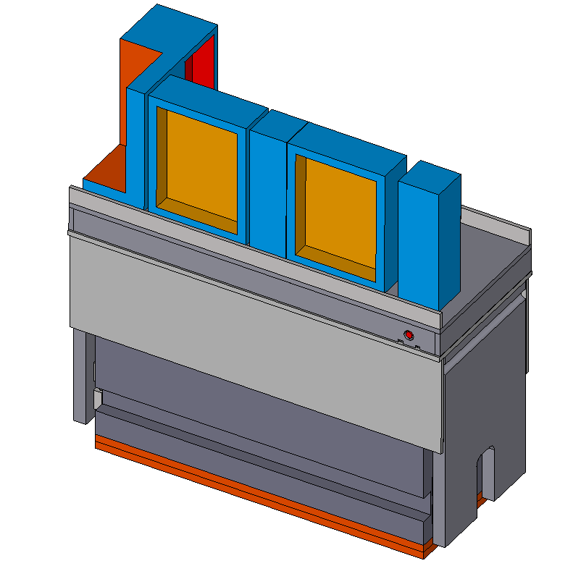
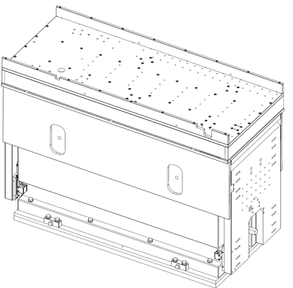
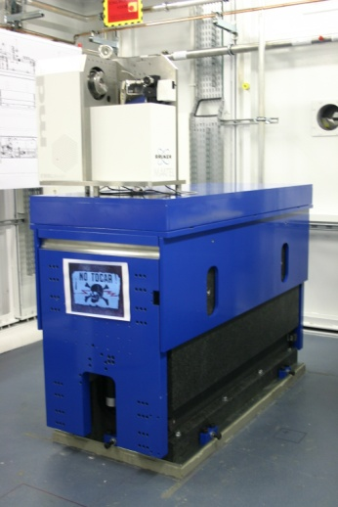
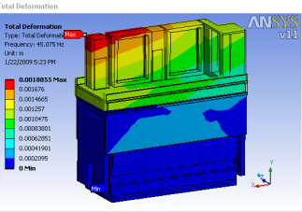
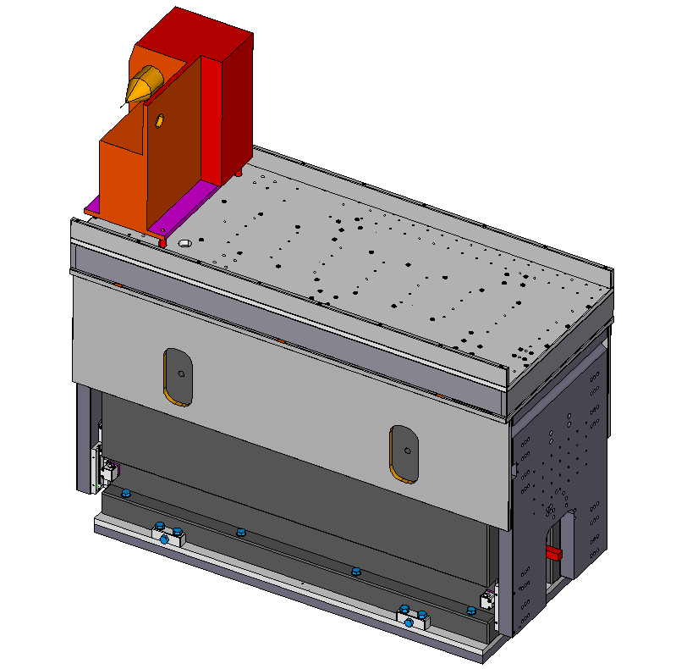
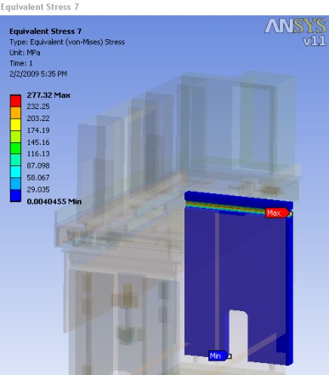


Engineering Division: design, support, maintenance
Example: XALOC supports - from Design to installation
4
Scientific case, specifications
Conceptual Design
Detailed Design
Manuf. & Inst.
Integration

Slide 29
One year of Operation
29

Slide 30

2012: Start of user operation
94.2% avaibility of beam on average for Jan.-Oct. 2012
First official use at one BL
e- beam current
100 mA
FE open
2012

Slide 31


Operation in 2013
All BLs simultaneously hosting users
beam availability: 98.5%
97.7%
94 %
120 mA
Shutdown due to
cooling system problem
15 January – 31 March
18 June – 25 July

Slide 32

Operation since summer shutdown
beam availability ~ 98%
120 mA
Top-up operation foreseen for late spring 2014
Nominal current (250 mA) to be reached thereafter

Slide 33

Usual operation : 2 injections per day

Slide 34

In preparation of top-up mode of injection
Maintaining constant current of electrons through continuous injection process

Slide 35

Operation calendar 2014
5240 hours
3888 BL
Two long shutdowns for actions on cooling system plus maintenance

Slide 36
Users

Slide 37
Three user calls
Non national
2012 – 18%
2013 – 22%
2014 – 26%
Average Overbooking factor: 2 – 2 - 2.5

Slide 38
2014 – 3rd User call, closed on 4th Nov.
250 proposals

Slide 39





Industrial users
    Henkel – Performing Experiments on adhesives (MSPD) - PostDoc on board since 16 sept.
    Almirall – Performing experiment on pharmaucetics (MSPD)
    PhD student financed
    Collab. with Structural Drug Discovery Section defined (XALOC)
    ICIQ (Fundació Institut Català d’Investigació Química) de Tarragona.
    Experiment performed in MSPD (sept13)
    Enantia and Labcrew – Experiments in nov13
+ Contacts with
Many others

Slide 40
Future
OBJECTIVES 2013-2016
Full exploitation, upgrade of existing BL and completion of the accelerator potentiality
New BeamLines start-up
Three scientific areas
Nanoimaging for nanoscience and nanotechnology,
Pump-and-probe experiments for investigating the dynamics of physical, chemical and biological processes
Coherent diffraction-related techniques

Slide 41
Potentiality for new BLs
Original strategy plan: 3 BL every 2 years
Present economic situation preventing this plan realization
2 Phase II BL already scientifically approved
Alternative plans for funding being prepared

Slide 42
Discussion on new BLs on going
# | Beamline | Source | E or λ | Techniques | Scientific field
8 | MIRAS | bending magnet | 10-100 mm | spectroscopy, imaging | biosciences, material science
9 | Instrument development | bending magnet | 5-20 keV | optics detector development | instrumentation: mirrors, detectors
10 | Nano-focusing | IV undulator | 5-20 keV | spectroscopy, imaging | materials science, environment
11 | LOREA | long period undulator | 4 -100 eV | angular resolved photoemission | nanoscience, cond. mat. physics
12 | Absorption Diffraction | bending magnet | 5-20 keV | absorption, diffraction | cultural heritage, material science industrial research
13 | Coherent-diffraction | IV undulator | 5-20 keV | coherent diffraction, m-diffraction | biosciences, material science
14 | Micro PX | IV undulator | 5-20 keV | micro crystallography | biosciences

Slide 43


8th BL: MIRAS: Spectro-imaging Infrared beamline
In construction
Bending magnet radiation
Microscopy resolution : 1 μm
live samples may be studied
Applications in: Material Science
Cultural Heritage
Medicine
Collaboration with Soleil Group
Most of the mechanical components will be engineered at Alba and
manufactured nearby:
Mirror extraction system, supports, mechanical adjustments of the mirrors,
non standard vacuum chambers
IR microscope
Bending
magnet

Slide 44
Collaborations, among others:
CERN – CLIC, LHC, accelerators, beam diagnostics
SESAME – Measurement of SR dipoles, training scientists
MEXICO – Future project of a new synchrotron radiation facility, training scientists and participation in the project design
CLPU – Design of laser chamber
SOLEIL – Design of MIRAS
ELI III Pillar – Participation in gamma system
WEIZMANN Institute from Israel – exchange of scientists
TANGO & SARDANA
And of course SSRF

Slide 45

16 November 2013 : Open Day
Thank you for your attention

