Slide 1
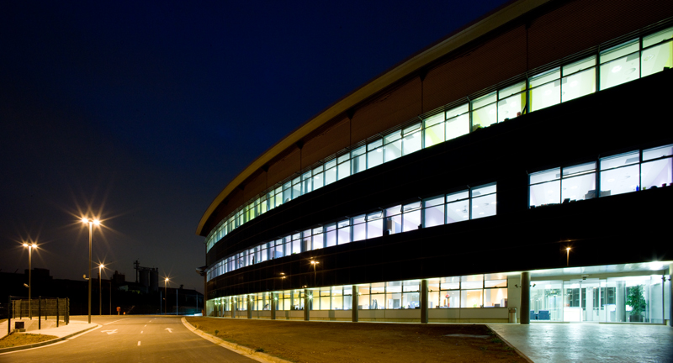
MACHINE OPERATION AT ALBA
Montse Pont, CELLS-ALBA
16-18/12/2013

Slide 2
Outlook
Introduction to ALBA accelerators
Operation of ALBA accelerators in 2013
Ongoing projects

Slide 3
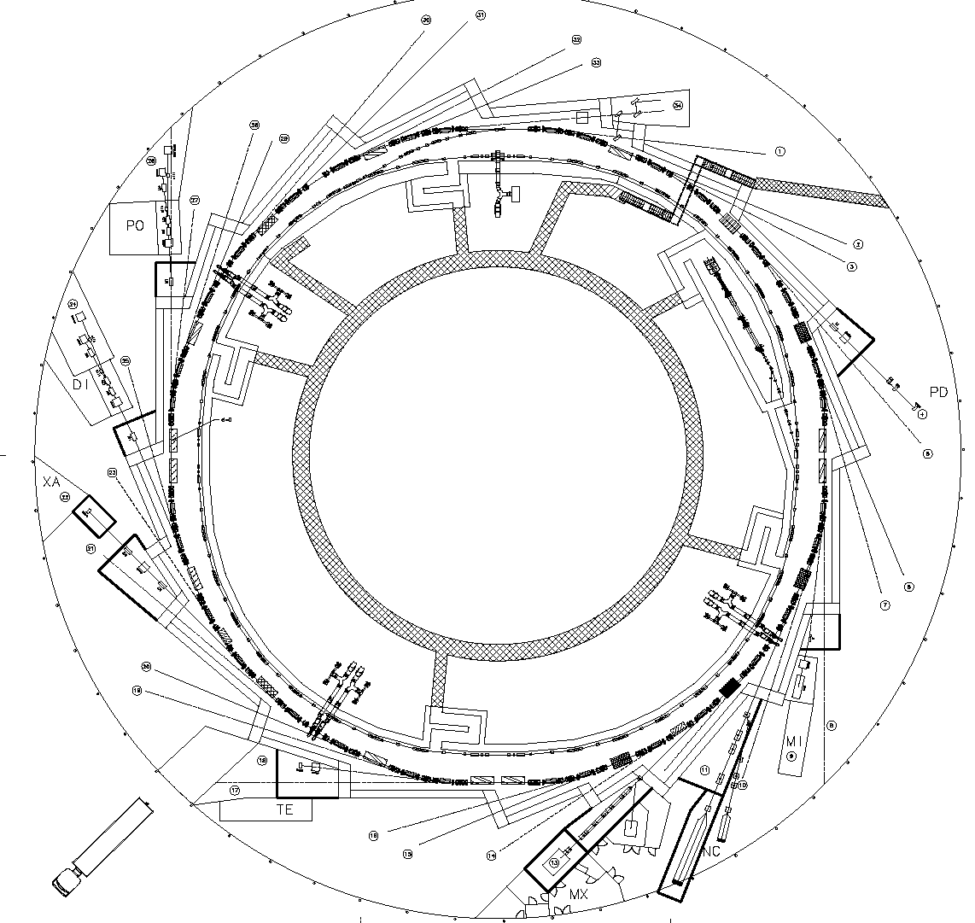
ALBA Accelerators
LINAC
100 Mev
BOOSTER
100 MeV – 3 GeV
STORAGE RING
3 GeV

Slide 4
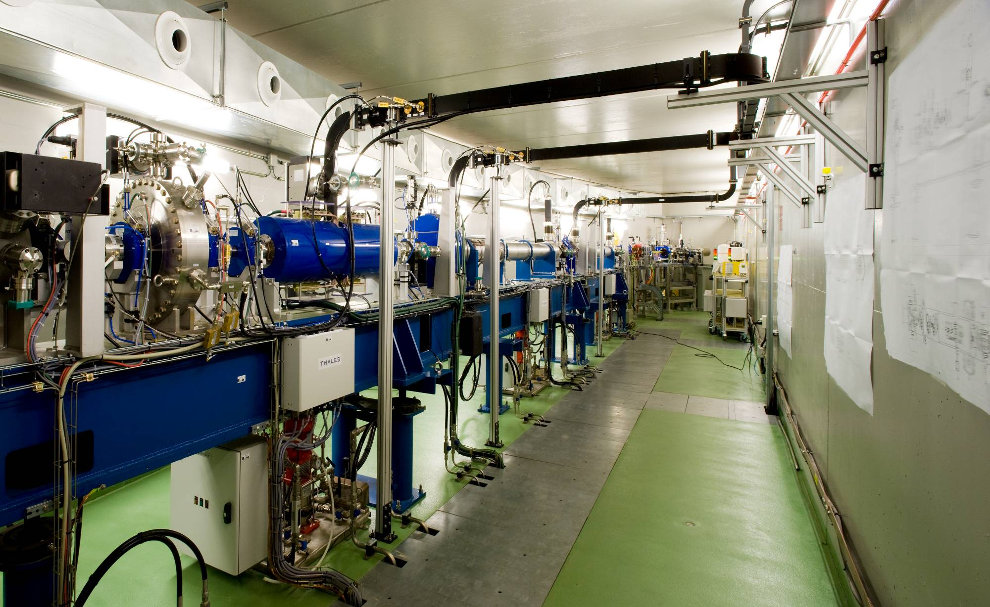
100 MeV LINAC
Main LINAC parameters
Turn-key system
Single and multibunch operation
Repetition rate up to 5 Hz

Slide 5
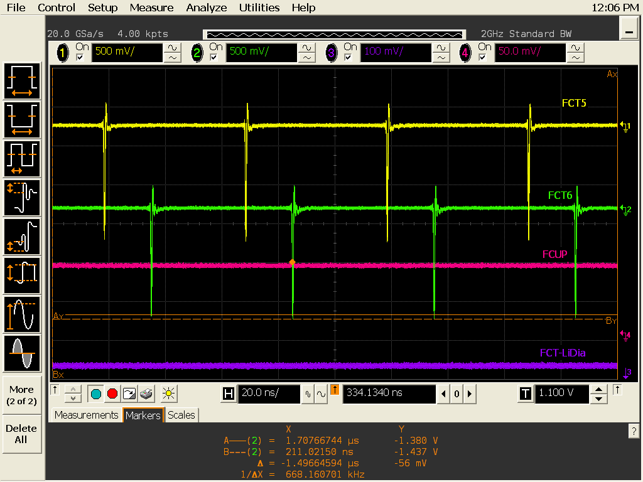
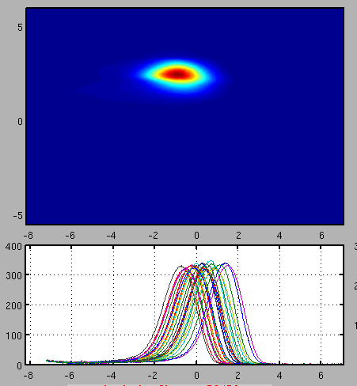
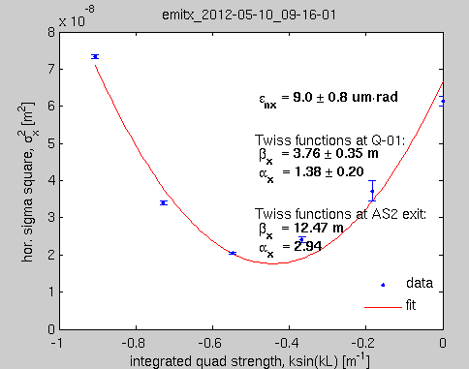
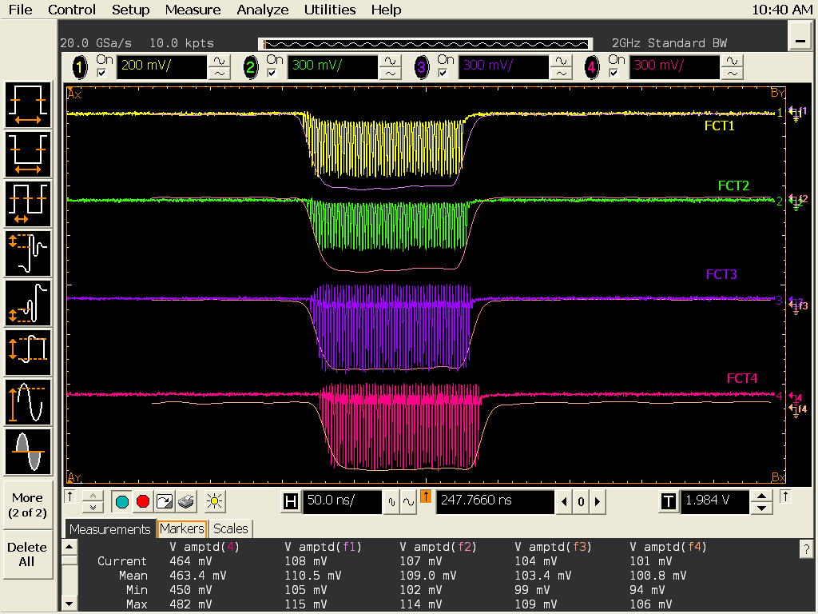
100 MeV LINAC
Main linac parameters:
Few bunches mode
0.25 nC/bunch at linac exit
ΔE/E = 0.16% (rms)
ε_{x} (norm.) ≈ 9 mm·mrad
Multibunch mode
4 nC at linac exit

Slide 6
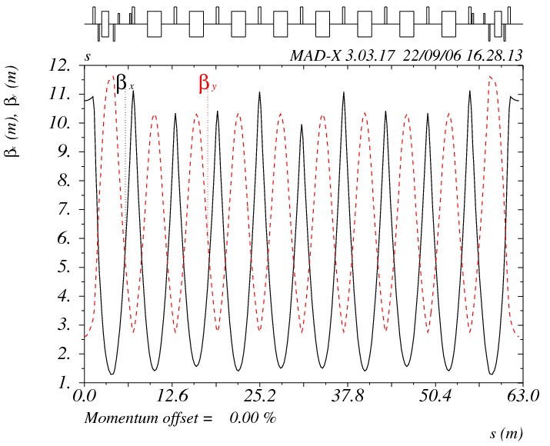
BOOSTER
Main BO parameters:
C = 249.6 m, shares tunnel with SR
E = 110 MeV to 3.0 GeV
ε_{x} ≈ 9 nm·mrad
Repetition rate: 3.125 Hz
Lattice: 4 x fold symmetry
Orbit correction:
    28 BPMs
    44 HOR_CORR + 28 VER_CORR
    9 are ramped, 63 @ dc

Slide 7
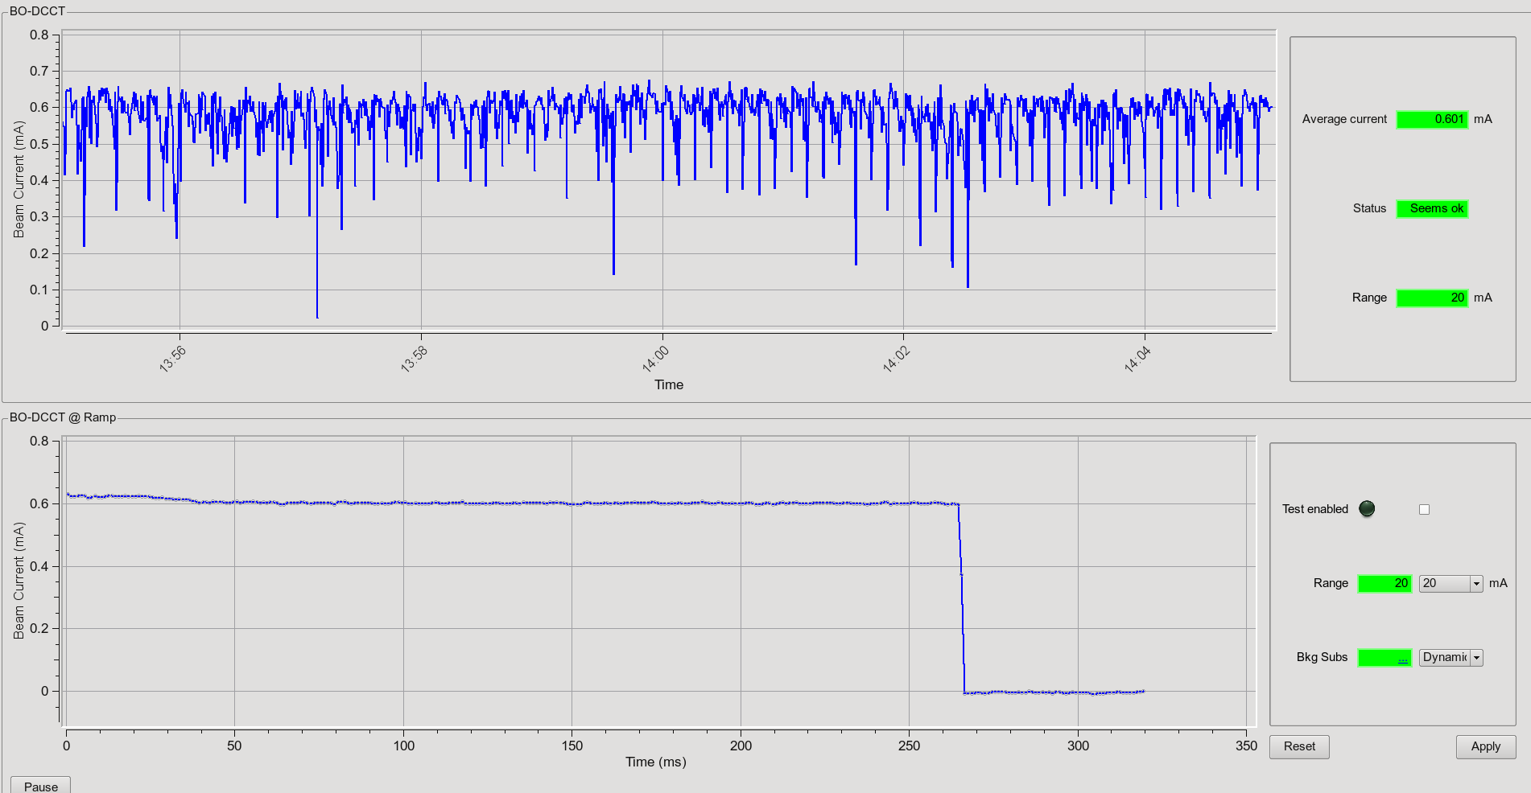
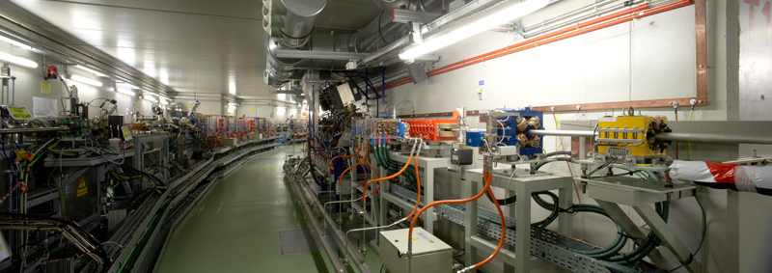
BOOSTER
200 MeV
3 GeV
BO matching cell

Slide 8
STORAGE RING
Main parameters of the Storage Ring
Electron beam energy 3.0 GeV
Storage Ring Circumference 268.8 m
Number of cells 16
Symmetry 4
Straight section lengths 4 x 7.8 m ( 3 ID’s)
12 x 4.3 m (12 ID’s)
8 x 2.3 m ( 1 ID’s)
Beam current, nominal 250 mA
Emittance 4.3 nm.rad
Tunes 18.18, 8.37
RF frequency 500 MHz
Coupling 0.6 %
Lifetime @ 125 mA 22 h

Slide 9
STORAGE RING
σ_{x} = 132 μm
σ’_{x} = 46 μrad
σ_{y} = 7.5 μm
σ’_{y} = 5.8 μrad
σ_{x} = 310 μm
σ’_{x} = 22 μrad
σ_{y} = 15 μm
σ’_{y} = 2.9 μrad
σ_{x} = 270 μm
σ’_{x} = 20 μrad
σ_{y} = 16 μm
σ’_{y} = 2.7 μrad
long
medium
short
medium

Slide 10
CLOSED ORBIT
Beam Stability over 24 h
RMS-Values:
σ_{x} = 0.5 μm
σ_{y} = 0.2 μm
SOFB
Running every 3 s
With RF frequency included on SOFB

Slide 11
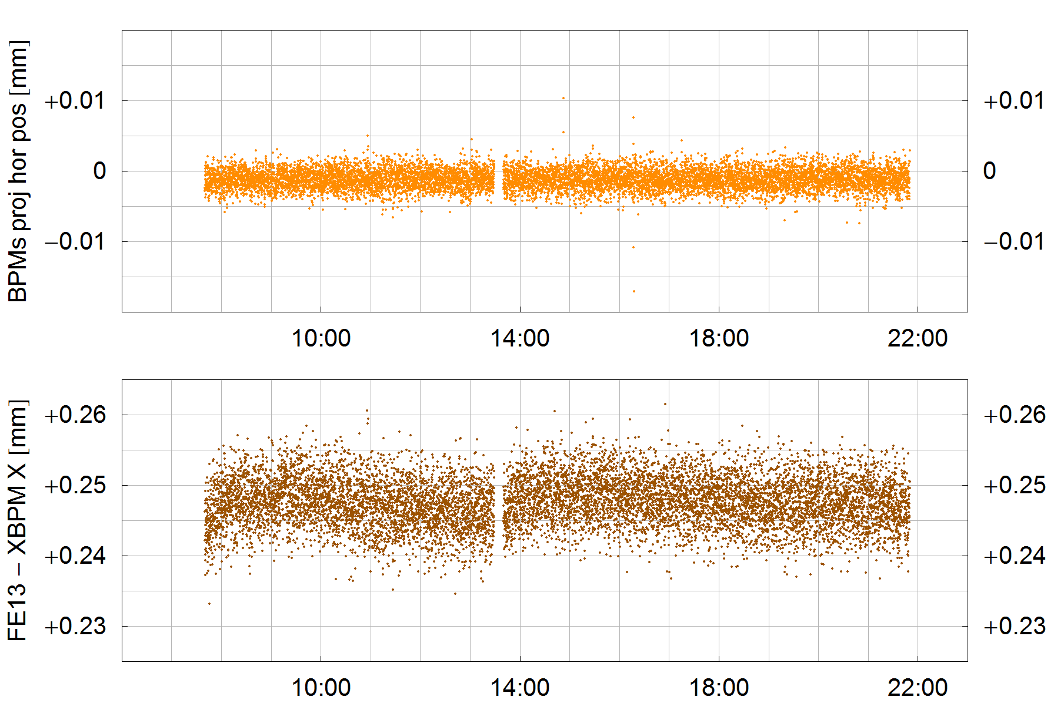
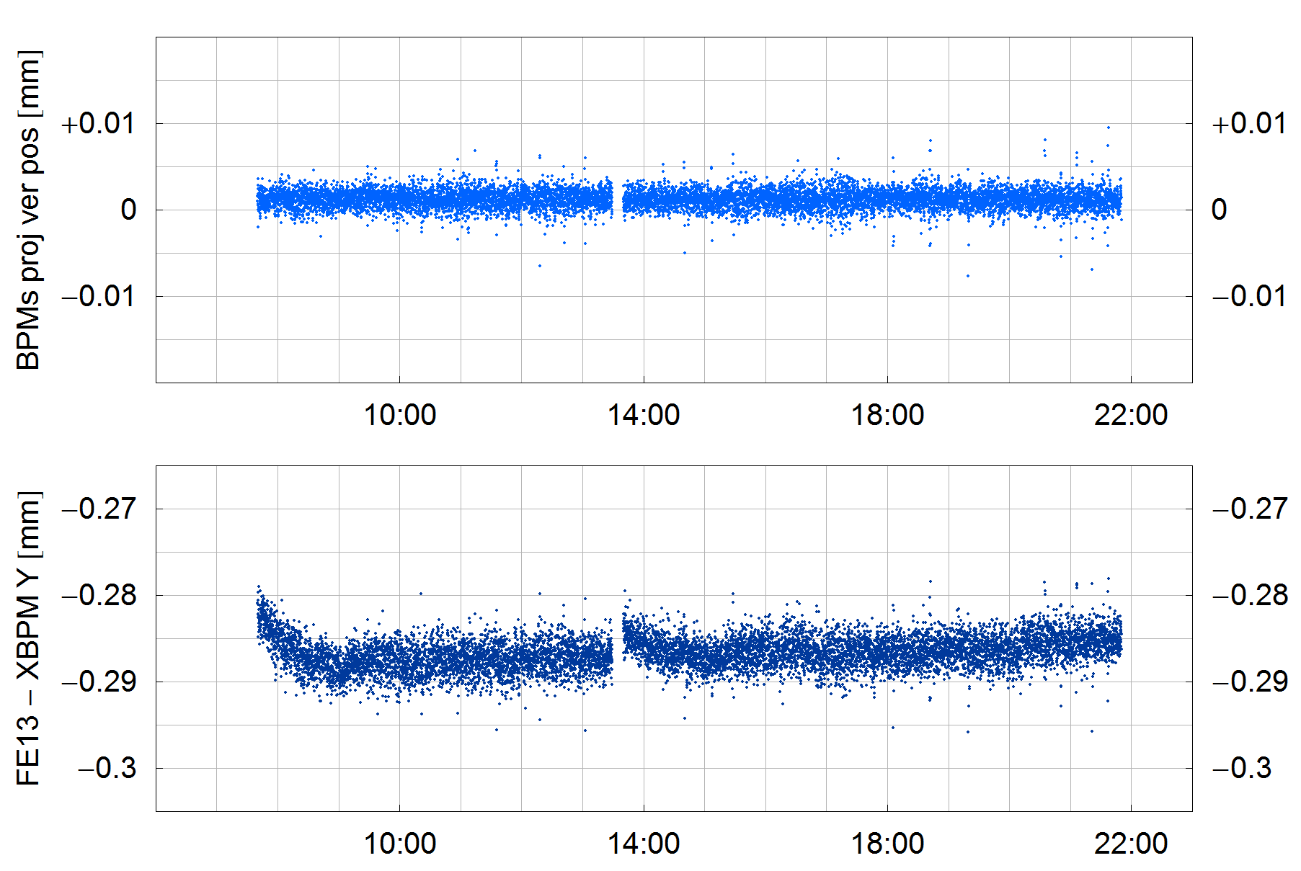
rms photon beam stability for different FEs
FE (source) | Source distance | eBPM data |  | XBPM data
 |  | Horizontal | Vertical | Horizontal | Vertical
FE09 (bending) | 7.00 m | ----- | 0.5 μm | ----- | 2.5 μm
FE04 (SCW31) | 8.66 m | 1.5 μm | 0.8 μm | 3.0 μm | 1.0 μm
FE11 (IVU21) | 10.29 m | 1.2 μm | 0.9 μm | 3.0 μm (fixed gap) | 1.5 μm (fixed gap)
FE13 (IVU21) | 9.85 m | 1.2 μm | 0.9 μm | 3.0 μm (fixed gap) 10 μm (moving gap) | 1.5 μm (fixed gap) 5 μm (moving gap)
Photon beam stability @ FE13-XALOC on 2012/03/24 (fixed gap):
horizontal plane
vertical plane
Projection
eBPMs
FE XBPM

Slide 12
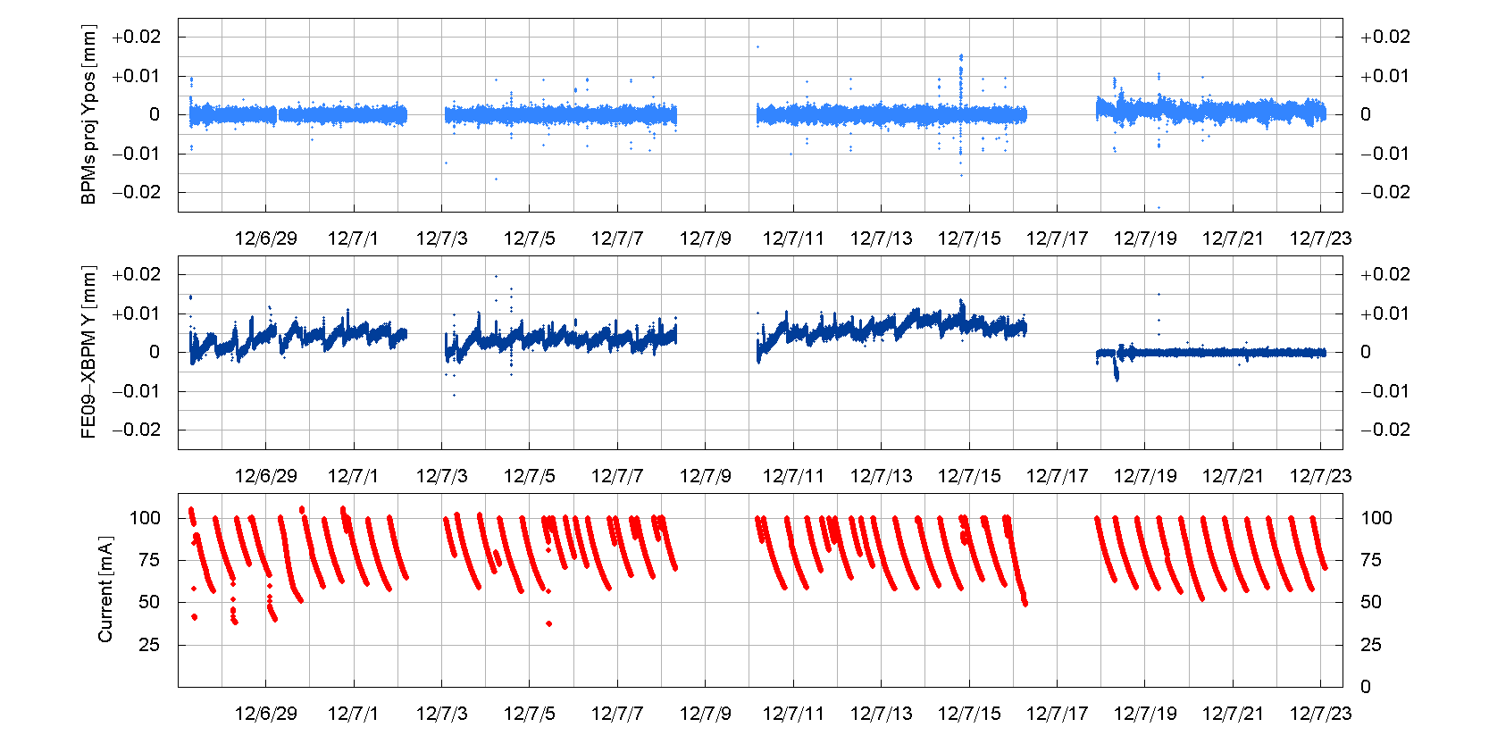
Introduction of xbpm on SOFB for BM BL
projection eBPMs
(BPM05_2 & BPM05_3)
2012/07/18 @10:00 new SOFB (elog 726)
FE09 XBPM
SR current

Slide 13
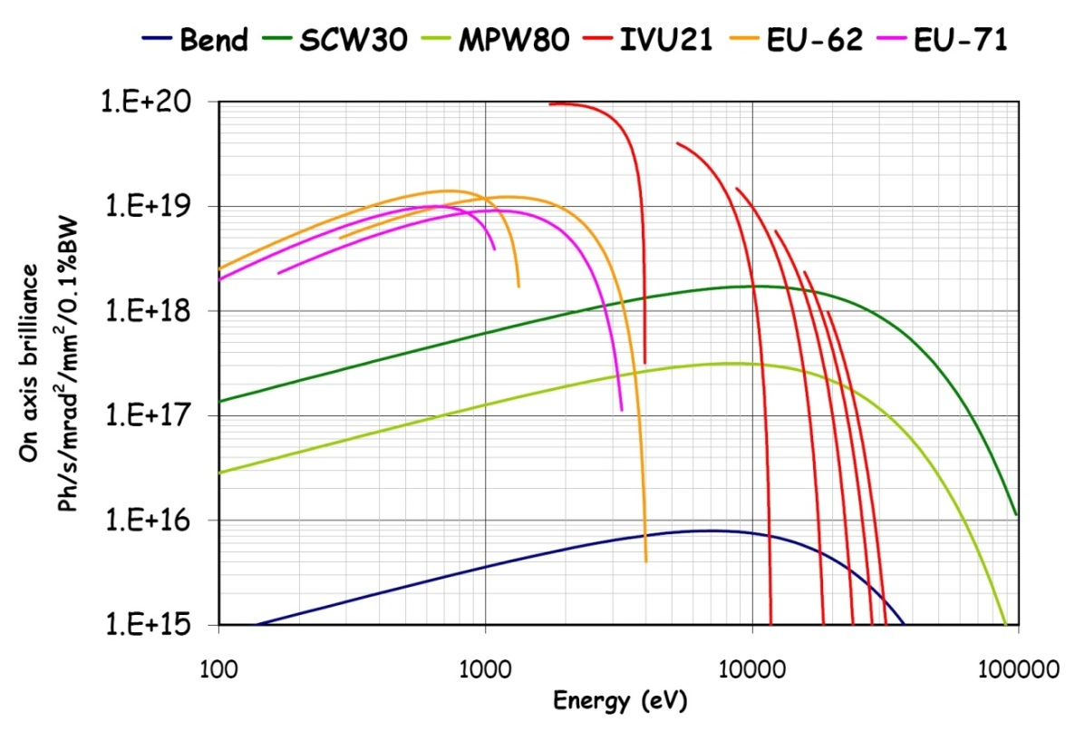
STORAGE RING
Phase I beamlines: 6 x IDs
1 x Bending
Spectral range: from UV (80 eV) to hard x-rays (50 keV)
High brilliance: 10²⁰ at 2 keV

Slide 14
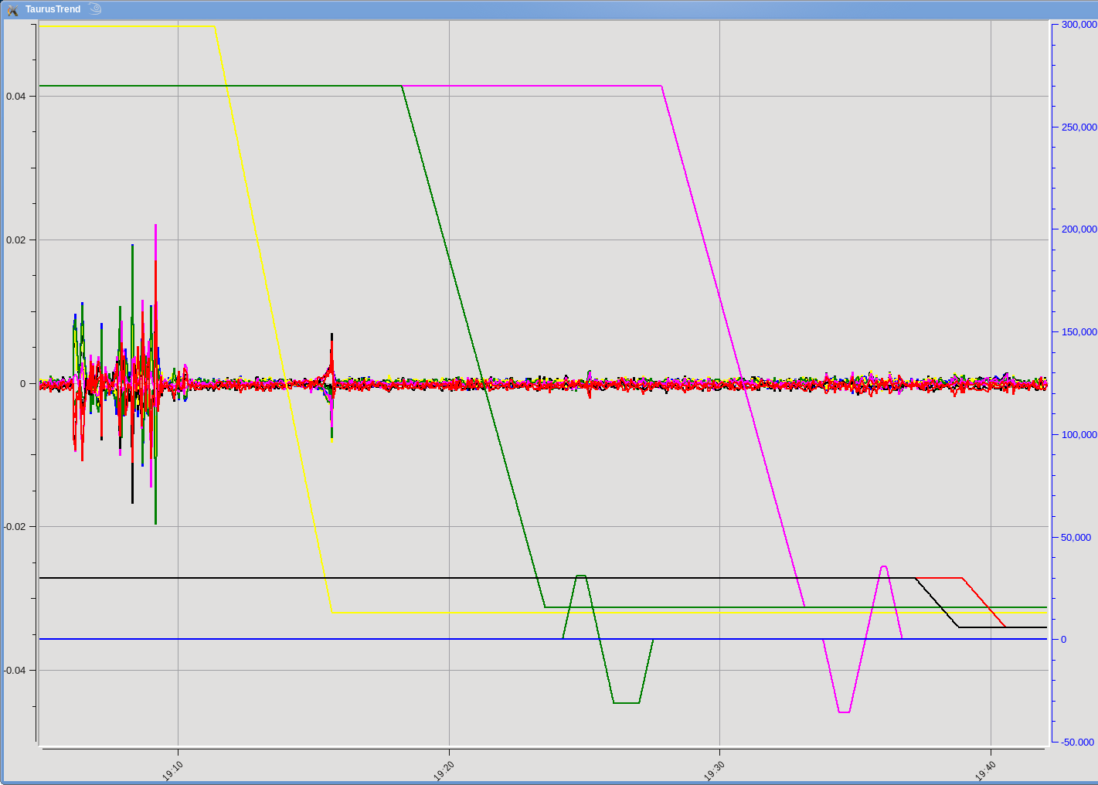
ID COMMISSIONING
CLOSING THE IDs: Horizontal orbit deviation
SCW
MPW
Apple-II
Apple-II
± 10 um
IVU
Additional correction coils installed

Slide 15
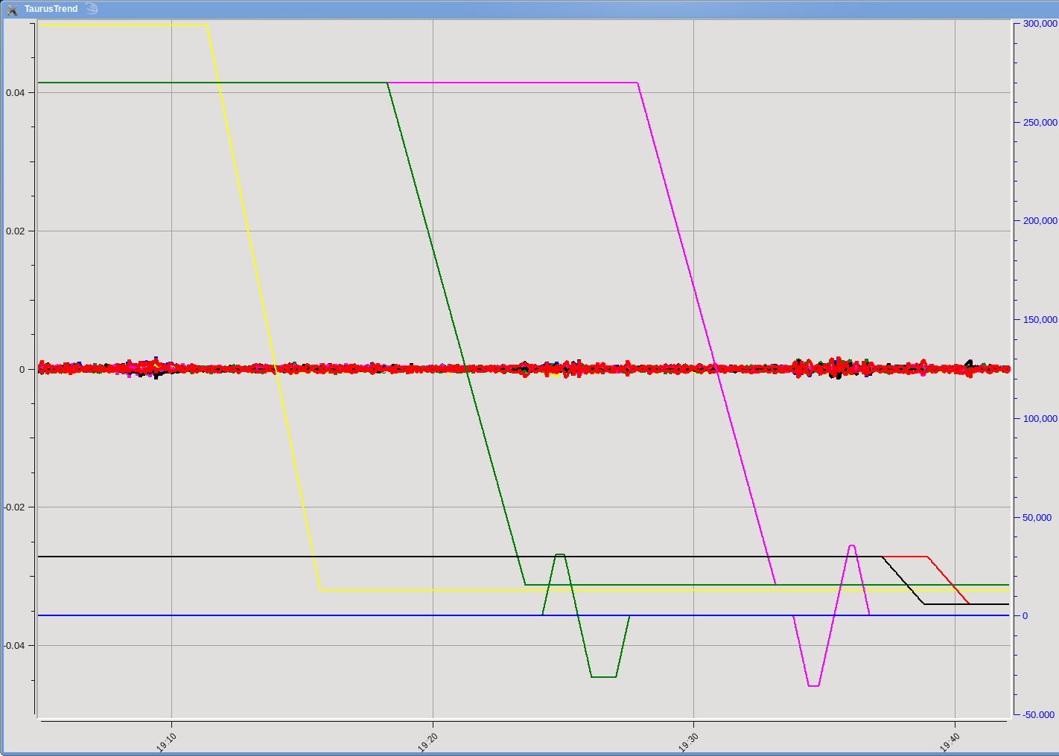
ID COMMISSIONING
CLOSING THE IDs: Vertical orbit deviation
SCW
MPW
Apple-II
Apple-II
± 10 um
IVU

Slide 16
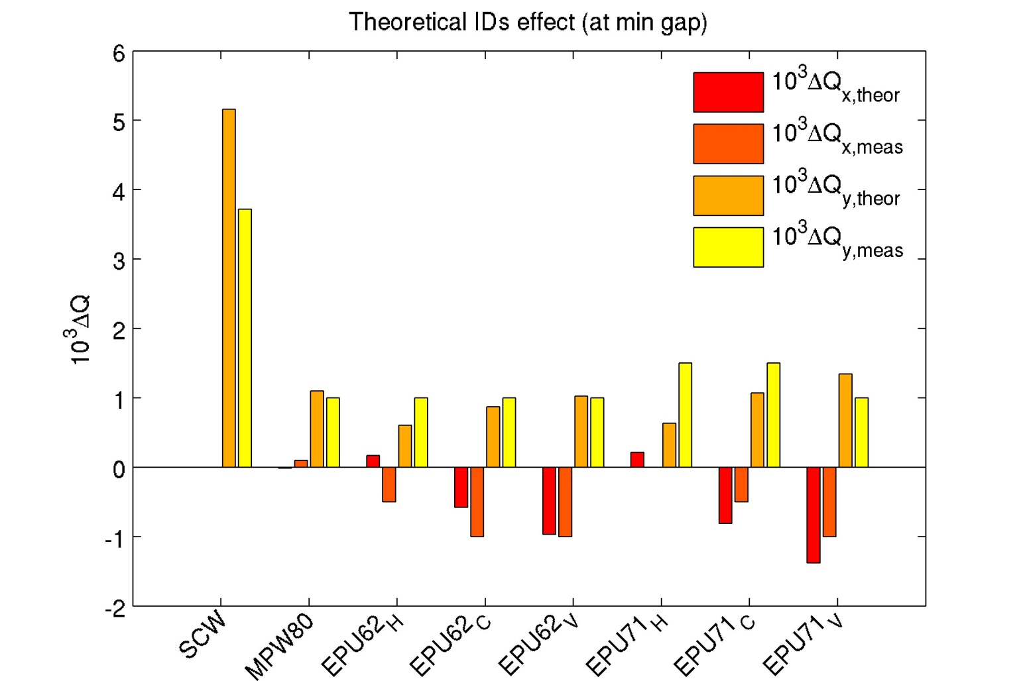
ID COMMISSIONING
TUNE SHIFT
MPW80
IVU21

Slide 17
OPERATION 2013
  Scheduled for 2013: 5280 h of operation
  3555 h for BLs (excluding injection)
  1488 h for AD & radiation tests

Slide 18
OPERATION 2013
Beamline operation: 3555 h Scheduled January
  4081 h Re-scheduled July
  2972 h Delivered
  84.0 % Beam availability (over initial schedule)
Cooling unstable hydraulically

Slide 19
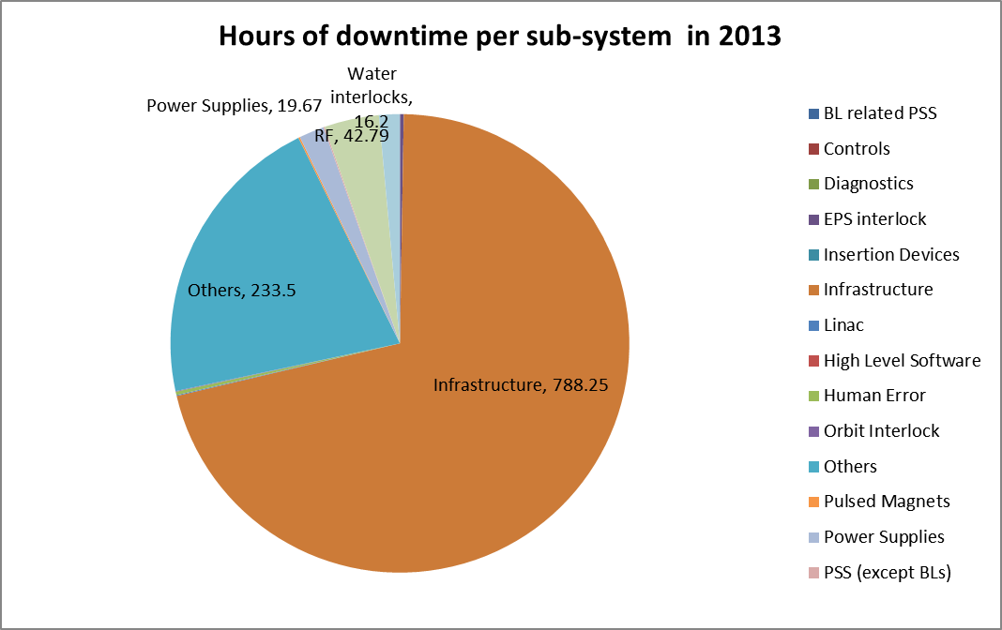
OPERATION 2013
Down time (1109 h) per sub-system
91 % due to the unstable cooling

Slide 20
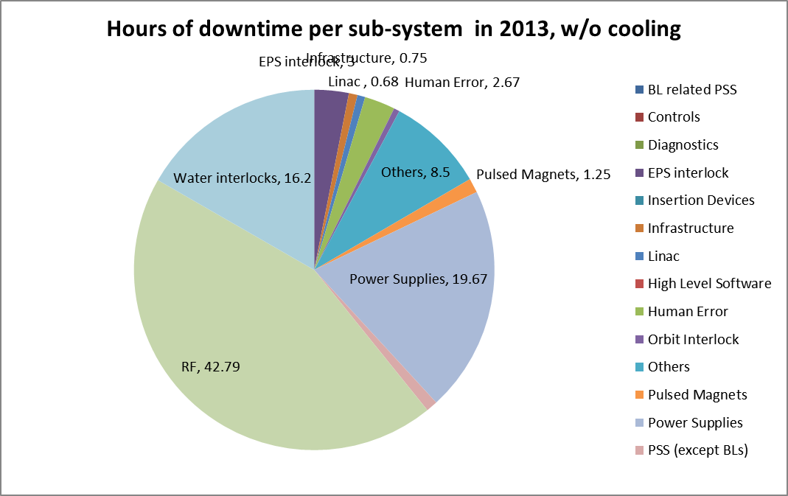
OPERATION 2013
Down time (97 h) per sub-system
(w/o cooling & exchange of vacuum chamber considered)

Slide 21
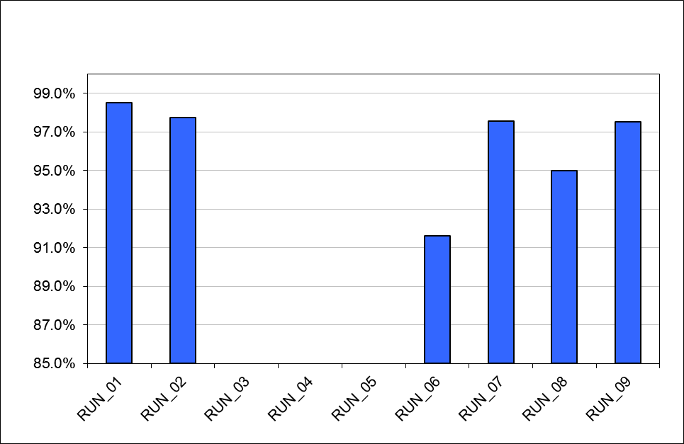
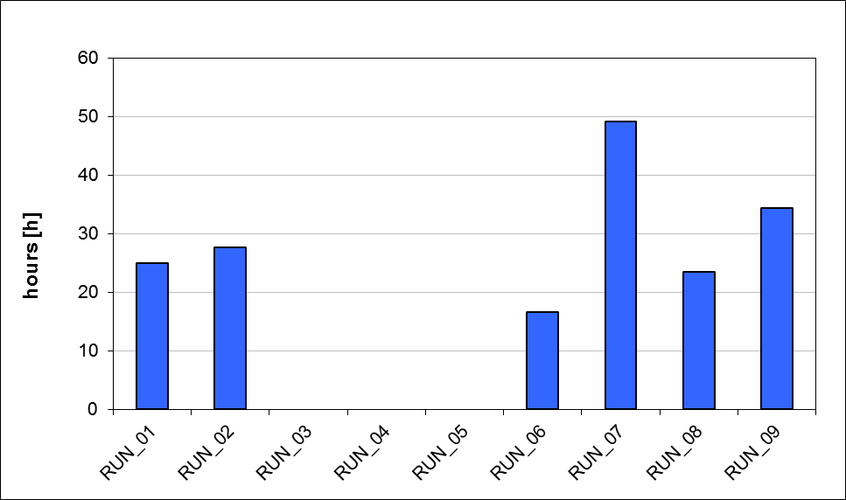
OPERATION 2013
Accelerator Availability: 97.0 %
MTBF = 24.75 h

Slide 22
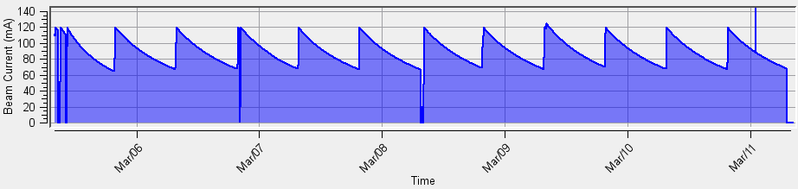
ALBA OPERATION
Running 3 shifts/day
Runs of 24 days on average
2 long shut downs, 7 short (1 w) shut downs
Monday: Accelerators start-up
Tuesday 07h00 – Monday 07h00 Beam for users

Slide 23
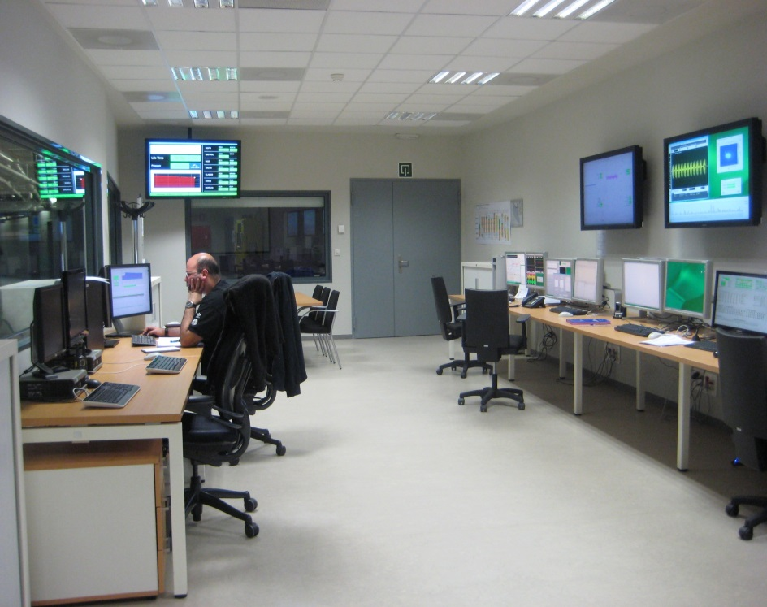
ALBA OPERATION
  CR manned 24 h when beam in the machine
  Always 2 people on the CR
  Crew of operators to guarantee operation
  People on shift: dedicated OP + a member of the Accelerator Division
  CR also manned during shut downs: 1 OP/day (8h)

Slide 24
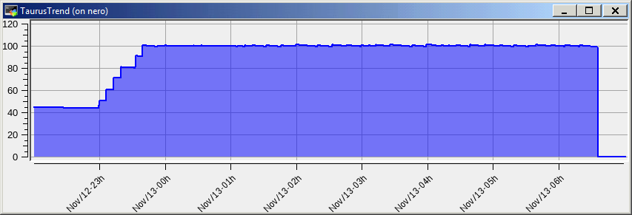
TOP-UP
  First tests of top-up over 6 h

Slide 25
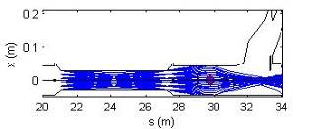
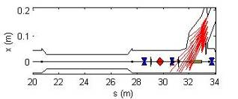
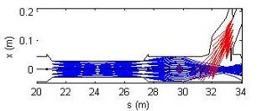
Beam line safe for top-up if (I.Martin, Diamond):
Electrons travelling forwards from straight section cannot pass down beam-line
Electrons travelling backwards from beam-line cannot pass through to straight section
Electrons travelling in either direction do not have same trajectory at any intermediate point

Slide 26
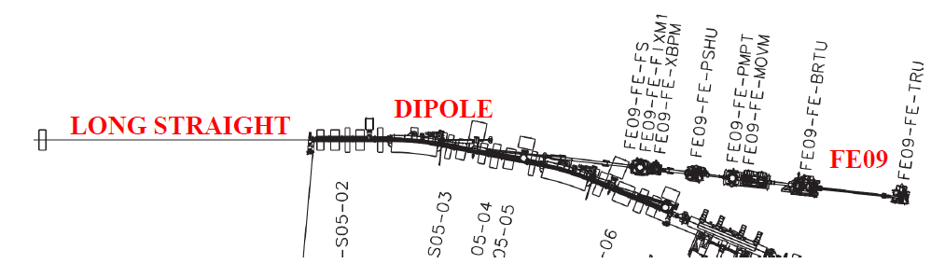
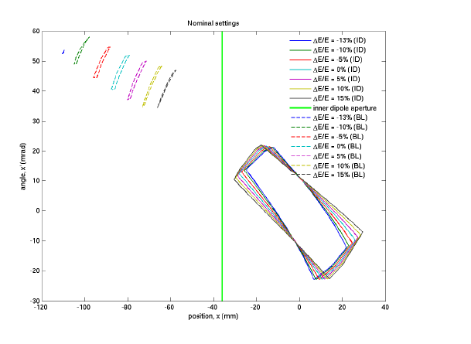
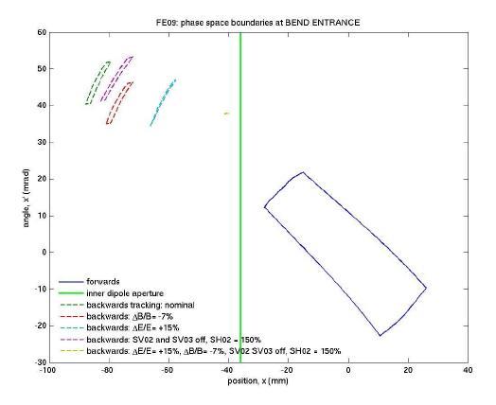

Slide 27
  PSS upgrade
    Energy matching between BO and SR:
    BT_BEND_02 within +/-5 A of the nominal setting
    Disables Linac and BO-RF
    ✓ Additional hardware intlk: installed and tested
    Warning level on any radiation monitor (accumulated dose > 1.5 uSv)
    Disables Linac and BO-RF, decay mode for max 4 h.
    Stored beam < 20 mA
    Closed FEs
    Alarm level on any radiation monitor (accumulated dose > 2.0 uSv)
    Kills beam and closed FEs

Slide 28
    No bucket selection: Multibunch injection
    Re-use existing injection DS & GUI
    Additional conditions for top-up:
    min. lifetime: 10 h
    min. injection efficiency
      to avoid injecting with a low injection efficiency, number of shots will be limited
    Project started for single bunch injection with bucket selection using a time correlated single photon counter

Slide 29
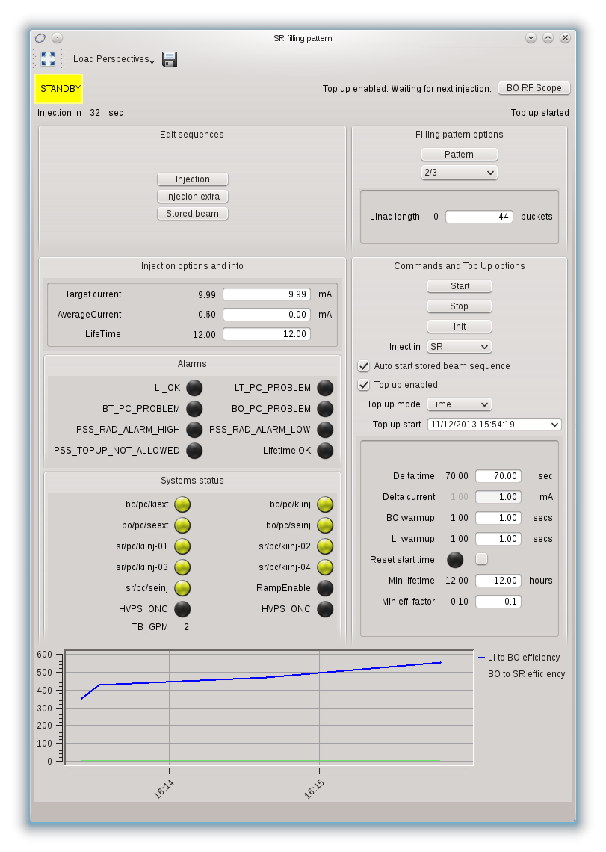
    Jan - April further tests:
      BLs tests
      Radiation measurements
      GUI debugging
  Δi = 1 mA, injections every 10 min

Slide 30
FOFB
Scheme
88 BPMs: [x,y] data at 10 kHz
88 H Correctors
88 V Correctors
Data transfer
Correction computation
Write in 176 PS

Slide 31
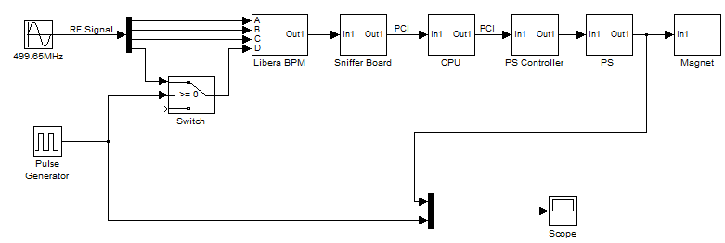
  Tests w/o beam
  Tested electronics latency
  Measured latency of 380 us

Slide 32
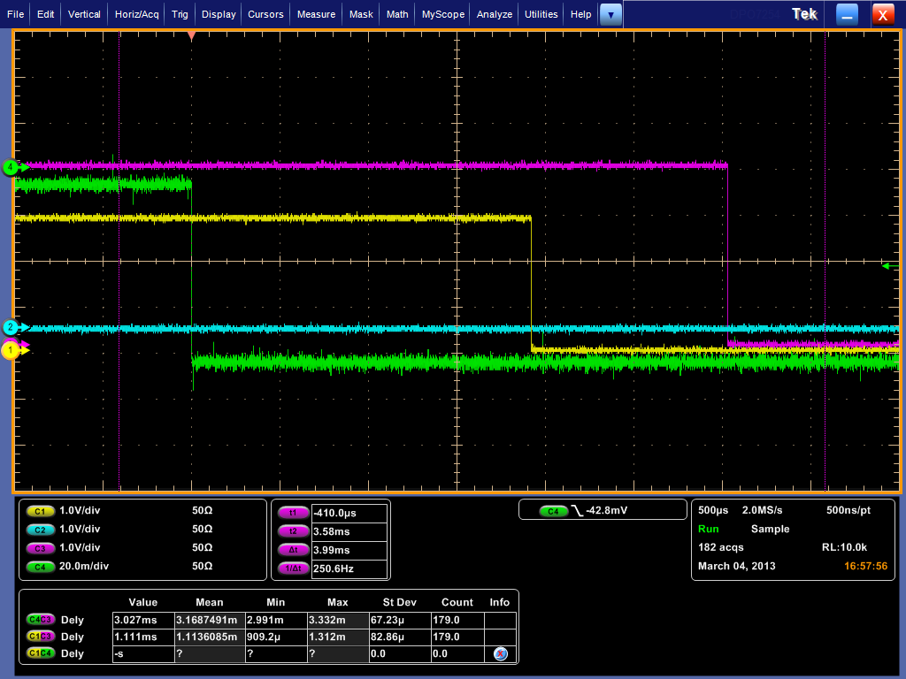
  Latency of the whole system
      Including iron core corrector coils
      Including vacuum chamber
        Tests with beam ongoing
DAC PS output
Sniffer detection of change
Measured latency of ≈ 1-2 ms
Ok. with previous simulation
Ok. for 100 Hz correction
1.8 ms

Slide 33
SUMMARY
Accelerators operate reliable for users
    97% 2013
Objectives for 2014
  FOFB
  Top-up
  Injectors stability
  Bunch by bunch feedback
  Increase operation current
May 2014
On going
End 2014

