Slide 1
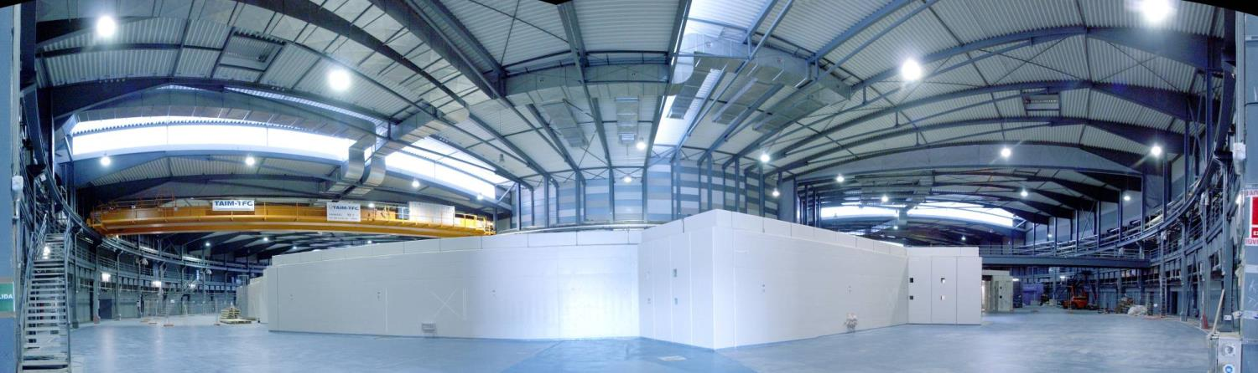
ALBA RF Systems
Francis Perez

Slide 2
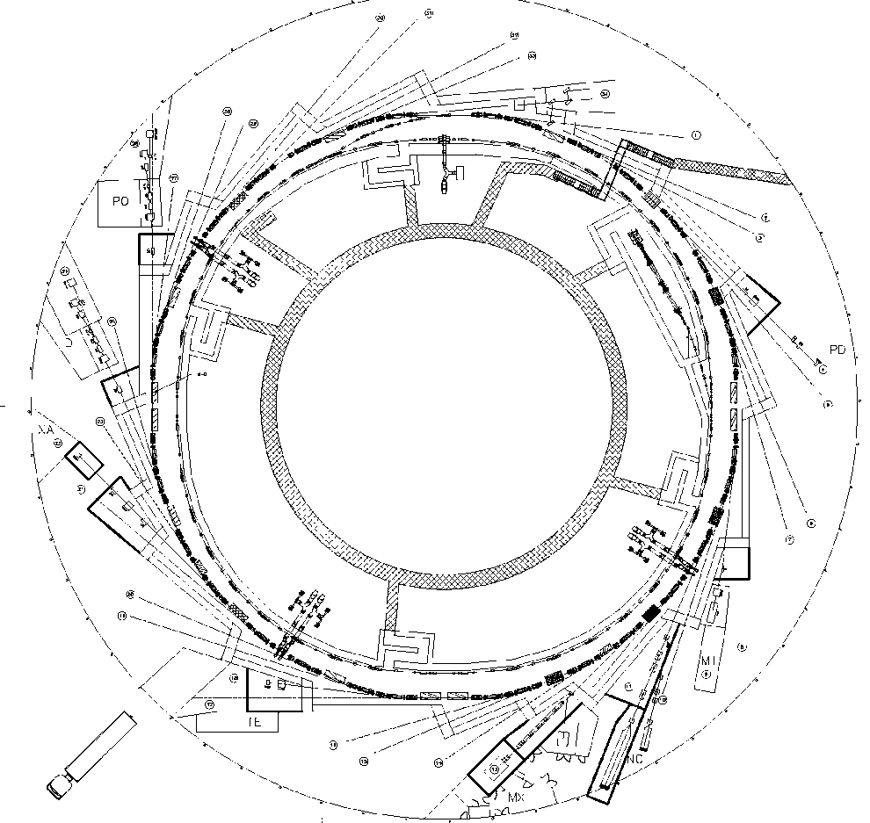
ALBA Accelerators
LINAC
100 Mev
BOOSTER
100 MeV – 3 GeV
STORAGE RING
3 GeV

Slide 3
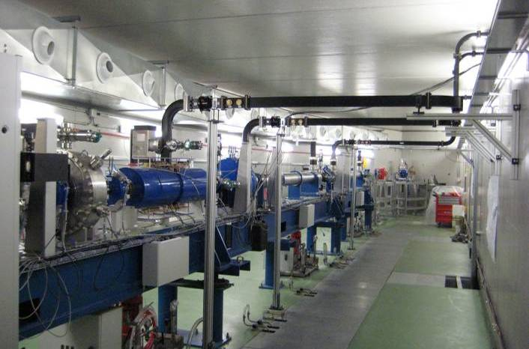
LINAC RF System

Slide 4
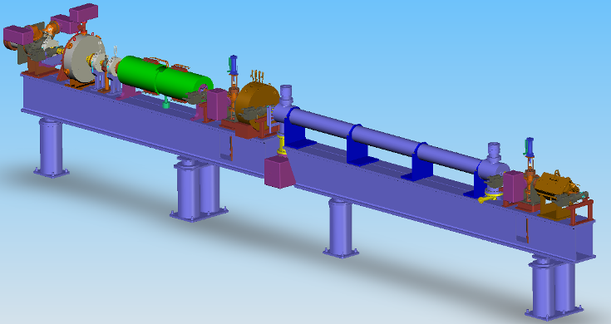
Linac RF
Thales Turn Key
100 MeV
Electron Gun : Thermionic (Pierce type), 90 kV DC gun with grid modulator at 500 MHz
Bunching Section: Pre-buncher: single cell @ 500MHz
Buncher: 1 SW bunching section @ 3GHz
Energy at the bunching section output = 16 MeV
2 Acc. sections: TW 2/3π Constant Gradient 3 GHz.
Energy gain= 55 MeV @ 20MW nominal input power.
2 Klystron modulators: 35 MW each klystron at 3GHz.
The first one feeds the 3 GHz bunching section and the 1st acc. structure.
The second one feeds the second accelerating structure

Slide 5
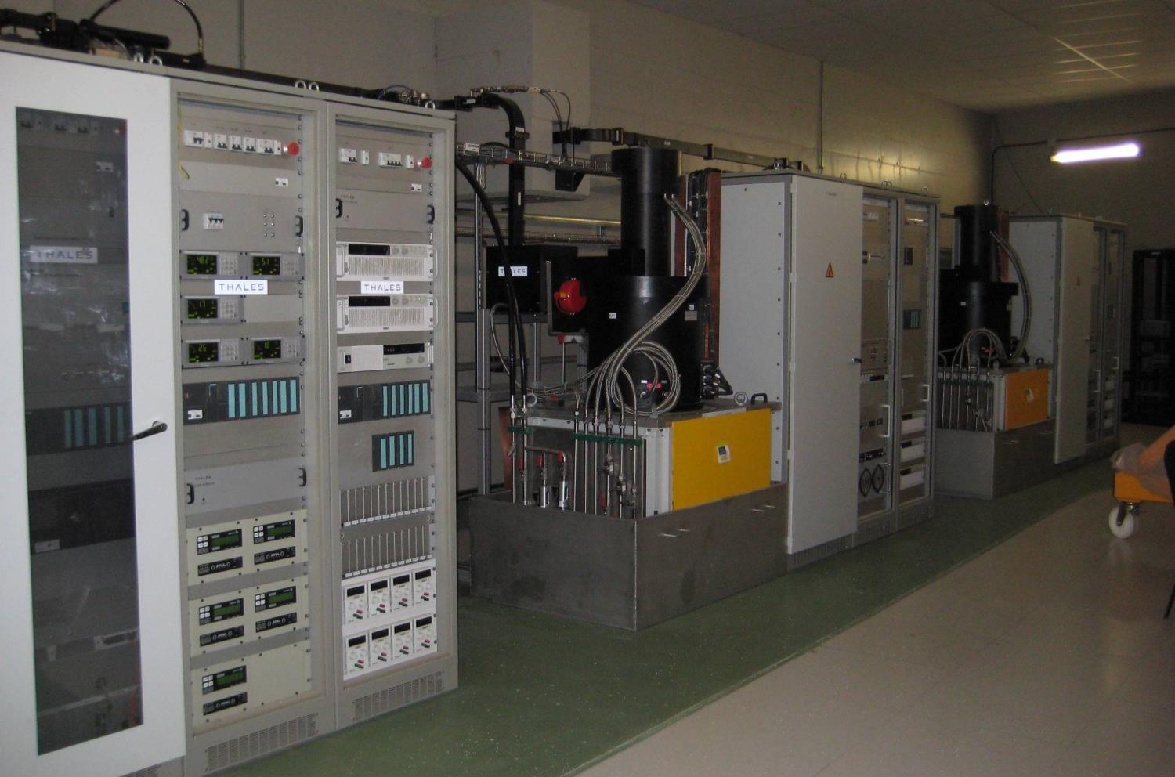
Linac RF
Modulators: 270 kV – 290 A
Controls
Vacuum
PS
Klystrons: 3 GHz - 35 MW - pulsed

Slide 6
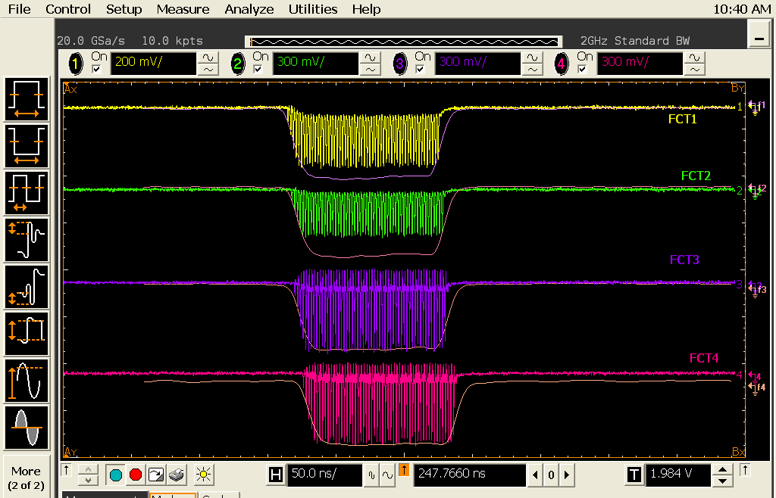
Linac RF
 | P [MW] | E [MeV]
Buncher | 5 (K1) | 15
Acc.section 1 | 20 (K1) | 55
Acc.section 2 | 20 (K2) | 55
EXIT | 45 MW | 125 MeV

Slide 7
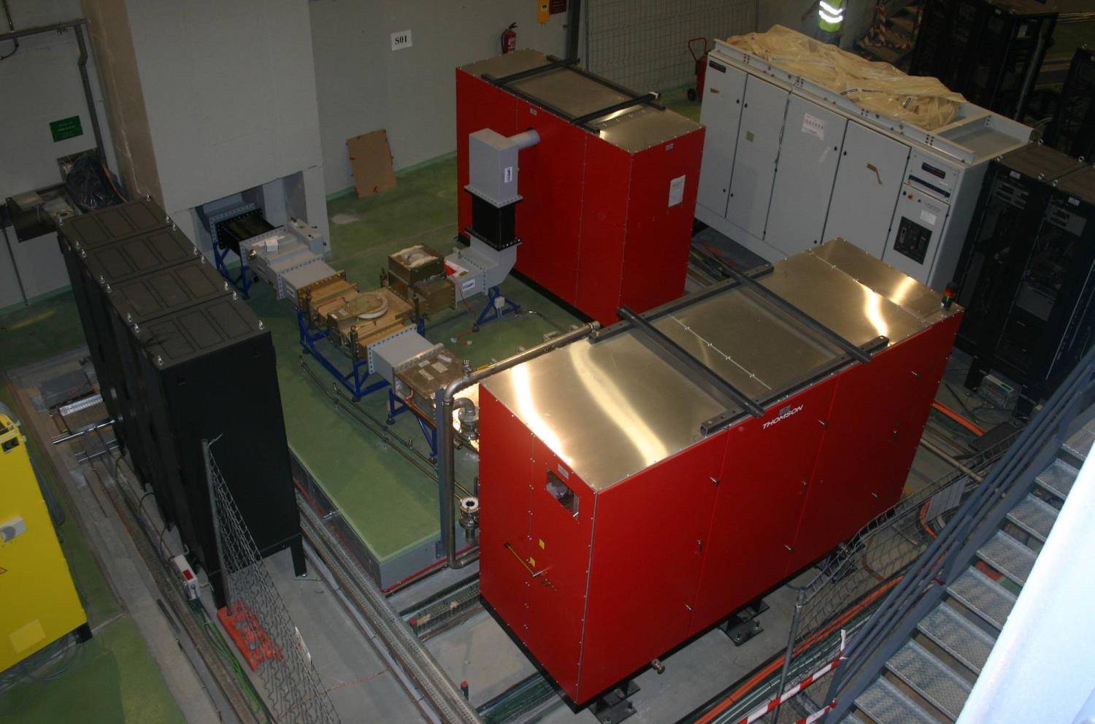
Booster RF System

Slide 8
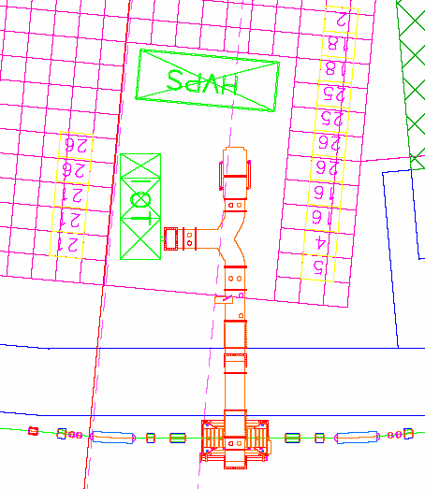
Booster RF
At 3 GeV:
RF Voltage 1000 kV
Beam current 4 mA
Losses 627 keV/turn
Beam power 2.5 kW
Cavity power 34.5 kW
TRANSMITTER
Tube type IOT
HVPS 36 kV / 4 A
RF Power 80 kW
Efficiency > 60%

Slide 9
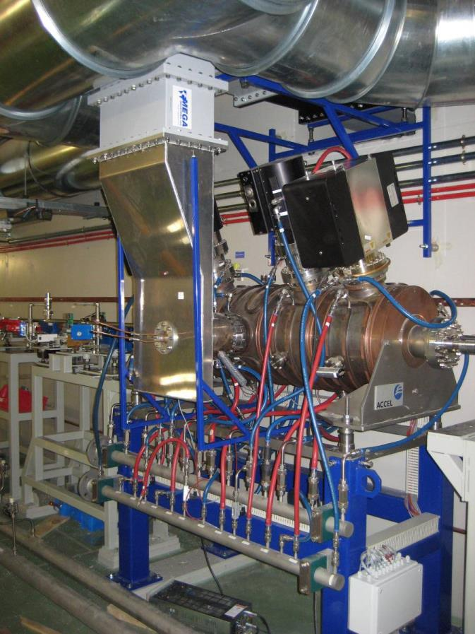
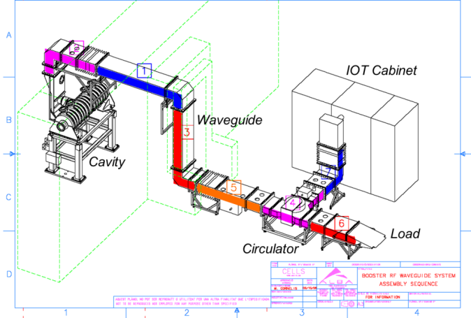
Booster RF
Cavity: 5 cell Petra type
Basic Parameters
Rshunt 15.4 MΩ
Maximum Power 75 kW
Length 1,65 m

Slide 10
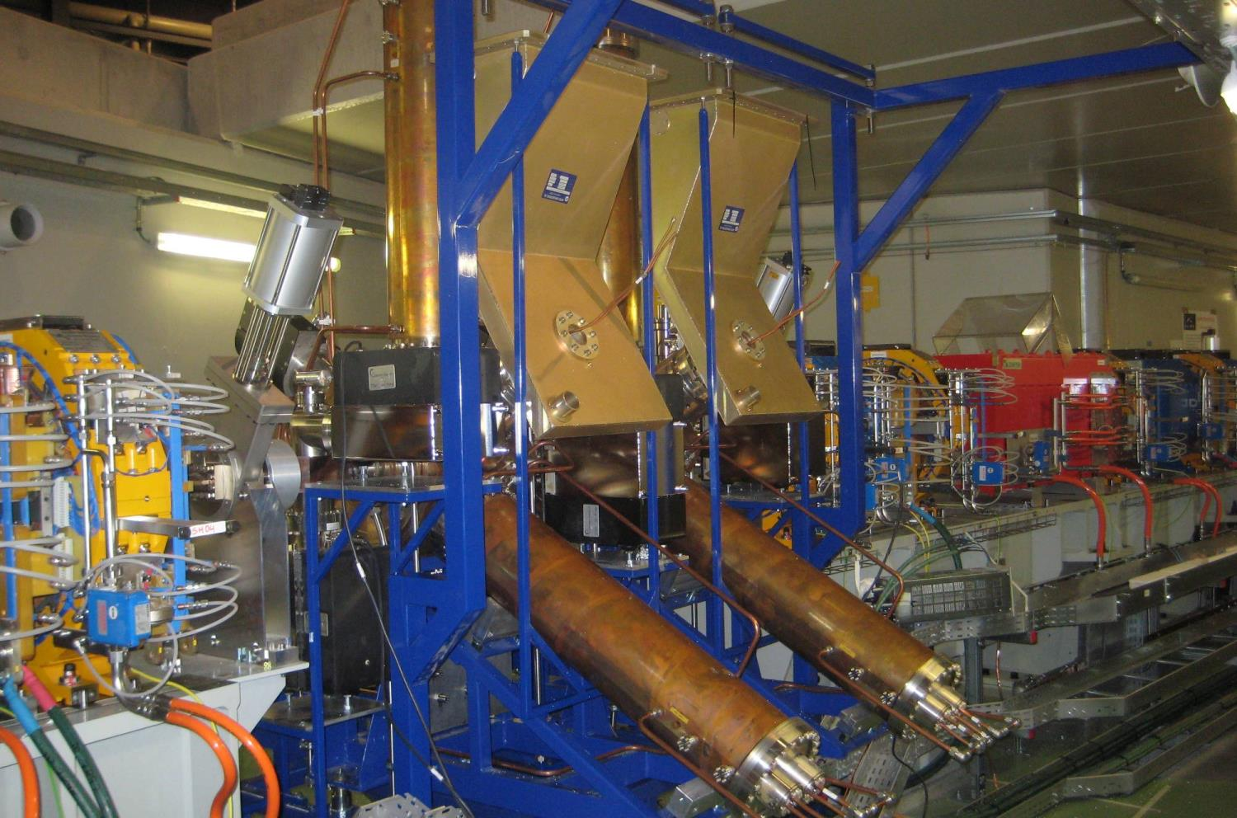
Storage Ring RF System

Slide 11
Power Requirements
SR RF
Beam current 400 mA
Bending losses 1000 keV/turn
ID losses 300 keV/turn
Other losses 50 keV/turn
Total losses 1350 keV/turn
Beam power 540 kW
Energy Acceptance 3 %

Slide 12
SR RF
RF Voltage 3600 kV
Digital
LLRF
TRANSMITTER
Tube type IOT
Number 6 x 2 IOTs
Power 2 x 80 kW
Combination CaCo
Layout 6 cavities

Slide 13
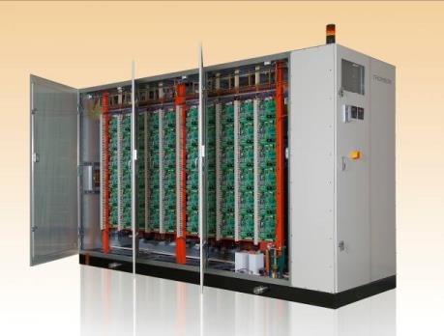
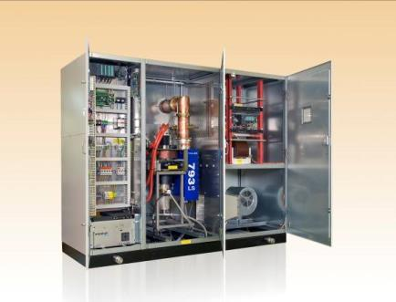
SR RF
Transmitter (Thomson)
HVPS Cabinet:
36 kV – 4 A power supply
60 Pulse Step Modulation Cards
New PSM card 700V – 4A
HVPS
IOT Cabinet
IOT Cabinet:
80 kW IOT
400 W SSA
Auxiliaries
Controls PLC

Slide 14
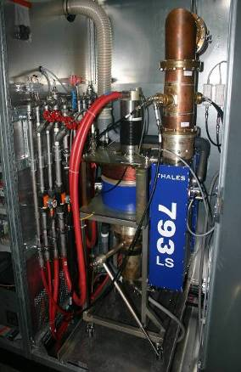
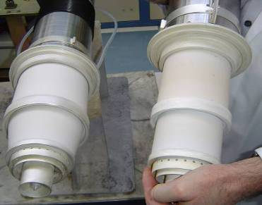
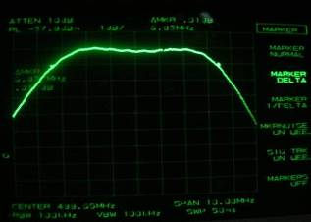
SR RF
LS-IOT (Light Source IOT in collaboration with Thales)
New cavities with 6 1/8’ coaxial output
Tube with wider ceramics
Tested in factory at 80 kW for more than 24 h and at 90 kW for 1/2 h
6.8 MHz
Improvements
LS version
TV version

Slide 15
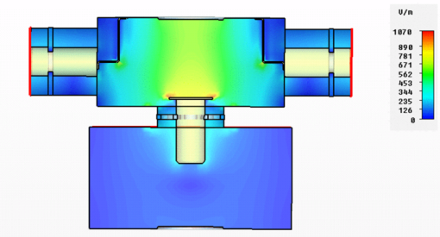
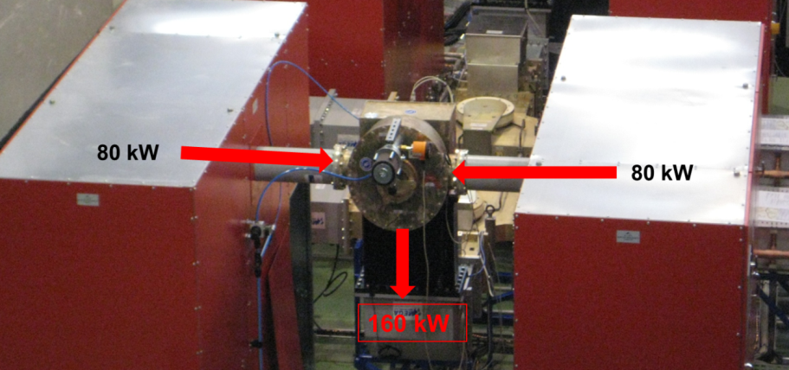
CaCo: Cavity Combiner
SR RF
Combine 2 IOTs
Filter Harmonics
Operation with faulty IOT

Slide 16
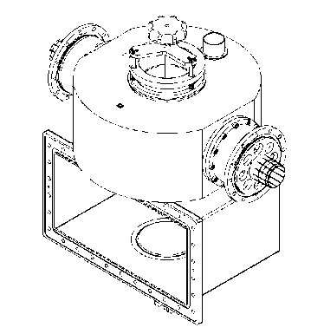
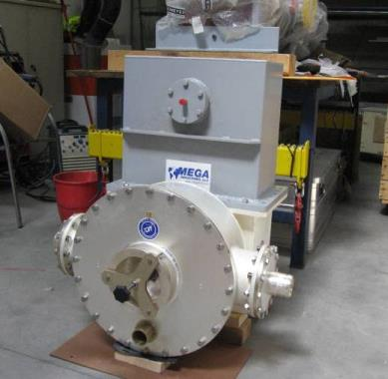
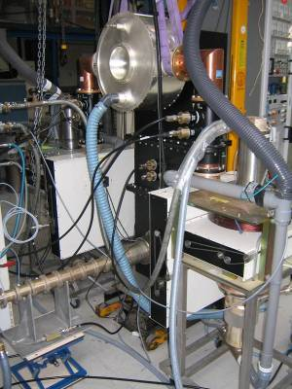
CaCo
SR RF
In routine operation, CaCo has performed reliably and without problems.

Slide 17
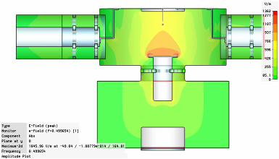
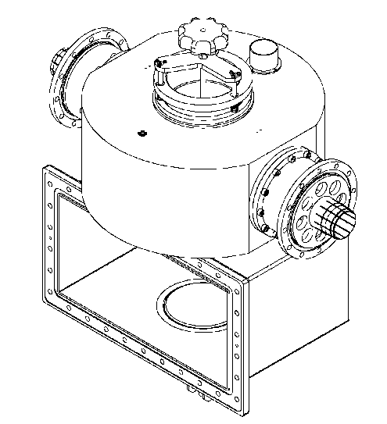
SR RF
CaCo
80 kW operation in single IOT
Plunger for single IOT operation
(actuated with a piston)

Slide 18
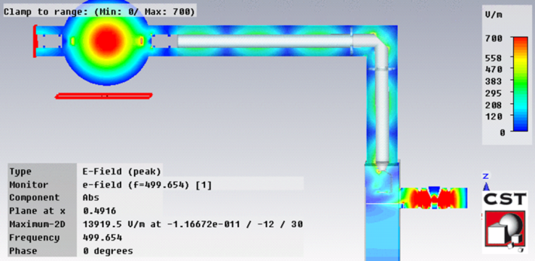
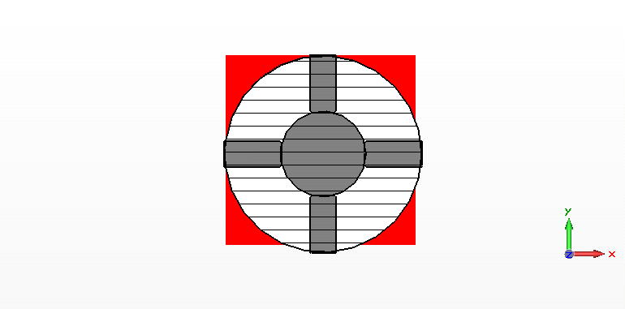
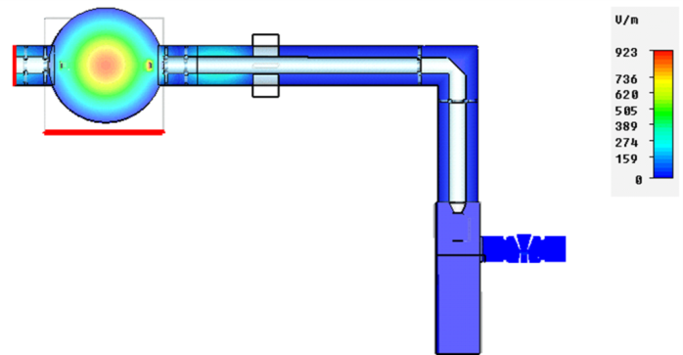
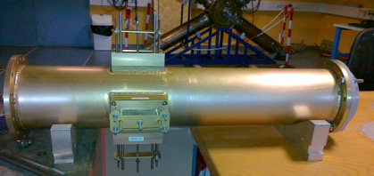
SR RF
CoStub: Coaxial shortcut using stub tunners
To isolate the not operational IOT for single IOT operation

Slide 19
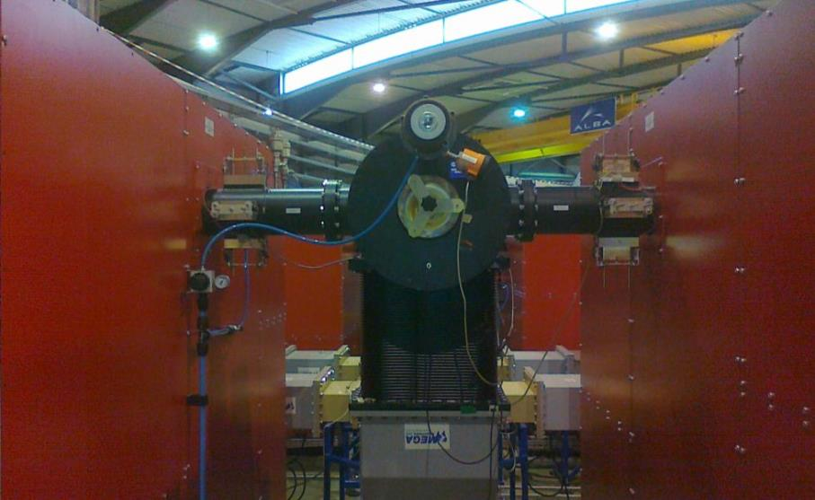
SR RF
CoStub
Power after Costub AT 80 kW | 0.365 W
Initial/ final temperture of the stubs at 80 kW | 24ºC/26ºC
Arcs | Not detected
RF Leaks | Not observed
Power Reflected to the active IOT at 80 kW | 85 W
In operation
CoStub
CoStub
CaCo

Slide 20
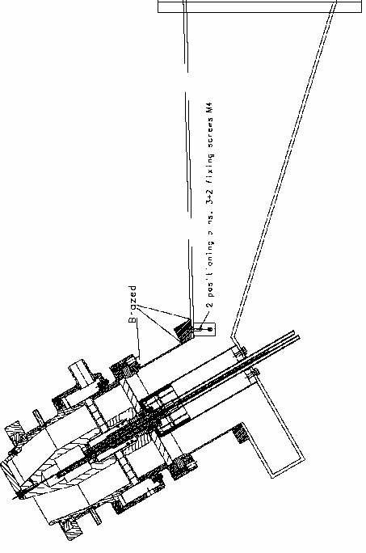
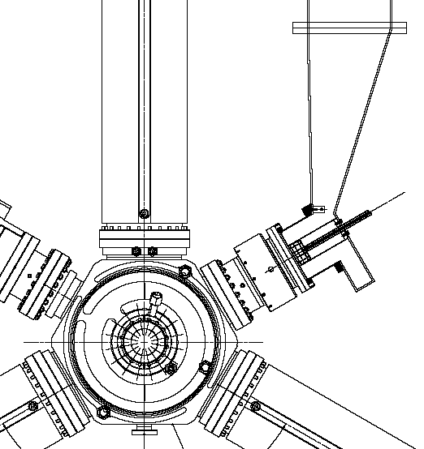
Watrax: Waveguide to Coaxial transition
SR RF
Allow water cooling channels in
Up to 160 kW
Fit the geometry

Slide 21
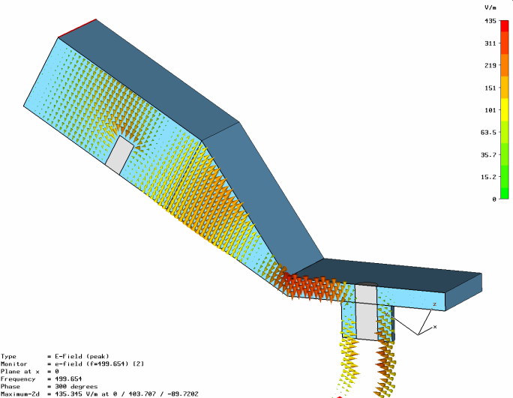
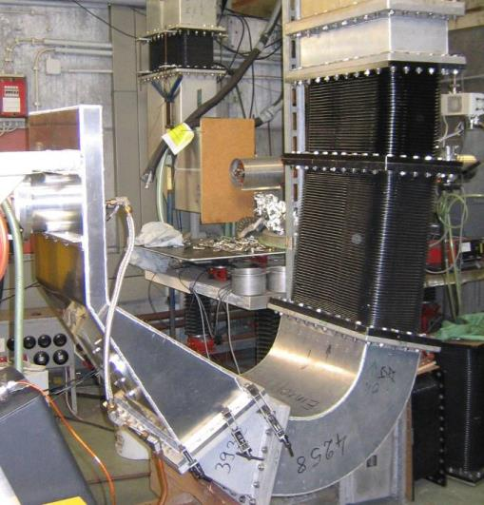
Watrax
SR RF
Maximum CW power: 160 kW
VSWR: 1.061
Max. peak electric field: 239 kV/m
Power dissipated: 74.1 W

Slide 22
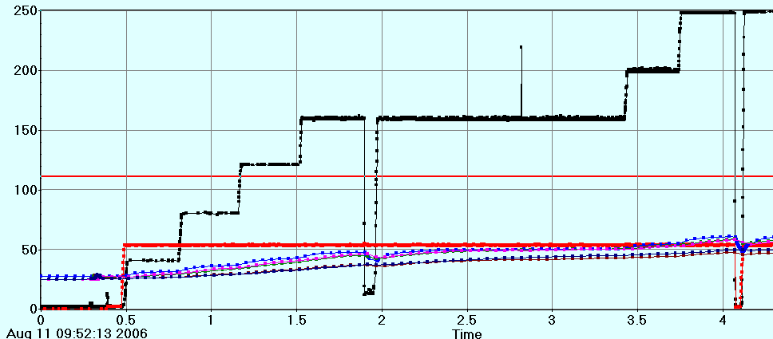
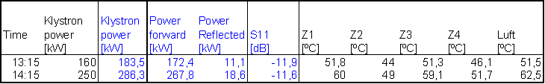
SR RF
Watrax: Power test at DESY
250 kW

Slide 23
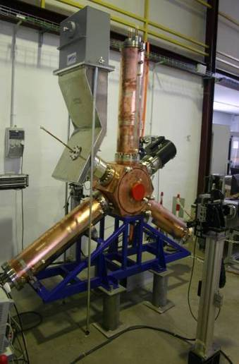
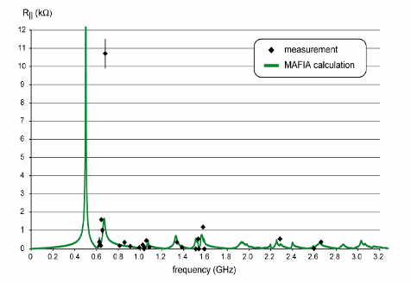
SR RF
RF cavity: DAMPY - HOM damped cavity
(in collaboration with Bessy)
HOM damped RF cavity
Bead motion
Wire on which beads are attached
bead
CAVITY DAMPY
Type single-cell
Number 6
Frequency 500 MHz
Rsh 3.3 Mohm
Alignment
Tension

Slide 24
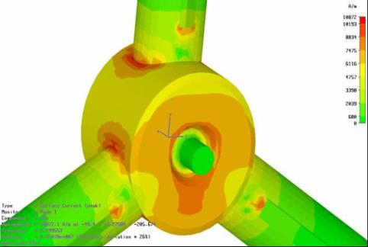
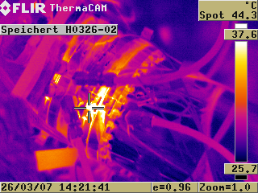
SR RF
SR Dampy 01 to 06 Power tests
All cavities operate without problems

Slide 25
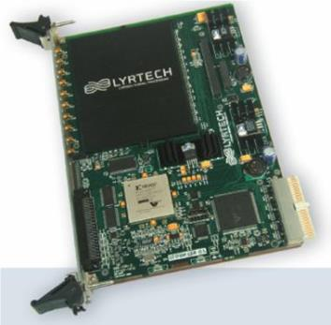
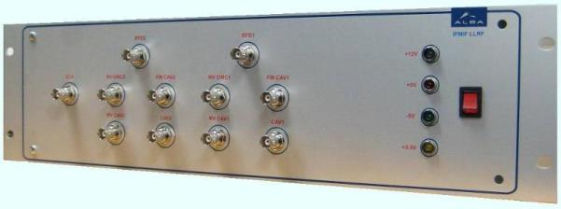
SR RF
Digital Low Level RF
Based on a commercial FPGA board (Lyrtech VHS-ADAC)
Analog Front Ends for pre-processing of RF signals
Amplitude, phase and tuning loops implemented
Diagnostics and extra capabilities
Lyrtech Digital Board
Analog Front End

Slide 26
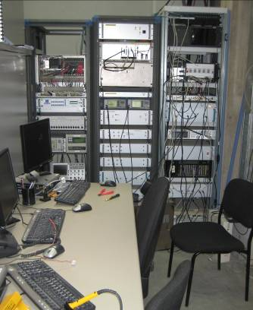
SR RF
DLLRF Power test
Tests at 75 kW
Amplitude RMS Errors: 0.11% @ 80MHz
0.03% @ 1MHz
Phase RMS Errors: 0.05º @ 80MHz
0.02º @ 1MHz

Slide 27
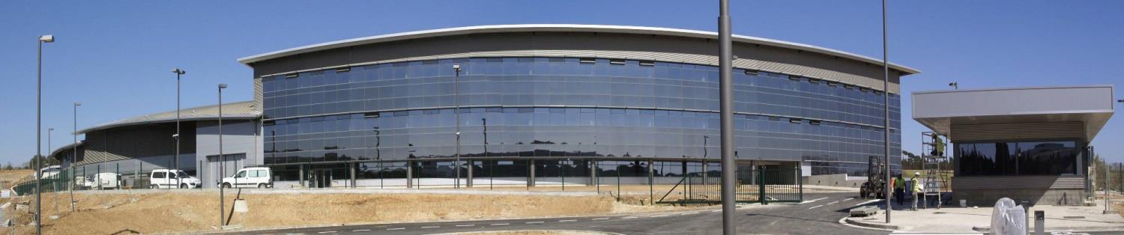
Conclusion
RF developments at ALBA:
Cavity Combiner CaCo
Coaxial Short-Switch CoStub
IOT improvements LS-IOT
HOM Damped Cavity Dampy
Waveguide-Coax transition Watrax
Digital LLRF DLLRF
Thank you

