Slide 1
RF Techniques and Developments at SSRF
Wenzhi Zhang
On behalf of RF group
Dec. 2013

Slide 2
Outline
Introduction of RF System at SSRF
Operation status of RF
R&D of SRF at SSRF

Slide 3
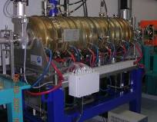
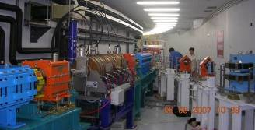
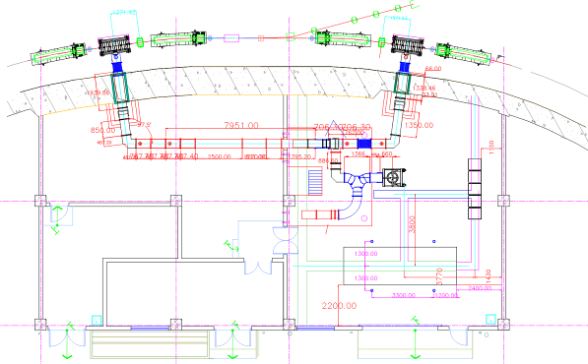
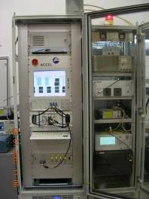
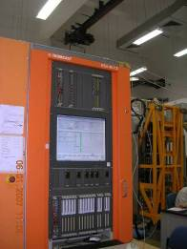
The layout of the booster RF system
One 180KW transmitter feeds power to two normal conducting 5-cell cavities, ramping energy from 150 MeV to 3.5 GeV, and its LLRF is analog I/Q from ACCEL company.
It has been commissioned successfully in June of 2007

Slide 4
Main Designed and Measured Parameters of Booster RF System
Parameter | Value | Unit
RF frequency | 499.654 | MHz
Beam energy | 3.5 | GeV
Energy loss per turn | 0.915 | MeV
Single/Multi-bunch mode beam current | 2/10 | mA
Beam power (Multi-bunch) | 9.15 | kW
RF voltage | 1.80 | MV
RF Phase Stability | <±1 | o
RF Amplitude Stability*(*Ramping) | <±1 | %

Slide 5
Main requirements of SRF for SSRF storage ring
RF frequency | 499.654 MHz
RF voltage | ≥4.0MV (5.0MV*)
RF phase stability | ≤±1°
RF amplitude stability | ≤ ±1%
Beam power | 491 (625*) kW

Slide 6
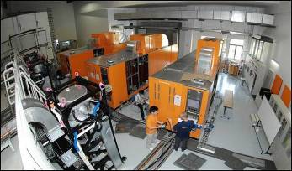
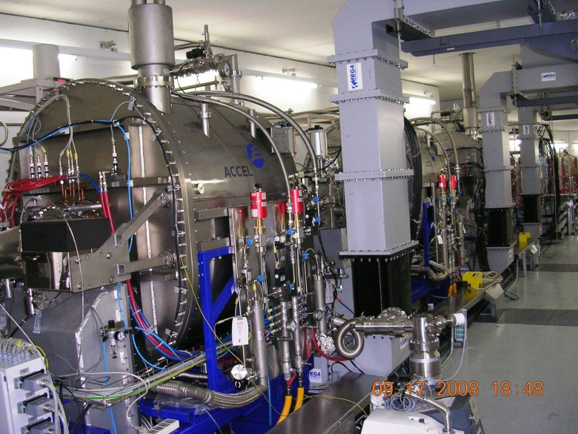
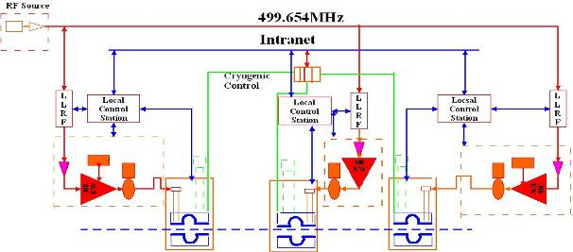
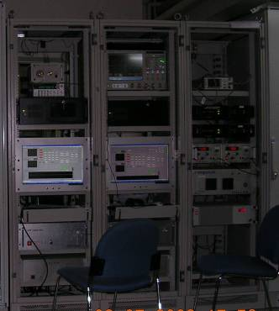
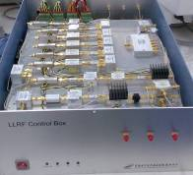
The layout of the storage ring SRF system
2
3
1
TESTING CAVE

Slide 7
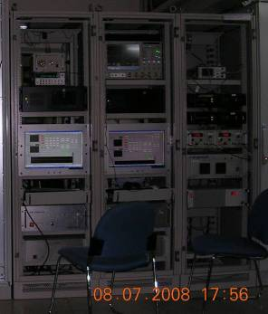
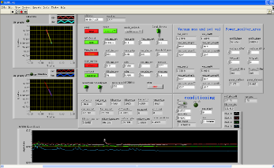
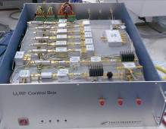
Block Diagram of SSRF_SR_LLRF
SINAP has successfully developed its own digitalized LLRF system. Its operation was stable and reliable both for backup system and superconducting modules.

Slide 8

From Sept. 17,2008, 3 sets superconducting modules have been put into operation.

Slide 9
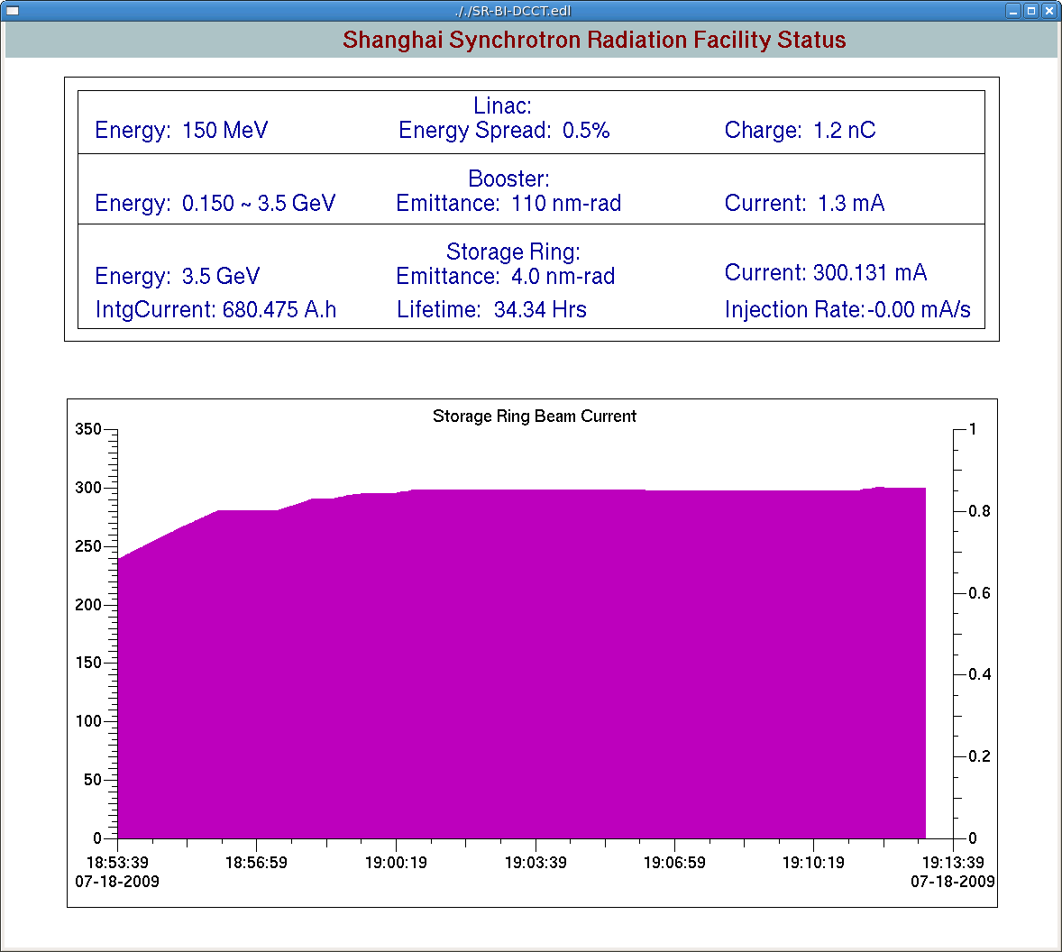
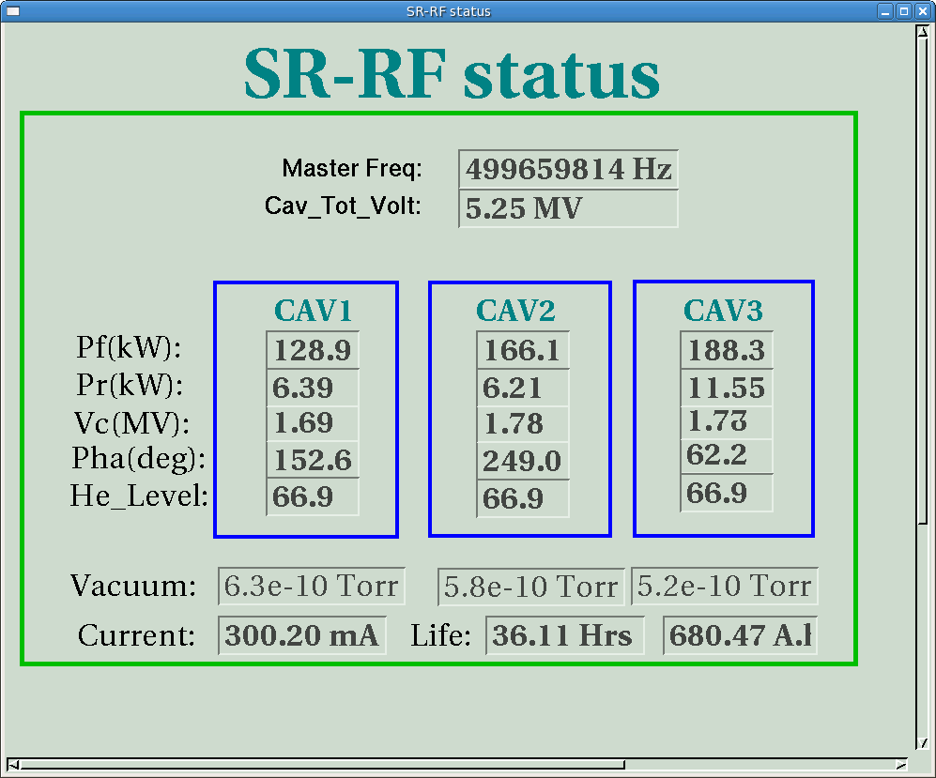
18/7/2009 Beam Current 300mA --the Maximum Designed Beam Current--

Slide 10
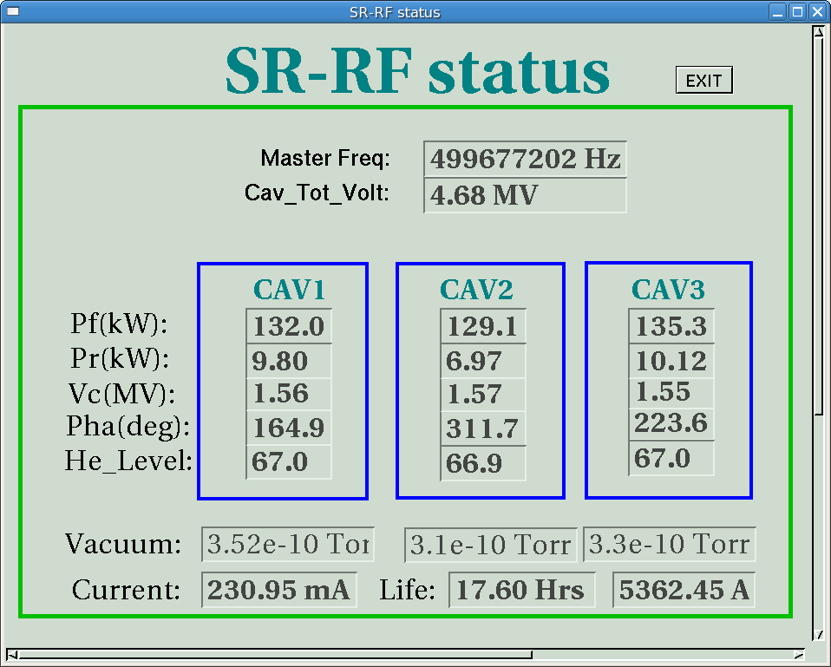
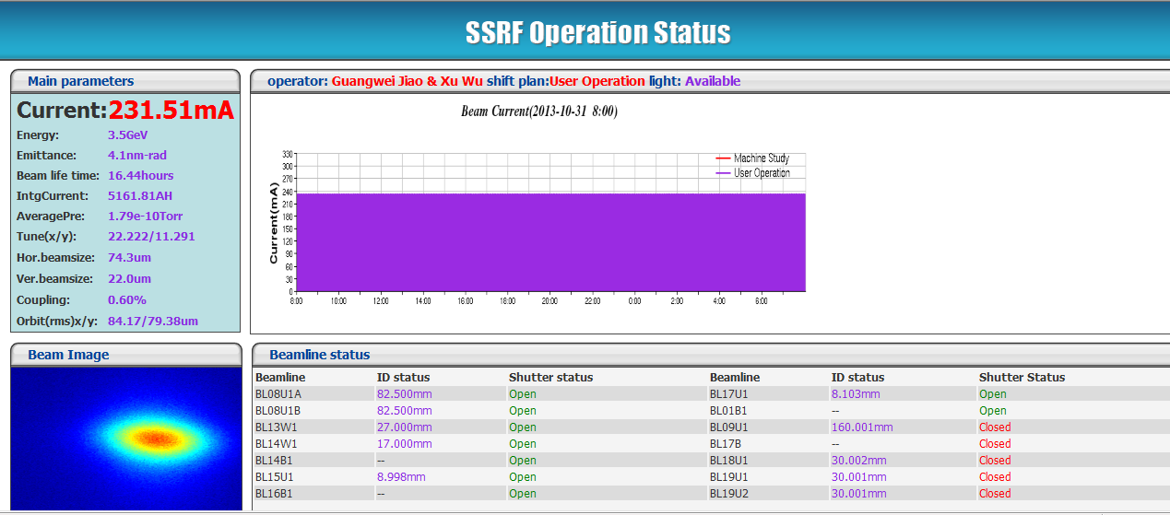
For 230mA top up operation

Slide 11
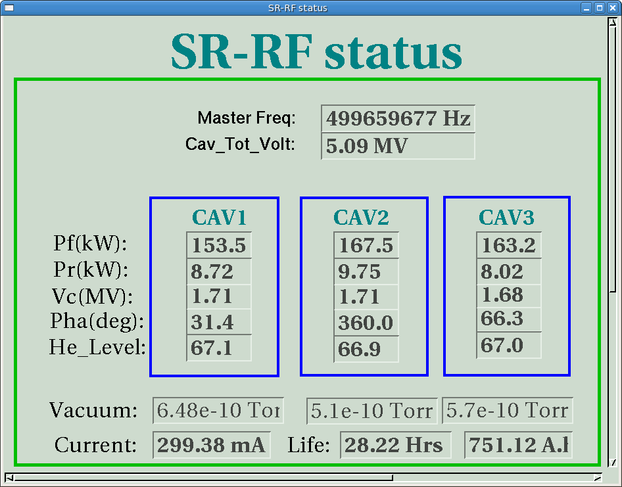
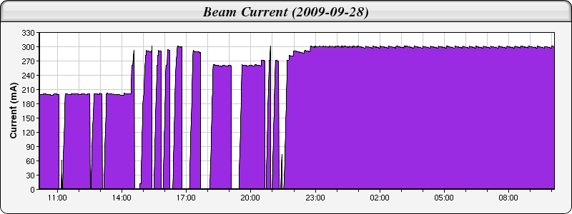
28/9/2009, 24 hours beam conditioning, and operated at beam current 300mA for 12 hours
300mA top-up
Operated for 12 hrs tripped by vacuum near RF window of module #1
Trip during beam conditioning

Slide 12
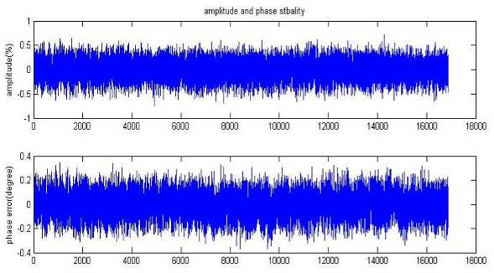
Stability of Amplitude and Phase with SC
200mA, 3.5GeV
RF frequency | 499.654 MHz
RF phase stability | ≤±1°
RF amplitude stability | ≤ ±1%

Slide 13
Contents
Brief Introduction of SSRF
RF System of SSRF
Operation of RF
R&D of SRF at SINAP

Slide 14
Main trips from 2012 to now include:
Trips over 4 times
FBT Vacuum burst, 11 times;
Insulation vacuum burst, 4 times.
Circulator and load arc, 5 times
Trips with long break-down time
Damaged kinds of auxiliary power
Total 12hours

Slide 15
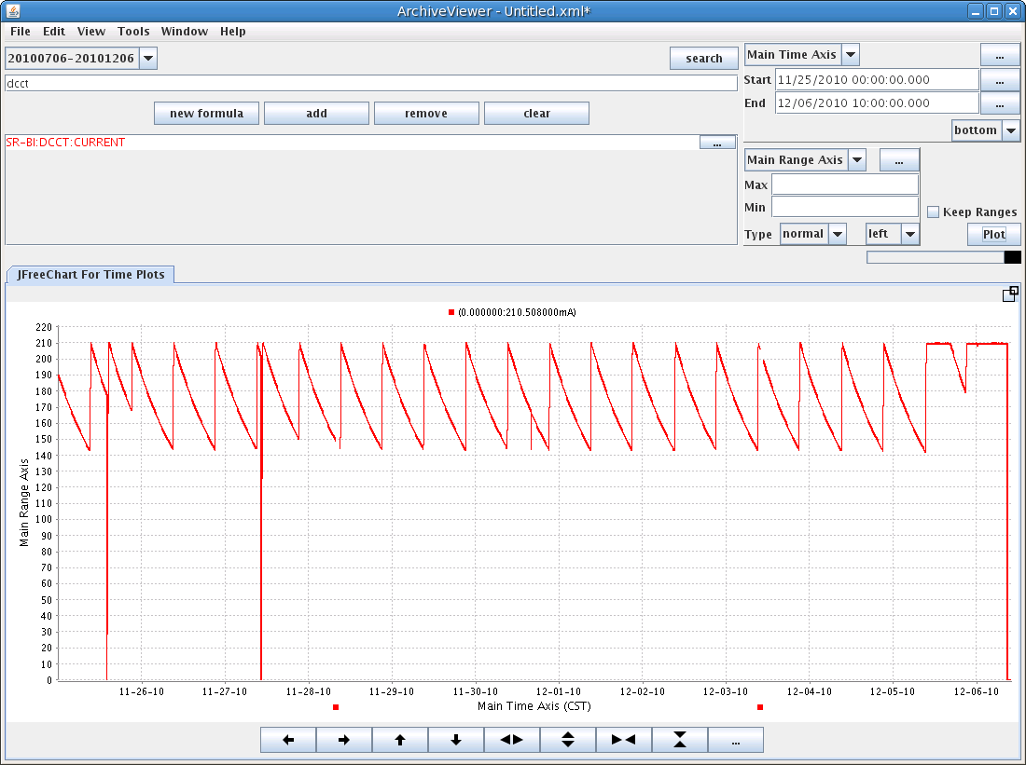
>200hrs
Maintenance
Orbit interlock by
magnetic power supply

Slide 16
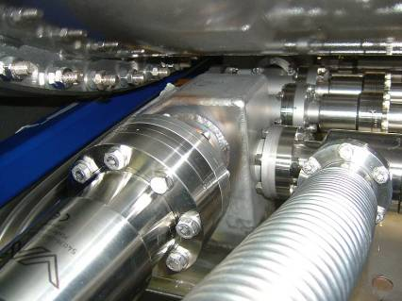
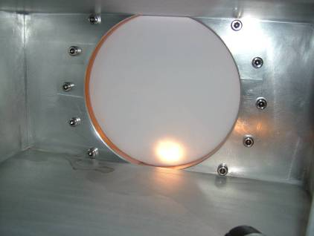
2. Interlock from SRF Modules and Solutions
Beam trip by RF window out-gassing
The module was ever exposed to atmosphere during SAT due to the leakage around pump-out box;
Water mark was found around the window after RF window baking during SAT
Solution
More conditioning
RF window baking

Slide 17
Cavity Processing
Conditioning of the RF window with up to 100kW RF power at about 100kHz off resonance again under the LLRF control.
Change the phase of standing wave to increase the forward power while keeping the cavity voltage at 1.5MV with frequency loop and IQ loop of LLRF are closed.
Conditioning of the RF window with beam current. One method is to increase the beam current by a slow increase, the other is to adjust the accelerating phase of the cavities slowly while keeping the same beam current.

Slide 18
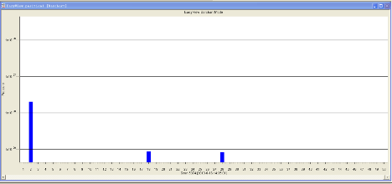
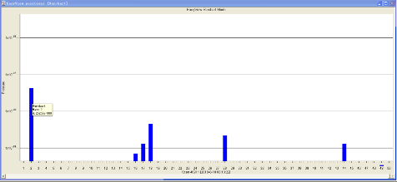
RF Window Baking
More than 120 hours with temperature up to 120 ℃.
Connect all three kapton windows in serial by pipes with dry pure N2 gas.
Be sure to clean the water cooling pipes firstly.
4.2E-8mbar
2.0E-8mbar
Residual gas before baking of module #1
Residual gas when baking of module #1
with 120 ℃

Slide 19
Vacuum of SRF modules after cool-down
Position | BCC01 | BCC02 | BCC03 | BCC04 | BCC05
 | mbar | mbar | mbar | mbar | mbar
#1 | 1.3e-10 | 9.0e-11 | 1.8e-10 | 2.1e-7 | 1.1e-7
#2 | 1.3e-10 | 1.4e-10 | 1.9e-10 | 1.2e-6 | 9.1e-8
#3 | 1.4e-10 | 1.9e-10 | 1.9e-10 | 2.3e-7 | 1.1e-7
Vacuum of SRF modules with 1.7MV voltage(cavity were detuned)
Position | BCC01 | BCC02 | BCC03 | BCC04 | BCC05 | Vc | Pf
 | mbar | mbar | mbar | mbar | mbar | MV | kW
#1 | 2.4e-10 | 1.1e-10 | 1.9e-10 | 1.6e-7 | 1.2e-7 | 1.7 | 107
#2 | 1.7e-10 | 1.3e-10 | 1.6e-10 | 1.2e-6 | 1.1e-7 | 1.73 | 65
#3 | 1.9e-10 | 1.7e-10 | 1.7e-10 | 3.6e-7 | 1.1e-7 | 1.72 | 76

Slide 20
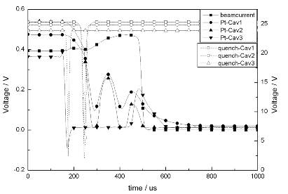
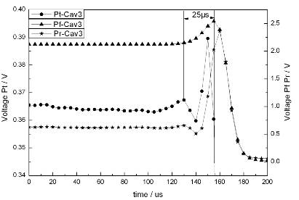
Quench by Multipacting
It was found only at module #3.
First interlock signal was reflected power other than quench;
No change of helium vessel pressure.
Cavity vacuum became worse to interlock the gate valves (threshold value 1E-7mbar).
Is it related to cavity voltage or forward power?
More cold helium gas flow (>30 l/min) to cool-down the coupler?

Slide 21
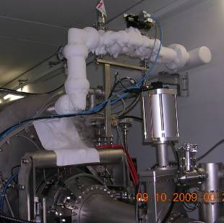
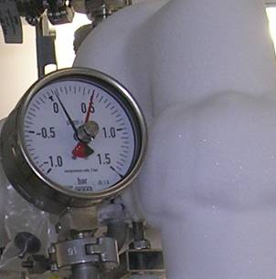
IF Cryo-plant is shutoff by power supply or others,
what can we do? Just watching?
Electricity was off, cryoplant was down suddenly, return lines of helium vessel were closed.
The helium gas was set out only by the safety valve.
Sometimes the solenoid valves are frozen.
IS THERE OTHER BETTER SOLUTION except watching?

Slide 22
Warm up of module
The helium gas was set out through warm return line other than cold return line;
Warm-up of module many times, will it damage the insulation vacuum?
For SSRF, the compressor has to be maintenance every year in the summer, thus SRF modules have to warm-up. Is there some solutions?
A spare compressor?

Slide 23
Cool down of SRF modules
Three modules were cool-down in the same time with cooling speed 10K~15K/hour;
When temperature is around 120K, increase the cooling speed;
Carefully switch the warm return valve and cold return valve after the module is cooled.

Slide 24
Contents
Brief Introduction of SSRF
RF System of SSRF
Operation of RF
R&D of SRF at SINAP

Slide 25
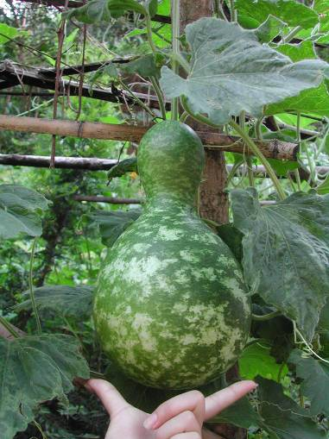
SRF Lab in SINAP
Cavity R&D
Surface Processing
Vertical test facility

Slide 26
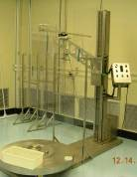
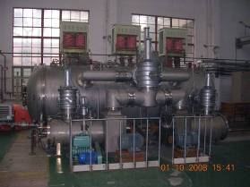
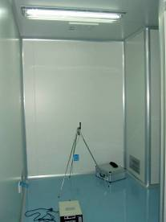
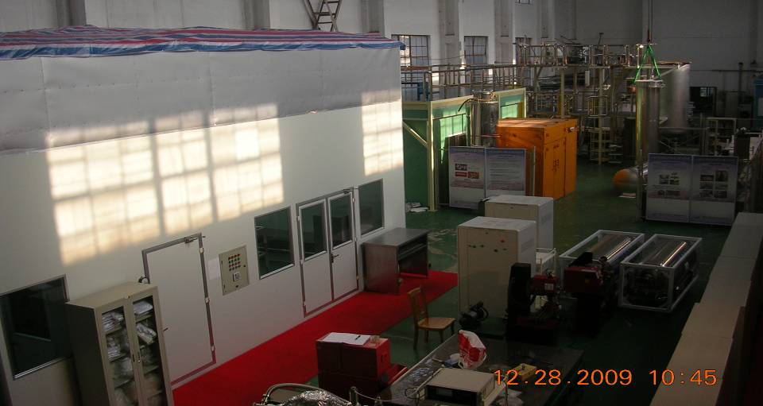
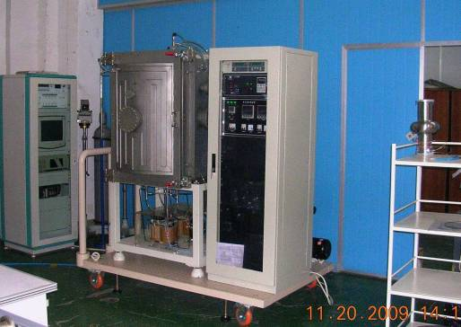
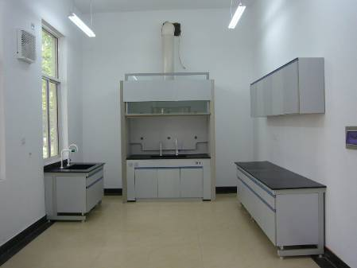
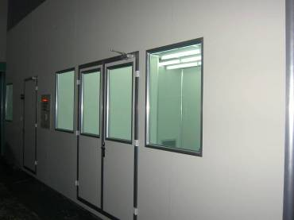
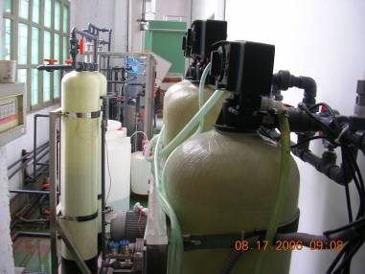
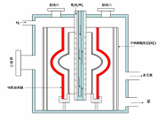
Shanghai Key Laboratory of cryogenics & SRF Technology
Baking furnace
MgB2 furnace
Clean room
BCP Lab
Pure water

Slide 27
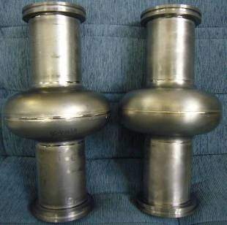
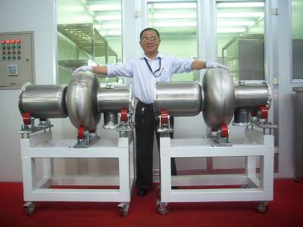
Cavity R&D
Deep-drawing + EBW
500MHz Nb cavity
1500MHz Nb cavity

Slide 28
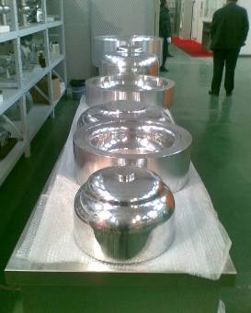
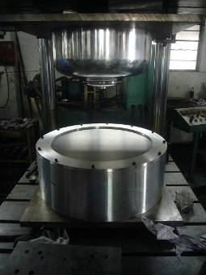
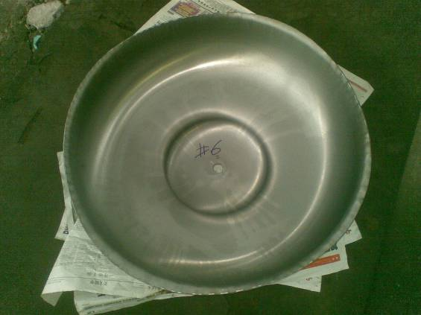
dies
Deep-drawing
Half cell

Slide 29
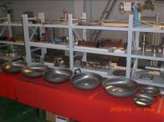
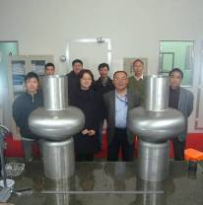
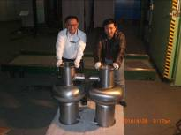
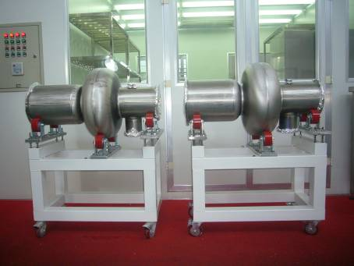
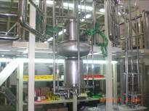
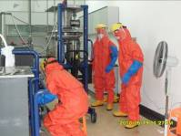



2. Fabrication of 500MHz Niobium cavities based on KEKB type
Half cells and transition parts
Successful EBW at Harbin Institute of Technology
Assembly before EBW
Cavities in SCLab
Cavity hung on vertical test facility after Indium
seal, waiting for pumping
Cavity BCP
High pressure pure water rinsing (HPR) after BCP
LHe cool-down for vertical test
vertical test low level RF equipment

Slide 30





















Niobium cavity fabrication process
material Nb sheet - Ningxia Orient Tantalum industry CO.LTD
surface preparation includes mechanical grinding, BCP, HPR,etc
indium seal of niobium cavity and couplers in clean room
t=3mm.RRR=300
forming technique. Spinning or deep drawing.
RF performance measurement of niobium cavity at room temperature
Evacuation and Leak check at room temperature
Deep drawing
1.Less reduction of the thickness
2.Smoother surface
design and fabrication of Dies and female dies
electric beam welding. vacuum is better than 5E-5 torr
after BCP&HPR
preparation for vertical test includes assembly to vertical test platform, cool-down, RF power source, LLRF
Before BCP
Niobium sheets check
deep drawing on hydraulic machine
Max. pressure 20MPa
fabrication of beam pipes and Nb-Ti flanges
vertical test at 4.2K
trimming of half cell
pre-processing of half cell
frequency measurement of 2 half cells

Slide 31


Surface Processing
mechanical polishing

Slide 32


Buffered Chemical Polishing
200um heavy etching+20um slight

Slide 33


High pressure rinsing with ultra-pure water
18MΩ.cm, 8MPa

Slide 34

Low temperature baking (110℃)

Slide 35
Test procedure

Slide 36
Heavy Q-drop in the first two tests.
The 3rd test reach high performance: Eacc>10MV/m with Q0 ~4E8
Slight BCP;
HPR with fresh ultra-pure water;
Clean room assembly;
Low temperature baking >70 hours

Slide 38

RF system for proton synchrotron therapy accelerator

Slide 39
Main Parameters
circumference | 14.6 m
Injection Energy | > 7 MeV
Accelerating Energy | < 250 MeV
Momentum spread at injection | < ±0.5%
Revolution frequency | 1.48-7.48 MHz
Harmonic number | 1
RF frequency | 1.4~7.5 MHz
Accelerating voltage | 2kV pk

Slide 40



RF frequency | 1.4~7.5MHz
Cavity length | ~ 0.7 m
Accel. gap | 1
Cores type | MA-FINEMET
cores number | 2×4
Accel. voltage | 2kV pk-pk
RF power amp. | 2×5kW
Cooling | Forced air
Tuned style | Wideband untuned
Power feeding | Multi feed coupling

Slide 41

Solid state amplifier

Slide 42

thanks

