Slide 1
Impact of Relative Humidity on EBPM Readings
Guenther Rehm, Chris Bloomer
DEELS15, Barcelona

Slide 2
History Q
We’ve been archiving the BPM Q signal from the start as a check on the ‘sanity’ of BPM pickups, cables, and electronics
We’ve long noticed a strong correlated component across all BPMs, but could never explain it
Various theories had been investigated and falsified:
Q changes as flat beam tilts: true in principle, but to explain anywhere near the amount of Q change we saw the beam had to tilted by 45 degree (which it does not at all)
Standing waves on BPM cables change as RF frequency changes: True, but again, magnitude of the effect is not compatible with observation

Slide 3
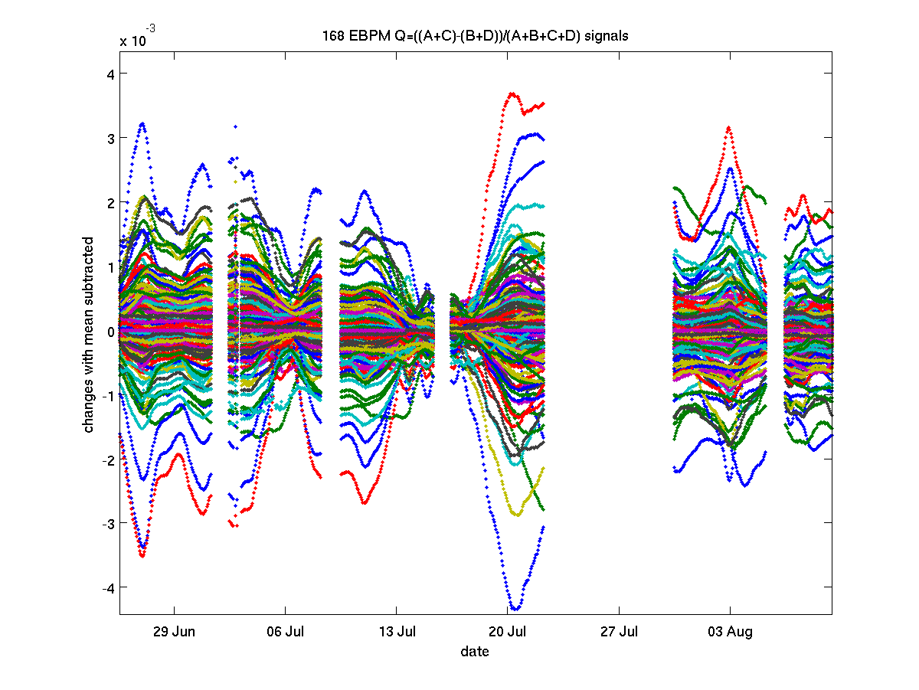
Q data

Slide 4
History S
We had also been using the BPMs as ‘secondary beam current monitors’. To this end we put a calibration on each BPM that converted the sum signal (taking into account the built-in attenuation) into beam current.
We soon observed that this calibration varied strongly over time, so we just chose to run an automatic slow calibration process with the DCCT as reference, and archived the calibration constant.
When we looked at the calibration constants over time, they would all vary in near lockstep.
Theories to reason why were tested and falsified:
Its is not correlated/related to RF voltage (thus bunch length) changes as seen at the ESRF

Slide 5
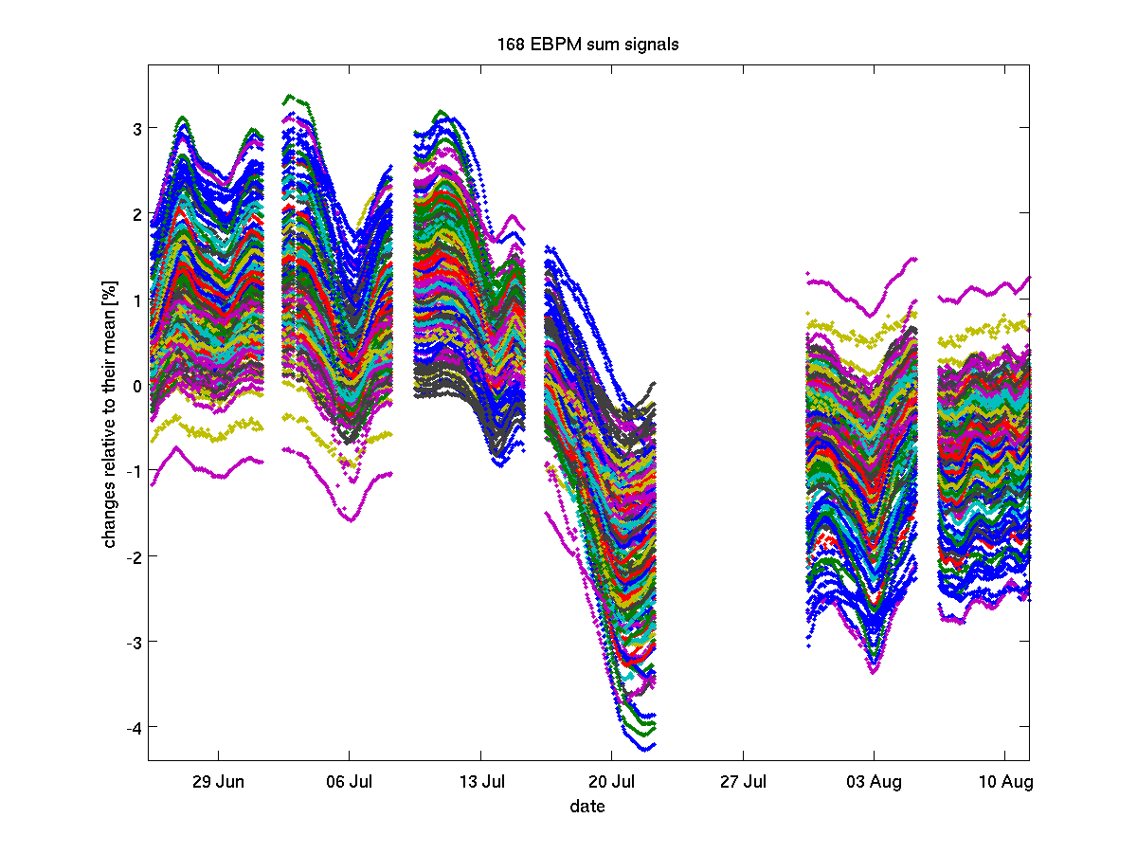
Sum data

Slide 6
History X
We’ve also had tungsten vane XBPMs on every undulator frontend, and archived the positions there.
Again, we found correlation across the ring, and even with the EBPM Q
We reasoned there are actually ABCD individual drifts at the EBPMs, and some of this comes out as Q, some as X and/or Y, which then the orbit feedback ‘corrects’, it actually moves the beam to correct for the drift of the monitor.
The XBPMs then sense the photon beam movement caused by this.

Slide 7
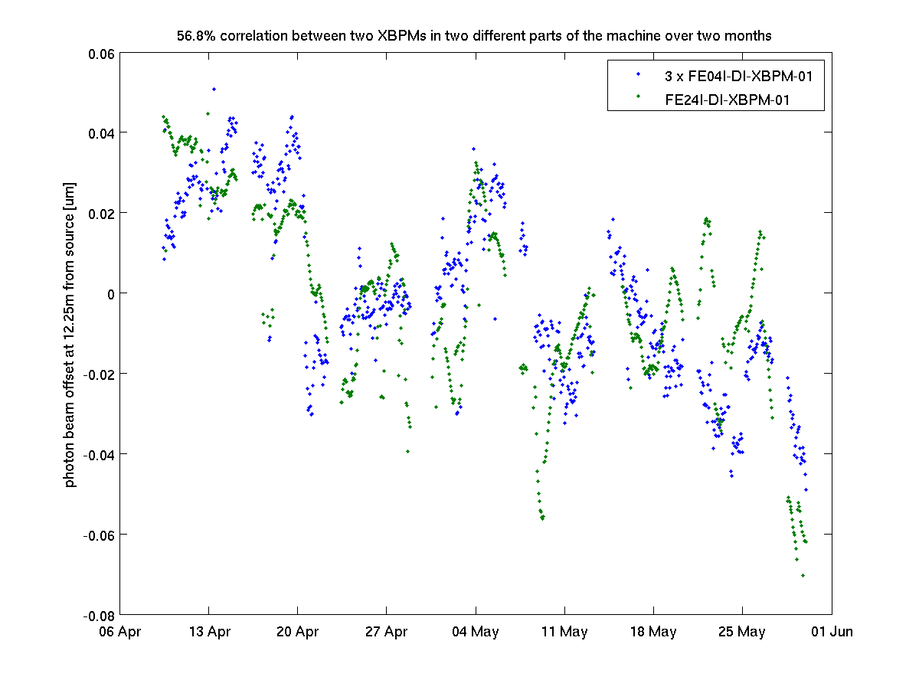
XBPMs correlate

Slide 8
History B
Until recently, all these observations occupied the ‘very curious, but of little practical relevance’ corner of the ‘problem space’.
Then recently we found a correlation between photon intensity as recorded on a very sensitive beamline*.
As these fluctuations had been the source of considerable grief for this beamline, the subject suddenly became a ‘big issue’.
*with a four bounce mono, thus very small acceptance angle into the mono, or very high sensitivity to beam position

Slide 9
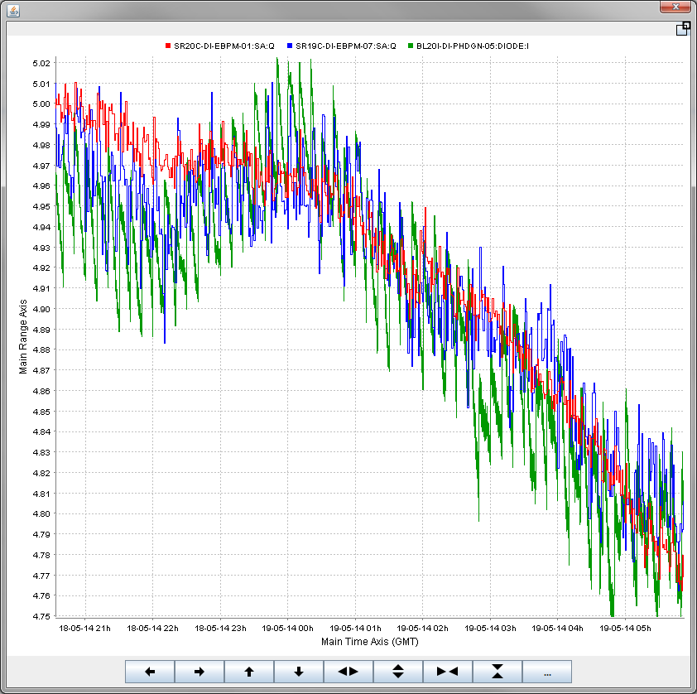
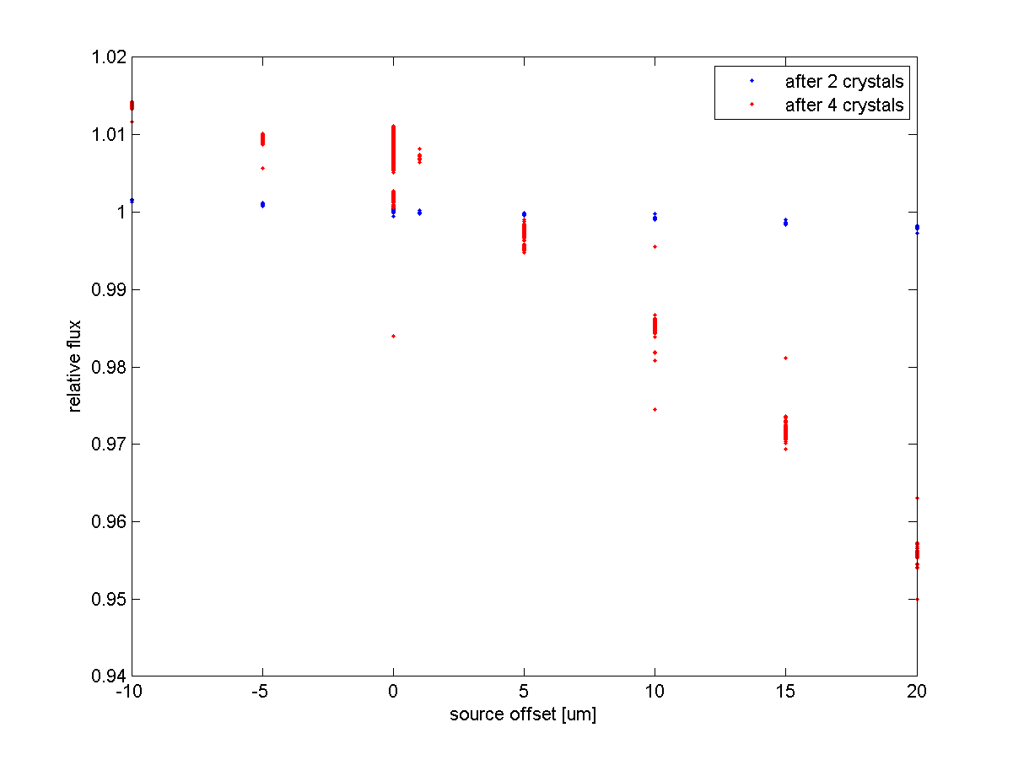
EBPM Q and Beamline diode
Correlation of flux on diode after 4 bounce with EBPM Q
Controlled experiment of
source displacements
-3%
-3%

Slide 10
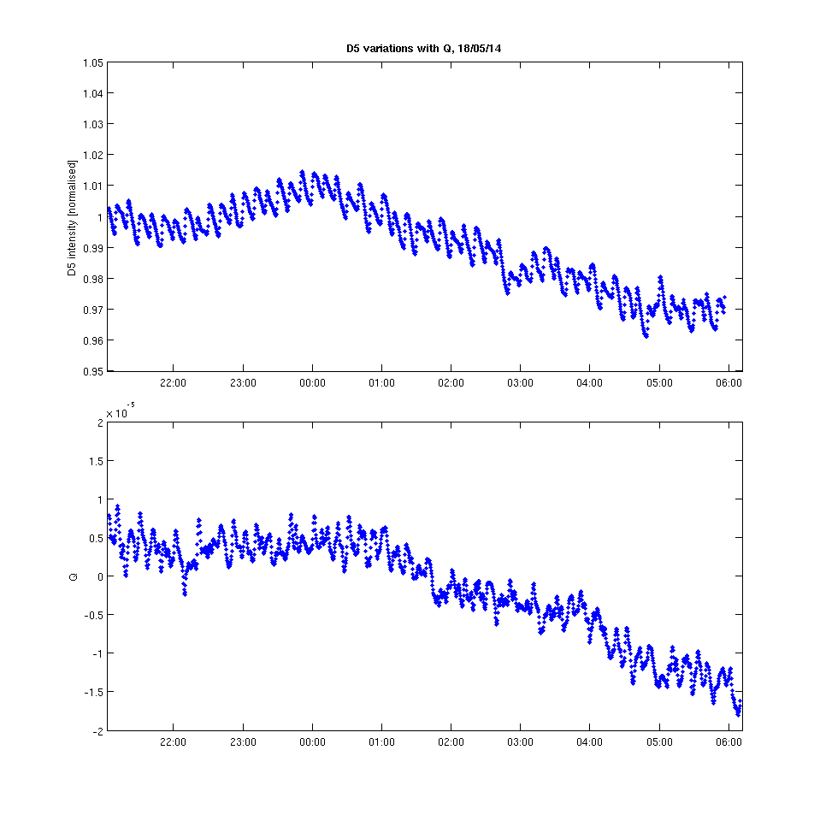
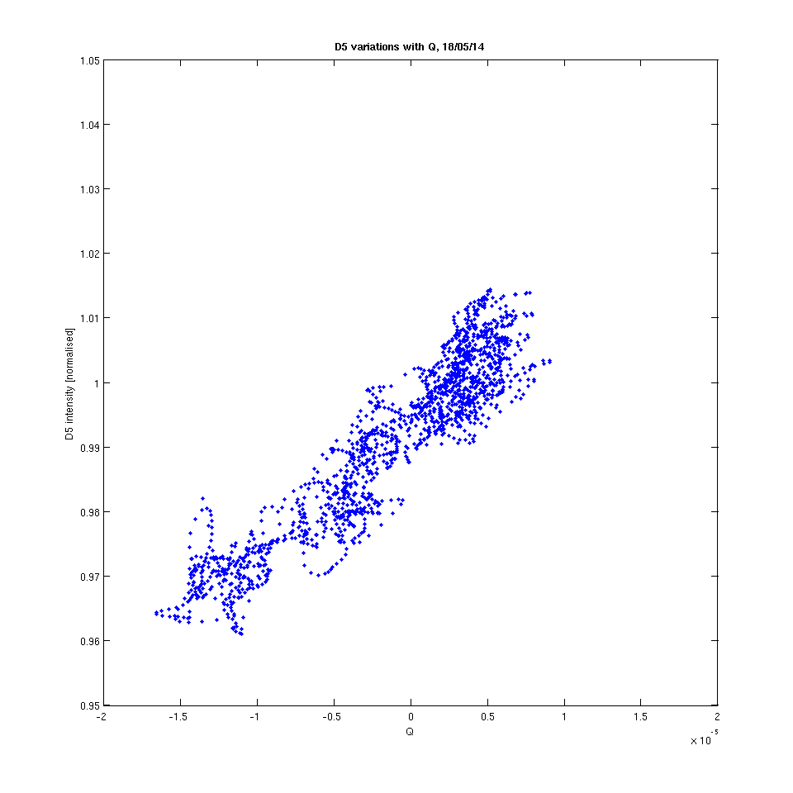
I20 flux compared with EBPM Q :
18 May 2014
D5 intensity
D5 intensity
EBPM Q
EBPM Q

Slide 11
Enlightenment
In a brainstorming meeting, one of or beamline scientists brought up the idea that the cable dielectric might be influenced by environmental factors like temperature or relative humidity
We do control temperature in the tunnel and racks to 0.1C, but relative humidity (RH) is not controlled
But luckily we had an environmental monitor installed in the tunnel which records RH
It turned out there is good correlation between the EBPM S, EBPM Q or photon beam position data and RH, which improves further when a single pole IIR low pass filter is applied to the RH data. Time constants vary from cable to cable and over time, they are in the range of tens of hours.

Slide 12
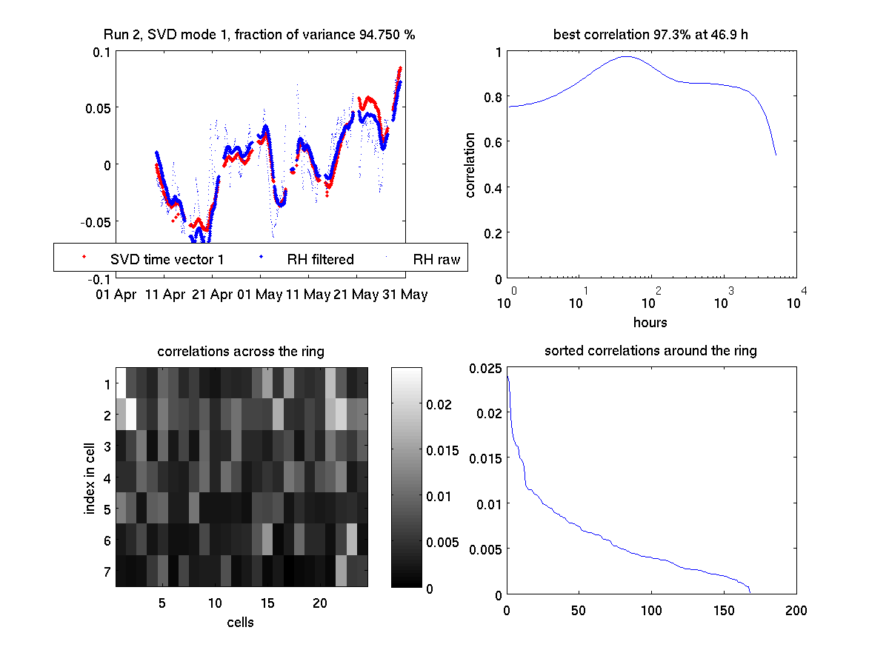
EBPM S run2 2014

Slide 13
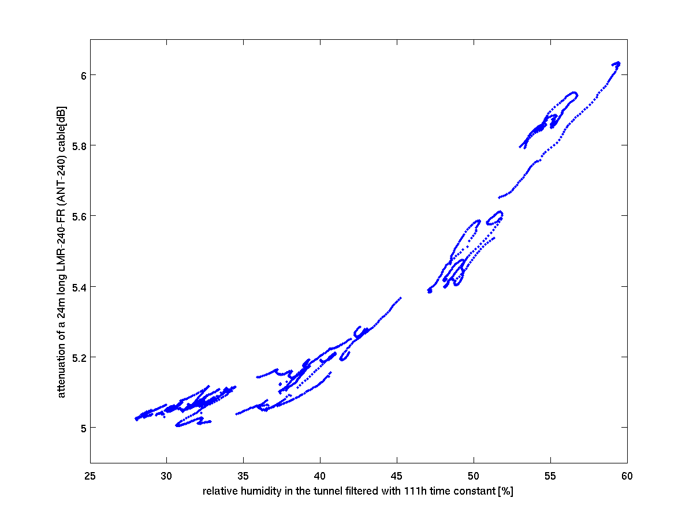
Signal attenuation v RH
This is from all of 2014 for the one set
of four cables that is most affected.
Attenuation is calculated from EBPM S
plus datasheet attenuation at 500MHz
for 24m of cable.

Slide 14
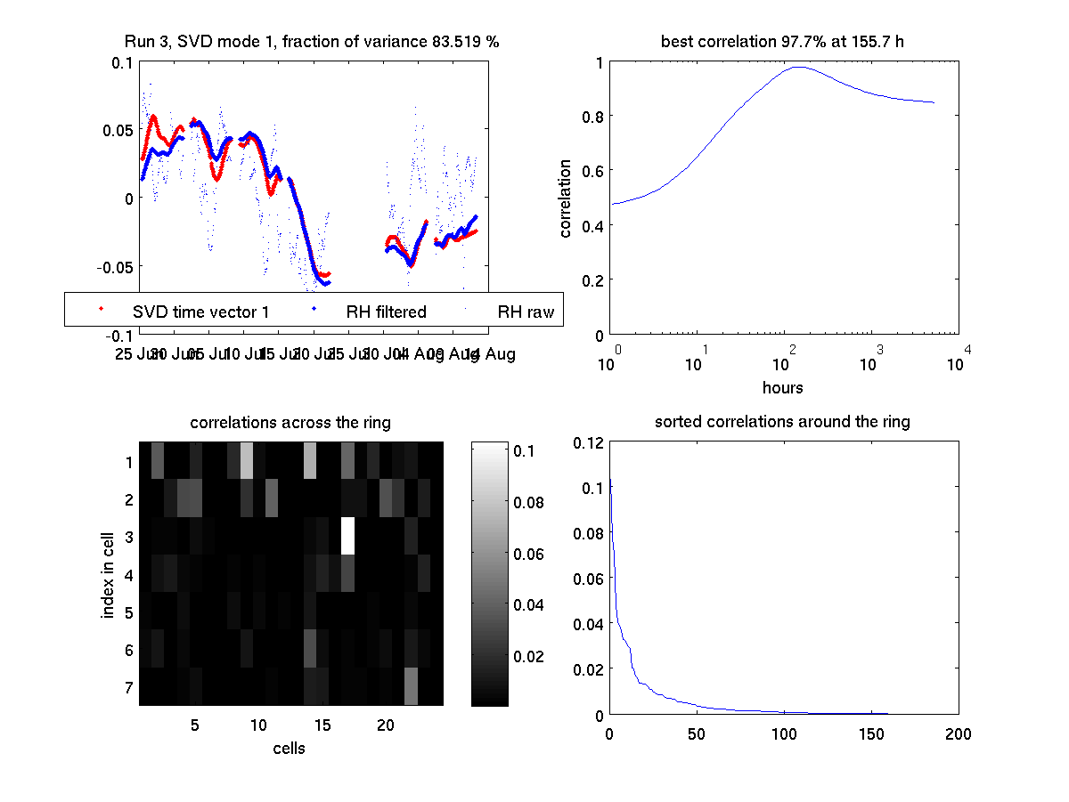
EBPM Q run 3 2014

Slide 15
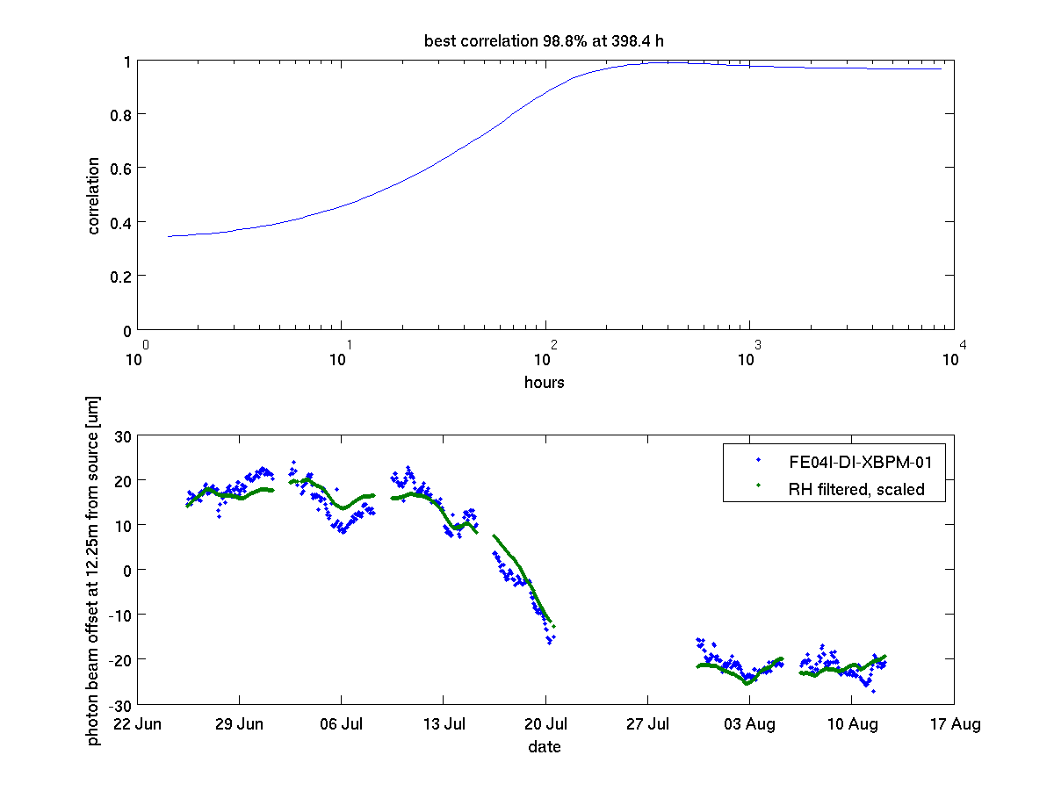
XBPM in frontend 4 run3 2014

Slide 16
Conclusions August 2014
Cable (24m PE foam dielectric) signal transmission might change from 5dB to 6dB over the course of a year
Deviations of Q of 4e-3 over the course of two months are explained by correlation with RH
Similar deviations on Δ/Σ for X or Y would mean 40um with a 10mm scale factor
Such order of correlated deviations have been observed on XBPMs

Slide 17
Questions
Have you ever heard about this effect (cable attenuation change with relative humidity), if yes, did it impact on your choice of cables? NO
What cables (manufacturer/part reference) are you using for your BPMs? Are they somehow specially treated (like bundled in a common sheath)? Most use LMR-240, ESRF RG223, PETRA corrugated copper
In your choice of cables, did they have to be LSHF (low smoke halogen free)? At DLS, we MUST have this to comply with our fire insurance. No PVC jackets, no PTFE dielectrics! Only NSLS-II requires LSHF as well
Have you got a record of relative humidity, as measured in the tunnel? RH recorded outside is not relevant, as changing the temperature of the air (to keep it the same inside) does modify the RELATIVE humidity! NO
Have you got a long term record of either BPM sum signal (or a proxy for that), ABCD signals, EBPM Q, corrector strengths, XBPM positions? A few months of records qualified for ‘stable beam positions’ should be enough. Have you ever looked for correlations in these? If not, send me some data and I will put it through the paces… Got S data from SSRF (nothing of the same magnitude visible, RH controlled) Got data from Soleil, but too much other variation and not RH data

Slide 18
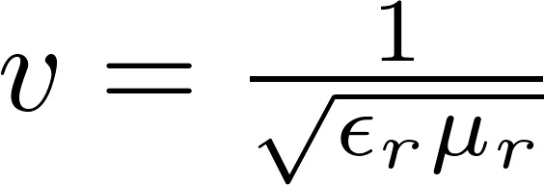
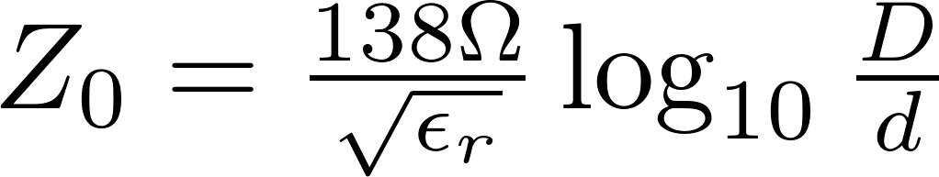
What we found out since then…
A lab experiment with 25m lengths of various cables in a box (with ‘controlled’ and monitored RH) showed no variation of signal attenuation with relative humidity.
SLAC and PSI reported a variation of propagation delay with RH ca. 3fs/%RH/m for Sucoflex 404 (low density PTFE)
But at the same time:
Is it a variation of cable impedance rather than attenuation? But the velocity change is only 1ppm/%RH, so the impedance change would be the same relative change? But we have a foam PE…

Slide 19
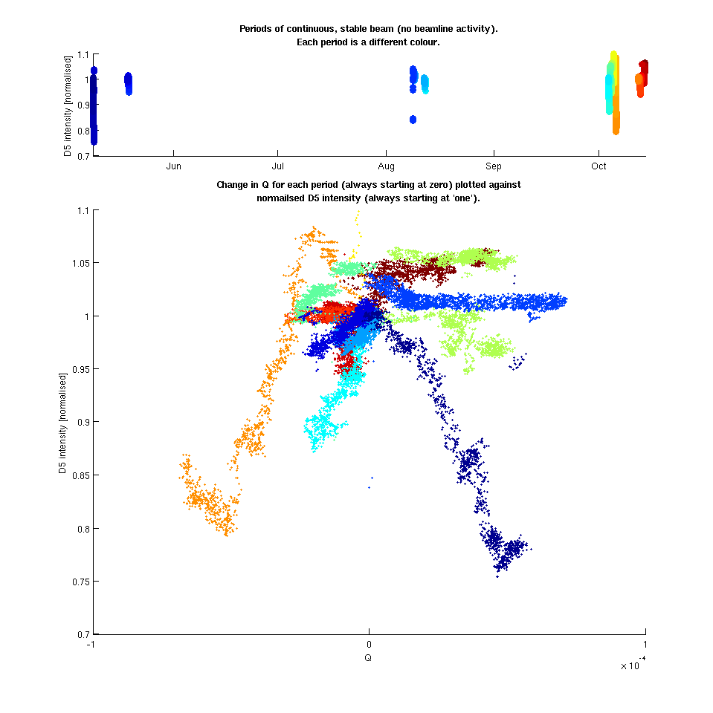
What happened to the beamline?
Observation over longer periods showed the alleged correlation between BPM Q (or relative humidity) and there flux did not exist.
The problem is back to
‘very curious, but of little practical relevance’
Courtesy Chris Bloomer

Slide 20
Current Conclusions
There is evidently an effect of relative humidity on the BPM signal
It is not a change of the cable attenuation
It might be a change of the cable impedance, and in particular the signal coupled into the cable from the button
It is slow, and probably of the same magnitude as ground motion. Beamlines either ignore it, wash it up with re-alignment every few weeks, or have an XBPM feedback to reject it.

Slide 21
Data Processing
Find ‘good times’ within a specified date range:
FOFB running
Stored beam >290mA
Not Tuesday = Machine Physics day
Get data for RH,S,Q,XBPMs for the relevant date ranges
Interpolate to ‘good times’ to have all data from the same points in time
For S data, normalise with mean, then subtract 1, to get relative changes of each value.
For all others, just subtract mean to get only changes.
Finally, run each dataset through an SVD, this finds the correlated modes in the U matrix and their time vectors in the V matrix.
Correlate time vector of a strong mode with RH time vector filtered with a range of time constants to find which time constant fits best.
Display one mode over time and across the ring. For each the fraction of total variance explained by this mode, and the correlation between this time vector and the RH time vector are shown.
Repeat for different date ranges, I used ‘runs’ which are nearly continuous block of operation of 2-3 months length.

Slide 22


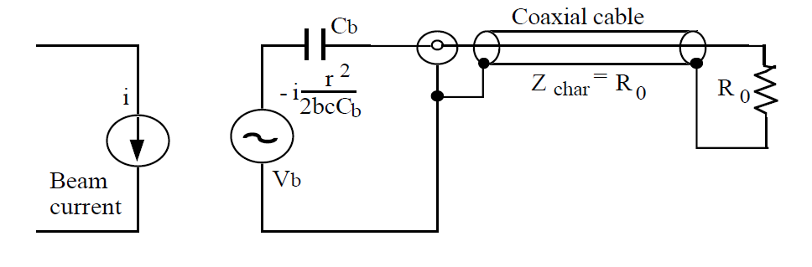
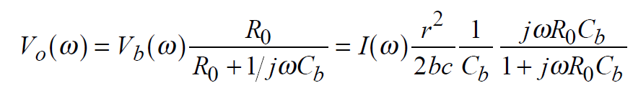
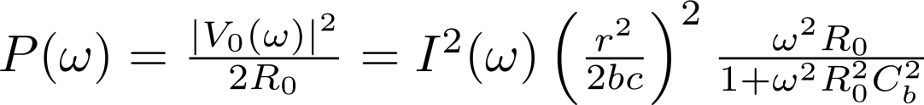
Signal into button
So the observed change of P of 3% would require R₀ to change by 3%,
Which would require ε_{r} to change by 6% ?

Slide 23
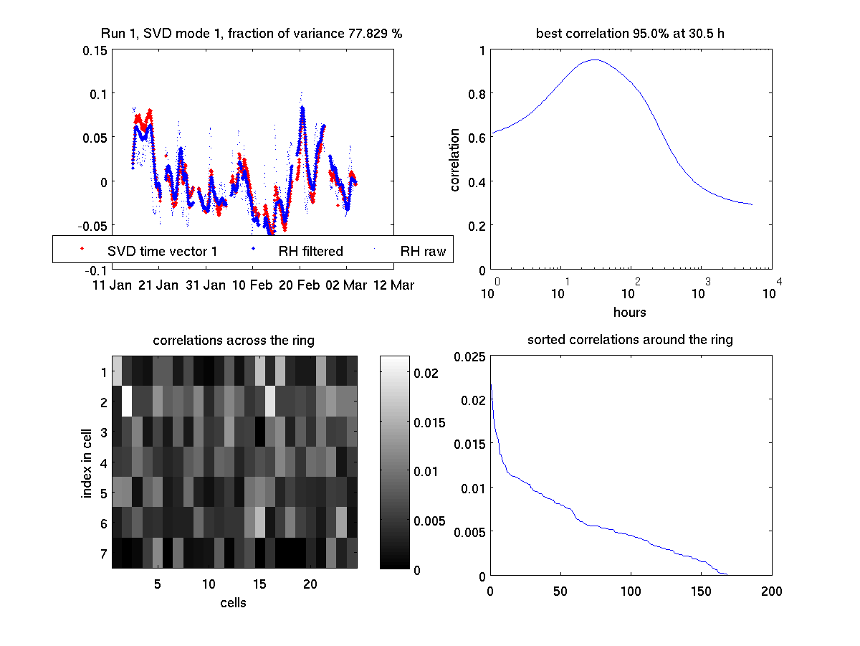
EBPM S run1 2014

Slide 24
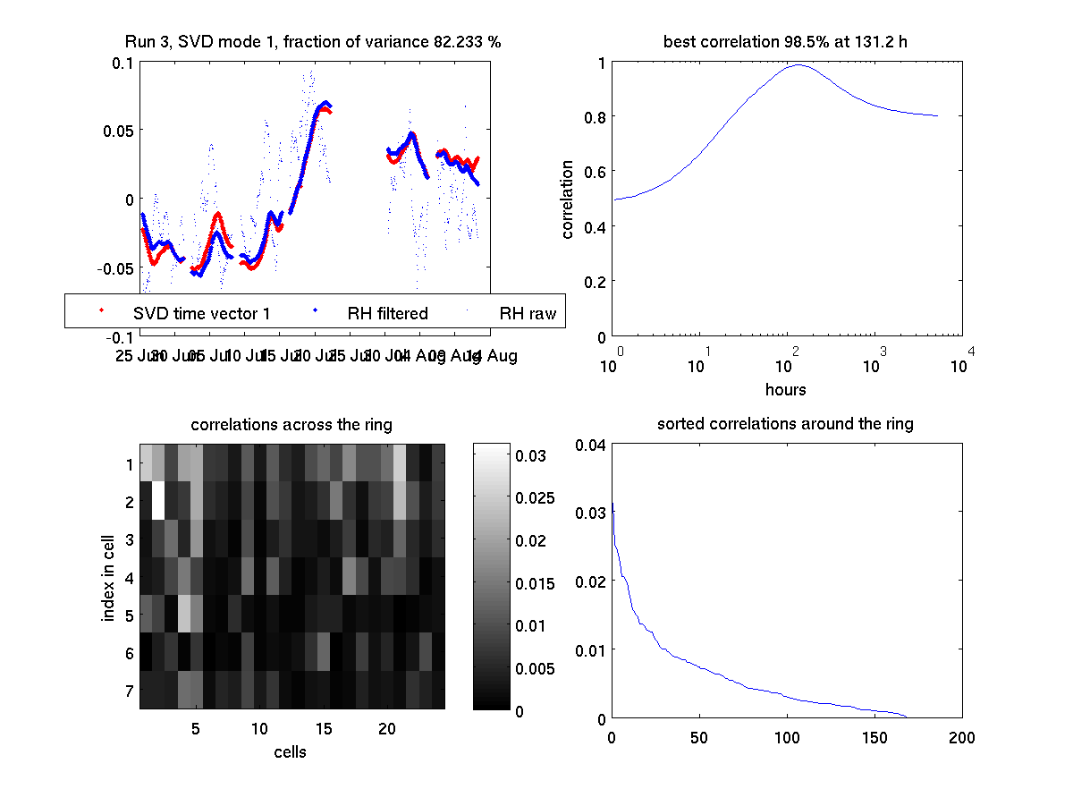
EBPM S run3 2014

Slide 25
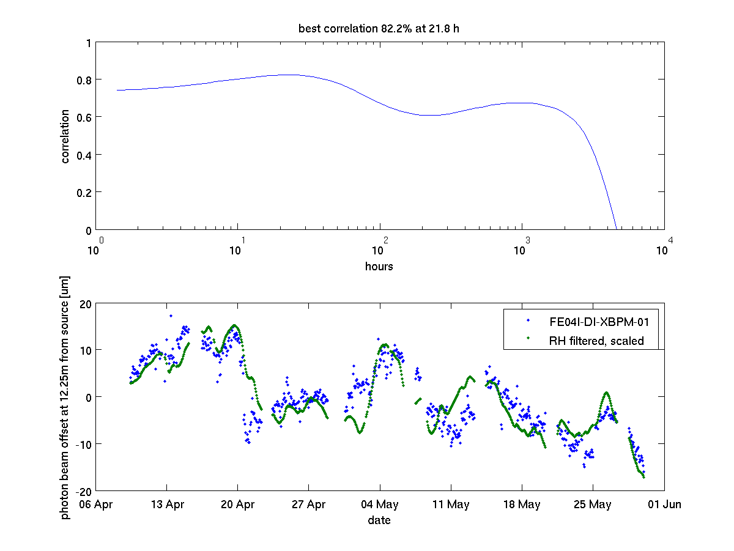
XBPM in frontend 4 run2 2014

Slide 26
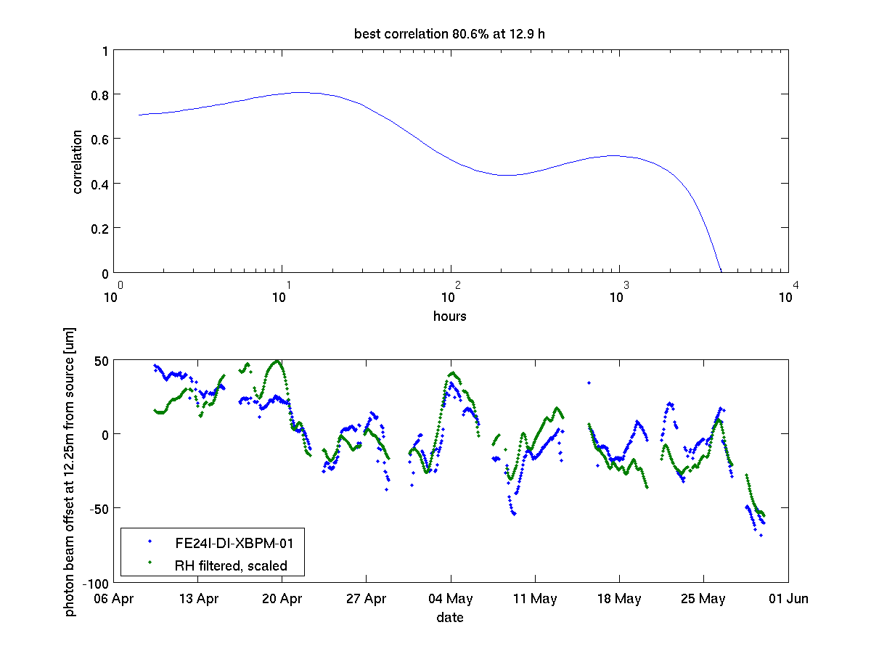
XBPM in frontend 24 run2 2014

