Slide 1

DEELS 2015 Diagnostics Experts of European Light Sources

Slide 2
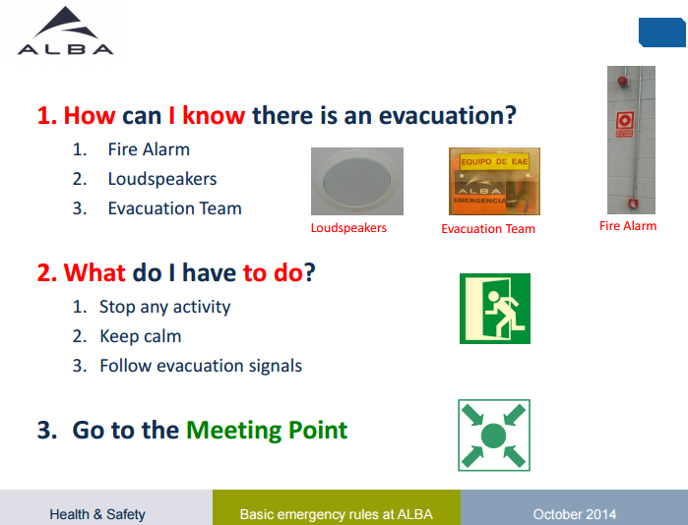
SAFETY

Slide 3
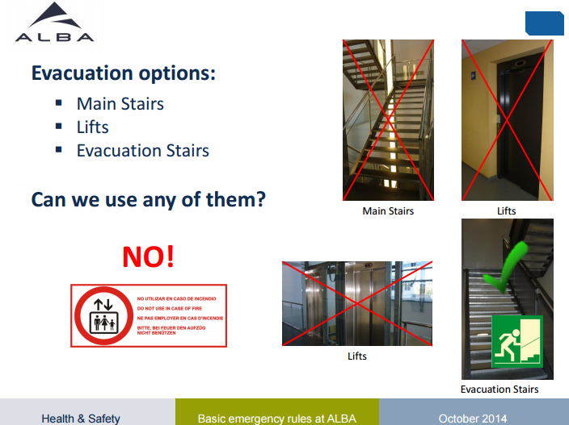
SAFETY

Slide 4
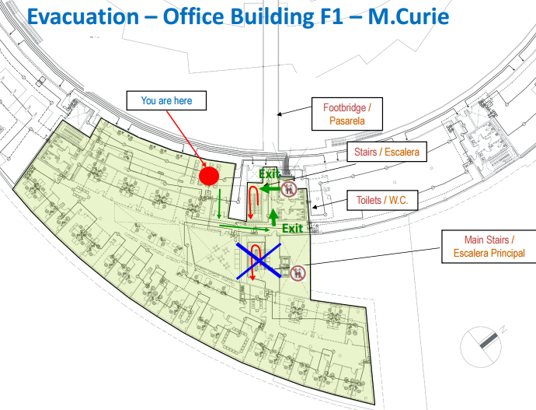
SAFETY

Slide 5
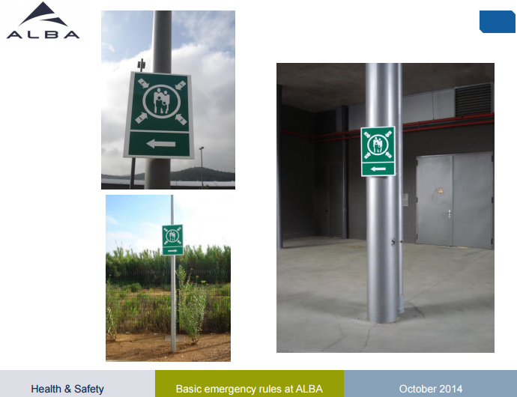
SAFETY

Slide 6
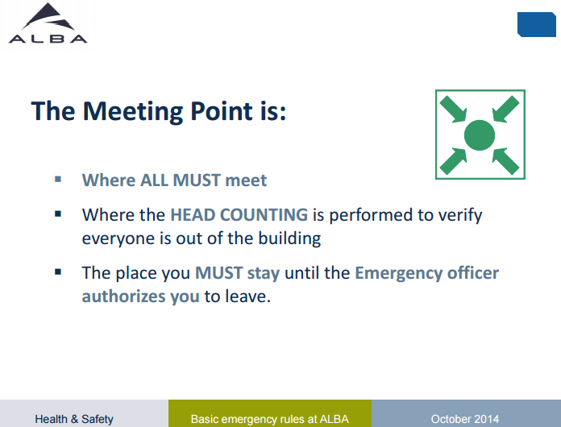
SAFETY

Slide 7
Dinner
Lunches & Coffee Breaks:
At CELLS cafeteria
Dinner Location:
Dinner in Barcelona, Restaurant “3 nusos”, Port Vell area.
You need to choose the 2nd plate – see options menu
Dinner Transportation:
Transport is arranged for participants from the Hotel Campus to the venue and back to Hotel.
Bus is leaving from Campus Hotel at 19:30h

Slide 8
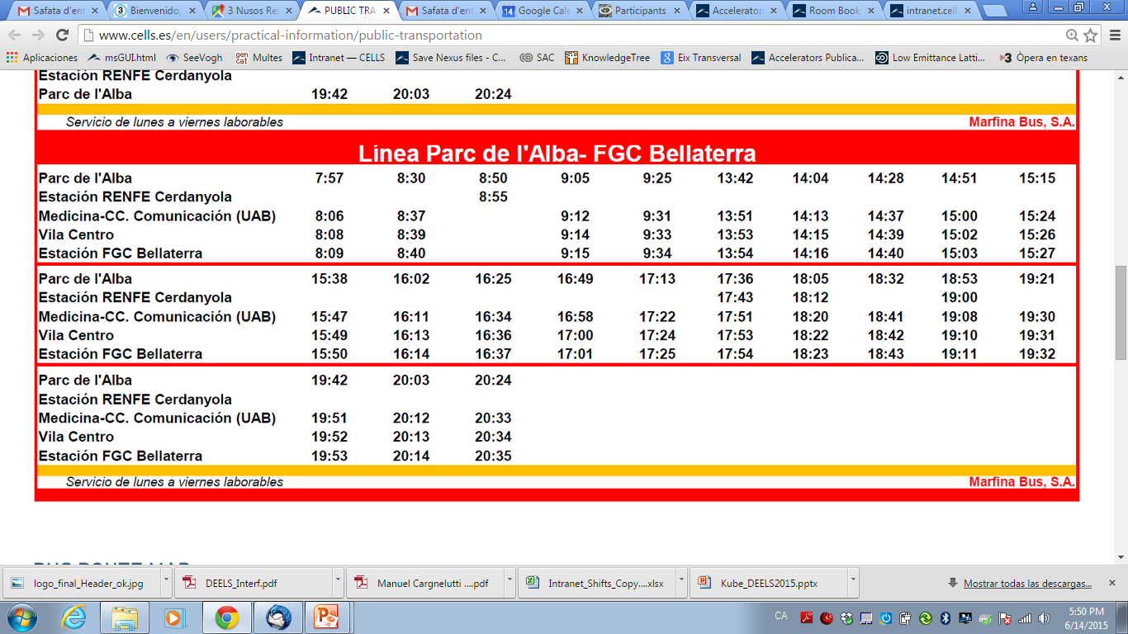
Bus CELLS – Hotel

Slide 9
Airport Transportation
Taxi for Tuesday?
For people leaving on Tuesday directly to Airport, please write down:
If you want a taxi
If you want to share the taxi
Time of your flight

