Slide 1
Bunch cleaning in the booster
Cancellation of beam position oscillations caused by the injection
On behalf of :
M. Dubrulle, A. Franchi, B. Joly, J.M. Koch, T.Perron, E. Plouviez, K. Scheidt
DEELS 15th of June 2015

Slide 2
THE ESRF STORAGE RING UPGRADE AND THE DIAGNOSTIC GROUP DIAGNOSTIC ACTIVITY
2016: Top up operation will start
Possible following the upgrade of the booster magnet power supplies and the booster RF system
What do we need to make each top up as unnoticeable as possible to the users:
Move the bunch cleaning system from the SR to the booster
Cancellation of the spurious oscillations caused by the injection kickers and septum

Slide 3
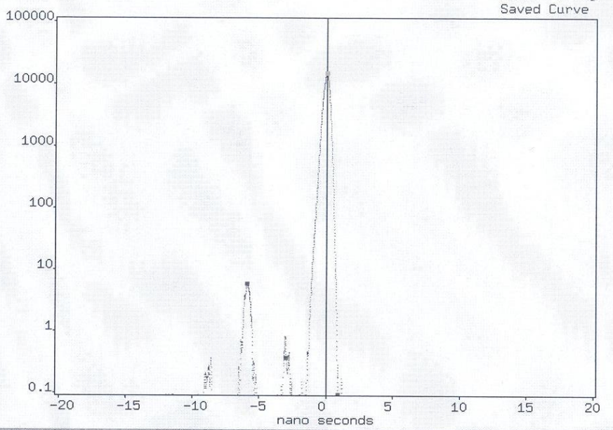
What do we call bunch cleaning?
Coming from the linac there is typically a train of one main bunch, 3 bunches with 10⁻⁴ to 10⁻⁵ lower charge and bunches with about 10⁻⁸ lower charge for the rest of the buckets.
The first cells of buncher section of the linac contributes also to the pollution of all the others ideally empty buckets with electrons extracted from their surface by the high accelerating fields
Some users (ID18…) demand 10⁻⁸ in the 4 nearest bucket and 2 10⁻⁸ integrated on the 992 buckets (not more than one electron/bucket!)
5mA in a single bunch
=> 15nC
=> 1.1 10¹¹ e⁻
2.8ns
Bucker number:
1
2
3
4
5
6
7
8
9
10
11
scrapper
How to get rid of all the parasitic bunches while keeping untouched the main bunches?

Slide 4
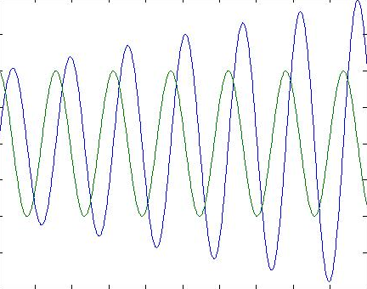
Single kick or resonant cleaning?
Turn by turn beam position at the cleaning kicker location during a resonant cleaning:
Bunch position
Kick amplitude
Turn number:
1
2
3
4
5
6
7
8
9
10
11
Beam position at turn n: z_{n}= z₀ sin (2πυ_{z}*n)
Kick at turn n: z_{n}= z₀ cos (2πυ_{z}*n)
We neglect the decoherency due to ξ

Slide 5
Cleaning: where to do it ?
Linac gun (90KeV):
Single kick possible. But we will not eliminate some parasitic electrons emitted by the first cells of the linac buncher (=> 10⁻⁸ background )
SY booster injection (200MeV):
A fast high voltage pulse generator is needed (single kick)
SY booster (200MeV up to 6GeV, resonant cleaning):
Beam with stable parameters over about only 1ms for resonant cleaning; large transverse size => large scrapper aperture.
SR (resonant cleaning):
Not any longer possible in top up operation:
bad purity during the period between injection and cleaning
Scrapper closing

Slide 6
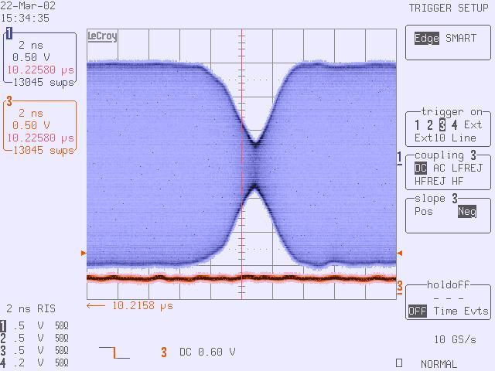
Bucket selection: stripline gated shaker setup
2 X 100W amplifier
X 1
X -1
tune frequency
beam
H stripline shaker
Bunch selection
wide band
gating
RF synchro

Slide 7
cleaning in the booster: it is now mandatory
Results achieved so far:
<3.10⁻⁶ one RF period before the main bunch
2.10⁻⁴ one RF period after the main bunch
Relative injection in the SR efficiency with SY cleaning ON:
2.10⁻⁵ one RF period before the main bunch
2.10⁻³ one RF period after the main bunch
Bunch purity in the SR after SY cleaning:
<10⁻¹⁰ one RF period before the main bunch
4.10⁻⁷ one RF period after the main bunch
4.10⁻¹⁰ two RF periods after the main bunch
But: erratic bursts of badly cleaned injected beams in the SR about every 30 seconds …

Slide 8
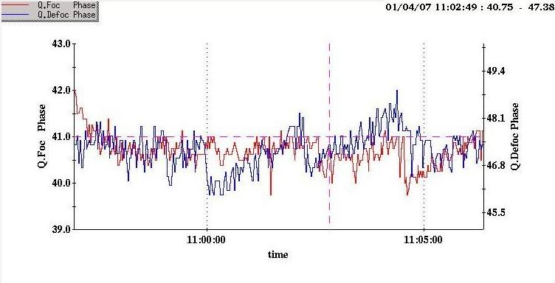
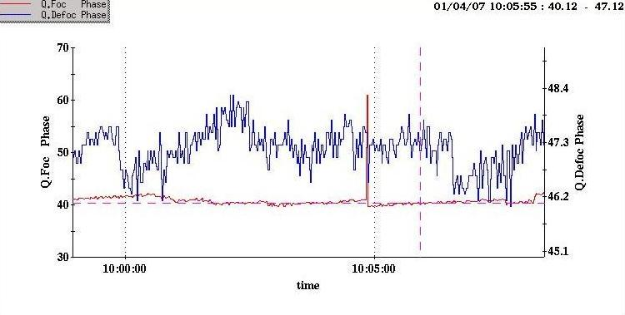
Likely cause of the problem
Phase stability of the 10Hz current driving the SY focusing or defocusing quadrupoles
Solving this problem would involve a major BPSS redesign

Slide 9
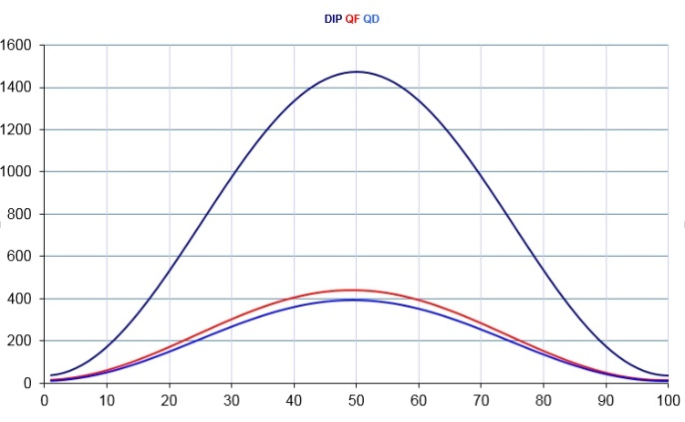
Booster magnets current measurement (J.M. Koch /PS group)
Processing
→ FPGA board + CPU module
Analog
front-end
Very accurate DCCTs electronics
3 channels
24 bits
ADCs
3 channels
FPGA
board
Cleaning frequency generator
Towards cleaning device
CPU module
Trigger
PCIe
Control
Ethernet
Processor
12/06/2015
ESRF Accelerator & Sources Division JM Koch
9
Notes:
9
Let’s now come to the correctors , the processor of this module is a powerful FPGA, it will be used:
As communication node and signal processor:
this part is real time
For diagnostic purposes or transfer of parameters through the PCI interface :
this part is not in real time

Slide 10
BPSS currents measurement
Comparison set-up
→ X tune estimation / tune measured on beam
I Dipole
I QF
I QD
Tunes estimation from Booster Magnets current
Server
Synchronous
data recording
Trigger
(T0 + 6ms)
Server
BPM
X positions from Beam
(Itech Spark)
12/06/2015
ESRF Accelerator & Sources Division JM Koch
10
Notes:
10
Concerning the development, there are a few pieces of code to put together inside the FPGA, data collection from the ADCs converters, the standard access to the PCI express and, of course, the signal processing.
Some interfaces are already existing like the PCIe interface or the interface towards ADCs which will have to be adapted to the ones that will be chosen for this application.
I propose to develop the part using System Generator.

Slide 11
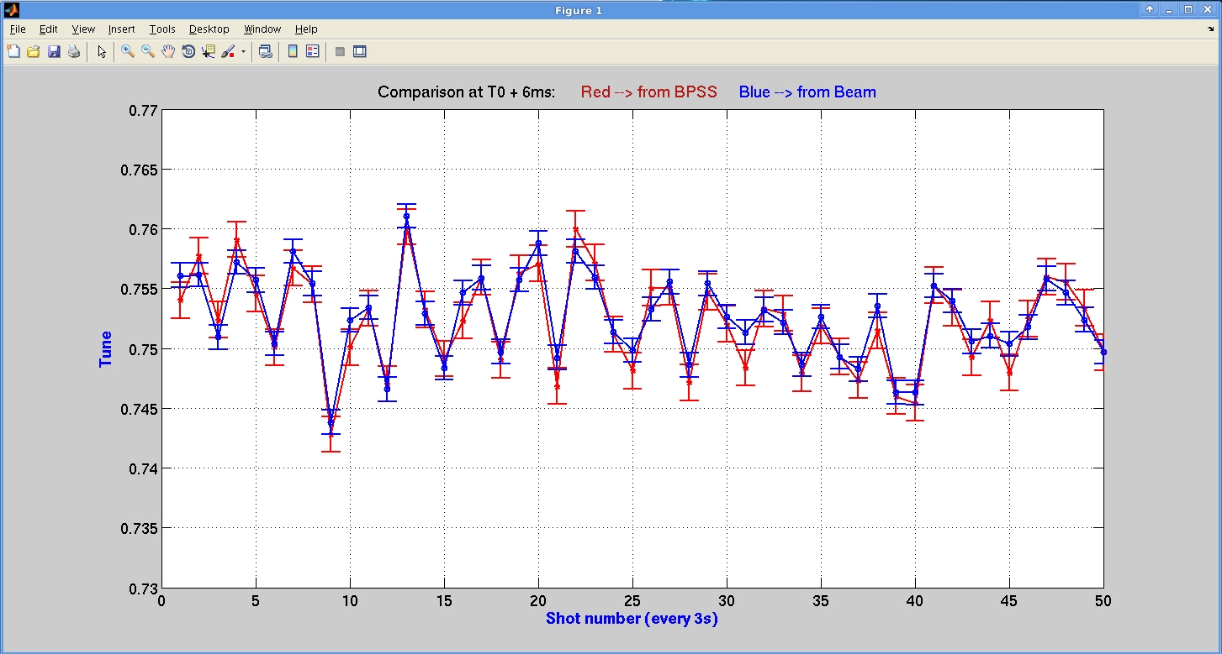
BPSS currents measurement
Comparison result
→ X tune estimation / measured on beam
12/06/2015
ESRF Accelerator & Sources Division JM Koch
11
Notes:
11
Concerning the development, there are a few pieces of code to put together inside the FPGA, data collection from the ADCs converters, the standard access to the PCI express and, of course, the signal processing.
Some interfaces are already existing like the PCIe interface or the interface towards ADCs which will have to be adapted to the ones that will be chosen for this application.
I propose to develop the part using System Generator.

Slide 12
Cancellation of beam position oscillations caused by the injection
At each injection oscillation of the beam position and orbit distortion in both H and V plane
Amplitude in the horizontal plane plane:
2 mm position oscillation / 7ms damping time
.5mm peak orbit distortion during 2ms
Amplitude in the vertical plane:
.1 mm position oscillation / 7ms damping time
.05mm orbit distortion peak orbit distortion during 2ms
However due to the 10³ ratio of horizontal/vertical emitance,
the relative increase of the emitance is much larger in the vertical plane

Slide 13
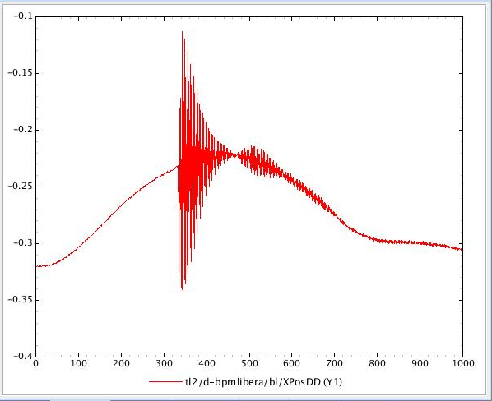
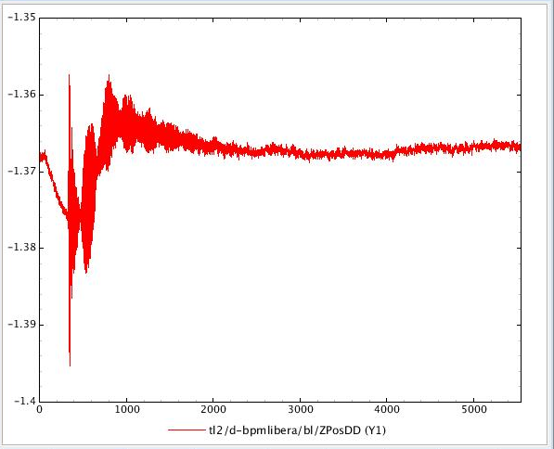
Beam orbit perturbation during the injection
Septum field leak
Non closure of the kickers bump
Kickers tilt
Septum field leak
2ms
2ms
Left: H plane Right: V plane (different horizontal and vertical scales)
A mix of septum field leak, injection kickers tilt and non closure of the bump formed by the kicker

Slide 14
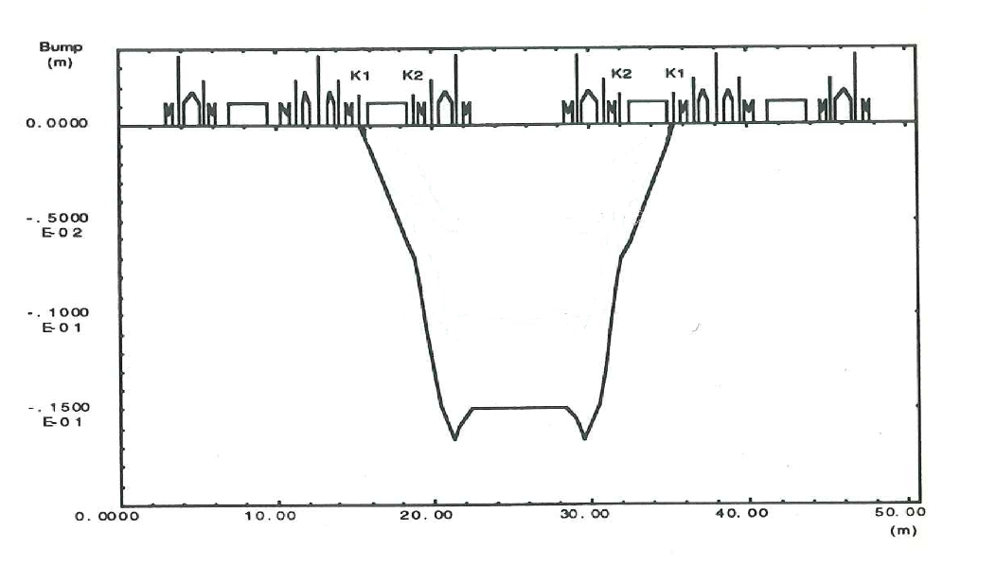
Injection components
kickers
septum
Stored beam path
Injected beam path
The injection kick path includes sextupoles =>
the kicker bump is not closed during the kick rise time and fall time

Slide 15
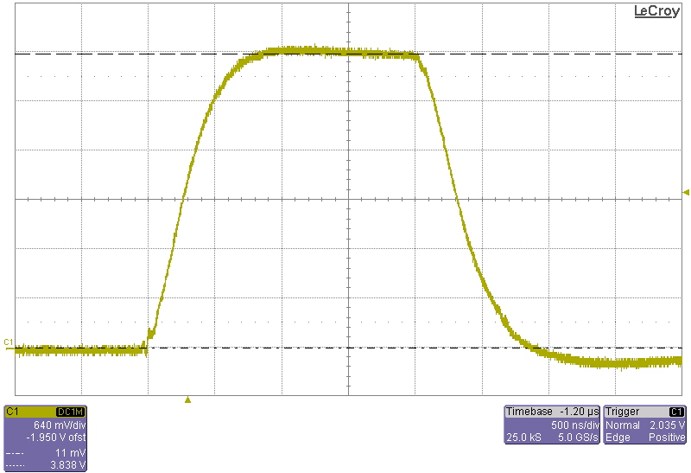
kickers pulse shape

Slide 16
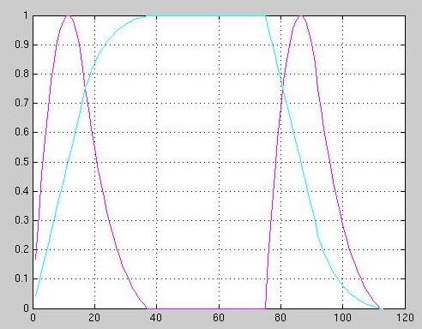
Parasitic kicks shape
2.8 μs
Cyan: kickers pulse shape
Magenta: shape of the parasitic kicks due to non closure of the bump

Slide 17
How are we going to adress the problem:
Septum leakage:
less than 1KHz BW, repetitive shape perturbation
Solution:
Use fast correction magnet driven by a pulse generated by an arbitrary signal generator triggered by the septum signal
Kikers tilt:
Tilt evaluation derived from turn by turn H and V position measurements
Suppression of the tilt by a realignement of the kickers
Non closure of the horizontal injection bump:
more difficult…
Why do the FOC and bunch by bunch feedback cannot take care of it?

Slide 18
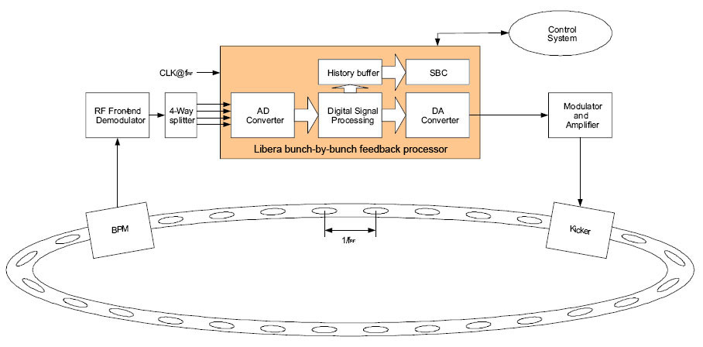
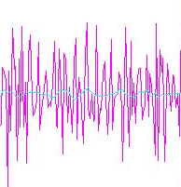
Back to the cleaning in the SR
Feedback system
Correction signal derived in real time of the
measurement of the beam parameter perturbation
Random perturbation
Drawback:
the loop cut off frequency is limited to about 10% of the loop components bandwidth

Slide 19
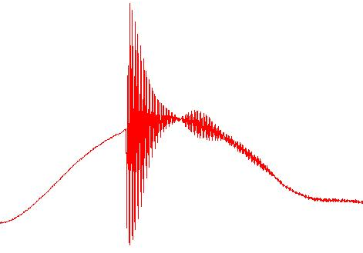
Back to the cleaning in the SR
Feedforward scheme:
Injection trigger
Perturbation
recorded offline
Generation of the correction
signal lookup table
Correction signal generated using the lookup table
Repetitive perturbation
More efficient use of the corrector :
the full bandwidth of the corrector can be used without stability problem

Slide 20
Fast correctors for the suppression of the injection related perturbations
1MHz BW shaker
Stored beam path
H and V fast correctors
(of the old FOC system)
Injected beam path

Slide 21
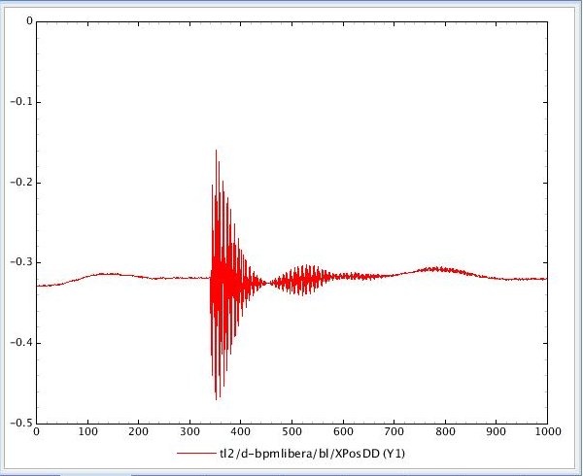
Suppression of the horizontal orbit distortion due to the septum field leak
Non closure of the kickers bump
Non closure of the kickers bump is the only effect remaining
Septum field leak
2ms
Using one of the horizontal fast orbit correctors, driven by an arbitrary shape signal generator, the suppression of the effect of the septum leak is very effective (right plot)

Slide 22
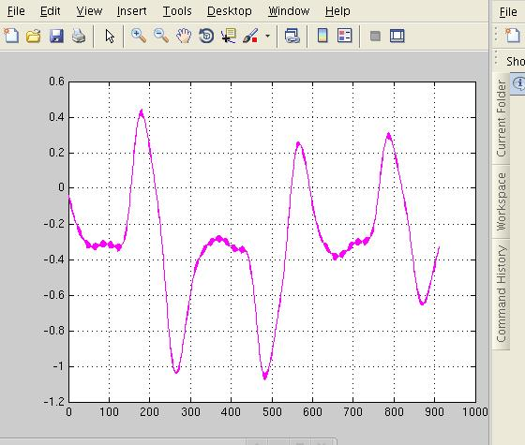
H kicker bump non closure: measured orbit distortion
3 turns

Slide 23
Effect of the kicks in the sextupoles
Compensation kicker
Perfect compensation:
Two parabolic shaped kicks of 1ms separated by 1μs;
Several KV, >10²A pulser
First sextupole
Second sextupole
Bandwidth:
original kicks: about .5 MHz (pulser and ceramic coating thickness)
Sextupoles effect: quadratic effect => bandwidth doubled…
Perfect compensation: technically very demanding…

Slide 24
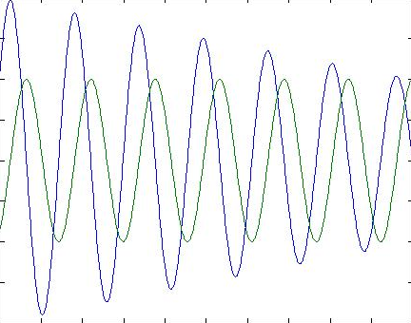
Turn by turn change of the beam position at the shaker location
Easier: damping over several turns:
Bunch position
Kick amplitude
Turn number:
1
2
3
4
5
6
7
8
9
10
11
Beam position at turn n: z_{n}= z₀ sin (2πυ_{z}*n)
Kick at turn n: z_{n}= z₀ cos (2πυ_{z}*n)
We neglect the decoherency due to ξ

Slide 25
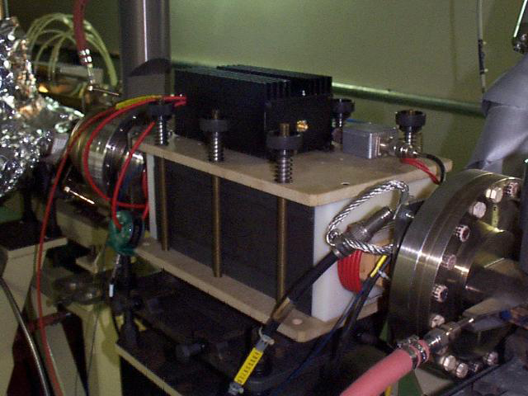
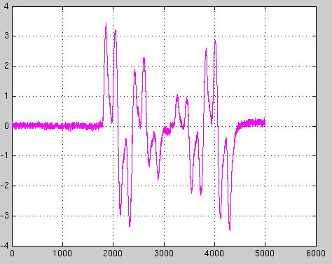
SHAKER FOR THE APPLICATION OF MULTITURN KICKS
Magnetic shaker:
6 coils
Bandwidth is 1MHz
Driven by a 700 Watts amplifier
9 turns pulse shape generated by an arbitrary waveform signal generator

Slide 26
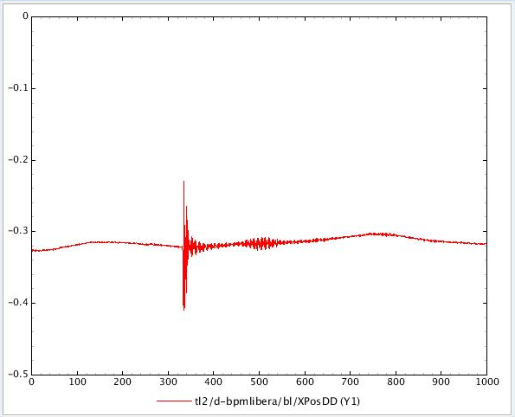
Effect of the horizontal oscillation damping
2ms
Right plot: the oscillation is reduced to a bit less than 50% of the initial amplitude
after 9 turns instead of 7 ms…

Slide 27
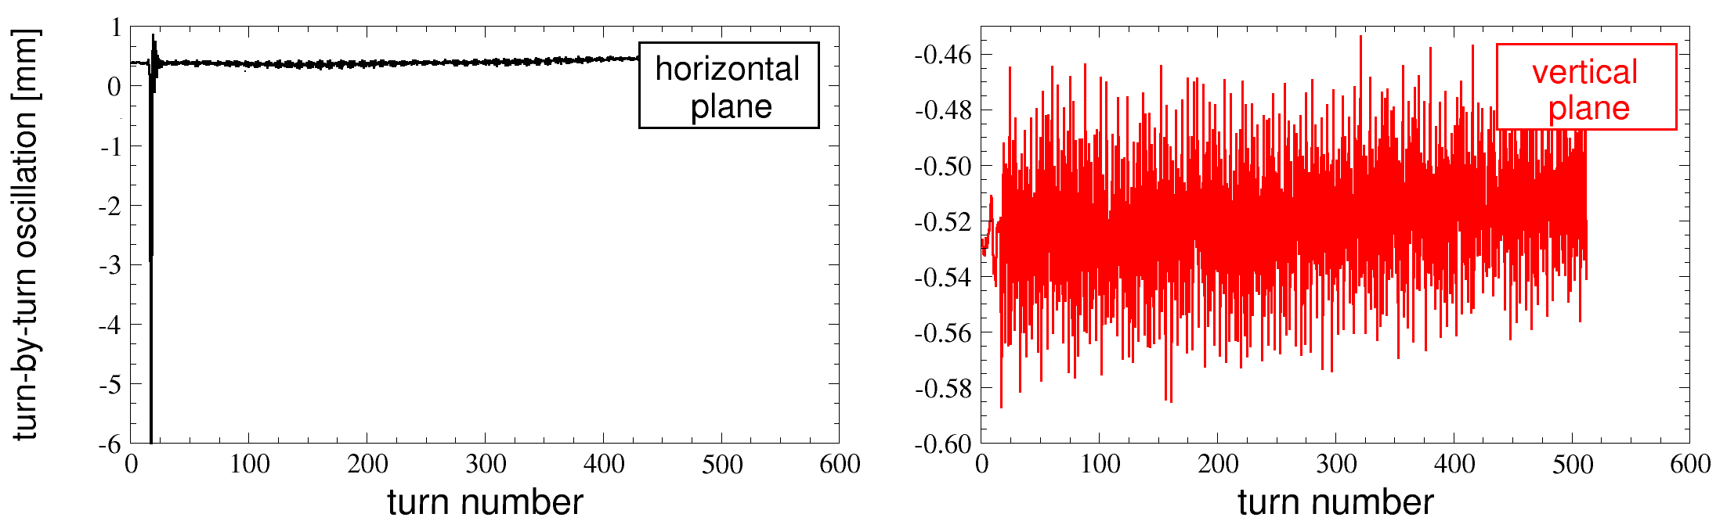
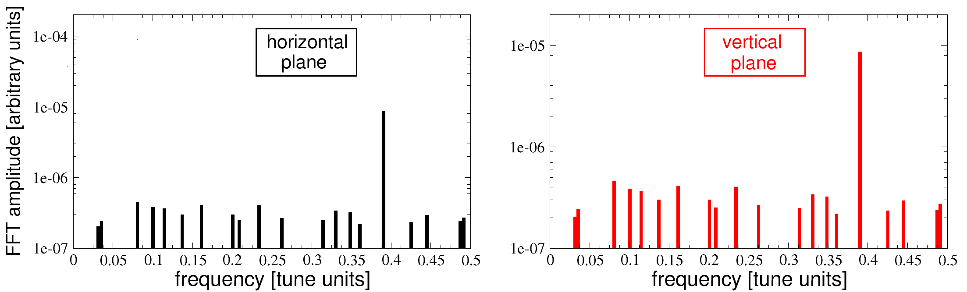
Vertical oscillation due to the tilt of the kickers
Work in progress (A. Franchi)
Record the turn by turn H and V position
after the firing of the injection bump
main hamonic at Qx=.44
main hamonic at Qx=.39

Slide 28
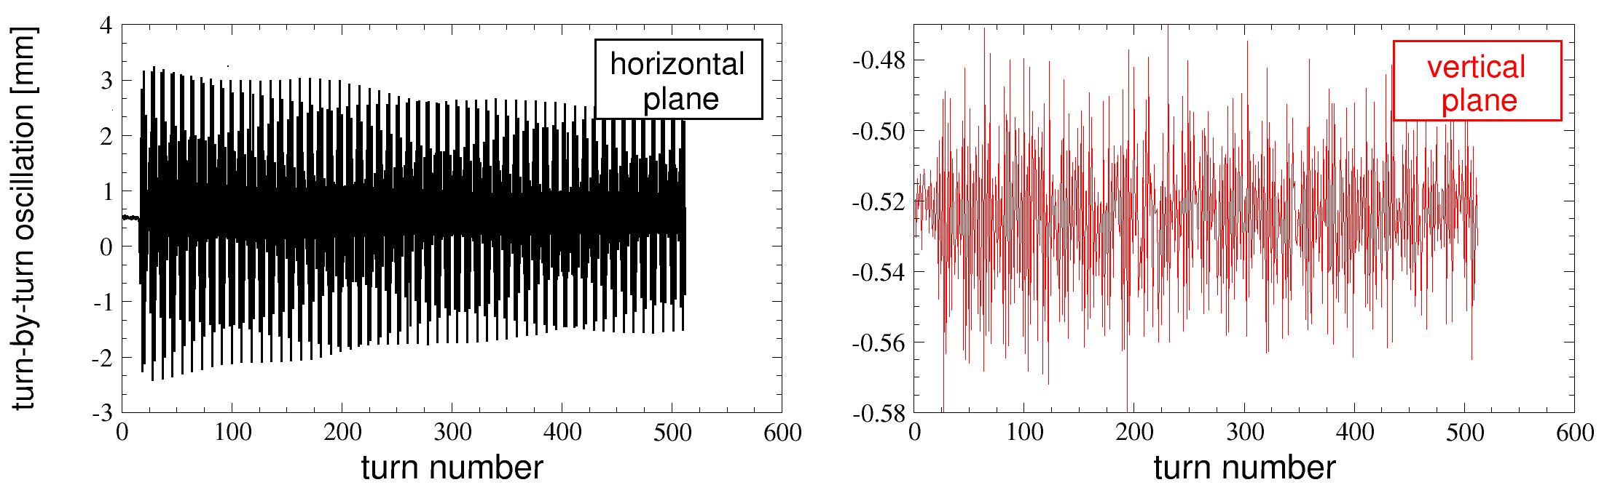
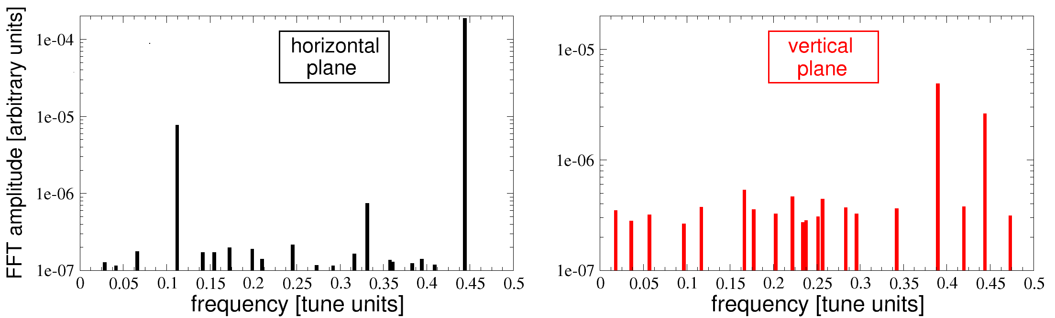
Vertical oscillation due to the tilt of the kickers
Work in progress (A. Franchi)
Record the turn by turn H and V position
after the firing of K1,K2,K3,K4
Do a fft analysis to find the tilt of the kickers;
Derive the correction tilt on K2 and K3 which will cancel the oscillation recorded after the firing of the injection bump…
Looks straightforward but it is not!
We have not yet found the right K2 and K3 tilt
main hamonic at Qx=.44
main hamonic at Qx=.39

Slide 29
Conclusion
A lot of this project is still a work in progress:
Booster cleaning:
Improve the integration of diagnostics to the system (synchronous monitoring at the injection rate of the tune and BPSS currents)
Horizontal oscillation damping:
Implement the control to make it usable in operation
Vertical kickers tilt:
during 2015, implement a remote control of the kickers tilt
Septum fields leak compensation:
Add the vertical correctors to the set up; implement the control to make it usable in operation

Slide 30
ID24 detectors principLe
Particularly sensitive to the horizontal beam position stability…

Slide 31
Perturbation caused by the injection
Blue dots: no kickers compensation
Red dots: compensation active

Slide 32
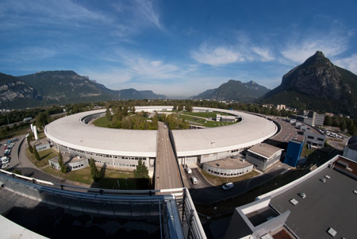
Thank you for your attention

