Slide 1
Pinhole Camera Issues at Diamond
L. M. Bobb, A. Morgan and G. Rehm

Slide 2
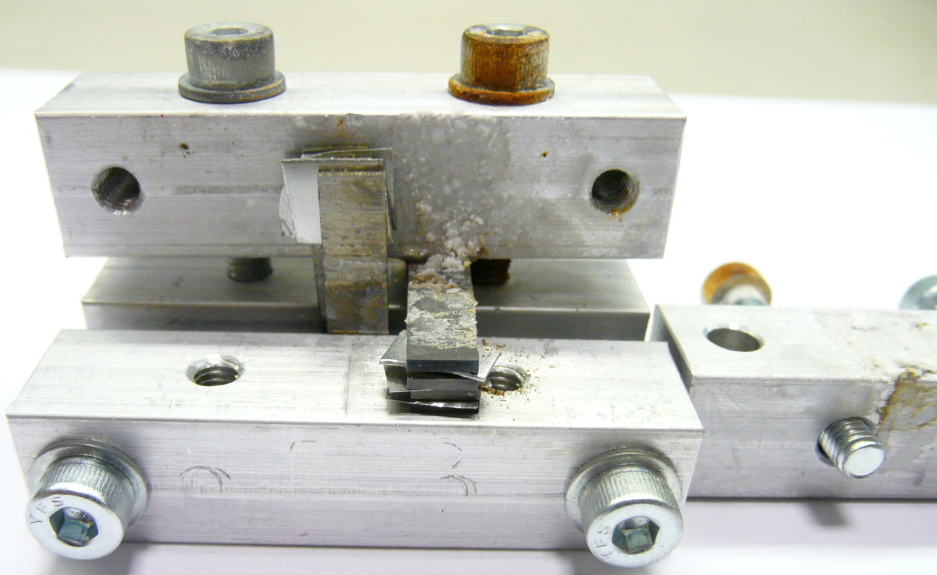
Nov 2013: Initial Design of Pinhole Assembly After a Few Years of Beam
Stainless steel screws
Tungsten blades
“Stuff” that shouldn’t be here!
Aluminium holder

Slide 3
Nov 2013: Proposed Mechanism
Ozone
→ Oxidation of metals
X-rays
Pinhole is in AIR
X-rays from 1.4 Tesla bending magnet

Slide 4
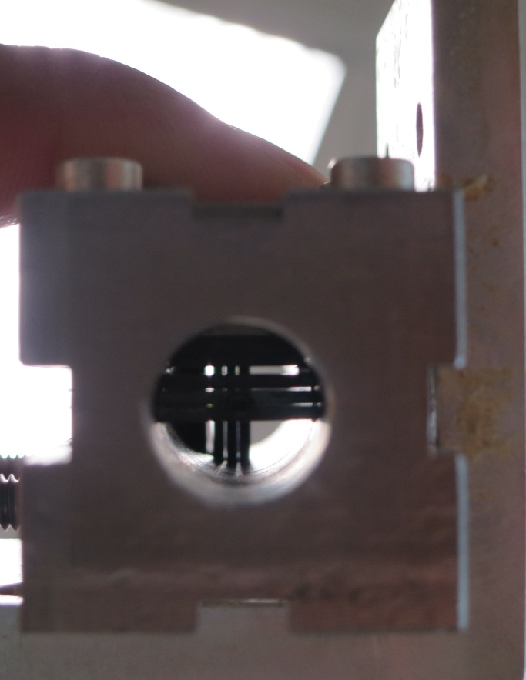
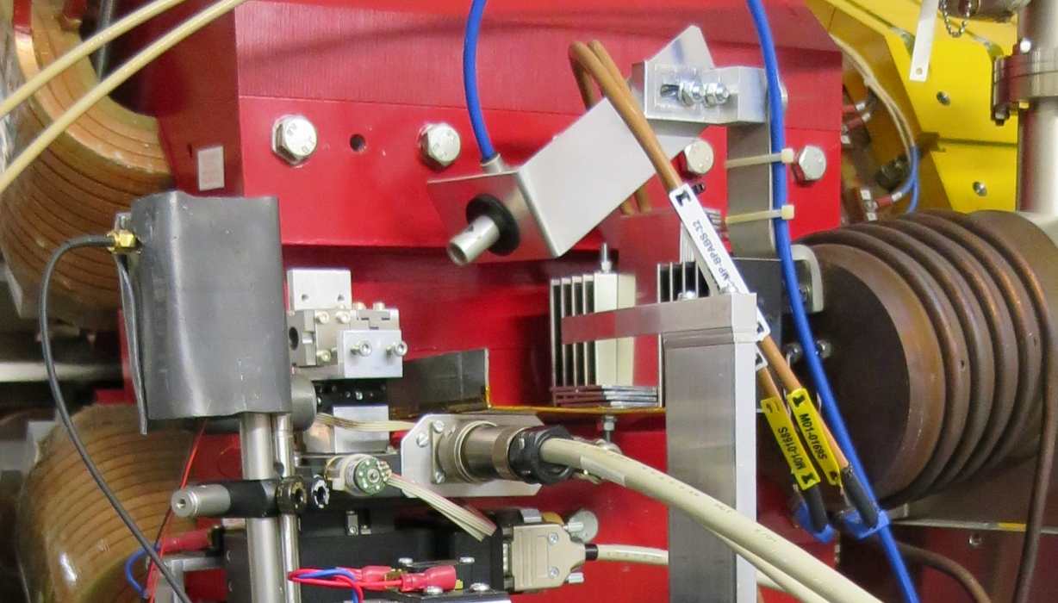
Nov 2013: Design Modification
Choose metals less prone to oxidation
Install air blower to prevent Ozone build-up
Add attenuation to “control” rate of growth
Silver plated screws
Gold plated Tungsten blades
Aluminium holder

Slide 5
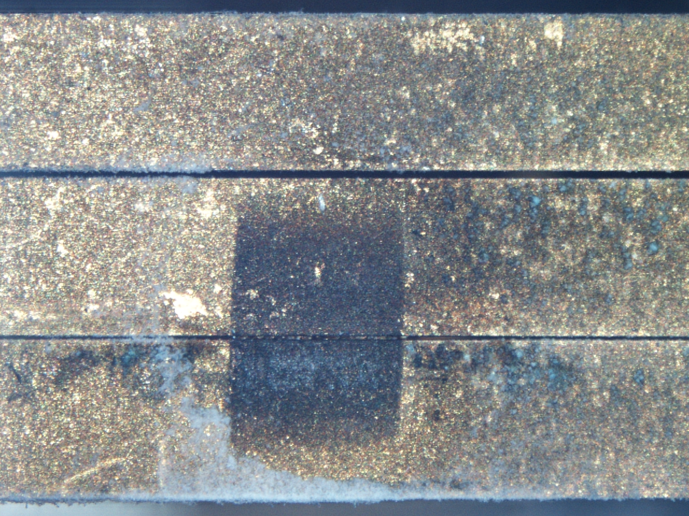
Nov 2014: Gold Plated Tungsten Blades (1)
400 µm
Tungsten Oxide (blue) forms on bare Tungsten areas
50 µm
25 µm
Gold “nuggets” clogging pinhole
Fluffy white deposits
= Aluminium Oxide
Upstream view of Pinhole 2

Slide 6
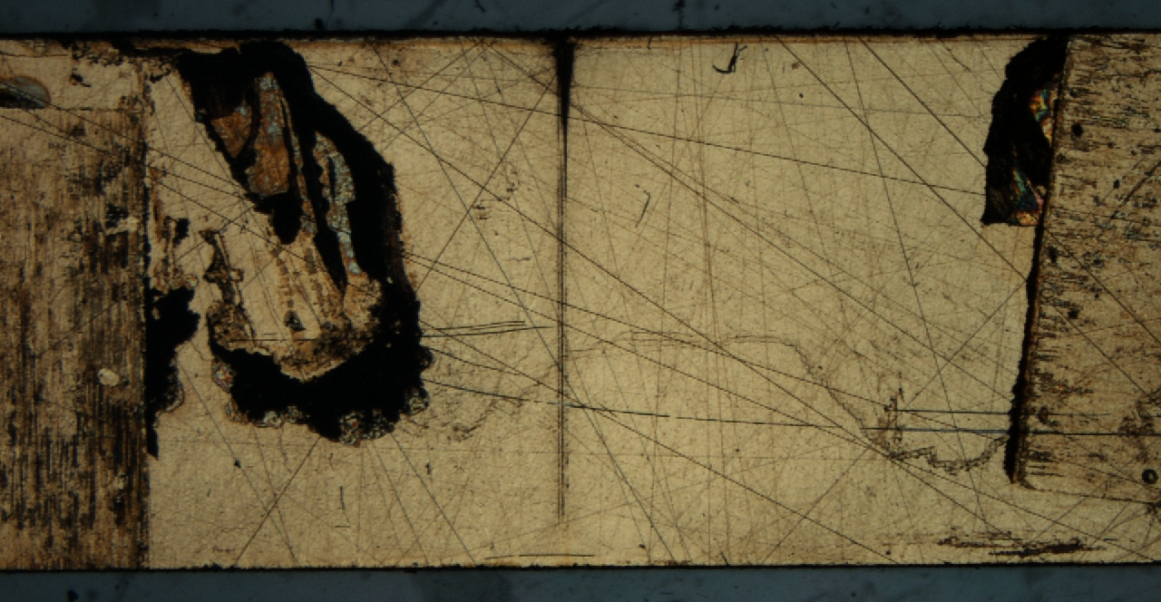
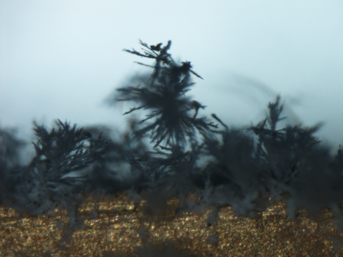
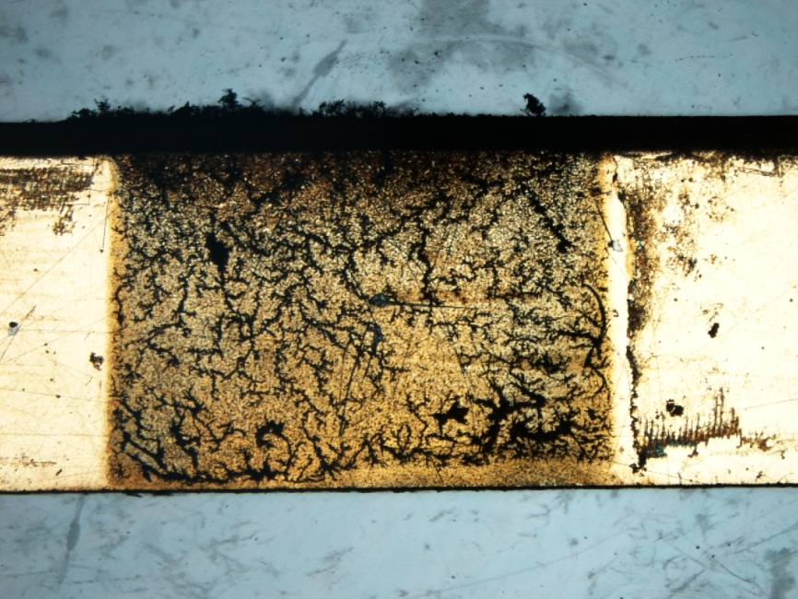
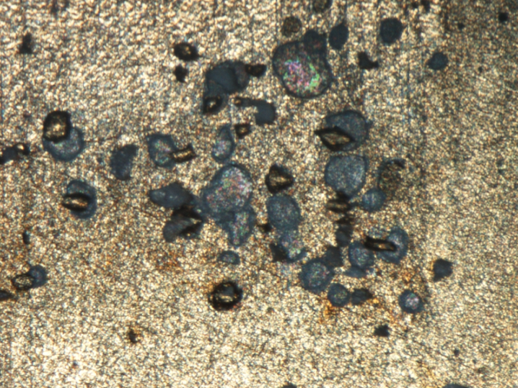
Nov 2014: Gold Plated Tungsten Blades (2)
25µm surface
400 µm blade surface

Slide 7
Nov 2014: Design Modifications
Go back to bare Tungsten blades
Remove air blower
Keep attenuation to “control” rate of growth
Develop Pinhole 3 system specifically for R&D
Potential Improvements to be investigated:
Alternative materials used for the blades:
  Solid gold or platinum (Zero oxidation but expensive)
  Machined Molybdenum so that shims aren’t required
Nitrogen purging through pinhole assembly
NB: We do not want to put the pinhole assembly in vacuum to ensure easy access and maintenance.

Slide 8
Comparison of X-ray ports
 | DLS | ALBA | ESRF
Energy [GeV] | 3 | 3 | 6
Stored current [mA] | 300 | 100 | 200
Bend field [T] | 1.4 | 1.42 | 0.5
H angle [mrad] | 0.26 | 1 | 1
Al window [mm] | 1 | 1 | 2
Power after window [W] | 1.7 | 2.1 | 15.1
Absorber | 9.5mm Al | 0.4mm Cu | 1mm Cu
Power after absorber [mW] | 130 | 120 | 830
Peak energy after absorber [keV] | 38 | 42 | 58
Power absorbed in 0.5m air [mW] | 1.8 | 1.6 | 8.8
Thanks to G. Rehm (DLS), U. Iriso (ALBA) and F. Ewald (ESRF)

Slide 9
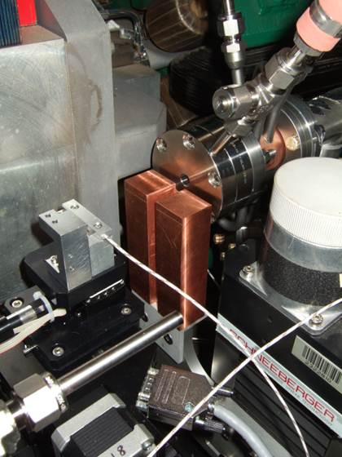
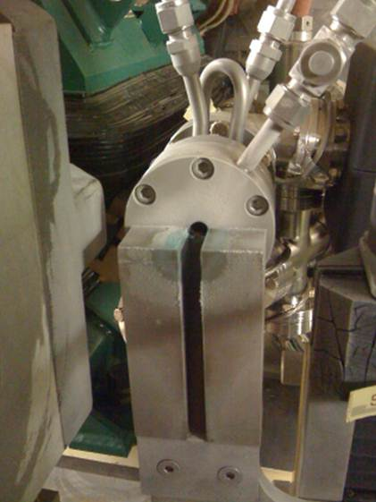
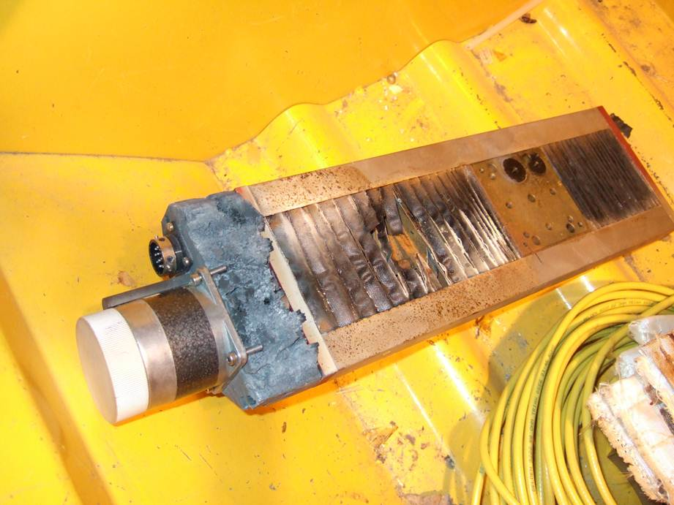
Ozone Damage at ESRF
New X-ray window with CVD diamond.
Weeks later…
Fan near the pinhole stage failed.
The fan was supposed to blow the ozone away
Thanks to ESRF for these images and discussions

Slide 10
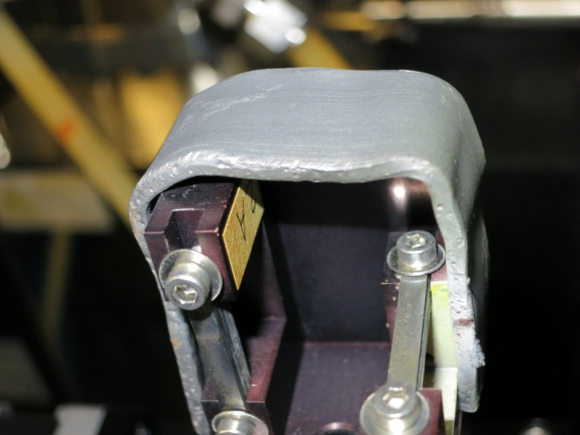
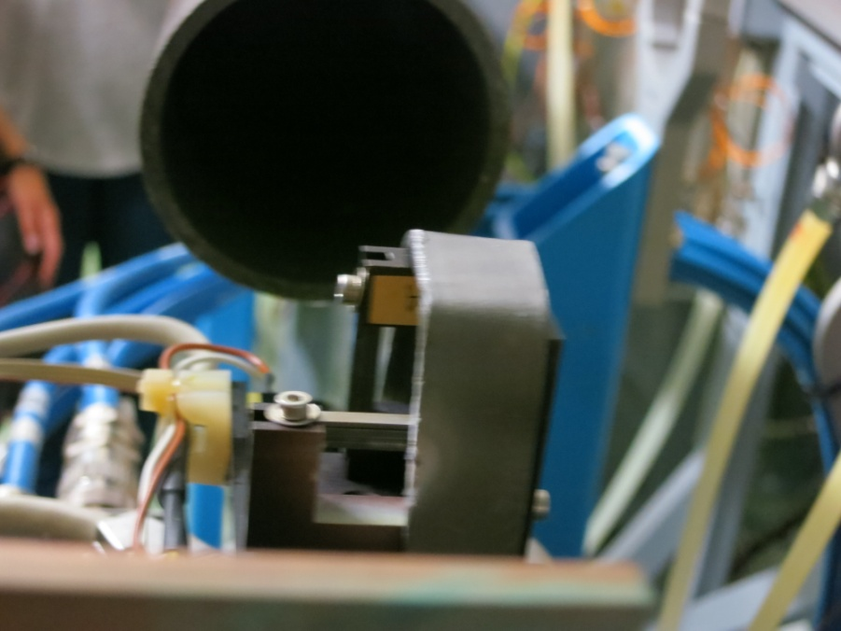
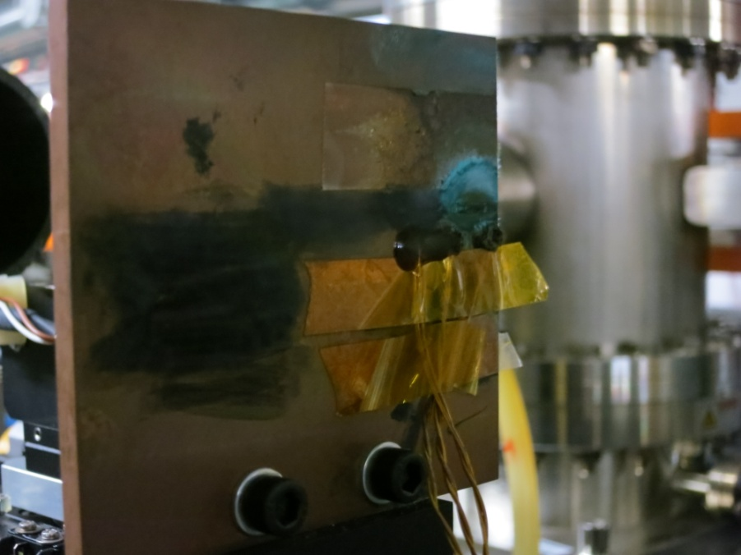
Ozone Growth at ALBA
“Open air” mount for Tungsten blades in comparison to DLS pinhole assembly
Main region of growth is on Copper attenuator
Thanks to ALBA for the tour

Slide 11
Thank you for your attention!

