Slide 2
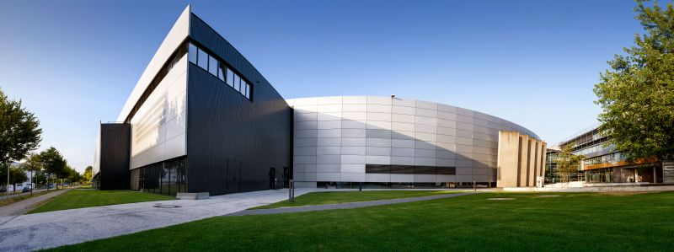
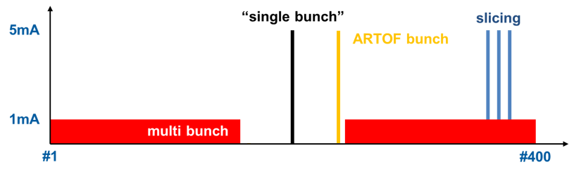
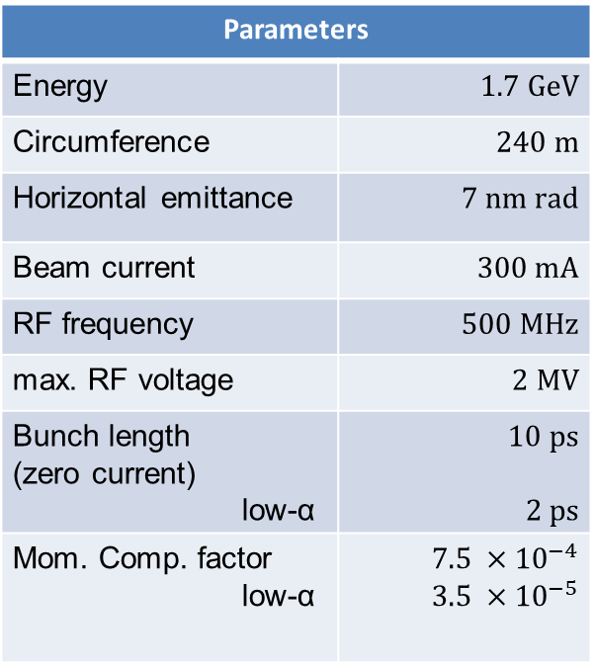
BESSY II – A third generation light source
Parameters
Energy | $$1.7 GeV$$
Circumference | $$240 m$$
Horizontal emittance | $$7 nm rad$$
Beam current | $$300 mA$$
RF frequency | $$500 MHz$$
max. RF voltage | $$2 MV$$
Bunch length (zero current) low-α | $$10 ps$$ $$2 ps$$
Mom. Comp. factor low-α | $$7.5 ×{10}^{−4}$$ $$3.5 ×{10}^{−5}$$
in user operation since 1998
diverse user community
offering short x-ray pulses and timing
PPRE

Slide 3
content
2019 …
Operation statistics
Machine commissioning / Events
Developments
outlook

Slide 4
content
Operation statistics

Slide 5
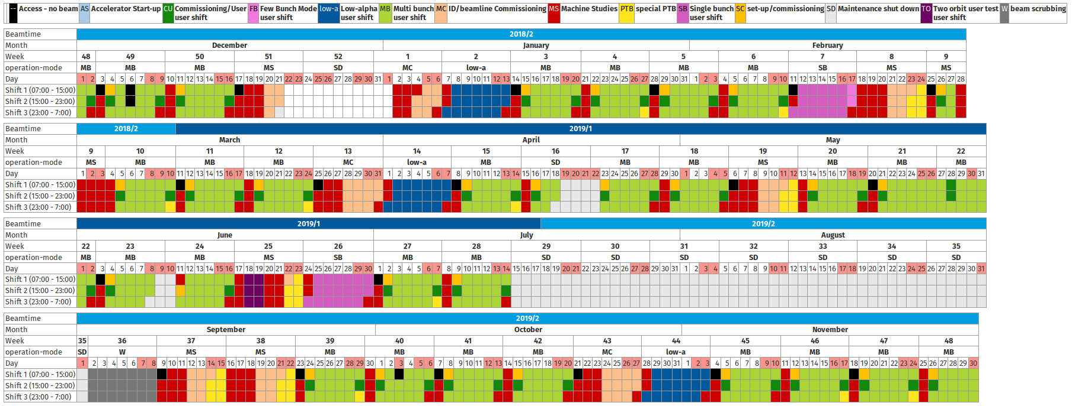
Operation statistics – schedule

Slide 6
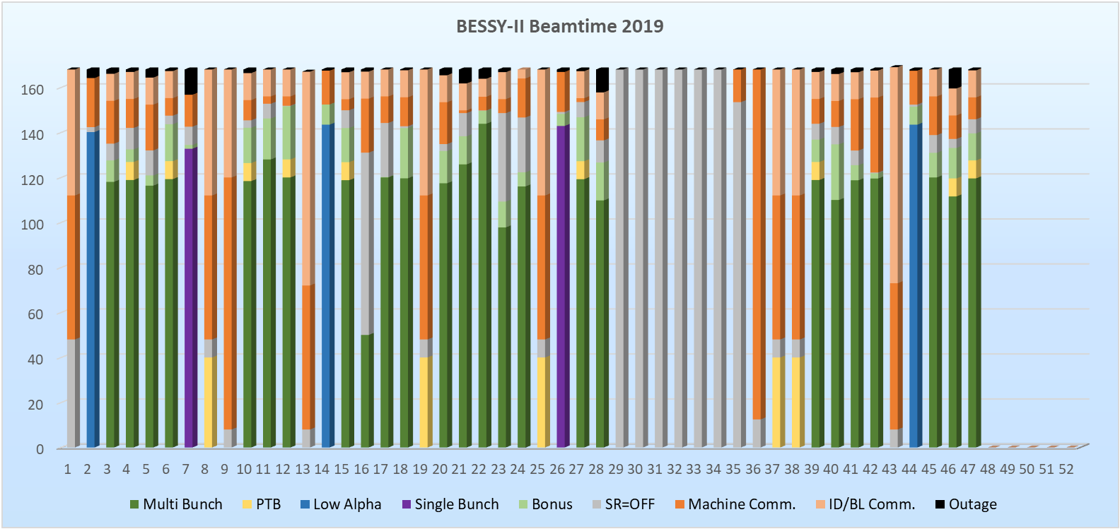
Operation statistics – delivered beam

Slide 7
Operation statistics – delivered beam
T7 event
booster current issues
UPS failure + power outage

Slide 8
Operation statistics
year | scheduled | downtime | bonus | # outages | availability | +bonus | MTBF | MTTR
2018 | 3578 h | 28.3 h | 415 h | 51 | 99.2 % | 111 % | 70.2 h | 0.56 h
2019 (… cw47) | 3938 h | 67.7 h | 322 h | 67 | 98.3 % | 107 % | 58.8 h | 1.0 h

Slide 9
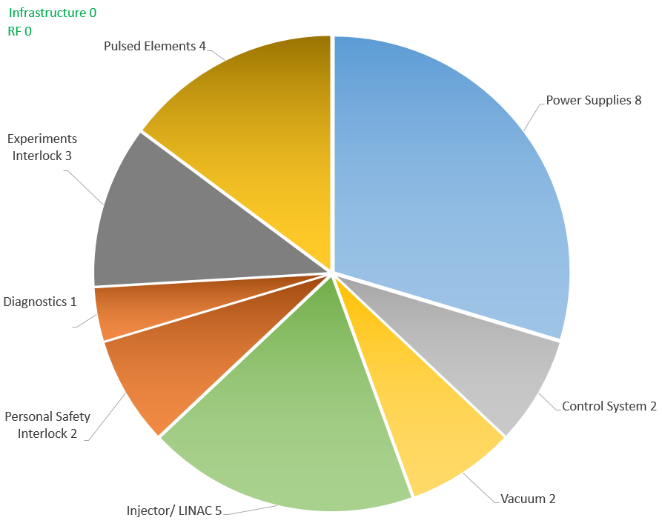
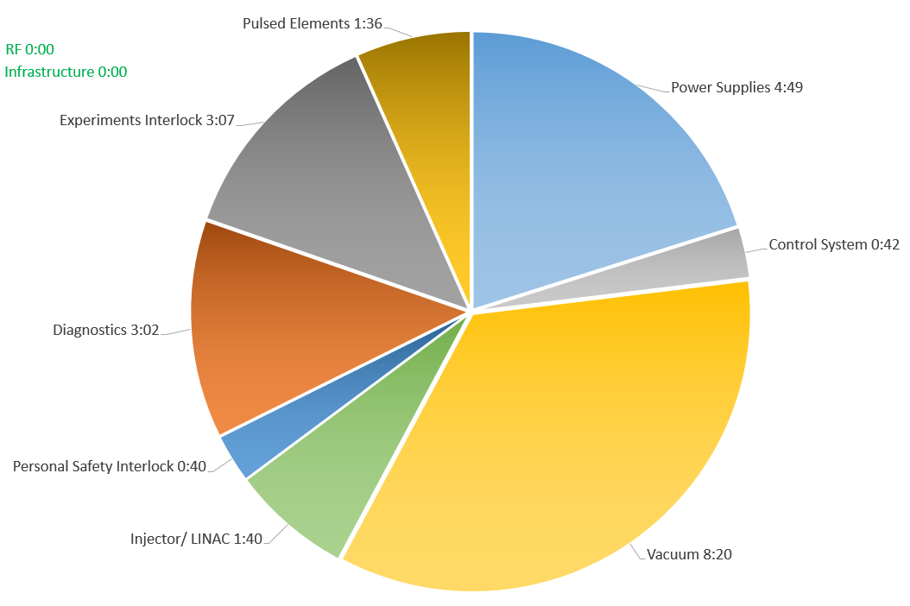
Operation statistics – beam losses by component
by occurrence
by duration
23
24h
transition: beam loss & components → outage & root cause

Slide 10
content
Machine commissioning / Events

Slide 11
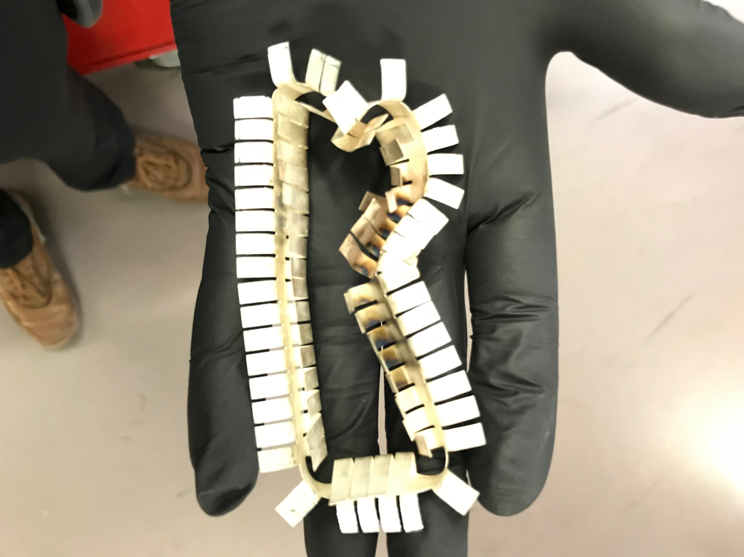
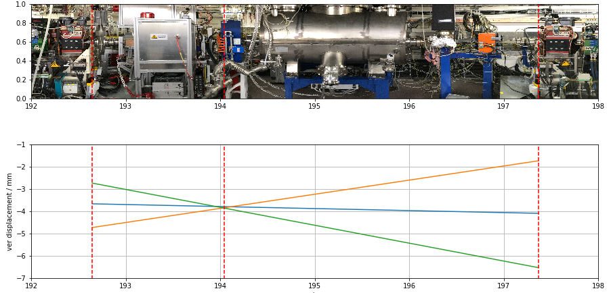
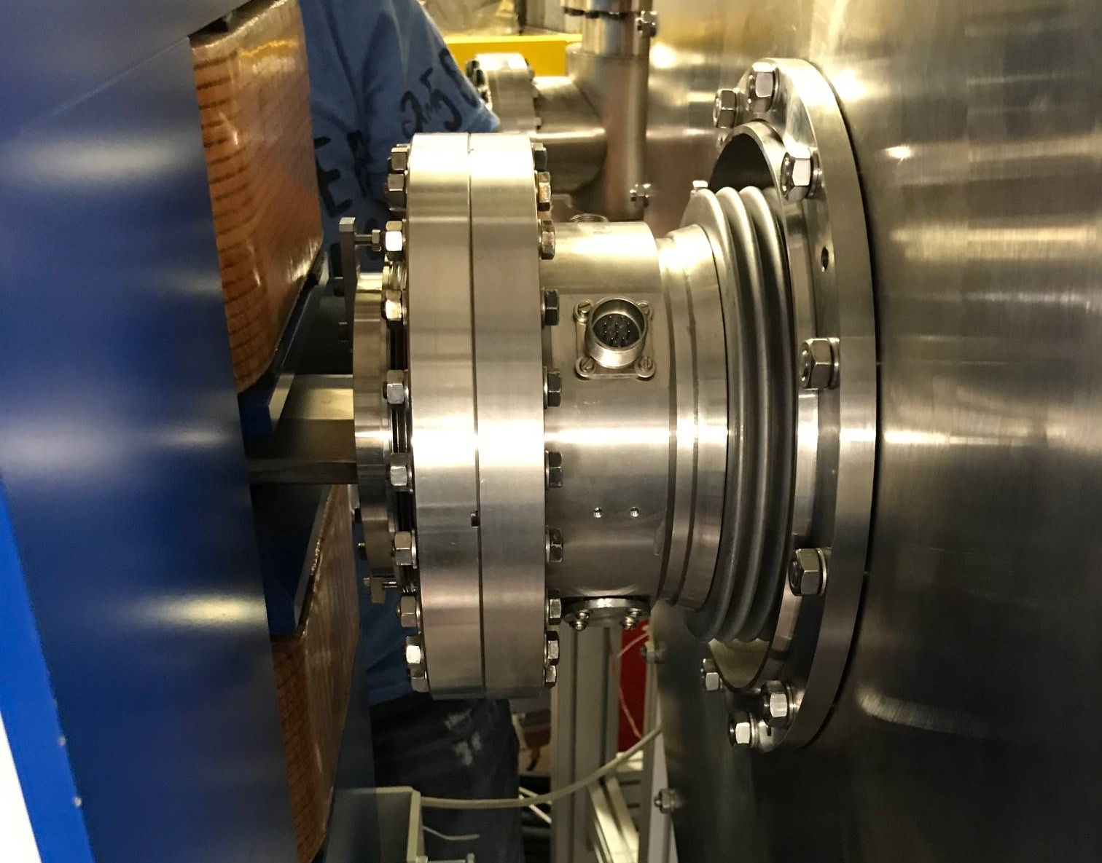
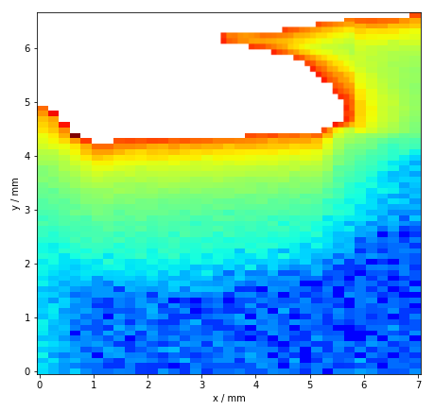
Machine commissioning / EVENT – T7 event – CW 7
crictical event during user operation, triggered by WLS refurbishment
Short-term recover of user operation (SB week)
beam-based localisation ± 0.2 m
breaking storage ring vacuum, improvising intermediate modifications
preliminary risk mitigation strategy
operation at 250 mA until shutdown
turnaround time 36 h
BAM WLS not affected
solution implementated summer shutown
→300 mA operation recovered

Slide 12
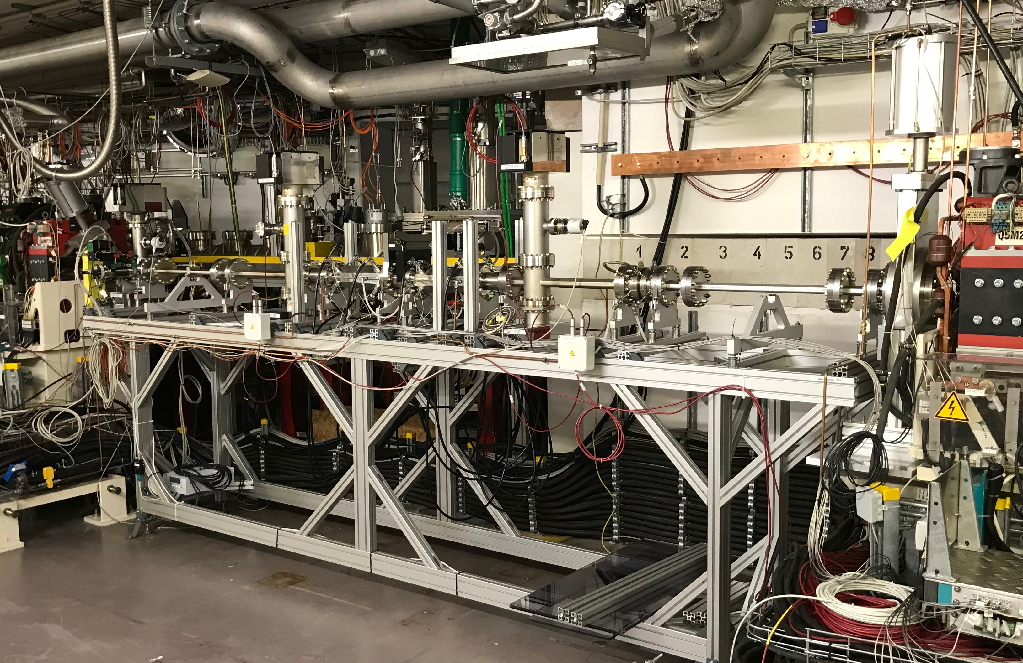
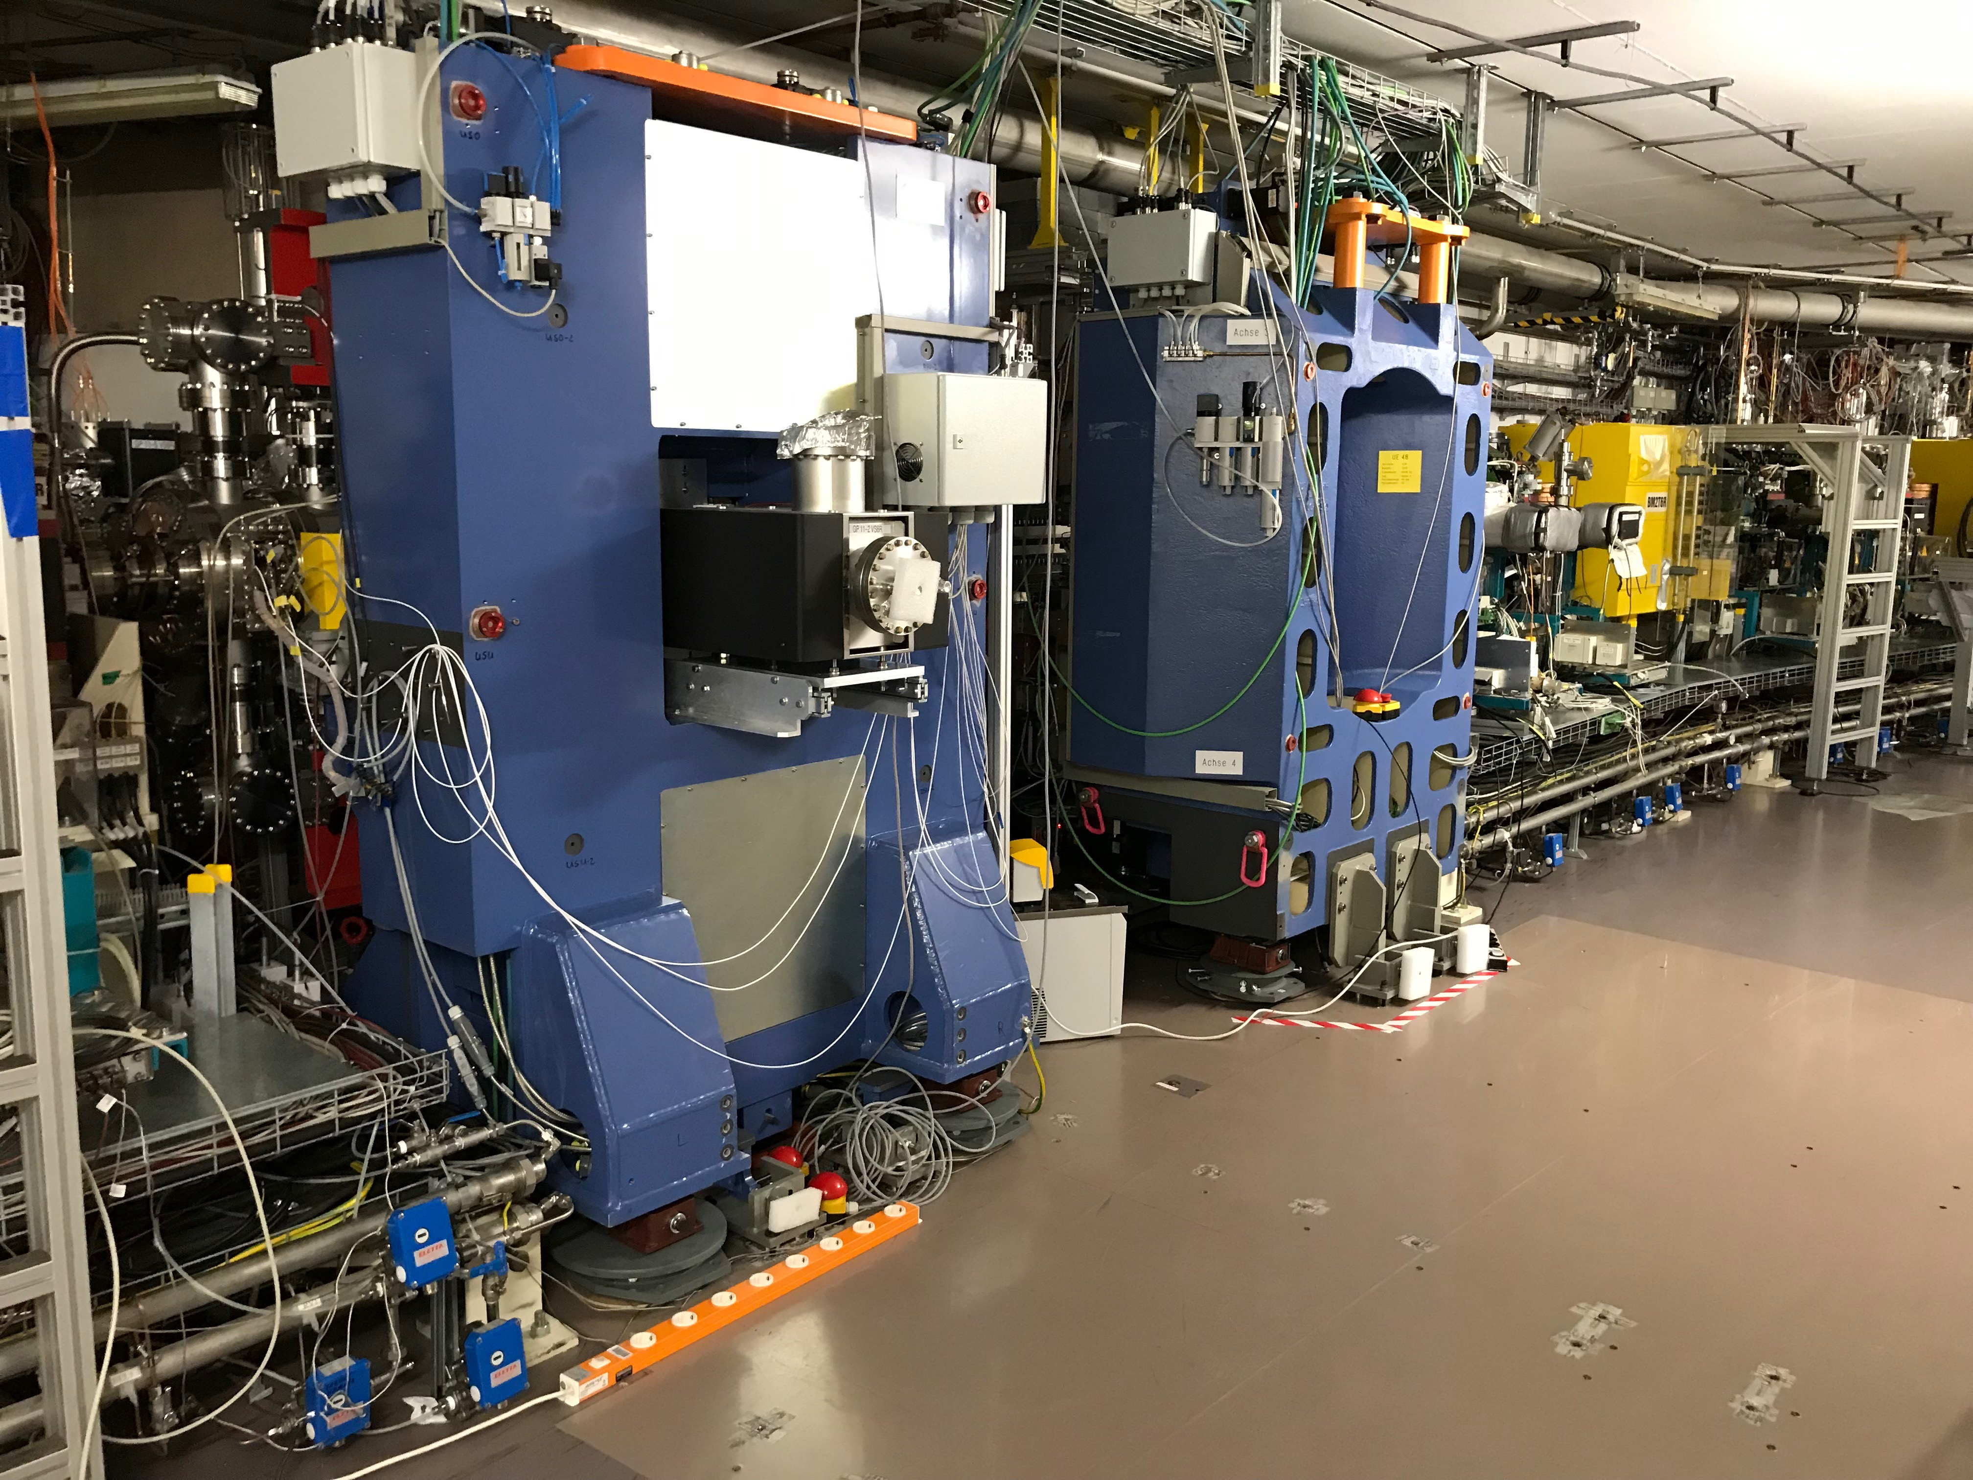
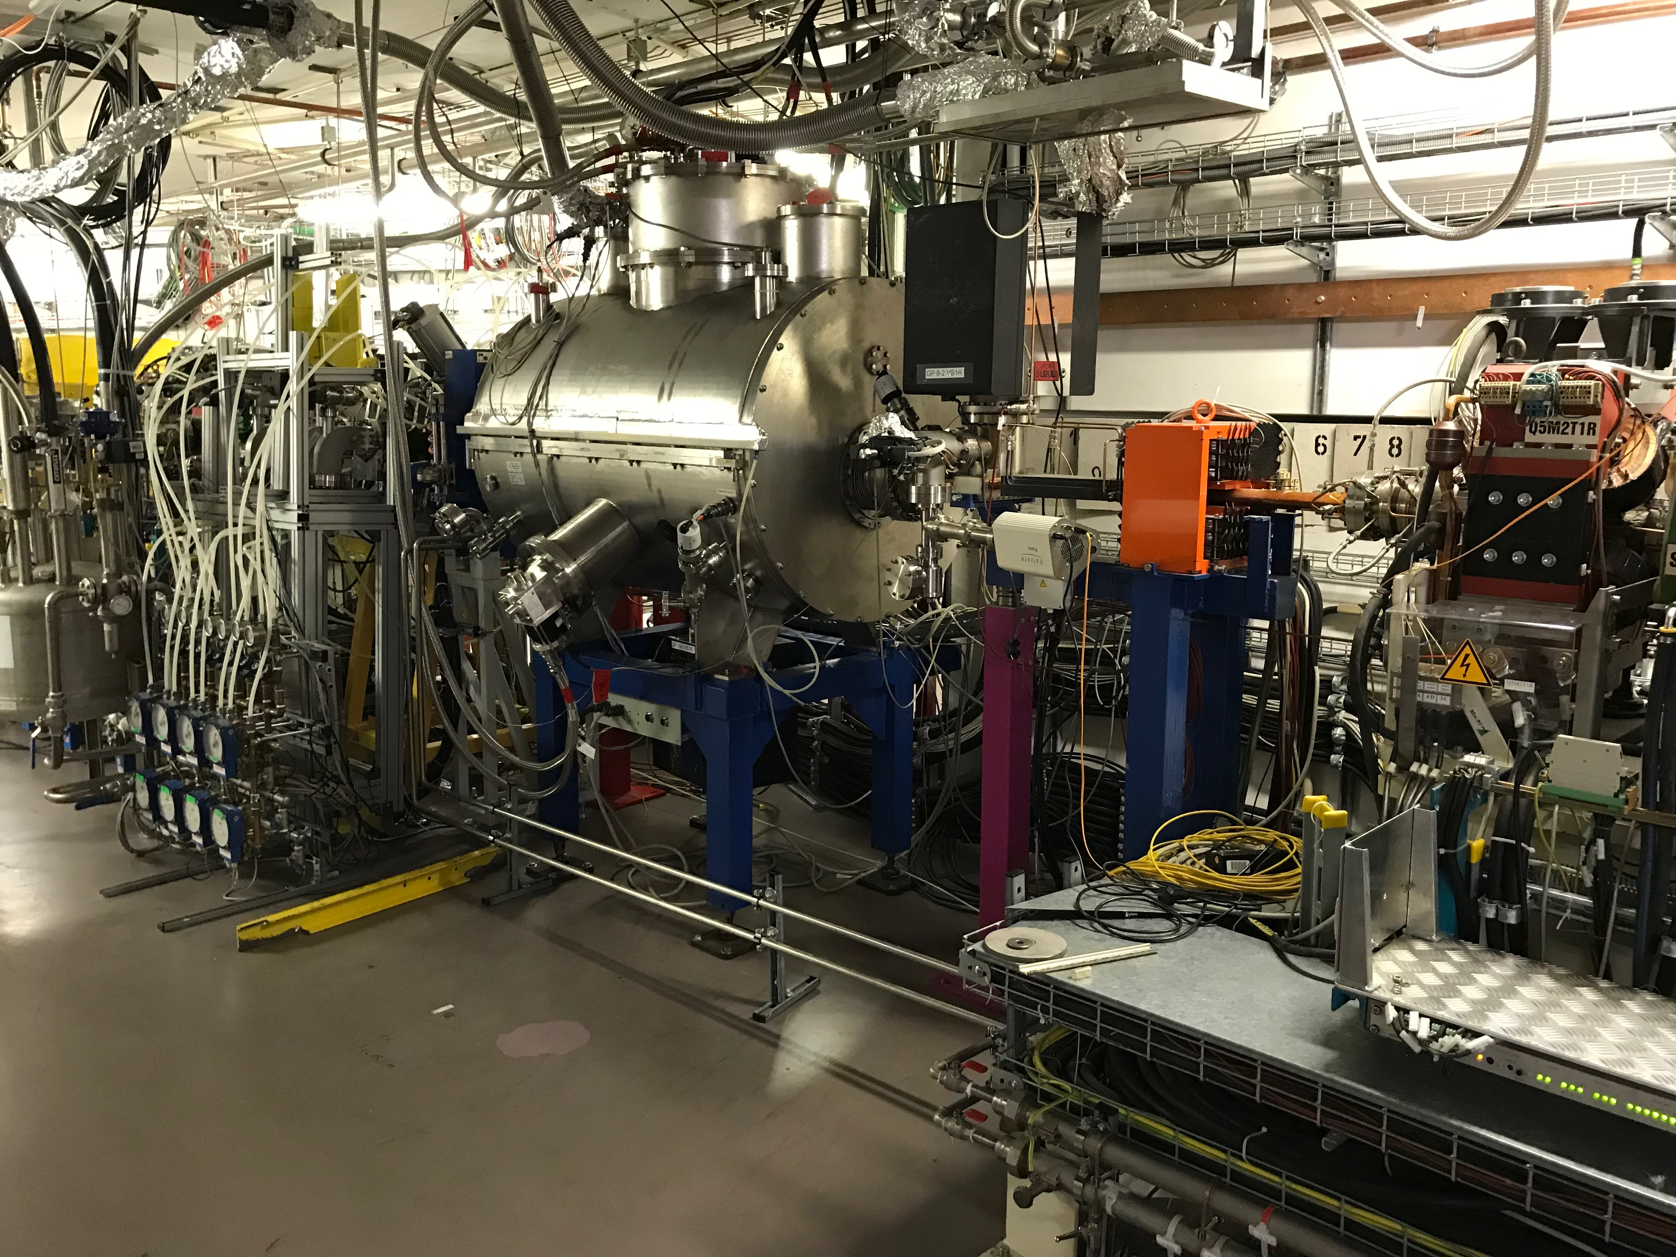
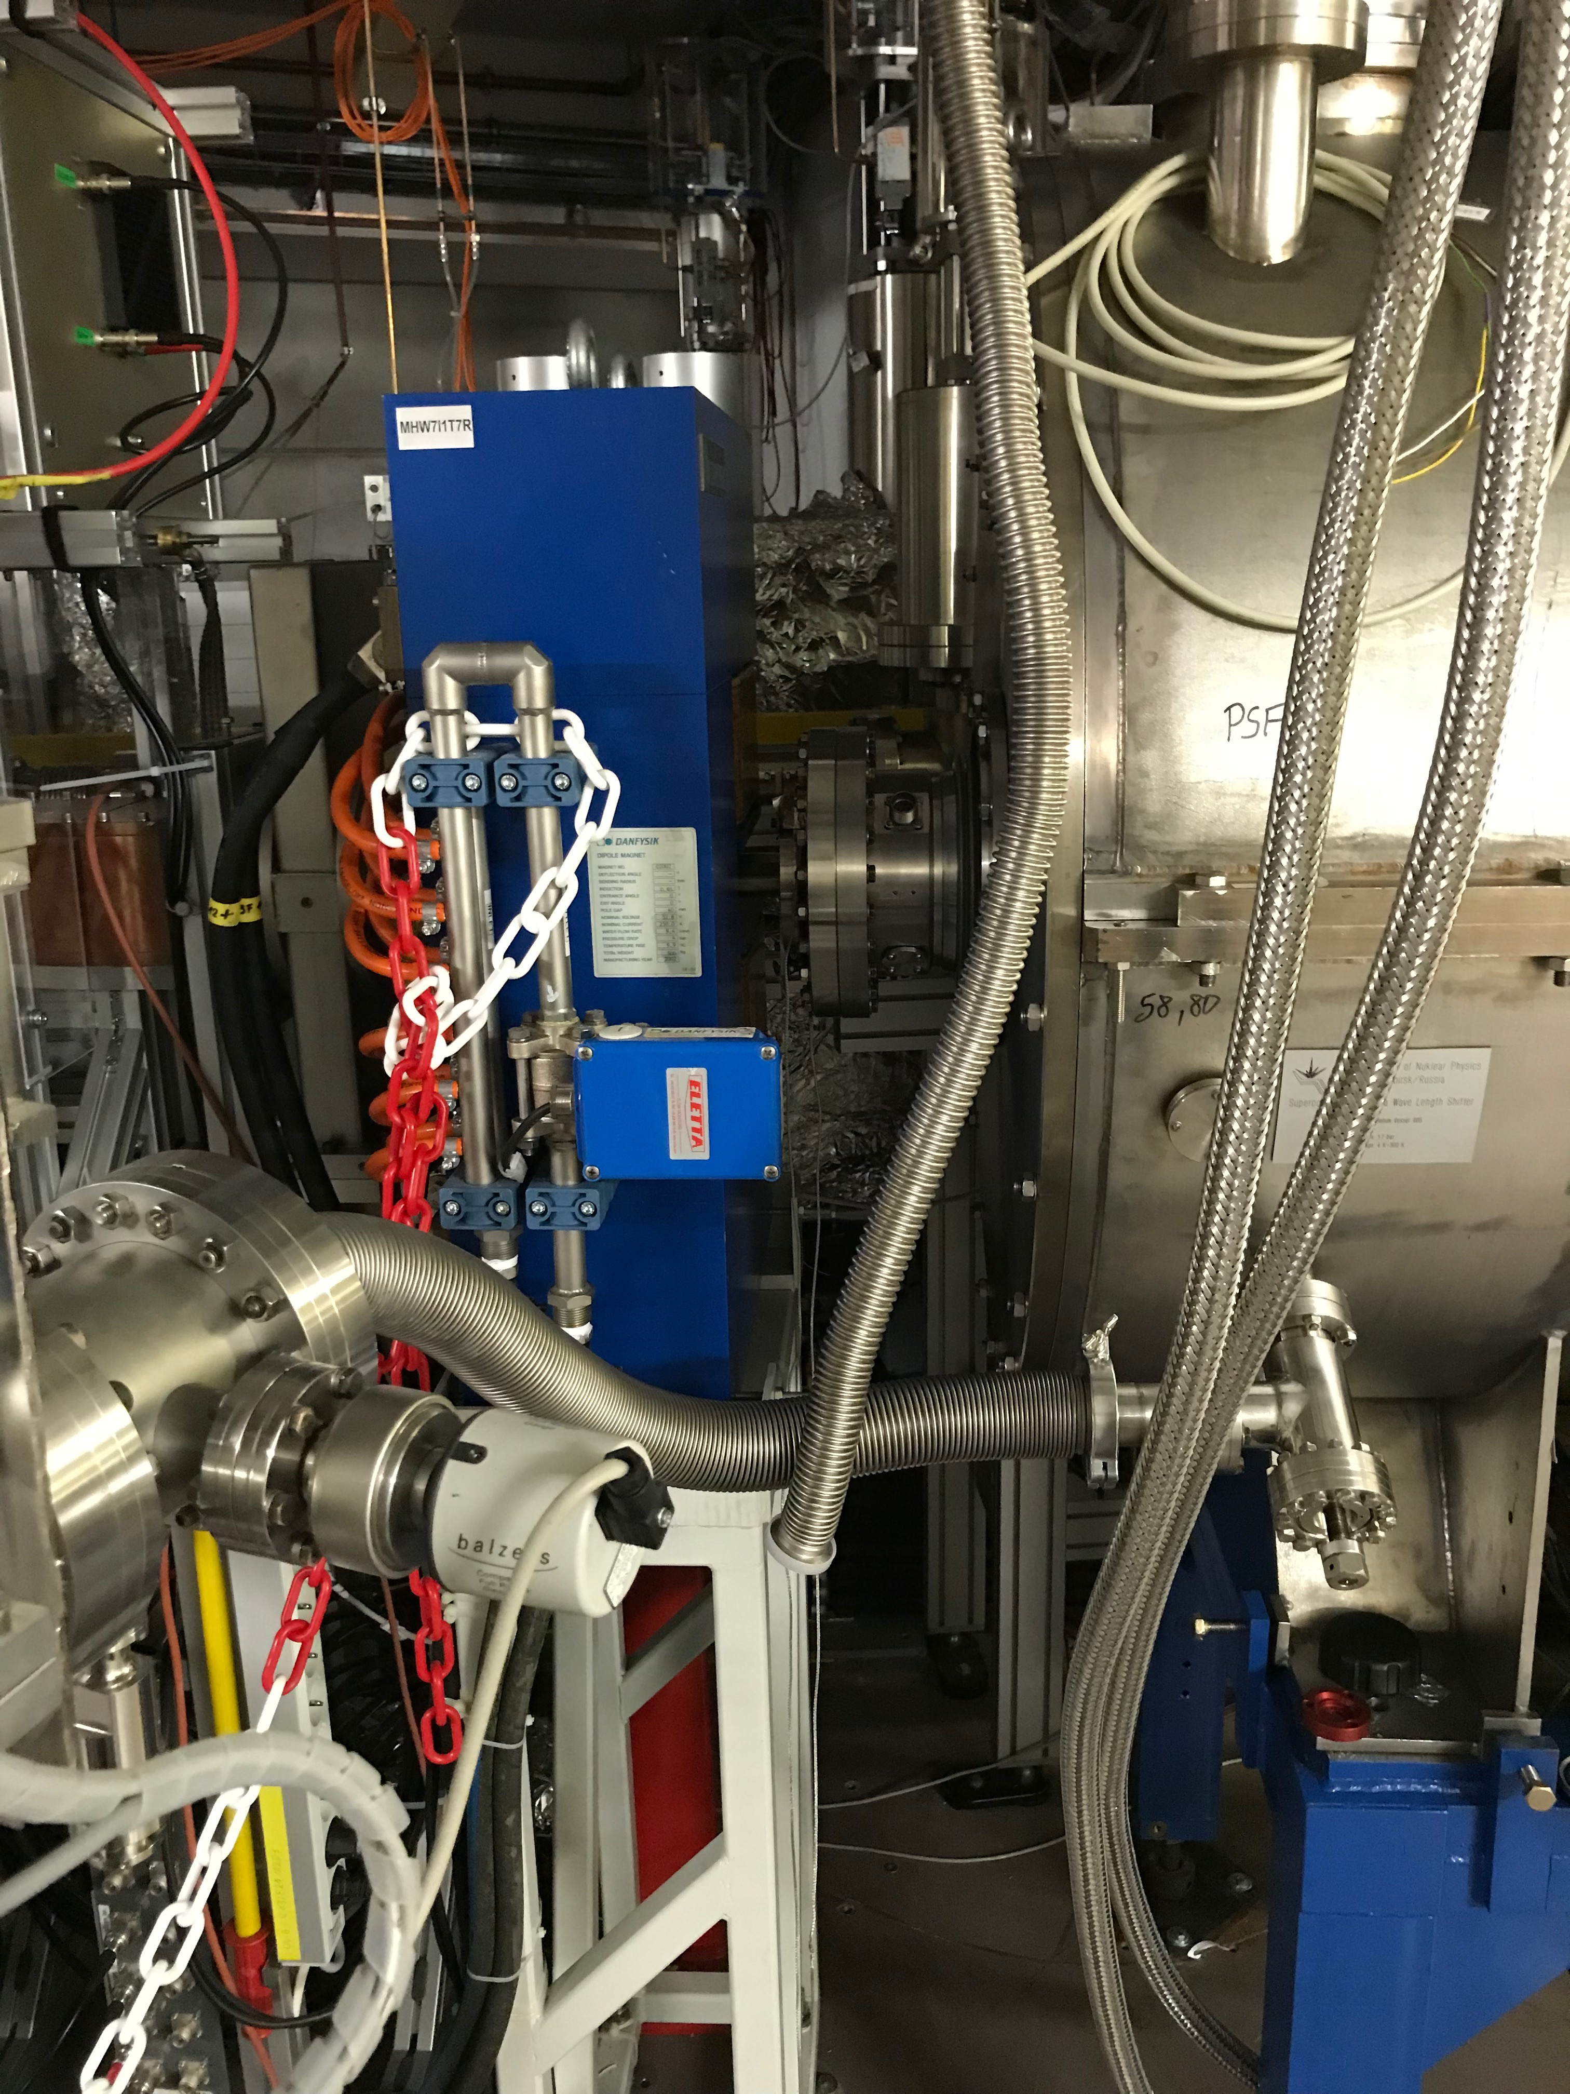
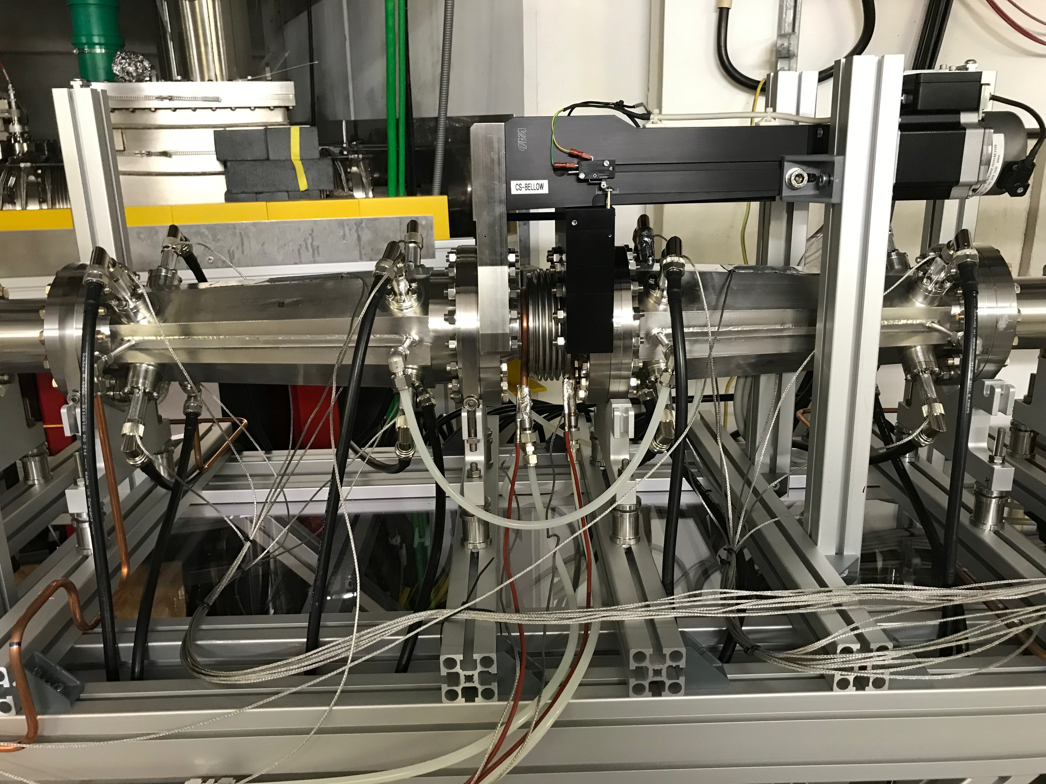
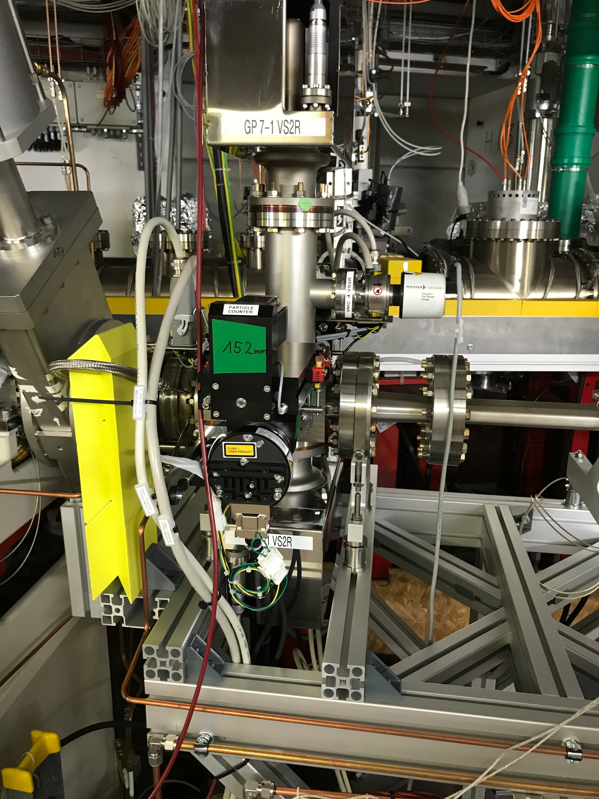
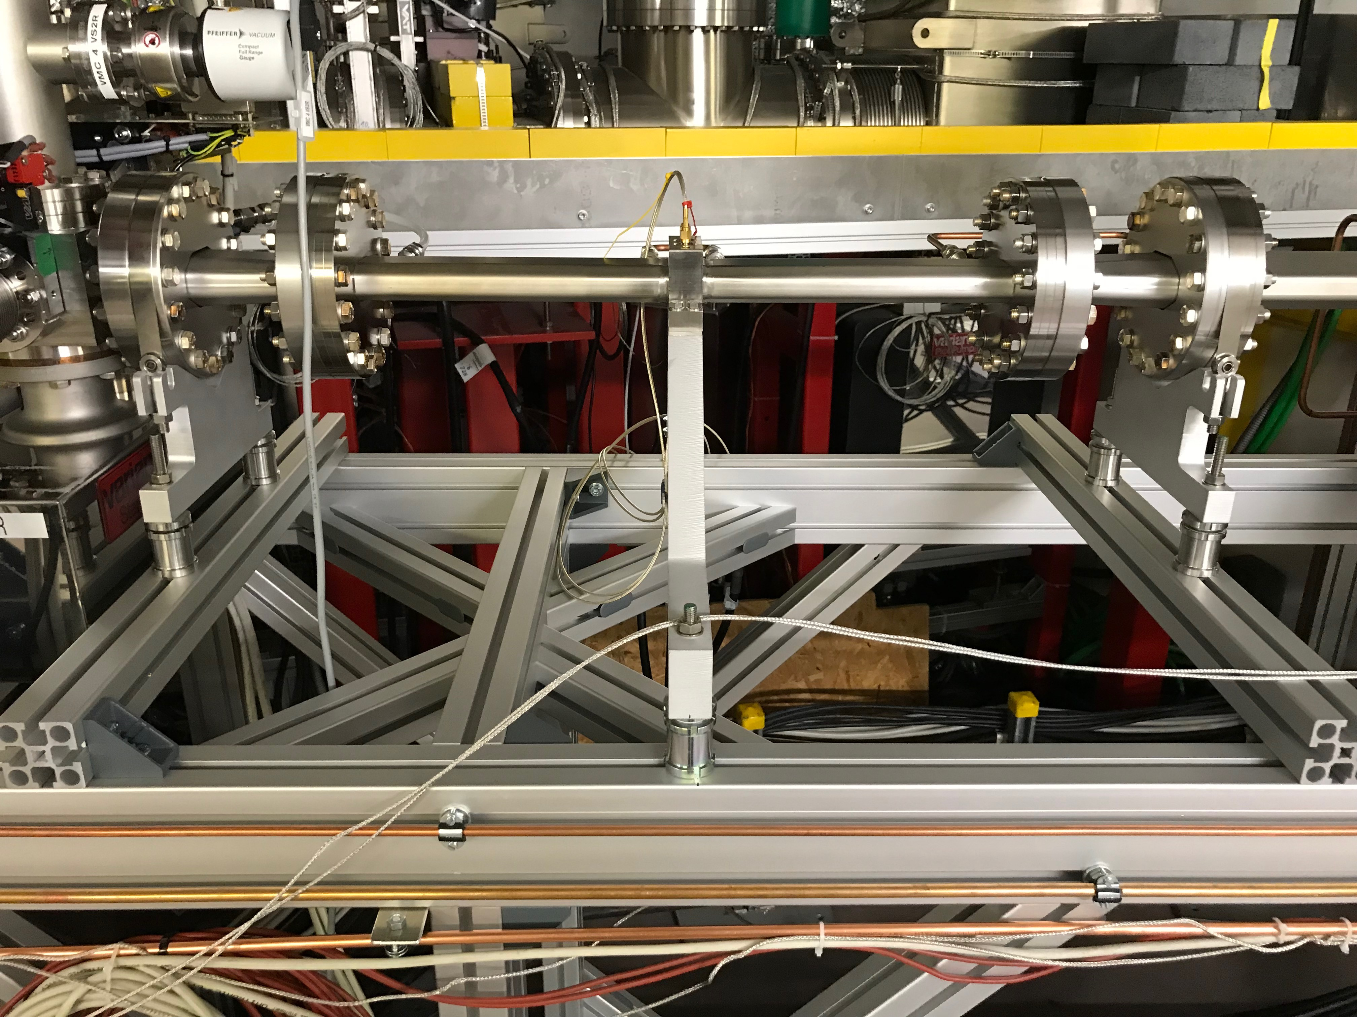
Machine commissioning / EVENT – Shutdown activities
storage ring
U17 refurbishment
BAM WLS reinstallation
PSF WLS bellow modification
VSR test straight installation
  particle counter
  new BPM
  Shielded bellow

Slide 13
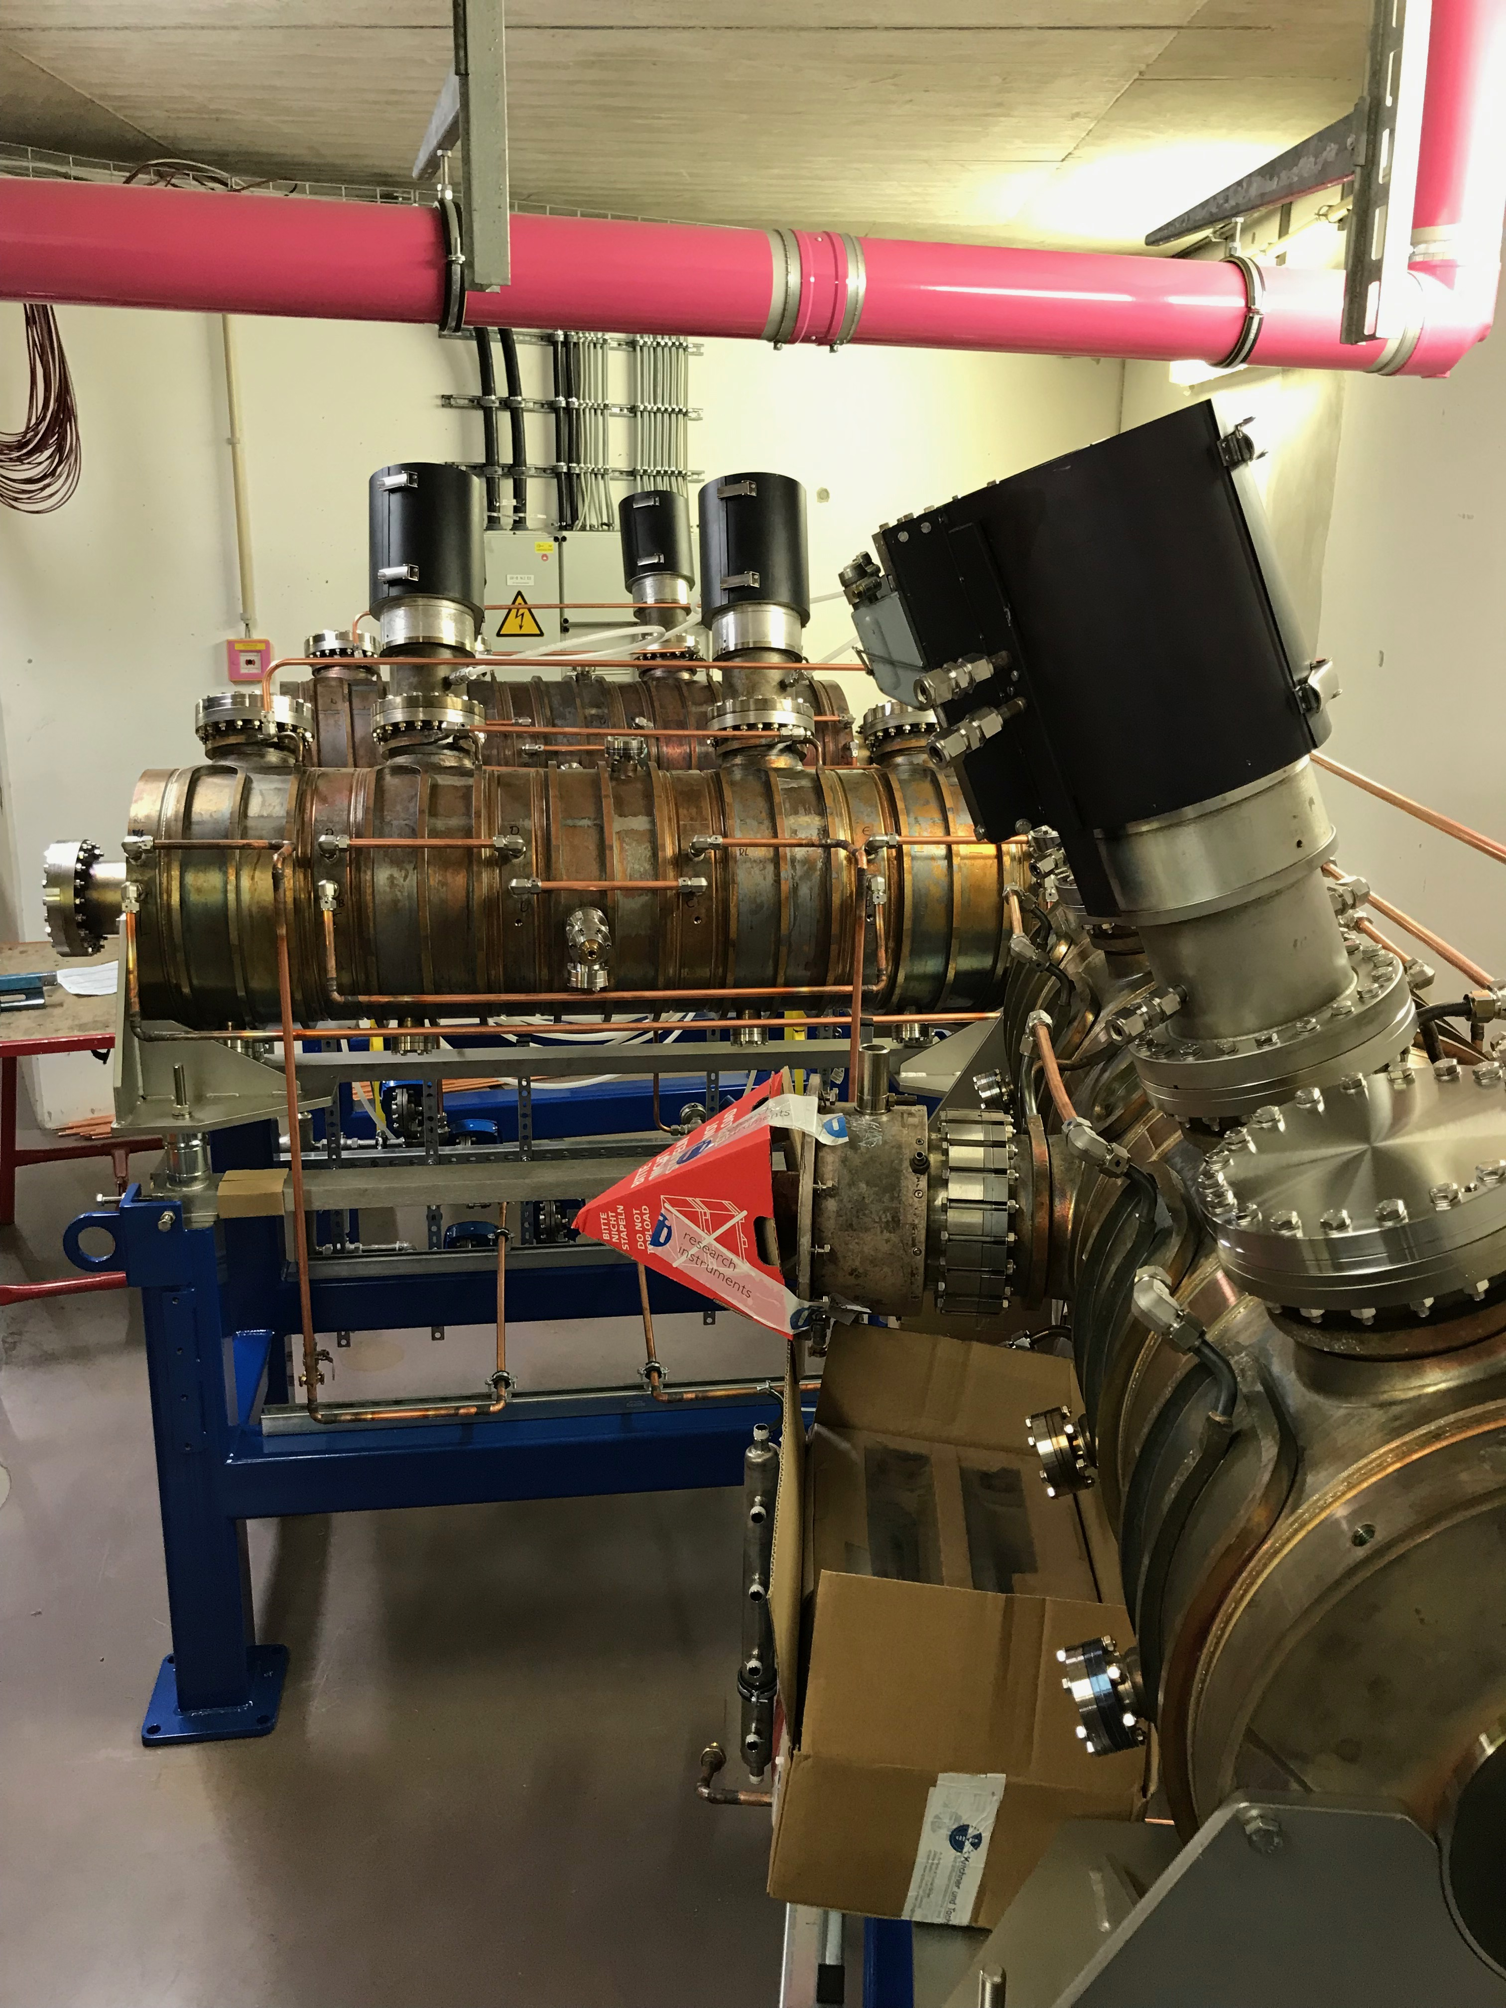
Machine commissioning / EVENT – Shutdown activities
injector
Microtron removal
PETRA cavities in synchrotron bunker
Spare extraction septum in synchrotron bunker
(re-)moved diagnostics & steerers to make room for cavity installation
longitudinal kicker cavity installed
bunch by bunch feedback units

Slide 14
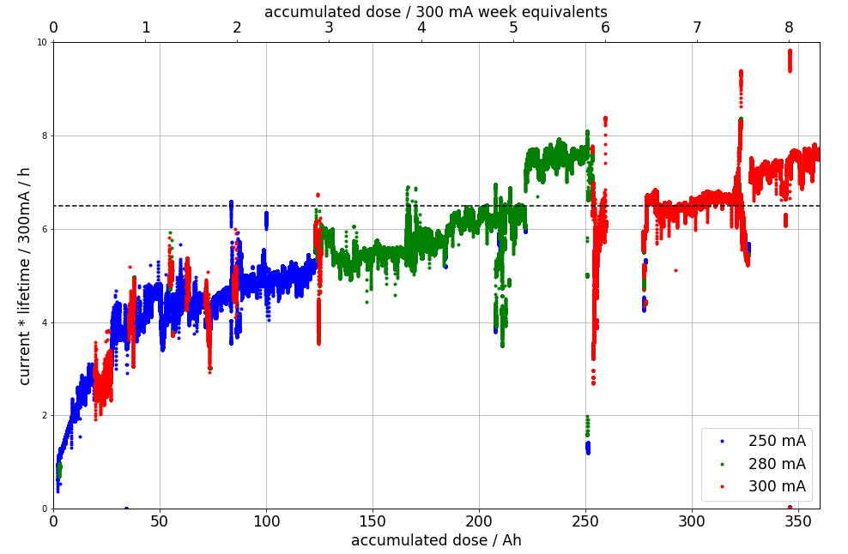
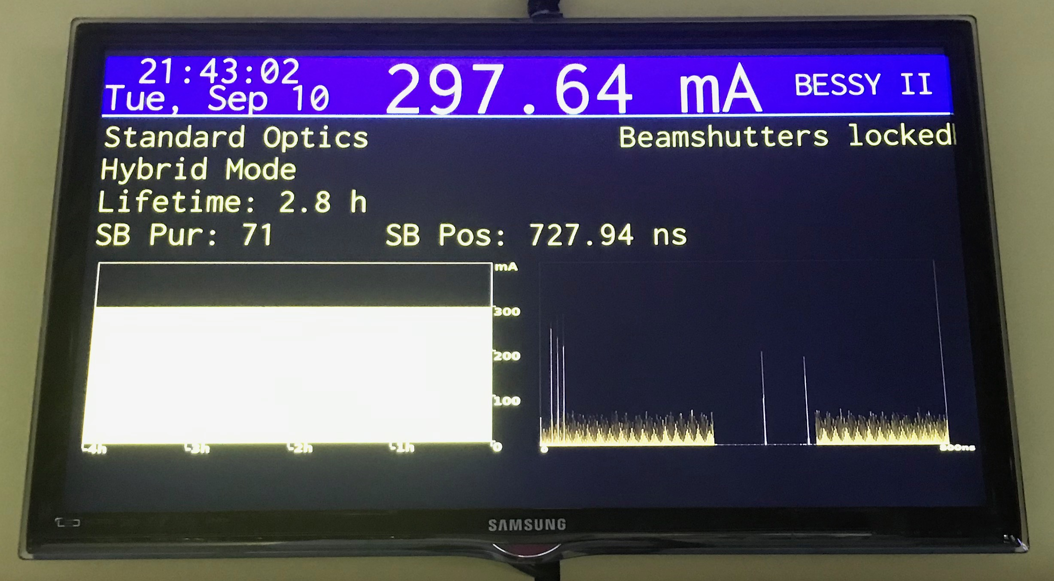
Machine commissioning / EVENT – Shutdown recovery 2019
4 straights vented
many elements never seen beam
slower but acceptable recovery
cryo cooler event
neither beamline commissioning nor user beam time reduced

Slide 15
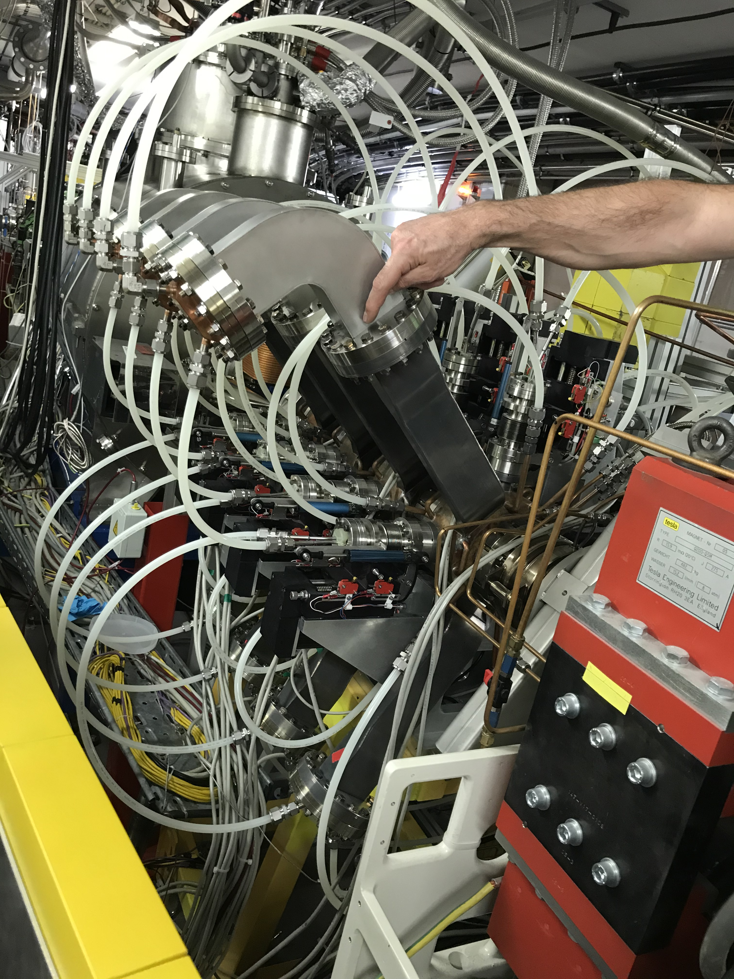
Machine commissioning / EVENT – Landau issue
failure in 2015/2016 → leak in cavity body
refurbishment:
  ¼ cavity bodies replaced
  HOM damping antennas modified
  HOM loads replaced
reinstallation summer shutdown 2018
ability to limit current reduction to handle T7 event& U17 issues
Bremsstrahlungs levels still high → user beam line locked
leak found in waveguides → sealed → user beam line unlocked
repair planed in summer shutdown 2020

Slide 16
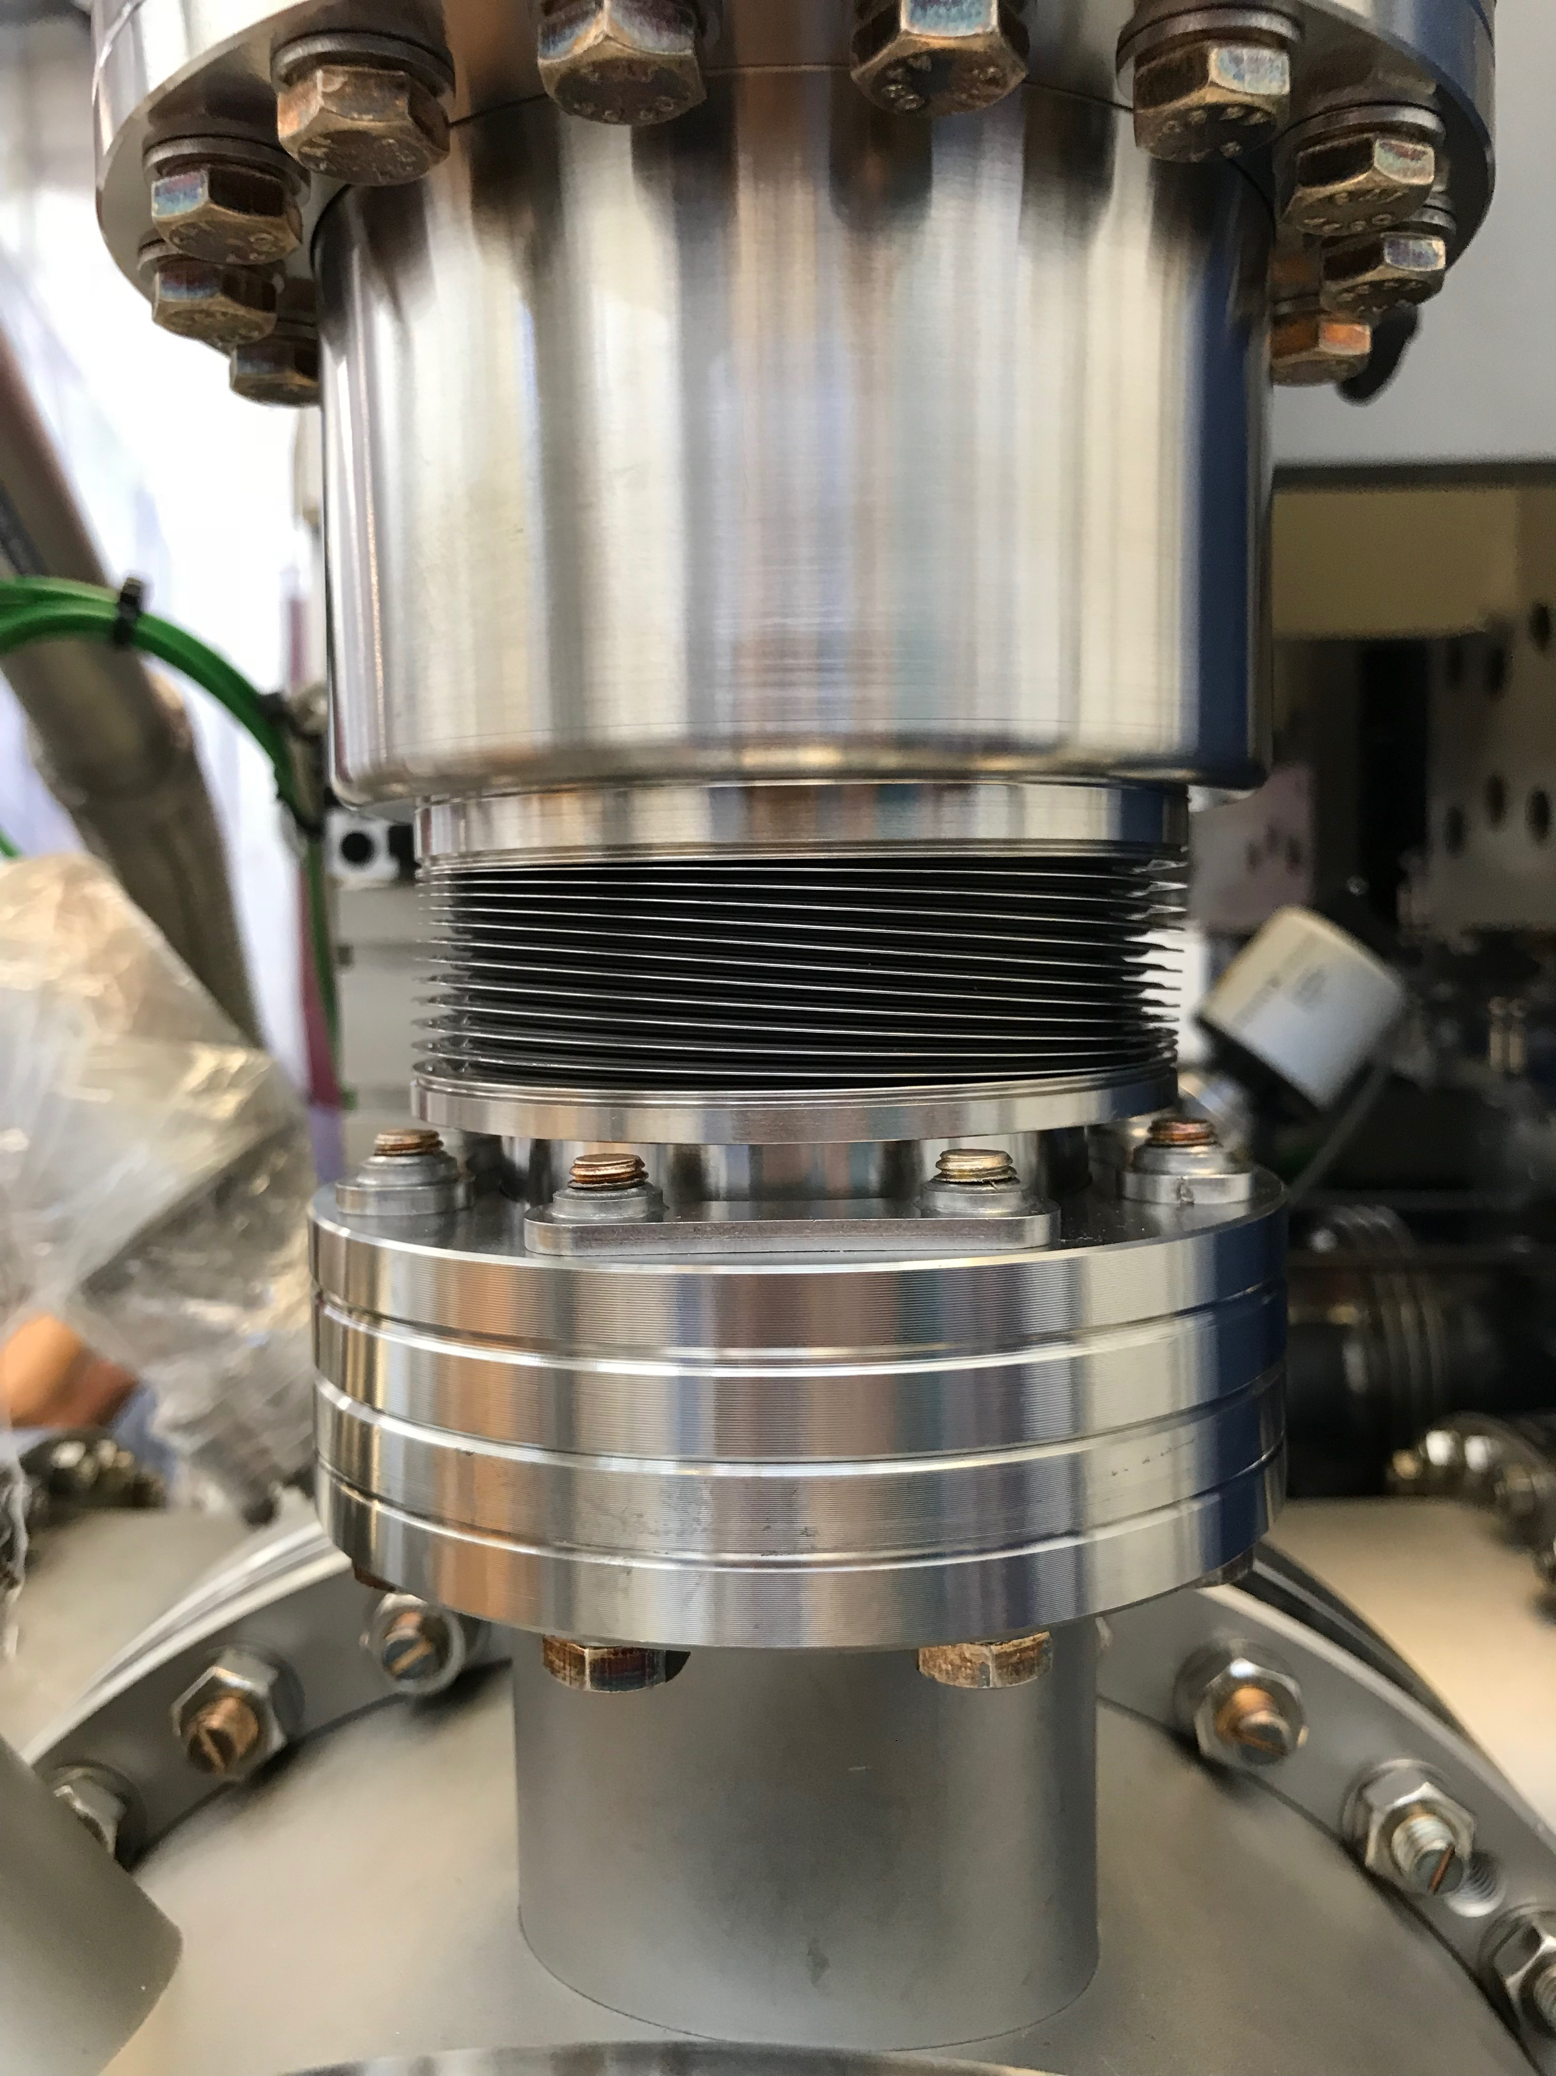
Machine commissioning / EVENT – U17 Refurbishment
since end of 2018 minimum
gap limited to 10 mm
water cooling added to taper section
machine integration posponed to 2019
cryocooler failed after shutdown
→ loss of 4 days of beam scrubbing, i.e. machine commissioning

Slide 17
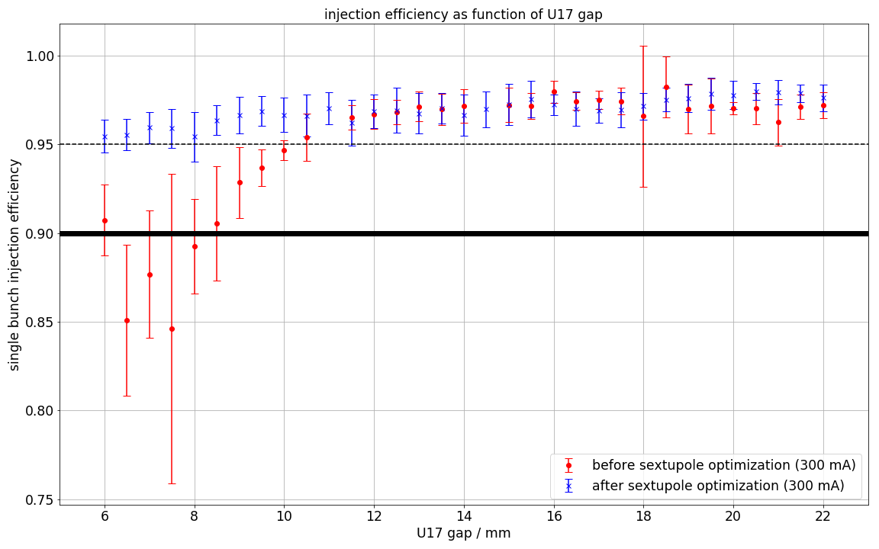
Machine commissioning / EVENT – U17 commissioning
beam based alignment
machine protection system
canting bump definition with beamlines
injector optimization started
optimization
  kicker lifetime
  SB inj. eff
  Sextupoles
Bremsstrahlung loss spot identified

Slide 18
content
Developments

Slide 19
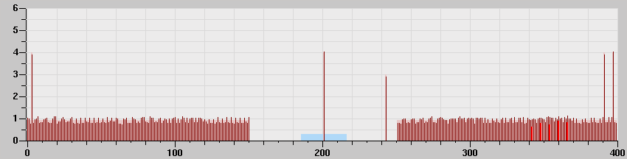
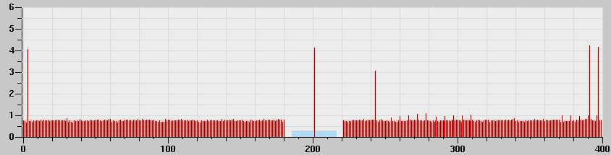
Developments – Short gap test operation
test operation of 80ns pulse picking gap → 4 weeks in user operation
improved Touschek lifetime (20%)
less transient synchronous phase shift (120ps → 60ps)
less impedance heating
more difficult pulse picking

Slide 20
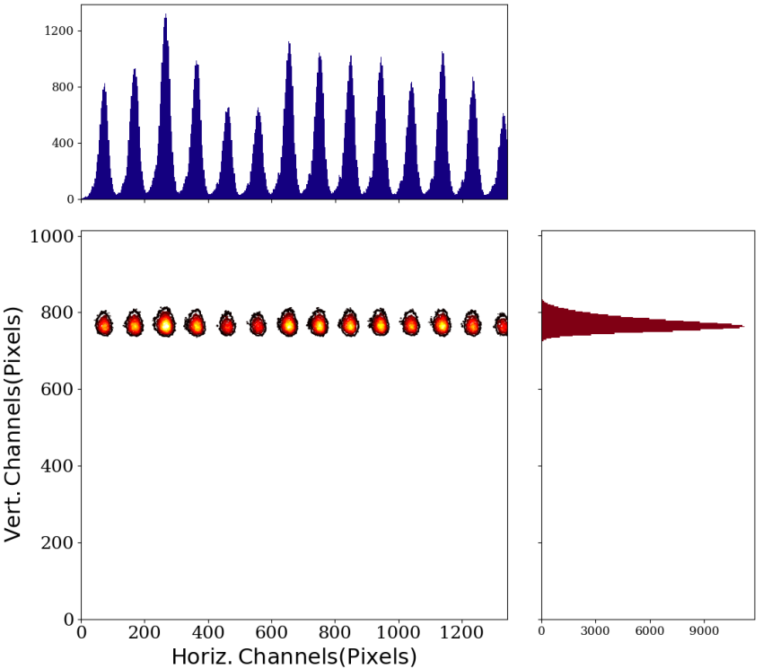
Developments – sub PS bunch diagnostics
Fast Streak Camera (HAMAMATSU) with
t vs x mode
improved toroidal mirror
improved 125 MHz generation (OPTRONIS)

Slide 21
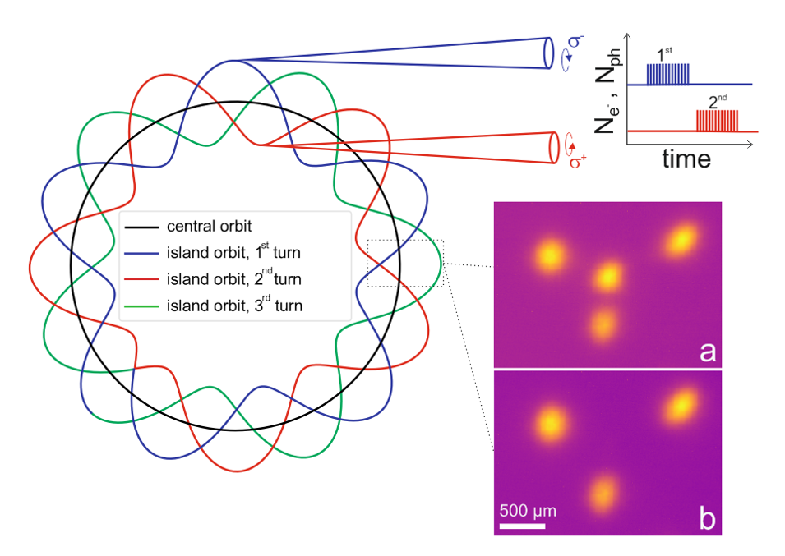
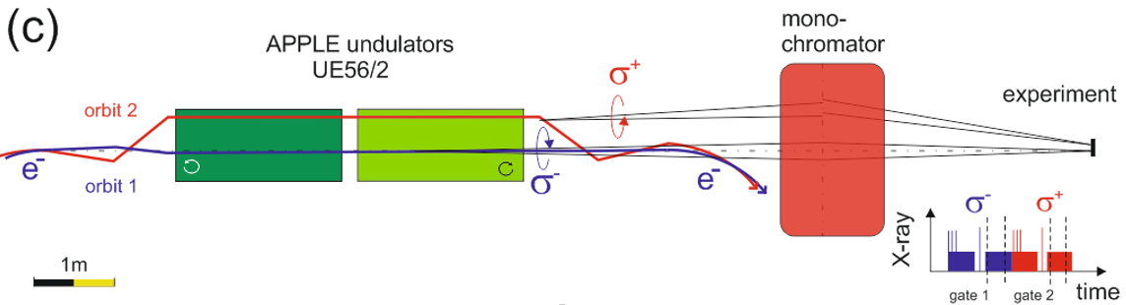
Developments – TRIBs XMCD experiment
2 full days spent in July 2019 for a pioneering
experiment at UE56/2
XMCD detection used as probe to detect
turn-by-turn helicity reversal of circular X-rays
tricky combination of stable TRIBs settings
in machine and UE56/2 twin undulator
at special setting
first two TRIBs orbits accepted by beamline
K. Holldack, C. Schüßler-Langeheine, P. Goslawski, N. Pontius, T. Kachel, F. Armborst,, M. Ries, A. Schälicke, M. Scheer, W. Frentrup and J. Bahrdt
Flipping helicity of X-rays from an undulator at unprecedented speed, submitted, under review.

Slide 22
Developments – 2 week operation schedule
motivation:
increase available user/commissioning time and reliability by minimizing transient machine states
successful
take it one step further?

Slide 23
Developments – 2 week operation schedule
20% more user time
more commissioning weeks
1st test week revealed no significant trouble
Only very few facilities do a two week rhythm → Is it worth trying?

Slide 24
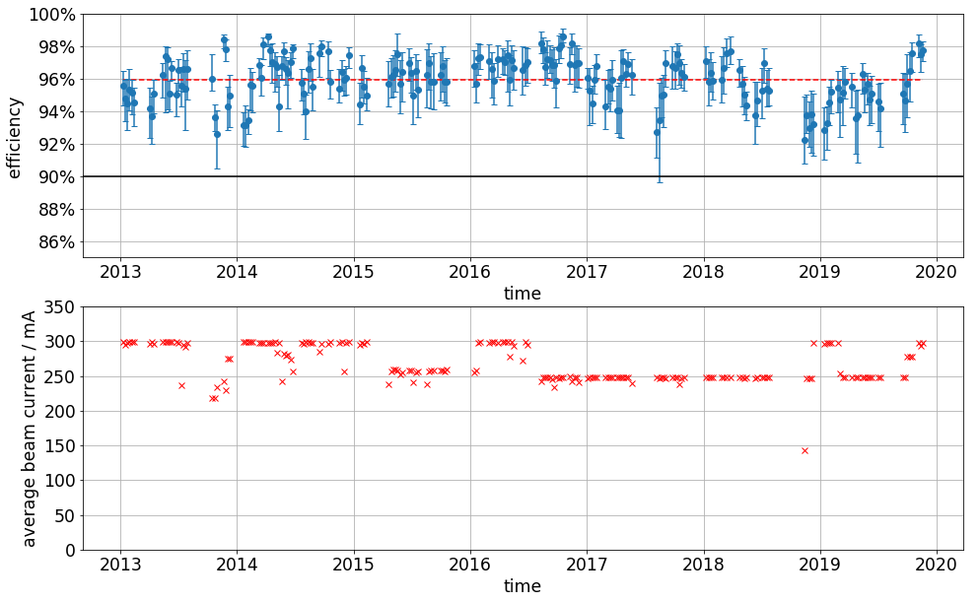
Developments – TOPUP optimization
2
1
3
7 years ot TopUp
96% weekly avg. eff.
250 mA / 300 mA
EMIL optics
MPW removal
CPMU17 installation

Slide 25
content
Outlook

Slide 26
Summary / highlights
good operational performance and reliability in 2019
300 mA user operation recovered
RF spring event handled with short turn around time of 36h
U17 implemented and in full beamline commissioning / user operation
shielded bellow acceptable for user operation & studies so far
landau cavity refurbishment, workaround in operation
TRIBs XMCD experiment

Slide 27
outlook
shielded bellow – single bunch user operation capability & studies
landau cavity repair
particle counter removal
integration of radiation protection dosimetry data to control system
suppression of collective effects in booster synchrotron
further U17-integration optimization loops
push development for TRIBs user operation
Booster refurbishment & upgrade
BESSY VSR studies

Slide 28
Acknowledgement
Michael Abo-Bakr, Wolfgang Anders, Felix Andreas, Felix Armborst, Terry Atkinson, Joachim Bartilla, Yvonne Bergmann, Thomas Birke, Daniel Böhlick, Anne Bundels, Markus Bürger, Rober Burneleit, Emanuel Cambas, Mathias Diehn, Marc Dirsat, Olaf Dreßler, Michael Edling, Silvio Ehlert, Dan Eichel, Volker Dürr, Pablo Echevarria, Hartmut Ehmler, Fjodor Falkenstern, Jörg Feikes, Nadine Fischer, Roland Fleischhauer, Thomas Flisgen, Andre Frahm, Benjamin Franksen, Sabine Giray, Holger Glass, Hans-Walter Glock, Felix Glöckner, Anny Gora, Rainer Görgen, Paul Goslawski, Mario Haucke, Jochen Heinrich, Svenja Heling, Andreas Heugel, Harry Hoffmann, Falk Hoffmann, Karsten Holldack, Holger Huck, Ji-Gwang Hwang, Andreas Jankowiak, Christian Jung, Christian Kalus, Jens Knobloch, Jörg Kolbe, Marten Koopmans, Bernhard Kuner, Jens Kuszynski, Victoria Laux, Nicole Leuschner, Ji Li, Klaus Ludwig, Michael Markert, Aleksandr Matveenko, Meghan McAteer, Tom Mertens, Gert Meyer, Gregor Mielczareck, Ingo Müller, Roland Müller, Christian Nass, Klaus Ott, Fabian Pflocksch, Lutz Pichl, Henry Plötz, Joachim Rahn, Markus Ries, Stefan Rotterdam, Roswitha Schabardin, Andreas Schälicke, Tobias Schneegans, Ines von Scheibner, Günter Schindhelm, Ines Seiler, Gregor Schiwietz, Bernhard Schriefer, Thomas Schröter, Michael Schuster, Dirk Schüler, Hannes Stein, Tom Struppert, Ervis Suljoti, Yegor Tamashevich, Michael Ulrich, Stefan Wiese, Daniel Wolk, Antje Vollmer, Sven Wrede, Nora Wunderer … and many more

Slide 29
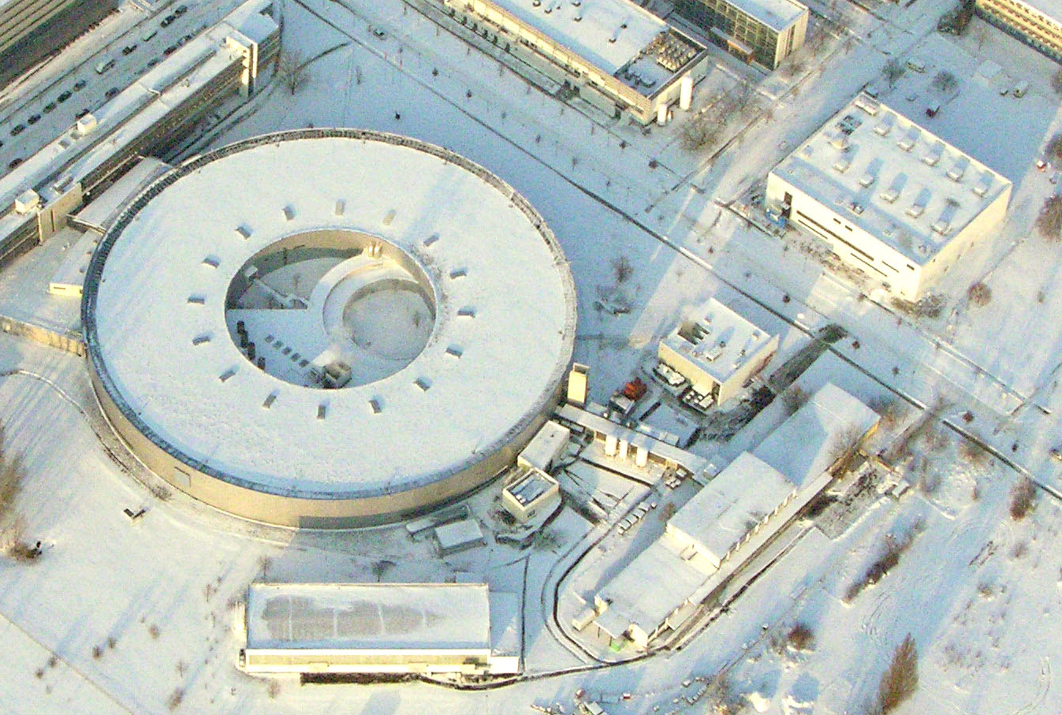
Acknowledgement

Slide 30
content
Backup

Slide 31

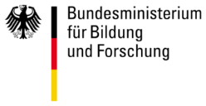
BESSY III
… the wheels start to spin
… fueled by the appointment of our new “photon science” director Jan Lüning
storage ring based light source
soft & tender x-rays
DLSR approach following directions of SOLEIL / SLS / ELETTRA…
target emittance in the order of ≈ 200 pm rad
electron energy ≈ (2.0 … 2.5) GeV
green field approach is investigated (C ≈ 350m) as well as in-facility (C ≈ 240m)
≈ 2030
CDR-Phase started – CDR expected 2022
Science Case will be worked out during the next year
→ Workshops with Science Expert Groups
Investigation of short-pulses, need for time-resolved experiment under way
Possible site for BESSY III facility in Berlin-Adlershof has been reserved

Slide 32
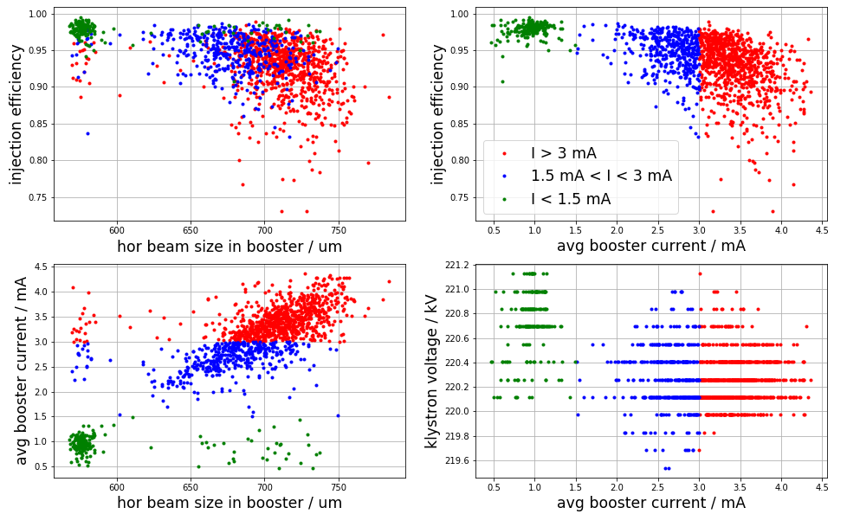
Coupled bunch instability in booster synchrotron

Slide 33
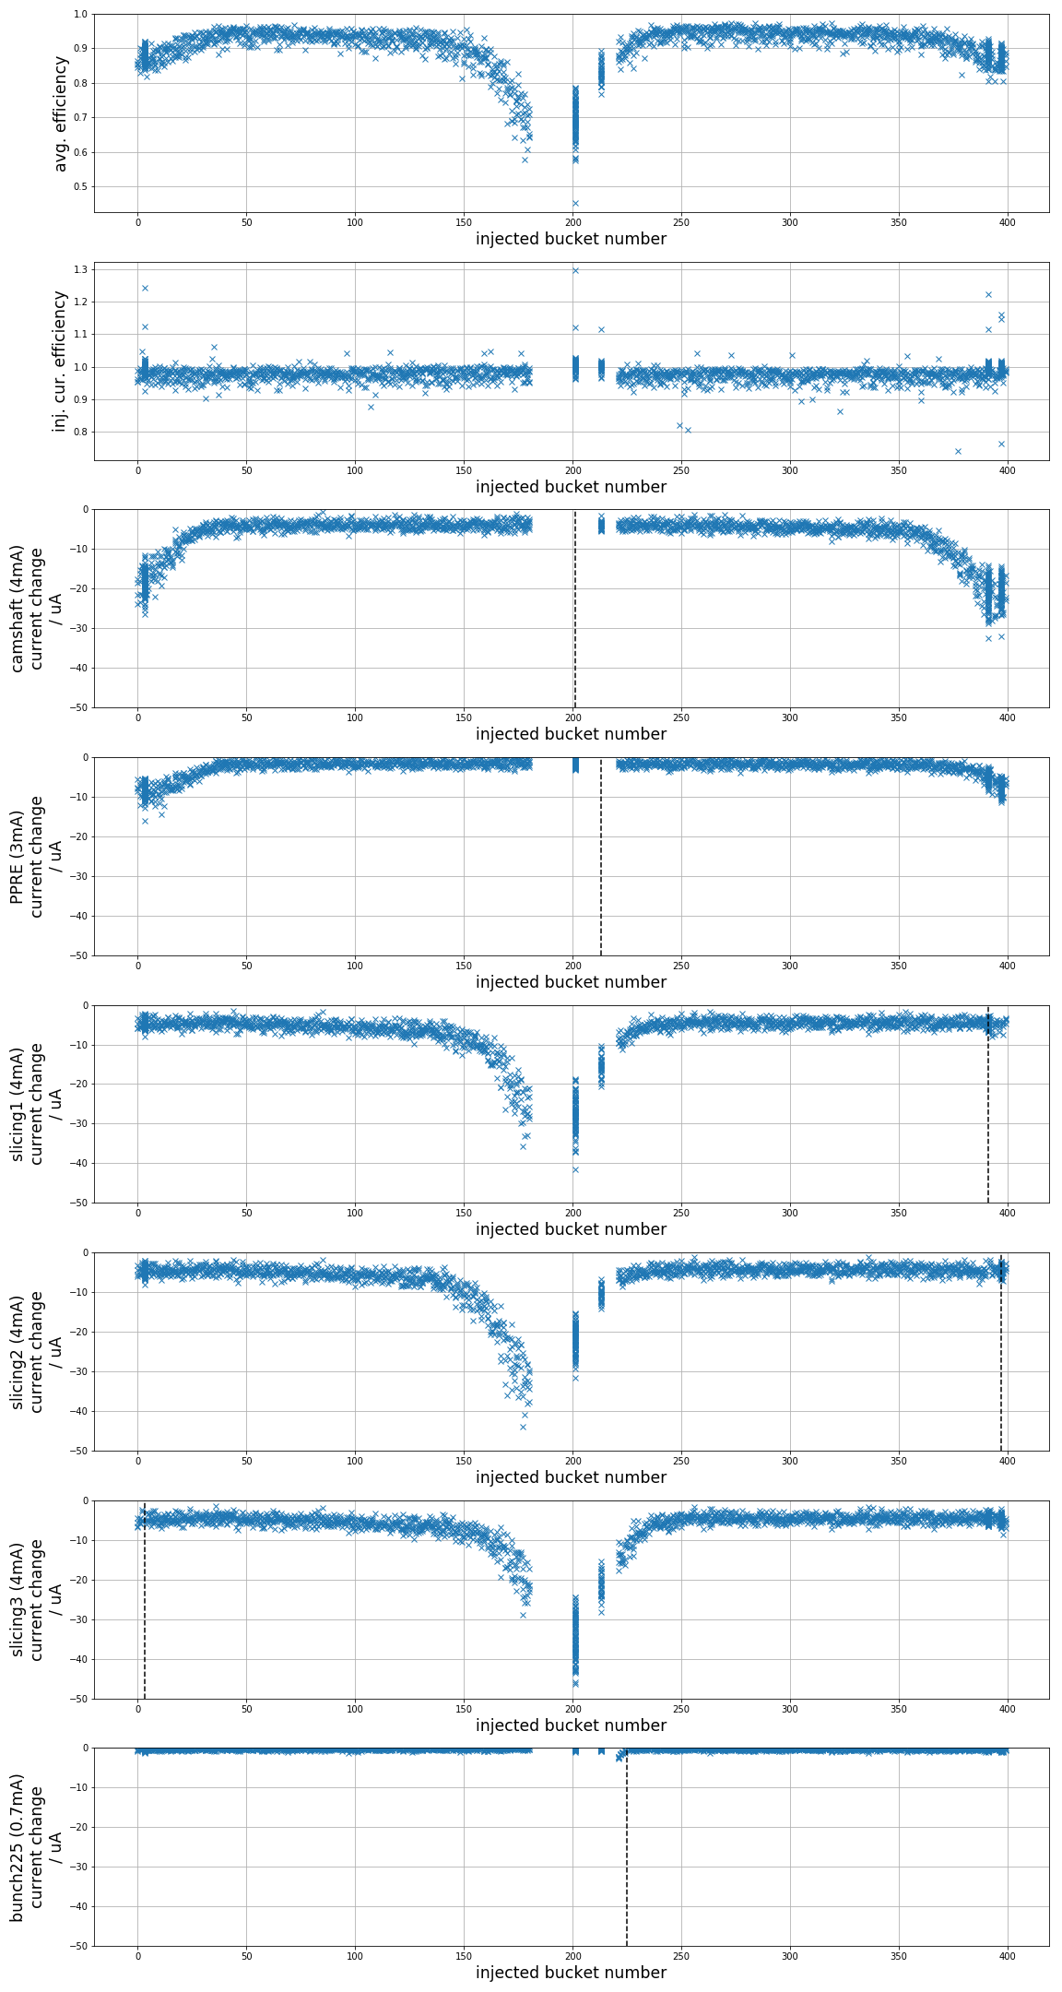
Kicker lifetime investigation & optimization

Slide 34
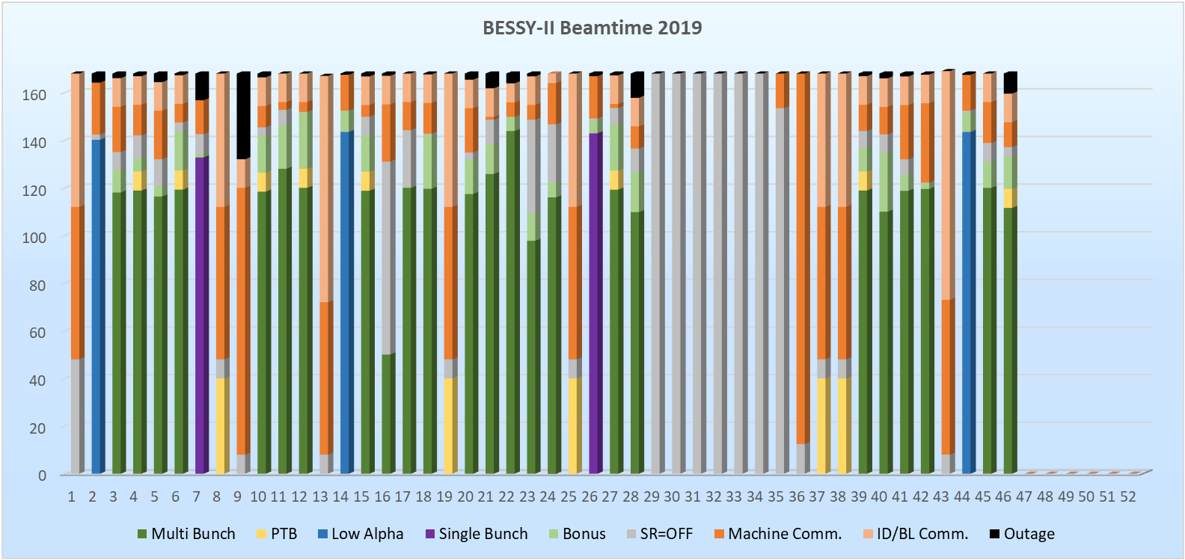
Operation statistics – delivered beam – precompensation

Slide 35
Operation statistics – delivered beam – precompensation
year | scheduled | downtime | bonus | # outages | availability | +bonus | MTBF | MTTR
2018 | 3578 h | 28.3 h | 415 h | 51 | 99.2 % | 111 % | 70.2 h | 0.56 h
2019 (… cw46) | 3846 h | 103.3 h | 310 h | 67 | 97.3 % | 105 % | 57.4 h | 1.5 h

