Slide 1
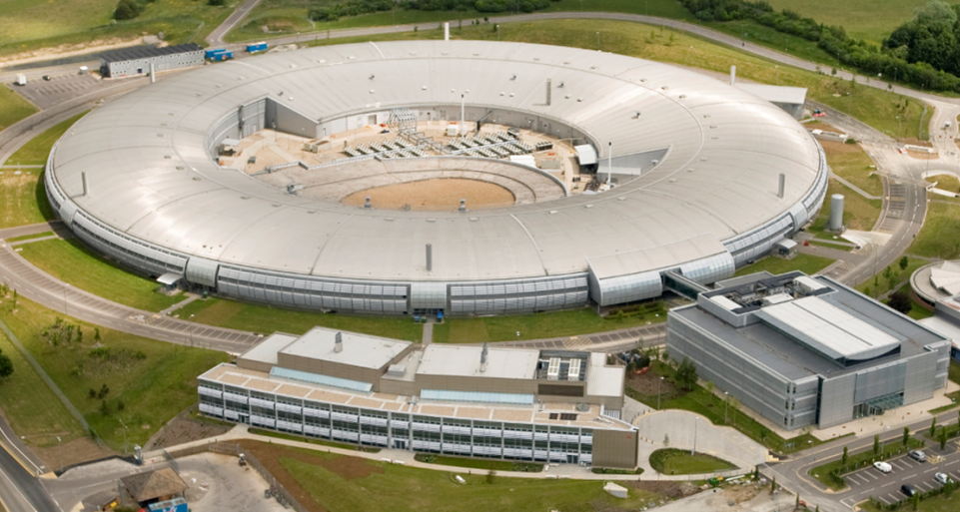
Diamond storage ring present status and lattice upgrade
H. GHASEM
Diamond Light Source Ltd, AP group
hossein.ghasem@diamond.ac.uk
27th European Synchrotron Light Source Workshop (ESLS), ALBA, Barcelona, Spain
27-29 November 2019

Slide 2
Outline
Diamond status
  Operation statistics
  RF
  Diagnostics
  AP measurements
Diamond storage ring upgrade
  Design goals of Diamond-II
  Diamond storage ring lattice evolution
  M-H6BA lattice (off axis solution)
  Linear beam dynamics
  Nonlinear beam dynamics
  Error study
  IBS + HC
  IDs

Slide 3
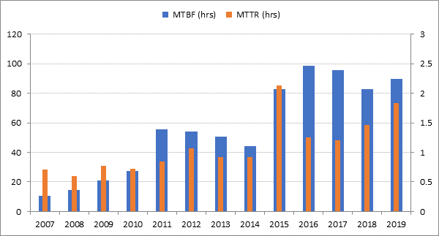
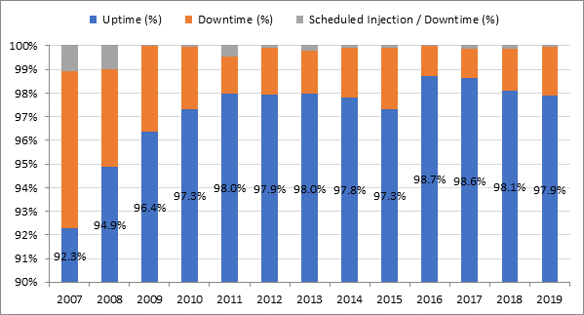
Diamond status – Operation statistics
DDBA, Nov. 2016
courtesy C. Bailey
Missing SEXT., May 2018
Target > 72 h MTBF

Slide 4
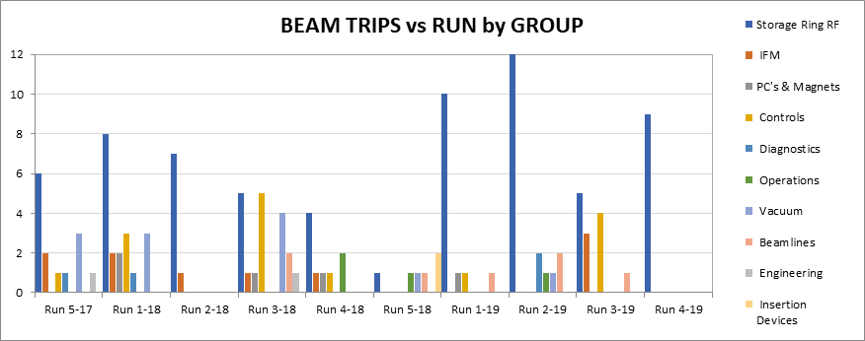
Diamond status – Operation statistics
courtesy C. Bailey
The majority of the RF trips have been on the IOTs and their supporting systems.

Slide 5
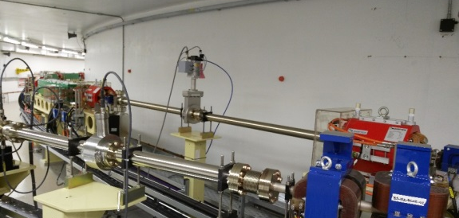
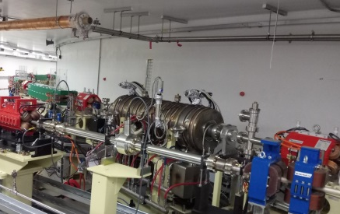
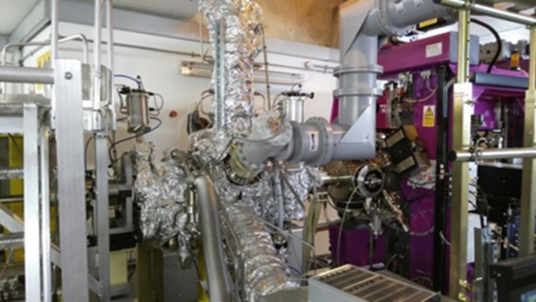
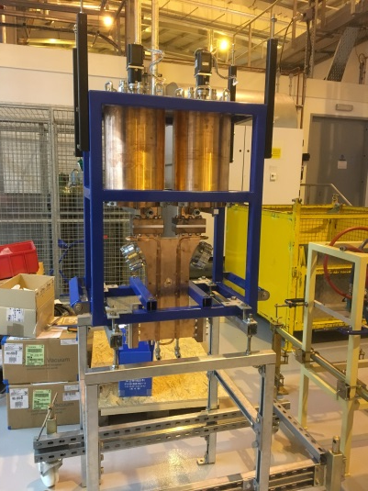
Diamond status – RF
2nd booster cavity has been successfully installed for redundancy propose.
  5 cell Petra cavity from DESY
  Baked in tunnel in summer 2018
  Installed in November 2018
  To be powered by solid state amplifier and controlled by digital LLRF
Two new NC cavities have been installed in the storage ring
Third cavity is purchased and is under preparation for baking. It will be installed in straight 15
In the normal course, two NC cavities will assist the SC cavities in terms of voltage and power
~600 kV across each cavity
Can support operation at ~200 mA.
SLED cavity has been delivered and tested
  Cavity, phase shifter, power divider & High Power window are delivered
  Assembly and installation in progress
  Problem with phase shifter drive mechanism
  Sent to the supplier for rectification
Solid state amplifier (ongoing work)
courtesy C. Christou

Slide 6
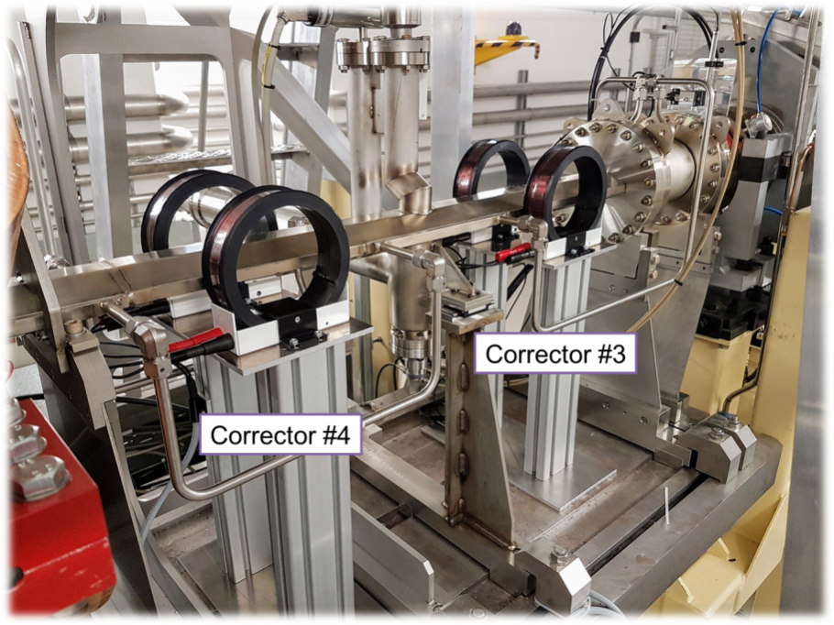
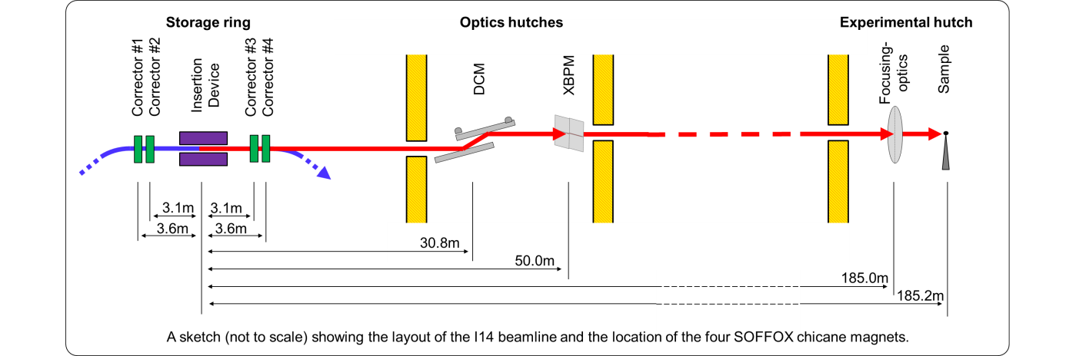
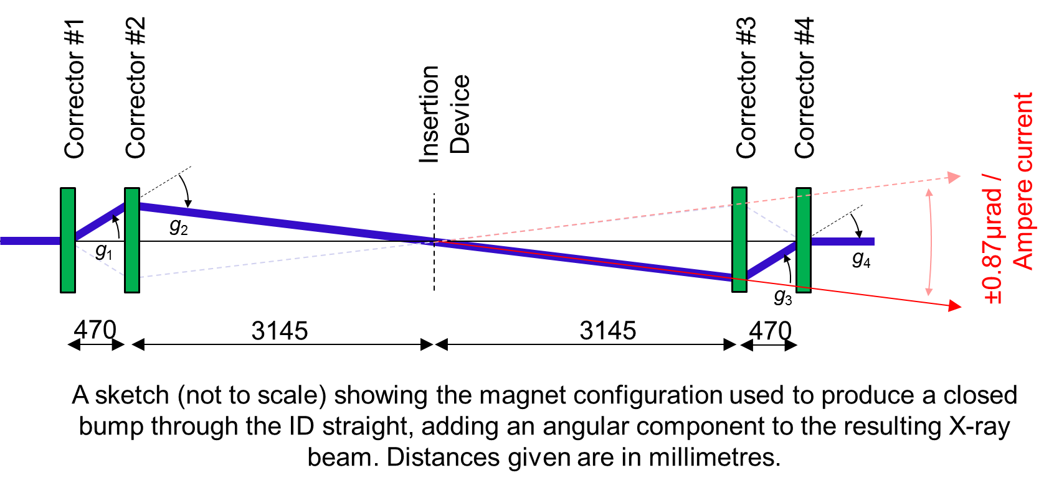
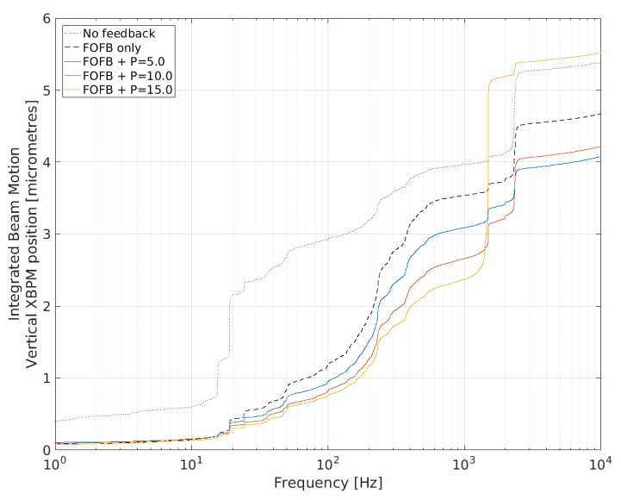
Diamond status – Diagnostics
Doris: beam phase instead of RF phase.
  It will be used in the next couple of days.
Local fast feedback control on single beam line.
courtesy G. Rehm, C. Bloomer, A. Tipper

Slide 7
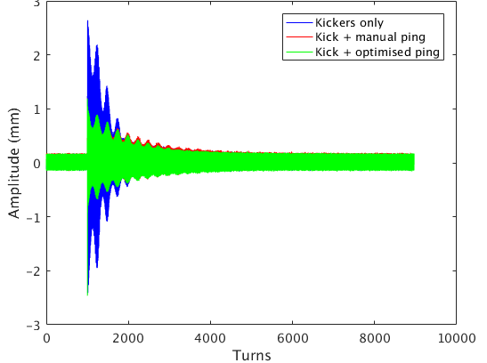
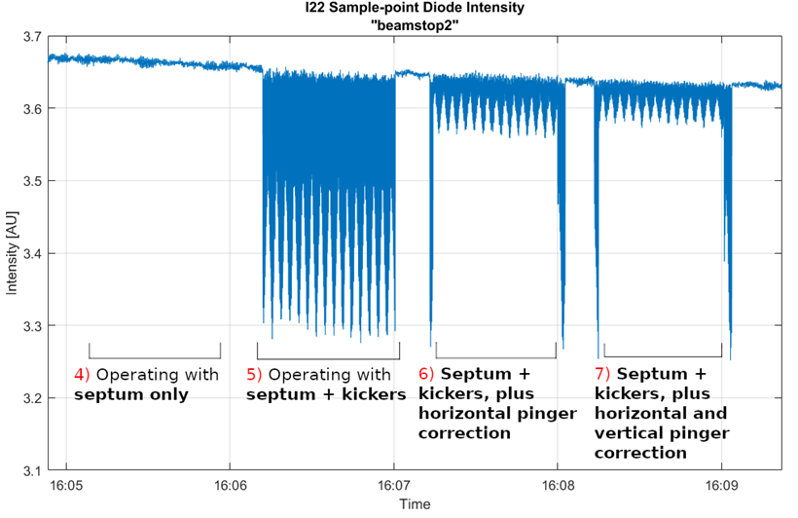
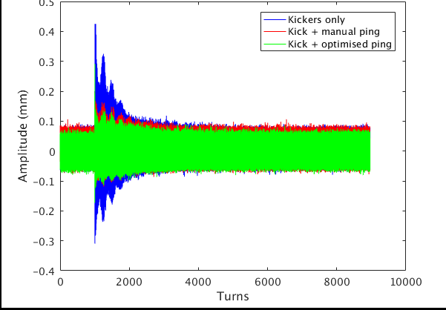
Diamond status - AP
Pinger for injection transient compensation;
courtesy R. Fielder , M. Apollonio
Vertical emittance excitation
Impedance & grow damping rate measurements (TO talk)
Diamond-II
Others: CPMU

Slide 8
Diamond II Design GOALs
Design goals for Diamond-II storage ring:
Improve quality of photon beams delivered to users:
  Increase spectral brightness (electron beam emittance, beam energy)
  Increase transverse coherence (electron beam matched to photons)
  Reduced source size, line-width (emittance, energy spread)
  Optimise spectral range (beam energy, ID parameters)
  2) Increase number of straight sections:
  Convert bending magnet beamlines (ID / wiggler / bespoke 3-pole wiggler)
  Relocate existing IDs (I04.1 and I20-EDE)
  Space for new beamlines (up to six)
  Space for ancillary components (RF cavities, diagnostics equipment, …)

Slide 9
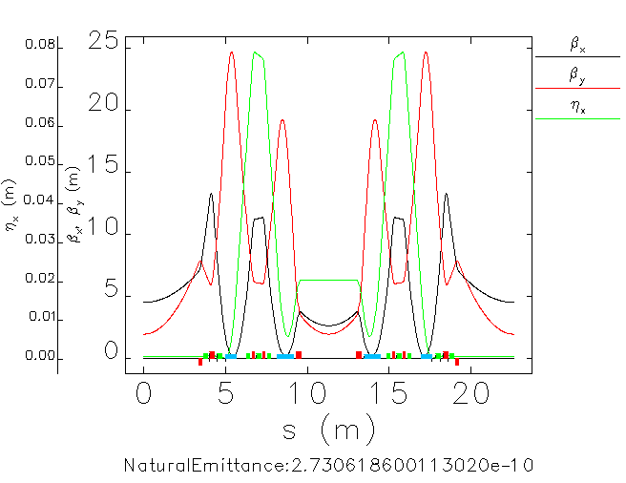
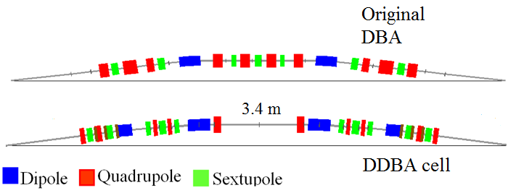
Diamond Lattice Evolution
The DDBA lattice combines the idea of doubling the capacity of the ring with the low emittance.
The Diamond Board approved the project to replace the existing cell2 with a DDBA cell (270 pm), PRAB, 21, 050701 (20148).

Slide 10
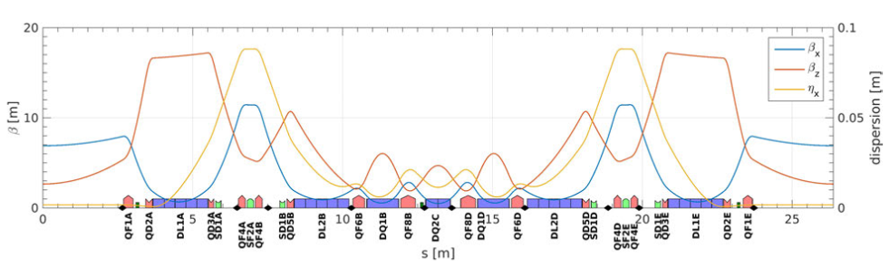
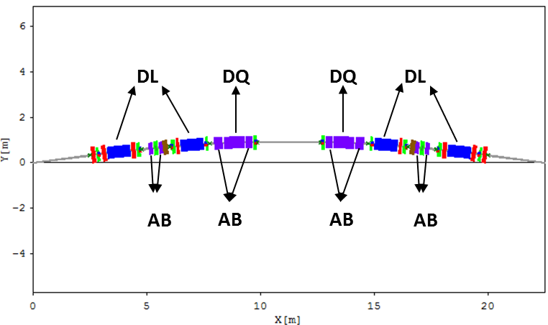
Diamond Lattice Evolution
A more aggressive design has been proposed that merges the ESRF HMBA concept with the Diamond DDBA and taking the best of both.
Use the ESRF cell (7BA with longitudinal gradient dipoles) – removing the mid dipole to make it a 6BA with a straight at the center.
After Diamond-II machine advisory meeting, it’s proposed to use Anti-bend concept in the lattice design to improve performance of the ring.
P. Raimondi, IPAC17, Denmark
ESRF HMBA lattice
Modified-Hybrid 6 Bend Achromat (M-H6BA)

Slide 11
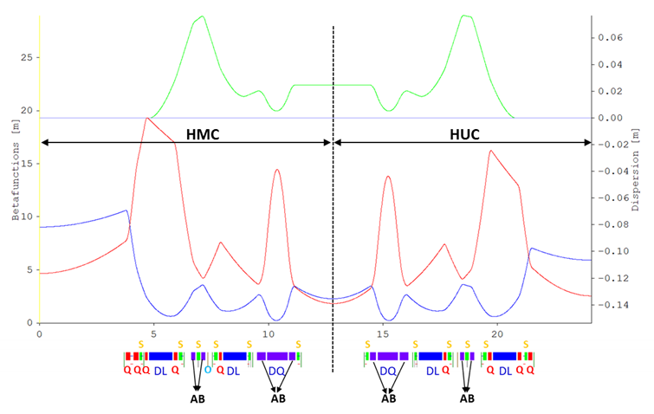
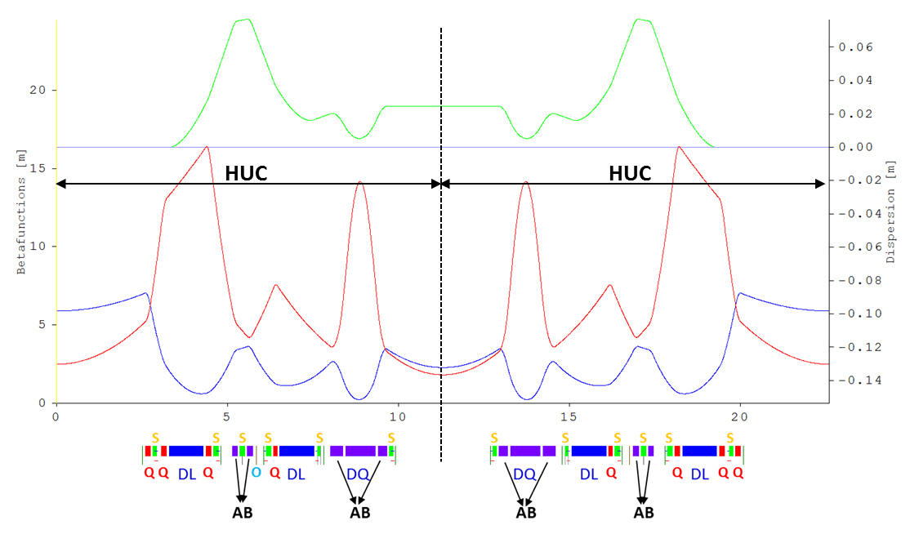
MH6BA unit cell (UC)
Phase advance conditions:
-I transformation [2.94 π, 0.94 π]
HOA condition up to third order (Driving terms cancelation after 8 cells [2 super periods])
Cell tune [2.25,0.8125]
In half a unit cell (HUC);
2 DL (Longitudinal variable dipole)
1 DQ (Transverse gradient dipole)
4 QUADs (there will be 5 QUAD in HMC)
6 SEXTs (3 chromatic and 3 harmonic)
1 OCT
5 HV COR in HUC – as winding inside sexts. 6 HV COR in HMC – 5 as additional winding inside sextupoles + one individual corrector (8 cm)
5 BPM in HUC (6 BPM in HMC)

Slide 12
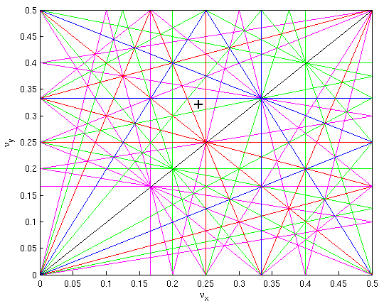
MH6BA optical functions
Parameters | Value
Energy [GeV] | 3.5
Circumference [m] | 560.61744
No. of super-periods | 6
Tune | 54.24/19.324
chromaticity | -68.8/-88.1
emittance[pm] | 146.3
Mom. Comp. | 1.01E-04
Energy spread | 9.41E-4
Length SS [m] | 7.544/2.919/5.195
Percentage [%] | 37.25
βx/βy/ηx[m/m/cm]
LSS | 9.04/4.75/0
MSS | 2.27/1.8/2.47
SSS | 5.9/2.5/0
Max. | 10.6/19.3/7.68

Slide 13
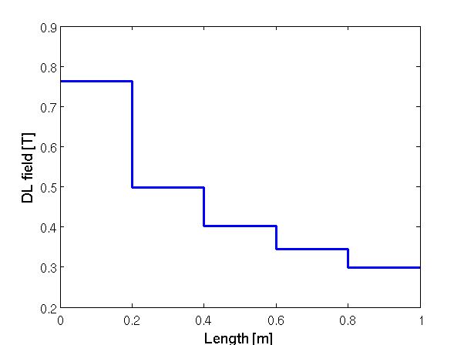
MH6BA magnets
DQ
Length [cm] | Field [T] | K [m⁻²] | Gradient [T/m]
87 | 0.788 | -2.77 | -32.32
DL
100 | 0.762 - 0.3 | 0 | 0
Quadrupole [R=12 mm] Max. [B_{pole}=1.1 T, K=91.6 m⁻², G=1069.4 T/m]
Length [cm] | K [m⁻²] | Gradient [T/m]
15 | 6.214866 | 72.507
15 | -4.400655 | -51.341
15 | -4.526322 | -52.807
10.5 | -5.610155 | -65.452
15 | -3.318948 | -38.721
10.5 | -3.352098 | -39.108
18.5 | -2.245415 | -26.197
18.5 | 4.804293 | 56.050
Sextupole [R=12 mm] Max. [B_{pole}=0.7 T, M=833 m⁻³, Str.=9720 T/m²]
Length [cm] | M [m⁻³] | Str. [T/m²]
14 | -547.3386 | -6385.64
14 | -441.6454 | -5152.55
14 | 766.0491 | 8937.27
10 | 56 | 653.34
10 | -80 | -933.34
10 | -76 | -886.67
Octupole [R=12 mm] Max. [B_{pole}=40 mT, M=9428 m⁻⁴, Str.=110000 T/m³]
Length [cm] | M [m⁻⁴] | Str. [T/m³]
9 | 0 | 0
Anti-bend [R=12 mm] [Max. B_{pole}=1.1 T, K=91.6 m⁻², G=1069.4 T/m]
Length [cm] | K [m⁻²] | Gradient [T/m] | Offset [mm]
15 | 4.914322 | 57.334 | 2.368
15 | 5.774658 | 67.371 | 2.015
15 | 3.756881 | 43.830 | 3.097
25 | 7.345607 | 85.699 | 0.950
36 | 5.959634 | 69.529 | 0.814
In total
144 Dipole [96 DL, 48 DQ]
204 Quad
192 Anti-bend
288 Sext.
252 BPM
252 HV COR (240 inside Sext. & 12 individual)

Slide 14
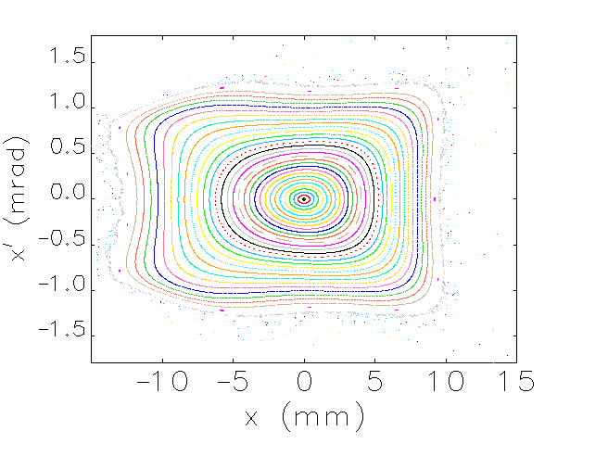
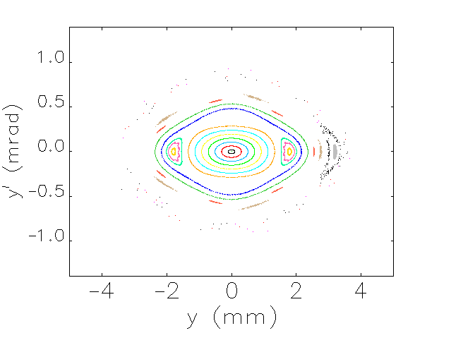
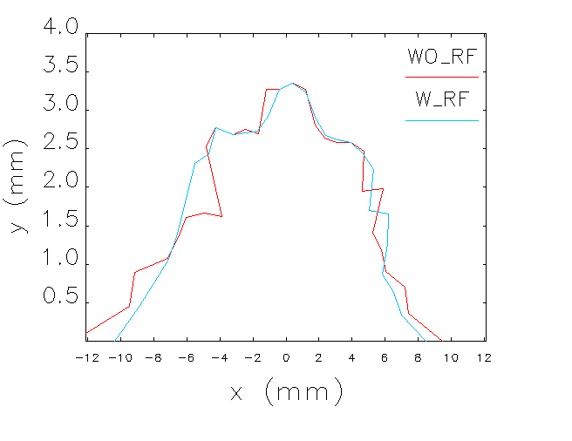
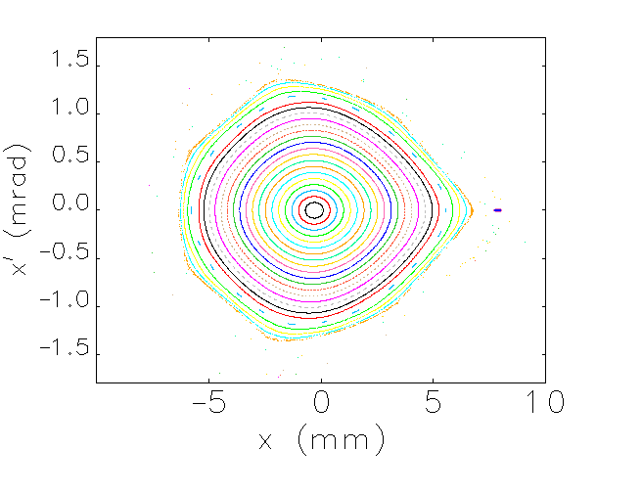
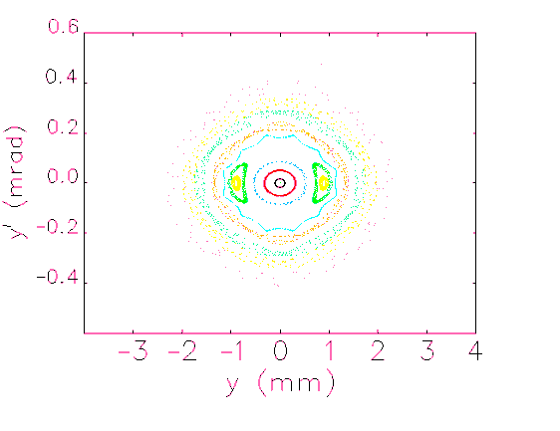
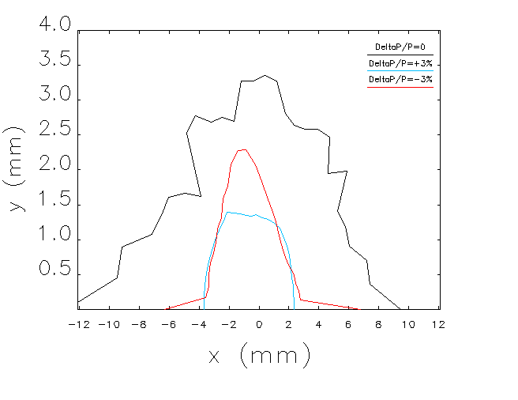
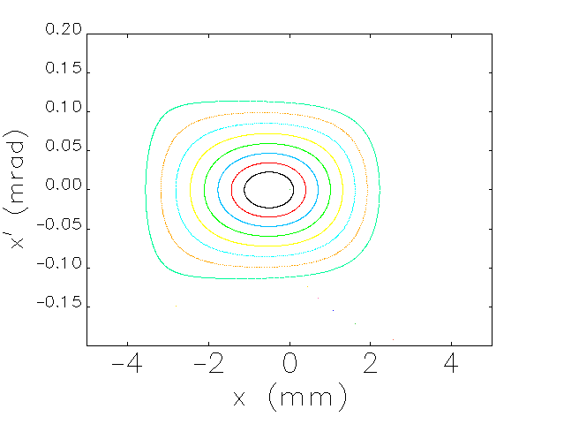
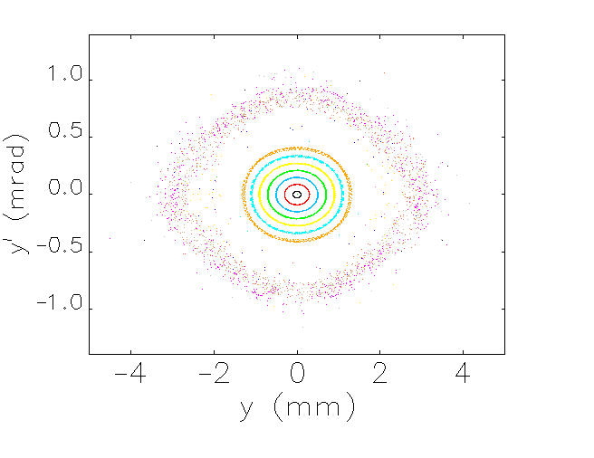
NLBD - DA
Natural chromaticity is corrected to 2.35/2.25.
Particle tracking has been done for 2500 turns through the ring.
VRF=1.50 MV
RF acc.= 3.0914 %
  Bunch length= 3.61 mm
On energy
Off energy, -3%
Off energy, +3%

Slide 15
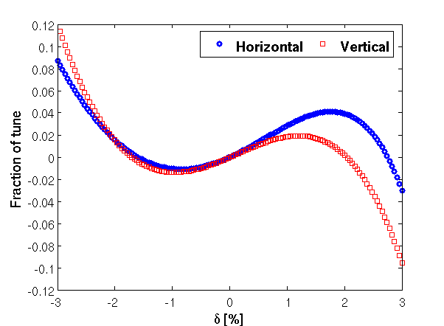
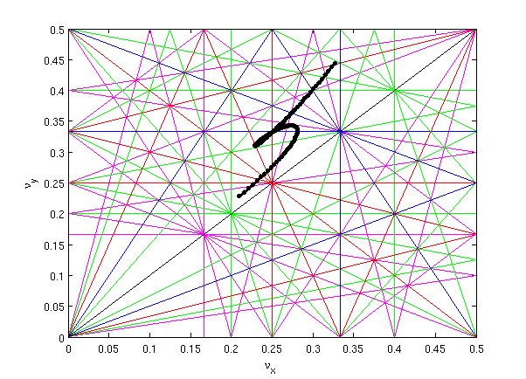
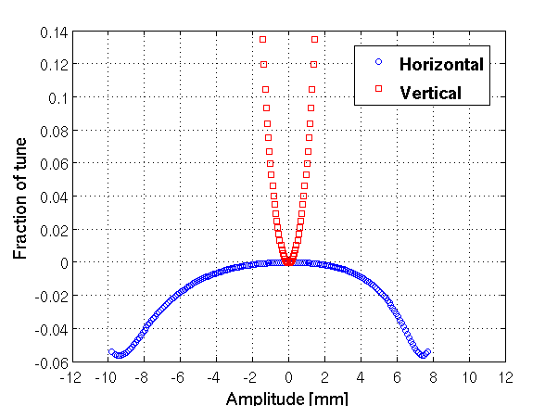
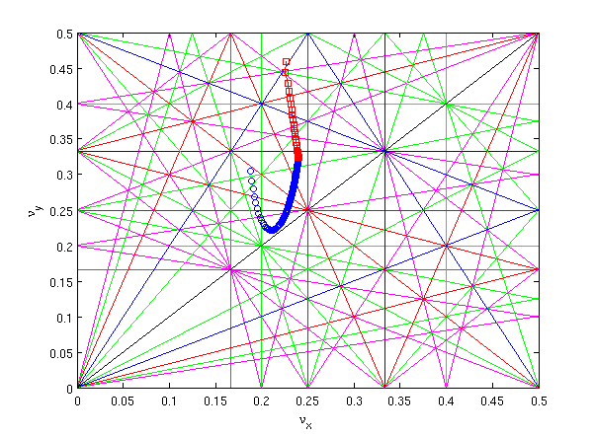
NLBD – Tune shift

Slide 16
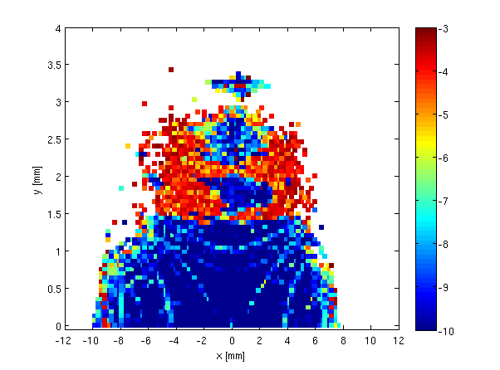
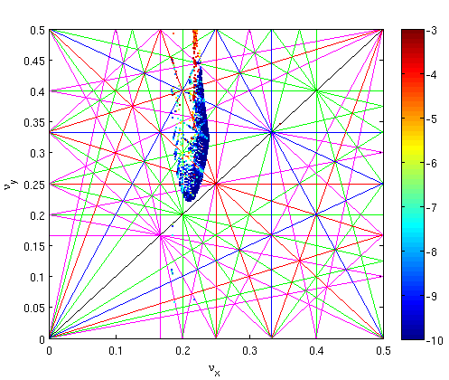
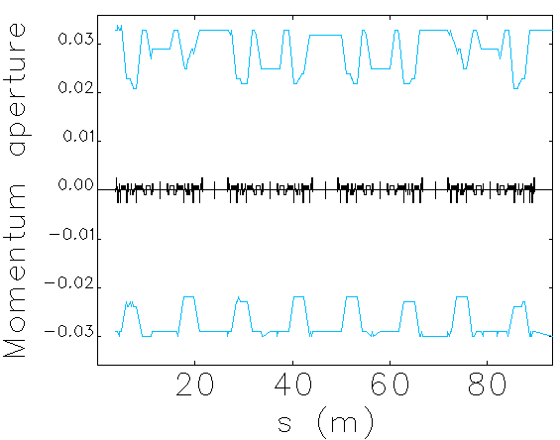
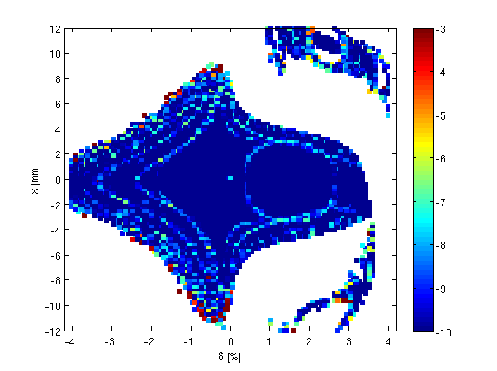
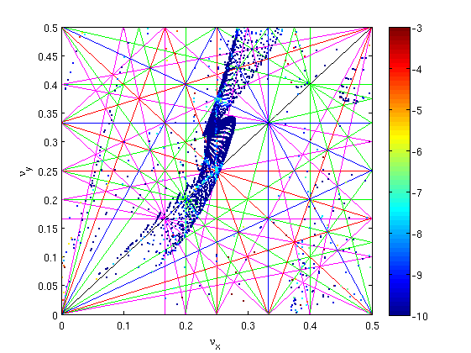
DA, FMA, Mom_AP, T_lifetime
VRF=1.50 MV
h=934
Charge/bunch=0.6 nC
Vertical emittance= 8 pm
No. of turns= 2500
RF acc.= 3.0914 %
  Bunch length= 3.61 mm
  tLifetime = 2.7 h

Slide 17
ERRORS
The error analysis has been split in two parts:
Reduced errors are used to quickly check the robustness of the lattice optimisation.
Parameter | Value [Gaussian Dist. @ 2σ cut off]
Dipole misalignment / roll [μm /μrad] | 15/100
Quad., Sext., Oct. misalignment /roll [μm /μrad] | 15/100
BPM misalignment /roll [μm /μrad] | 5/10
Dipole/Quad./Sext./Oct. fractional strength error | 10^{–4}/10^{–3}/10^{–3}/10^{–3}
I stress that the reduced error table is meant to provide only a first and fast check on the robustness of the optimisation, without the full simulation of the commissioning procedure.
Relatively large initial errors (real errors) are used to simulate the commissioning strategy replicating in detail the exact commissioning steps.
Parameter | Value [Gaussian Dist. @ 2σ cut off]
Girder misalignment /roll [μm /μrad] | 150/150
Dipole misalignment / roll within girder [μm /μrad] | 50/100
Quad., Sext., Oct. misalignment /roll within girder [μm /μrad] | 25/100
BPM misalignment /roll within girder [μm /μrad] | 100/100
Dipole/Quad./Sext./Oct. fractional strength error | 5⋅10^{–4}/10^{–3}/10^{–3}/10^{–3}
The reduced error table has been benched marked with large error table in 4D phase space.
In the next slides, only simplified errors have been considered.
Systematic and random multipoles of the magnets have been considered.

Slide 18
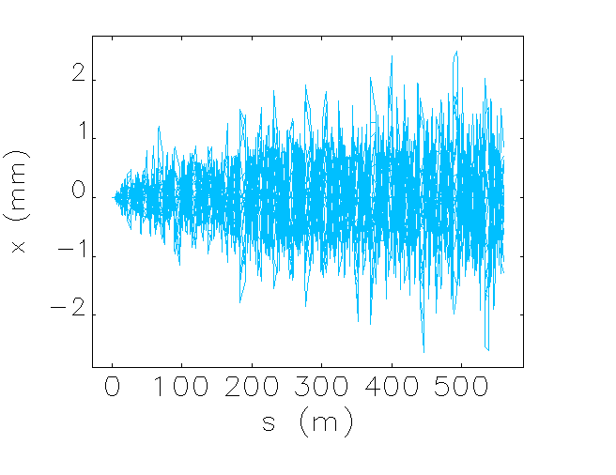
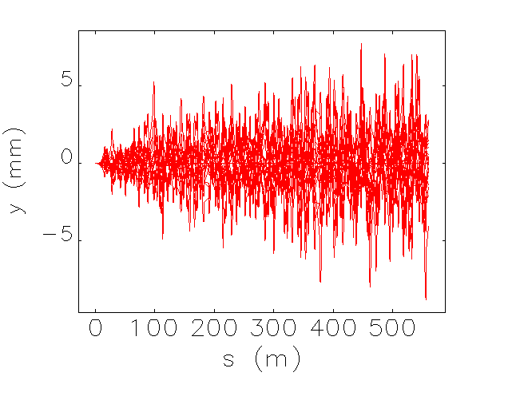
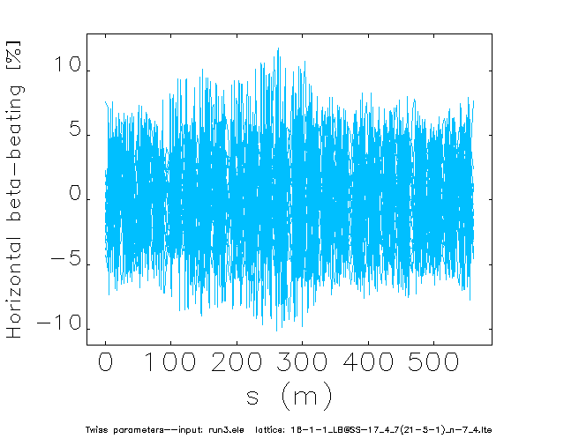
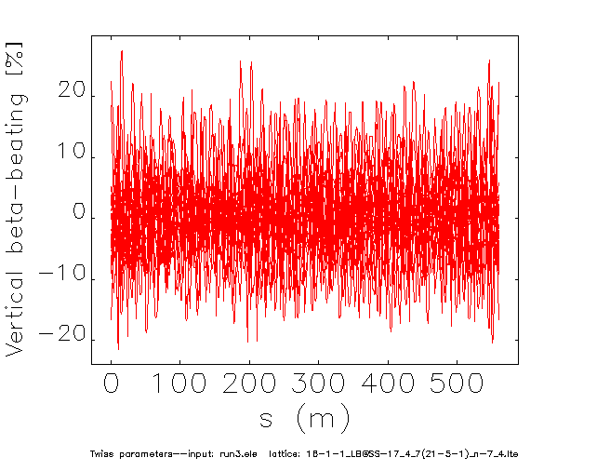
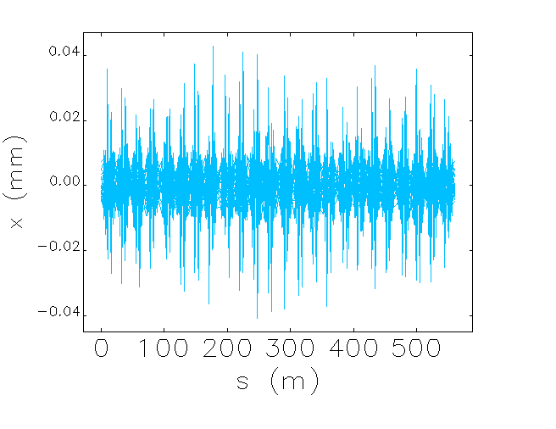
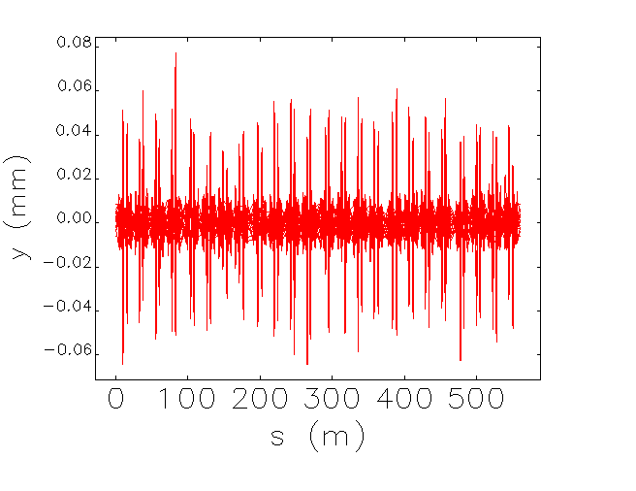
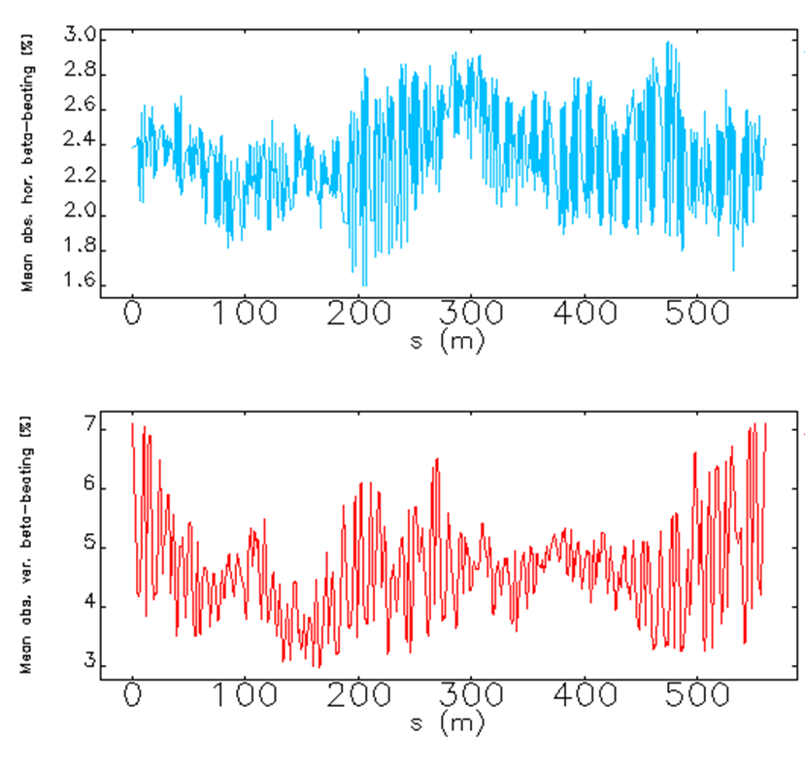
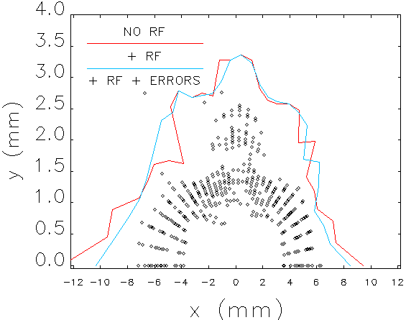
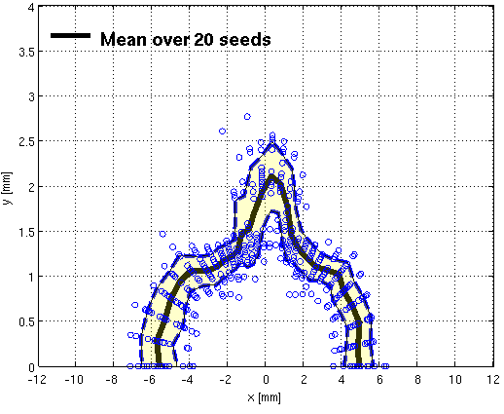
Reduced ERRORS - DA
The reduced errors have been imposed randomly for 20 seeds.
Trajectory correction (sextupoles have been switched off.)
Orbit, tune and chromaticity corrections (sextupoles have been switched on)
Corrected trajectory
Corrected orbit

Slide 19
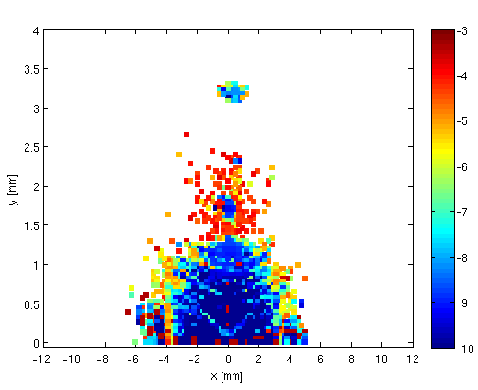




DA, FMA, Mom_AP, T_lifetime + ERRORS
VRF=1.50 MV
h=934
Charge/bunch=0.6 nC
Vertical emittance= 8 pm
No. of turns= 2500
RF acc.= 3.0914 %
  Bunch length= 3.61 mm
  MaxtLifetime (hour) = 2.55
  MintLifetime (hour) = 1.30
  AveragetLifetime (hour) = 1.94

Slide 20








IBS + HC
Natural horizontal emittance (εx0) has been scanned from 25 pm rad to 300 pm.
Effect of harmonic cavity (HC) is included by multiplication of natural bunch length by a factor 4.
Vertical emittance is kept constant at 8 pm rad during the simulation and changes of horizontal emittance due to IBS and HC is compensated by the coupling factor.

Slide 21


T_lifetime + IBS + HC + ERRORS

Slide 22




IDs
Total No. of IDs for Diamond-II : 40 ( 16 @ MSS and 24 @ LSS & SSS)
CAV. Will be replaced with new I17 beam line.
Five MSS will be occupied with RF and H cavities.
Five Brand new IDs (K03, K10, K12, K13, K19) will be added.
Maximum possible IDs: 43
IDs | Emittance |  | Energy Spread
 | pm rad | % | *E-4 | %
Bare Lattice | 146.3 | - | 9.417 | -
Bare + 3 TPW (K18, K22, K23) | 148.98 | +1.8 | 9.372 | -0.48
Bare + I12 + I15 | 129.48 | -11.5 | 12.31 | +30.7
Bare + I12 + I15 (After alpha matching) | 129.69 | -11.3 | 12.31 | +30.7
Bare + 3 TPW(K18, K22, K23) + 12 IDs @ MSS | 194.14 | +32.7 | 9.356 | -0.65
Bare + 3 TPW(K18,K22,K23) + 24 IDs @ LSS & SSS | 102.50 | -29.9 | 11.05 | +17.3
Bare + 3 TPW(K18,K22,K23) + 24 IDs @ LSS & SSS + 12 IDs @ MSS | 137.68 | -5.9 | 10.792 | +14.6
Beta-beating has not been corrected.
Effects of IDs gaps have been considered.

Slide 23






IDs (I12 + I15)
Alpha matching: Two nearest quads at each side of IDs have been used for alpha matching.
Tune and chromaticity have been corrected as well.

Slide 24
Summary & Conclusion
  Diamond Status
    Operation: achieving the target > 72 h MTBF for the last 5 years, but still aiming to improve.
    Two booster and two NC cavities have been installed. SLED cavity has been tested and sent to the supplier for rectification.
    Four CPMUs are in production and 2 to 3 will be installed next year.
    Local fast feedback control has had successful first tests and will be further developed.
    Pinger has been successfully tested to reduce injection disturbance and is planned to be brought into routine operation.
  Diamond upgrade
    Diamond-II CDR machine design meets the expectation of users, but further improvements are being sought before freezing the design.
    DA with errors is ±5 mm in horizontal and ±1.5 mm in vertical direction (in average for 20 seeds of errors) and off axis injection looks feasible. Momentum aperture at most of the straight sections is ±3% and in the arcs is ±1.7%.
    Real Touschek lifetime is 1.94 h in average for 20 seeds of errors. In the best case, it can be improved to 8.5 h with use of harmonic cavity.
    Effects of IDs have been studies and the results show that the DA is still ±5 mm in horizontal and ±1.5 mm in vertical direction after alpha matching.

Slide 25

Thank you for your attention!

