Slide 1
Elettra Status and upgrades Emanuel Karantzoulis on behalf of the Elettra group
Outline:
Introduction
Elettra status and statistics
Short term developments
Next upgrade: Elettra 2.0
Notes:
Slide 2: Title of the Presentation
Before you start editing the slides of your talk change to the Master Slide view:
Microsoft Office :Menu: View > Slide Master;
Macintosh – View > Master > Slide Master
Edit the following items:
On the Slide Master (first master slide) – lower area
a) On the left Delete the text and write the title of the event/Conference, Location
b) On the right delete the text and write the name and surname of the speaker and the date (day, month , year)
Close Master View
To start adding slides insert a new slide and select a Layout:
For Title & Subtitle
For text with bullet points
For Text
For Picture, graphs, visuals
Two columns
Blank

Slide 2
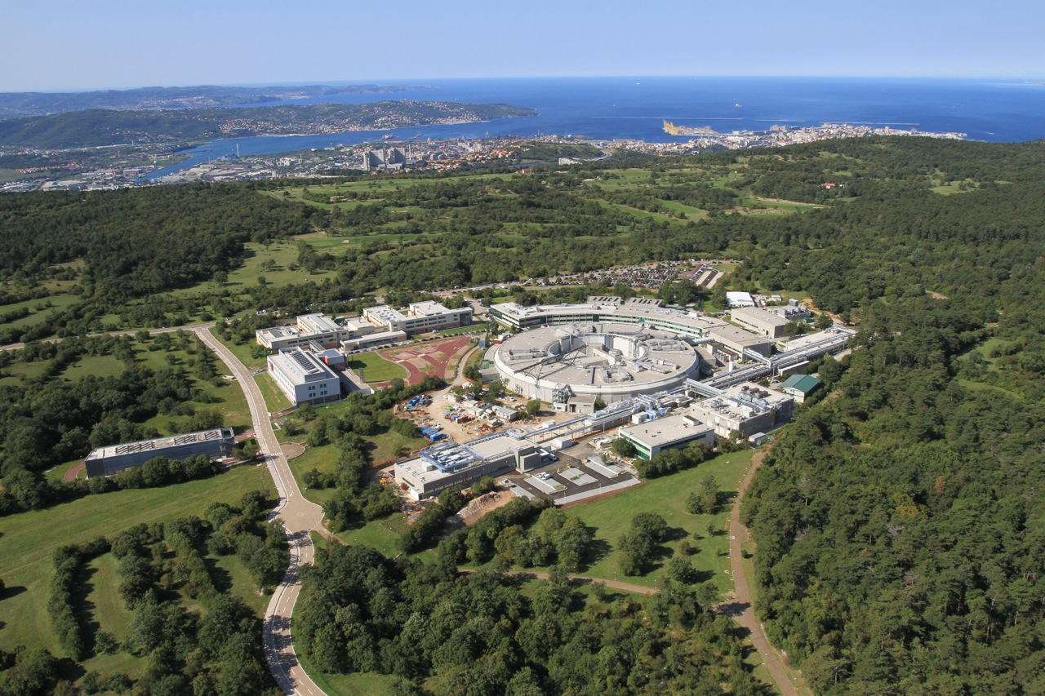
Elettra - Sincrotrone Trieste, Italy: 2 complementary Light Sources
FERMI: seeded FEL (4-20-100 nm ) open to users since 2012 (FEL1) and 2015 (FEL2)
Elettra: open to users since 1994
Notes:
Slide 3 – (..) : Content of the presentation
Insert a new slide: Home > “New Slide” and choose a slide Layout:
For Title & Subtitle
For text with bullet points
For Text
For Picture, graphs, visuals
Two columns
Blank
If you want Copy & paste an element from the Clip Board to the particular slide: 1. Click on a box to mark it.
2. Position the mouse pointer on the box frame: Copy! 3. Click on the particular slide: Paste!
How you intend to use the elements is your choice. You can combine the text block style with the background colour in different manner.

Slide 3
FERMI FELs: FEL-1 & FEL-2
Ref. E. Alaria
FEL-1: single stage HGHG seeded by a UV laser, covers the range 100 nm – 20 nm.
FEL-2: double cascade HGHG to reach the wavelength 20 nm – 4 nm.
FEL-1 (Nat. Photon. 6, 699 (2012))
Tuning range | 100-20 nm (12-60eV)
Relative bandwidth | 1X10⁻³ (FWHM)
Pulse length | <100 fs
Pulse energy | 20-100 μJ
FEL-2 (Nat. Photon. 7, 913 (2013), Journal of Synchrotron Radiation 22 (2015))
Tuning range | 20⁻⁴ nm (60-300eV)
Relative bandwidth | 1X10⁻³ (FWHM)
Pulse length | ~50 fs
Pulse energy | 10-70μJ
Both FELs have APPLE-II undulators in the final radiator allowing polarization control.

Slide 4
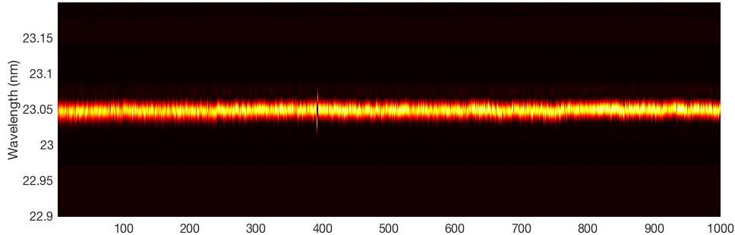
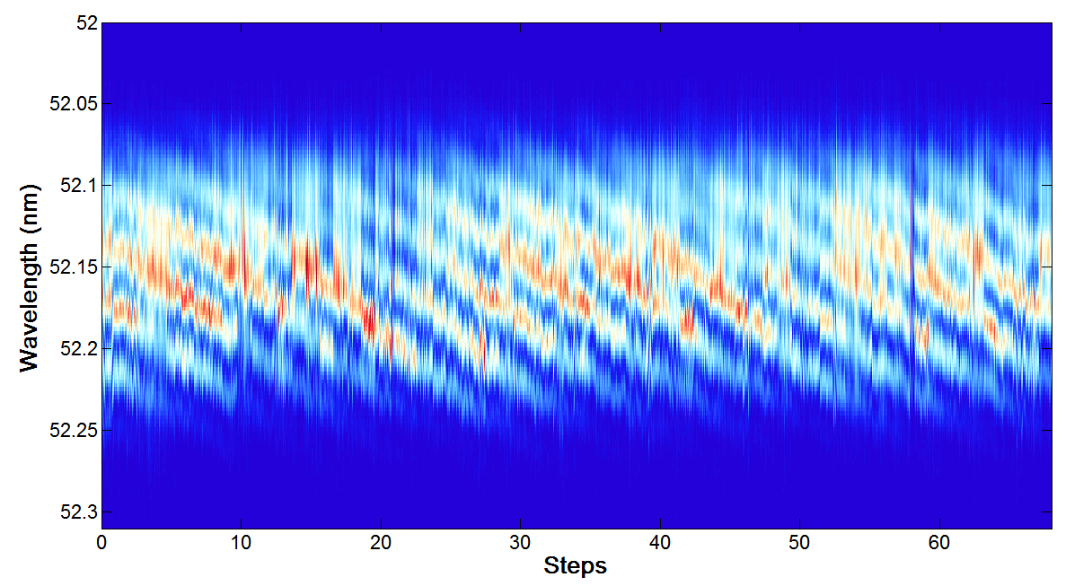
FEL coherent pulses
FEL-1 – H13
Thanks to the seeding, FERMI produces FEL pulses highly coherent with relative bandwidth down to few 10⁻⁴.
Power, temporal and spectral stability also benefit from seeding.
Twin seed pulses
Twin FEL pulses
Laser pulse
τ
Dispersive section
modulator
radiator
τ
spectrometer
e⁻ beam
D. Gauthier et al., Phys. Rev. Lett. 116, 024801 (2016)
µ-controled
birefringent plate
to beamlines
Interferogram
Experiments exploiting the FEL coherence have recently started using special FEL configuration with phase locked 2 color or 2 pulses.
Interference between two coherent and phase-locked pulses is evident in the spectral domain.
D. Gauthier et al., Phys. Rev. Lett. 116, 024801 (2016)
ΔΦ_{FEL} = 2π
Δϕ_{SEED} (a.u.)
Notes:
similar spectral quality can be obtained, with limitations mainly depending on the optical properties of the mirrors transporting the seed to the undulator

Slide 5
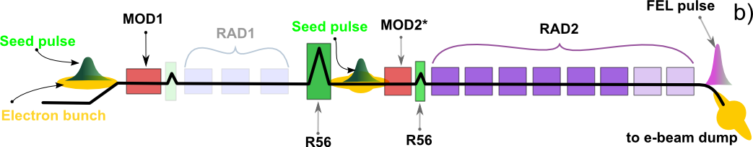
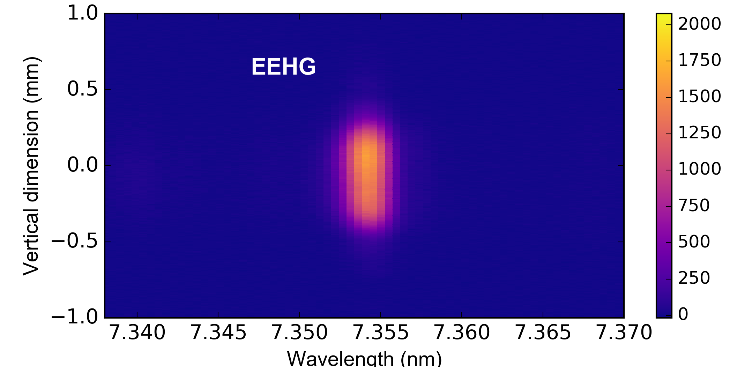
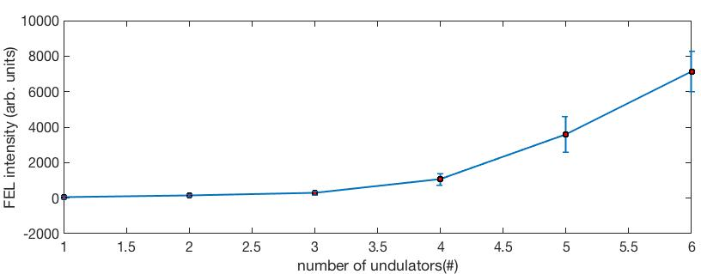
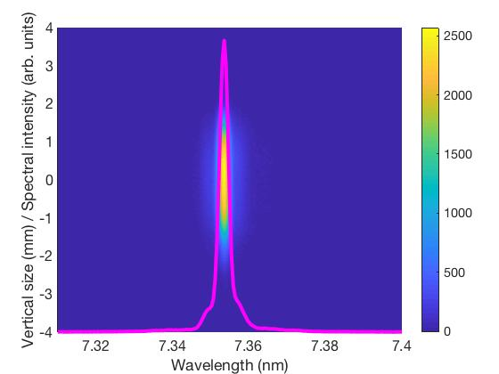
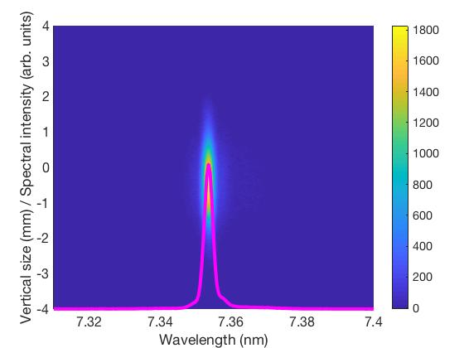
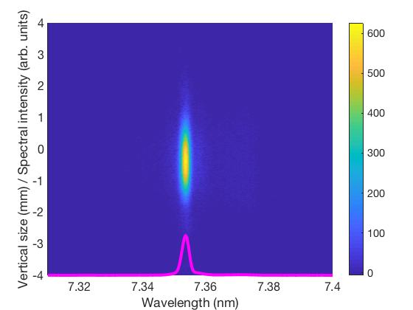
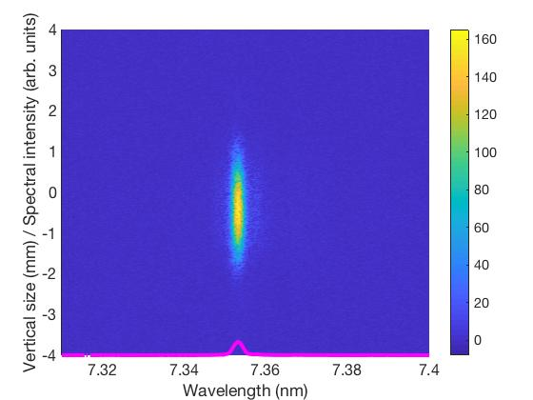
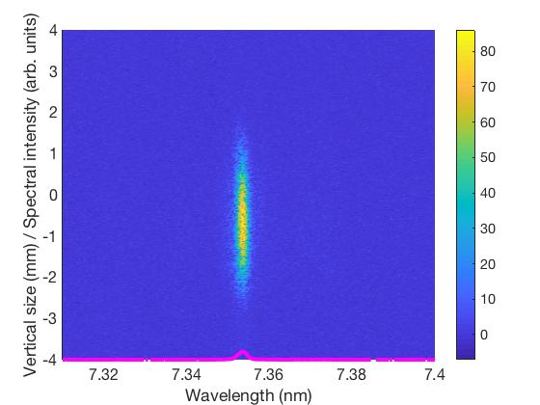
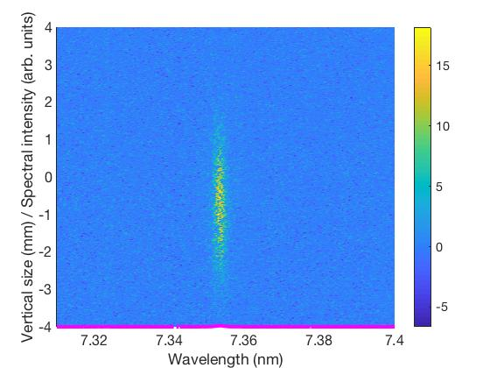
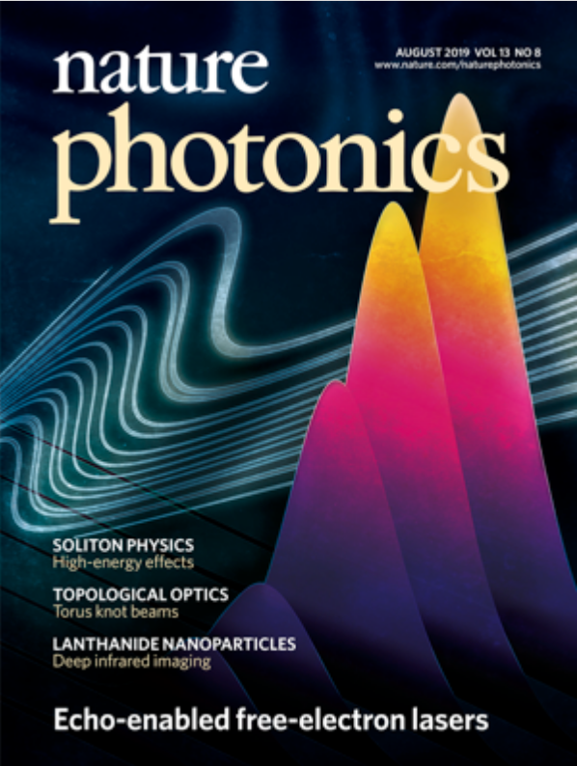
Demonstration of EEHG with FEL-2
With EEHG we have seen improvements in the FEL bandwidth down to the soft x-ray.
A clear FEL gain has been measured at 7 nm and 5 nm with EEHG
We had clear evidence of coherent emission at harmonic 101 (2.6nm)
Nature Photonics 13, 555 (2019)

Slide 6
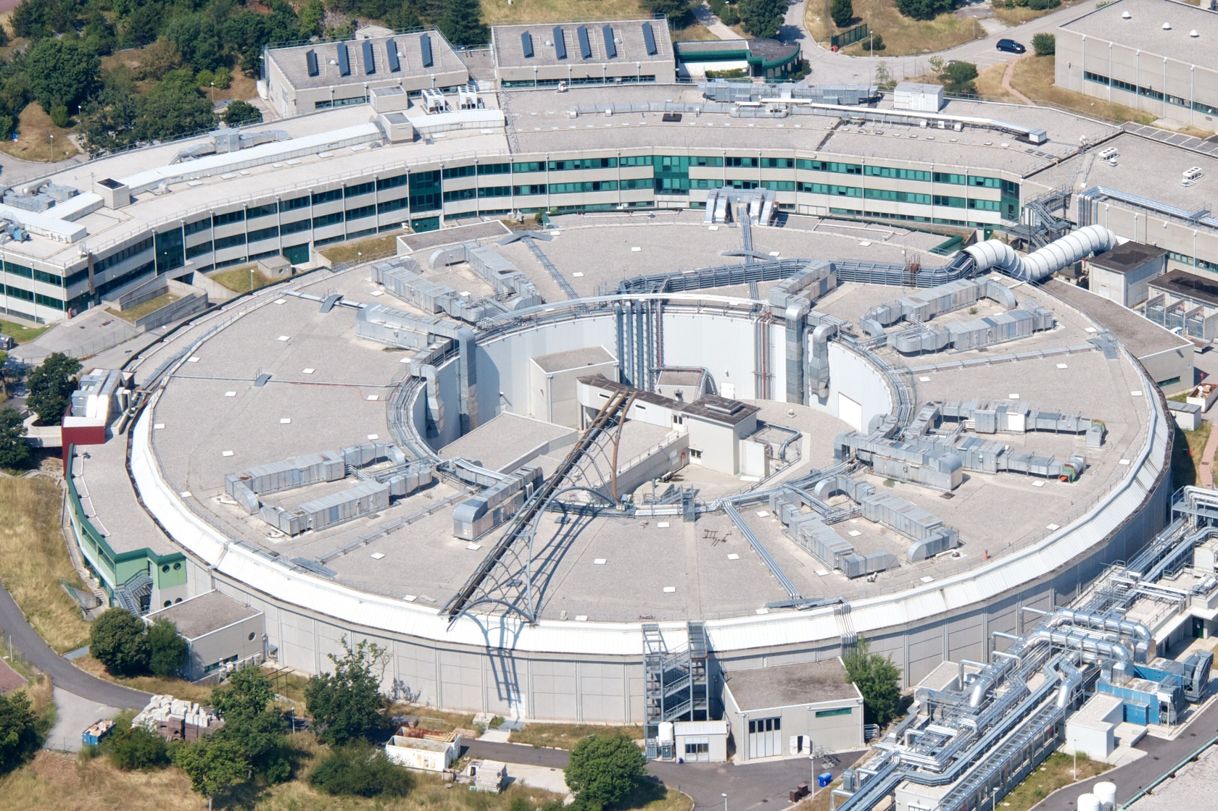
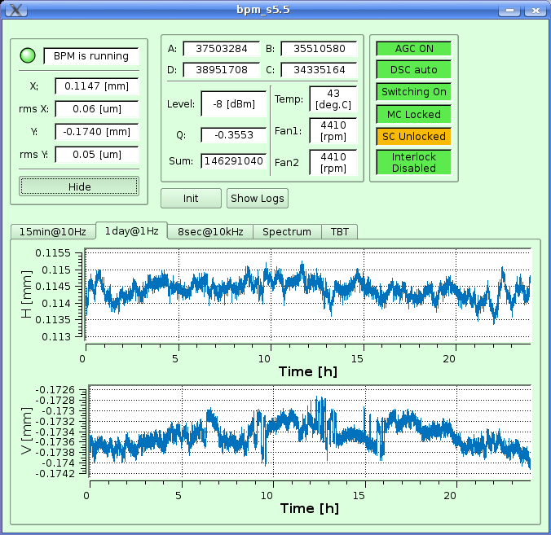
Elettra
Third generation light source (DBA lattice, 12 fold symmetry ) , commissioned in October 1993 and open to external users since 1994. First 3rd generation in Europe for “soft” x-rays (now also hard)
Operating modes for users (all in top-up since 2010):
Operates for about 6400 hours per year (24h, 7/7 ), 5016 hours reserved for users in 2 energies:
2.0 GeV, 7 nmrad, 310 mA for 75 % of users time
2.4 GeV, 10 nmrad, 160 mA for 25 % of users time
27 operating beam lines – over 1000 user and user poposals / year
Filling patterns: multi-bunch 95 % filling or hybrid, single bunch, few bunches or other multi-bunch fillings
Linac + Booster (114 m)
Electron orbit stability requirements met most of the time provided that ambient temperature is within the defined limits, i.e., ± 0.5⁰C
Short term stability (< 24 hours) is < 10% of the electron beam size.
Long term (>24 h) is ≤ ± 5 μm ptp (max value for >120 h).
Storage Ring (259 m)
H: 1.6 um V: 1 um

Slide 7
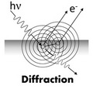
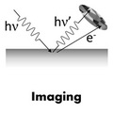
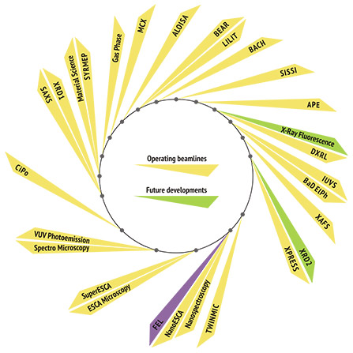
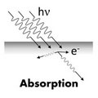
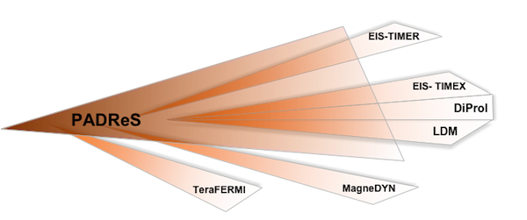
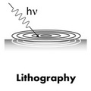
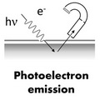
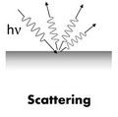
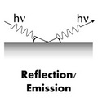
Beam lines 27+1 (+ 6 FERMI)

Slide 9
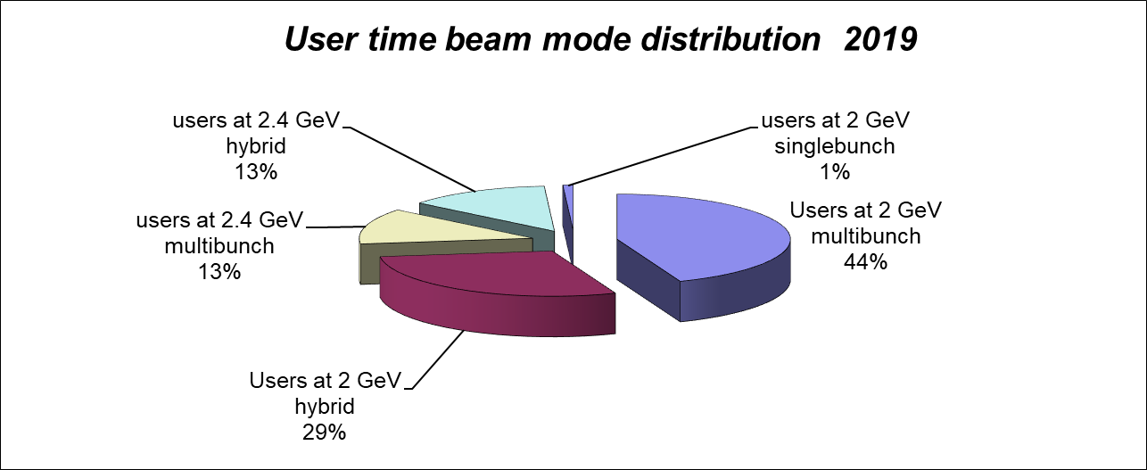
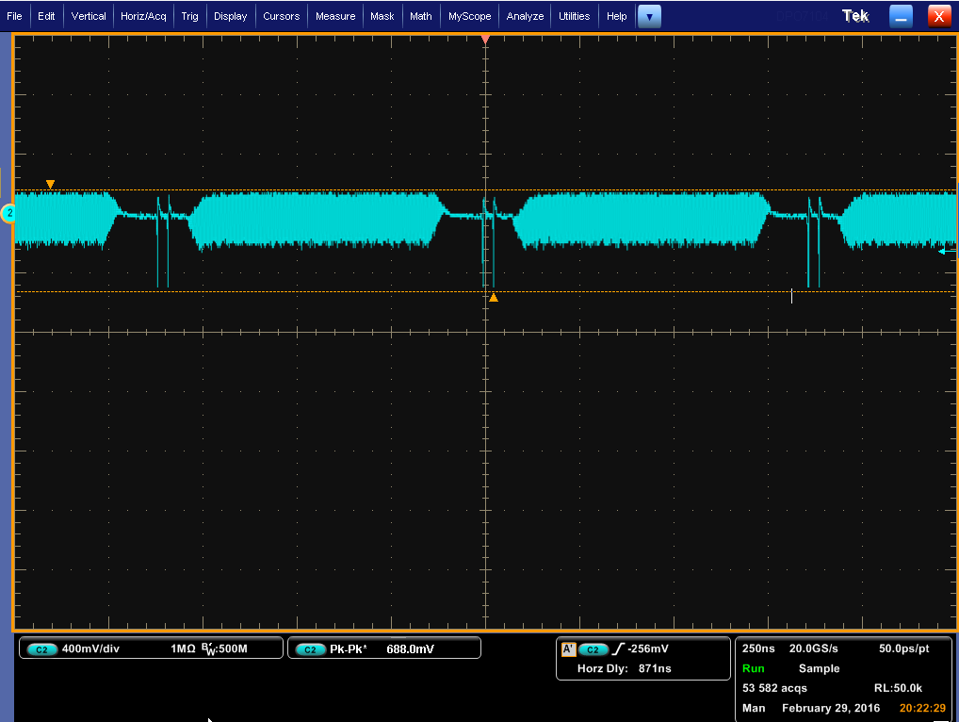
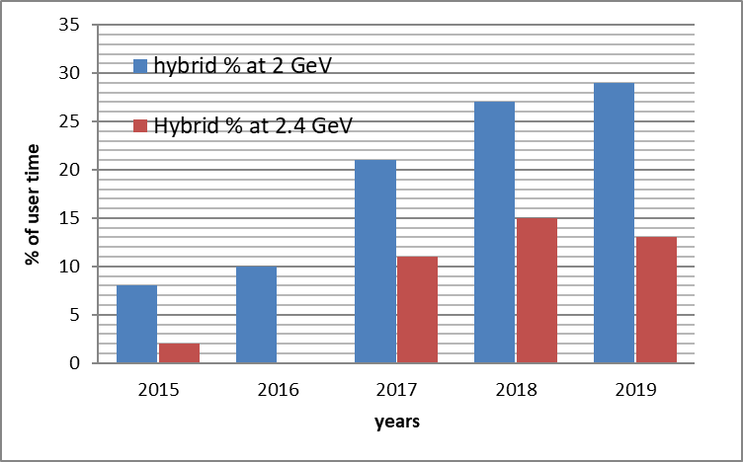
User time distribution
Increased interest for time resolved

Slide 10
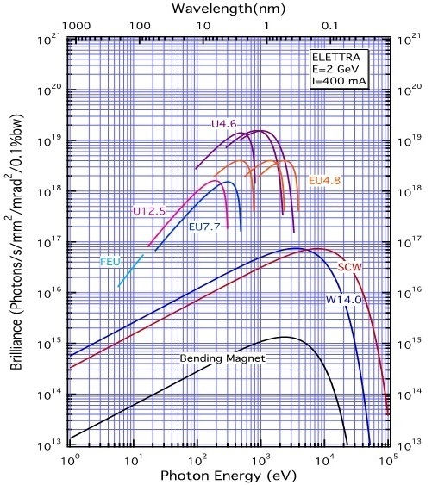
IDs and brilliance
21 ID PM segments + 1 SCW + 1 EM -> 19 beam lines: planar, elliptical, canted, electromagnetic, superconducting
6 bending magnet source points serving 9 beam lines

Slide 11
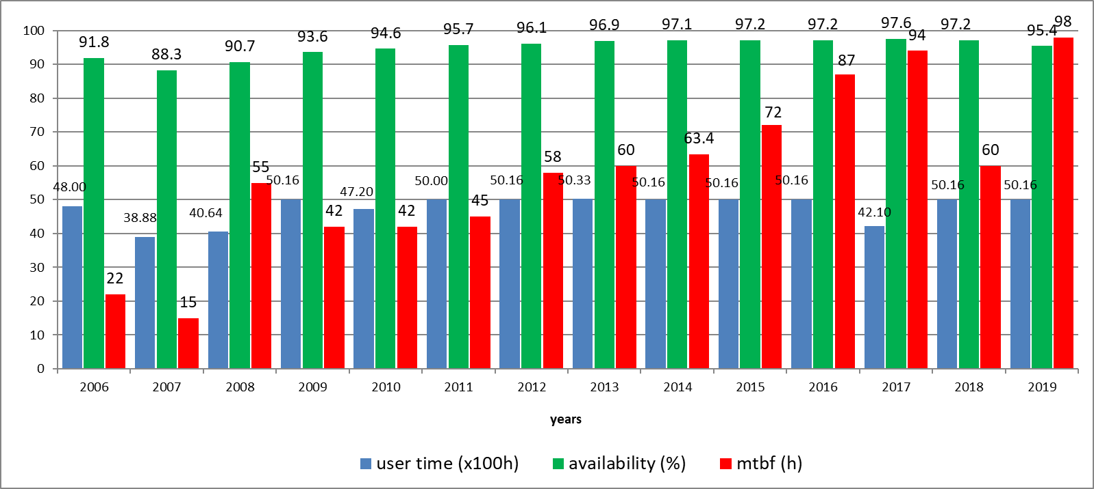
Uptime Statistics
Statistics of 2019 at 90% of the total user time
No downtime due to the injectors

Slide 12
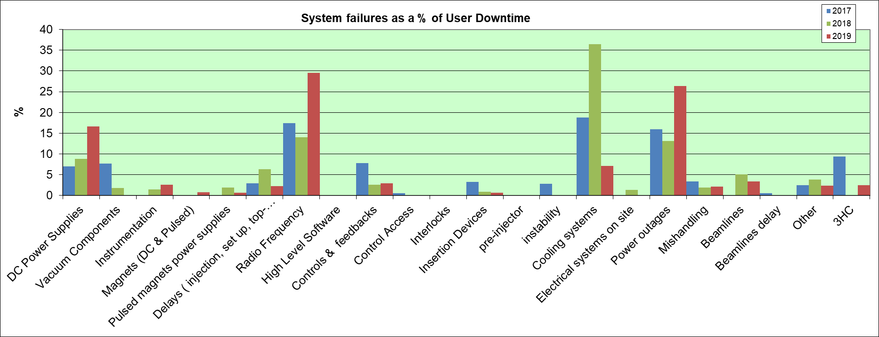
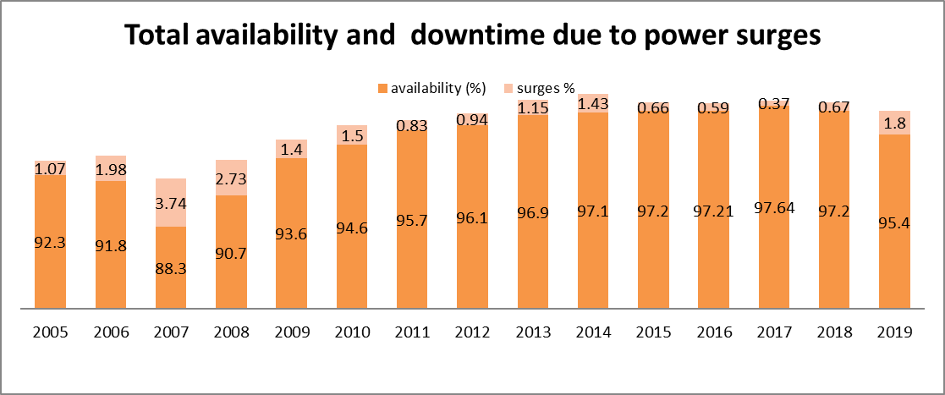
System failures

Slide 13
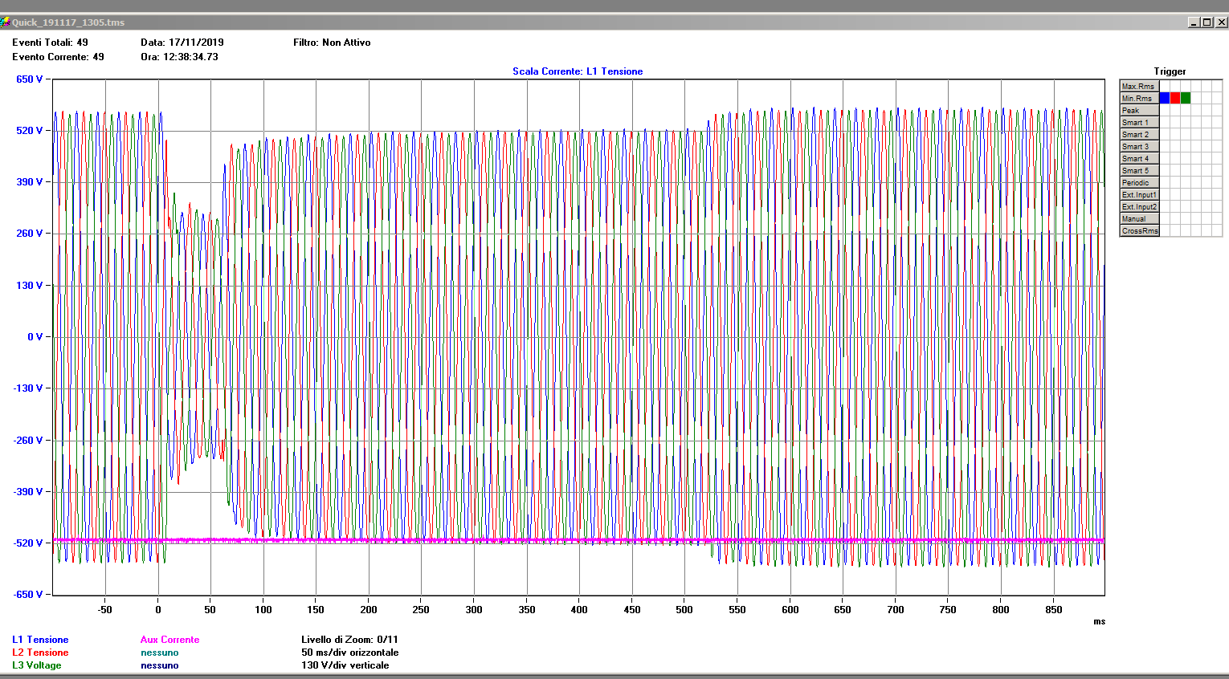
Electrical surges or interruptions list during August 2019 from the Electricity company. It is the first time that we have experienced such a situation...and it din’t stop in August..

Slide 14
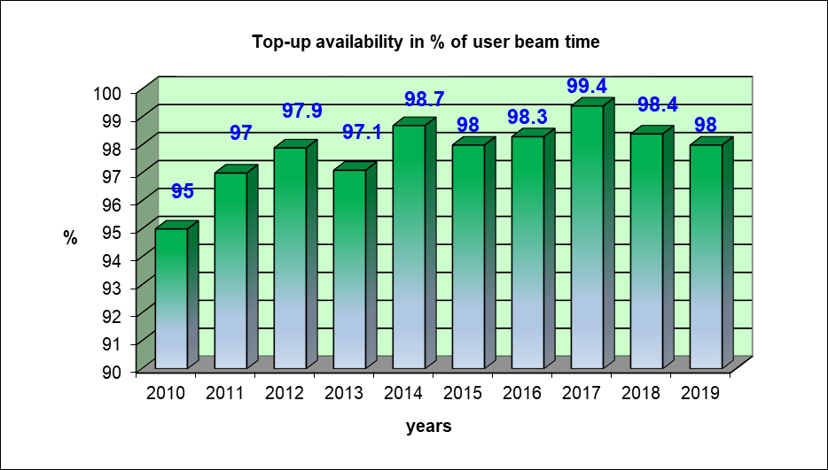
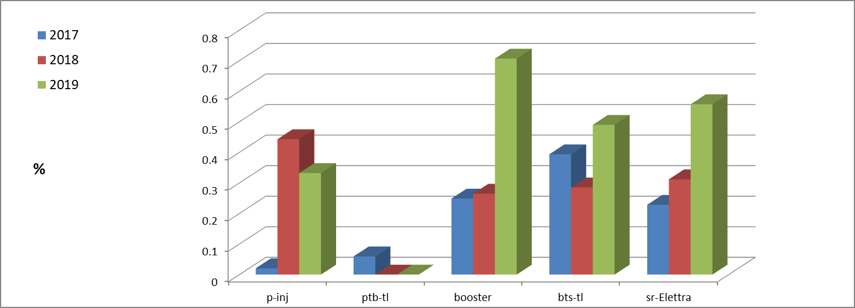
Top-up statistics
During top-up systems run well and the top-up % of user beam-time is high. The remaining ≤2% is due to failures that, however, do not impact on the availability.
Distribution of Topup failures in % of user beam time due to various parts of the Accel. complex

Slide 15
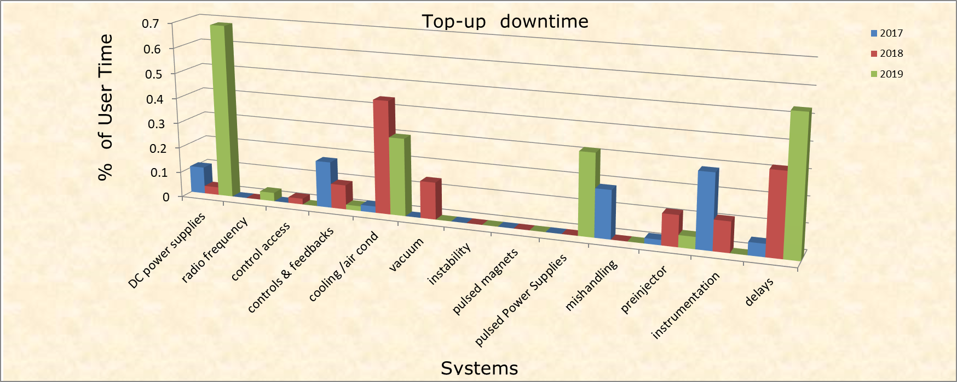
Top-up downtime
considered when the intensity is less than 99.5% of the nominal
Note: the failures here are not considered as downtime, BUT they can be considered (and therefore not shown here) if the intensity goes below 50% of the nominal.

Slide 16
Present developments
Tunnel temperature stabilization -> better than ±0.5⁰C
Upgrade of the interlock system -> completed
PS-controls upgrade -> finished
RF upgrade (booster Solid State Amplifier) -> completed
Replacement of all Elettra RF amplifiers with SS-> in progress
Upgrade vacuum system electronics -> completed
TMFB upgrade -> completed
LMBF upgrade -> in progress
Build new bpm electronics (detectors) -> 8 in construction and 200 in collaboration with external company
Quench protection system -> completed, in operation
Complete realignment in parts for the past 1 1/2 years->competed
Fixed gap undulators -> the one constructed and installed in for the beam line Aloisa performs very well
A double fixed gap undulator for TwinMic in progress.
Two new undulators (MOST project) (ref: B. Diviacco)
Notes:
Slide 3 – (..) : Content of the presentation
Insert a new slide: Home > “New Slide” and choose a slide Layout:
For Title & Subtitle
For text with bullet points
For Text
For Picture, graphs, visuals
Two columns
Blank
If you want Copy & paste an element from the Clip Board to the particular slide: 1. Click on a box to mark it.
2. Position the mouse pointer on the box frame: Copy! 3. Click on the particular slide: Paste!
How you intend to use the elements is your choice. You can combine the text block style with the background colour in different manner.

Slide 17
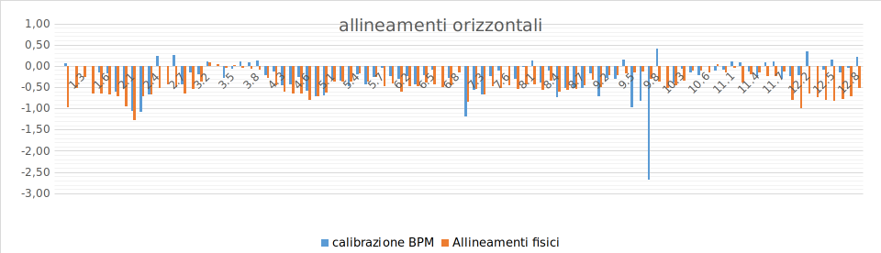
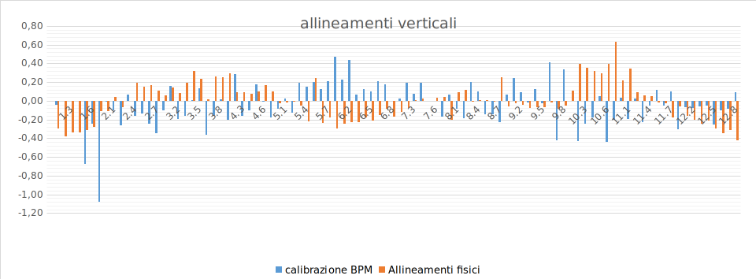
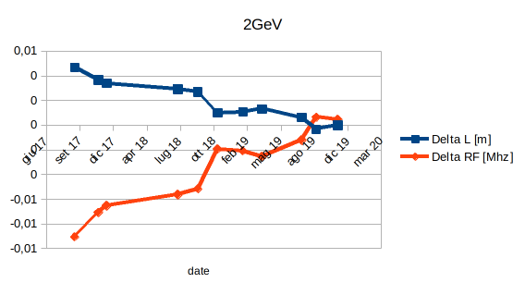
Realignment after 8 years in total DL=5 mm

Slide 18
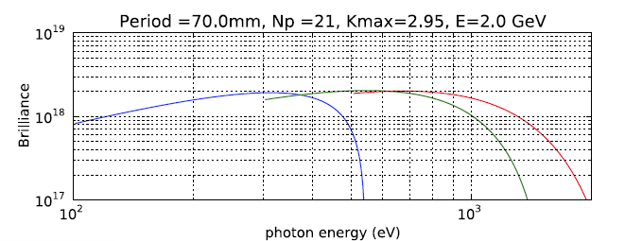
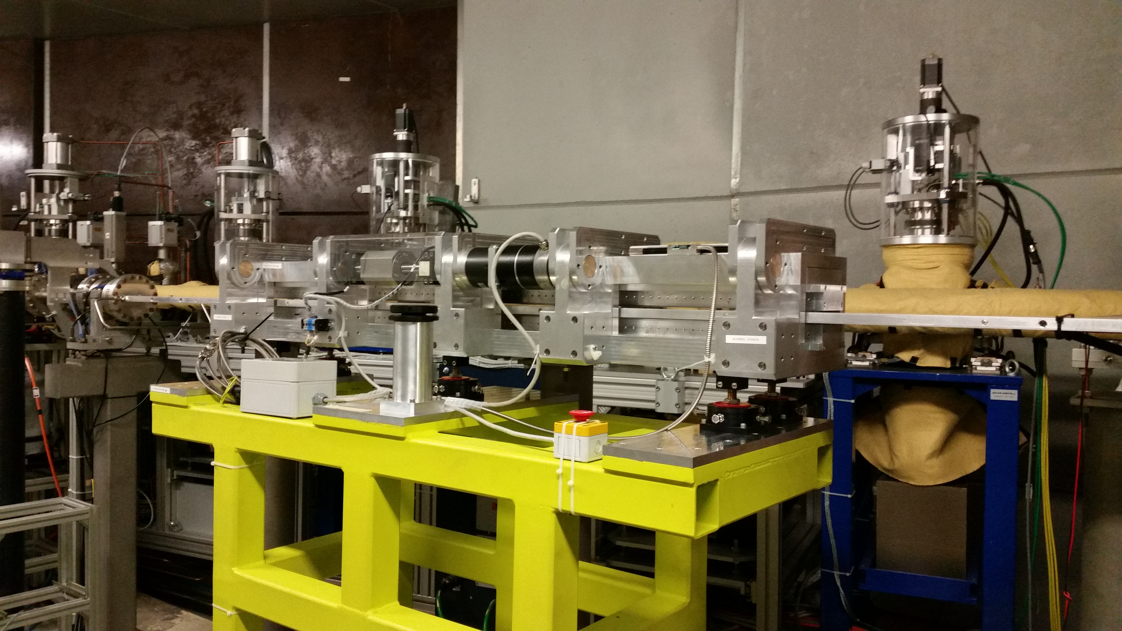
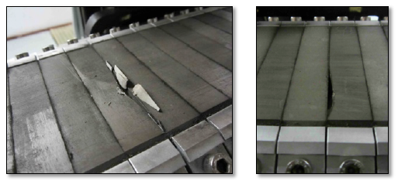
Fixed gap undulator
Installed for ALOISA beam line. Excellent performance and for operations almost “invisible”
Ref: B. Diviacco
APU
Original AGU: magnets from 1994
Material Neorem 450i uncoated

Slide 19
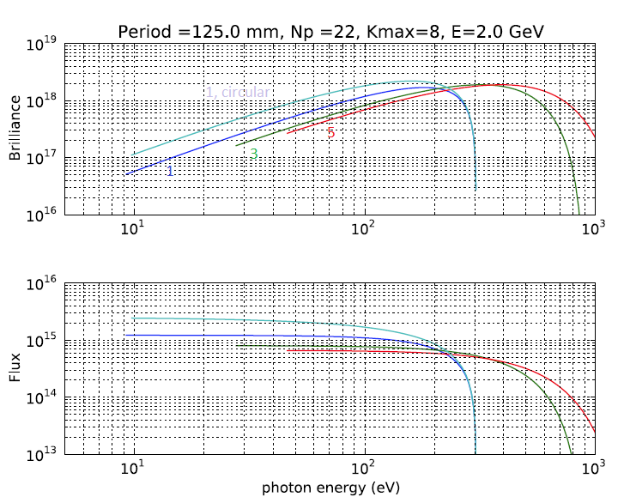

MOST Beam Line
All straight sections of Elettra are occupied but still there is demand for new insertion device based beam lines. An upgrade plan is presently being developed which will merge the experiments running on the existing GasPhase and CiPo (Circular Polarization ) beam-lines. Two new variable polarization undulators will be developed for this purpose, one for the lower (10÷200 eV) VPU and one for the higher photon energies (80÷2000 eV), VGU while the old electromagnetic elliptical wiggler serving CiPo will be dismissed.
Low energy -> variable polarization APU (fixed gap)
(http://www.kyma-undulators.eu/) is constructing the high energy one and expressed interest to construct the low energy one as well.

Slide 20
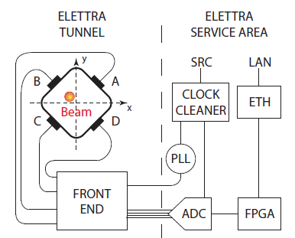
E²BPM Elettra Electron Beam Position Monitor system
G.Brajnik, S. Bassanese, G. Cautero, S. Cleva, R. De Monte, M. Predonzani
A NOVEL ELECTRON-BPM FRONT END WITH SUB-MICRON RESOLUTION BASED ON PILOT-TONE COMPENSATION: TEST RESULTS WITH BEAM
G. Brajnik, S. Carrato, University of Trieste
S. Bassanese, G. Cautero, R. De Monte, Elettra-Sincrotrone Trieste
Proceedings of IBIC-2016, Barcelona, Spain
Novel and original four-channel-front end developed for a beam position monitor (BPM) system. It is demonstrated for the first time the continuous calibration of the system by using a pilot tone for both beam current dependency and thermal drift compensation, completely eliminating the need for thermoregulation.
The Project will finish by end of 2018 aiming at a better and cheaper, than the existing, detector.
A prototype of the new E²BPM has been successfully tested and used in Elettra machine in real environment within a control system and Global Orbit Feedback replacing one old BPM electronics. The measured “on field” performances for E²BPM with 20 mm gap chamber are based on “pilot tone” compensation:
Resolution: 200 nm
8hrs stability: < 300nm
Direct measurement of the measurement quality

Slide 21
Elettra 2.0 requirements
Operating energy 2.4 GeV (and for sometime at 2 GeV)
Reduce the horizontal equilibrium emittance at least one order of magnitude
Maintain the existing ID beam lines
Maintain the existing dipole magnet beam-lines
Conserve the slots available for insertion devices
Preserve the present intensities and the time structure of the beam
Let open the possibility for installing bunch compression scheme
Include super-bends and in-vacuum undulators
Keep the present injection scheme and injection complex
Minimize the downtime for installation and commissioning to about 18 months

Slide 22
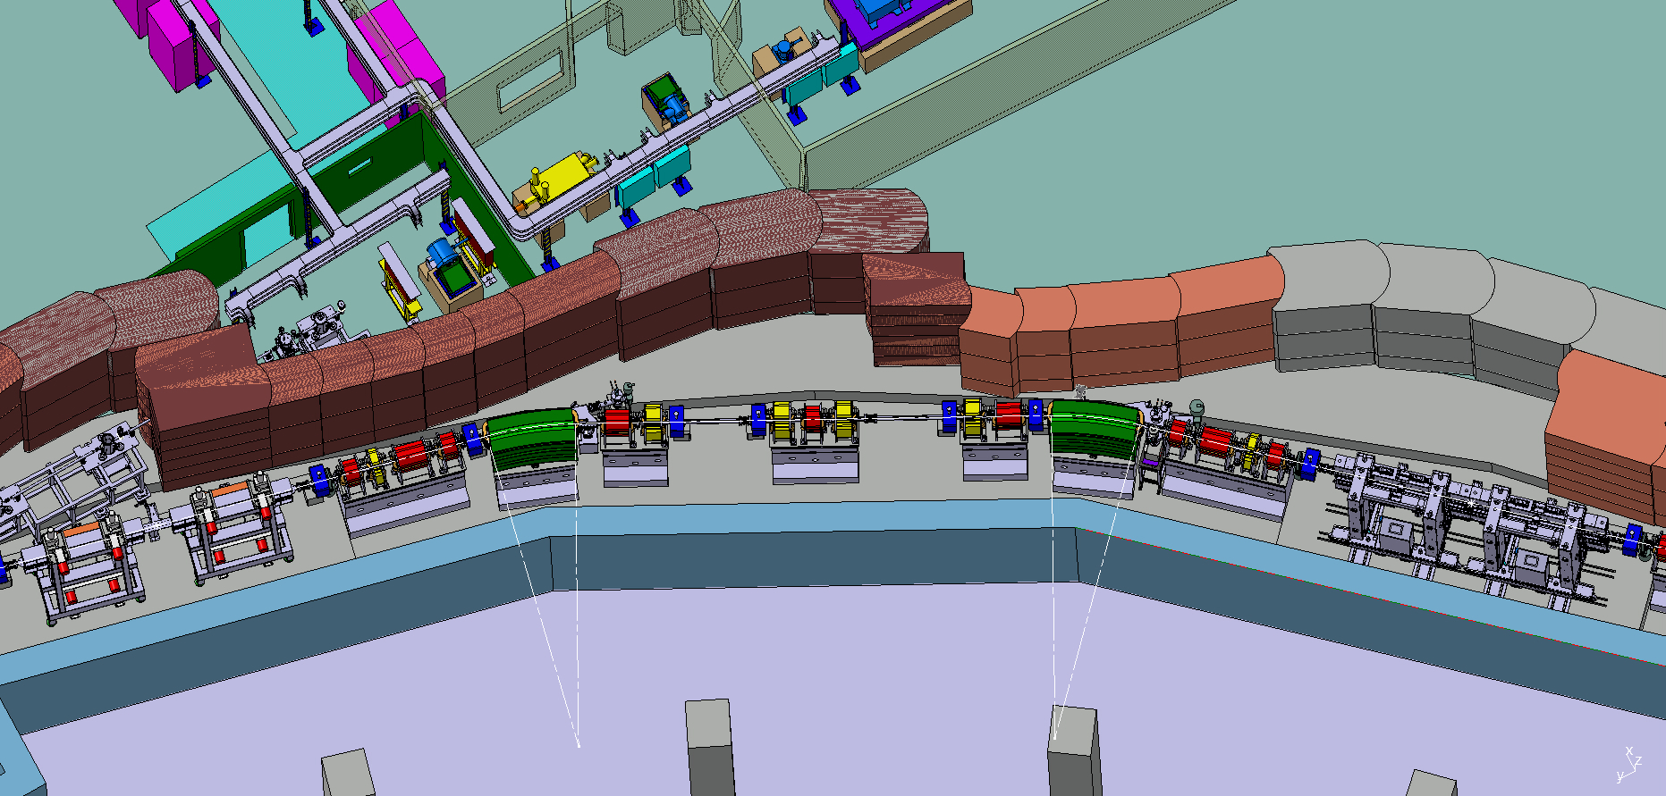
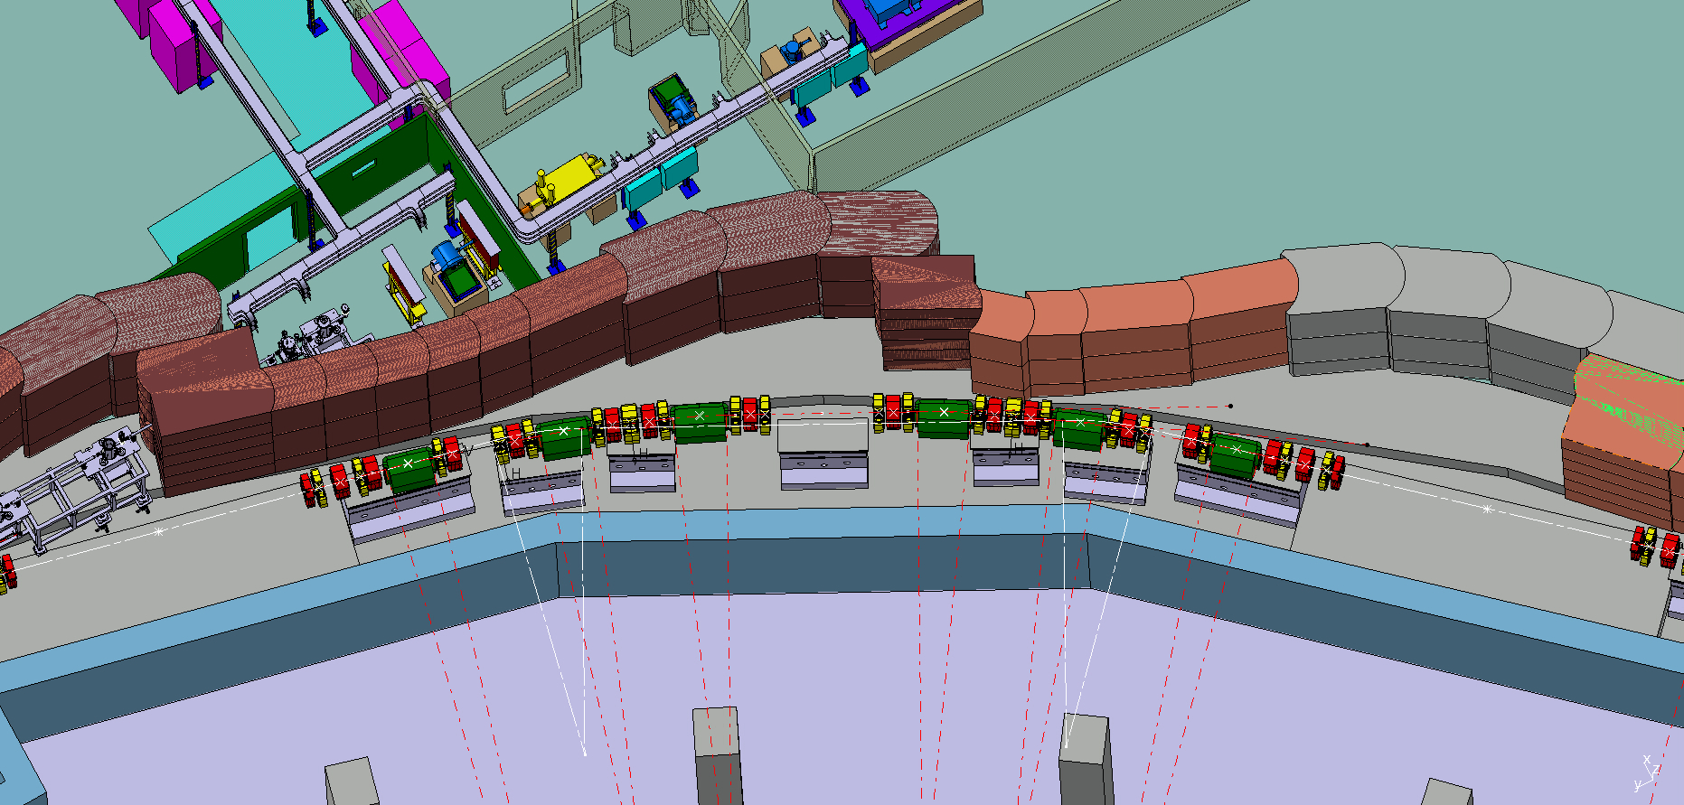
Elettra 2.0 Lattice in the tunnel
Best configuration that satisfied the all requirements, including the free space for IDs is based on our symmetric enhanced six-bend achromat S6BA-E giving an emittance of 140 pm-rad at 2 GeV
Elettra
Elettra 2.0
Basic version was the S6BA with 250 pm-rad at 2 GeV

Slide 23
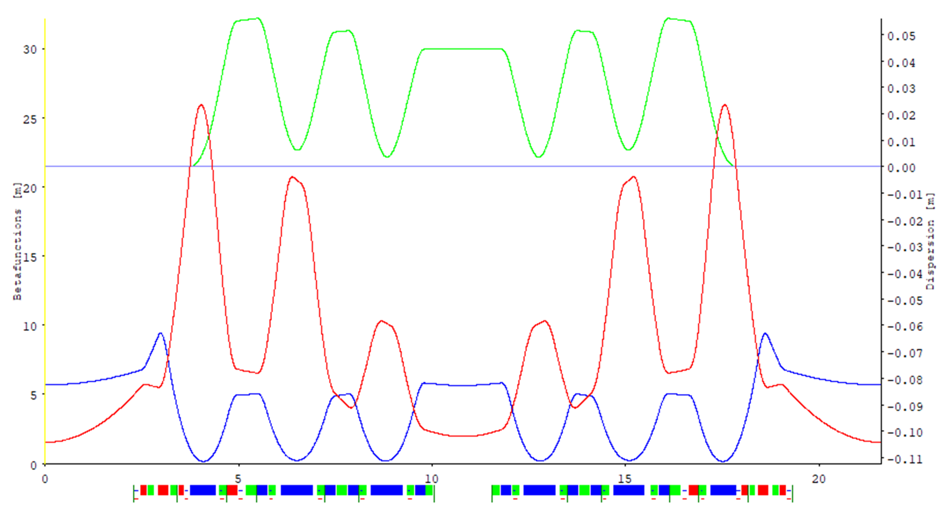

S6BA-E Lattice
2.25m
Emittance reduction by a factor of 50 i.e. at 2 GeV 0.14 and at 2.4 GeV 0.20 nmrad.
Note that relaxing the constaint on the horizontal beta function (blue line) in the long straight section towards 9 m the reduction increases to a factor of 71.
The lattice uses shifted quads and Dipoles with LG+TG gradient

Slide 24
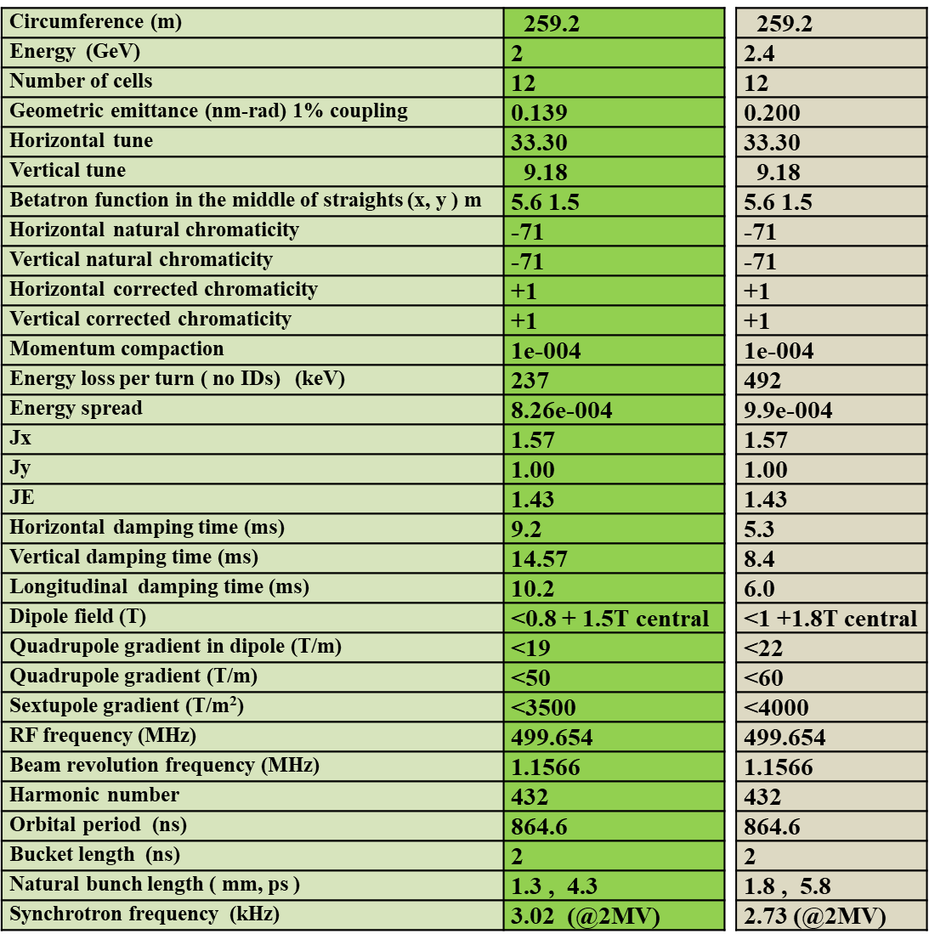

Slide 25
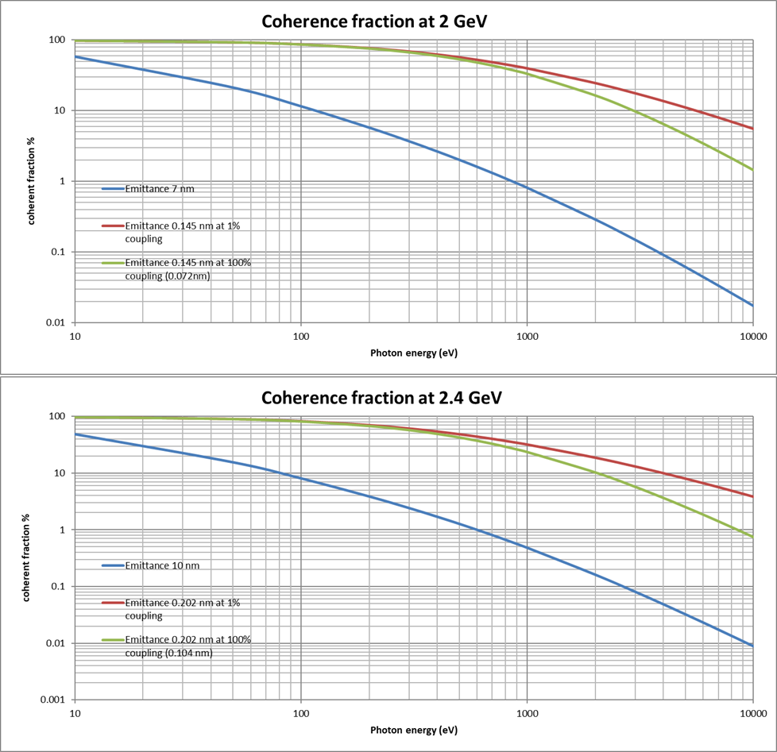
Brilliance increase factor and coherence fraction
flat beam
Round beam

Slide 26
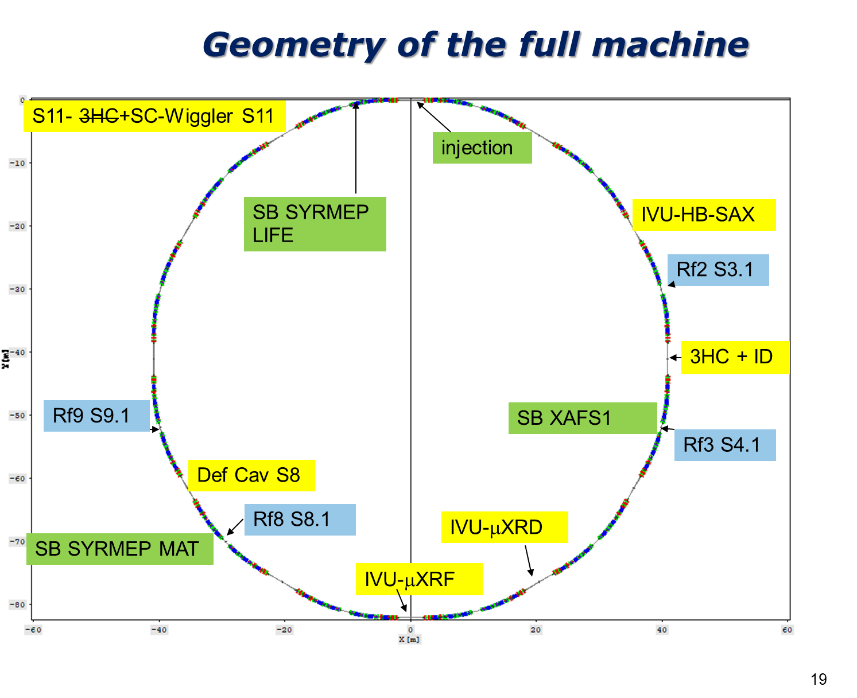
3 superbends at 6 T
3 dipole beam lines
3 IVUs
2 short wigglers
4 short undulators
1 SCW
6 long EPU (single or double) Ids
In total 31 beam lines

Slide 27
Brilliance of microspot
Graph by Anna Bianco
For the microspot beam lines (μXRD, μXRF and HB-SAXS ) with K_{max}=2, 20 mm period at 2.4 GeV (150 periods)

Slide 28
Short pulses
S6BA-E can provide e-bunch lengths with FWHM below 10 ps
due to its low momentum compaction <10⁻⁴
Assume 10 mA total current or 25 μA/bunch. For a flux of 10¹³ ph/s at 400 mA total (400 buckets) there are 2.5x10¹⁰ ph/s/pulse and with 25 μA/bunch the flux will be almost 10⁹ ph/s/pulse (6.25x10⁸).
Other methods being investigated:
Femtoslicing using 100 kHz or higher laser
Crabbing (S. Zholents - ANL Elettra collaboration)
Other exotic schemes
Flux density of 4 bunches with 16 mA total from an Elettra 2.0 dipole
Assuming therefore 4.5E9 ph/s flux, at 5% will have 2.25E8 ph/s similar to the previous result
The difference being that in this case all users can work.

Slide 29
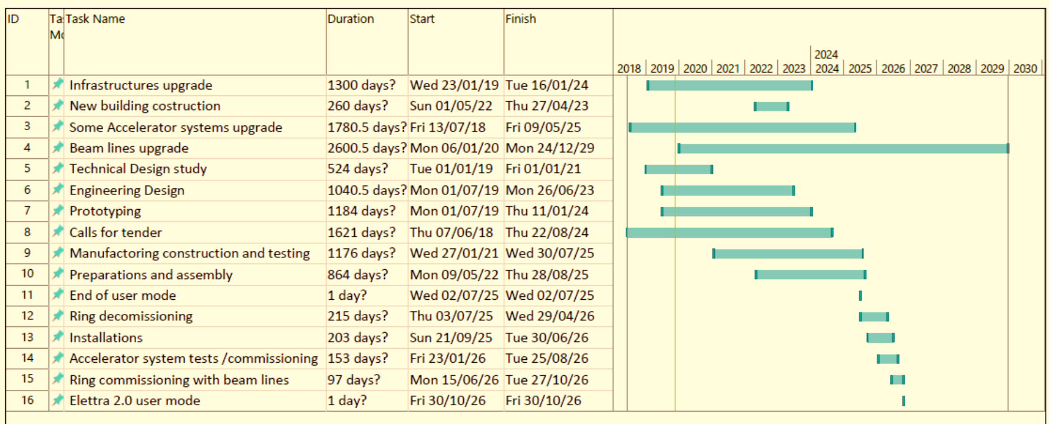


Elettra 2.0 Logistics (preliminary)
Total 170 M€

Slide 30
Summary
Elettra is running well although is 26 year old, many small projects contribute to this including replacement of old / obsolete hardware.
The Elettra 2.0 project has been approved and financed by the Italian government.
Our S6BA-E is the closest to the various requirements for Elettra 2.0 however it is more demanding from the engineering point of view.
We expect to freeze the lattice in December 2019
The 1.0 version of the Elettra 2.0 conceptual design report (CDR) based on our S6BA version is available since 2017. Most parts of the CDR need not change for the S6BA-E version.
A preliminary but complete Conceptual Design Report was produced in January 2017 (https://www.elettra.eu/lightsources/elettra/elettra-2-0.html?showall= )

Slide 31

Thank you for your attention

