Slide 1
ALBA Status
Ferran Fernandez
On behalf of the Accelerator Division

Slide 2
Outline
Introduction
Operation
  Statistics
  SCW reparation
  RF operation improvements
Accelerator Developments
  Linac
  Beam Dynamics
  Radiofrequency
  Beam instrumentation
  Magnetic measurement lab.

Slide 3
Introduction

Slide 4
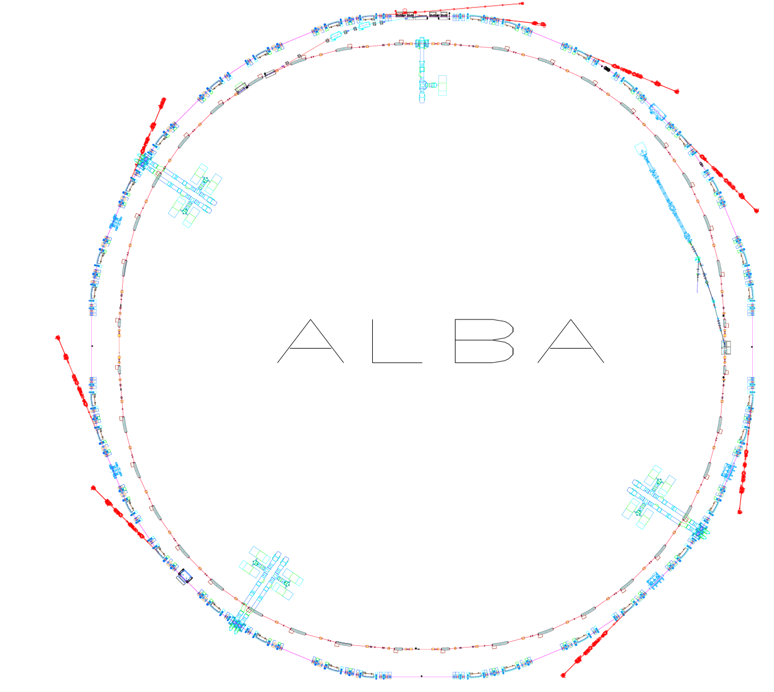
Layout
Parameter | Value
Energy | 3 GeV
Circumference | 268.8 m
Emittance | 4.5 nm·rad
Current | 250 mA
Rf frequency | 500 MHz
# cavities | 6
Long straights | 4 (8 m)
Medium straights | 12 (4 m)
LINAC
100 MeV
BOOSTER
100 MeV ->
3 GeV
STORAGE RING
3 GeV

Slide 5
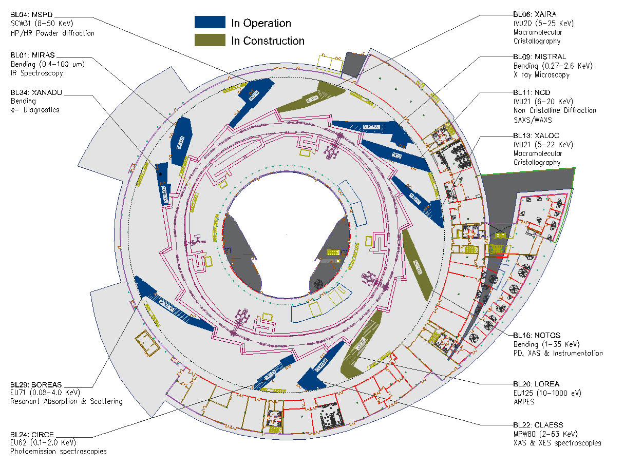
BLXX: FAXTOR
Hard X-Ray Imaging

Slide 6
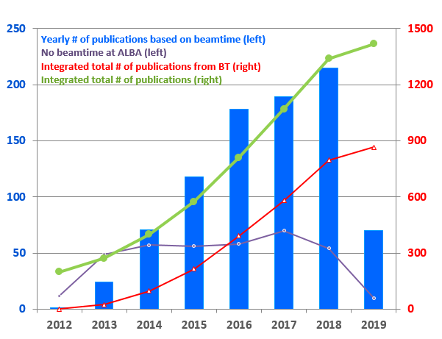
Scientific productivity

Slide 7
Operation
Statistics
SCW reparation
RF operation improvements

Slide 8
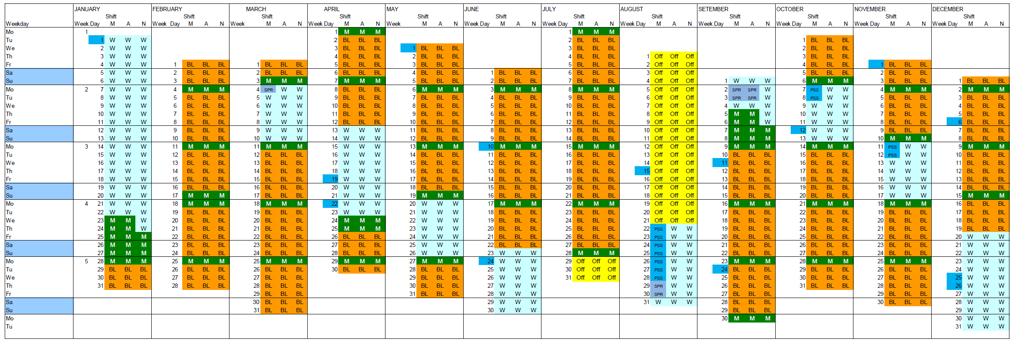
2019 Operation
BL [h] | 4680
M [h] | 1192
SPR [h] | 16
CSN [h] | 0
TOTAL [h] | 5888 h
Same numbers for 2020

Slide 9
Beam Availability (until 18/11/2019)
Beam availability = 97.8 %

Slide 10
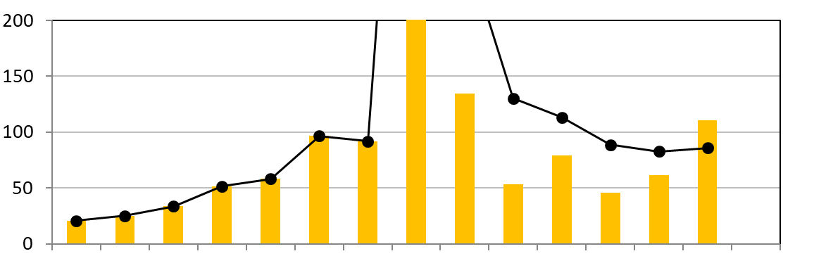
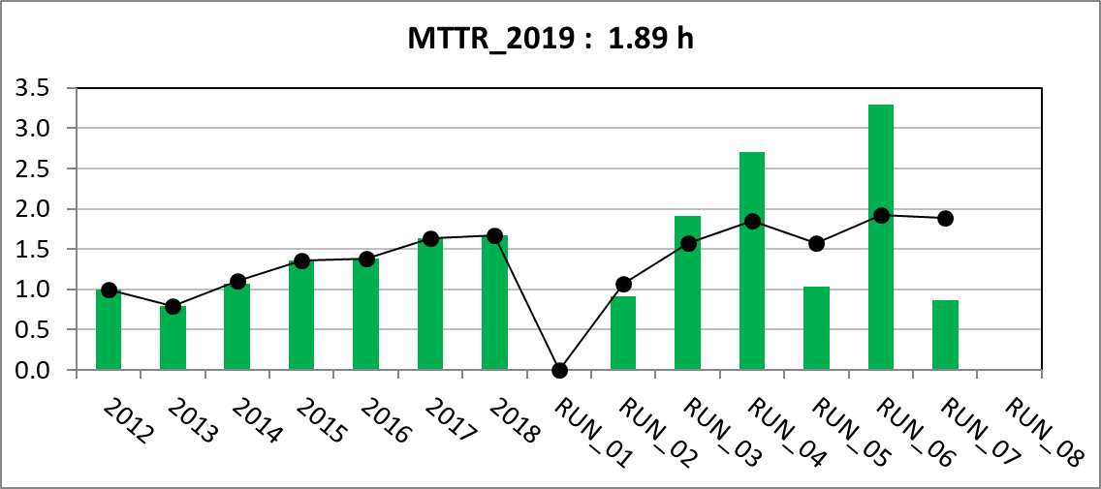
MTBF & MTTR
Mean Time to Between Failures 2019 = 85.8 h
Mean Time to Recover 2019 = 1.9 h

Slide 11
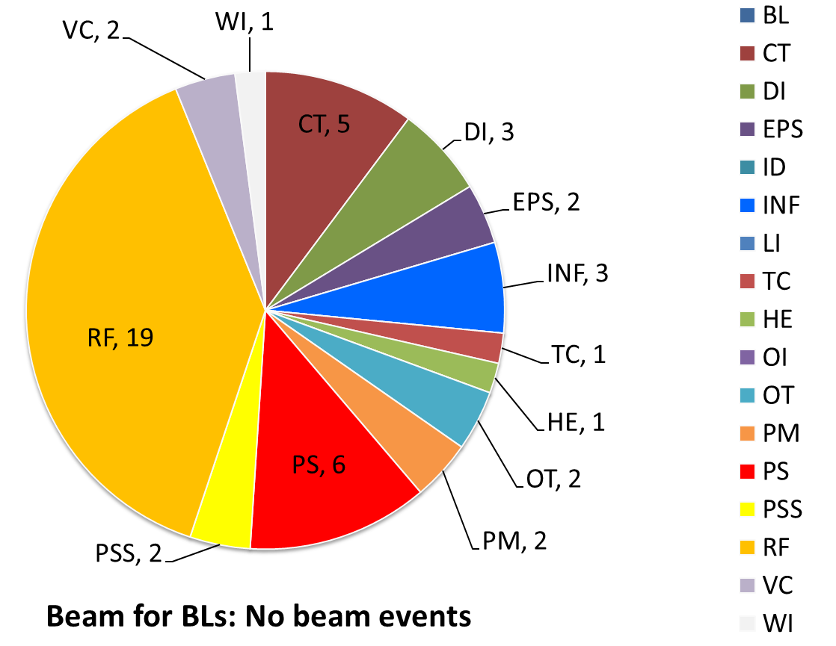
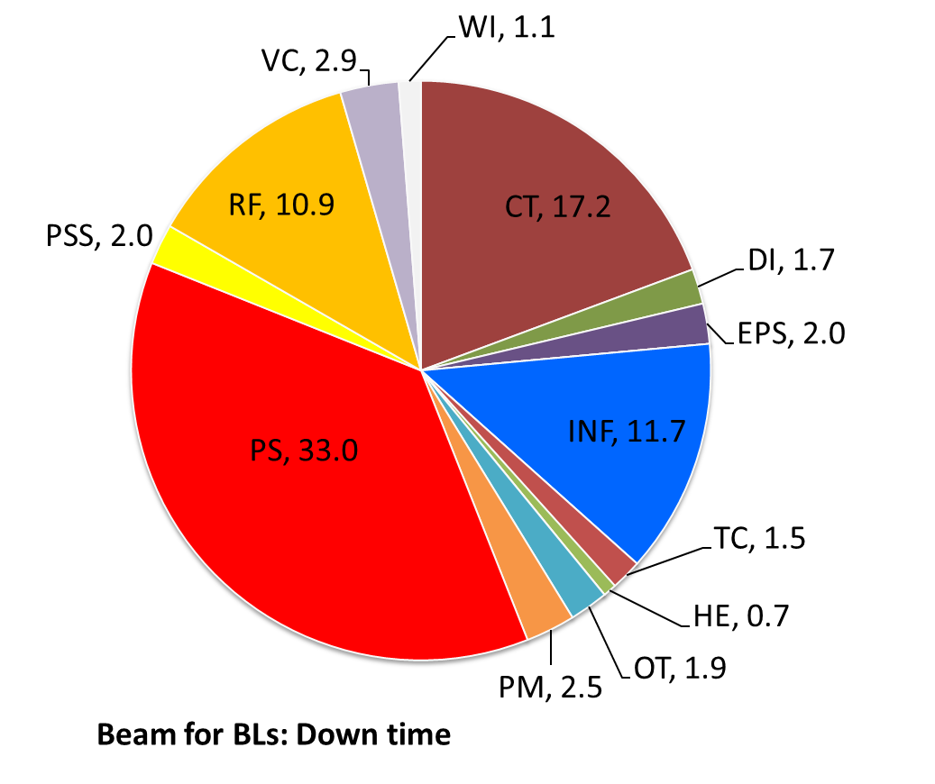
No beam events
49(-2) no beam events
89.0 h of no beam
+131.2 h in decay mode
5 FAILURES ACCOUNT FOR MORE THAN 40% OF THE DOWNTIME

Slide 12
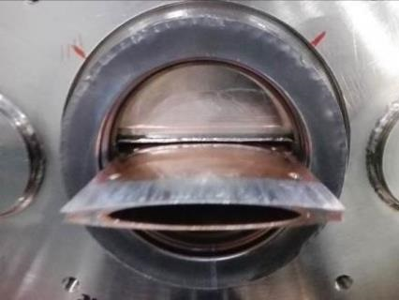
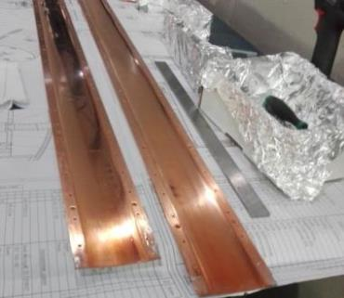
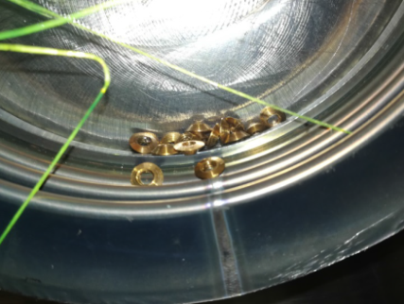
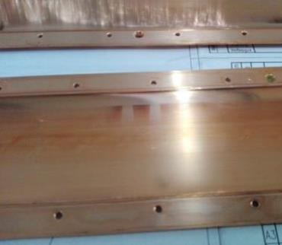
SCW repair
Upgrade works
On September 2018 current increased from 150mA to 200mA
Start having quenches at SCW (reported on ESLSW-2018)
Winter shutdown SCW repair
Bronze screws were broken.
Two halves of liner were separated, touching the cryostat vacuum chamber.

Slide 13
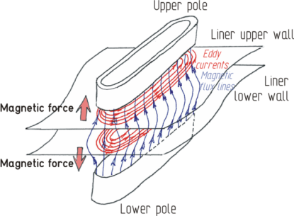
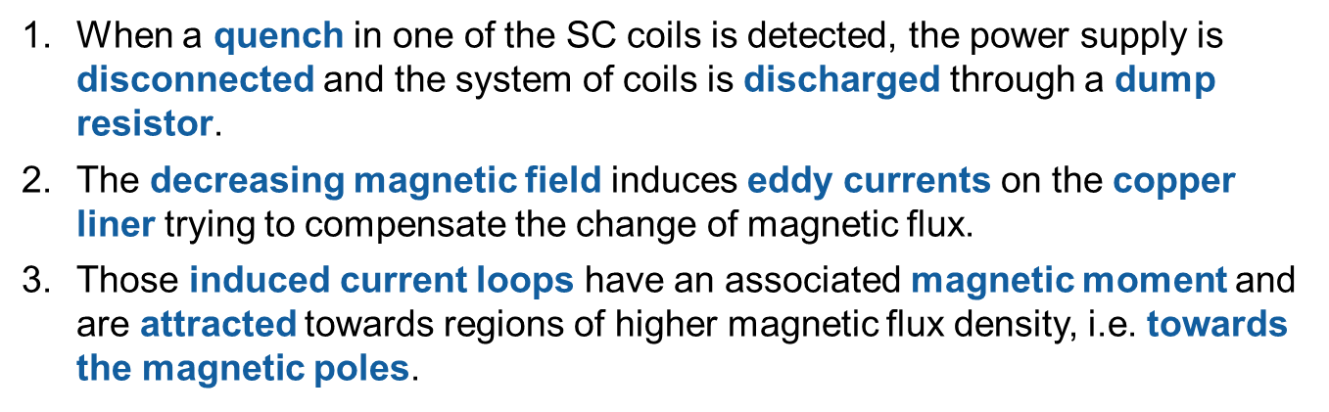
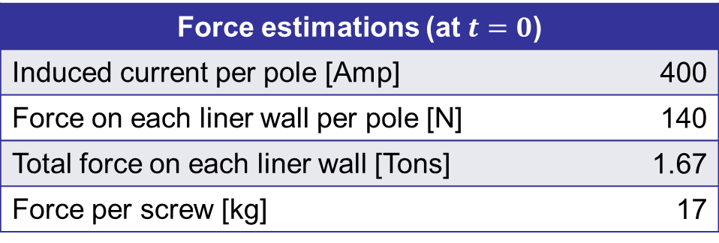
SCW repair
Upgrade works
REASON (?): Stress on liner by eddy currents when quenching (?)

Slide 14
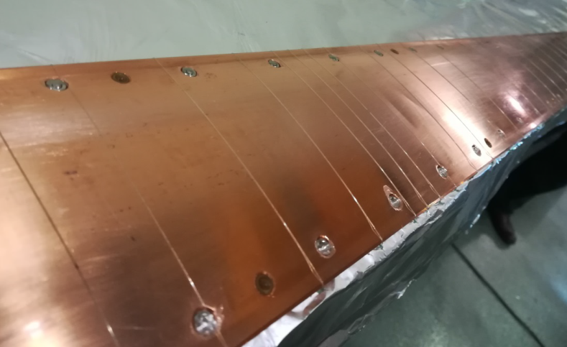
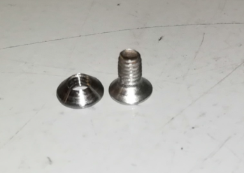
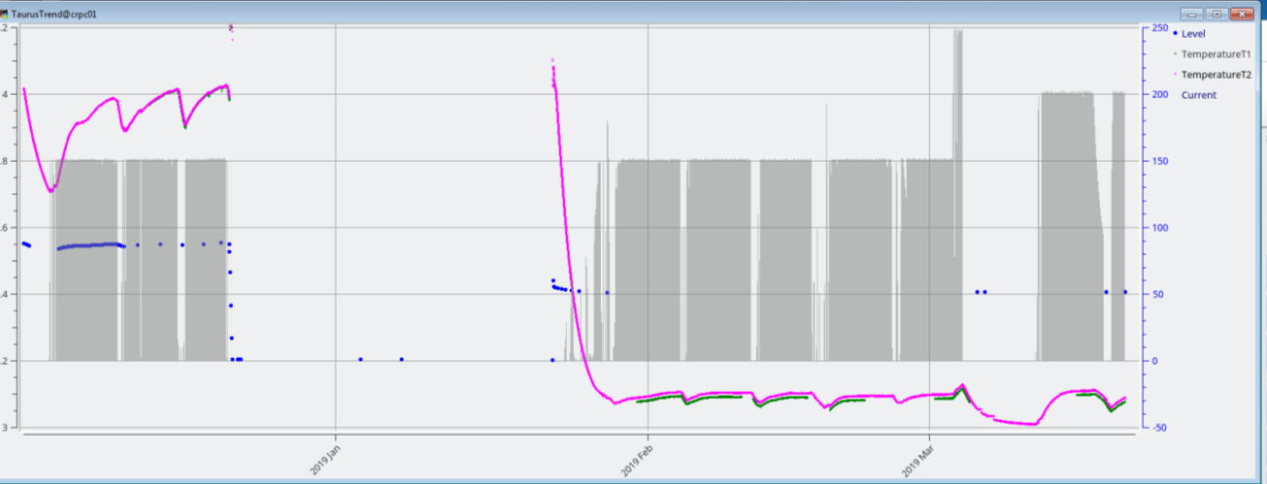
SCW repair
Upgrade works
Replace all bronze screws by stainless steel ones
4.05 K
150 mA
150 mA
200 mA
3.10 K
3.12 K

Slide 15
RF operation improvements
RF team is continuously working on reducing the beam dumps
  September 2019: 250 mA top-up
  Cavities voltage increased (3 MV total RF voltage)
  More conditioning is needed
  SR fully filled with L3 IOT since May 2019.
 | 2017 | 2018 | 2019
RF ITCK with beam dump | 18 | 28 | 17
Beam Downtime due to RF [hours] | 12.3 | 18.1 | 10.9
*
* Until September 2019

Slide 16
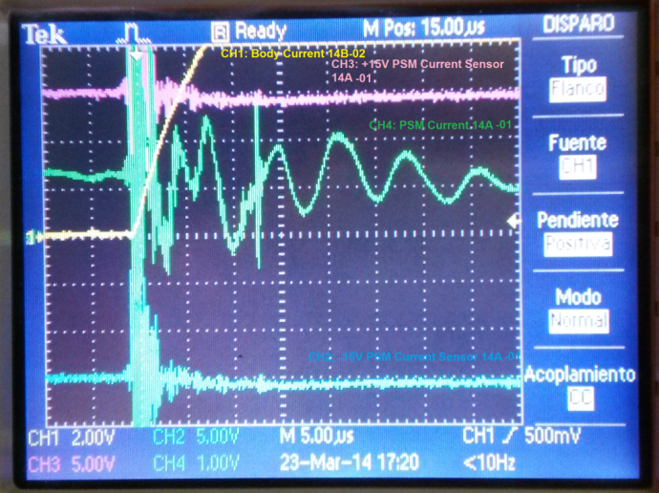
RF operation improvements
After Body Current interlock, noise is induced in electronics of neighbour plant
  PSM current filtered with ferrites
  PSM voltage filtered with RF low pass filters
  HV enable signal filtered with optical link
HVPS2
HVPS2
HVPS1
HVPS1
IOT2
IOT2
Circ
Circ
IOT1
IOT1
Body currents that tripped the beam
  Jan 2018 - Aug 2019: 31%
  From Sept 2019: 0%
Plant A
Plant B

Slide 17
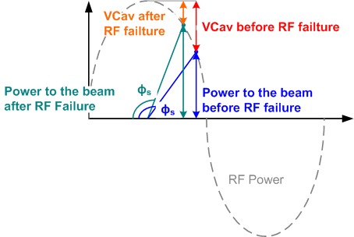
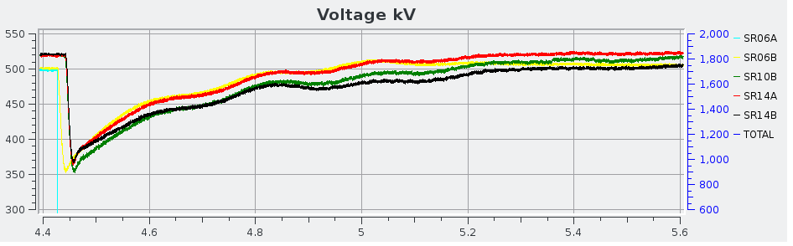
RF operation improvements
  Trip compensation: Oscillations after a trip cause voltage drop in the cavity and therefore to lose the beam
RF Failure
Beam Phase (º)
Cavity voltage (kV)
    Trigger is sent to the DLLRF for feedforward compensation

Slide 18
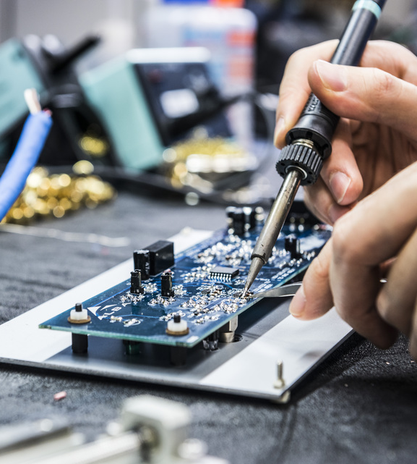
Accelerator Developments
  Linac
  Beam Dynamics
  Radiofrequency
  Beam instrumentation
  Magnetic meas. lab.

Slide 19
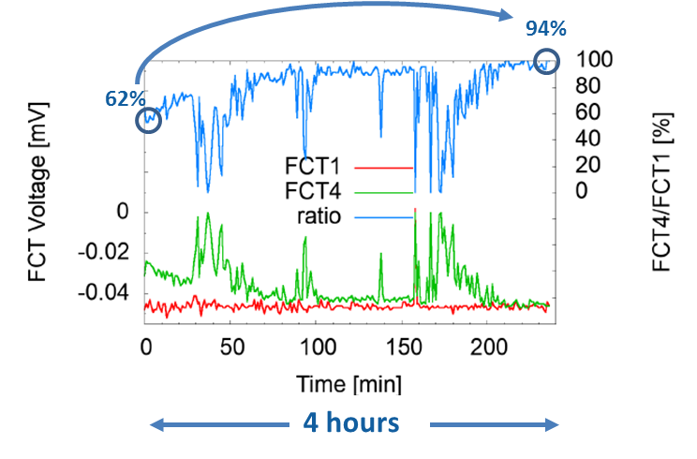
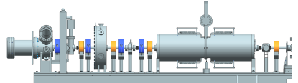
Linac improvements
SBM optimization by “simplex” algorithm
  Goals: improve beam transmission in SBM
  Figure of merit: FCT4/FCT1
FCT1
FCT2
FCT3
FCT4
SL1
SL2
SL3
SL4

Slide 20
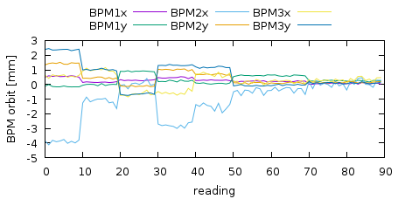
Linac improvements
Linac To Booster Optimization Project
  Ongoing: Li2Bo beam alignment using Beam Base Alignment scripts
  Ongoing: Optimization of LTB_quads settings by Simplex scripts
Preliminary results:
Good response to LTB-orbit correction script
LTB orbit worsened on purpose
LTB-orbit AFTER correction

Slide 21
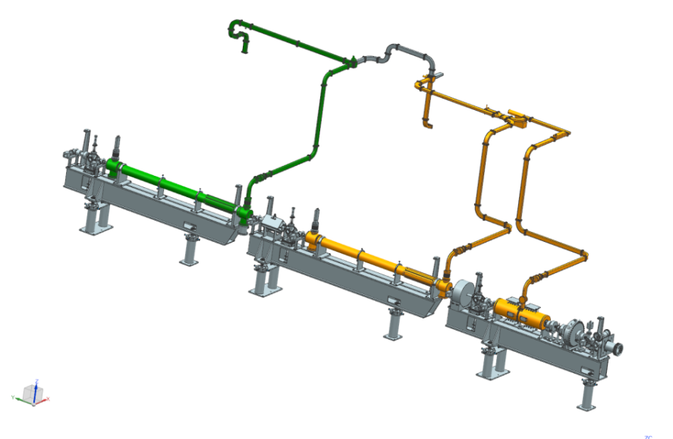
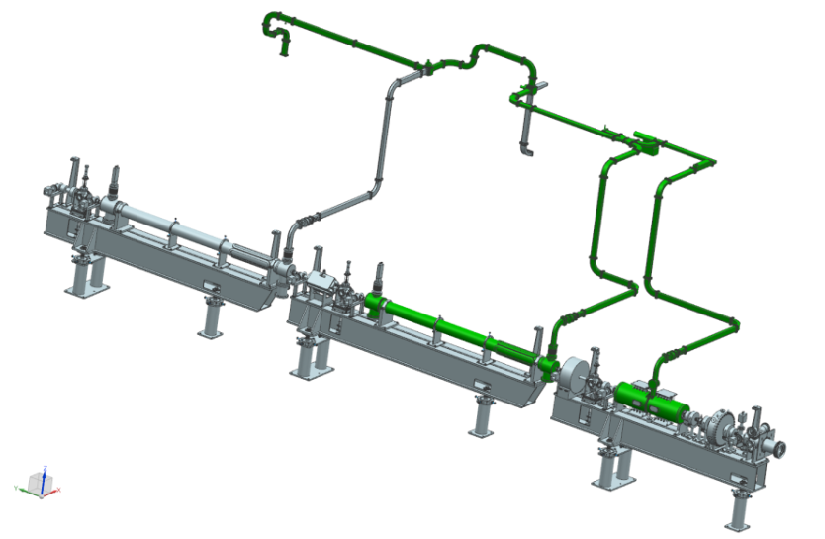
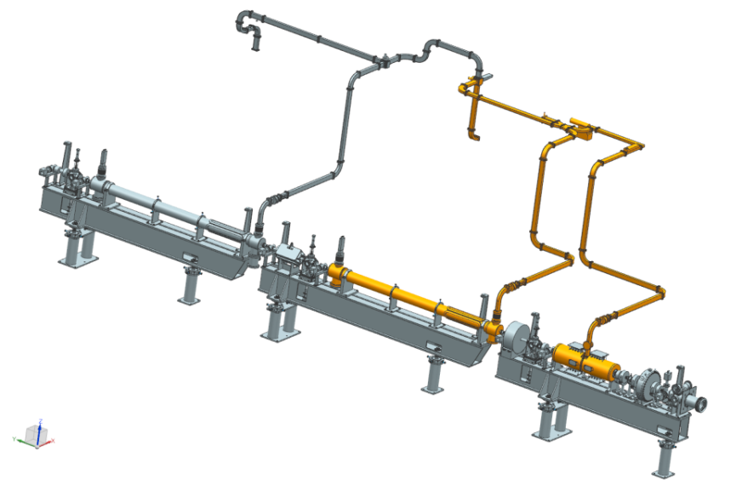
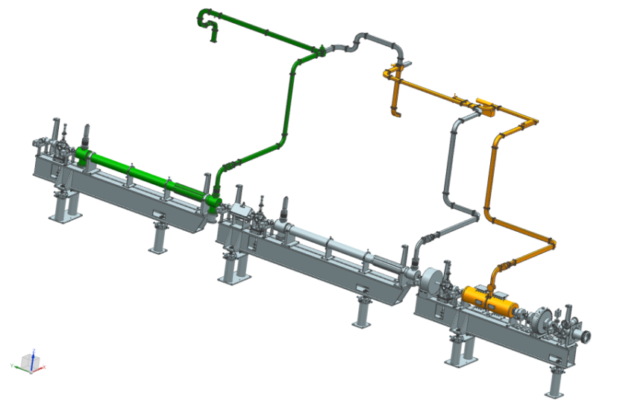
Linac improvements
Klystron 2 Klystron 1
Klystron 2
110 MeV – Nominal -KA1 + KA2
67 MeV with KA2
Klystron 1
Klystron 2 Klystron 1
67 MeV, KA1
67 MeV - KA1 + KA2
Ongoing: Find a solution in case Buncher-cavity fails

Slide 22
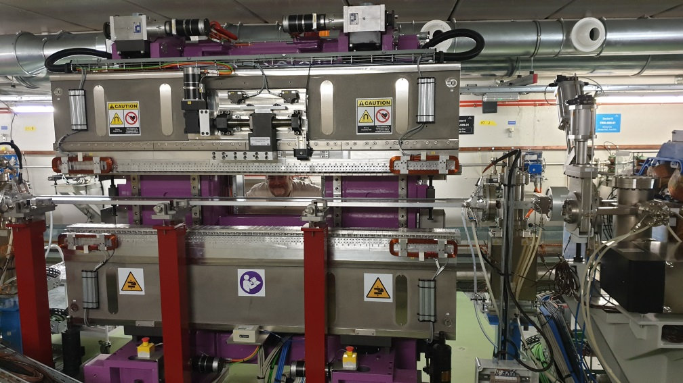
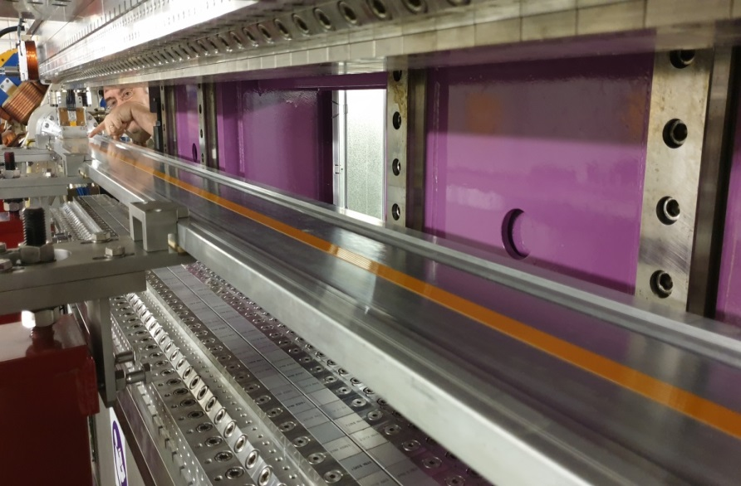
Preparing for LOREA operation
Design Phase:
Check vacuum chamber impedance to ensure beam stability
Check influence to other beamlines and possible solutions
Presently:
Correcting coils made of strips glued to vacuum chamber
Look Up Tables to avoid tune and beta-beating (avoid disturbances to rest of the BLs)

Slide 23
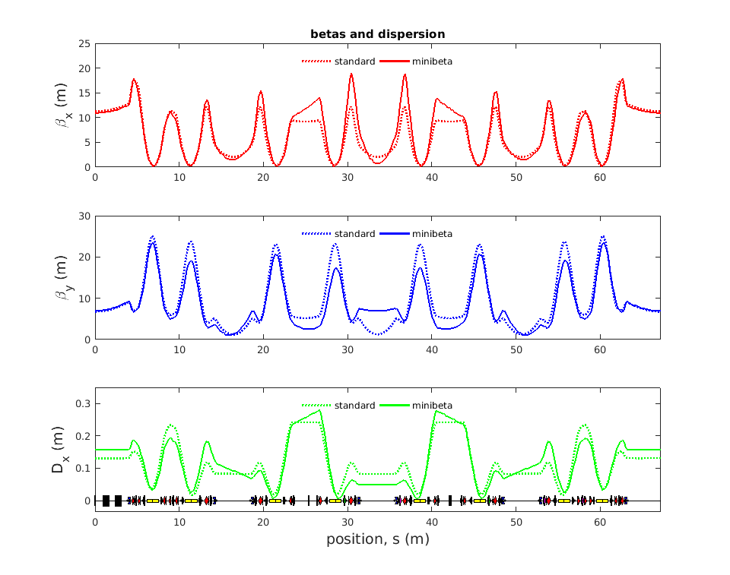
Preparing for FAXTOR operation
FaXtoR requires a more round beam in its source point
Several lattices have been studied/tested
Solution has been found, but lifetime and instabilities have to be improved
0.77 m
6.9 m

Slide 24




Mistral Fast Polarization Switching
Mistral slow (moving the slit) operation during Dichroism measurements
Mistral fast (moving the beam) operation during Dichroism measurements
$$e^{−}$$
$$e^{−}$$
1min
~
1s
~
$$e^{−}$$
$$e^{−}$$
It allows a faster polarization switch and a more repeatable beamline illumination of the two polarizations

Slide 25
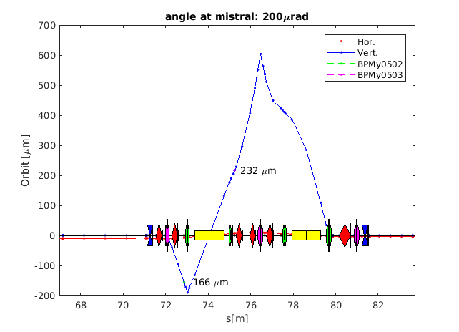
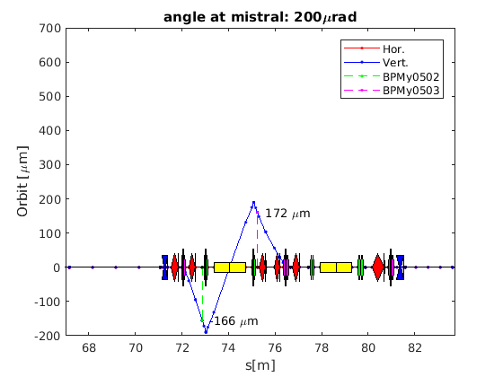


Mistral Fast Polarization Switching
Angle bump in MISTRAL to switch between two different polarizations
Change on the FOFB golden orbit; synchronized at 16 sectors
Simulations, tests with beam, and hardware modifications in power supplies
First tests with existing hardware (July)
Simulations – HW modifications required
$${∆I}_{VCM}=5.6 A$$
$${∆I}_{QSK}=3.8 A$$
$${∆I}_{VCM}=3.4 A$$
$${∆I}_{QSK}=1.2 A$$

Slide 26
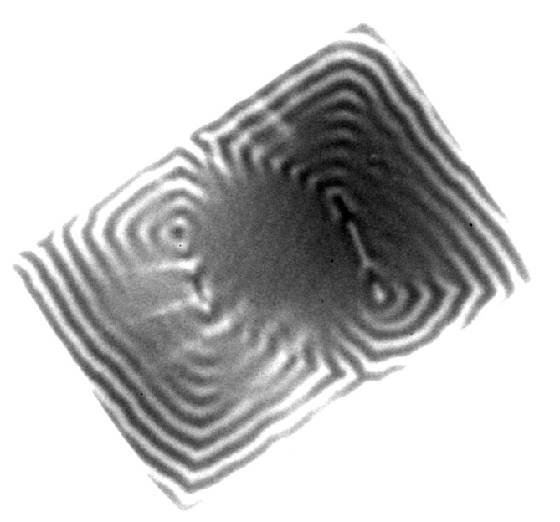
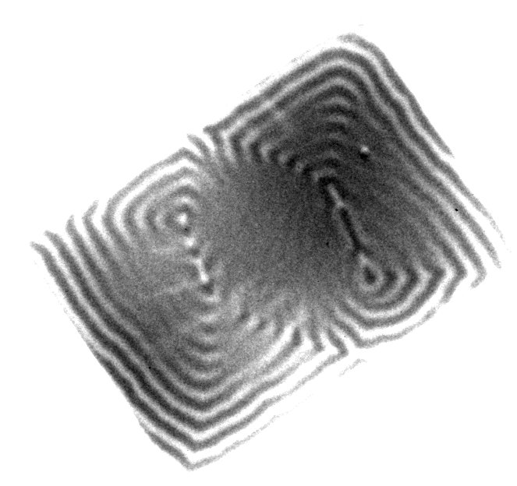
Mistral Fast Polarization Switching
Tests at the Beamline with a permalloy magnetic particle
The magnetization polarity of the magnetic domains can be clearly determined
BUMP zero (90 images, 2 sec)
We were almost centered on one polarization
BUMP -280 μrad (60 images, 2 sec)
Reversion around -200 µrad
Notes:
The images show a magnetic particle of permalloy of dimensions 2 x1.7 micrometers 2 with Landau domains. In both images the contrasts are inverted. This
Was achieved while having the slits quite open and producing a bump of 280 microrad.
Note : the microscope axis was NOT contained in the orbital plane, it was displaced to one of the polarizations , therefore look only relative values

Slide 27
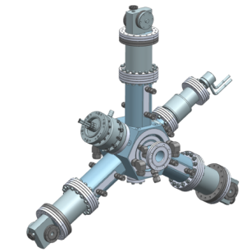
3rd Harmonic cavity
4 cavities at 1,5MHz
Active (20kW)
Same design as SR RF cavities scaled 1/3
HOM Dampers with N transition to extract power of HOM and to avoid ferrites + brazing
Cavity Prototype
  Sept ‘19 signed contract with AVS
  Delivery expected in spring ‘21
Transmitter (20kW SSA)
  Soon…
Former CLIC-CERN collaboration

Slide 28

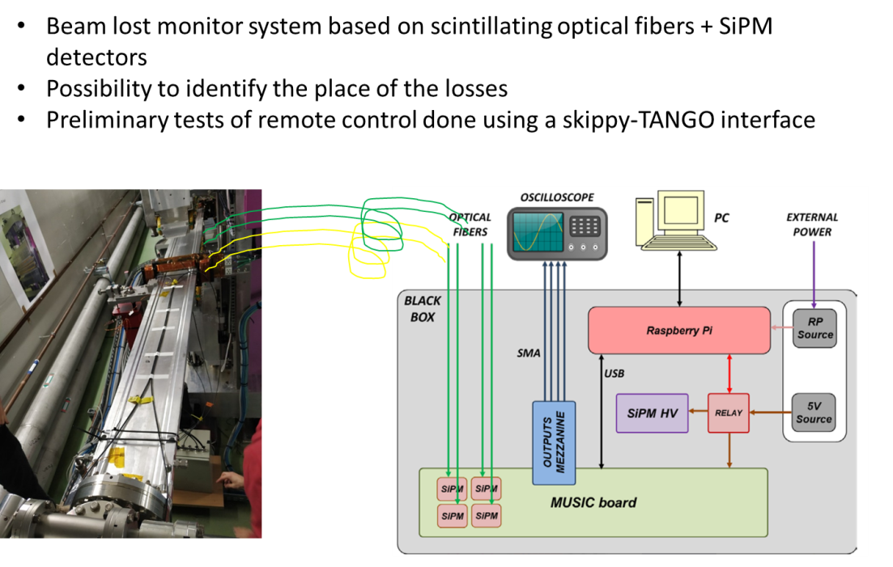
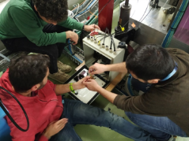
SiPM Beam Loss Detector
In collaboration with

Slide 29
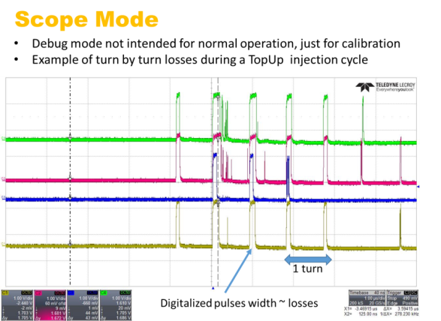
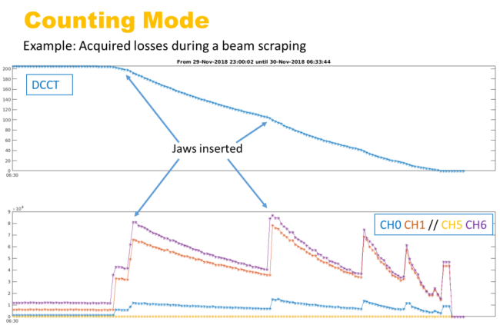
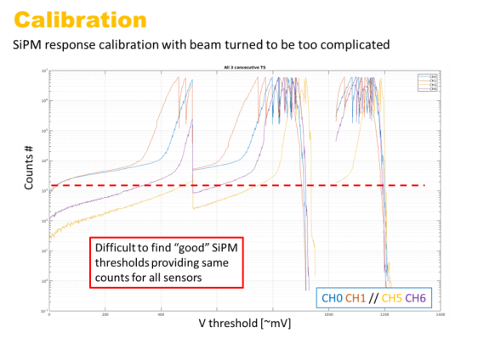
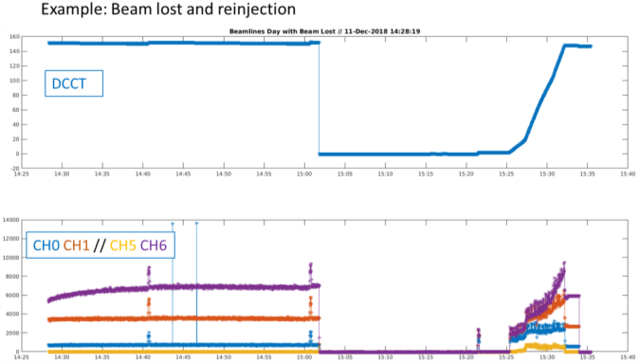
SiPM Beam Loss Detector

Slide 30
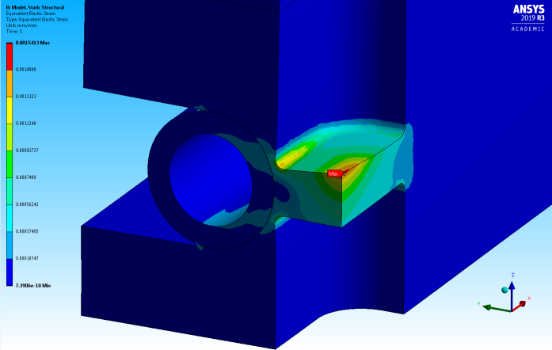
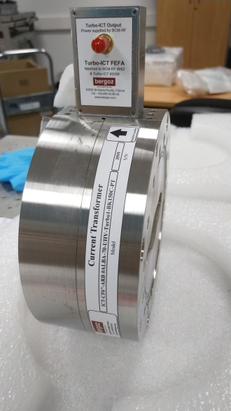

New Pinhole and ICT
New Pinhole
Complementary beam size measurements for SR
It will use light from bending magnet at FE21
Al Window design finished
Integrating Current Transformer
Alternative beam current measurements at SR (DCCT)
Pioneer tool for Light Sources (Bergoz)
Ready for installation during winter shutdown
Water cooling design and heat load studies

Slide 31
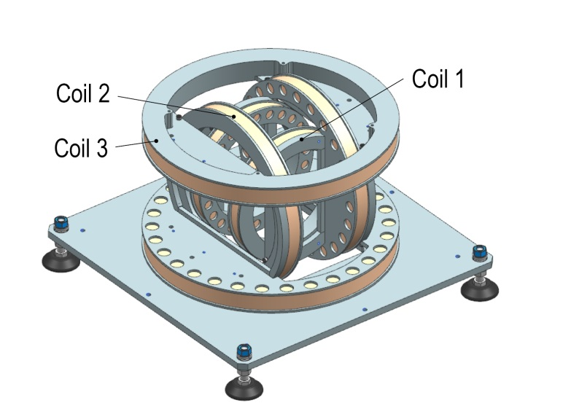
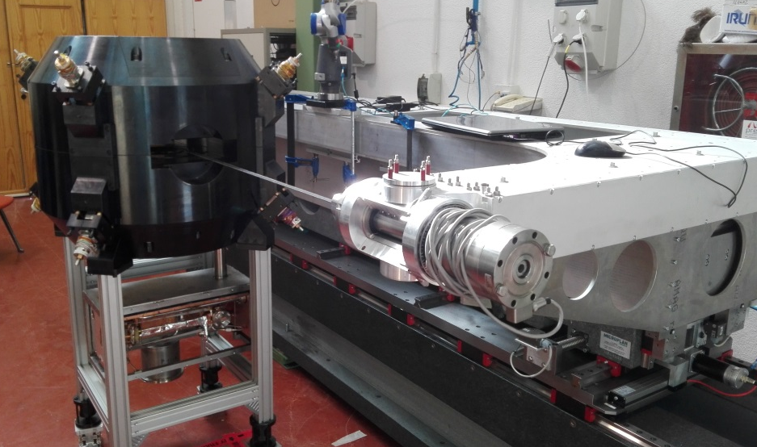
Magnetic measurements lab.
3D HELMHOLTZ BENCH
Determine 3d hall probe orthogonality
  Accuracy down to 2mrad
FLIPPING and ROTATING COIL
Measure small gap multipolar magnets
  Flipping down to 6mm gaps
  Rotating down to 11mm gaps
NEW HALL PROBE BENCH
Measure close structures
  Now: gaps down to 4.5mm
  In the future: gaps down to 3mm in vacuum and cryogenics

Slide 32
Thanks to the Accelerator Division…
Division Head
F. PEREZ
Operations Section
M. PONT
Operators group
F.FERNANDEZ
M. ALVAREZ
O. SERRES
D. YEPEZ
E. MORALES
RF & Linac Section
F,Perez
RF group
A. SALOM
Vacante
J. OCAMPO
Linac group
R. MUÑOZ
D. LANAIA
IDs & FEs Section
J. CAMPMANY
IDs & FEs group
J. MARCOS
V. MASSANA
Beam Physics Section
U. IRISO
Beam Dynamics Group
G. BENEDETTI
T. GÜNZEL
Z. MARTÍ
Diagnostics Group
U.Iriso
Vacante
A. NOSYCH
J.C GIRALDO
M. SOS
J. BAÑUELOS
P. SOLANS
P. KRKOTIK
Proyecto HTS–FCC
E. MARIN
Proyecto XLS
A. GOMEZ
P. LENGUA
ACE PostDoc - Vacante
Ana BUENO Empleo Joven
Nikki TAGDULANG DOC-FAM
Students:
Queralt Gallardo
Alvaro Huanay
Adrià Muñoz
Ingrid Mases
… and to ALL other divisions!

