Slide 1
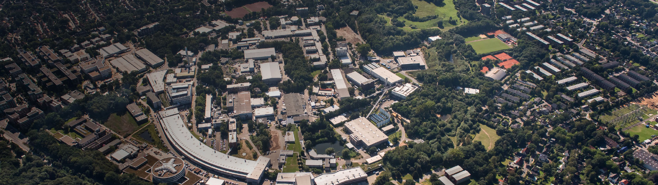
PETRA III
2019
Operation and Upgrade
Michael Bieler
ESLS XXVII, Barcelona, 28.11.2019

Slide 2
Agenda
1 PETRA III Overview
PETRA III Operation 2019
3 PETRA IV

Slide 3
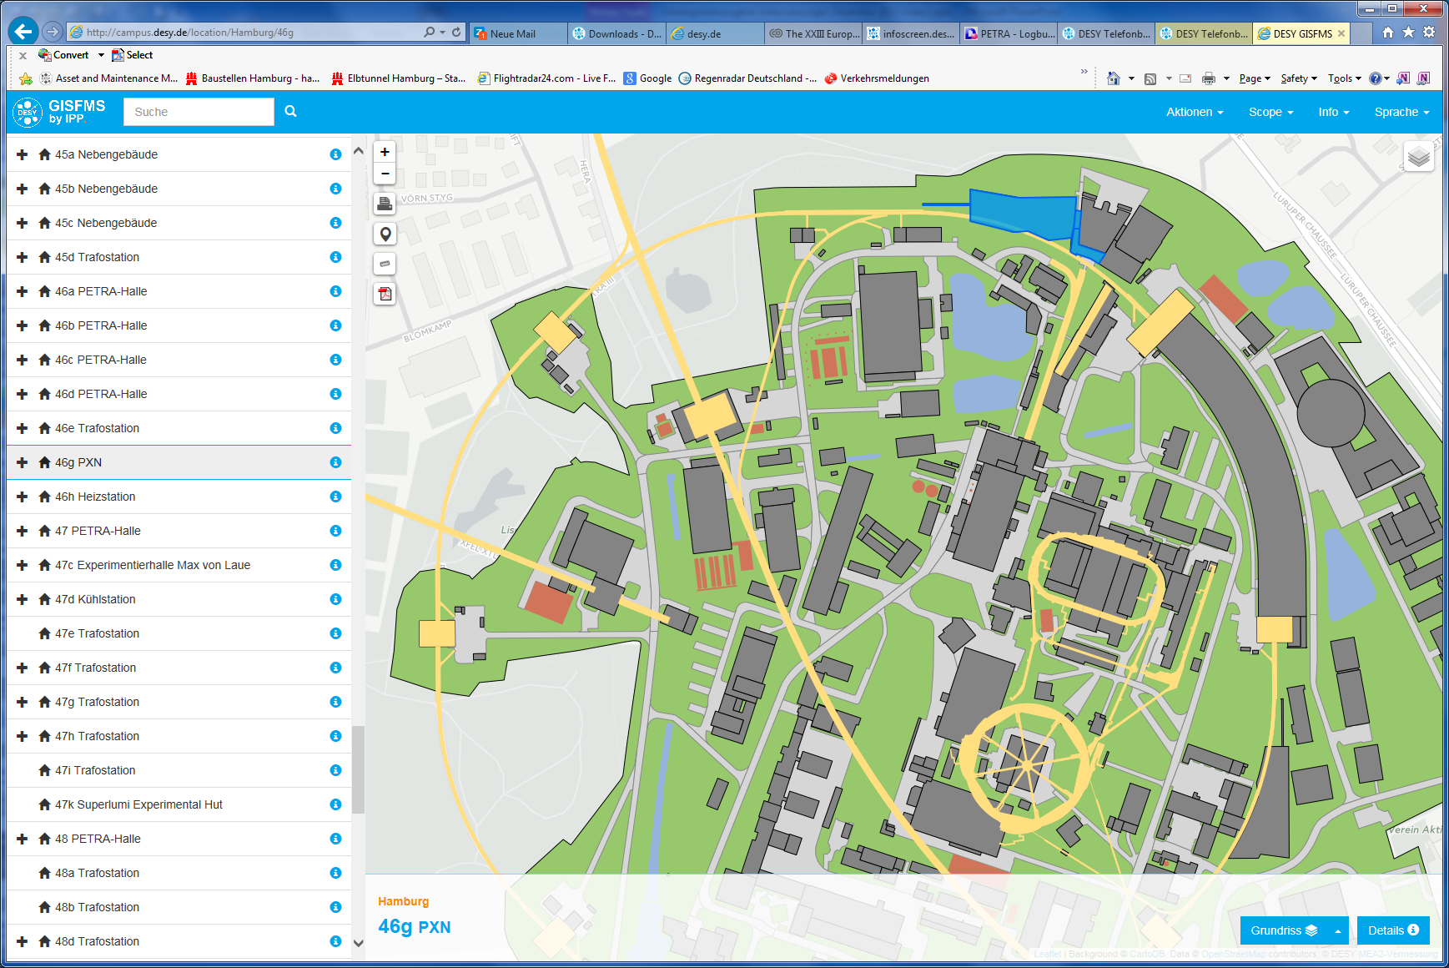
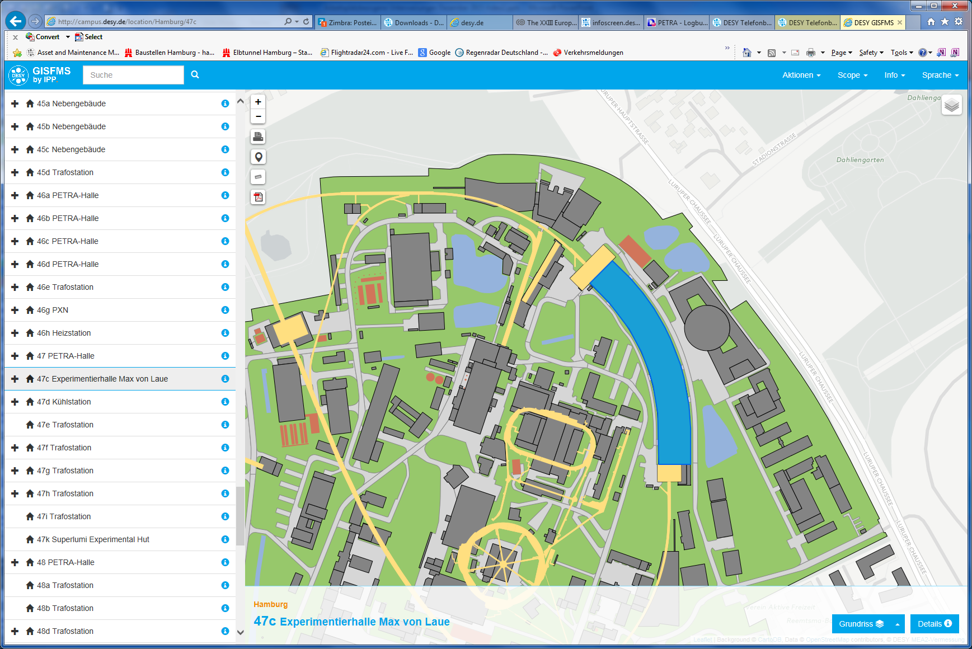
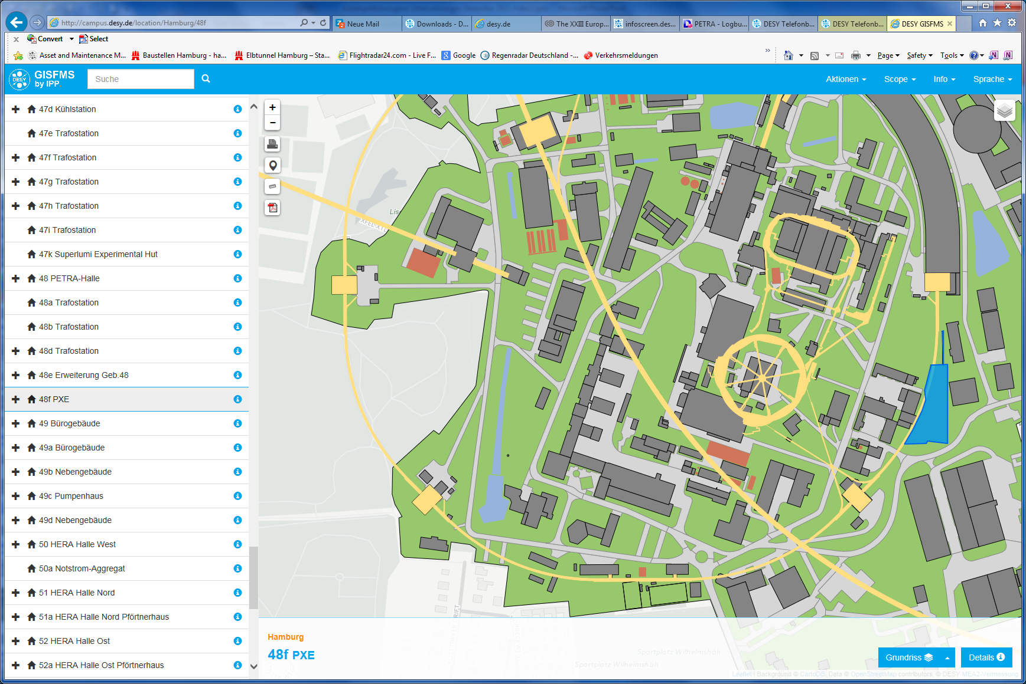
PETRA III Overview
2.3 km circumference
6 GeV electrons
20 damping wigglers
19 (+ 6) undulator beamlines
1 nm rad x 10 pm rad
100 mA
TopUp operation, 1% beam current variation

Slide 4
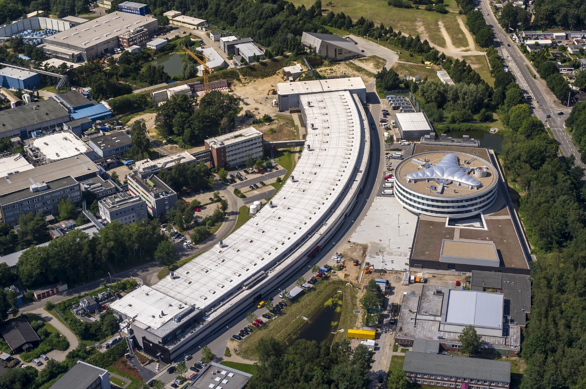
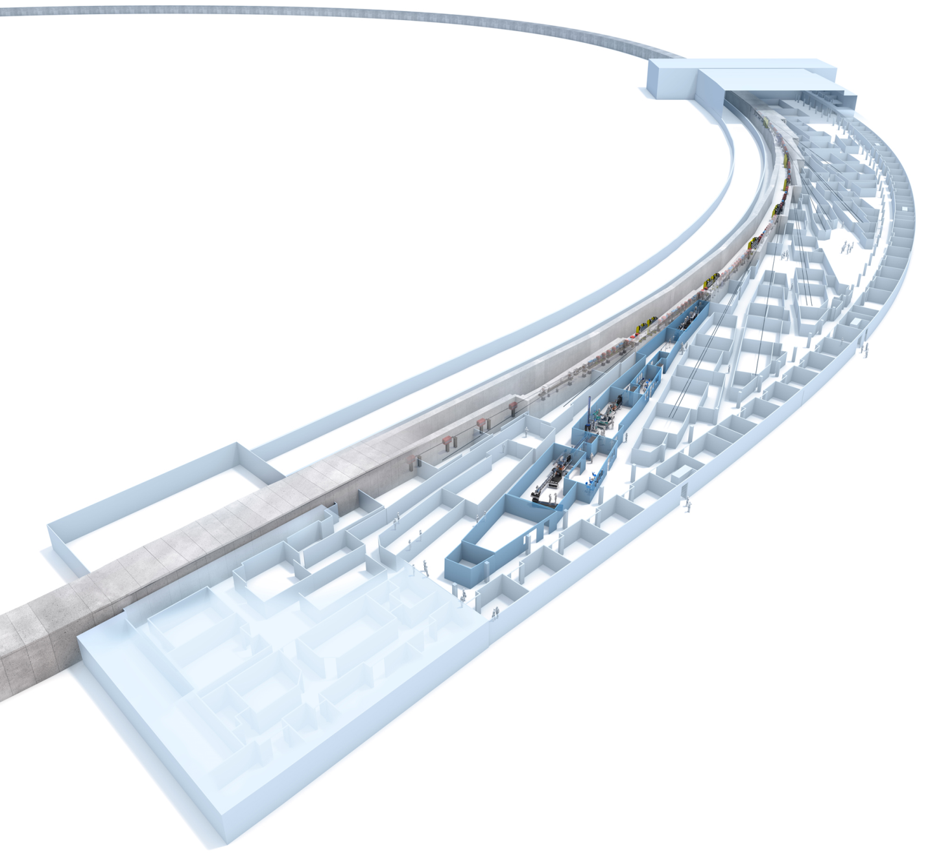
PETRA III Overview
Max von Laue Hall:
1/8 of the circumference of PETRA III
8 double bend acromat cells
14 undulator beamlines:
  2 m Undulators: 11
  5 m Undulators: 3 (2+1)
  5 m Apple Undulator: 1

Slide 5
User Operation 2019
External users from March 11 to July 14
and from Aug. 5 to Dec. 19.
4752 hours for users in 2019, 4944 in 2020.
 | Service Week
 | Sunday (User Run)
 | Userrun
MDT | Machine Development

Slide 6
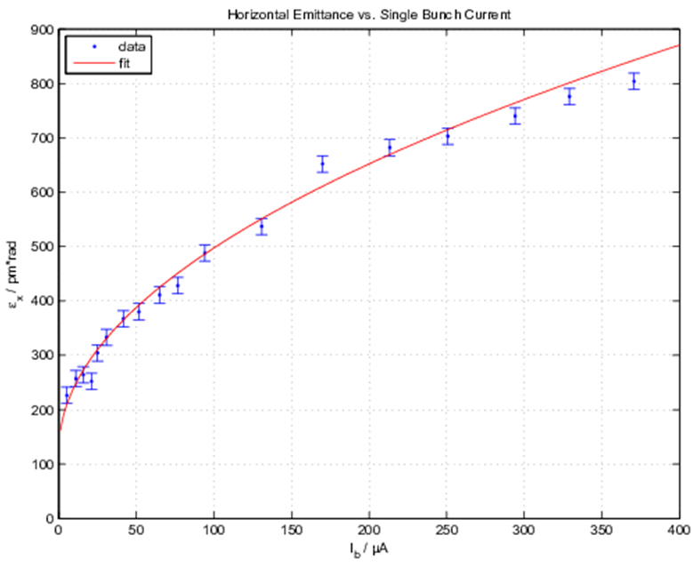
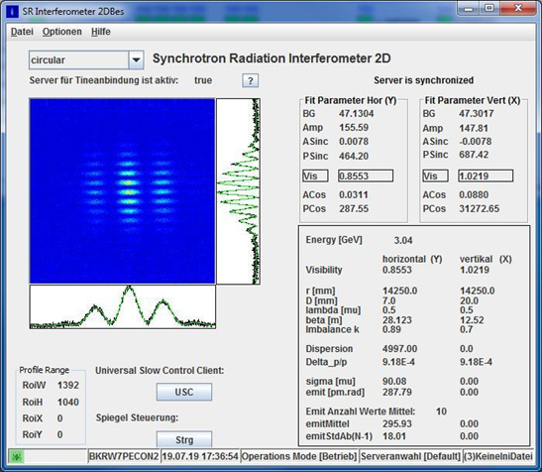
User Operation 2019
Summer Break 2019: 3 GeV
2 weeks at 3 GeV:
smaller emittance
tests for PETRA IV (instrumentation, users)

Slide 7
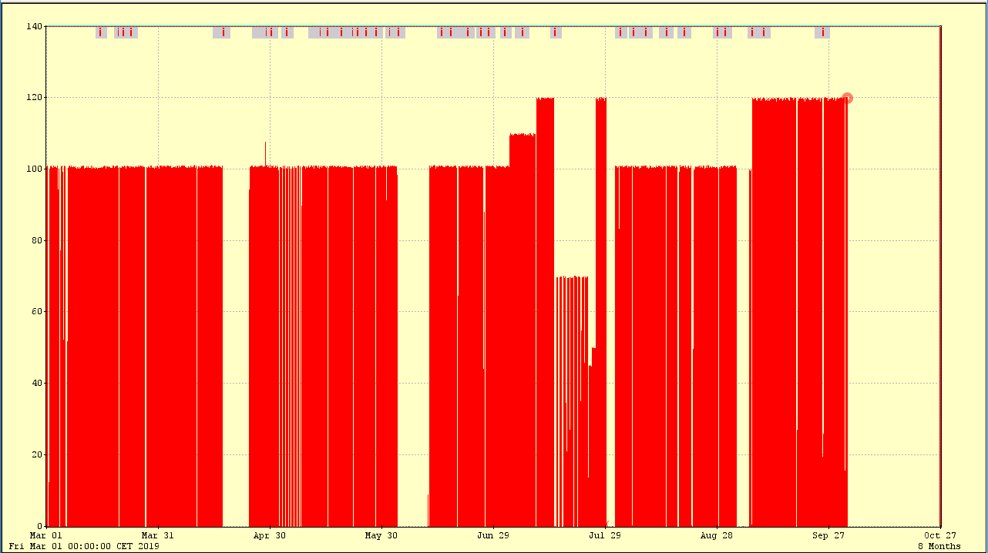
User Operation 2019
July: Beam Current increased
(480 bunch mode only)
480
Bunches
480
Bunches
480 / 40
Bunches
40
Bunches
Exploring higher power levels at the user side
Beam Current / mA
3
GeV

Slide 8
User Operation 2019
User Run 2019
Scheduled time: 4752 h
57 % Timing Mode (40 Bunches)
Availability 98.5 % (as of Nov. 25nd)
2 bunch patterns used:
Timing Mode
  40 bunches, 192 ns
Continuous Mode
  480 bunches, 16 ns
480 bunches
40 bunches

Slide 9
Availability 2019
98,5 %
2018:
96,37 %
as of Nov. 25
Power Glitch
Studies,
Testruns
weekly average
Service Week
goal
yearly average

Slide 10
Availability 2019
65 h
2018:
51 h
as of Nov. 25
Service Week
Studies,
Testruns

Slide 11
Availability 2019
as of Nov. 25
10 h lost by 1 incident

Slide 12
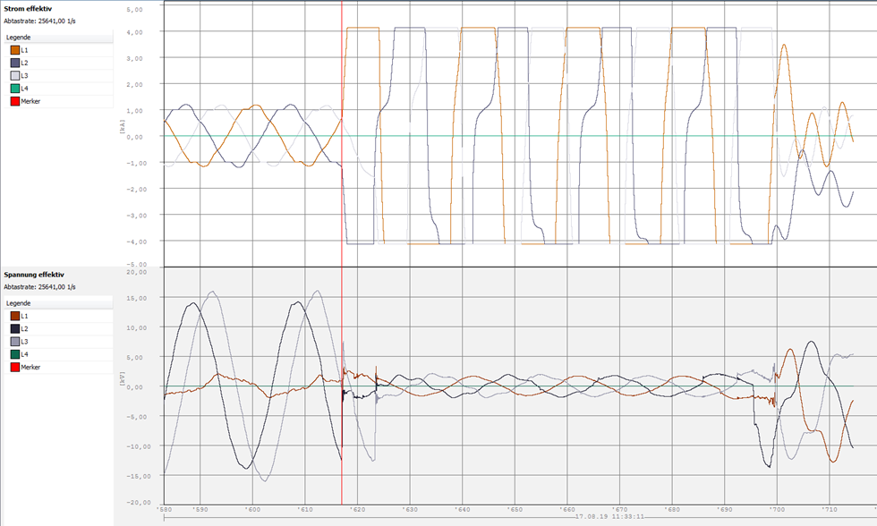
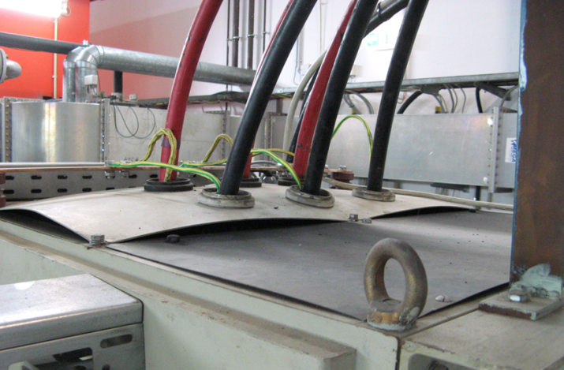
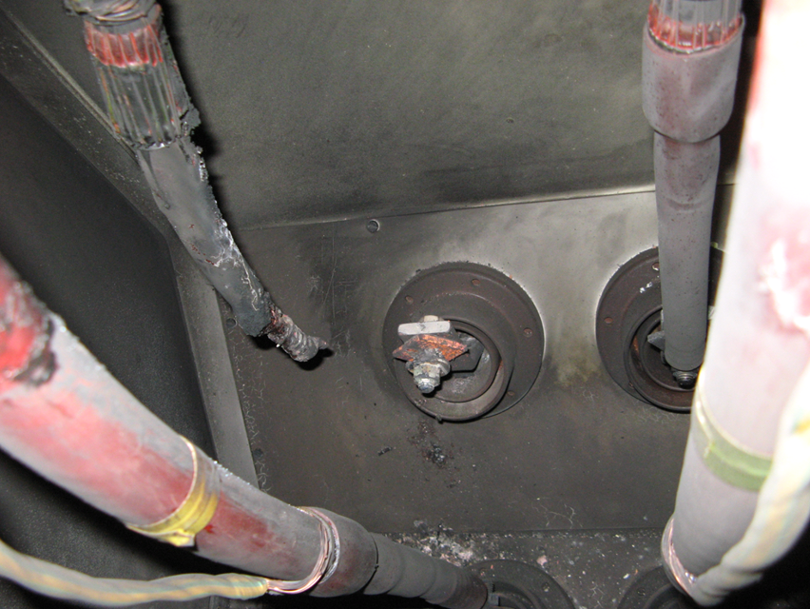
Availability 2019
Saturday, 17.8.2019,
10 kV supply for RF transmitter:
10:05 AM: 1 phase shorted to ground,
transmitter runs on 2 phases for 1.5 hours.
11:33 AM: 3 phases shorted to ground for 80 ms, DESY wide power glitch.
Current / kA
Voltage / kV
10 kV cabinet
Root cause: Loose cables

Slide 13
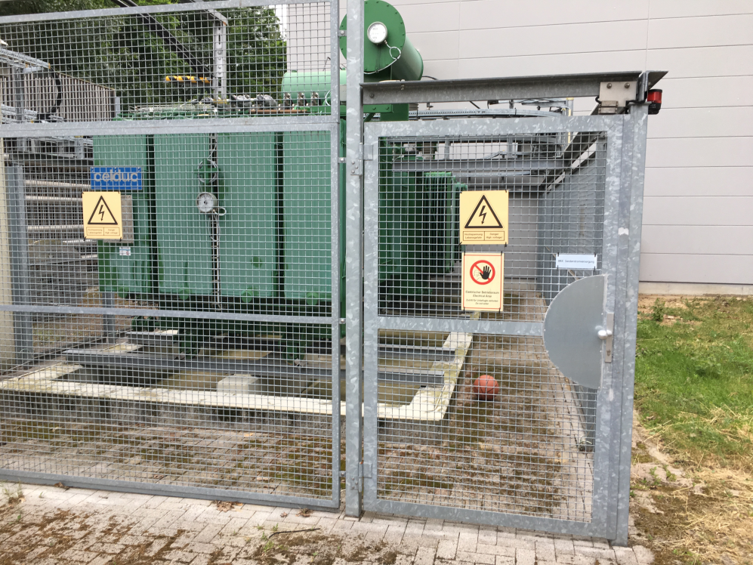
Availability 2019
Power Glitches
Magnet Power Supplies
Kickers
Users / Beam lines
Unknown
….

Slide 14
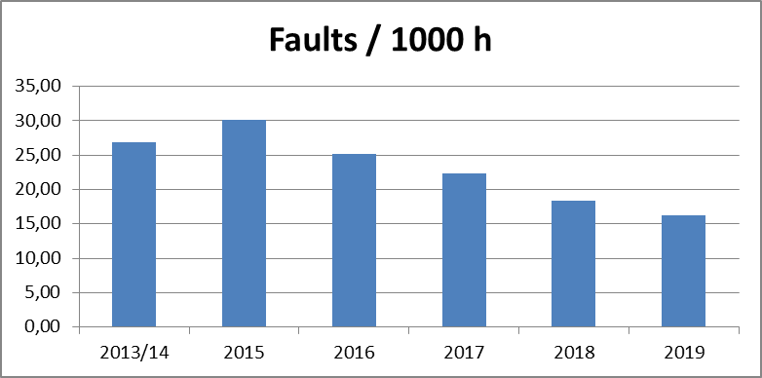
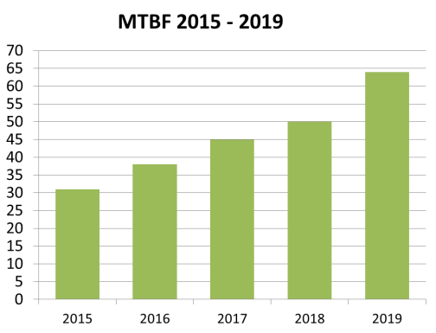
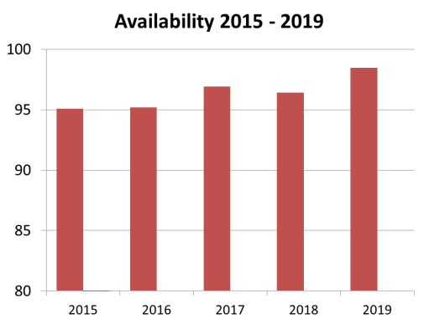
Availability 2019
Improvements over the years

Slide 15
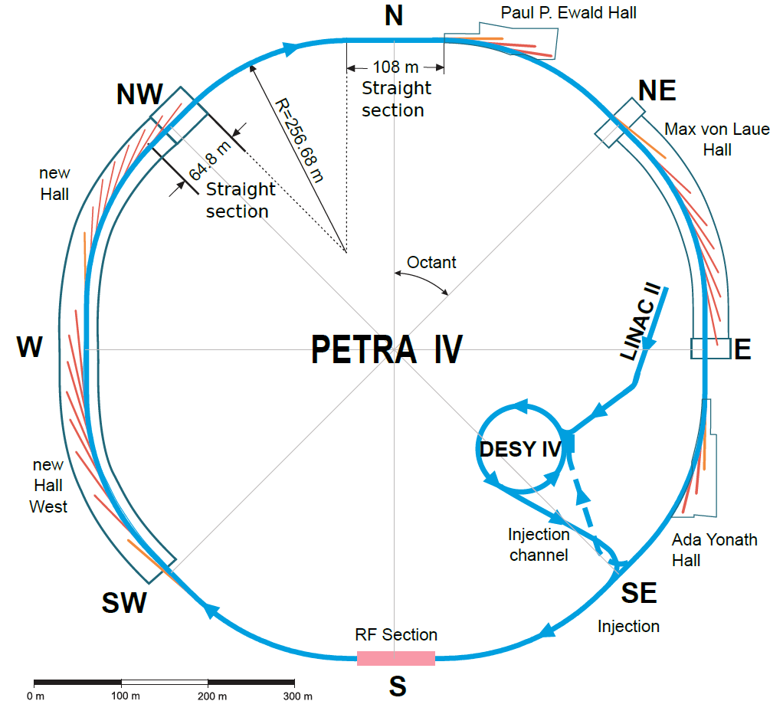
PETRA IV
PETRA IV:
2 new experimental halls
4 undulator cells in the long straight sections
H7BA – ESRF-EBS style lattice
8 cell / arc
26.2 m cell length. Beamlines have to be moved/adapted to the new lattice layout
option: canted beamlines
on-axis injection with fast kickers
500 MHz RF + higher harmonic cavity
vacuum system, 20 mm inner diameter
magnets, bore radius 13 mm

Slide 16
PETRA IV
Parameter | Value (with 29 IDs)
Energy E | 6 GeV
Length L | 2304 m
Tune Q_{x}/Q_{y} | 164.18 / 68.27
Nat. chromaticity ξ_{x}/ξ_{y} | -230 / -185
Damping part. number J_{x} | 1.24
Nat. emittance ε_{x} | 7 pm*rad
MCF α_{c} | 1.48e-5
Energy spread σ_{e} | 0.92e-3
Energy loss per turn U₀ | 4.0 MeV
Design Parameter | PETRA IV
Energy / GeV | 6
Circumference /m | 2304
Emittance (horz. / vert.) /pm | < 20 / 4 | <50 / 10
Total current / mA | 200 | 80
Number of bunches | 1600 | 80
Bunch population / 10¹⁰ | 0.8 | 6
Bunch separation / ns | 4 + gaps | 96
Brightness Mode
Timing Mode
on axis injection, 96 ns timing structure
20 bunches (76 ns + 20 ns gap)
1 bunch
Notes: (lattice version 15.7)
Zero-current values – without IBS!
3 halls, no canting!
Design goals achieved !
(with IBS + collective effects, Harmonic cavity)
Parameter | Reference | Brightness mode | Timing mode
Bunch current /mA | 0.01 | 0.125 | 1
Hor. emittance /pm rad | 7.37 | 11.6 | 19.21
Ver. emittance /pm rad | 1.47 | 2.32 | 3.84
Bunch length /mm | 11.7 | 13.7 | 19.3
Bunch length /psec | 39.1 | 45.7 | 64.3
Energy spread / 10-3 | 0.914 | 0.963 | 1.562
Touschek lifetime / h | 49.4 | 4.7 | 1.2

Slide 17
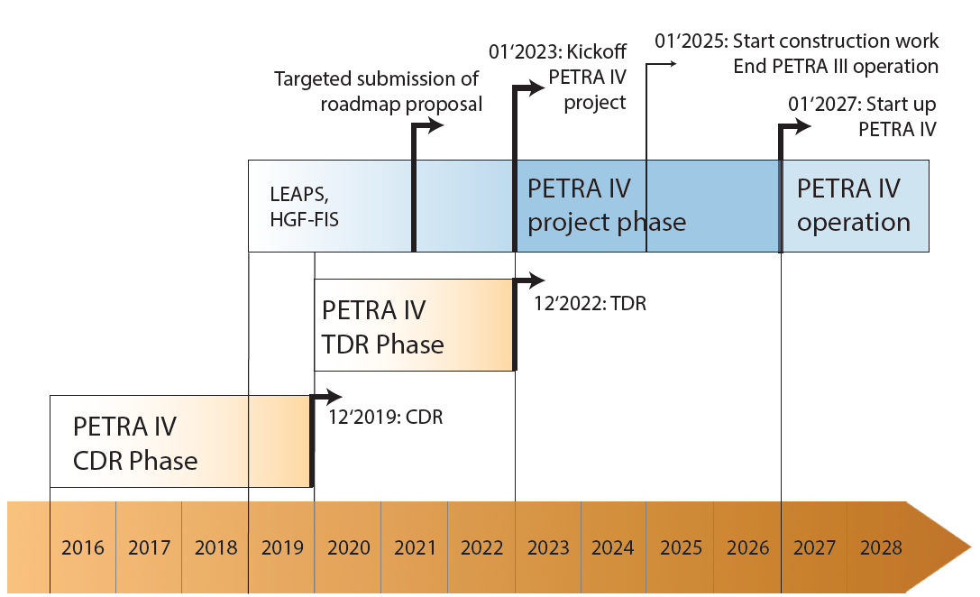
PETRA IV
TDR Phase defined from the project phase
Goal: 1) bring PETRA IV onto the national roadmap
of large-scale research facilities
2) TDR 12’2022
Presently: CDR completed

Slide 18
Thank you

Slide 19
Michael Bieler
MBB
Bieler@desy.de
+494089983805

