Slide 1
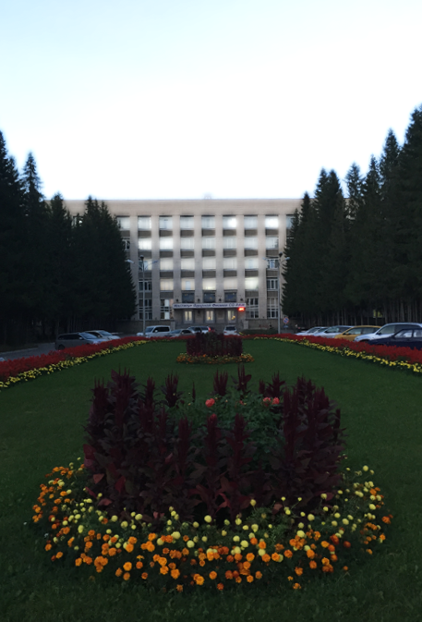

SKIF − Fourth generation synchrotron light source in Novosibirsk
G.Baranov, A.Bogomyagkov, V.Bukhtiarov, S.Gurov, G.Gusev, K.Karyukina, V.Kiselev, A.Krasnov, G.Kulipanov, V.Kuzminykh, A.Levichev, E.Levichev, P.Logachev, N.Mezentsev, I.Morozov, I.Okunev, P.Piminov, Y.Rakshun, T.Rybitskaya, V.Shkaruba, S.Sinyatkin, M.Skamarokha, A.Starostenko, A.Tribendis, A.Tsyganov, N.Vinokurov, P.Vobly, A.Zhuravlev, K.Zolotarev, I.Zubavichus et.al.

Slide 2

Russian acronym SKIF (Siberian Circular Photon Source) also means Scyth or Scythian. Scythians were ancient nomads originally located in northern Black Sea and fore-Caucasus regions.
Scytho-Siberian culture attributes to the population inhabited modern Altai Republic (south of Novosibirsk), which were known as skilled crafts gold workers. Altai kurgans – large burial mounds – provides many samples of beautiful gold works, and we believe that our new synchrotron light source will shine as bright as Scythian jewelries.

Slide 3
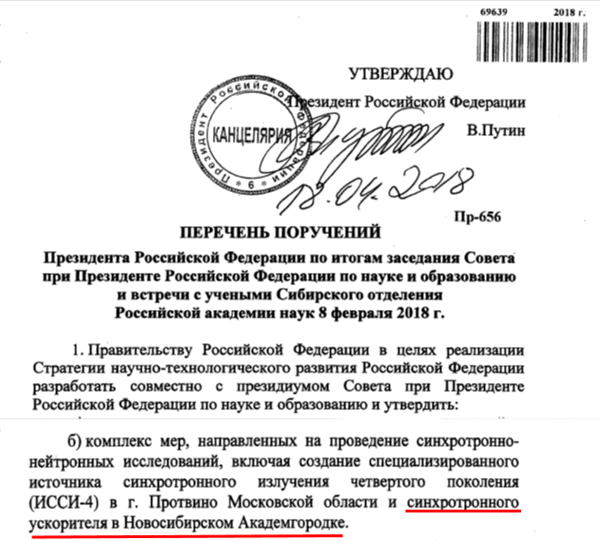
Formal motivation
08.02.2018 during his visit to Novosibirsk V.Putin supported development of Siberian synchrotron light source SKIF
Instruction of President of Russia, May 7, 2018, paragraphs 1b and 4.
Decree of President of Russia, #204, April 18, 2018.
Governmental Executive Order #2659-p, December 1, 2018.
Scientific Council headed by the Vice Prime Minister T. Golikova approved SKIF specs and location in November 2019.
Governmental Decree opening the project financing is expected in December 2019.
Government together with Presidential council of science and education must develop the full range of measures to build 4th generation light sources in Protvino and Novosibirsk Akademgorodok.
V.Putin
18.04.2018

Slide 4
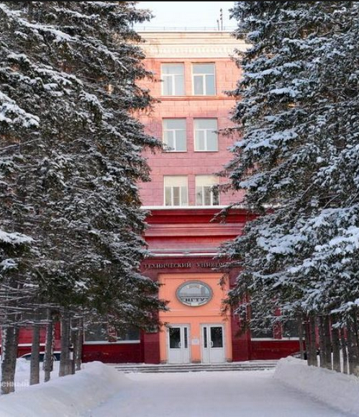
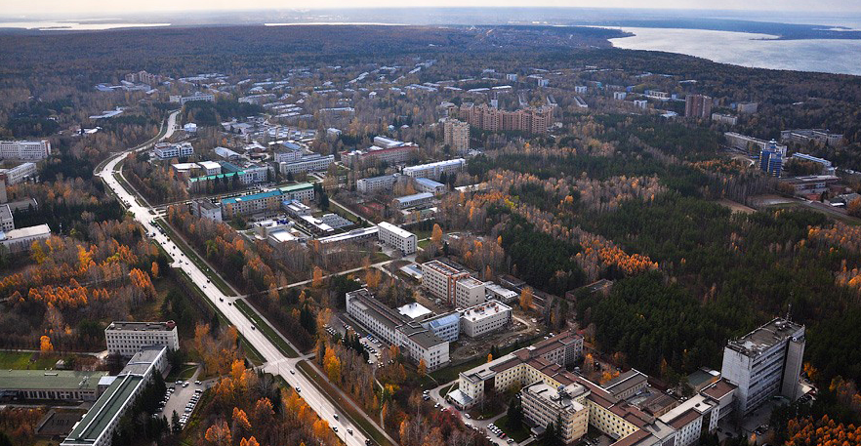
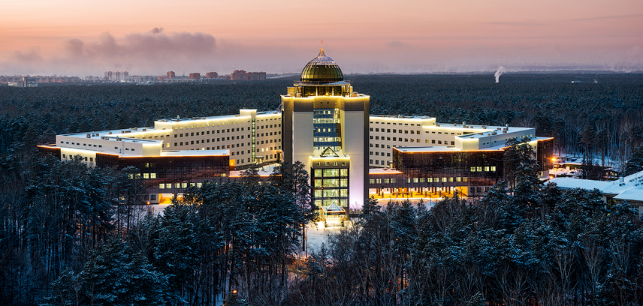
Informal motivation
Novosibirsk Akademgorodok (Academic town) consolidates more than 40 research institutes in physics, chemistry, biology, medicine, condensed matter, geology, etc. and most of them have expressed their interest in new facility
BINP has great experience in development, production, study and maintenance of large accelerator facilities including synchrotron light sources
Siberian Synchrotron and Terahertz Radiation Center consists of several dozen of research groups with more than 40 years of experimental experience
Novosibirsk State University and Novosibirsk Technical State University will secure new scientific center with young but skilled staff
Institutes of Akademgotrodok
Novosibirsk State University
Novosibirsk State Technical U.

Slide 5
Specifications
Beam energy 3 GeV
Circumference < 500 m
Natural horizontal emittance ≤100 pm (zero current, zero coupling, no IDs)
Injection complex à la NSLS II (150-200 MeV linac and full energy booster synchrotron)
Well proven top-up off-axis injection in the horizontal phase space with four-kicker bump, etc.
Transverse DA for injection Ax_{inj} ≥ 7 mm (with errors and misalignments)
Momentum DA for good Touschek lifetime with strong IBS (Δp/p)_{max} ≥ ~2.5%
Sufficient number of beamlines
  From wigglers and undulators (straight sections)
  Hard X-ray from strong field dipoles
  Soft X-ray and VUV from weak field magnets
Robust, effective, low price, fast development design

Slide 6
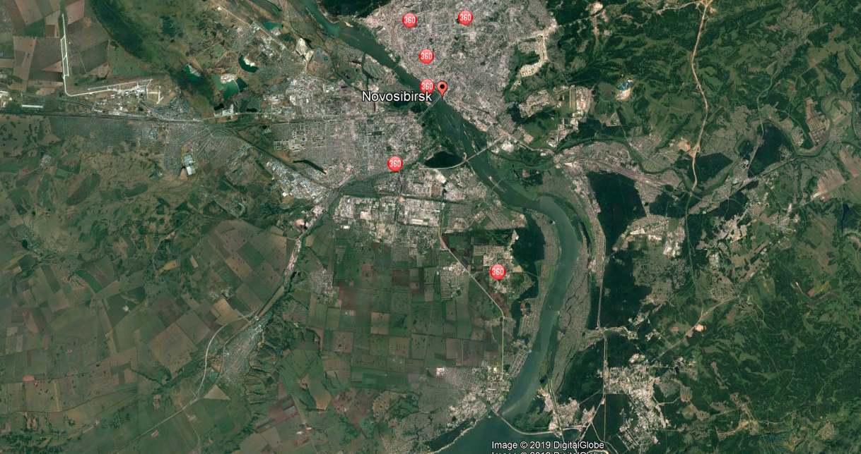
Location
Novosibirsk Int. Airport
Novosibirsk
≈20 км
SKIF locates in technopolis Kol’tsovo
Green field. No interference with other enterprises
Quiet area free from heavy industry
Electrical power substation is nearby
Almost equal distance from both downtown and Akademgorodok
SKIF
≈15 км
BINP

Slide 7
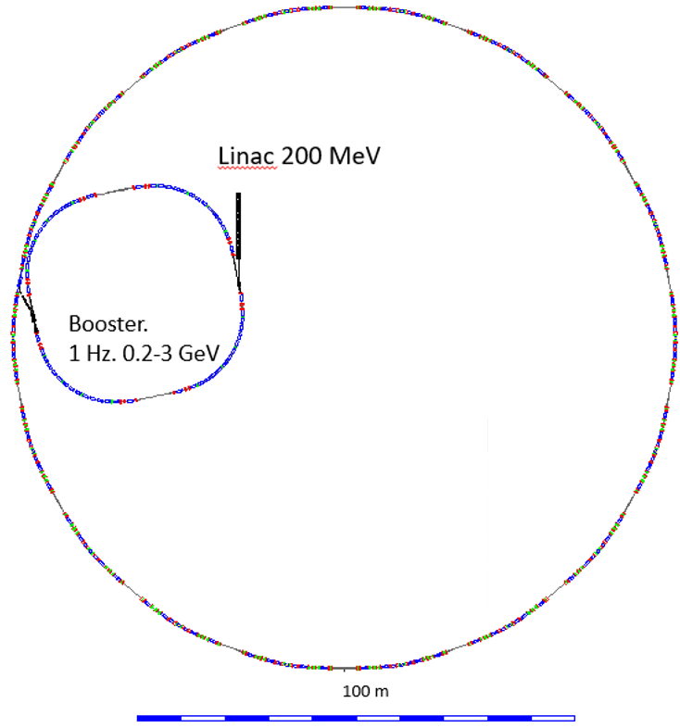
Configuration
Traditional and common configuration:
Injector linear accelerator with maximum energy 200 MeV
Small size booster synchrotron with maximum energy 3 GeV and orbit length 158.7 m
Electron storage ring 16-fold symmetry with 3 GeV energy and 476 m circumference
Е = 3 GeV
I_{max} = 400 mA
ε_{x} = 75 pm (0 mA, no IDs)
C = 476 m
16 SS (14 for IDs)

Slide 8
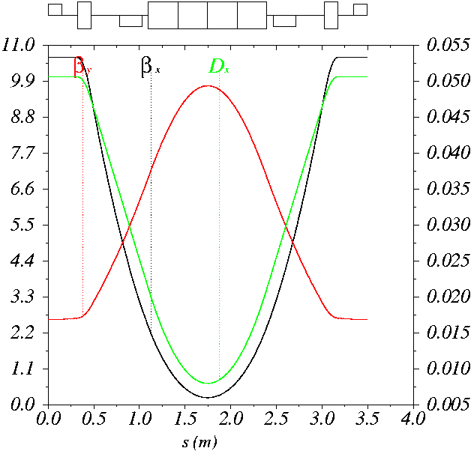


Basic cell (soft X-ray beamline)
SX
QXB
SY
BQY
SY
QXB
SX
TME/FODO cell 3.49 m in length with reflection symmetry
SX: focusing chromatic sextupole (≈2300 T/m²)
QXB: focusing quadrupole (51 T/m) moved over 4.6 mm outward to produce –3.6 mrad anti-bend
SY: defocusing chromatic sextupole (≈ –2300 T/m ²)
BQY: bending magnet (0.55 T) with low defocusing gradient (–7.7 T/m)
Drifts between elements are enough to accommodate BPMs, flanges, bellows, etc.

Slide 9
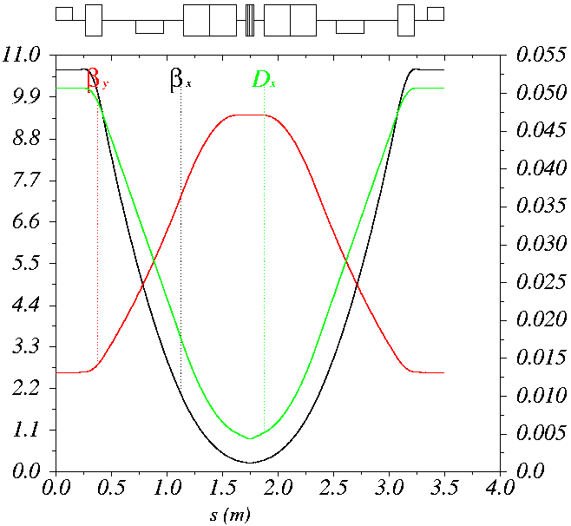
Modified cell (hard X-ray beamline)
SX
SY
SY
SX
QXBM
BQYM
BQYM
QXBM
BHF
High field dipole BHF is inserted inside modified BQY.
QXBM: focusing quadrupole (49 T/m) moved over 7.3 mm outward to produce –5.4 mrad anti-bend
BQYM: bending magnet (0.64 T) with low defocusing gradient (–10.1 T/m)
BHF: high field (2.1 T) short (7 cm) zero gradient permanent magnet dipole producing hard X-ray radiation
The modified cell replaces the middle cell in every other lattice super-period, giving 8 hard X-ray beamlines from bending magnets.

Slide 10
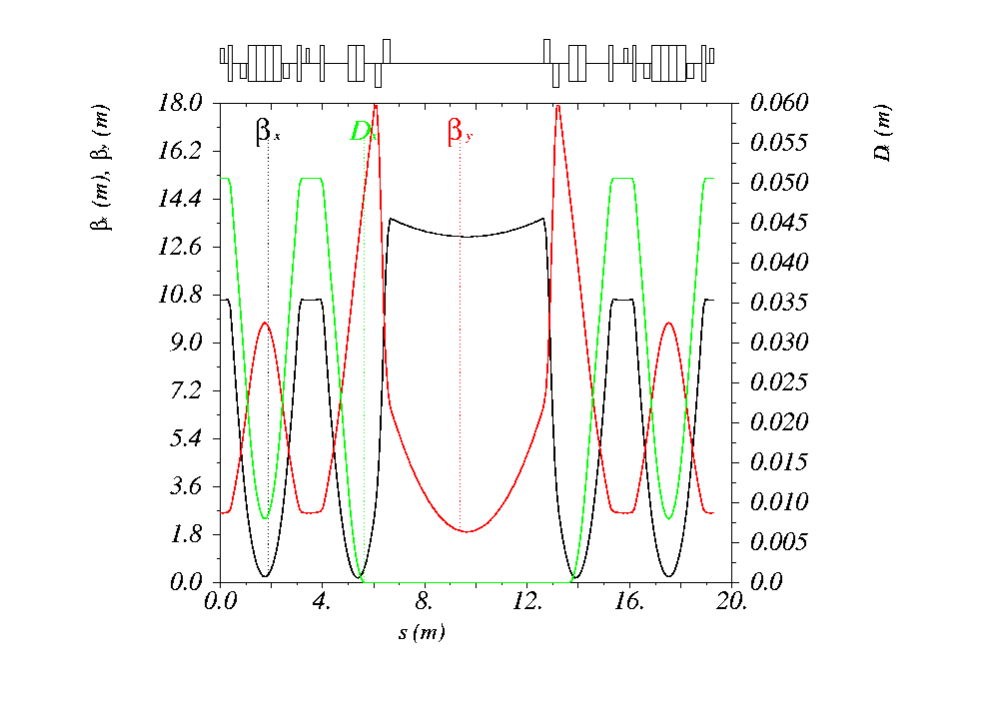
High β_{x} straight section
Disp.
supp.
Disp.
supp.
Cell
Cell
6-m-long dispersion-free straight section with two quadrupole doublets (double doublet or DD section) accommodates undulators, relatively low field wigglers (~4.5 T 50 mm period 2 m long wiggler does not increase but decrease emittance), injection and RF equipment.
Beta_y* is low enough to suppress optic distortion caused by insertion devices. Beta_x* is large enough for traditional injection with horizontal bump of stored beam.
6 m
β_{x}/ β_{y}=13/1.9 m

Slide 11
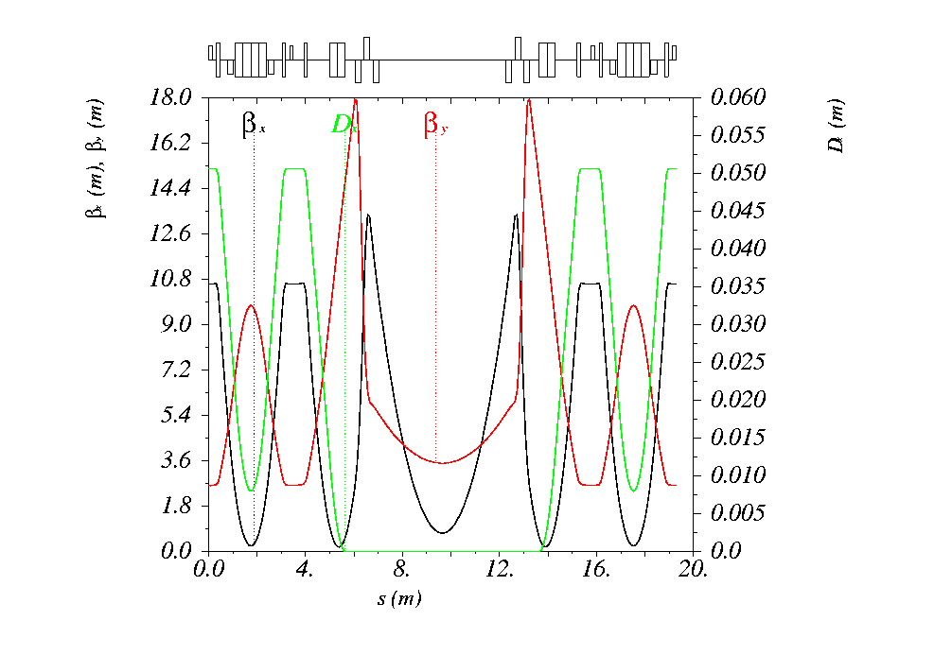
Low β_{x} straight section
Disp.
supp.
Disp.
supp.
Cell
Cell
4.24 m
Strong field (7-8 T) wigglers/shifters being installed in the high β_{x} section may increase the beam emittance. To prevent it a low β_{x} section is designed by installing 2 additional quadrupoles (double triplet or DT section).
Only gradients in the straight section are changed slightly. All other magnets are identical to the DD-section solution.
β_{x}/ β_{y}=0.7/3.5 m

Slide 12
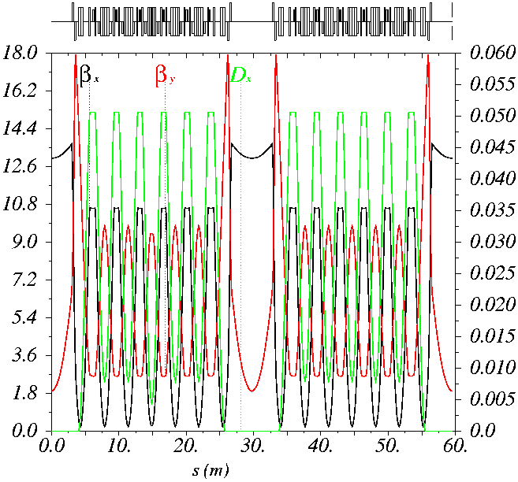
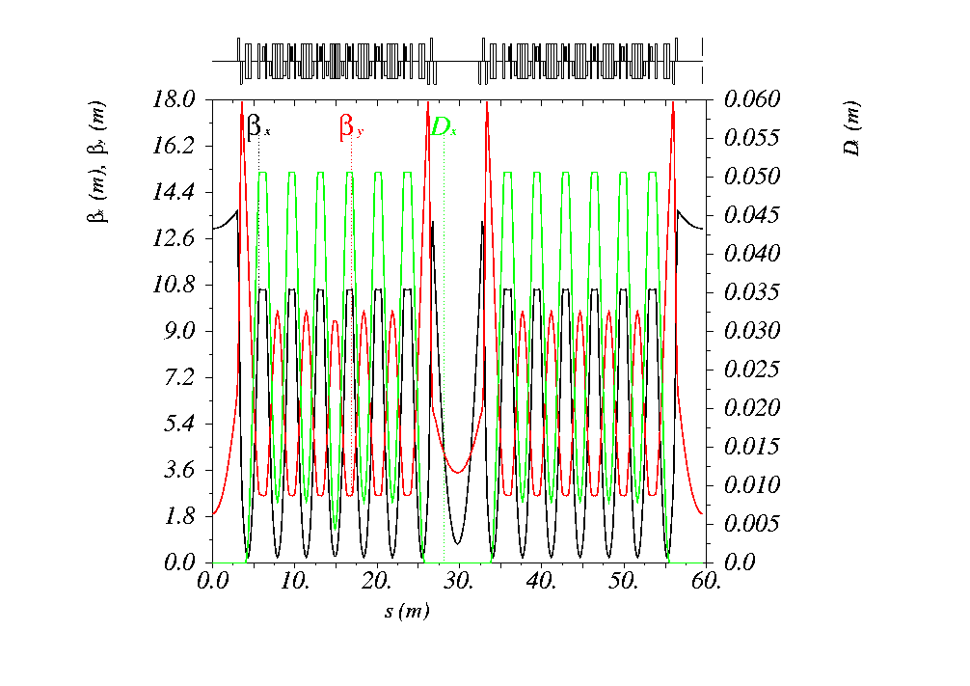
Super-periods
LS 6m
HFM 2.1T
LS 6m
LFM 0.5T
LS 6m
LS 6m
HFM 2.1T
SS 4.24m
LFM 0.5T
LS 6m
DD-solution
DT-solution

Slide 13
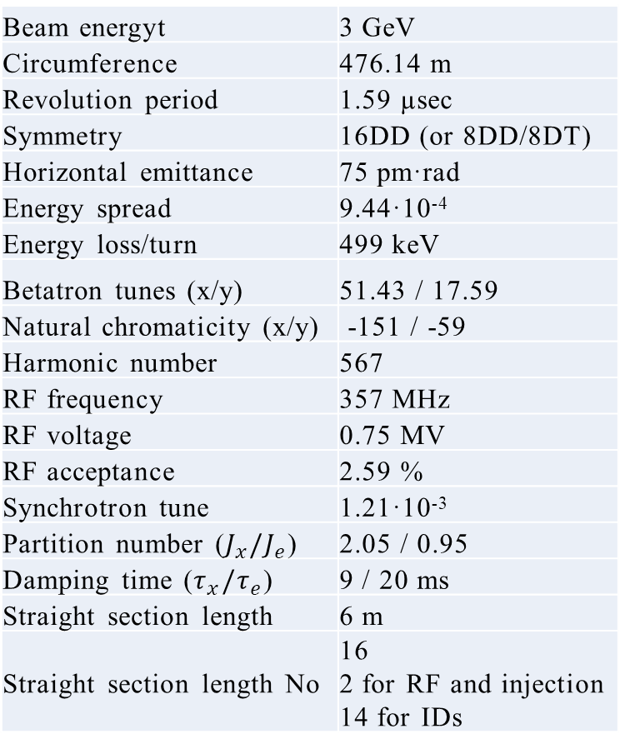
Parameters and features
Beam energyt | 3 GeV
Circumference | 476.14 m
Revolution period | 1.59 µsec
Symmetry | 16DD (or 8DD/8DT)
Horizontal emittance | 75 pm·rad
Energy spread | 9.44·10⁻⁴
Energy loss/turn | 499 keV
Betatron tunes (x/y) | 51.43 / 17.59
Natural chromaticity (x/y) | -151 / -59
Harmonic number | 567
RF frequency | 357 MHz
RF voltage | 0.75 MV
RF acceptance | 2.59 %
Synchrotron tune | 1.21·10⁻³
Partition number ($J_{x}/J_{e}$) | 2.05 / 0.95
Damping time ($τ_{x}/τ_{e}$) | 9 / 20 ms
Straight section length | 6 m
Straight section length No | 16 2 for RF and injection 14 for IDs
Lattice type: 7B Achromat
Symmetry: 16 (DD sections) or 8 (DT sections), TBD
1 straight section for main RF, 1 straight section for injection and 3hRF, 14 straight sections for IDs
Linac 2856 МГц/8 = 357 MHz
Synchrotron 158.76 m (harmonic number 189)
SKIF 158.76 m х 3 = 476.14 m (harmonic number 567)
14 beamlines from wigglers and undulators
8 hard X-ray beamlines from 2.1 T magnets (can be increased up to 16 if necessary)
8 soft X-ray beamlines from 0.52 T magnets (can be increased up to 16 if necessary)
In total, there are 46 beam lines

Slide 14
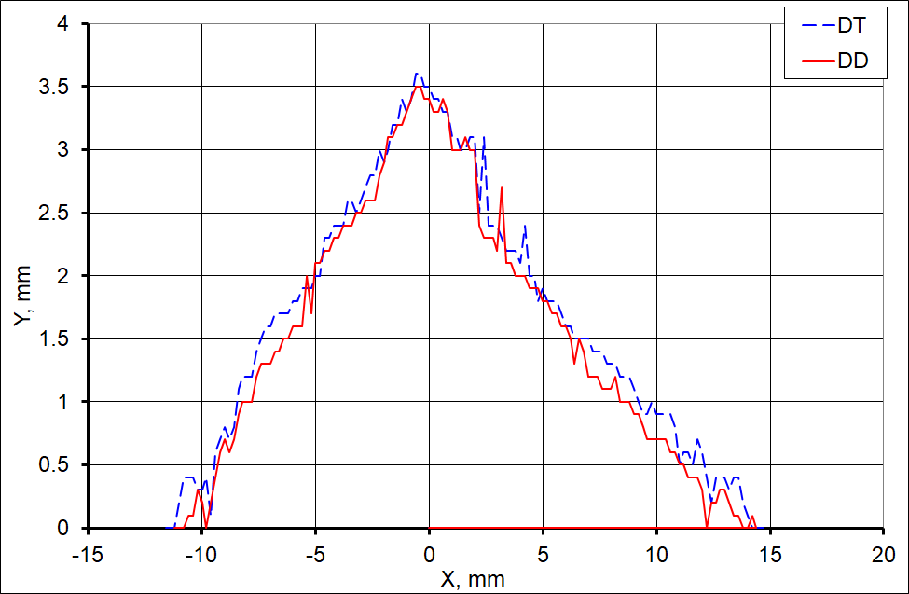
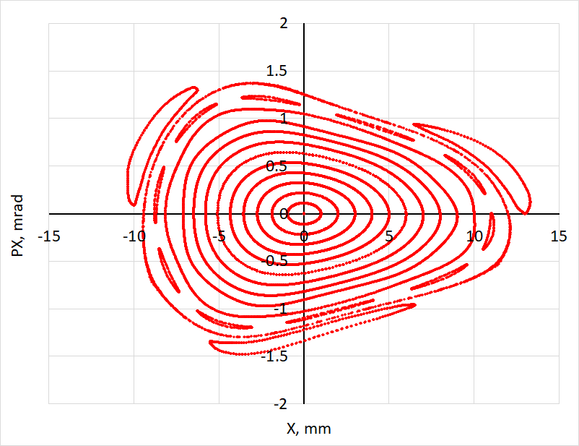
4D DA
Квадруполь
∅30 мм
70 Т/м
300 А х 10 витков
8 mm SR gap
Nonlinear beam dynamics was carefully studied with MAD-X, Accelerator Toolbox and two in house accelerator development codes. Correspondence is very good.
Particles stable for 2048 turns. Here and below β_{x} = 13 m, β_{y} = 1.9 m
Ay = 3.5 mm
Ax = -10… +12 mm
Ax = -10… +12 mm
MAD-X On-energy transverse dynamic aperture for two families chromatic sextupoles in the cells.
DD lattice, observation in the middle of the straight section.

Slide 15
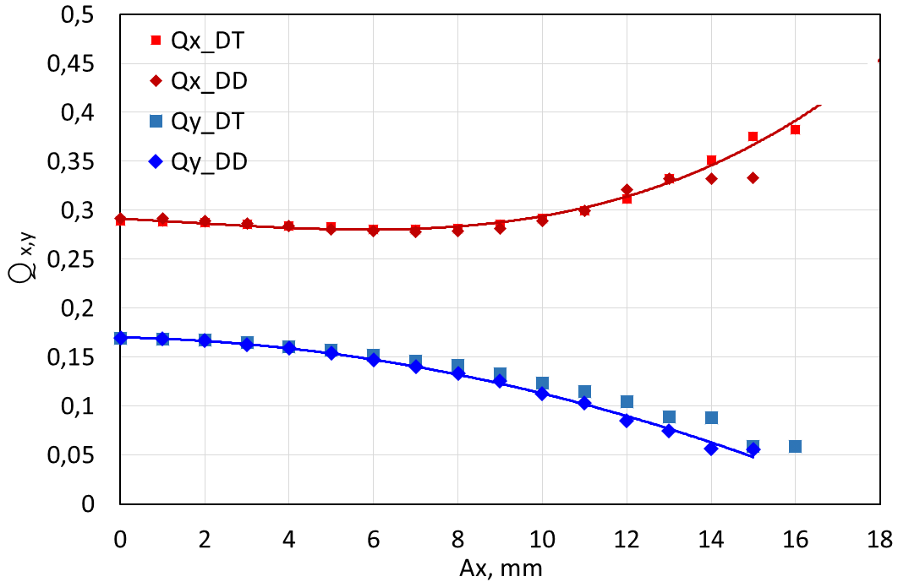
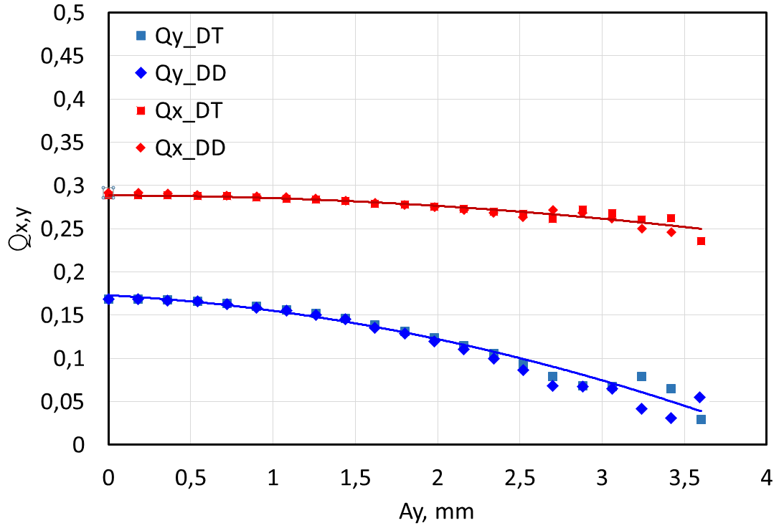
Betatron tunes vs. amplitude
Квадруполь
∅30 мм
70 Т/м
300 А х 10 витков
8 mm SR gap
Betatron tunes as a function of the amplitude for both planes and for both DD and DT configurations.

Slide 16
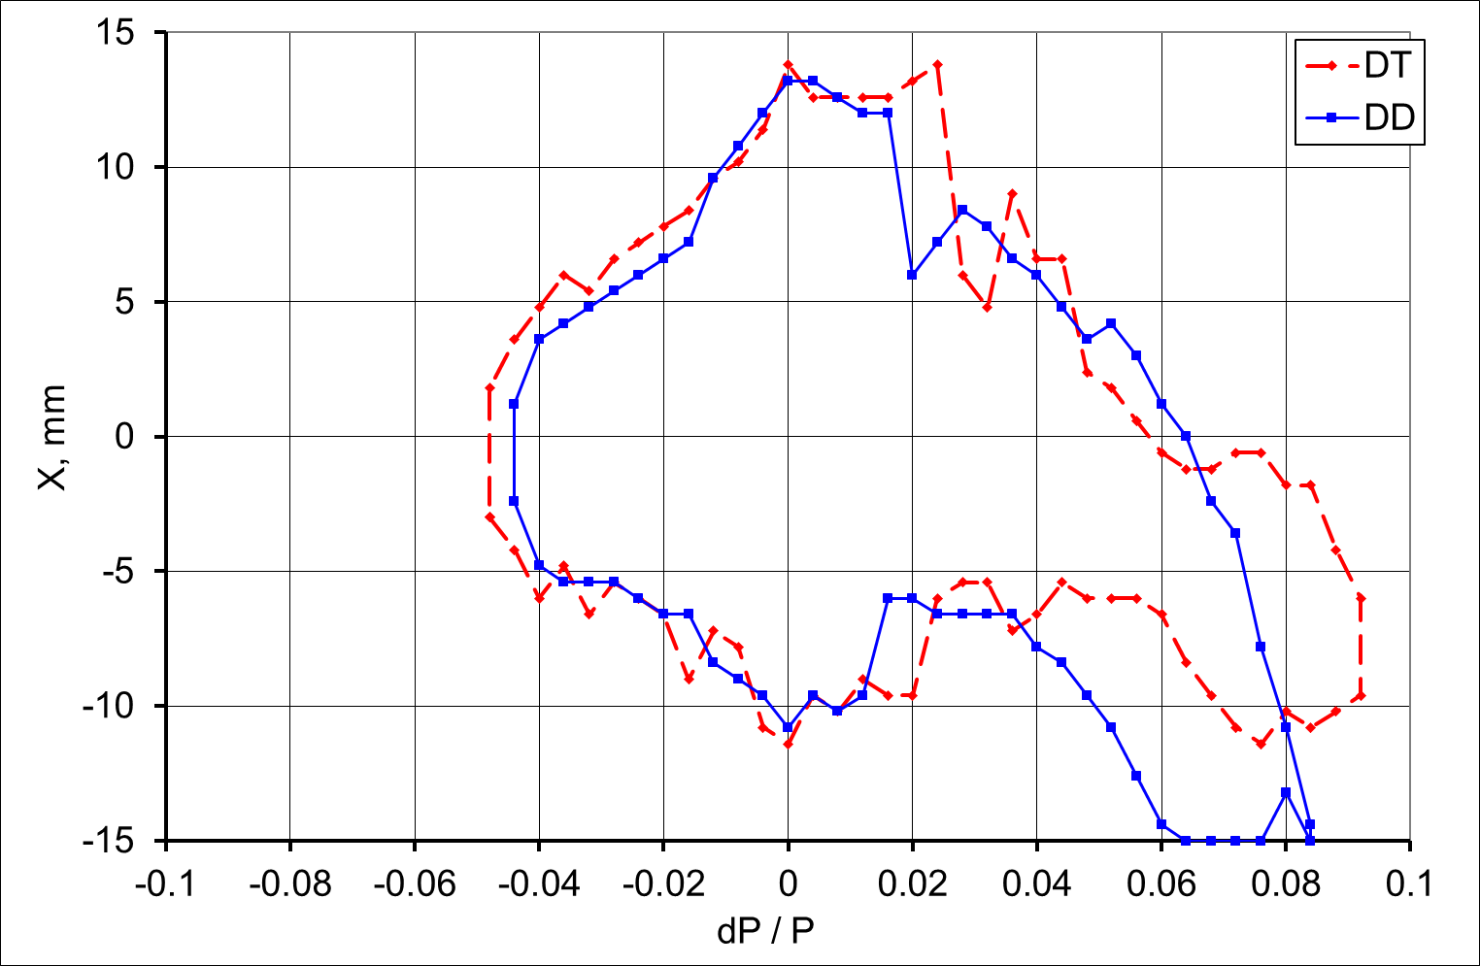
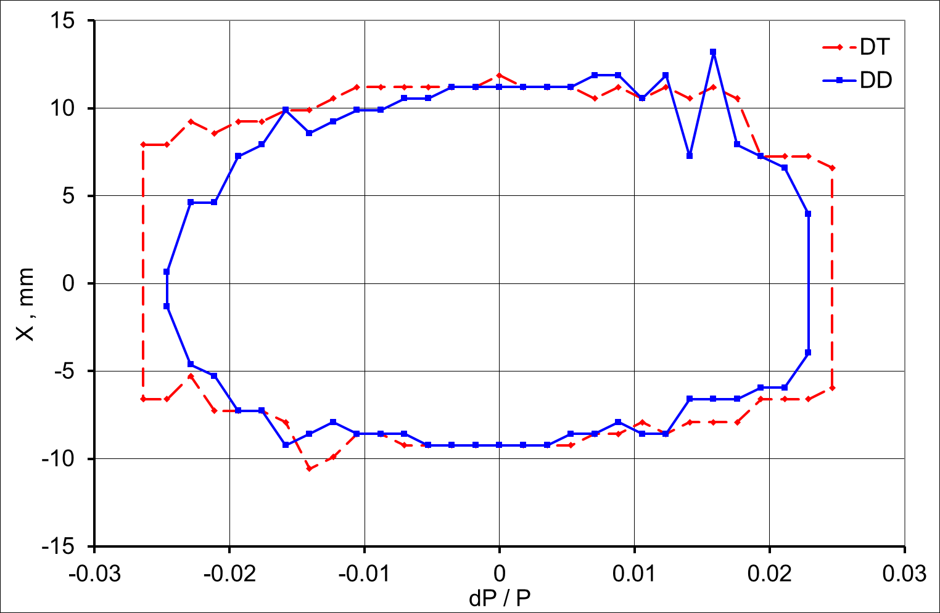
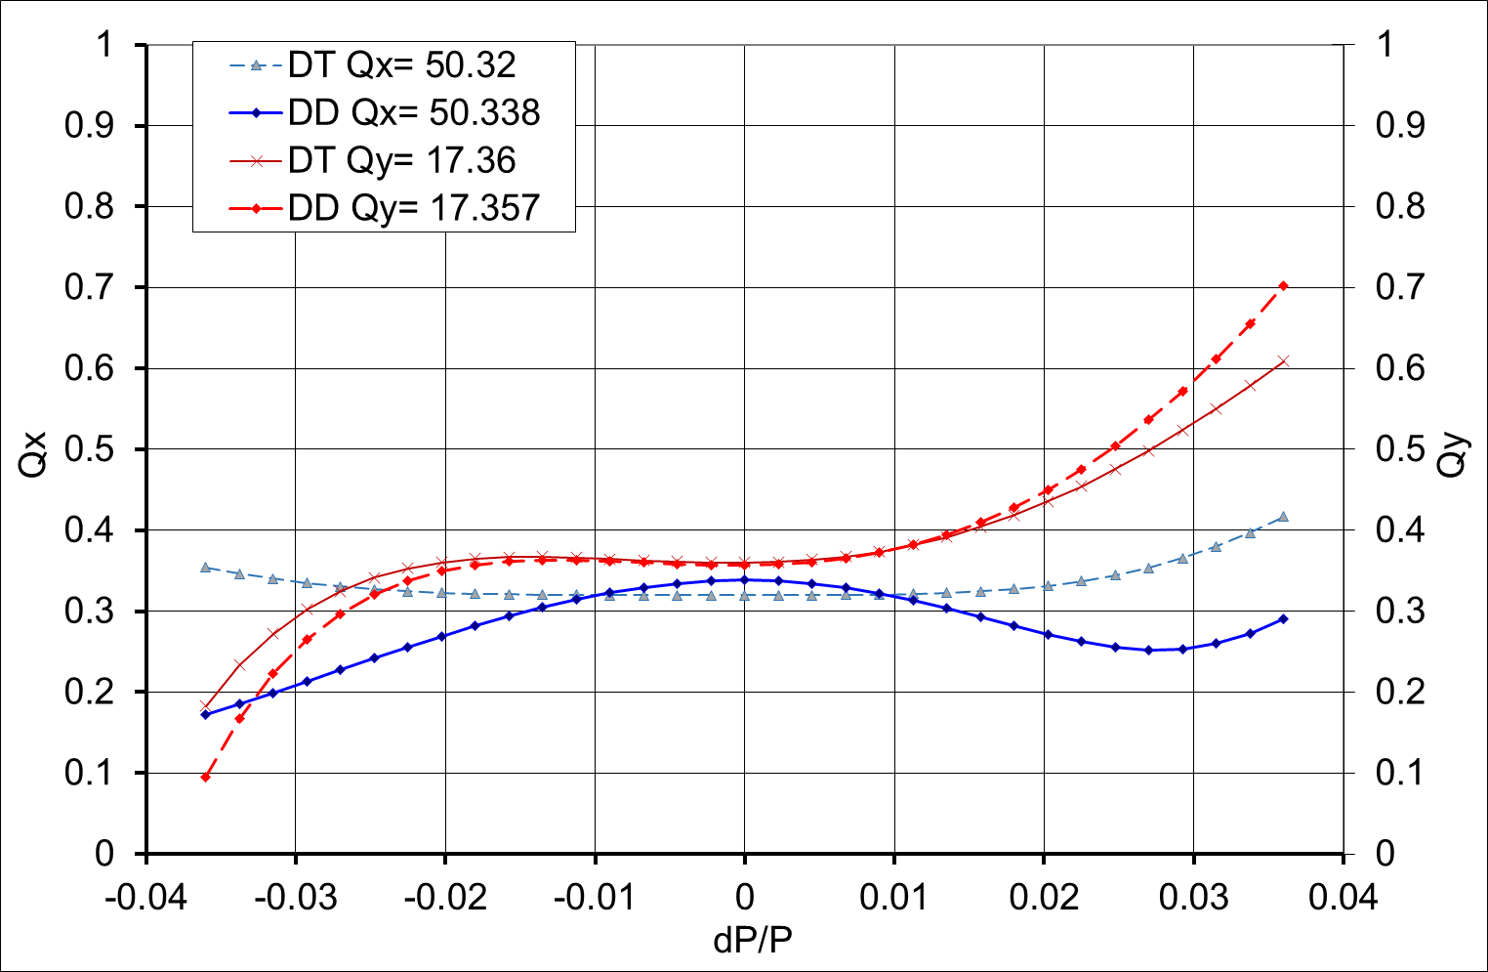
Momentum aperture and bandwidth
Квадруполь
∅30 мм
70 Т/м
300 А х 10 витков
8 mm SR gap
Main RF on (V₁ = 0.75 MV), 3hRF on (V₃ = 0.18 MV) providing threefold bunch lengthening. 10000 turns.
dP/P ≈ -4… +2.6 %
dP/P ≈ -4…+6 %
dP/P ≈ ±2.5 %
Dynamic acceptance (RF off)
Dynamic acceptance (RF on)
Tune bandwidth

Slide 17
Horizontal aperture map
Tunes selection (per super-period)
Color indicates the horizontal DA in mm (left DT, right DD)

Slide 18
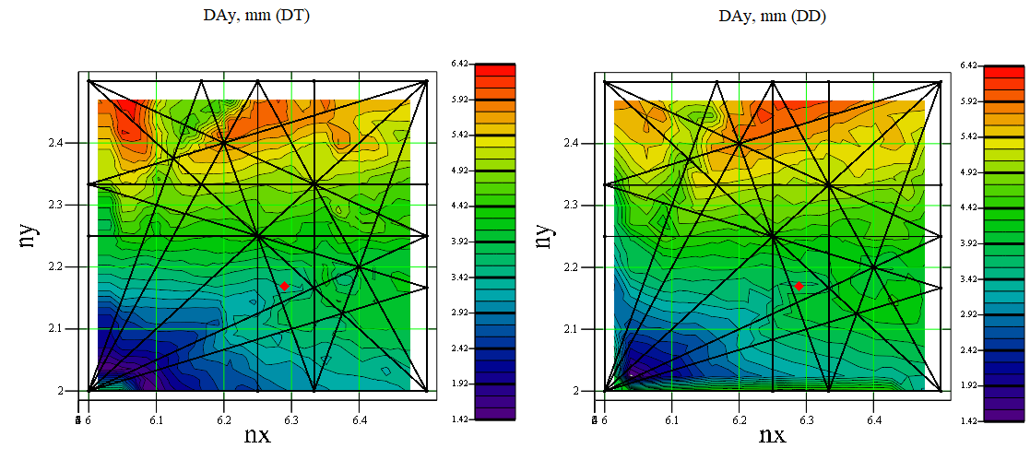
Vertical aperture map
Color indicates the vertical DA in mm (left DT, right DD)

Slide 19
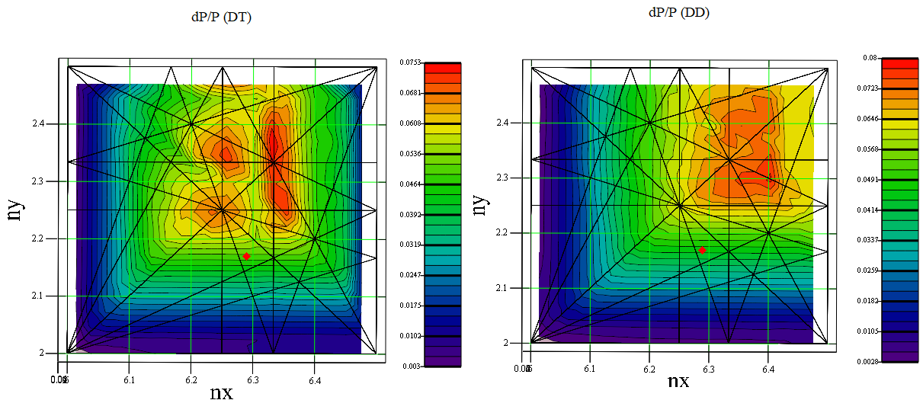
Energy aperture map
Color indicates the energy acceptance in % (left DT, right DD)

Slide 20
Dynamic aperture conclusions
Only two families of chromatic sextupoles in the cells provide reasonable dynamic aperture (transverse and longitudinal).
The aperture, decreased by the lattice errors (linear and nonlinear), is still sufficient for good Touschek lifetime (including IBS) and traditional robust injection with a horizontal bump.
There is room in the dispersion suppression section for additional multipole correctors to optimize the DA or/and bandwidth but it is not evident if it is really needed.

Slide 21
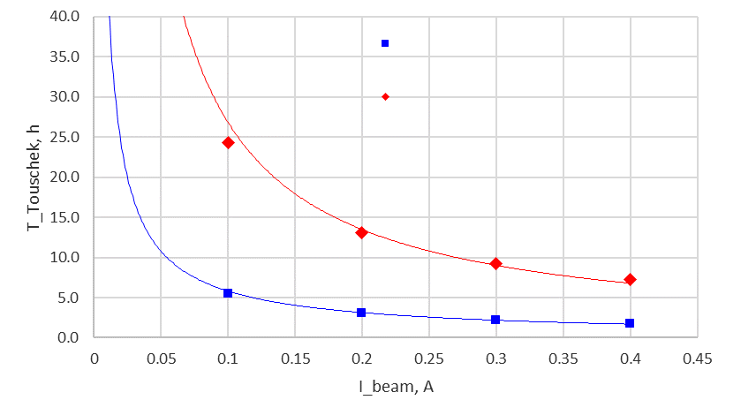
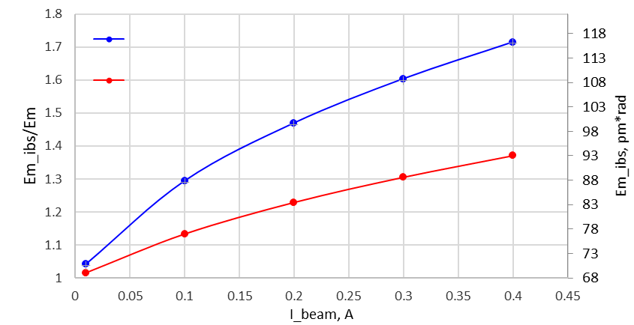
Intra beam scattering (bare lattice, DT)
σ_{s}=5.1 mm
V_{RF}=752 kV
N_{b}=510
= 10%
ΔE/E = ±2.6%
σ_{s}=5.1 mm
σ_{s}=15.3 mm
σ_{s}=15.3 mm
V_{RF}=752 kV
N_{b}=510
= 10%
ΔE/E = ±2.6%
Multi-bunch mode (510 bunches):
I = 400 mA (0.783 mA/bunch, 7.77×10⁹ е/bunch). Betatron coupling = 10% (ε_{y} ≈ 9 pm ≈ ε_{r} at λ_{c}= 1 Å).
A threefold bunch elongation by the 3rd harmonic RF provides 7 h Touschek lifetime and ε_{x0}= 67 pm → ε_{xIBS}= 93 pm.

Slide 22
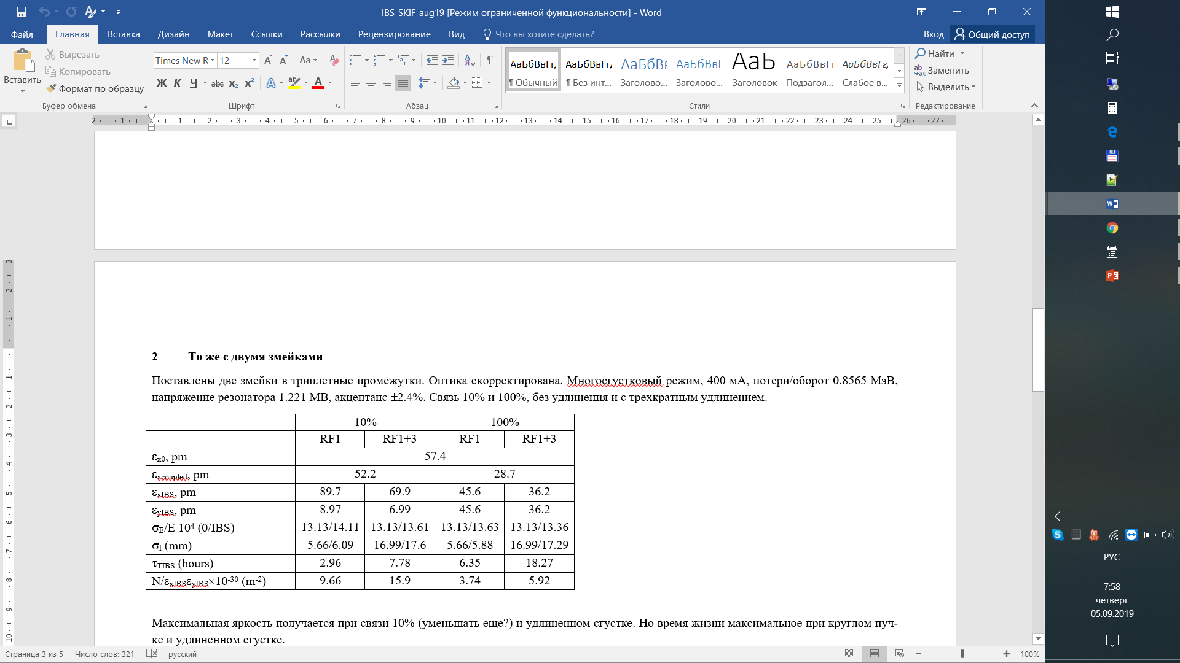
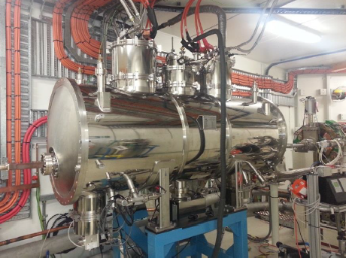
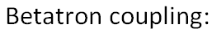
Intra beam scattering (2 wigglers)
For users we planned to install two SC multipole wigglers (B₀ = 4.5 T, λ₀ = 5 cm, L_{w} = 2 m) in the DD straight sections. The betatron function is optimized; therefore, the wigglers effectively reduce the emittance.
4.2 T, 5 cm, 2 m wiggler for Australian Light Source, N.Mezentsev
(Quasi) round beam, max lifetime
Flat beam, max brightness

Slide 23
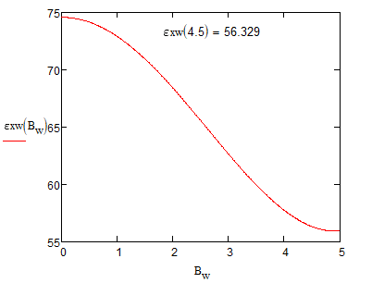
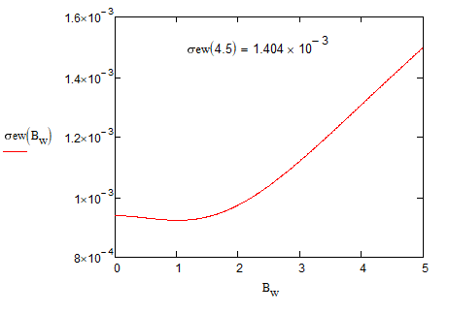
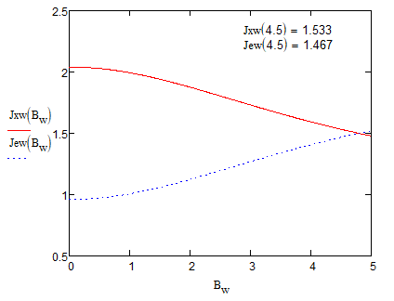
Wigglers and emittance
λ=5 см В = 4.5 Т N_{per}=20 L = 2 m
1 wiggler: 75 pm → 63 pm
2 wigglers: 75 pm → 56 pm
Energy spread
Emittance
Partitions

Slide 24
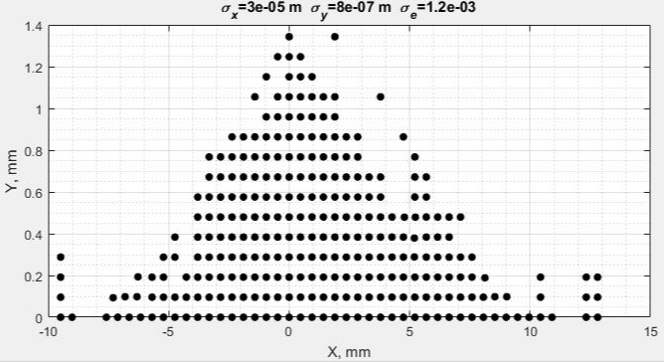
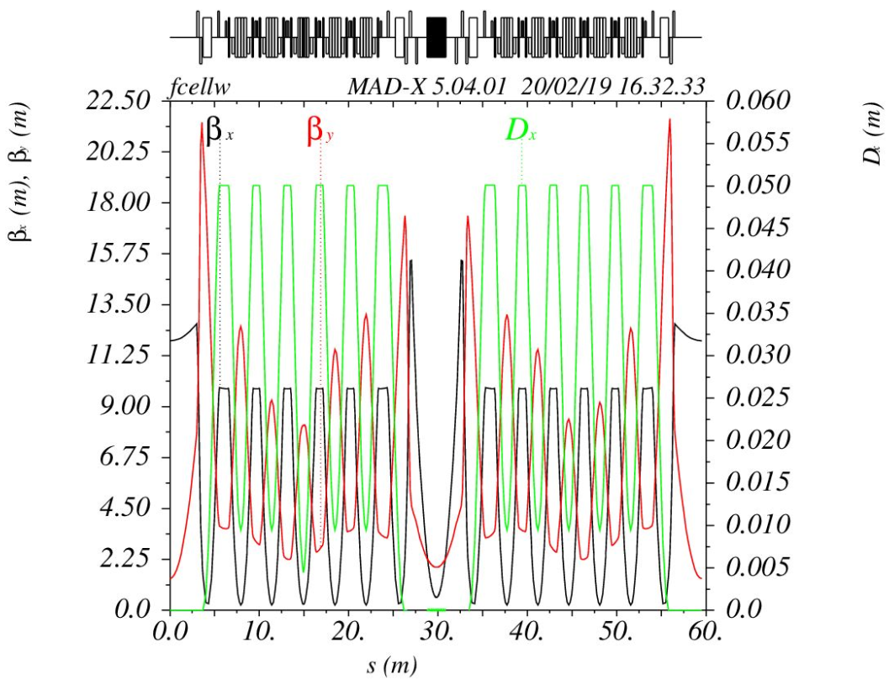
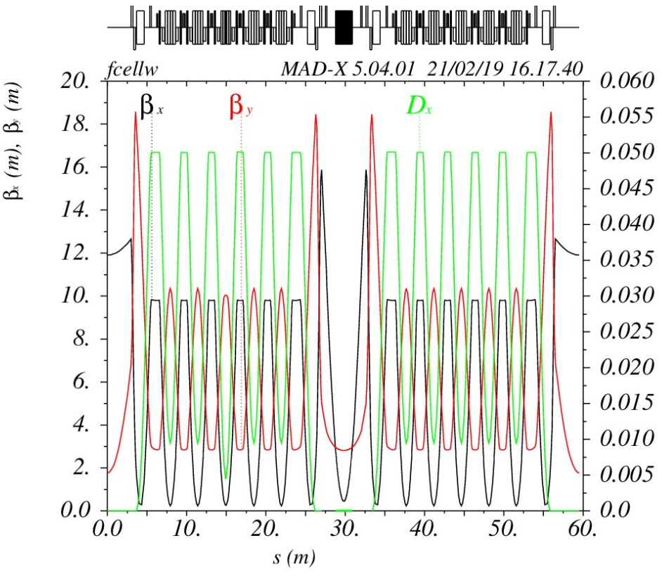
Wiggler and lattice
λ=5 см В = 4 Т N_{per}=20 L = 2 m
Only local (triplet) correction
K1_qm12: −4.8147 → −4.7703 m⁻²
K1_qm13: +6.5620 → +5.9983 m⁻²
K1_qm11: −0.5036 → +0.5574 m⁻²
Δν_{x}=0.01 Δν_{y}=0.001
DA w/o wiggler correction
Wiggler optics distortion
Δβ_{y}/β_{y}≈±25%
Before optics correction
After optics correction

Slide 25
Magnets
Preliminary 2D simulation did not show any showstoppers in the magnets design and production. 3D detailed simulation is ongoing.
Quadrupoles
Name | L, m | B,T | G, T/m | Gmax, T/m | α,mrad | Ø, mm | N | Comment
Q1 | 0.25 | - | 57 | 80 | - | 30 | 16 | Long straight section
Q2 | 0.25 | - | 60 | 80 | - | 30 | 15 | Long straight section
Q3 | 0.25 | - | 2 | 80 | - | 30 | 16 | Short straight section
Q4 | 0.25 | - | 62 | 80 | - | 30 | 16 | Short straight section
Q5 | 0.25 | - | 76 | 80 | - | 30 | 16 | Short straight section
BD2 | 0.15 | -0.15 | 49 | 60 | -2.21 | 36 | 32 | Dispersion suppressor Reverse bend
BD | 0.15 | -0.24 | 51 | 60 | -3.56 | 36 | 144 | Low field magnet cell Reverse bend
BDI | 0.15 | -0.36 | 49 | 60 | -5.41 | 36 | 16 | High field magnet cell Reverse bend
Sextupoles
Name | L, m | S,T/m² | Smax, T/m² | Ø, mm | N
SY | 0.25 | 2314 | 2500 | 34 | 160
SX | 0.3 | 2351 | 2500 | 34 | 64
SXH | 0.15 | 2351 | 2500 | 34 | 32
Dipoles
Name | L, m | B,T | G, T/m | α,mrad | Gap, mm | N | Comment
BF | 1.30 | 0.55 | -7.689 | 71.29 | 30 | 72 | Regular cell, low field magnet
BF2 | 0.65 | 0.59 | -2.033 | 38.29 | 30 | 32 | Dispersion suppressor
BFI | 0.47 | 0.64 | -10.132 | 30.16 | 30 | 32 | High field magnet side bend
BI | 0.07 | 2.10 | 0.000 | 14.66 | 30 | 8 | Permanent high field magnet

Slide 26
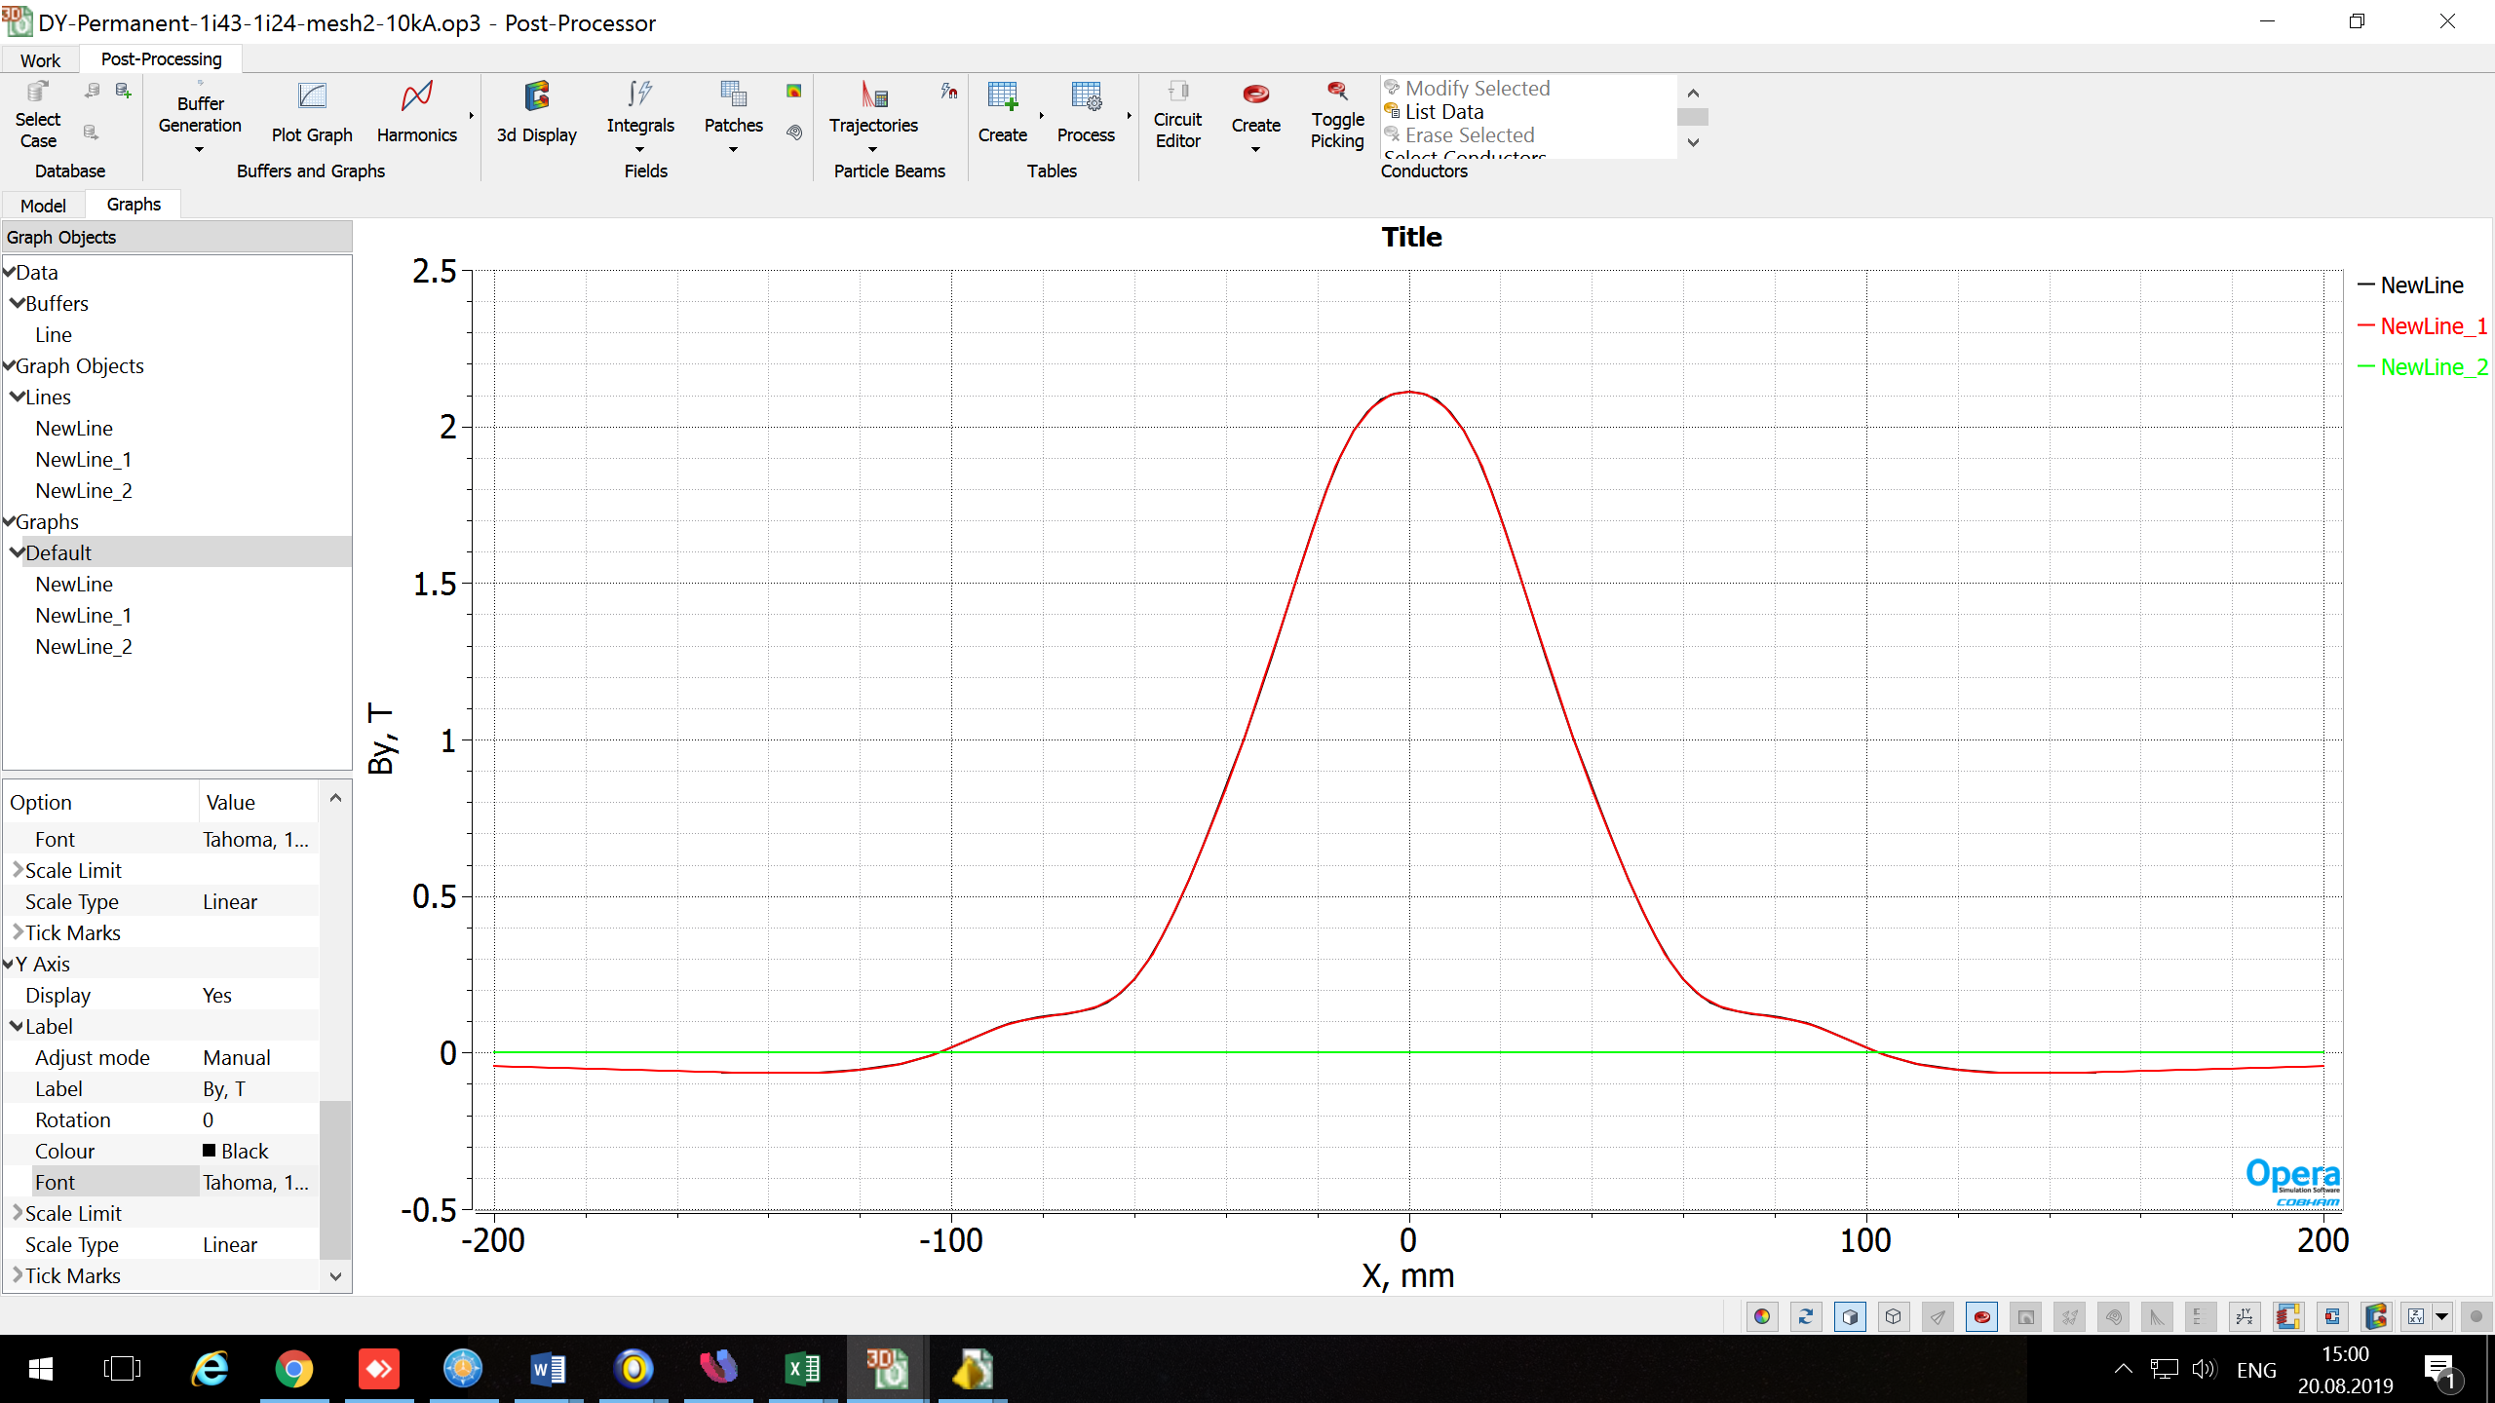
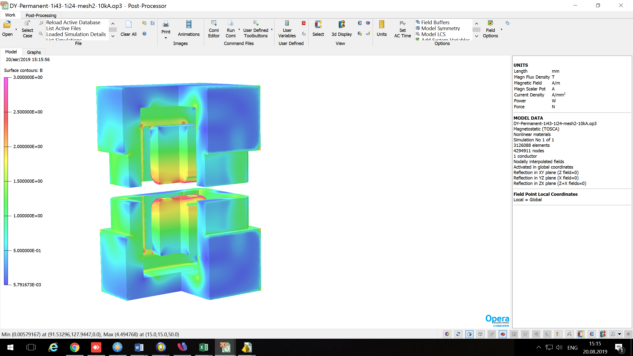
High Field Magnet
Permanent magnet with peak field of 2.1 T
L= 0.1 m
Bmax = 2.11 T
Iw/coil = 10 kA.
1
2
1 – Steel M1200-100
2 – NdFeB, 1.43T, permanent magnet
3 – NdFeB, 1.24T, permanent magnet
4 – Permendur;
3
4

Slide 27
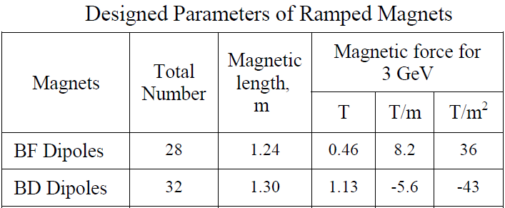
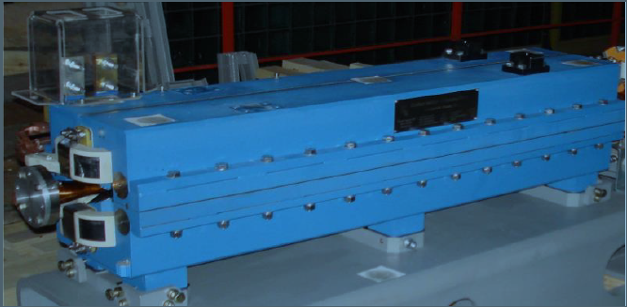
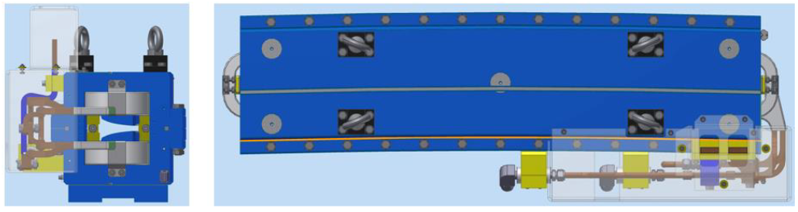
Low field magnet
Booster NSLS II magnets
There are two types of the low field gradient magnets:
L = 1.3 m, B = 0.55 T, G = -7.7 T/m (regular cell dipole)
L = 0.47 m, B = 0.64 T, G = -10.1 T/m (side bend for the 2.1 T magnet)
Both are similar to these for NSLS II booster synchrotron

Slide 28
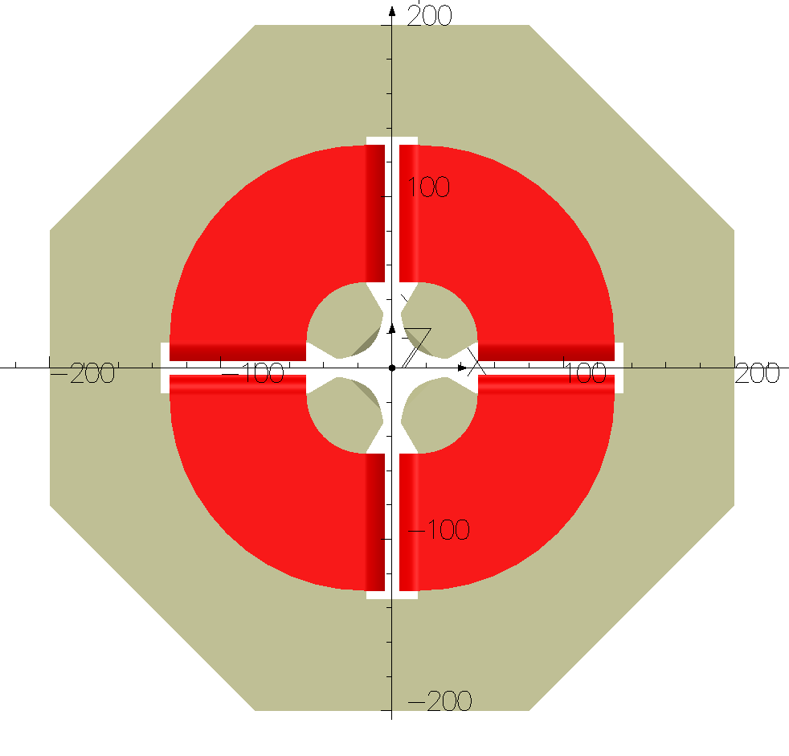
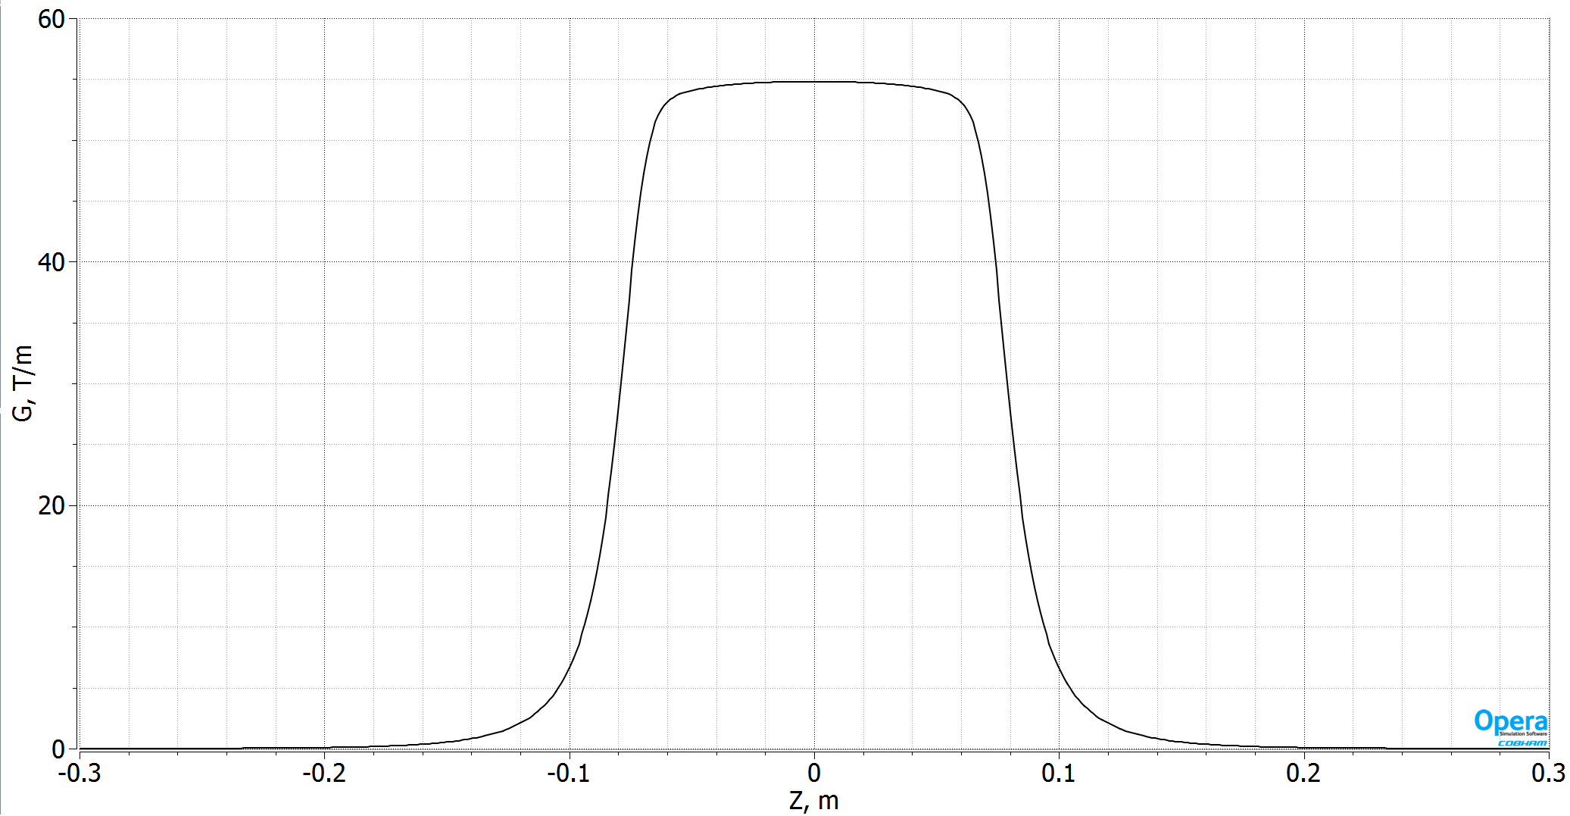
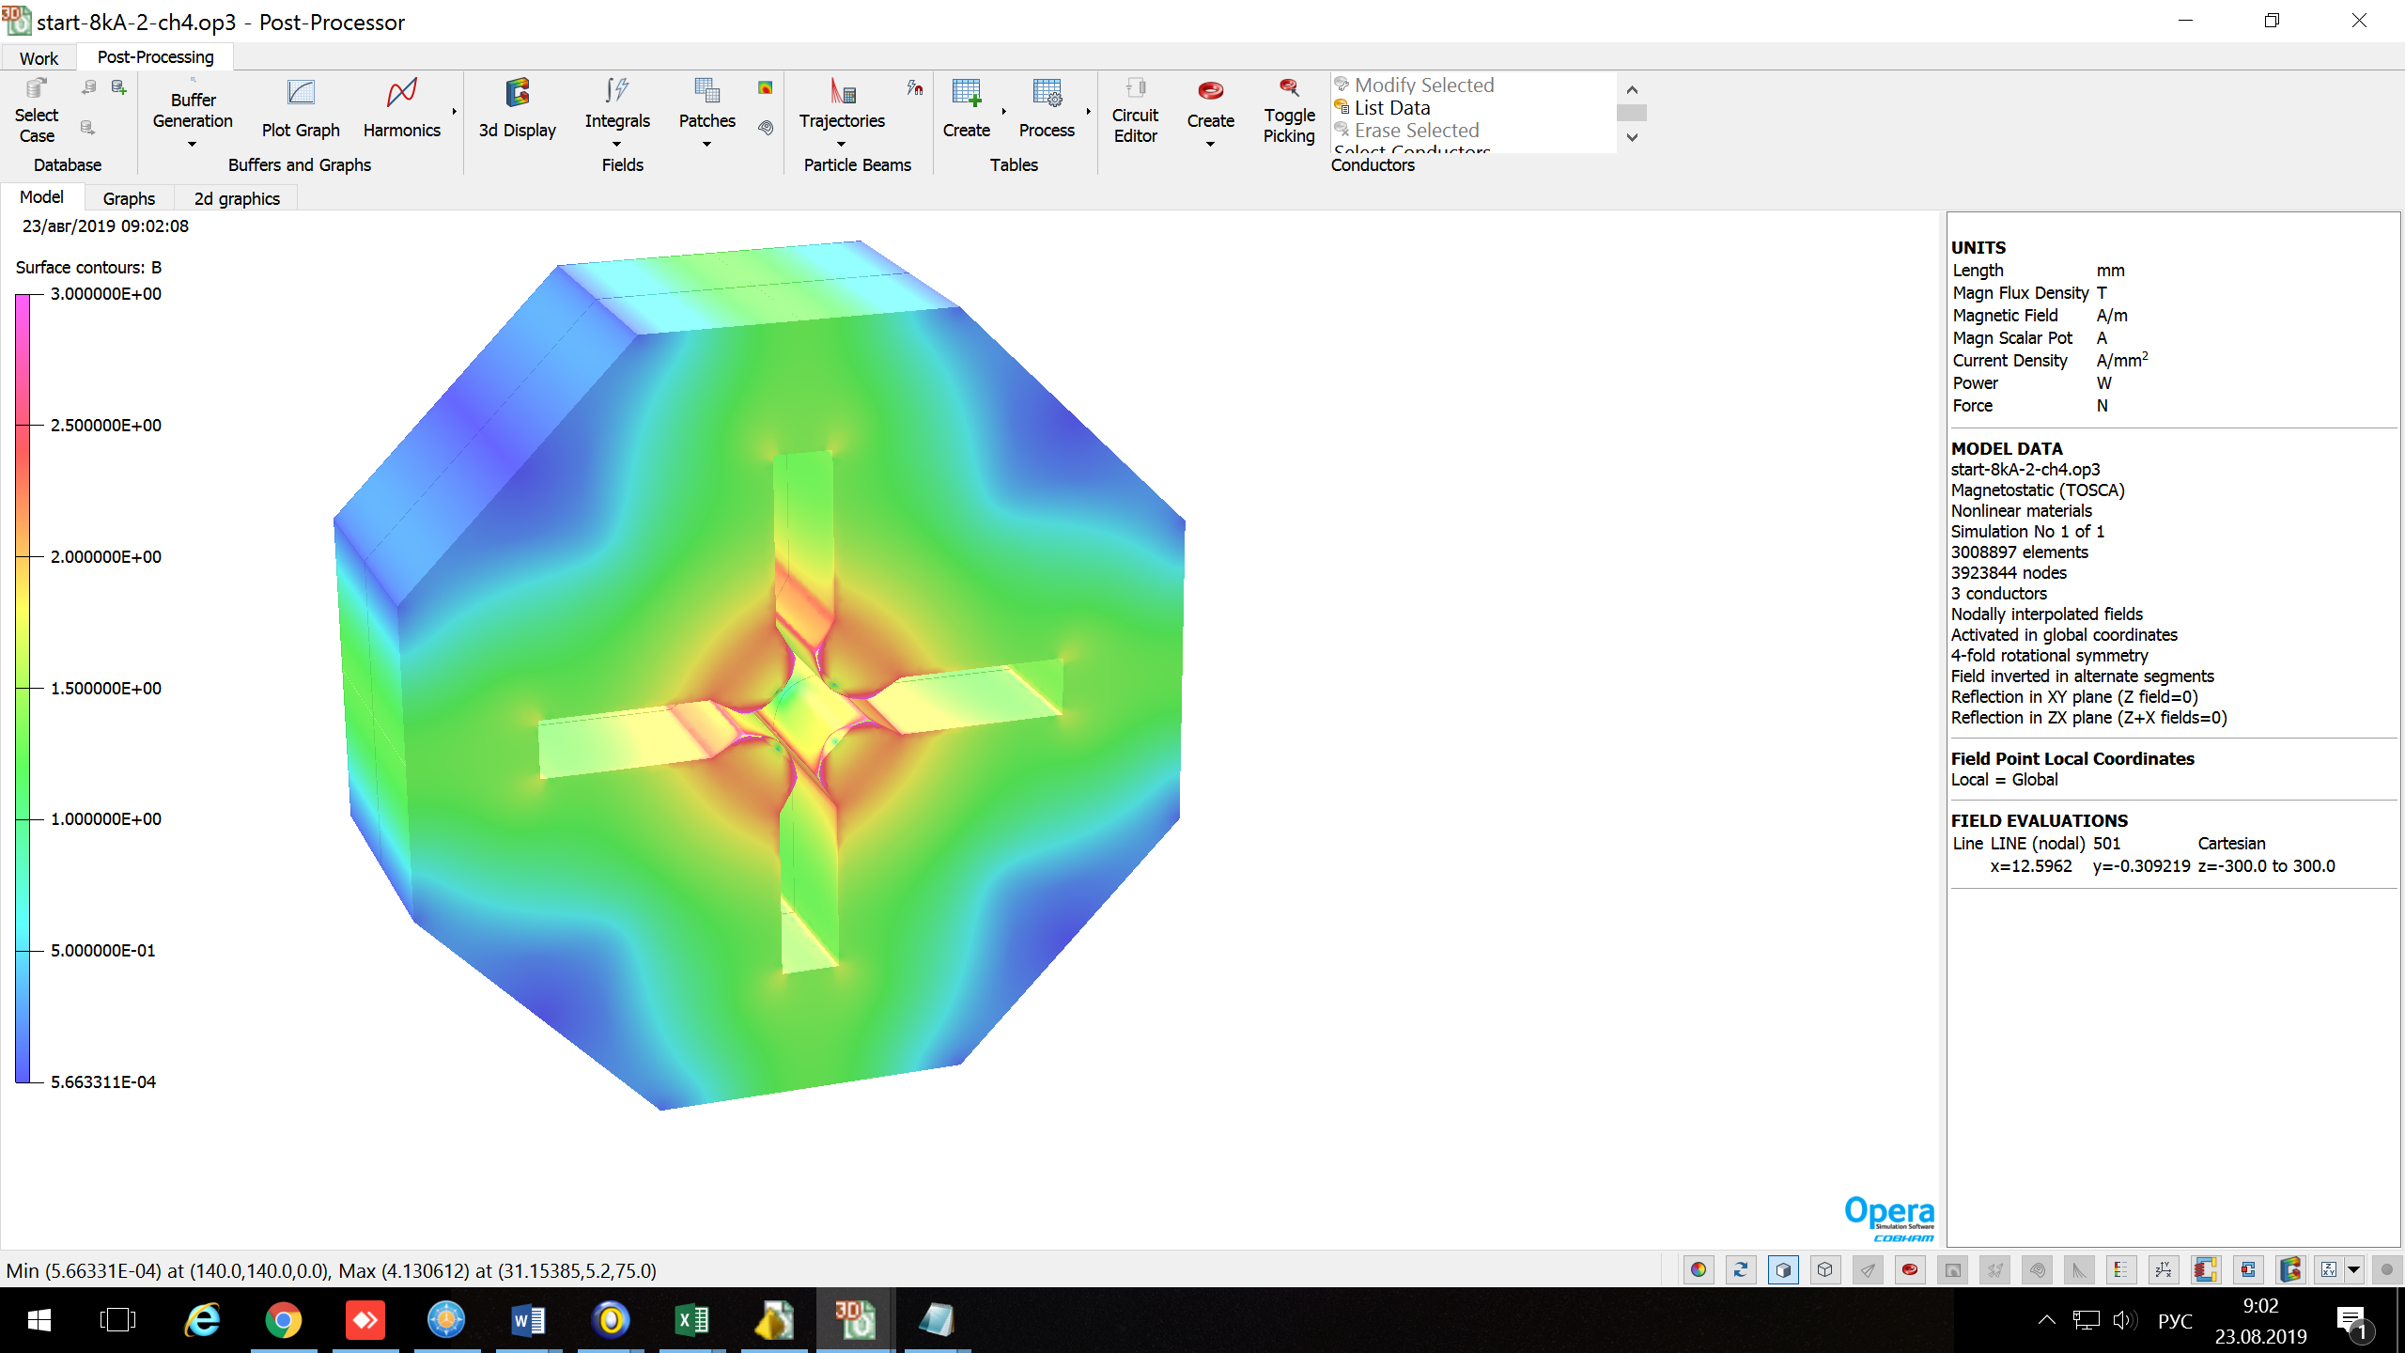
Shifted quadrupole (reverse bend)
Parameters:
G = 55 T/m L = 0.15 m
R= 18 mm Iw/coil = 8 kA

Slide 29
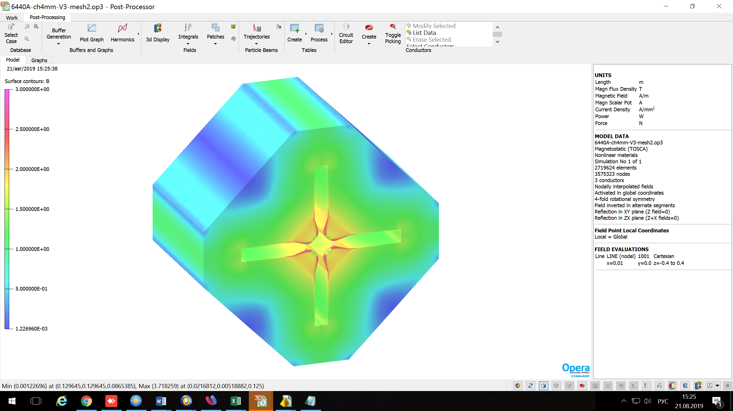
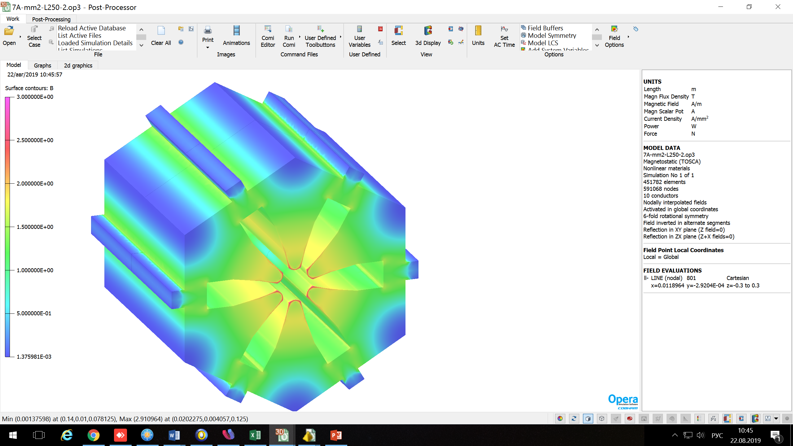
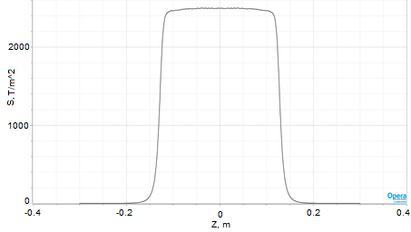
Quadrupoles & Sextupoles
Quad. parameters:
G= 67 T/m
(Gmax =80 T/m)
L = 0.25 m
R= 15 mm
Iw/coil = 6.4 kA
Sext. parameters:
S= 2500 T/m²
L = 0.25 m
R= 17 mm
Iw/coil = 7 kA

Slide 30
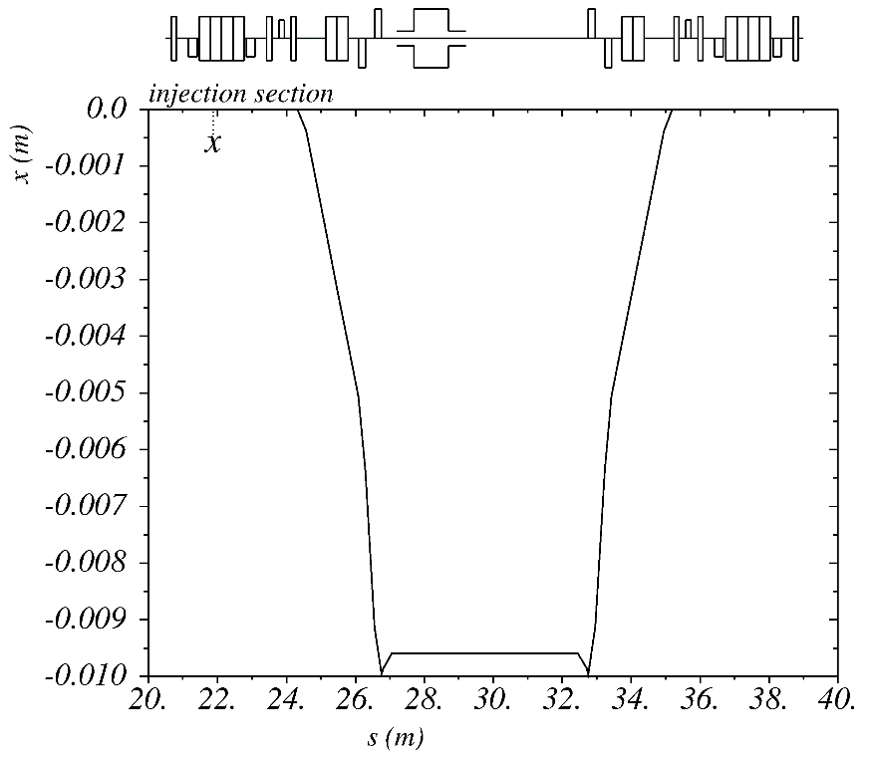
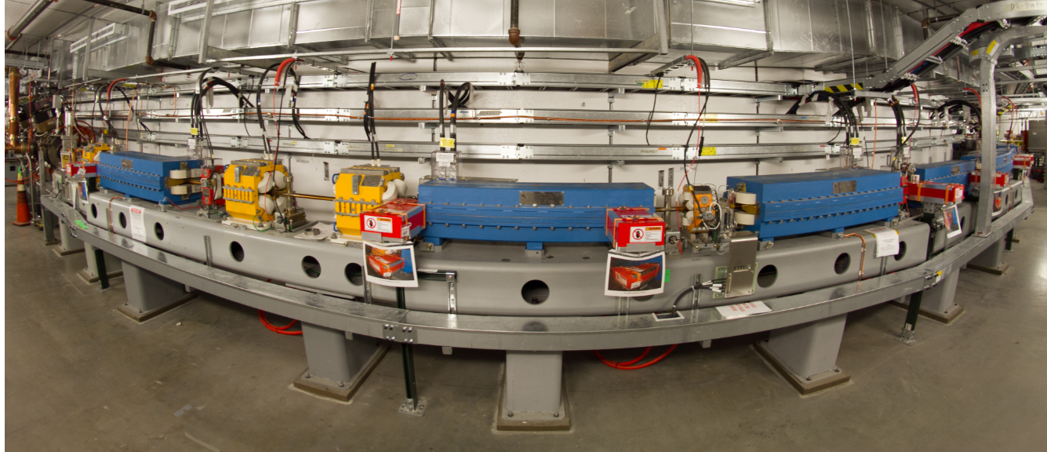
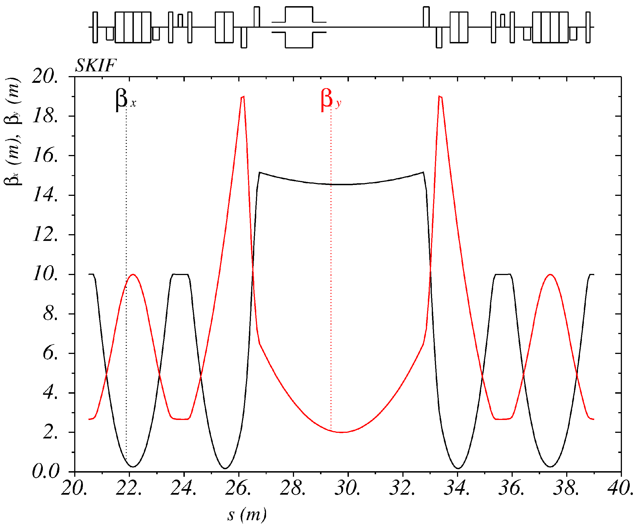
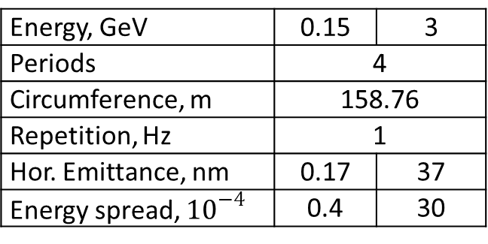
Injection
Injection is from the booster-synchrotron similar to NSLS II with 4-kicker horizontal bump.
 | L(m) | Fi(mrad) | Н(Т) | U(кV)
Kick1 | 0.25 | 3.1 | 0.124 | 40
Kick2 | 0.25 | 2.1 | 0.084 | 27
Kick3 | 0.25 | 2.1 | 0.084 | 27
Kick4 | 0.25 | 3.1 | 0.124 | 40
Sep1 | 0.4 | 30 | 0.75
Sep2 | 1.4 | 200 | 1.43
Energy, GeV | 0.15 | 3
Periods | 4
Circumference, m | 158.76
Repetition, Hz | 1
Hor. Emittance, nm | 0.17 | 37
 | 0.4 | 30
BINP has experience in design and production of 3 GeV booster.

Slide 31
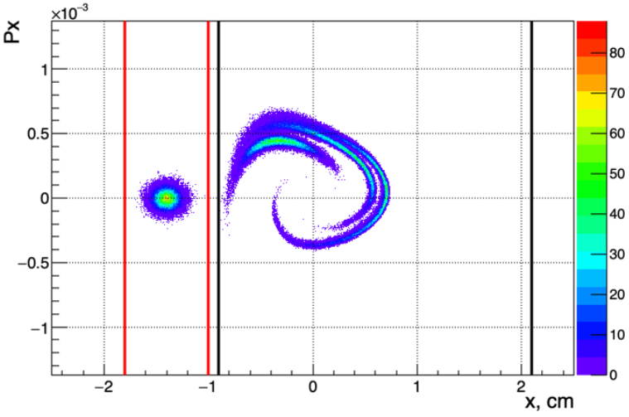
Injection
Injection tracking with nonlinearities and radiation
First three turns: 0 – injected beam in the septum, 1-3 – after the 1-3 turns respectively.
Ax_{inj} ≈ ±8 mm → ≈98% inj.efficiency
Ax_{inj} ≈ ±7 mm → ≈87% inj.efficiency
We have 2-3 mm of the aperture margin for errors and misalignments.
Further optimization is available.
Septum d = 2 mm
0
1
2
3
Ax_{inj} ≈ ±8 mm

Slide 32



FEL at SKIF for EUV lithography
Extreme ultraviolet lithography (EUV or EUVL) is a next generation lithography technology using a range of extreme ultraviolet (EUV) wavelengths, roughly spanning a 2% FWHM bandwidth about 13.5 nm.
We plan to install at SKIF Free Electron Laser based on a ≈6 m SC helical undulators to develop and study EUV lithography. The average power of about 50-100 W can be reached.
Undulator parameters
Power density for the 1st harmonic
Radiation ring at 30 m distance

Slide 33


3D view

Slide 34

Ring parameters:
1 – ESRF-EBS (ESRF-EBS Design Report,Fig.8.1, p.278):
E= 6GeV, Ibeam= 200 mA
εx = 147 pm*rad
εy = 5 pm*rad
2 – SKIF:
E= 3GeV, Ibeam= 400 mA
εx = 75 pm*rad
εy = 7.5 pm*rad
– ESRF-EBS, 4 m CPMU18
– ESRF-EBS, 4.8 m U35
– ESRF-EBS, 3.2 m U42
– ESRF-EBS, 1.6 m W150
SKIF, 4 m SC Undulators, λu = 15.6 mm, B= 1.2 T
SKIF, SC Wigglers, λu = 50 mm, B= 4.2 T

Slide 35
Conclusions
We have a basic design of the Novosibirsk 4th generation light source SKIF (3 GeV, 476 m, ≈70 pm @zero current and κ = 10%).
For nominal multibunch current 400 mA, IBS increases emittance to ≈90 pm with 7 hours of the Touschek lifetime and 17 mm bunch length (RF3 on).
16 straight sections (14 are for IDs) of two types: 6 m (β_{x} = 13 m, β_{y} = 1.9 m) for injection, RF and undulators and 4.24 m (β_{x} = 0.7 m, β_{y} = 3.5 m) for strong field wigglers.
30 beam lines are foreseen: 14 are from IDs, 8 high field permanent magnets (2.1 Т) and 8 from regular cell magnets (0.5 Т).
Transverse DA is sufficient for traditional, simple and effective injection. Longitudinal aperture/bandwidth provide good Touschek lifetime. Only two sextupole families are used.
Magnet types are minimized for the cost and production time saving.
Free electron laser for EUV lithography study will be installed at SKIF enhancing its experimental capability

