Slide 1
Solaris Status
Adriana Wawrzyniak
On behalf of Machine Team
National Synchrotron Radiation Center SOLARIS
XXVII ESLS 28.11.19, ALBA-CELLS, Barcelona, Spain

Slide 2
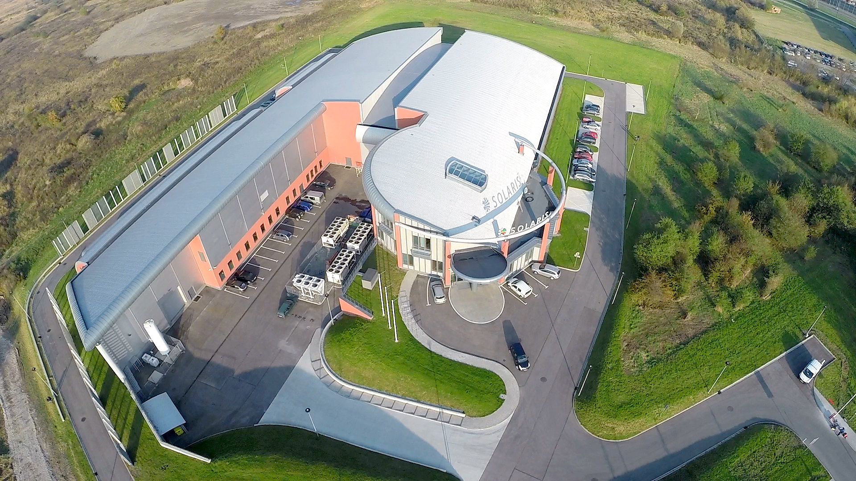
OUTLINE
Overview
Operation statistics in 2019
Main Failures
New Installations
Projects
Future plans
Summary

Slide 3
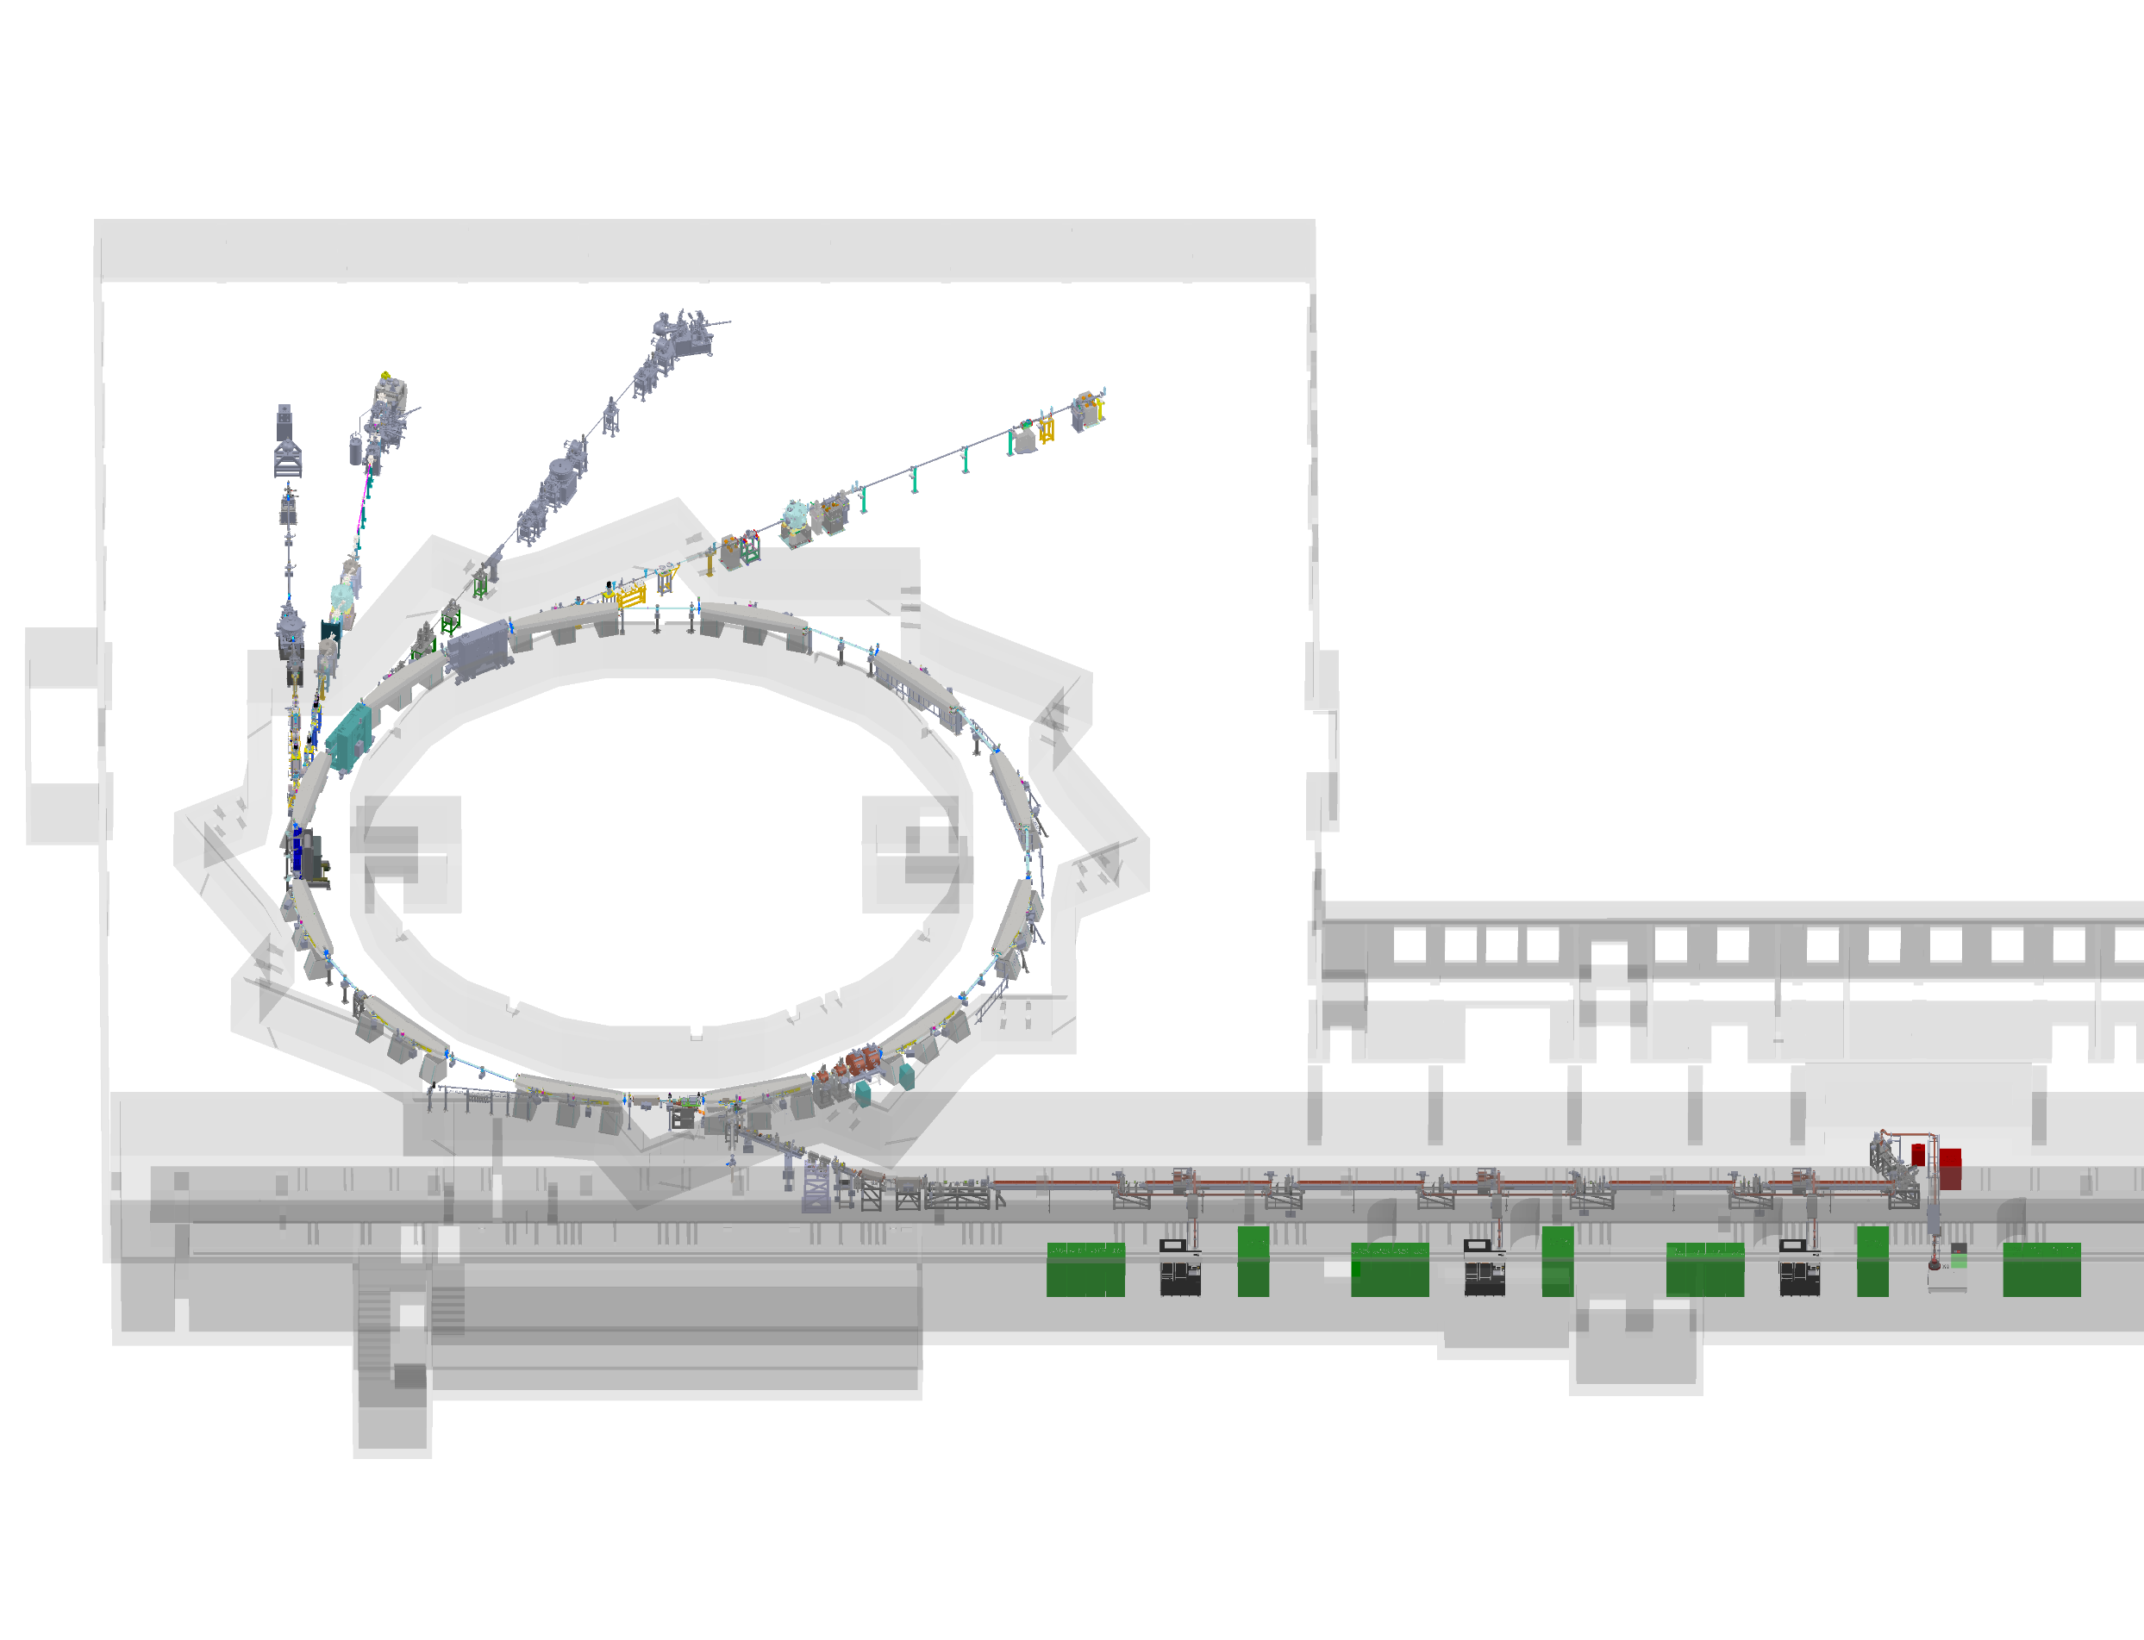
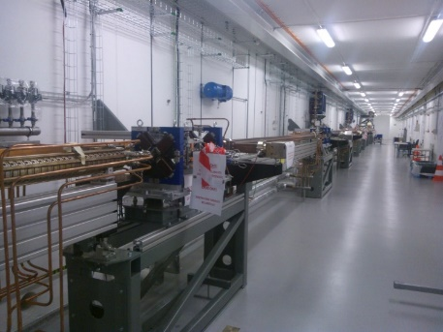
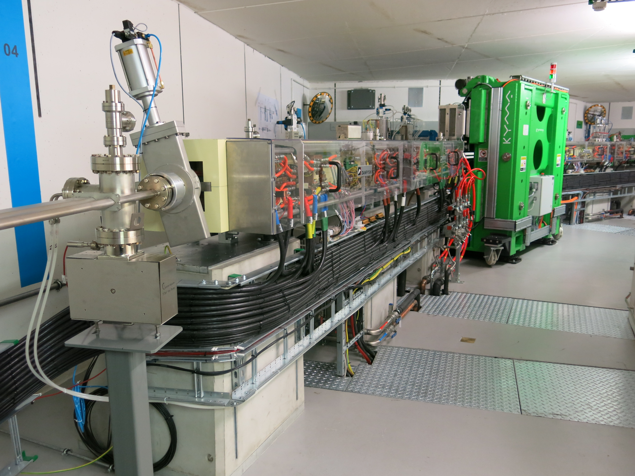
SOLARIS OVERVIEW
600 MeV Linac with RF Thermionic Gun
6 accelerating structures combined in 3 units
Accelerating gradient 20 MeV/m
S-band – 2998.5 MHz
3 RF Units & SLED cavities
In operation since Dec. 2014
U-ARPES
XMCD
PEEM/XAS
PHELIX
1.5GeV Storage ring
12 DBA Cells – 96 m circ.
Space for ID’s (10 sections) ~ 3.5 m
10 straight sections for IDs
100 MHz RF system
300 MHz Landau Cavities
Injection dipole kicker
Ramping
In operation since May 2015
PINHOLE
LUMOS
3/26

Slide 4
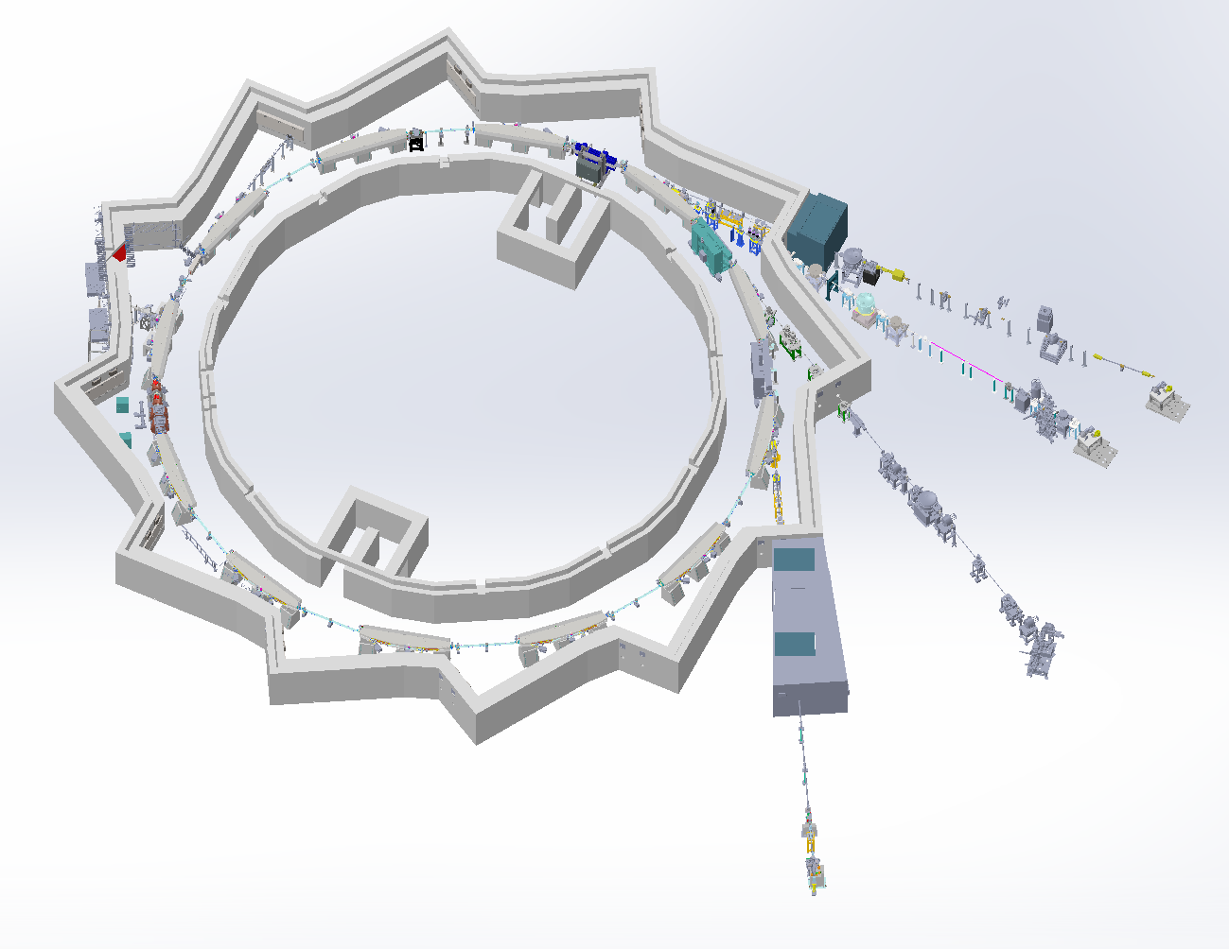
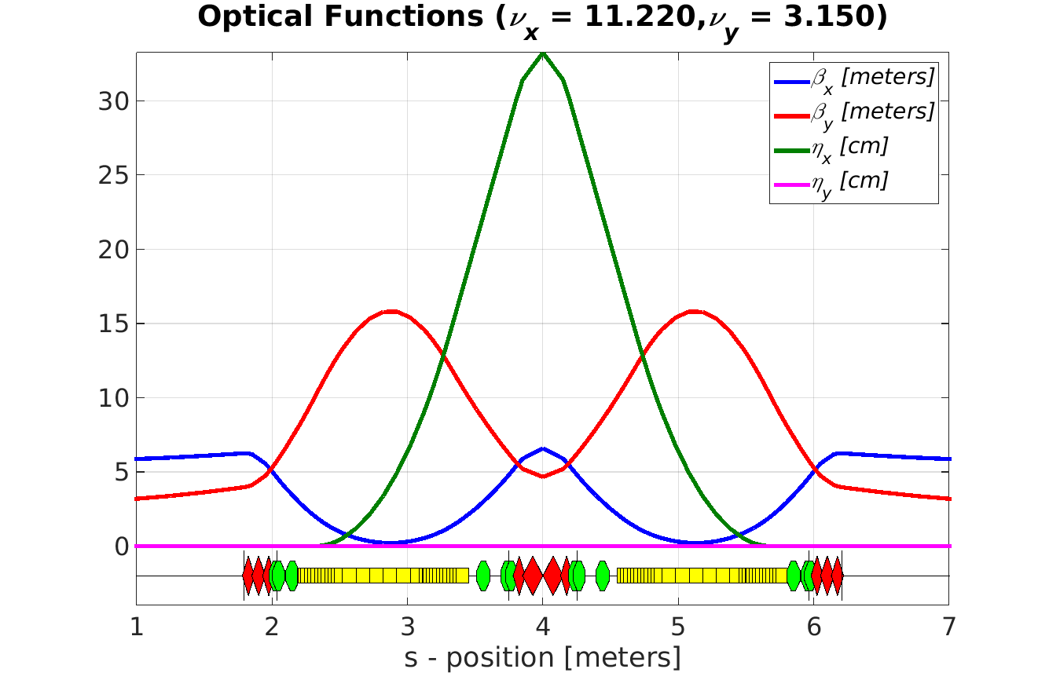
STORAGE RING PARAMETERS
Storage Ring Lattice
Parameter | Designed | Measured
Energy | 1.5 GeV | 1.45 ±0.05 GeV
Max. Current | 500 mA | 320 mA (op)
Harmonic number | 32 | 32
Natural emittance (bare lattice) | 5.982 nmrad | 7.5 ±1.5 nmrad
Coupling | 1 % | 0.83 %
Tune ν_{x}, ν_{y} | 11.22, 3.15 | 11.22, 3.15
Corrected chromaticity ξ_{x}, ξ_{y} | +2,+2 ; +1, +1 | +1.4, +1.6;+0.9,+0.9
Energy loss/turn | 114.1 keV | 103.7 ±12.3 keV
Momentum acceptance | 4% | 3.7± (0.3)%
Synchronous phase | 168º | 167.4º ± 2.7º
Synchrotron tune | 0.00239 | 0.00228
Physical acceptance h/v | 18 /4 mmrad | 15.68/3.77 mmrad
Lifetime | 13h | 23 h
Optics design by S.C. Leemann - MAXIV
MAXIV Facility, DDR, § 3, http://www.maxlab.lu.se/maxlab/max4/DDR_public

Slide 5
Operation statistics in 2019

Slide 6
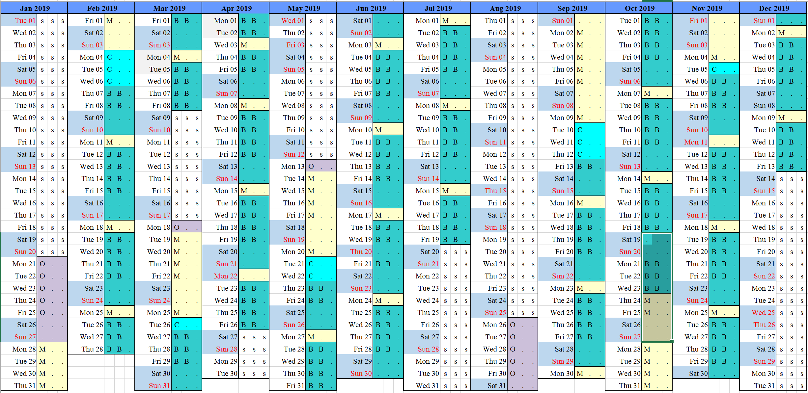
2008 h for Beamlines and 522 h for machine studies. In total 2530h/year of machine operation
OPERATION IN 2019
2 Shifts from Tue to Fri
2 operators on shift
From October shifts 7:00-15:00; 14:00-22:00
2 Injection per day 7:00; 16:00;
On call duties and extra hours during night shifts and Saturdays
Time distribution between machine and beamlines studies

Slide 7
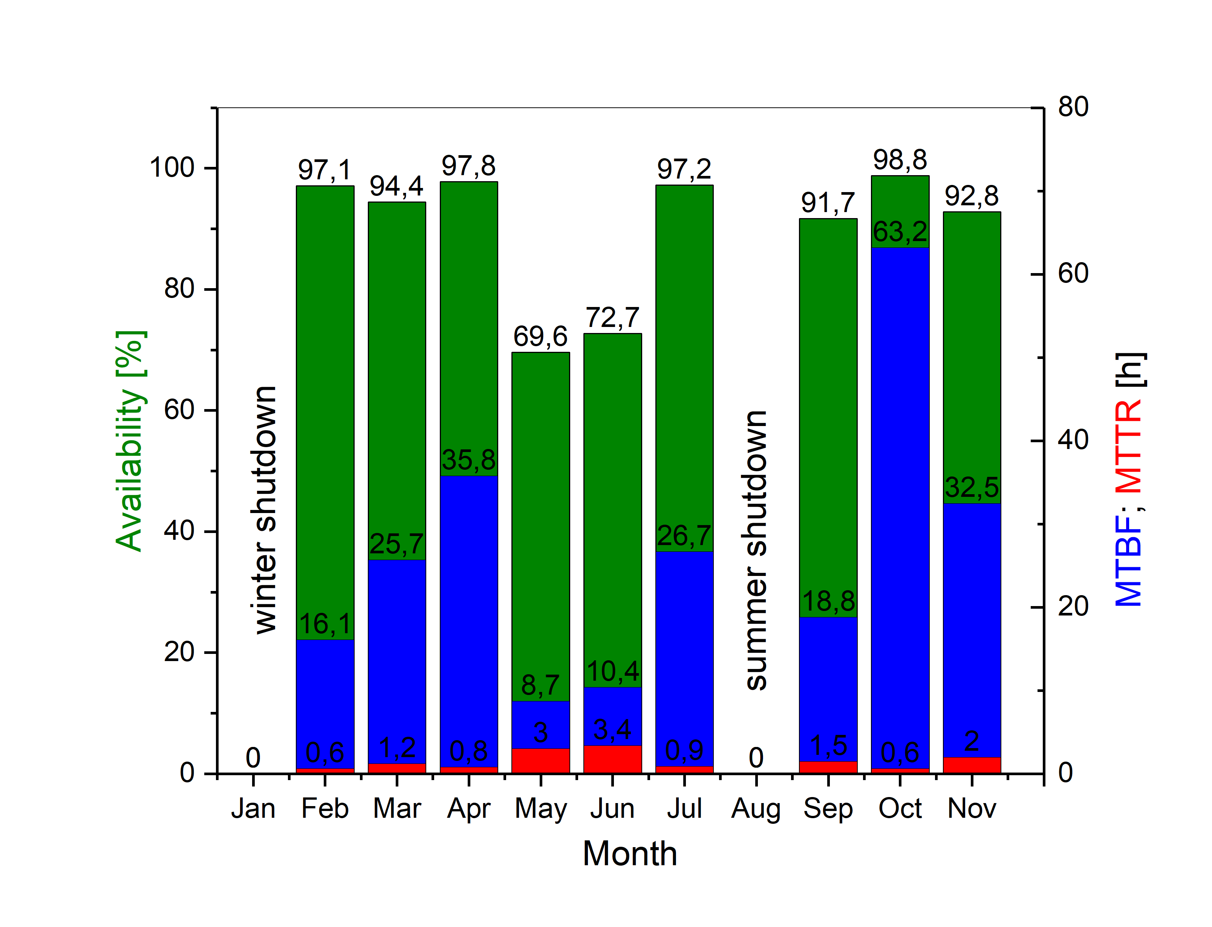
Availability=$\frac{Delivered time}{Scheduled time}$
AVAILABLILITY
 | Availability | MTBF [h] | MTTR[h]
2018 | 90.4% | 16.3 | 1.5
2019 | 91.9% | 23.6 | 1.7
Reliability of UPS with maintenance periods : 99,39%
Reliability of UPS without maintenance periods : 99,42%
Reliability of electrical system with maintenance periods: 97,95%
Reliability of electrical system without maintenance periods: 99,18%

Slide 8
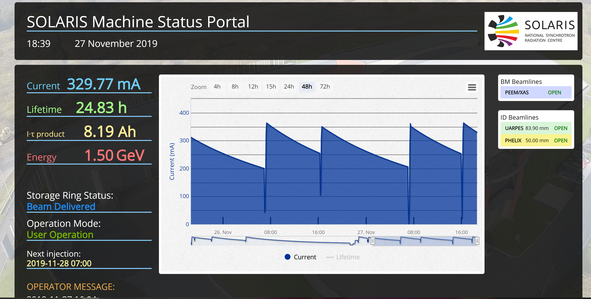
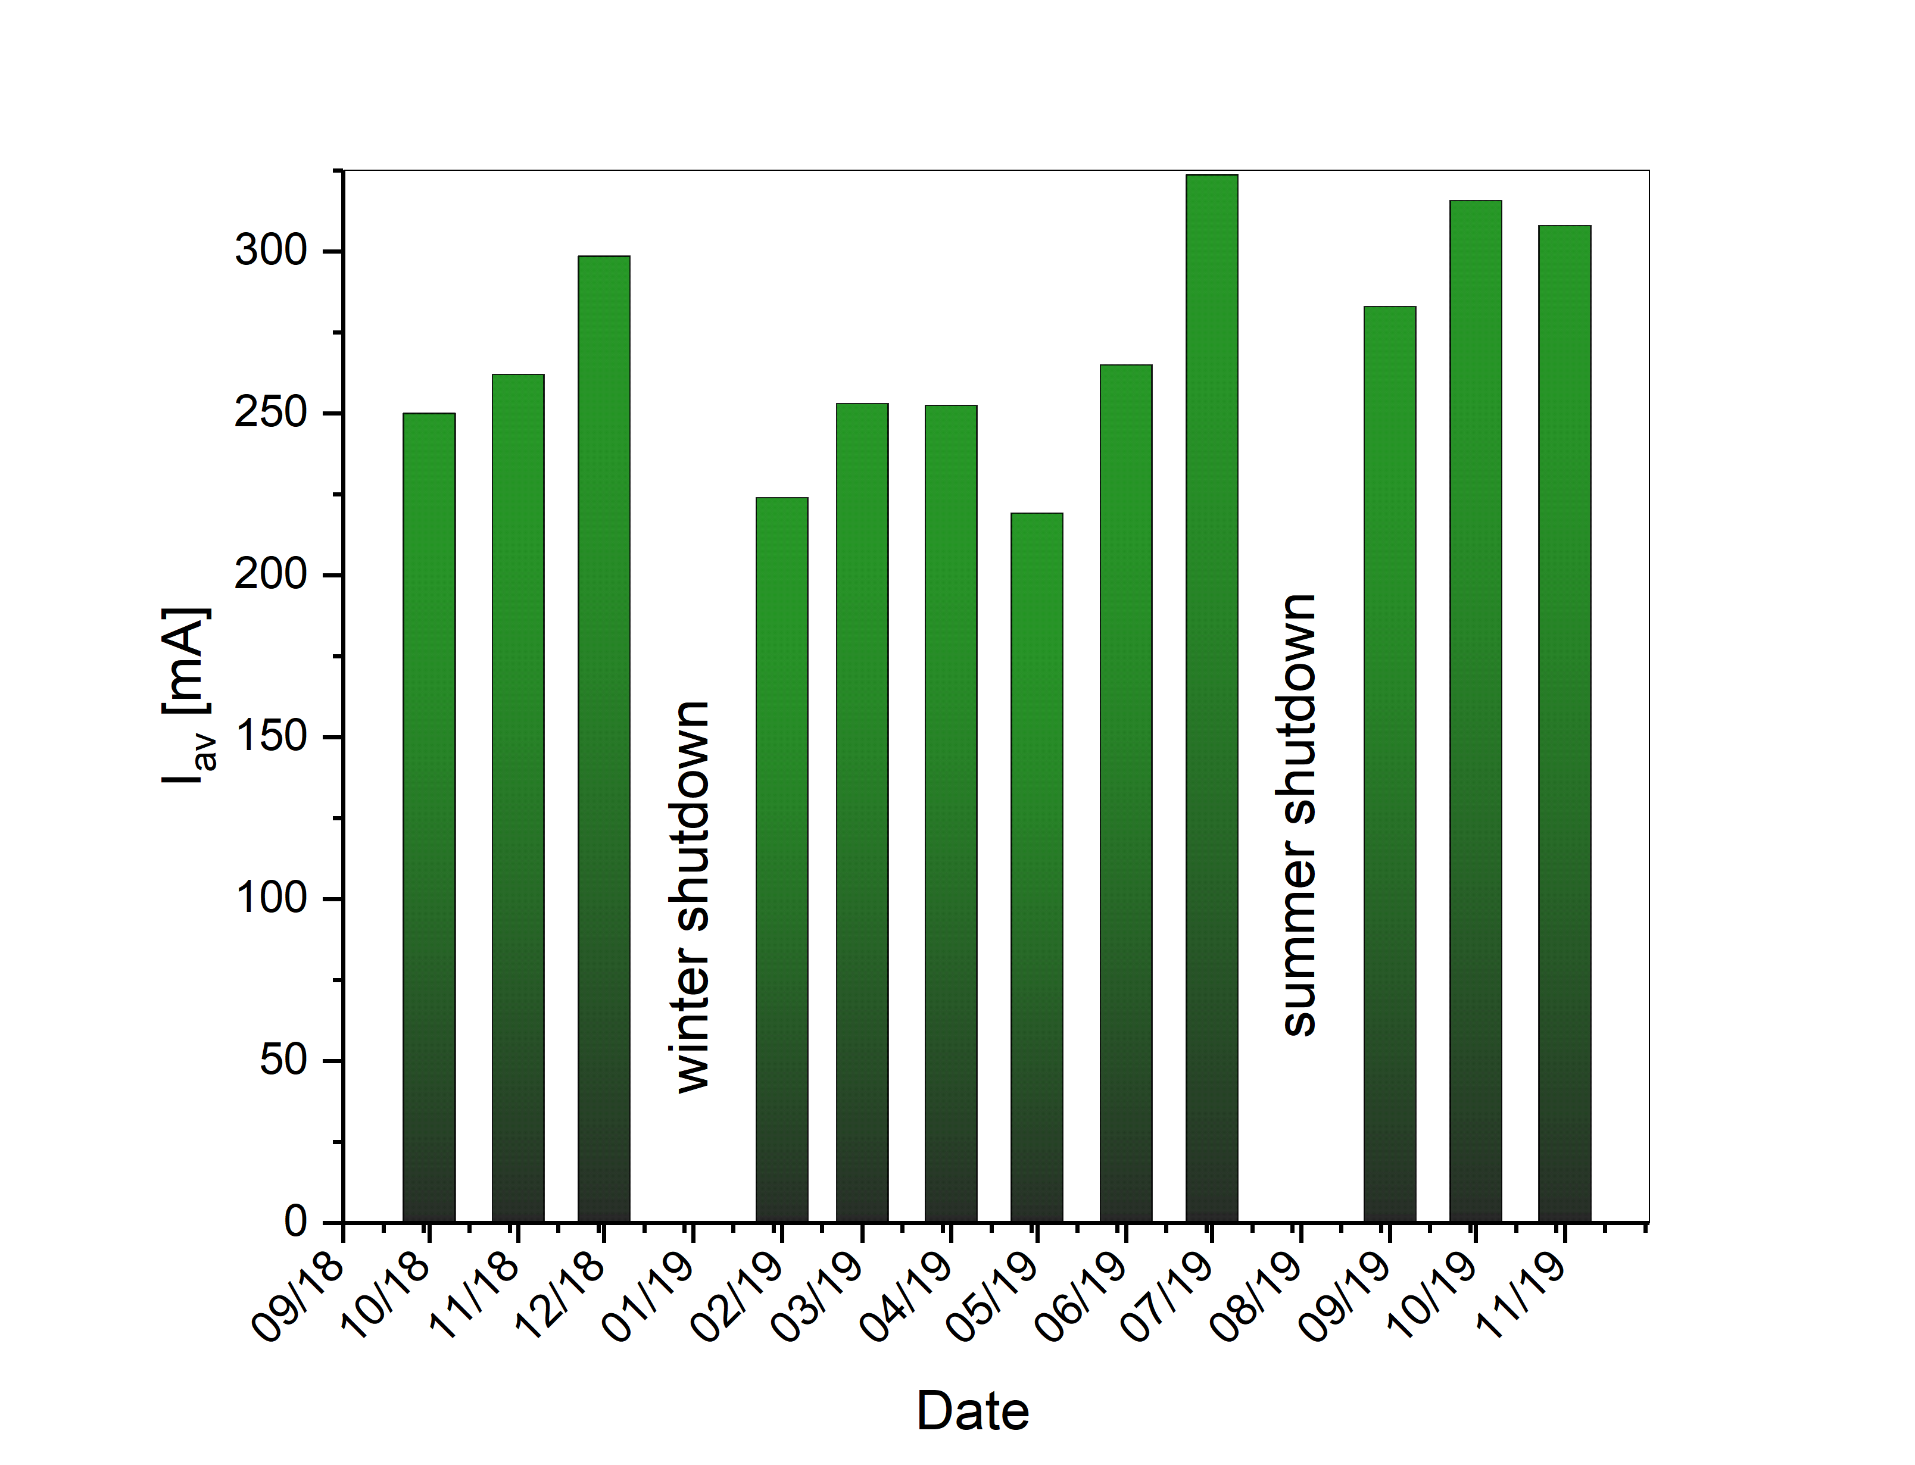
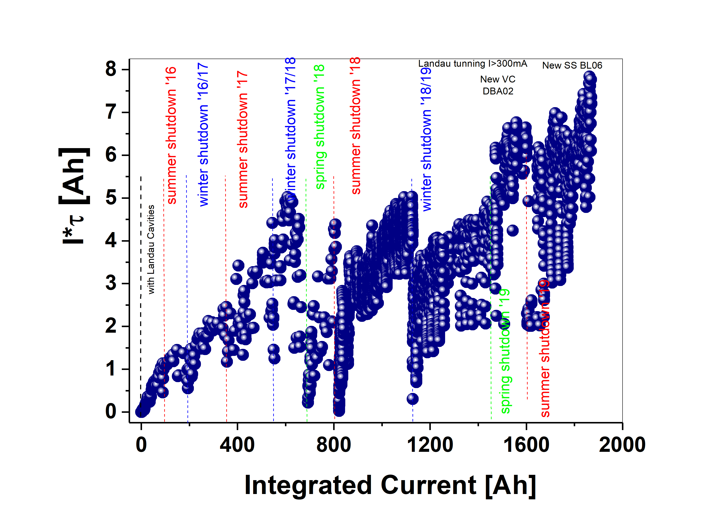
AVERAGE CURRENT DELIVERED

Slide 9
MAIN FAILURES
Failures by time
Failures by number

Slide 10
Main Failures

Slide 11

Main failures
MAIN FAILURES
Problems with injection and accumulation after Spring shutdown (OT)
Problems with orbit corrections and Liberas system (DIA, MML)
Flood in the 1.34 PS room (INF)
Beam losts due to instabilities and plungers (RF)
Problems with SQFI and Semiinstruments PS(MAG)
Problems with correctors magnets(MAG)
Short circuits of PFS (MAG)
100 kVA UPS Failures (INF)
Timing issuses – configurtion after switch off the event generator (CTL)
Communication problems device servers and PS(MAG)

Slide 12
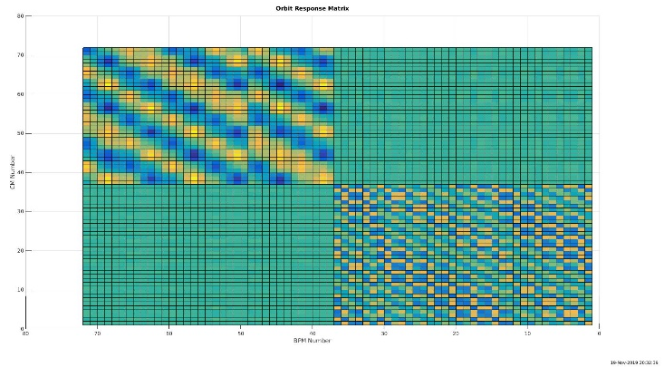
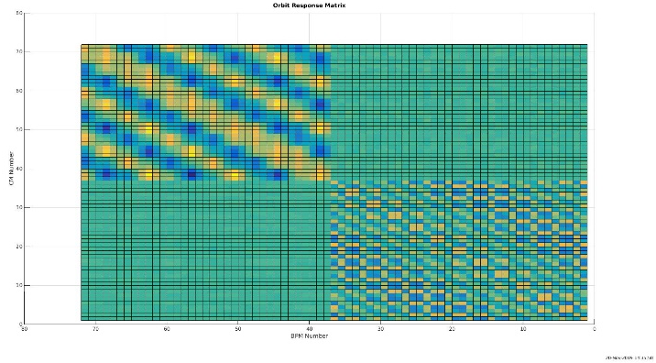
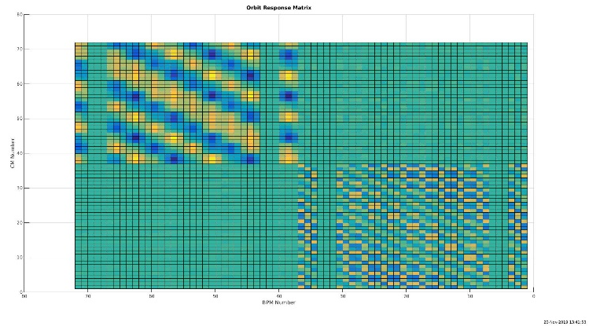
19/Nov/2019:
Hard reset of Liberas devices:
- caused loss of one of Libera configuration.
These Liberas which were supposed to control section 1,2 and 3 in ring, were actually controlling sections 6,7 and 8: - reflected in ‘mixed’ response matrix.
20/Nov/2019:
Another consequence of Liberas hard reset:
- caused a confirmation of Liberas hostnames changes introduced 2 weeks earlier.
Once synchronization between astor device servers, Liberas hostnames and IP addresses was done, response matrix has been measured and showed expected pattern.
21/Nov/2019:
Issue with temporary loss of communication between matlab and beam position readings:
- turned out that Java buffer used in Jive was too low: 128MB. Once changed to 4GB, communication issue causing beam drifting was resolved
Main issues with Liberas based on Ubuntu 14.04

Slide 13
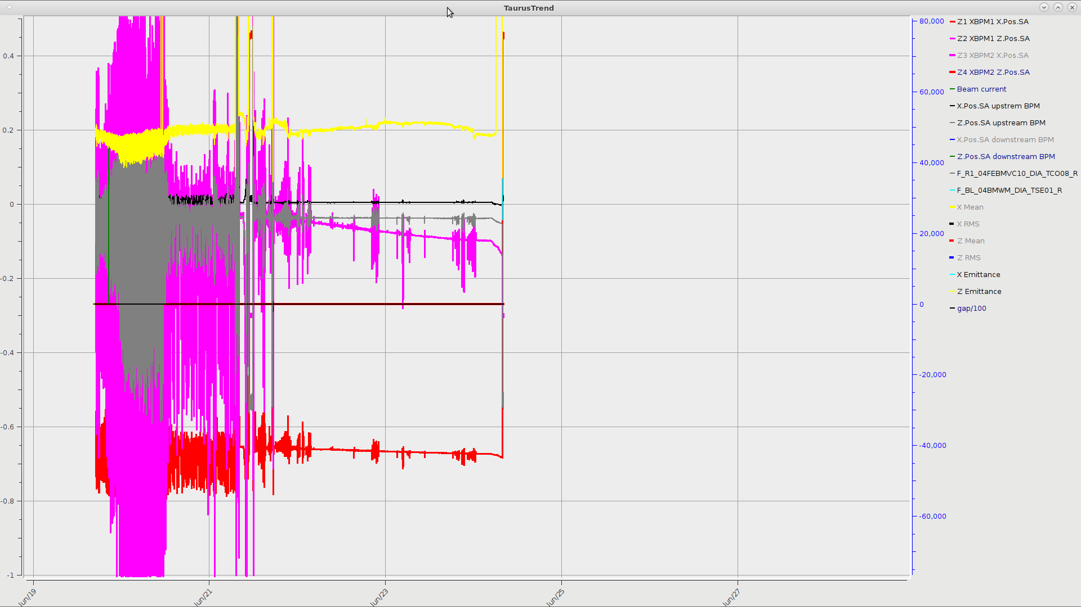
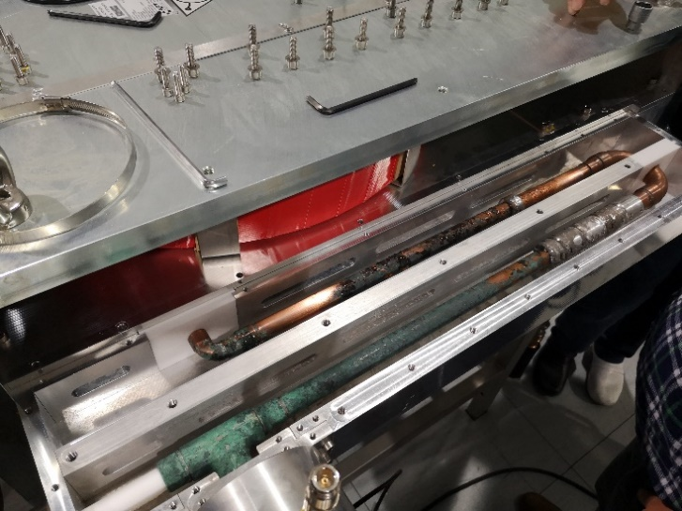
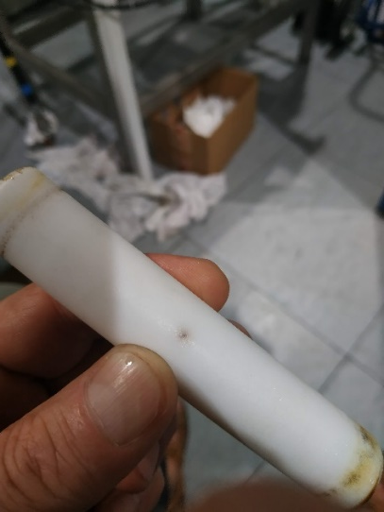
Beam instabilities
CIRCULATOR FAILURE
Circulator reflected power issue
Beam dumps caused by sudden loss of RF power on Transmitter 2
No signs of reflected power peaks in tango
Reflected power alerts in Tx2 GUI
Extensive testing carried out
Damaged teflon separator replaced with a new one, made to order
New piping installed and soldered in place
Impedance matching with ferrite beads carried out
Final measurements taken every week for about 2 months after repair concluded, that circulator is entirely operational and fixed
Peridical uncorrelated (duration-20min) distorsion of the beam above the accepted limit.

Slide 14
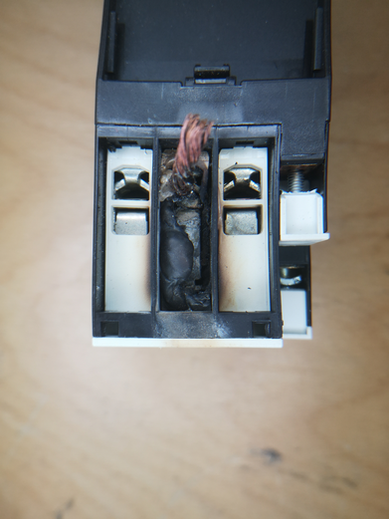
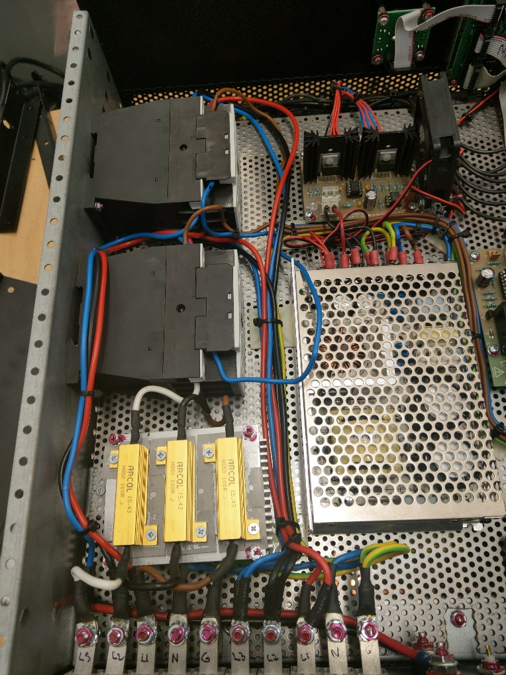
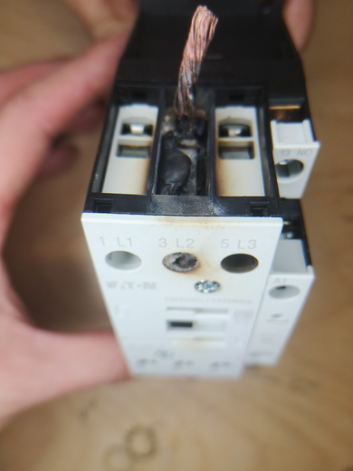
POWER SUPPLIES FAILURE
SQFo_Loc
Last failure: 18.09.2019
The SemiInstruments Power Supply went down during the user operation what caused a beam dump. The 3 phases fuse were switched off and PS interlocked. After switching on again it blowed up and went down again. Decision was taken to exchange it to the DELTA ELKTRONIKA PS „SM 15-400”.
PS replacement took about 5 hours.
Diagnostic of failure
The reason for the switch off fuse was a loose (not tightened) 230VAC wire on the contactor as a result of which a spark occurred and the contact has been burned.
Repair
Both contactors and wires has been replaced.
Parts order time: about 1 week
Repair time: about 1 hour
Conclusion
Delta Elektronika PS is less expensive and a stable supply. It still used for SQFo_Loc. Repaired SemiInstruments PS is destinated for a spare.

Slide 15
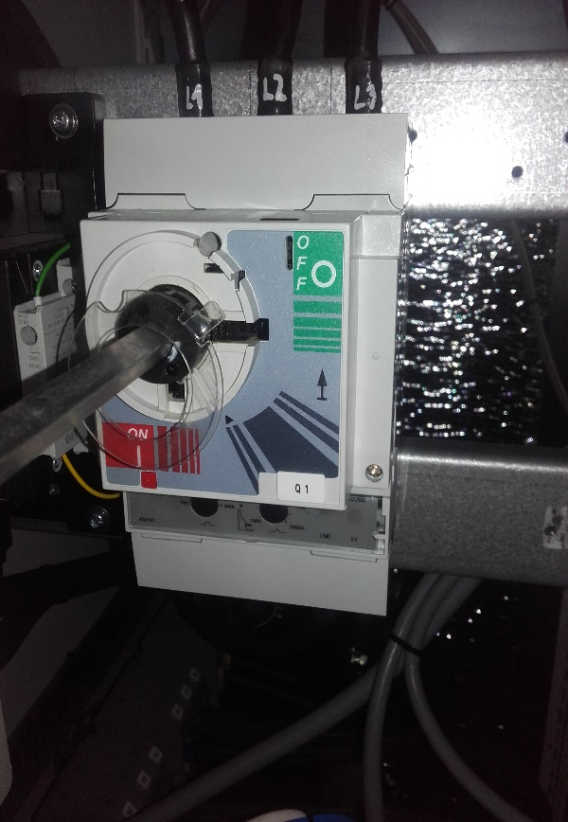
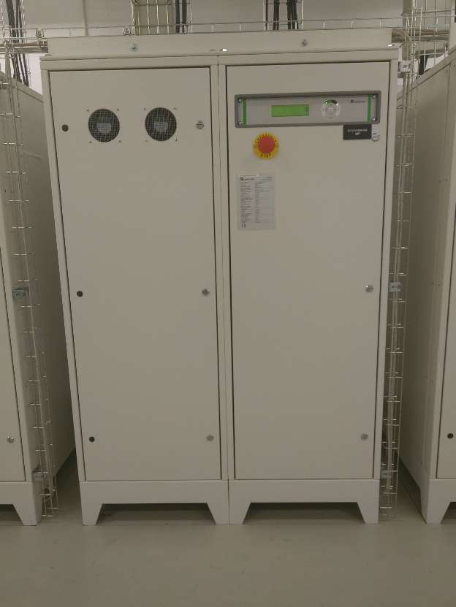
SQFi Last Failure
POWER SUPPLIES FAILURE
14.05.2019 - After magnets cycling, SQFi power supply (PS05) had an overcurrent interlock. It was inspected by operator and electrical team, and this may be a sign of device aging and malfunctioning.
17.05.2019 - Interlock on SQFI magnet disabled further operation as it can be reset only via 1.34, which we can't access at this point. Further maintenance planned to next week.
10.06.2019 – Beam lost due to Interlock on SQFi PS „Phase failure” Main Power Switch has been triggered by unknown rason. AC Current ~95[A], Temp. ~35 °C. It was planned to use current analyzer and obsrvation. The new Main Power Switch has been ordered.
11.06.2019 – Main Power Switch on the SQFi Power Supply has been measured. Current on the 3 phases was similar ~100A, but temperature on the 3rd phase was higher than other phases. It was about 100 deg and increasing. The Main Electrician ordered the machine to be turned off. The main switch has been replaced with a substitute. Beam has been lost for about 5 hours.
07.10.2019 – The substitute Main Power Switch has been replaced for the new one without beam lost (machine day). Repair time was about 2 hours. Presumably the reason for the malfunction was the current trigger in the switch, but there are no visible signs of damage. Failure was solved, and ordered one more switch for the spare.

Slide 16
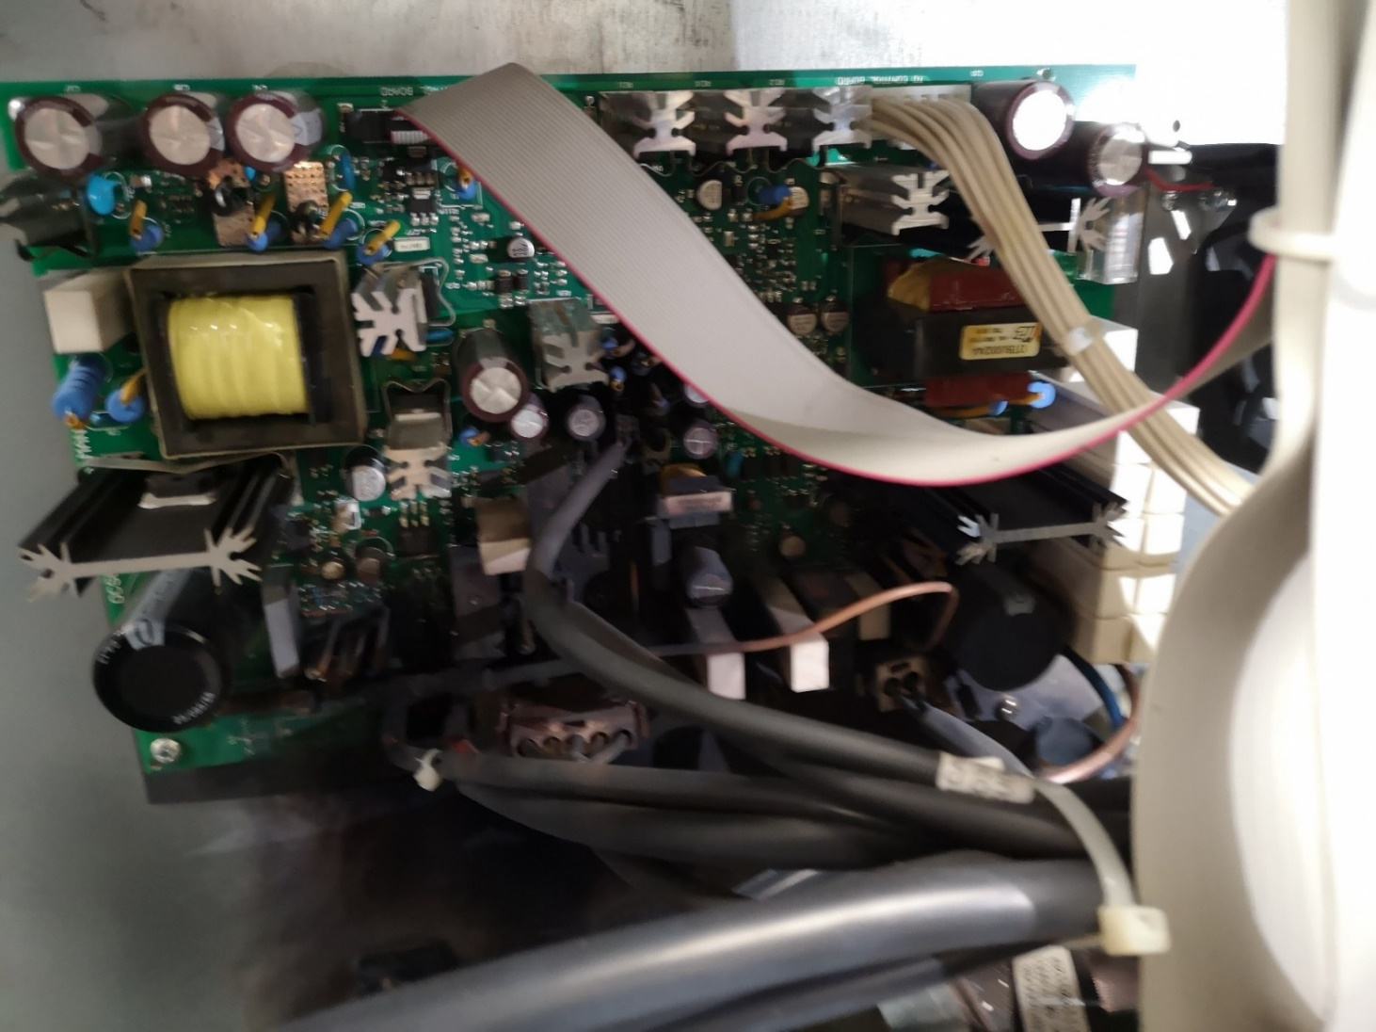
UPS 100 KVA FOR IT – CRITICAL DAMAGE 28.06.2019
Report from service :
Following components were damaged:
Tyrystor bypass L1
IGBT booster L1
IGBT inverter L1
Output inverter board L1
Main board power supply
Tape for flex driver IGBT
DC+ Fuse 100A L3
AC Fuse 180A L1
Input Circuit Breaker with auxiliary contact
Logs from UPS: none – damage was too violent.
Probably reasons:
Insects or rodent
Power supply anomaly - high potential on neutral wire or energy return to UPS
Damaged trigger circuit for main circuit breaker DPX 250ER (UPS 100kVA)
Time work without UPS 100kVA for IT- 23 hours
Damage solution:
Borrowed UPS from service ( agreement ) was installed . After 3 weeks new UPS was purchased.

Slide 17
New Installations

Slide 18
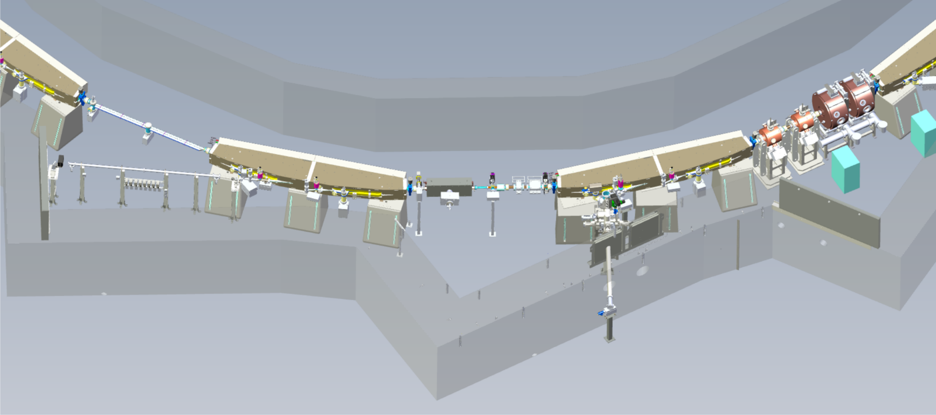
SOLARIS diagnostic beamlines
PINHOLE DIAGNOSTIC BEAMLINE
The PINHOLE, depicts the electron beam by analyzing the emitted X-rays.
The beamline was installed during summer shutdown 2018.
Now is available to monitor transversal beam size during operation.
LUMOS DIAGNOSTIC BEAMLINE
The LUMOS will be operated in the visible and IR region.
The beamline was installed during summer shutdown 2019.
It is foreseen to take the first beam profile measurements from LUMOS at the end of 2019.

Slide 19
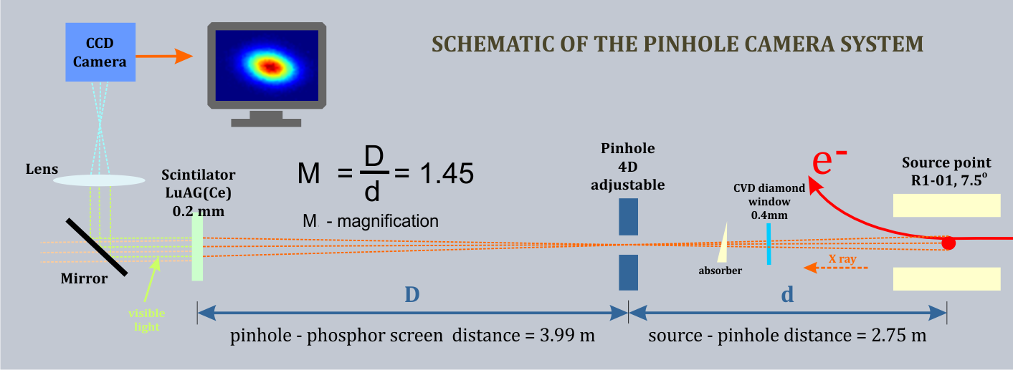
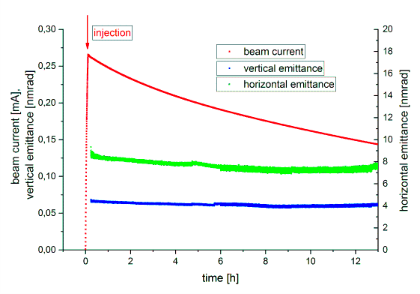
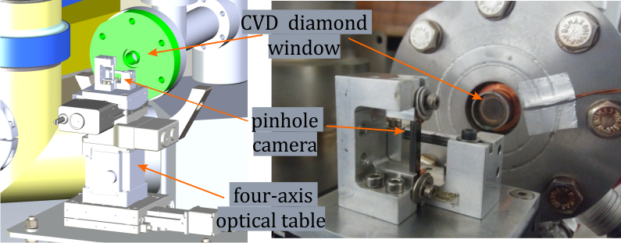
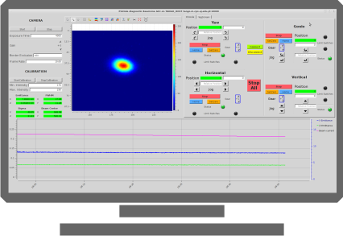
PINHOLE diagnostic beamline
The PINHOLE, depicts the electron beam by analyzing the emitted X-rays.
The beamline was installed during summer shutdown 2018.
Now is available to monitor transversal beam size during operation.
The design of the beamline was modified to provide sufficient X-ray photon flux for proper imaging (CVD diamond window).
CONTROL PROGRAM
X-ray beam is converted to the visible light at the image plane by 0.2 mm thin scintillator crystal LuAG(Ce) with a peak emission of 535 nm.
Instead of an aluminium exit window a CVD (chemical vapour deposited) diamond with thickness of 400 um was chosen. It improves the simulated photon flux by a factor of 200.
The PINHOLE software consists
of three layers:
- Taurus based GUI
- TANGO Controls devices
- PLC program
Horizontal (green dots) and vertical (blue dots) emittance measured continuously over 13 hours.

Slide 20
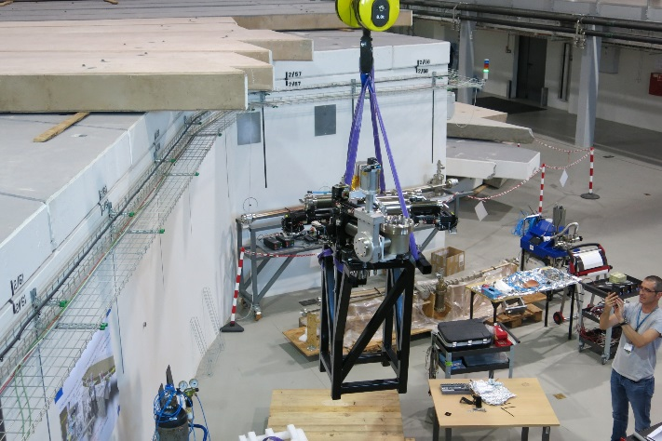
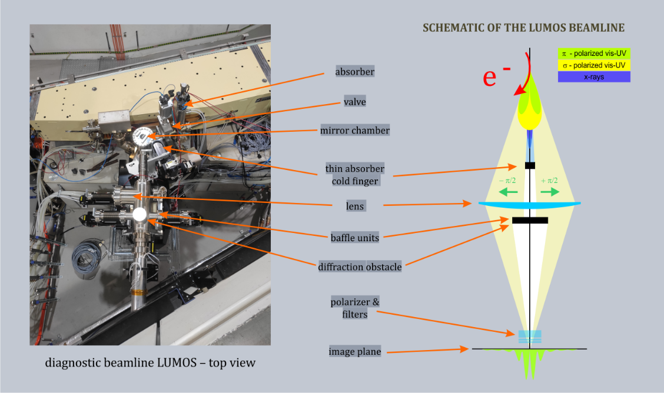
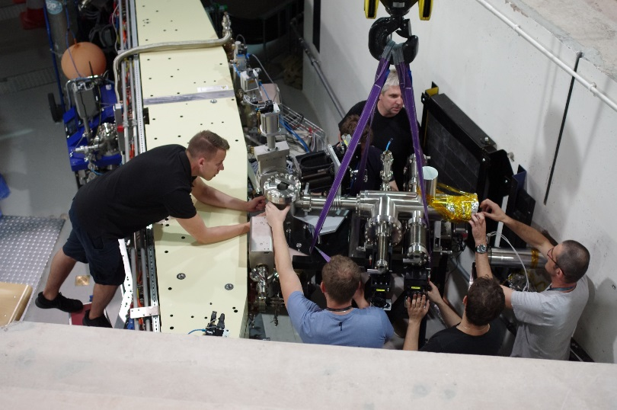
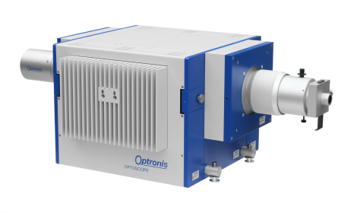
LUMOS diagnostic beamline
The LUMOS will be operated in the visible and IR region.
The beamline was installed during summer shutdown 2019.
It is foreseen to take the first beam profile measurements from LUMOS
at the end of 2019 (next week?).
This beamline will be used for transverse beam profile and longitudinal bunch length measurements as well as to study the longitudinal beam dynamics.
LUMOS has a similar configuration to the existing diagnostic beamline at MAX IV 1.5 GeV storage ring.
New beamline will enable a wide range of new optical diagnostic measurements.
Streak camera model SC-10 with S25 photocathode by Optronis
Adriana Wawrzyniak, Solaris Status, XXVII ESLS Workshop, 26-28.11.19, ALBA-CELLS, Barcelona, Spain

Slide 21
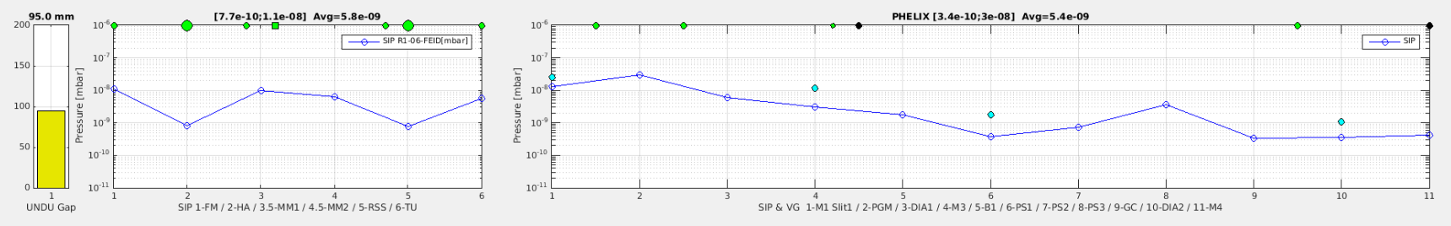
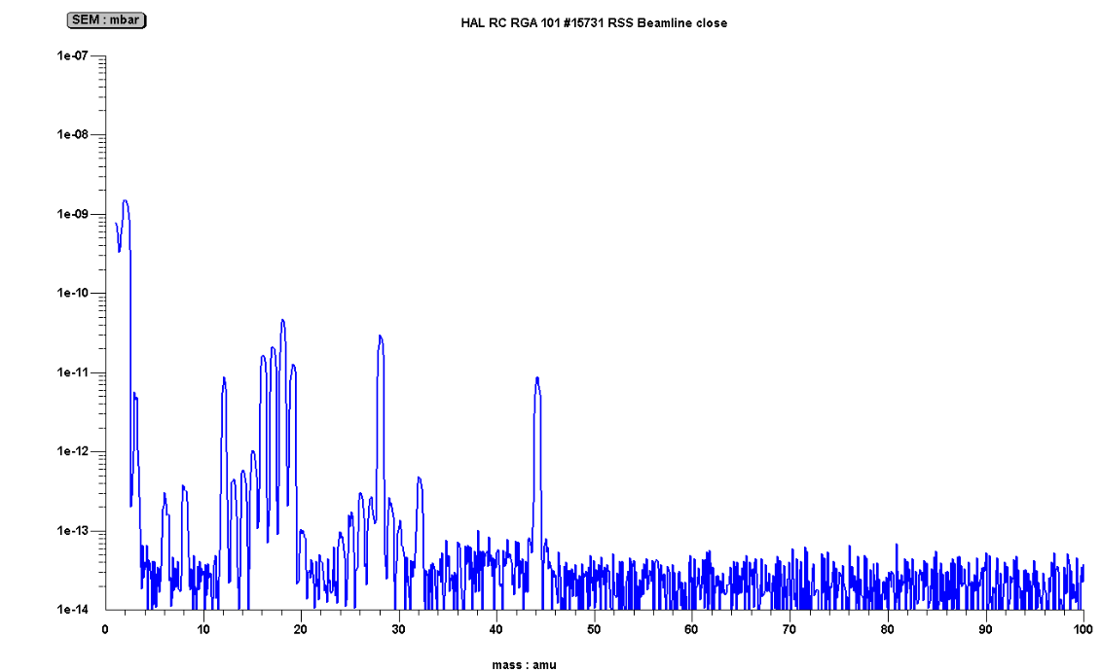
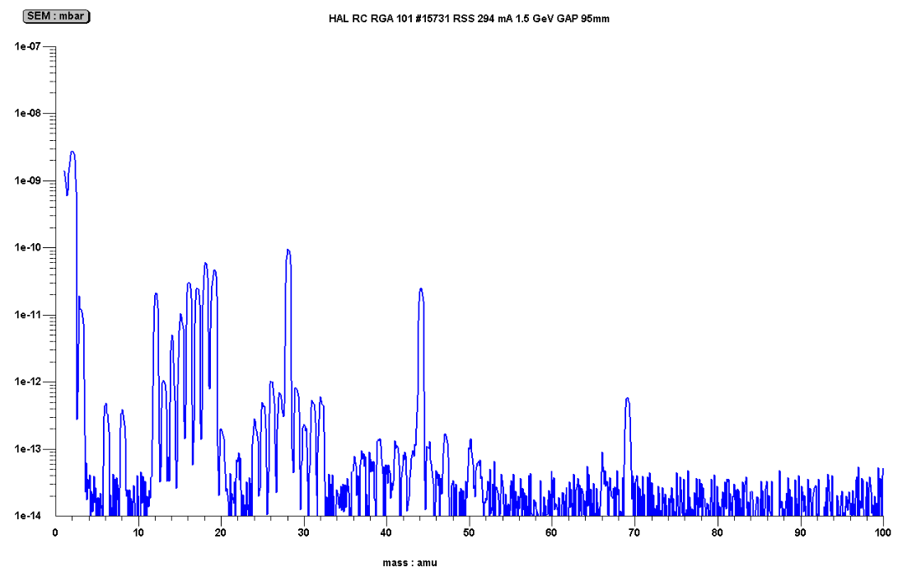

PHELIX FE commissioning
beamline open, average pressure at FE: 5.8e-9mbar and BL: 5.4e-9mbar
for a short period of time of conditioning, small contamination was detected at safety shutter in FE area.
m/q = 69

Slide 22
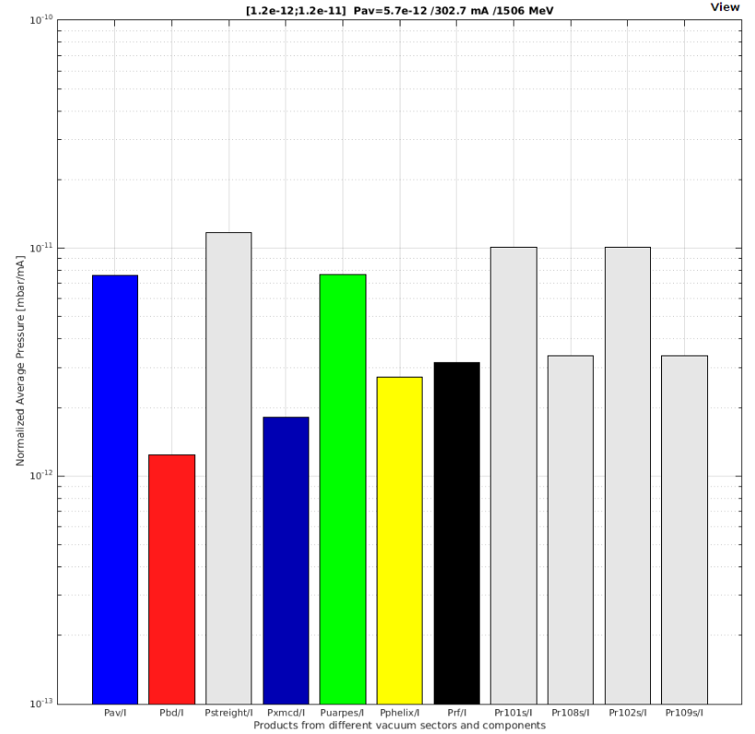
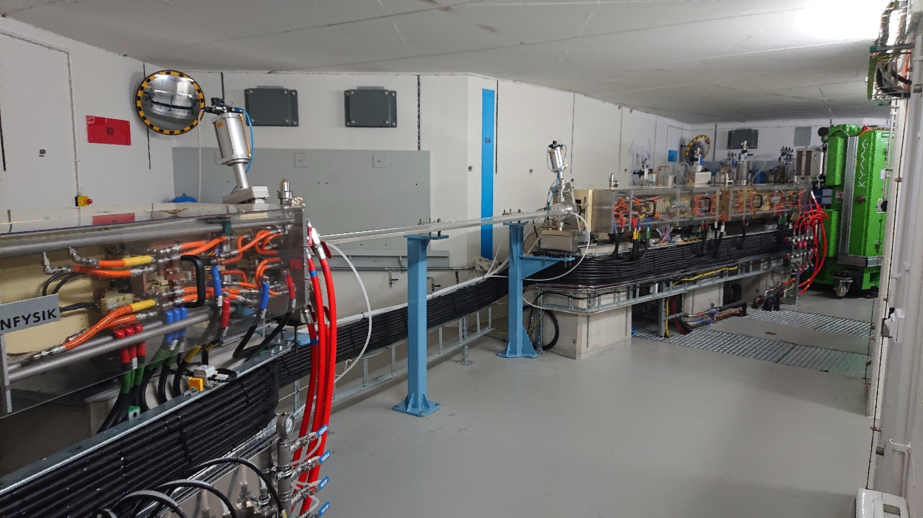
XMCD UVC installation
XMCD VACUUM CHAMBER
INSTALLATION
STRAIGHT ALL
STRAIGHT + KICKER
STRAIGHT + RGA
UARPES
Dipole VK1 + VK2
STRAIGHT R1-08
STRAIGHT R1-09
PHELIX
XMCD
XMCD NEG coated Undulator Vacuum Chamber has been installed by Solaris, after gaining experience from installation of UARPES and PHELIX NEG UVC’s. The lowest value of product P/Ie ~ 1.8e-12 [mbar/mA] calculated based on sputter ion pumps. In case of UARPES next NEG activation is foreseen.

Slide 23
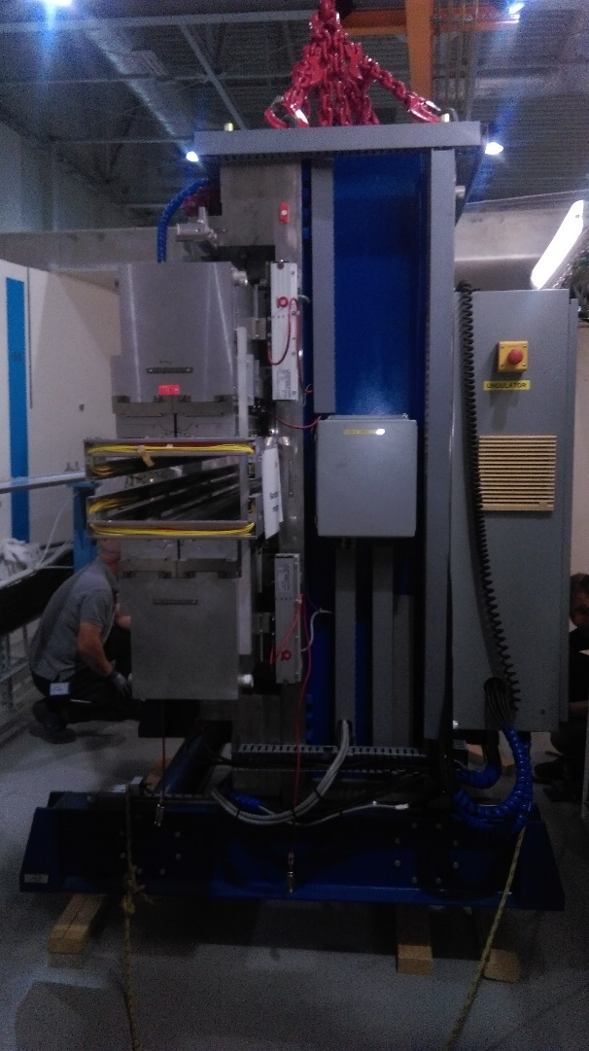
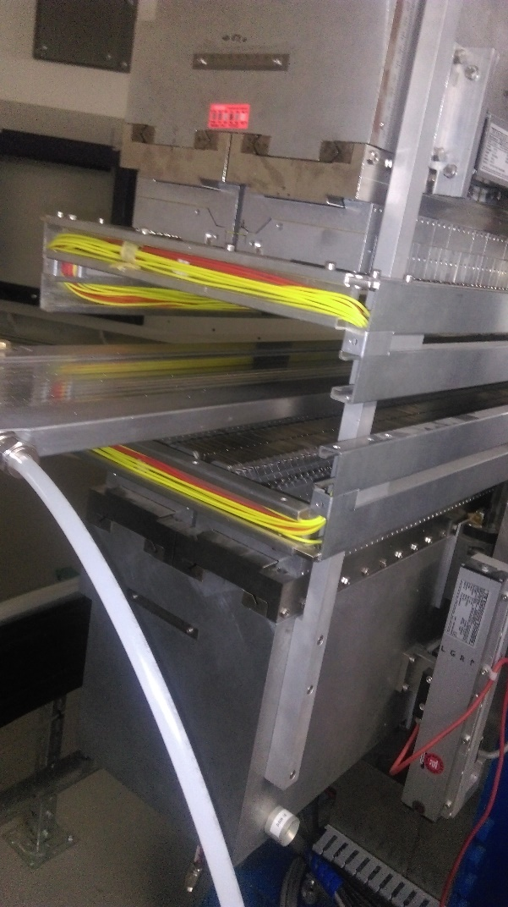
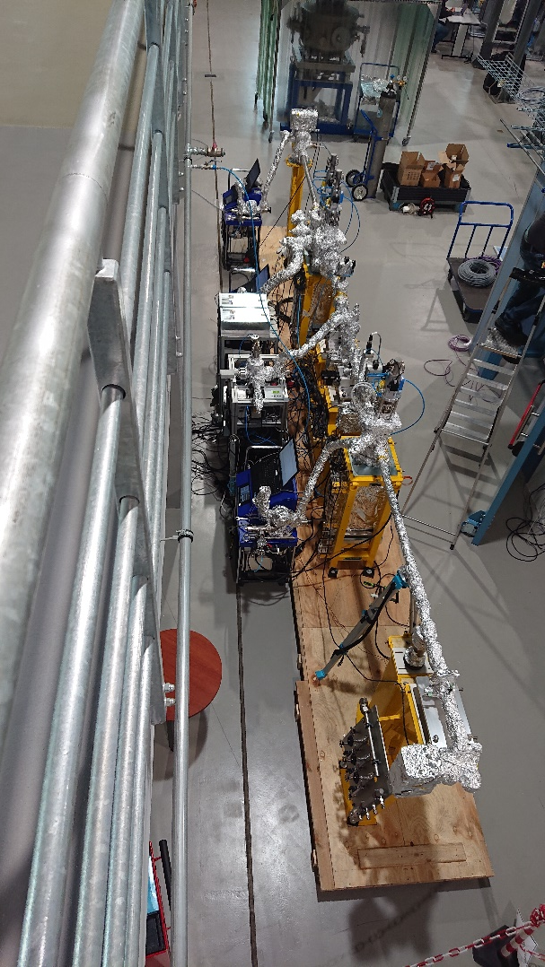
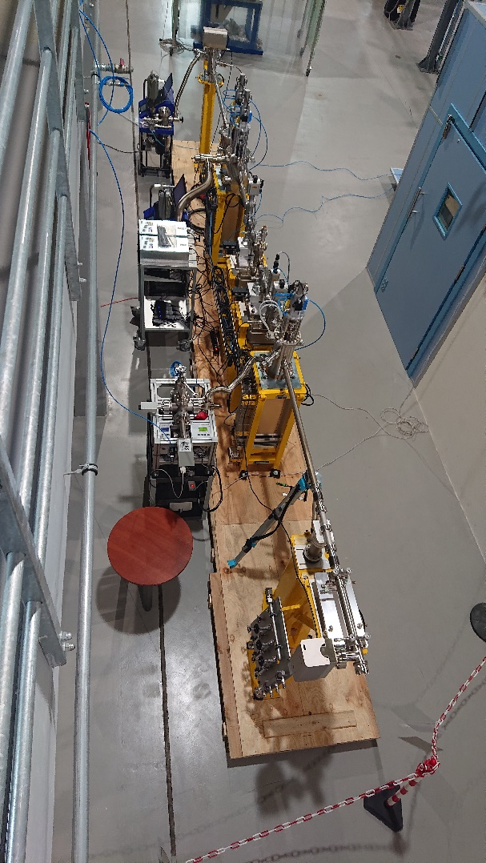
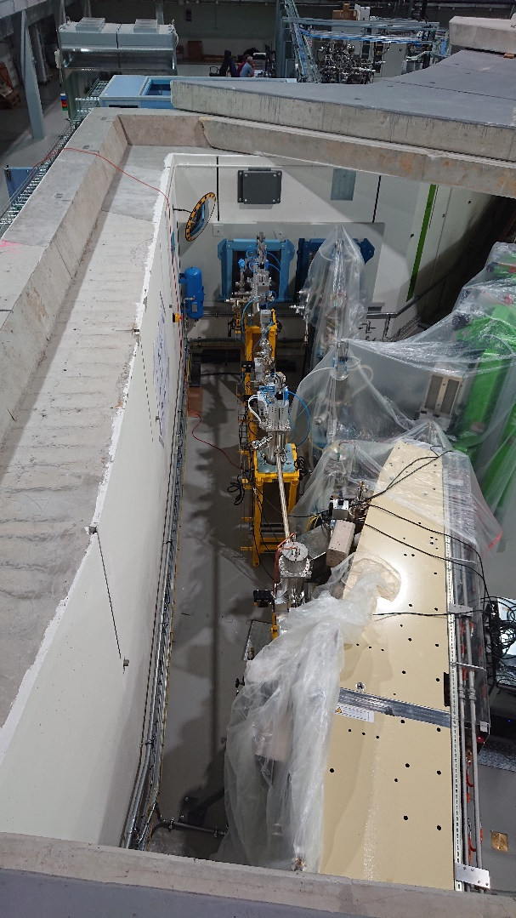
XMCD FE Installation Undulator Installation
XMCD FRONT END & UNDULATOR INSTALLATION
SAT: Test Stand area. Installation and bakeout - two weeks. Then installation and pumping in the storage ring – one week

Slide 24
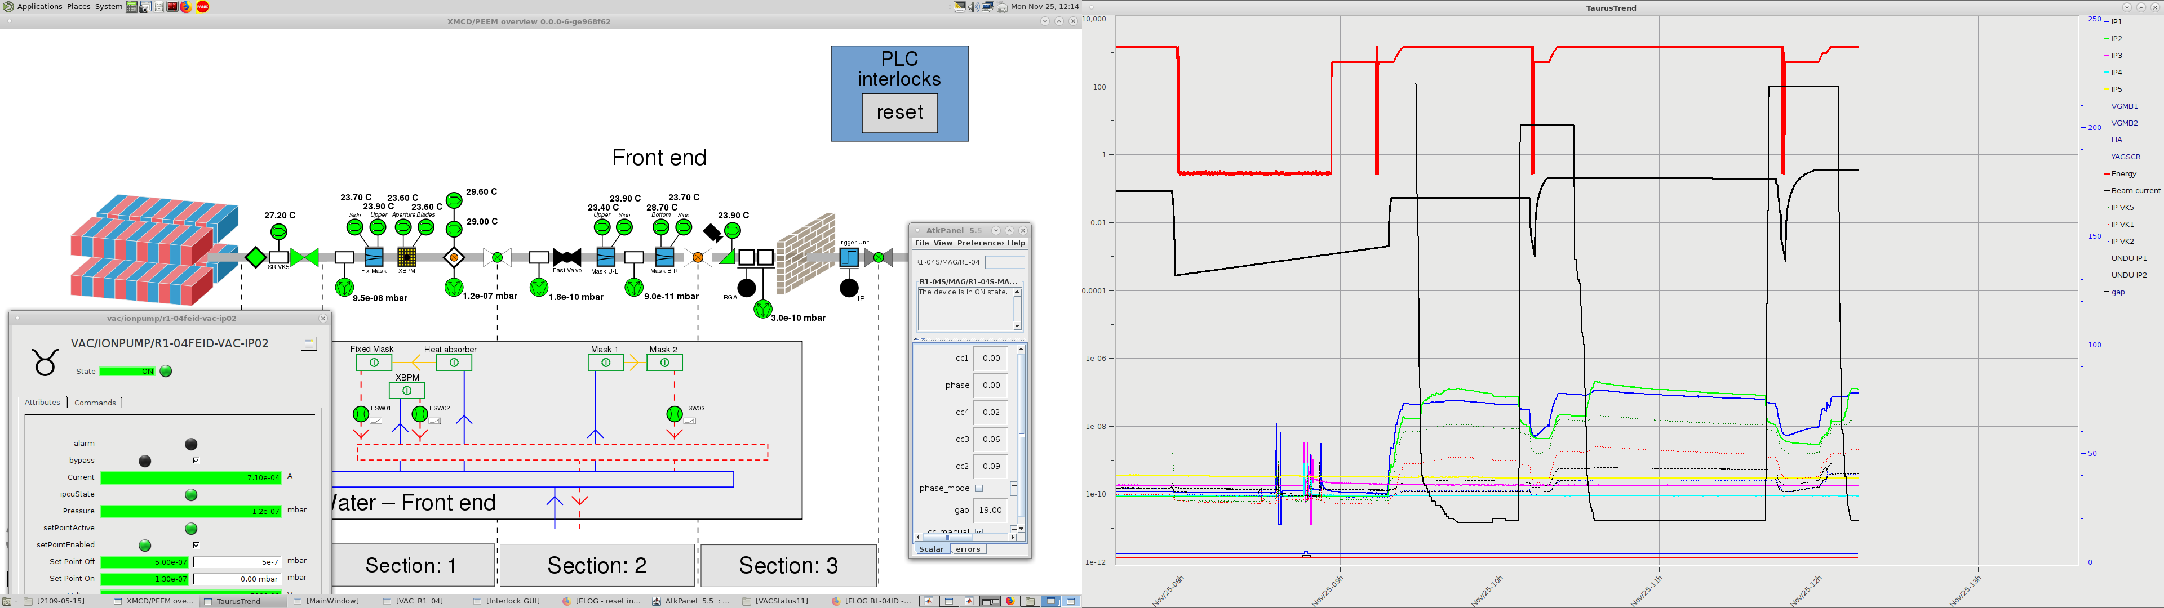
XMCD FE Degassing up to Heat Absorber
XMCD FE Degassing
Energy
Beam current
SIP HA
Beam current: 362 mA
Energy: 1.5 GeV
Undulator gap: 19 mm
Pressure at Heat Absorber: 1.2e-7 mbar
Temperature at Heat Absorber: ~30 deg. of C

Slide 25
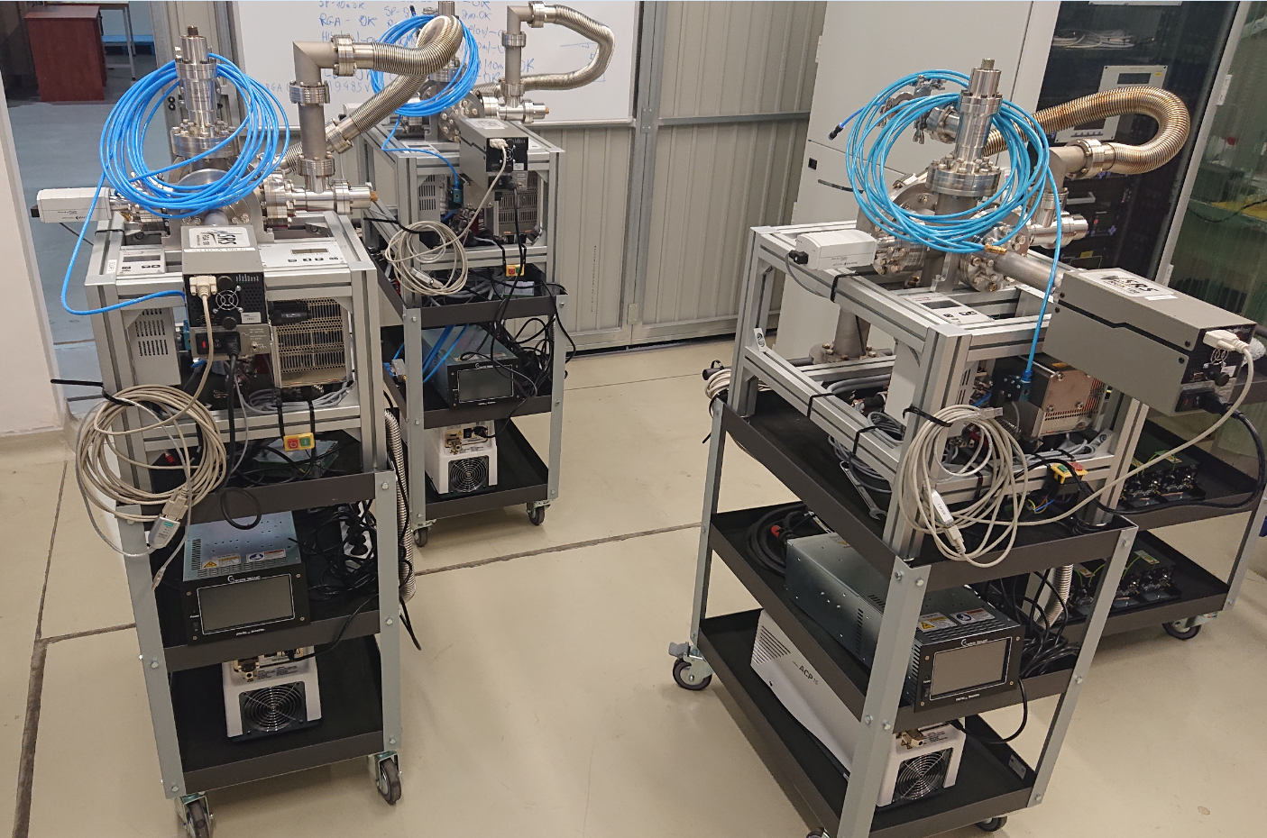
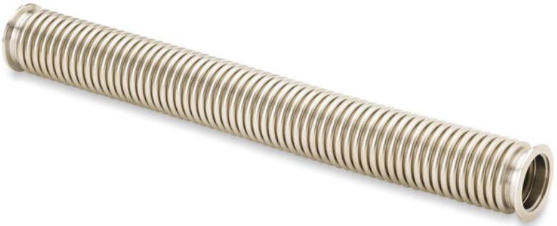

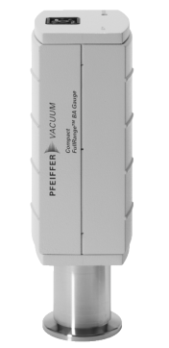
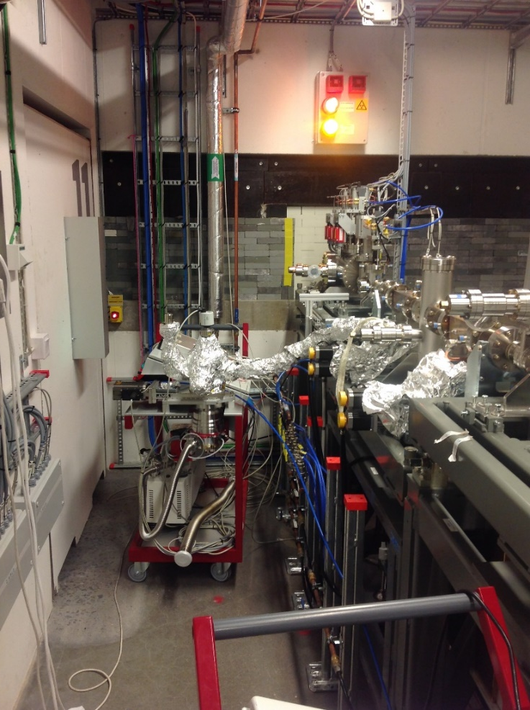
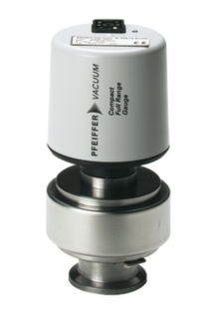
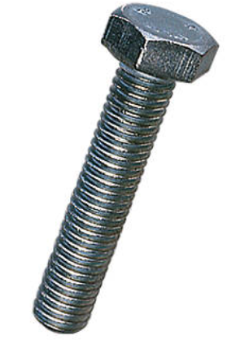
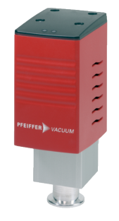









VAC Projects: Construction of Solaris pumping unit (2018/2019)
PROJECTS
Due to limited access to the front-end (missing doors) and to avoid long bellows during pumping customize pump station is needed
Three units, so far:
SOLAR 1/2/3

Slide 26

VAC Projects: Sophisticated bake-out Heating Unit Controller for synchrotron application (2017)
PROJECTS
Features:
Activation of NEG strips in dipole vacuum chambers
Access to machine signals/interlocks during NEG strip activation
Activation of NEG coated undulator vacuum chambers
Activation of NEG strips and NEG coated undulator vacuum chambers in one process
Bake-out of typical vacuum chambers
Protection against burned heating tape
Monitoring of temperature distribution over bake-out system
Cooperation with mobile pump station, pressure interlocks
One button machine
Parameters:
PLC & Tango control system
6 output heating channels (2KW)
2 DC power supplies
PC & Switch
CentOS operating system
Two units, so far:
HUC1 - prototype
HUC2 - copy

Slide 27



PROJECTS
Tune measurement device
Built according to MAXLAB specification
Stripline feeding network and reciever network operational
Succesful measurements
Analog reflected power interlock for Klystrons
Unreliable performance of Rhode&Shwarz scopes.
False reflected power interlocks – unable to inject beam.
Hardware fix – a dedicated module to detect and signal reflected power levels.

Slide 28

PLANS FOR NEXT BEAMLINES
POLYX
SOLABS
Cryo
EM
LUMOS diagnostic beamline to be installed in mid 2019
Pinhole diagnostic beamline operational since september 2018
Operation September 2019 –Users 2020
MX-SAXS-PD
SOLAIR
2018
Operational
Construction &
Commissioning
2019
2019
Under construction
PHELIX/NAPXPS
UARPES
PEEM/XAS
XMCD/STXM

Slide 29
SUMMARY & PLANS
Daily operation (Injections 7:00, 16:00 current between 280-320mA)
Maintenance activities during shutdowns (active plan for repair – fixing magnets connection, valves connection replacement, short circuit in PFS removal etc.)
Focus on beam stability
Closed orbit correction improvement and Libera firmware and device server upgrade
Working on the python application for the orbit correction
Landau cavities tuning and instabilities supressing (ongoing)
Suppressing impact of the UARPES, PHELIX & XMCD EPUs on the beam position (ongoing)
Installation of the FOFB
Implementation of the tune feedback
Installation and commissioning of the PINHOLE diagnostic beamline done
The installation of the LUMOS diagnostic beamline is almost done, commissioning expected in the beginning of next year
Equipment development (tune measurement device, LLRF test stand, heating unit controller, vacuum pump station)
Installation of the SOLABS FE
Redesign of the VK1 vacuum chamber for FTIR beamline
From 2020 more shifts sheduled for users (40%) and machine development (50%).

Slide 30


Thank you !
National Synchrotron Radiation Center SOLARIS
Kraków, 10.06.19

