Slide 1
Undulator Developments at HZB
Ed Rial on behalf of HZB Undulator Group, 29. November, 2019
European Synchrotron Light Source Workshop 2019, Barcelona

Slide 2
Undulator Developments at HZB
Contents
Background
CPMU17
IVUE32
Cryo-UE15
Future ideas and challenges
OPPORTUNITIES
E. Rial, Undulator Developments at HZB, 29.11.19
European Synchrotron Light Sources 2019

Slide 3
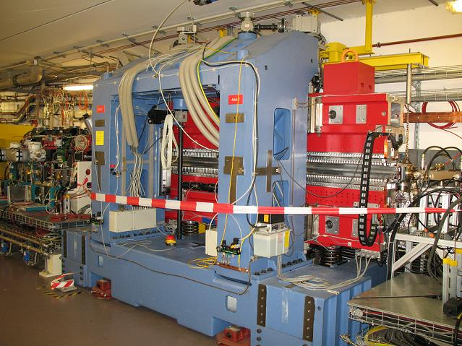
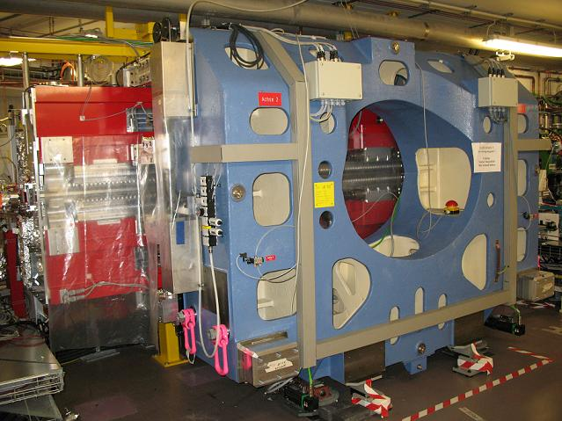
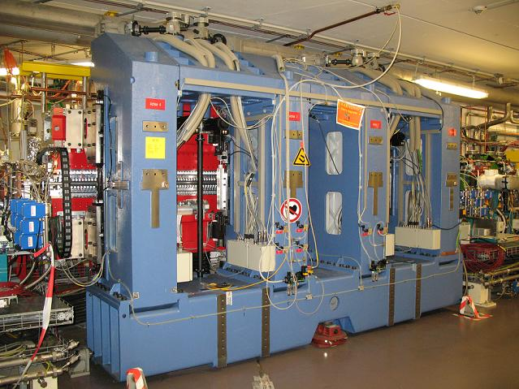
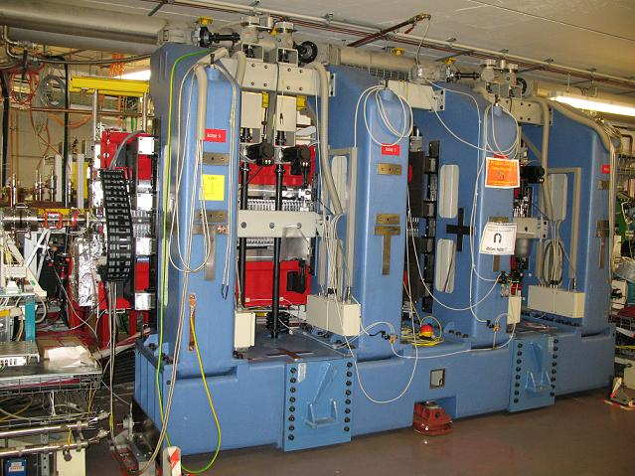
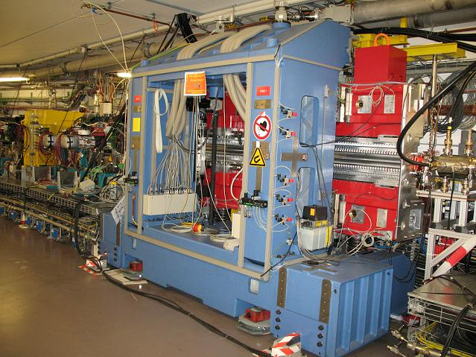
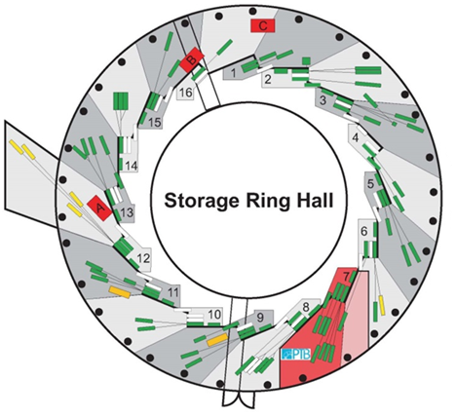
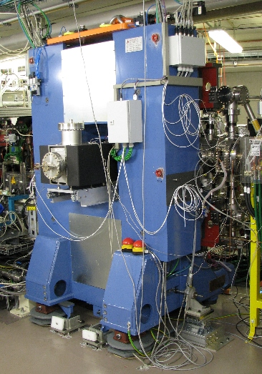
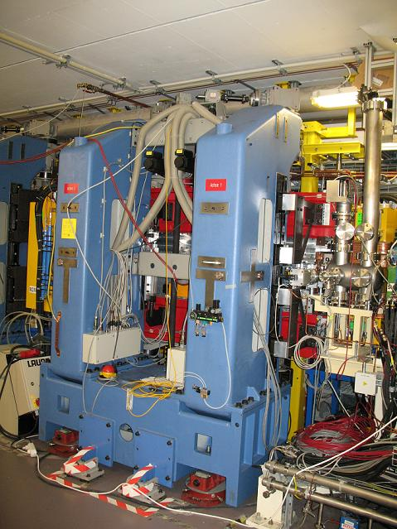
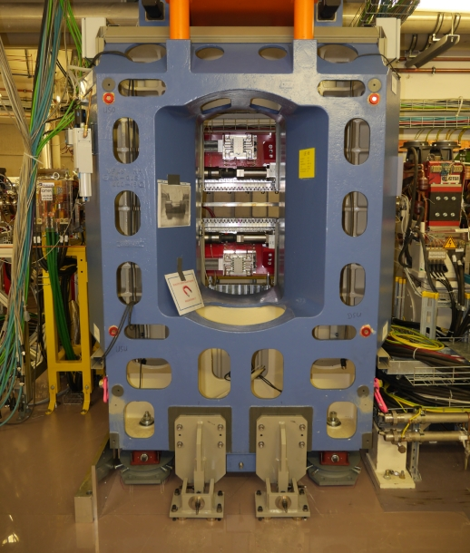
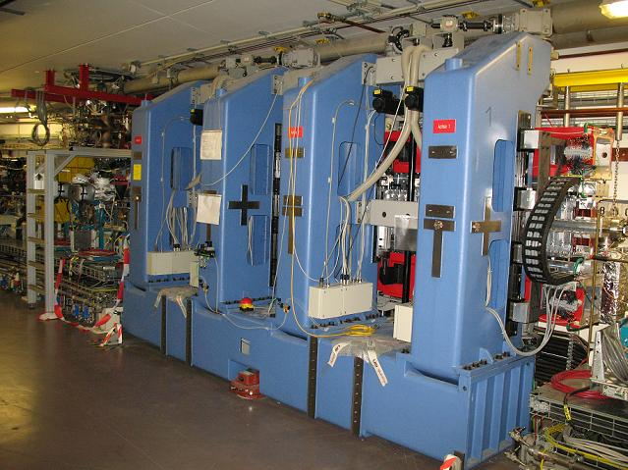
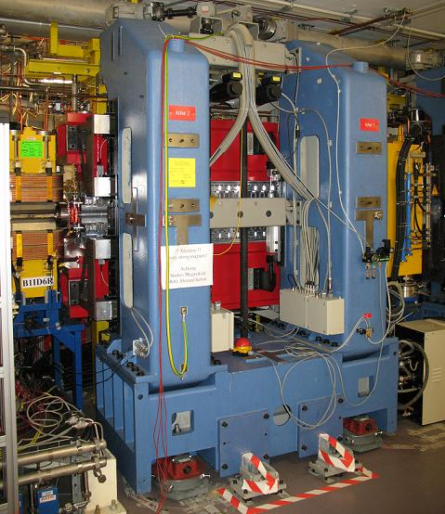
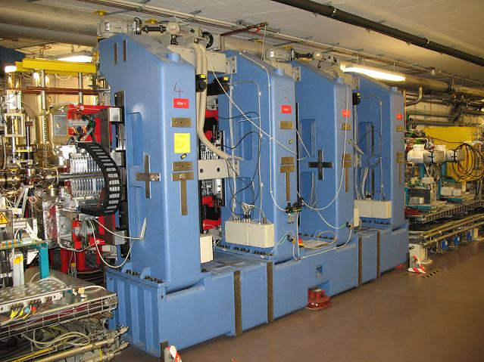
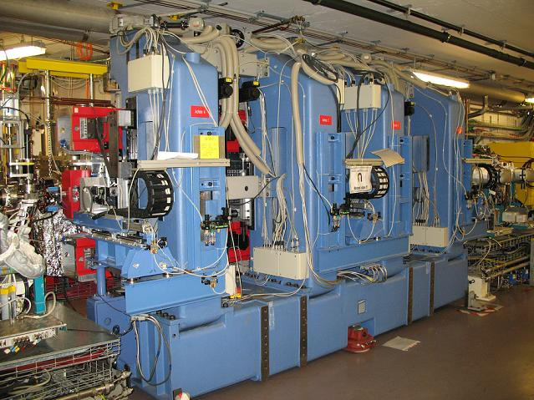
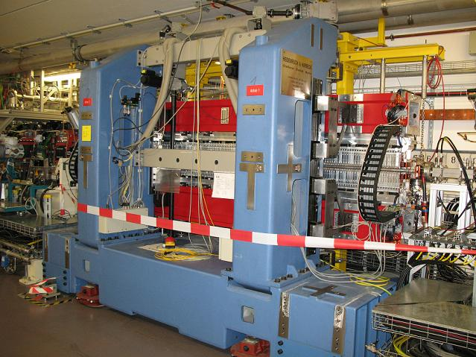
Experience of BESSY
UE46
UE112
UE52
U49-1
UE49
CPMU17
UE56-1
UE48
U125-2
U49-2
1998
1999
1999
1998
1999
2000
2000
2001
2002
2002
2003
2004
2004
2006
2007
2007
2009
2010
2015
2017
U139
UE56-2
U41
U49-1
U125-1
UE56-1
UE56-2
U41
U49-2
U125-2
UE56
UE46
UE52
UE56 R
U139
UE49
UE112
U48
UE56 K
UE65
CPMU9
UE48
CPMU17
E. Rial, Undulator Developments at HZB, 29.11.19
European Synchrotron Light Sources 2019

Slide 4

User Requirements
High Flux
High Brightness
High Energy
  CPMU
Large Energy Range
  Multi-λ_{u} Undulators
Fully Polarisable
  APPLE Undulators
Fast Switching
  TRIBs
High Flux
High Brightness
High Energy
Large Energy Range
  Constant Flux!
  No Energy Gap!
Fully Polarisable
  Pure polarised light only please!
  Fast switching!
High Flux
High Brightness
High Energy
Large Energy Range
  Constant Flux!
  No Energy Gap!
Fully Polarisable
  Pure polarised light only please!
  Fast switching!
E. Rial, Undulator Developments at HZB, 29.11.19
European Synchrotron Light Sources 2019
Notes:
Chopper 100Hz – TRIBS 1MHz

Slide 5
CPMU
Development Path: CPMU
E. Rial, Undulator Developments at HZB, 29.11.19
European Synchrotron Light Sources 2019

Slide 6
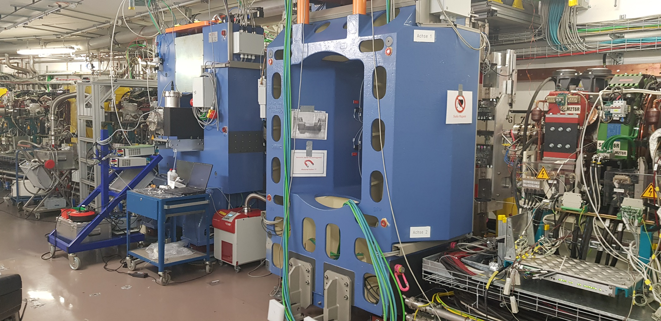
CPMU17: EMIL @ BESSY
A wide energy range for EMIL,
Energy Materials In-situ Laboratory
60 – 6000eV
Canted Double Undulator System
CPMU17
UE48
Dipole
Dipole
Dipole
.
E. Rial, Undulator Developments at HZB, 29.11.19
European Synchrotron Light Sources 2019

Slide 7
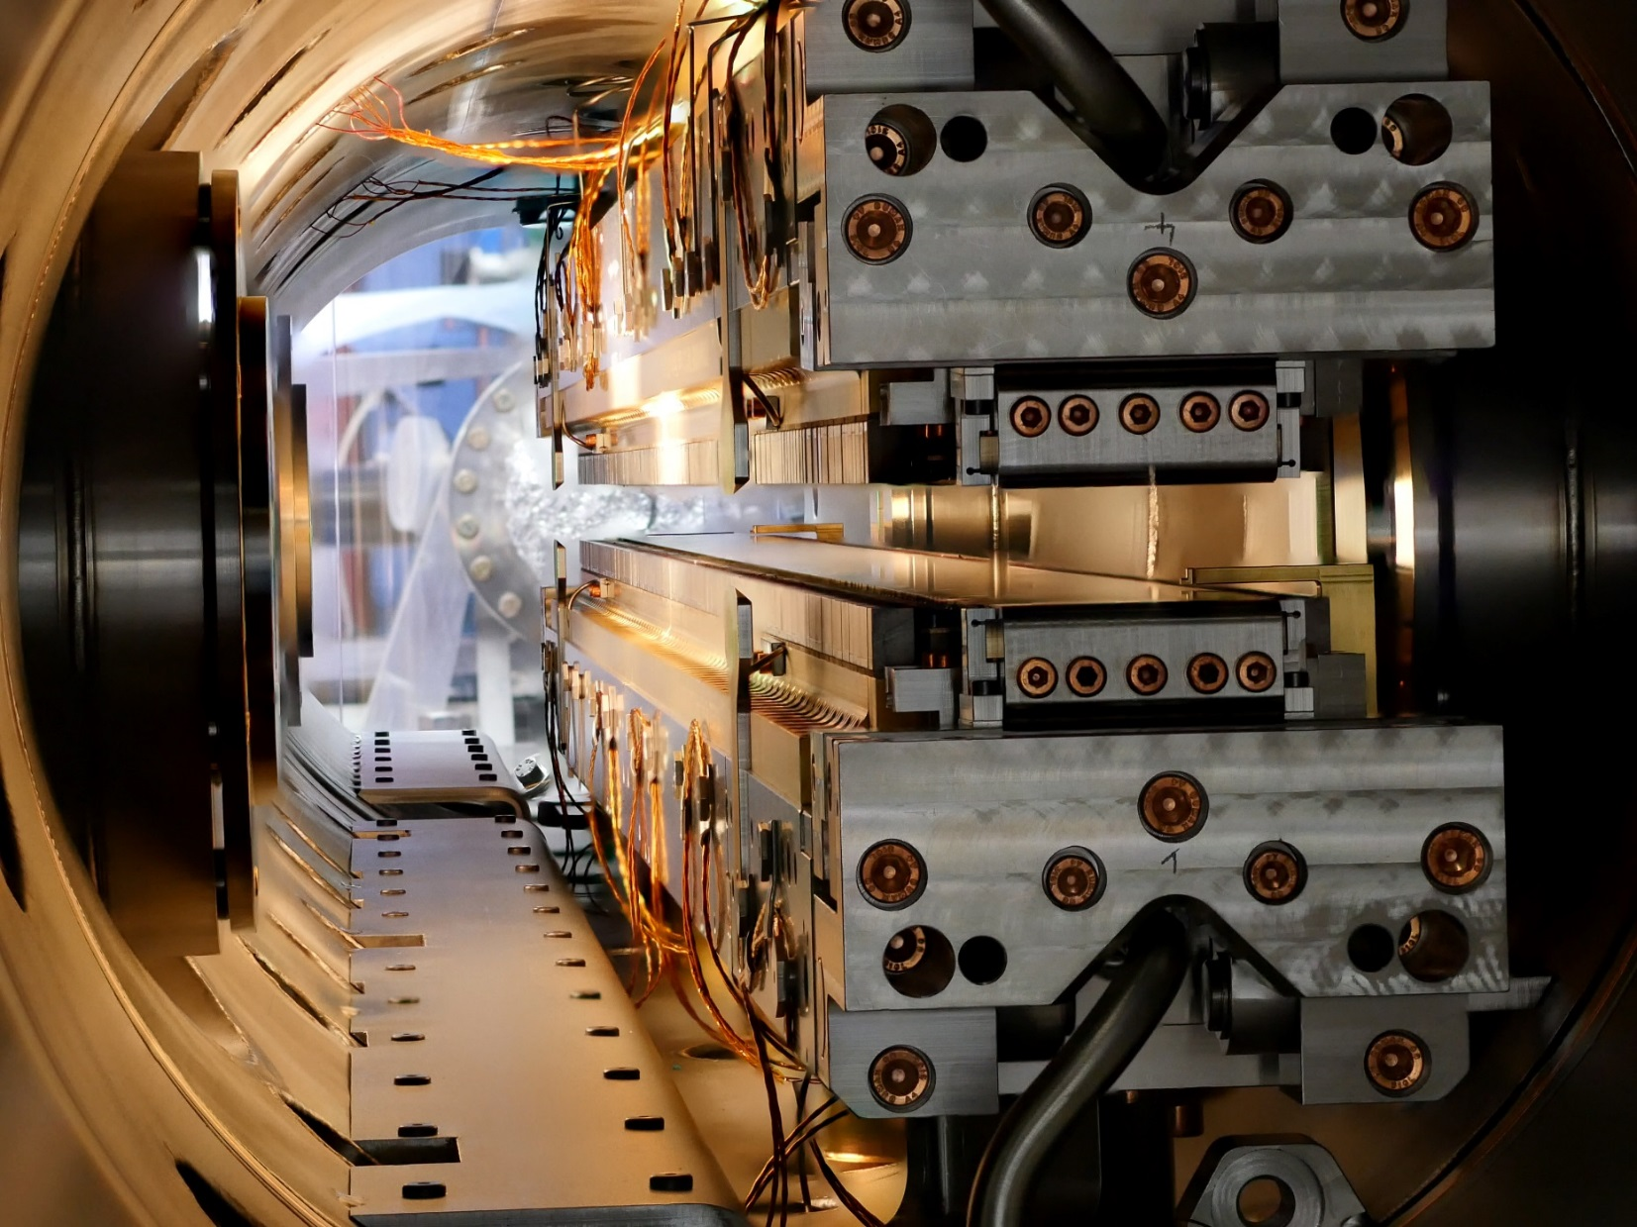
CPMU17: Internal View
E. Rial, Undulator Developments at HZB, 29.11.19
European Synchrotron Light Sources 2019

Slide 8
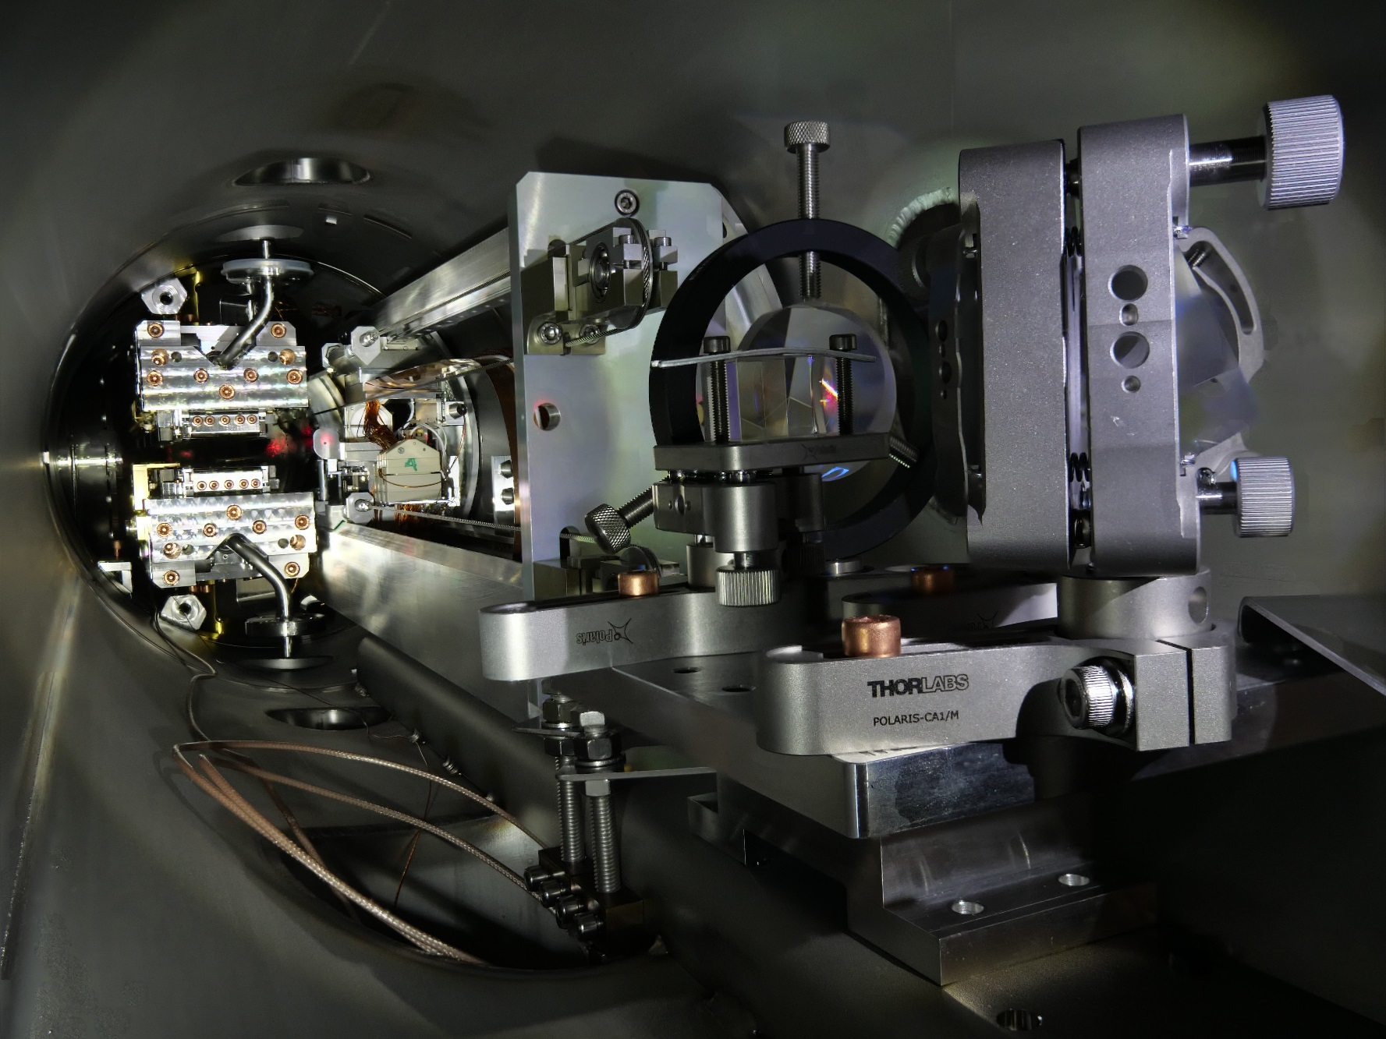
CPMU17: Measurement System
E. Rial, Undulator Developments at HZB, 29.11.19
European Synchrotron Light Sources 2019

Slide 9
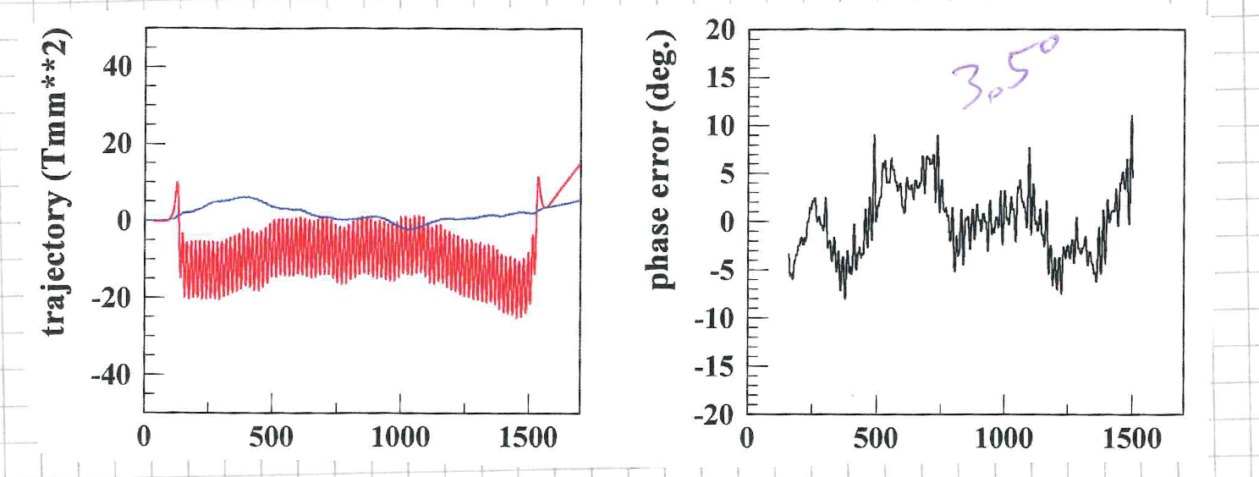
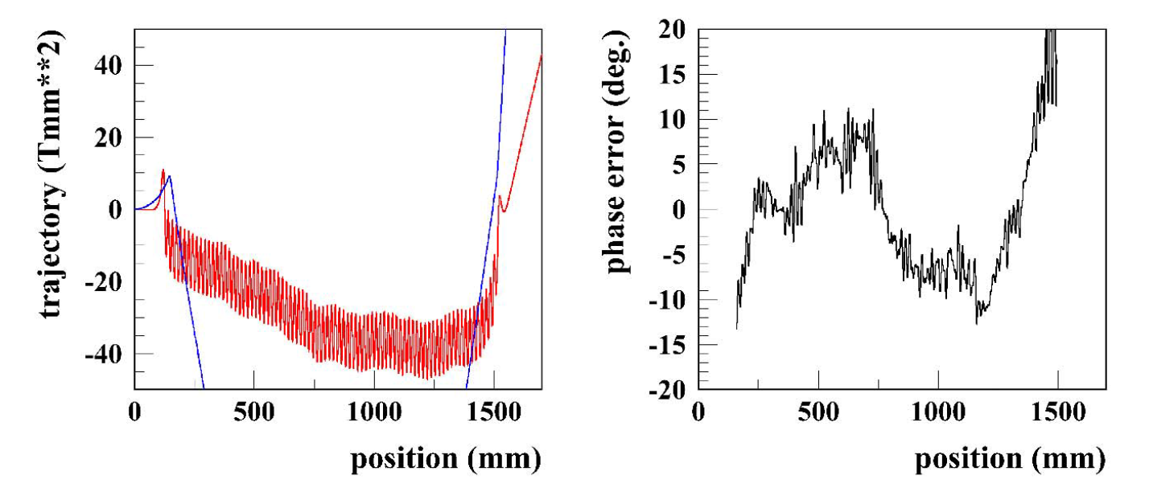
CPMU17: Measurement Results
room temperature
no taper correction
liquid nitrogen
temperature
with taper correction
4° phase error
7° phase error
Final taper setting and environmental field compensation with monochromator
E. Rial, Undulator Developments at HZB, 29.11.19
European Synchrotron Light Sources 2019

Slide 10
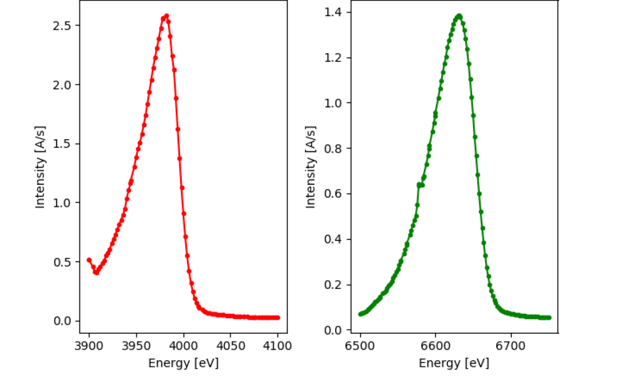
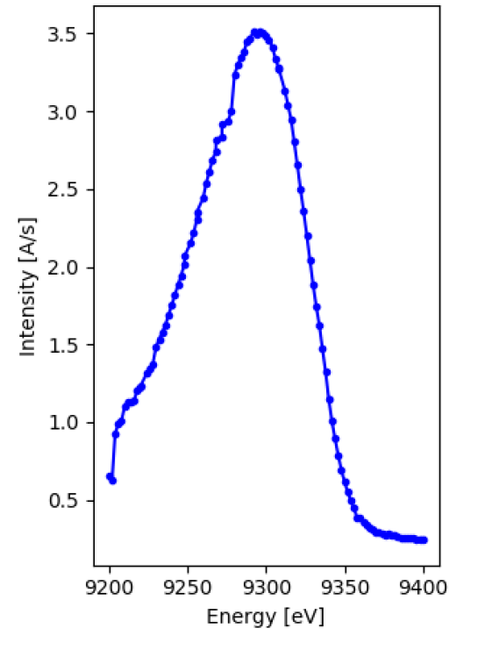
CPMU17: Initial Spectral Results
U17-DCM commissioning
3rd Harmonic
5th Harmonic
7th Harmonic
Si 111 crystal
Si 111 crystal
Si 422 crystal
Courtesy of F. Schäfers
Notes:
V2C XES – valence to core emission spectroscopy
Analysis of the weak VtC XES region can be used for ligand identity around an absorbing atom. Main advantage over EXAFS: C, N, and O, may be distinguished by VtC XES. Moreover, information about metalligand bond lengths and the activation of diatomic ligands (CO, N2, O2, or NO) may also be extracted from analysis of VtC spectra.
Comparison of measurements done at PETRA III P64 beamline and at PINK, measurement time is the same

Slide 11
CPMU17: Internal View
E. Rial, Undulator Developments at HZB, 29.11.19
European Synchrotron Light Sources 2019

Slide 12
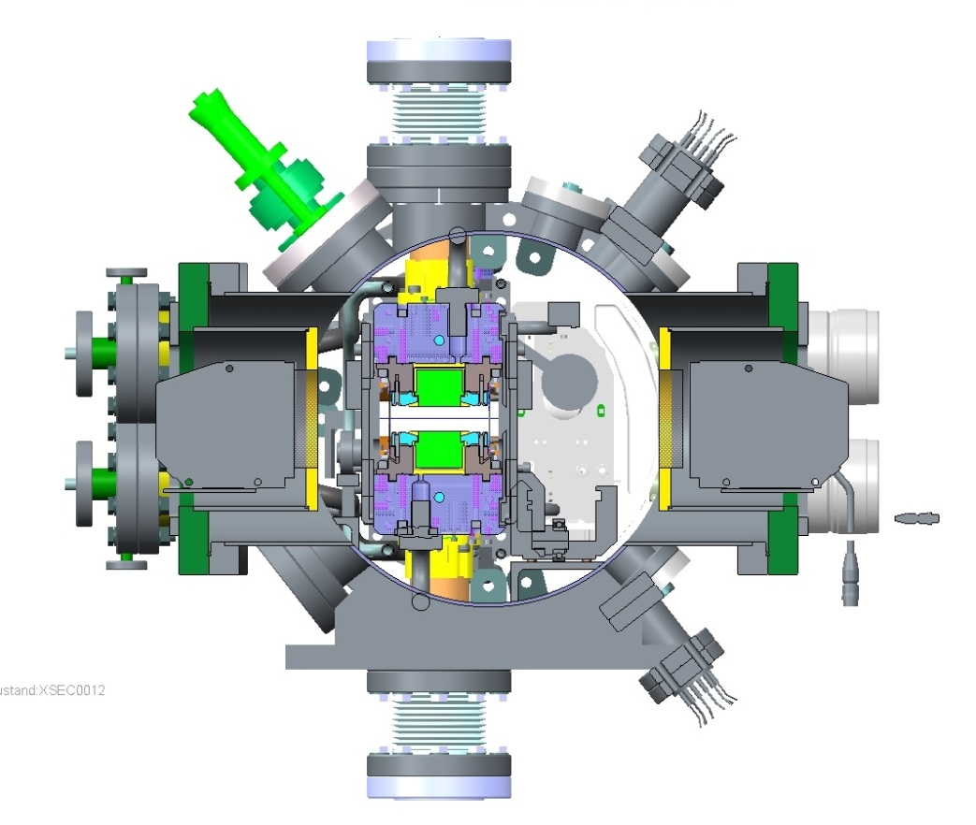
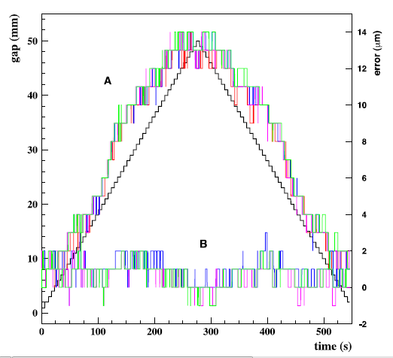
CPMU17: Gap Feedback
CPMU17
Hallprobe
bench
Optical micrometer consisting of
transmitter, receiver, blades
Temperature dependent length variations
are compensated automatically
receiver
transmitter
window
window
aperture
Gap Reproducibility on 1 𝝁𝒎 –Level;
Well suited for cryogenic undulators
systematic optical errors of window flange are reproducible, can be corrected
J. Bahrdt, C. Kuhn, Synch. Radiation News Vo. 28 No 3 (2015) 9-14.
E. Rial, Undulator Developments at HZB, 29.11.19
European Synchrotron Light Sources 2019
Notes:
Cross section of the CPMU17, left: undulator, right: in-vacuum hallprobe bench
We need temperature independent gap measurement system
Systematic errors due to window quality, but: reproducible

Slide 13
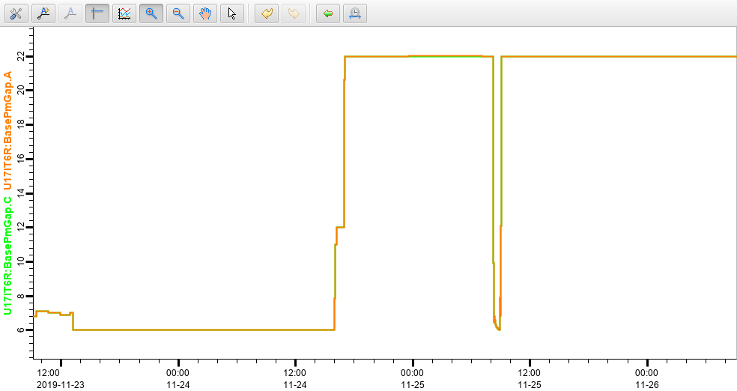
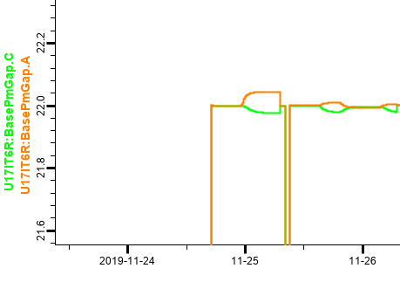
CPMU17: Gap Feedback
the importance of active gap feedback
E. Rial, Undulator Developments at HZB, 29.11.19
European Synchrotron Light Sources 2019

Slide 14
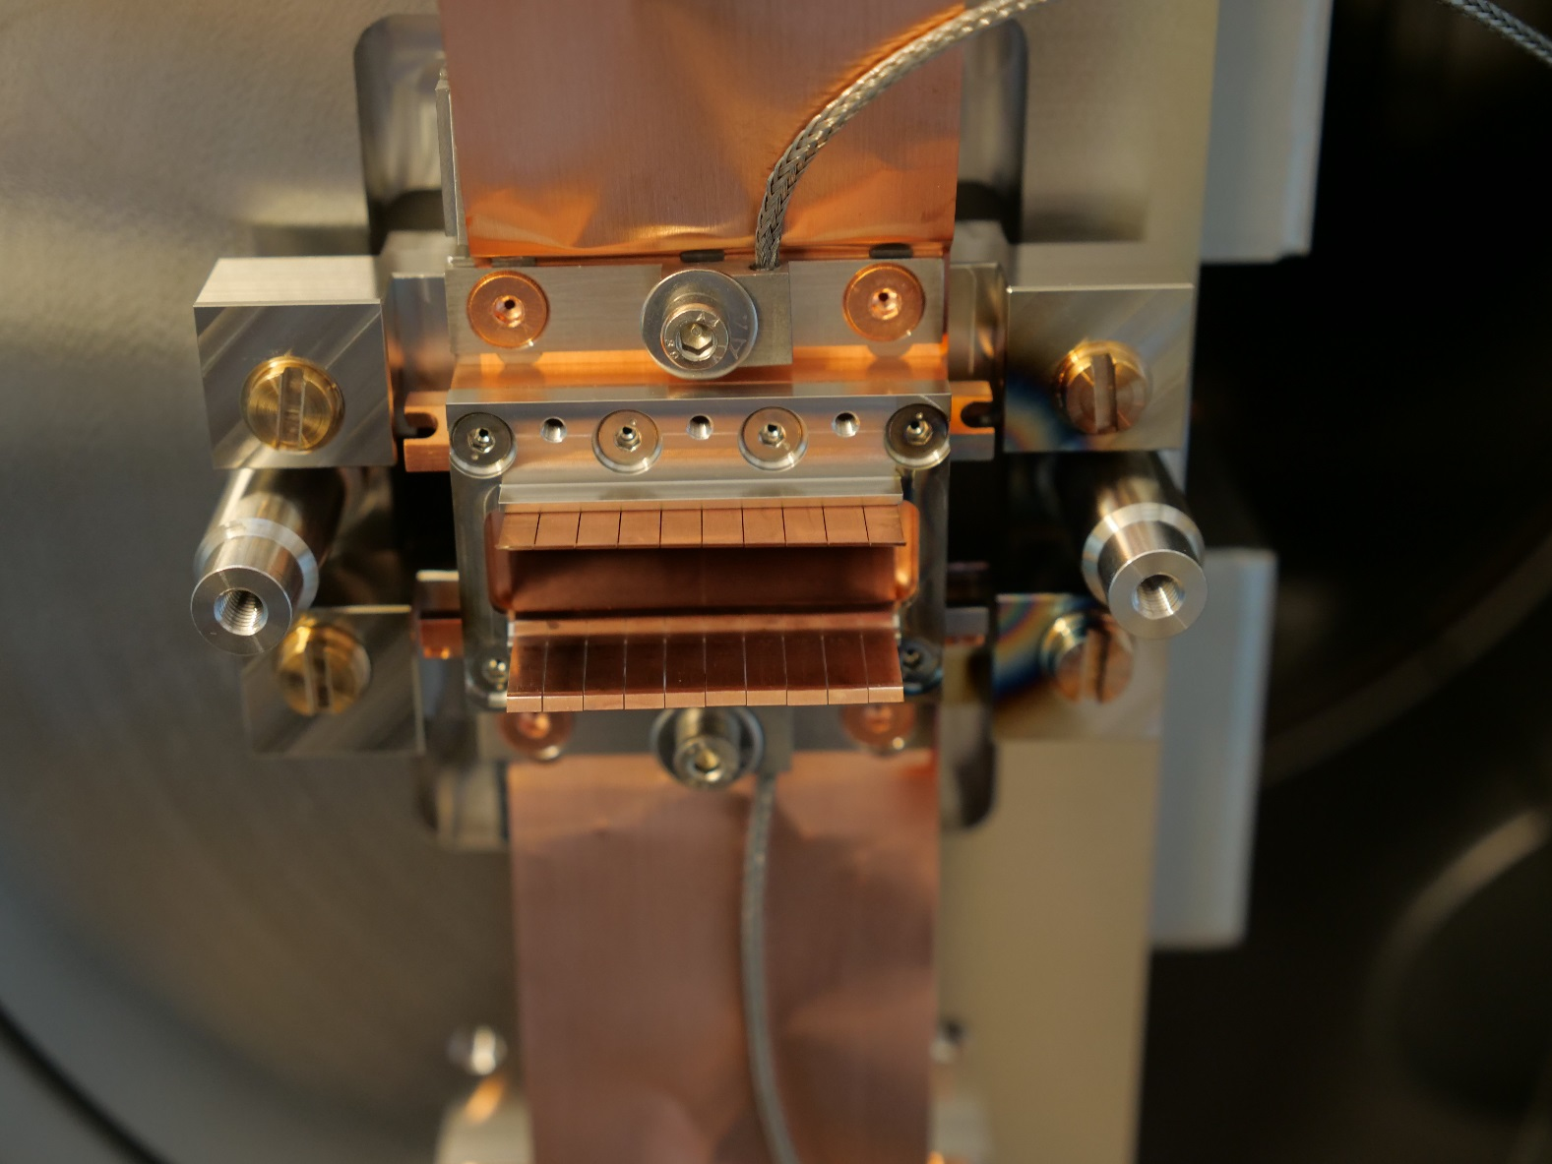
CPMU17: After One Year
E. Rial, Undulator Developments at HZB, 29.11.19
European Synchrotron Light Sources 2019

Slide 15
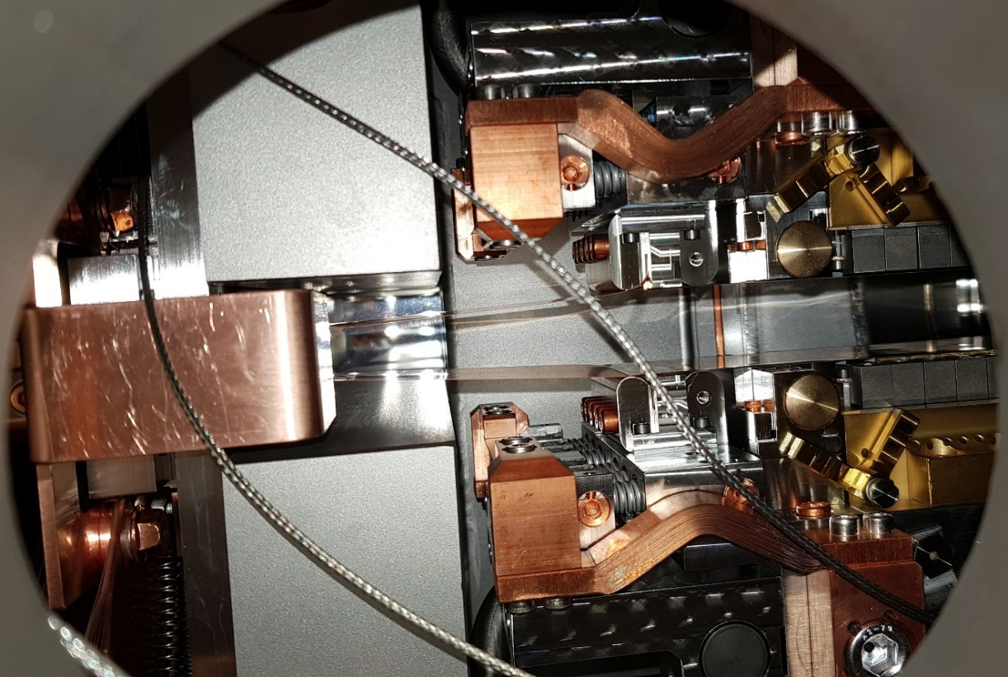
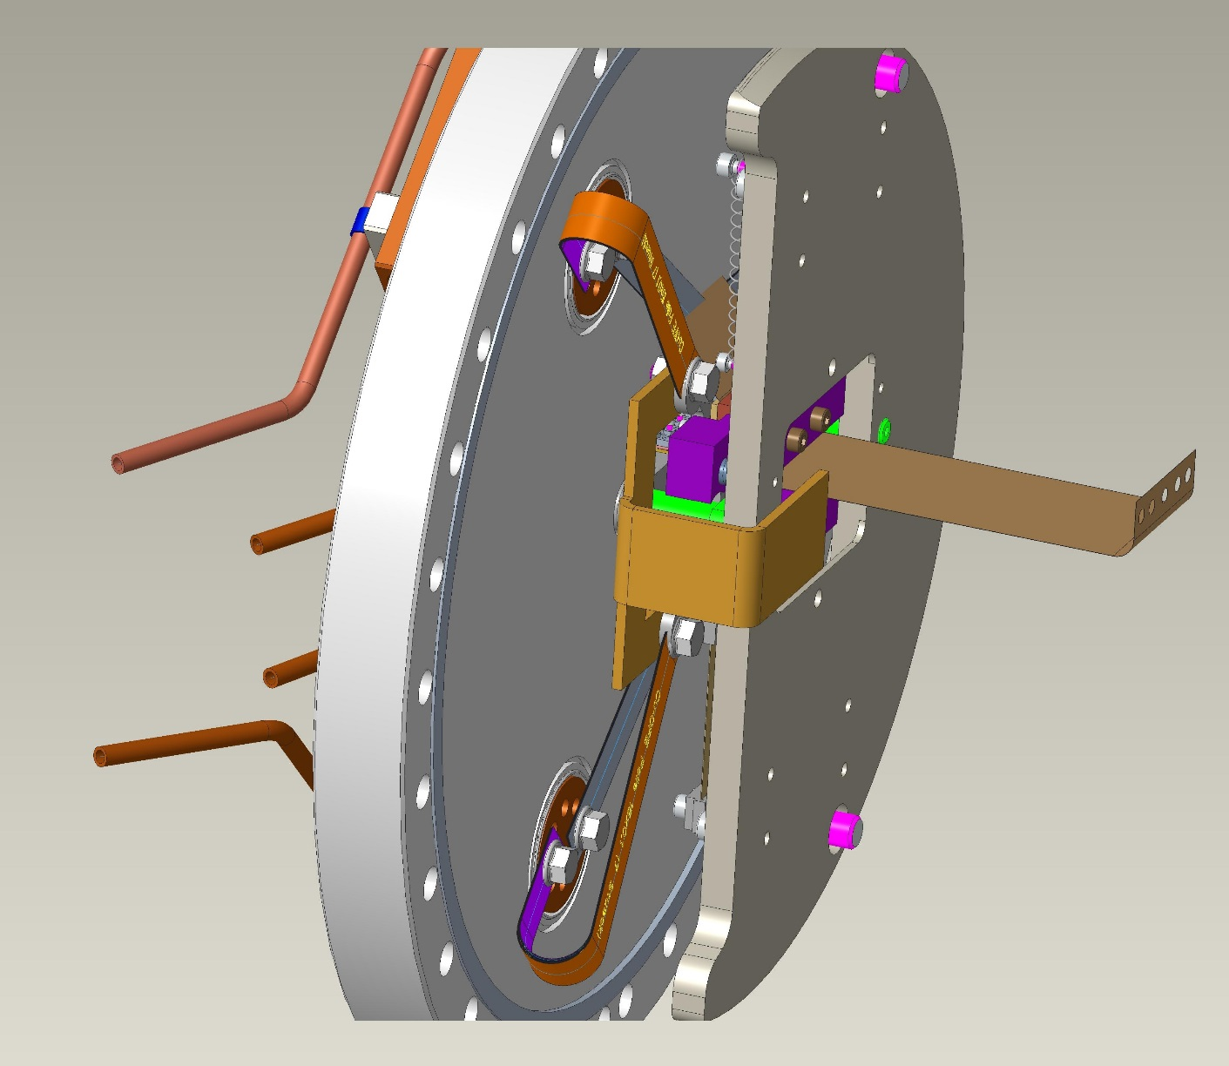
CPMU17: 2019 Modifications
E. Rial, Undulator Developments at HZB, 29.11.19
European Synchrotron Light Sources 2019

Slide 16
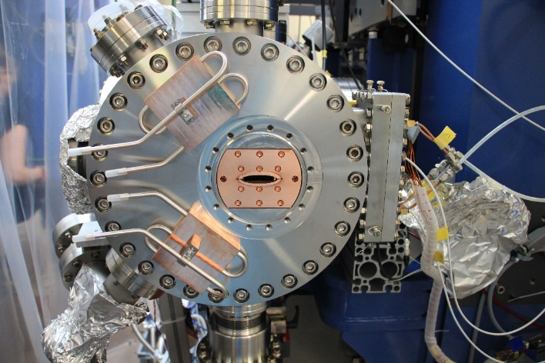
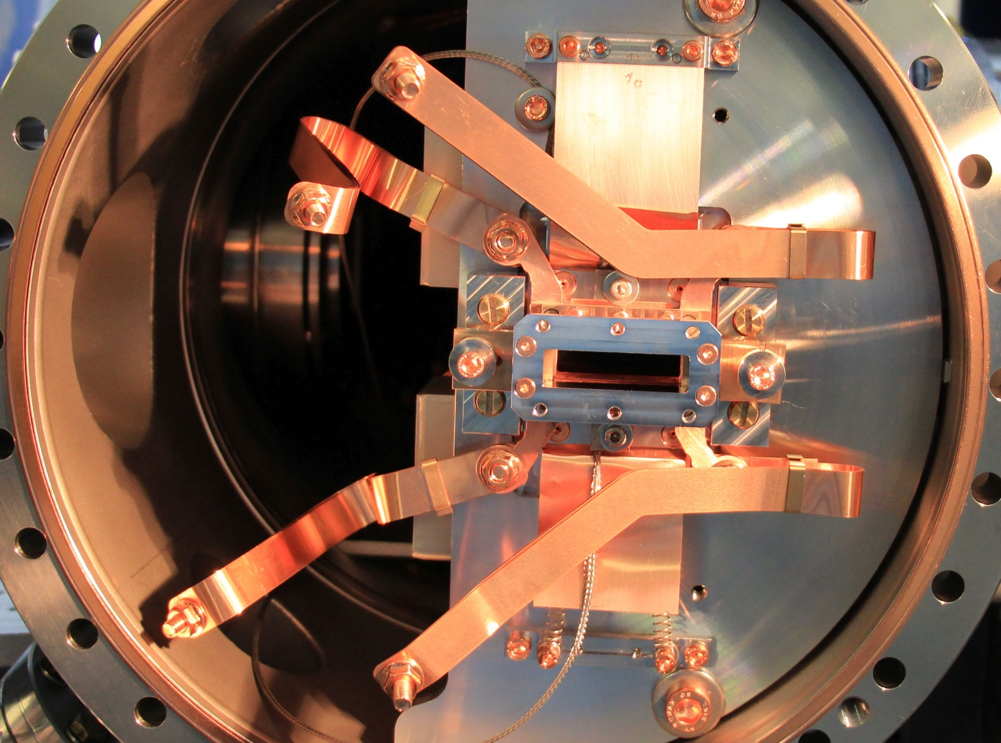
CPMU17: 2019 Modifications
E. Rial, Undulator Developments at HZB, 29.11.19
European Synchrotron Light Sources 2019

Slide 17
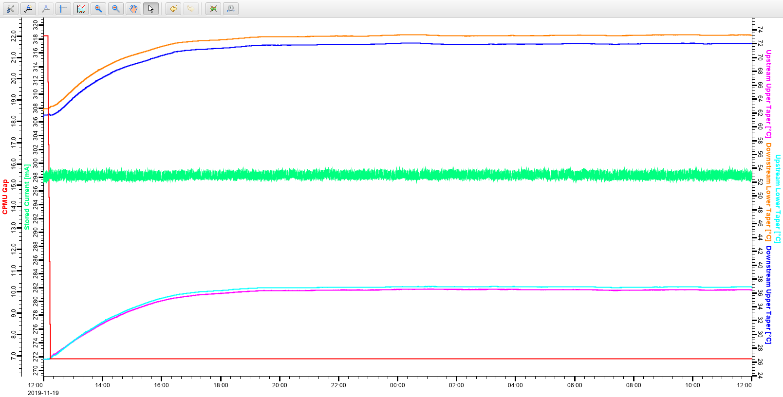
CPMU17: Heat Load in Operation
Nominal operation conditions.
Temperatures measured with PT100 thermocouples.
E. Rial, Undulator Developments at HZB, 29.11.19
European Synchrotron Light Sources 2019

Slide 18
CPMU
Development Path: In-Vacuum APPLE-II
In-Vacuum APPLE
E. Rial, Undulator Developments at HZB, 29.11.19
European Synchrotron Light Sources 2019

Slide 19
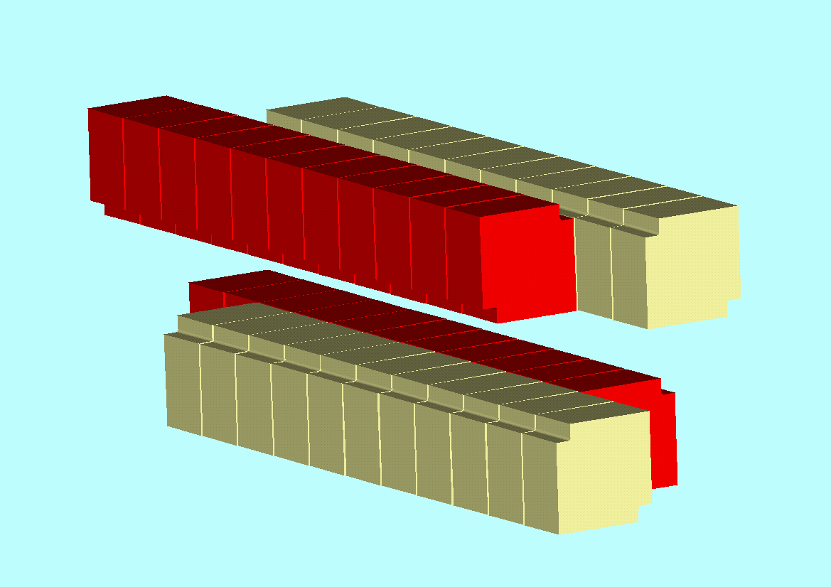

IVUE32: Requirements
Interests at straight L06
Substitution of the U41 Undulator:
METRIX and PEAXIS need:
  vertical polarization
  no complicated directional characteristics
  Energy range: 250 - 1000 eV
Microscopy needs variable linear polarization
  no need to rotate sample rotation necessary
  (very problematic with microscopy)
Energy range: 250 - 2500 eV
  Beamline optimized for high energies
Additionally variable elliptic polarization over the entire energy range
APPLE II, elliptical mode
Room Temperature In-Vacuum UE32
Period Length | 32 mm
Total Length | 2.5 m
Number of Periods | 78
Physical Aperture over 2.5m | 6.3 mm
Magnetic Gap | 7 mm
E. Rial, Undulator Developments at HZB, 29.11.19
European Synchrotron Light Sources 2019

Slide 20
IVUE32: Spectral Performance
Comparison BESSY II-UE49
Increase in Brilliance and Flux >/= Factor 2
No gap in the spectrum in vertical linear polarisation
E. Rial, Undulator Developments at HZB, 29.11.19
European Synchrotron Light Sources 2019

Slide 21
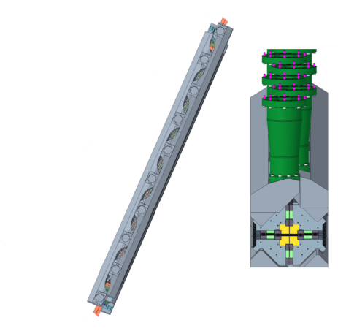
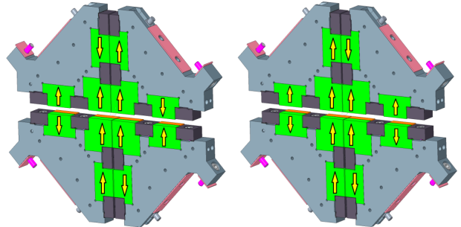
IVUE32: Mechanical Design Aspects
Staggered column design
Magnetic force Compensation
Functional Magnets (FMs) at the center Compensation Magnets (CMs) at the sides and top / bottom
Source: Bahrdt, Johannes & Grimmer, In-vacuum APPLE II undulator with force compensation. AIP Conference Proceedings. 2054. 030031. 10.1063/1.5084594.
E. Rial, Undulator Developments at HZB, 29.11.19
European Synchrotron Light Sources 2019

Slide 22
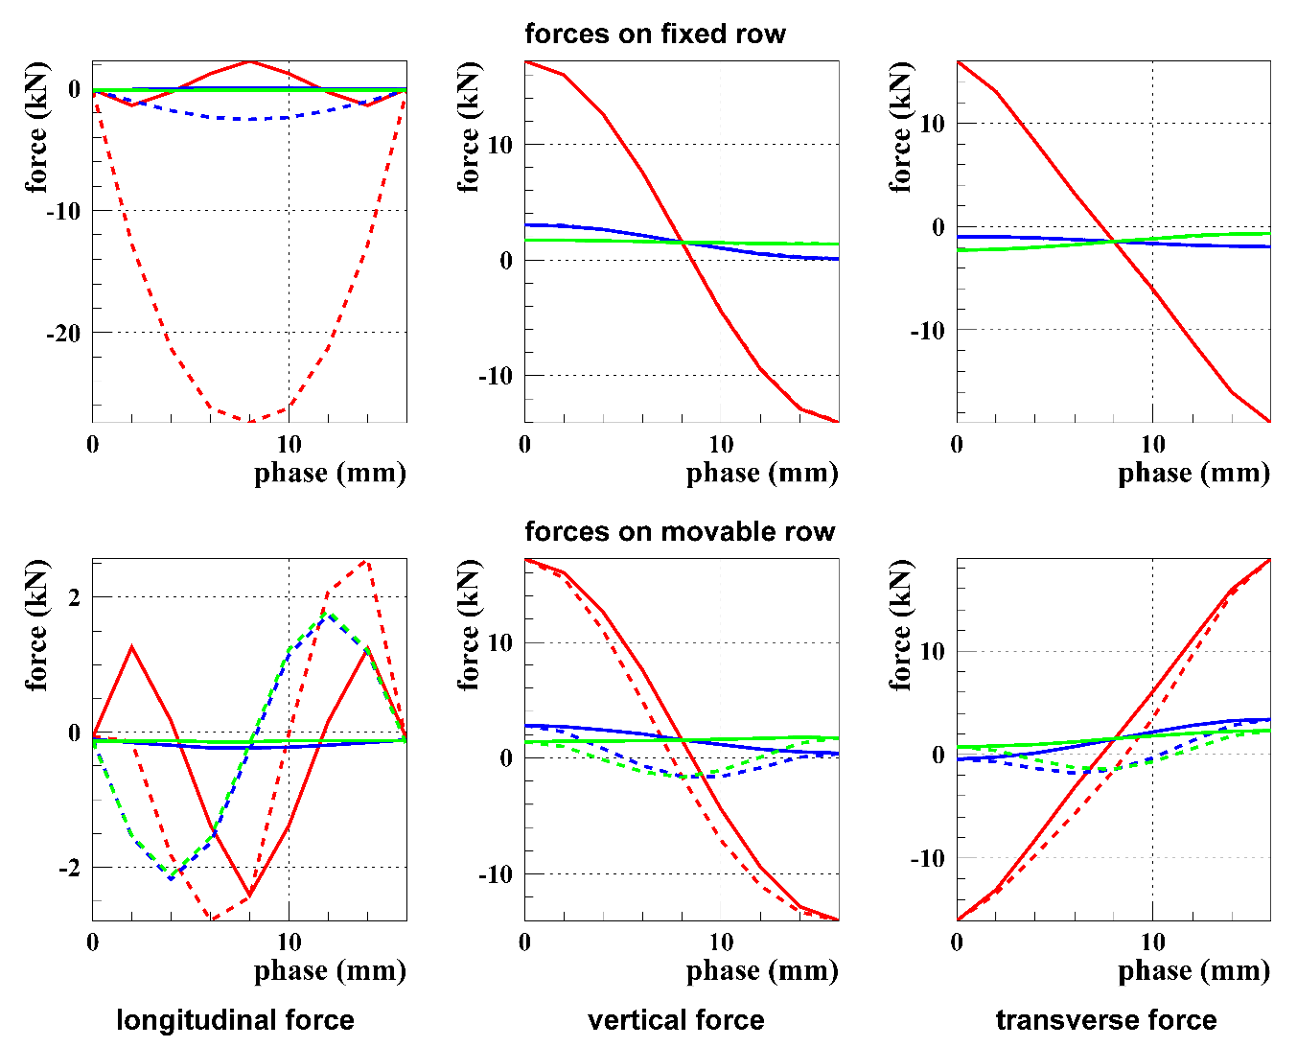
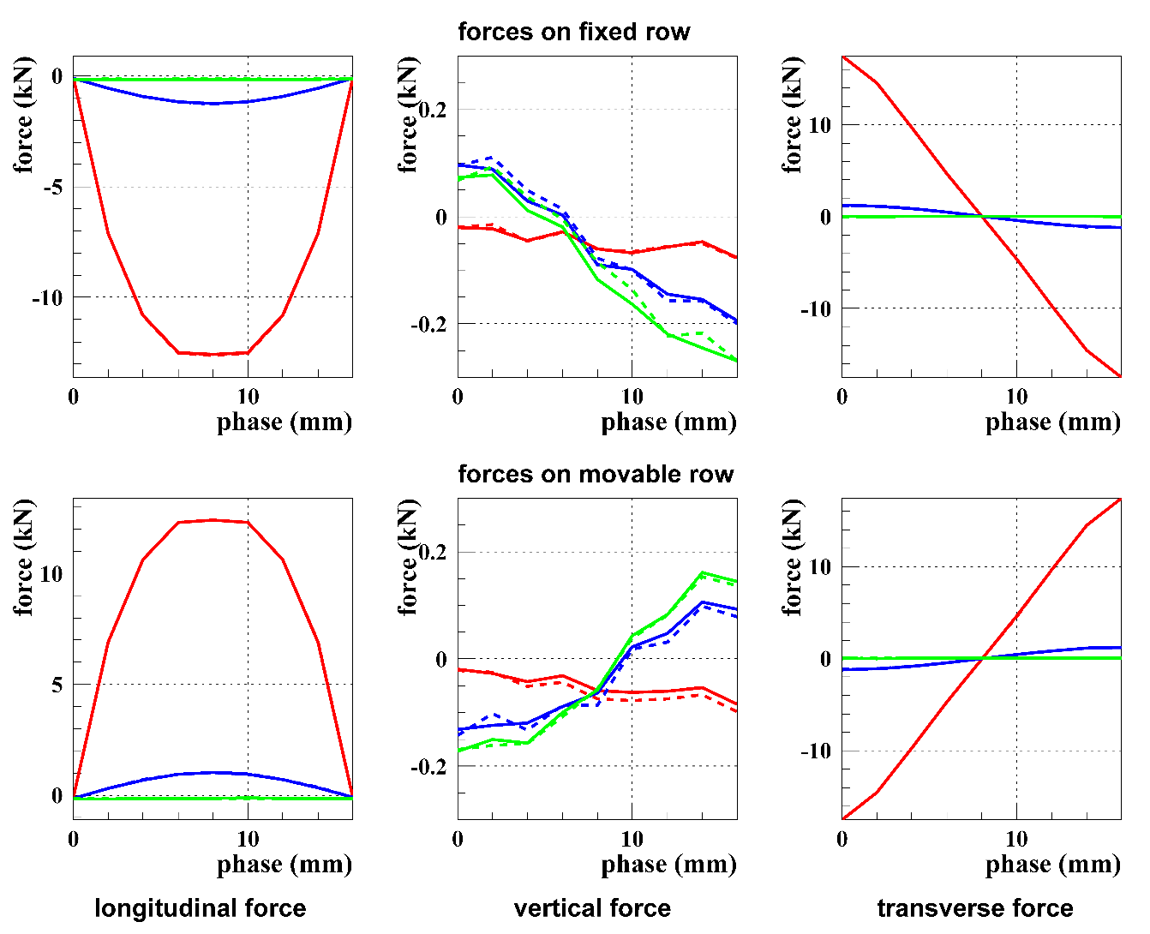
IVUE32: Magnetic Design Aspects
Gap = 7mm
Gap = 40mm
Polarization modes:
Elliptical (solid)
Inclined (dashed)
Uncompensated
Small CMs
Large CMs
E. Rial, Undulator Developments at HZB, 29.11.19
European Synchrotron Light Sources 2019

Slide 23
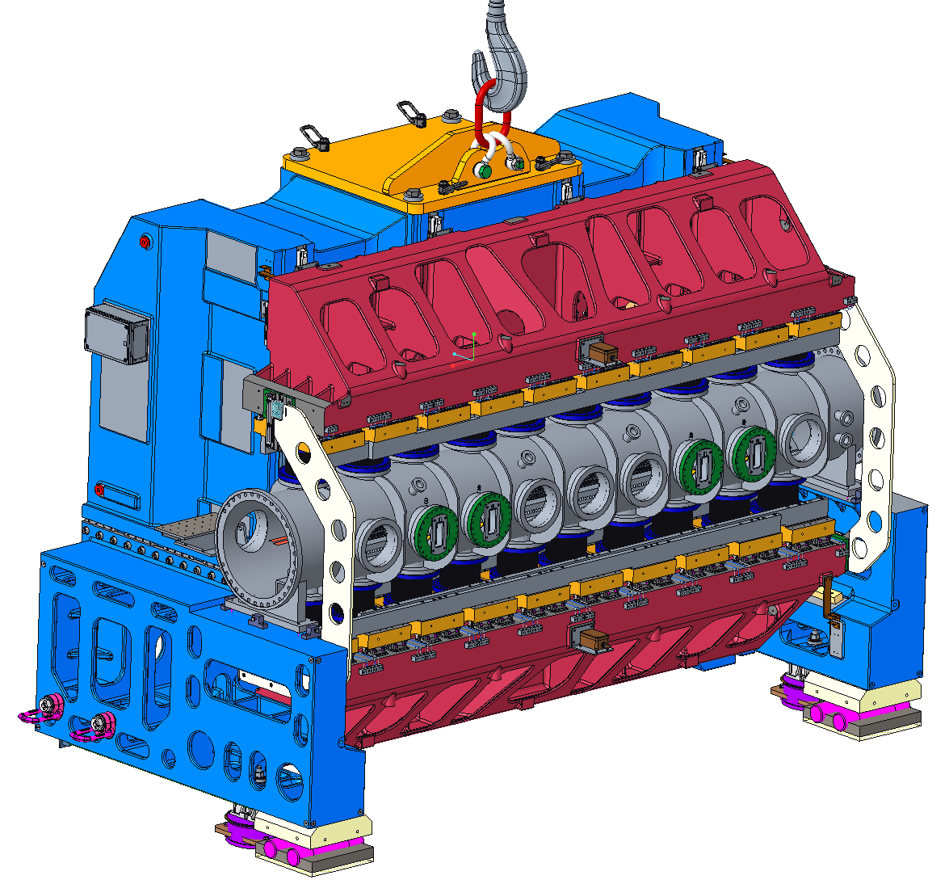
IVUE32: Status
IVUE32 Design work in progress
Development of magnet soldering technique on-going
Keeper design including force compensation magnets
Optimization of cast iron frame with casting company
Implementation of transverse column adjustment
Reduction of column height and bellow diameter
Finalization of gap drive mechanism
10 period prototype designed and ordered
E. Rial, Undulator Developments at HZB, 29.11.19
European Synchrotron Light Sources 2019

Slide 24
CPMU
Development Path: Cryogenic APPLE
In-Vacuum APPLE
Cryo-APPLE
E. Rial, Undulator Developments at HZB, 29.11.19
European Synchrotron Light Sources 2019

Slide 25
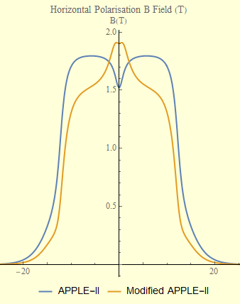
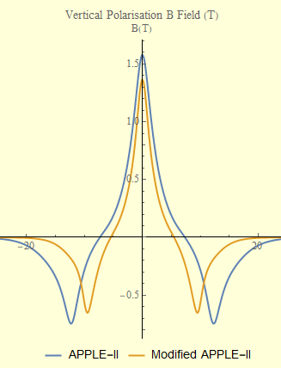
CUE-15: Magnetic Design
Traditional APPLE II
Modified APPLE II
Horizontal Polarisation
Vertical Polarisation
2mm Gap : 15mm Period: 15x15mm Block : PrNdFeB @77K
E. Rial, Undulator Developments at HZB, 29.11.19
European Synchrotron Light Sources 2019

Slide 26
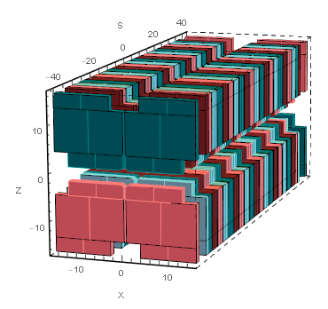
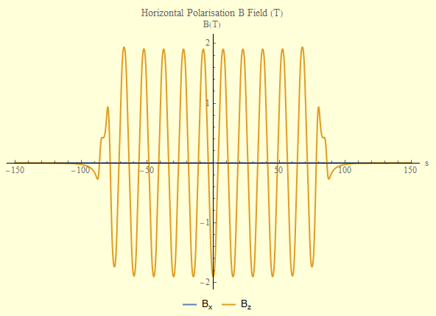
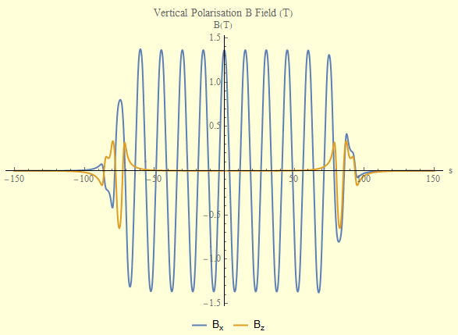
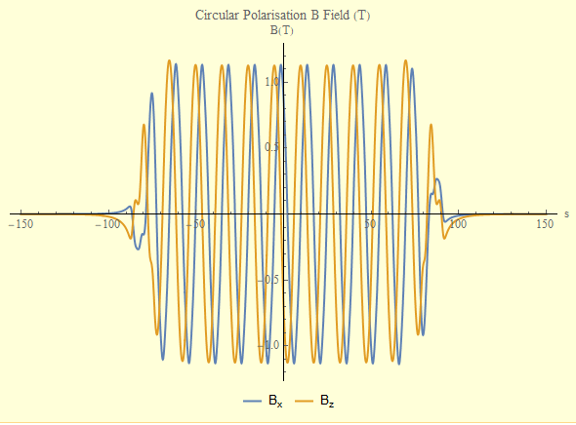
CUE-15: Magnetic Summary
Short Period Cryogenic Undulator
A fully tested, operational cryogenic undulator adapted to the ATHENA needs (to be installed at ATHENAe); financed by budget applied for by DESY as part of the ATHENA proposal.
Potential Solution – First Look
In-Vacuum Cryogenic APPLE device
λu = 15mm
Minimum Gap = 2mm
Block cross section 15mm x 15mm
Replicate Force-Compensation Design
Designed using Pr-NdFeB magnet material near 77K
Can match K-Value of 2.11 of existing device (FROSTY)
Variable Polarisation
Polarisation
Peak Field (T)
K
H
1.91
2.67
V
1.36
1.91
C
1.13
2.25
E. Rial, Undulator Developments at HZB, 29.11.19
European Synchrotron Light Sources 2019

Slide 27
CPMU
Development Path: Cryo Multi Period
Multi-λ_{u}
Undulator
In-Vacuum APPLE
Cryo-Multi-λ_{u}
Cryo-APPLE
E. Rial, Undulator Developments at HZB, 29.11.19
European Synchrotron Light Sources 2019

Slide 28
CryoMλU: Concept
BESSYII
  Low-Energy X-ray Specialists…
  …with designs on tender X-Ray regime.
20mm
Easier technologically than Cryo-APPLE
Development depends on user demand
TRIBs?
E. Rial, Undulator Developments at HZB, 29.11.19
European Synchrotron Light Sources 2019

Slide 29
CPMU
Development Path: IV Multi Period APPLE
Multi-λ_{u}
Undulator
In-Vacuum APPLE
Cryo-Multi-λ_{u}
Cryo-APPLE
IV
Multi-λ_{u}
APPLE
E. Rial, Undulator Developments at HZB, 29.11.19
European Synchrotron Light Sources 2019

Slide 30
CryoMλA: Concept
Polarisation Switching
  Mechanical Chopper ~ 100Hz
  TRIBs ~1MHz
E. Rial, Undulator Developments at HZB, 29.11.19
European Synchrotron Light Sources 2019

Slide 31

CPMU
Development Path: Moon-on-a-stick
Development Path:
Multi-λ_{u}
Undulator
In-Vacuum APPLE
Cryo-Multi-λ_{u}
Cryo-APPLE
IV
Multi-λ_{u}
APPLE
E. Rial, Undulator Developments at HZB, 29.11.19
European Synchrotron Light Sources 2019

Slide 32
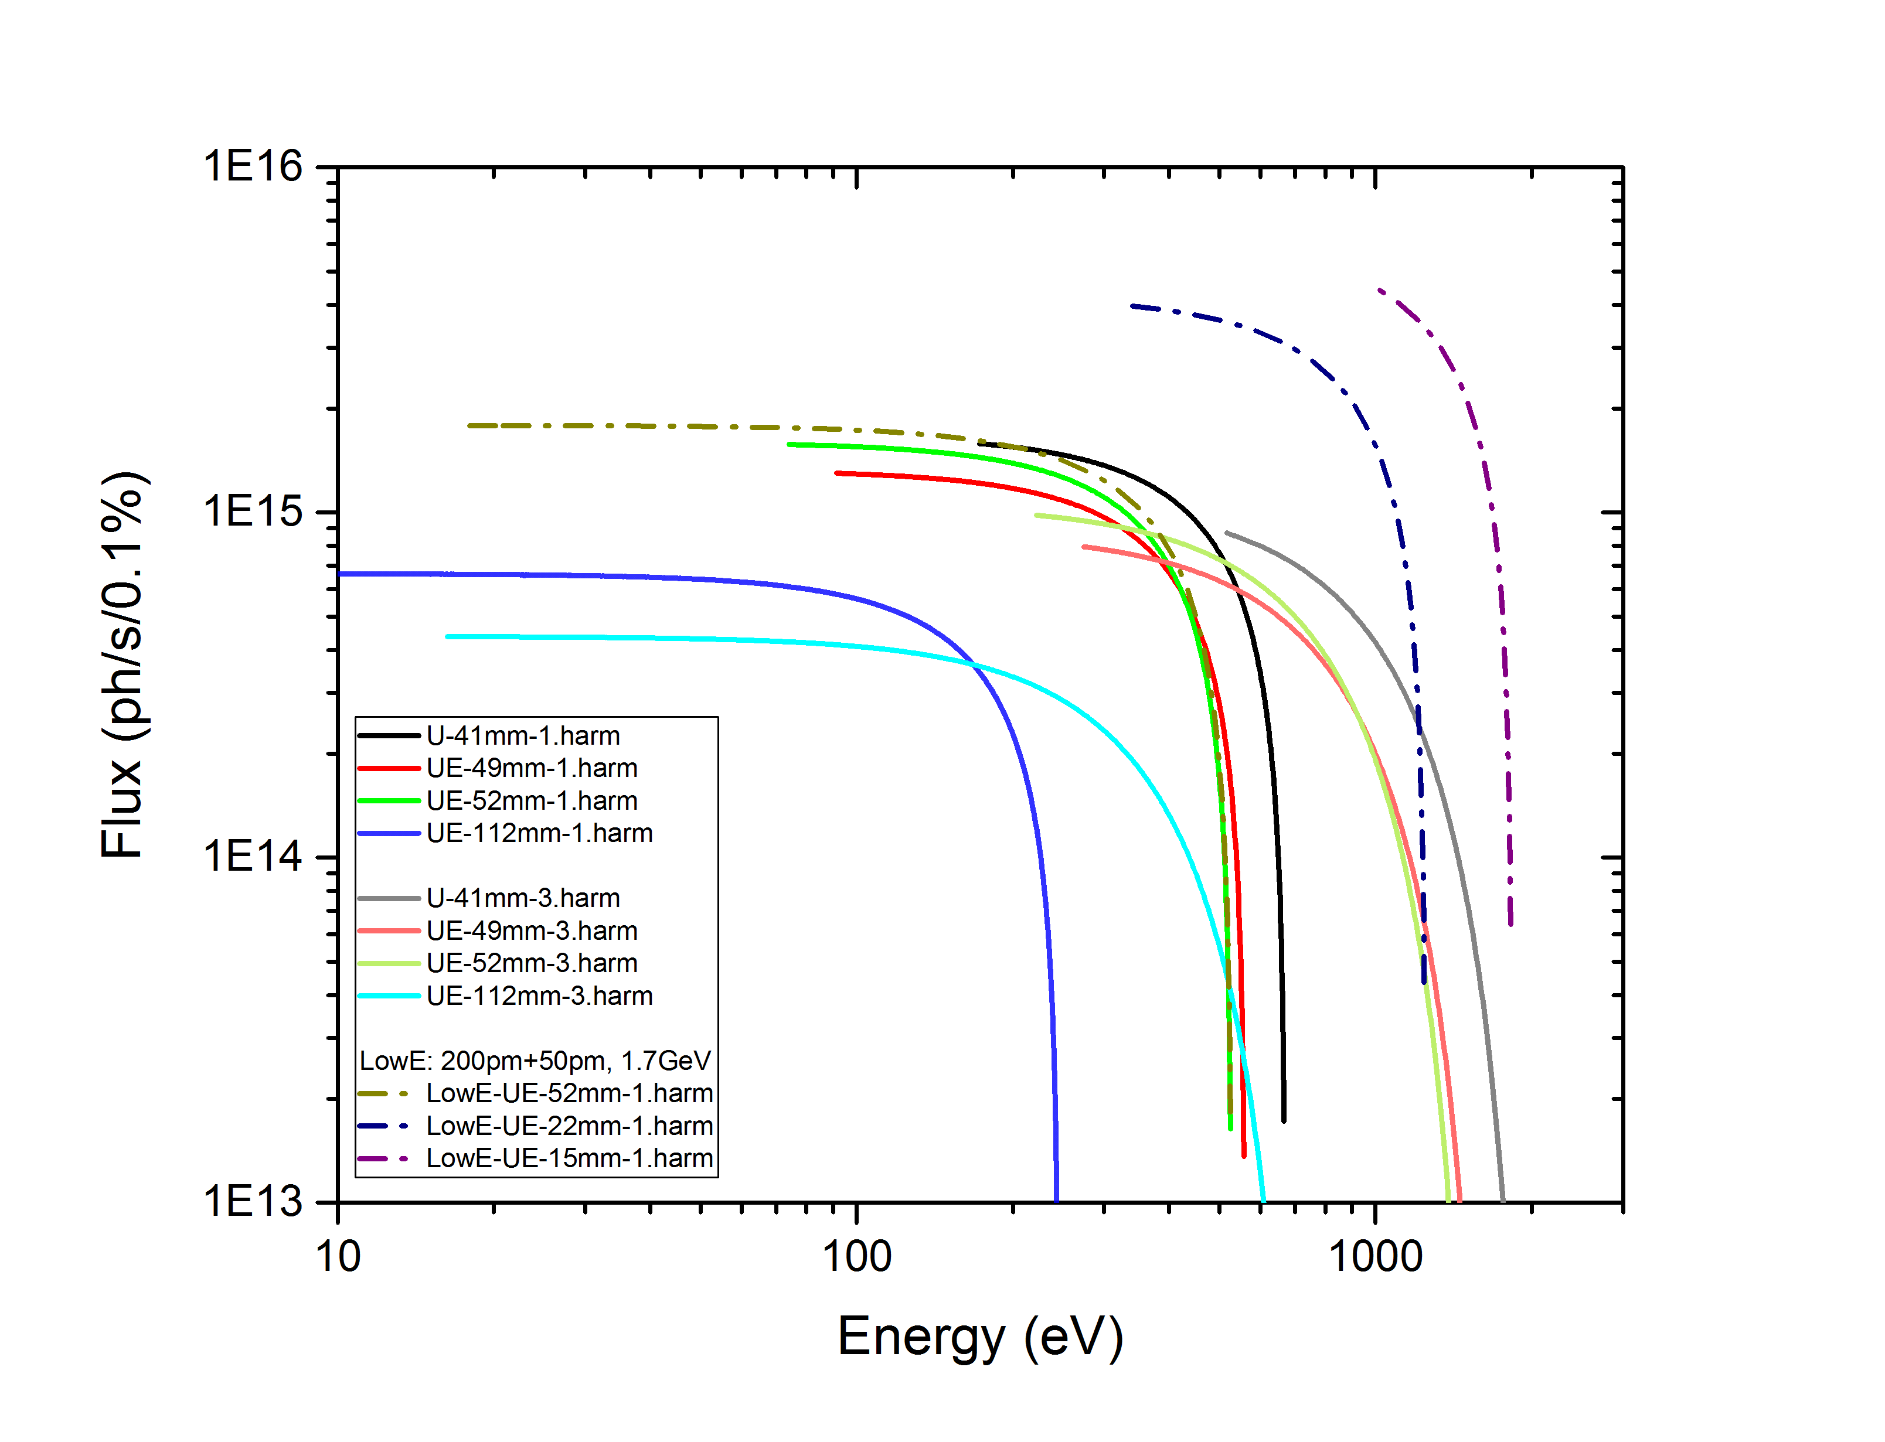
Moon-on-a-stick: Motivation
Triple Period Cryo APPLE: Motivation
Vision: Extend the photon energy range provided by IDs and provide continuously high flux across the energy range.
Triple Period Undulator:
Small-Gap Cryogenic-APPLE TPU
Vacuum chamber
Front
US-X
US-Y
US-Z
Above
OPPORTUNITY
Challenge
Building on current knowledge to exploit future possibilities made available by next generation synchrotron light sources, and provide users with their moon – on a stick!
E. Rial, Undulator Developments at HZB, 29.11.19
European Synchrotron Light Sources 2019

Slide 33
Acknowledgements
The Undulator Team at HZB
Johannes Bahrdt, Atoosa Meseck, Jürgen Bakos, Winfried Frentrup, Stefan Gottschlich, Stefan Grimmer, Maryam Huck, Carsten Kuhn, Florian Laube, Christoph Rethfeld, Anette Rogosch-Opolka , Michael Scheer, Bodo Schulz.
Specifically J. Bahrdt & A. Meseck
Special thanks to Franz Schäfers
E. Rial, Undulator Developments at HZB, 29.11.19
European Synchrotron Light Sources 2019

Slide 34
U125-2
timeline
U125-2
E. Rial, Undulator Developments at HZB, 29.11.19
European Synchrotron Light Sources 2019

Slide 35
UE56-2
UE56-2

Slide 36
U41
U41

Slide 37
U49-1

Slide 38
UE49
UE49

Slide 39
UE52
UE52

Slide 40
UE46
UE46

Slide 41
U139
U139

Slide 42
UE56-1
UE56-1

Slide 43
CPMU17
CPMU17

Slide 44
UE48
UE48

Slide 45
UE112
UE112

Slide 46
U49-2
U49-2

Slide 47
Experience of BESSY
1998
1999
1999
1998
1999
2000
2000
2001
2002
2002
2003
2004
2004
2006
2007
2007
2009
2010
2015
2017
U49-1
U125-1
UE56-1
UE56-2
U41
U49-2
U125-2
UE56
UE46
UE52
UE56 R
U139
UE49
UE112
U48
UE56 K
UE65
CPMU9
UE48
CPMU17
E. Rial, Undulator Developments at HZB, 29.11.19
European Synchrotron Light Sources 2019

