Slide 1

Present Undulator Activities at DESY
Markus Tischer, on behalf of the DESY ID group
27th European Synchrotron Light Source (ESLS) Workshop
27-29 November 2019 at ALBA Synchrotron, Barcelona

Slide 2
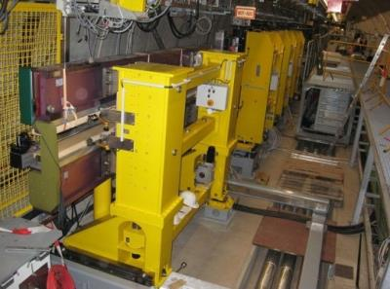
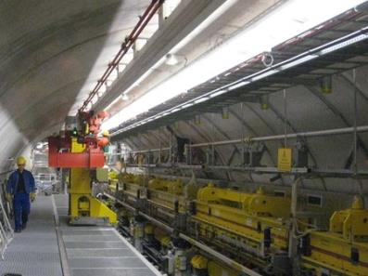
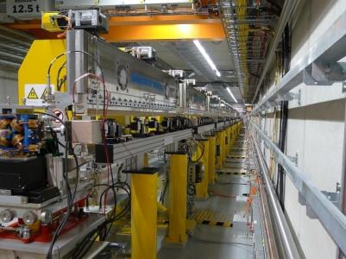
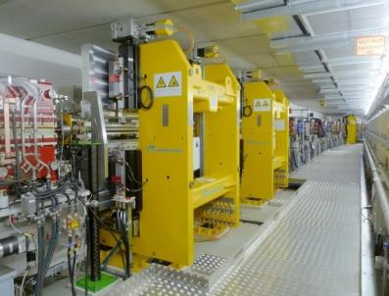
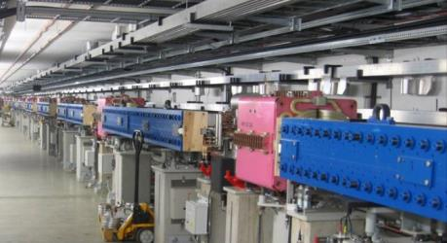
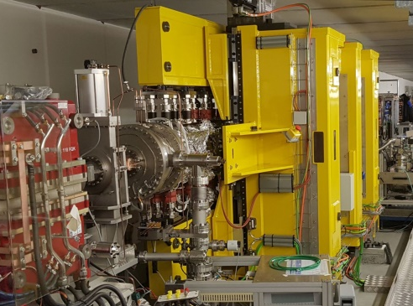
Undulator-Installations at DESY
FLASH1 SASE IDs (6)
sFLASH Seeding-Undulators (4)
FLASH2 SASE Undulators (12)
PETRA III Undulators (22)
PETRA III Damping-Wigglers (20)

Slide 3
Outline
1 Introduction
2 APPLE III Undulators
Design
Status
3 Variable Period Undulators
Concept
Design route, pre-prototype tests

Slide 4

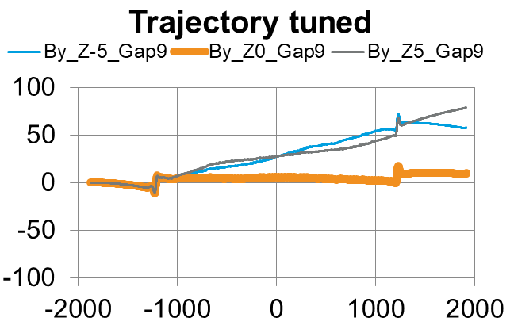
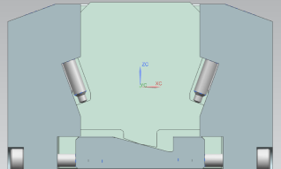
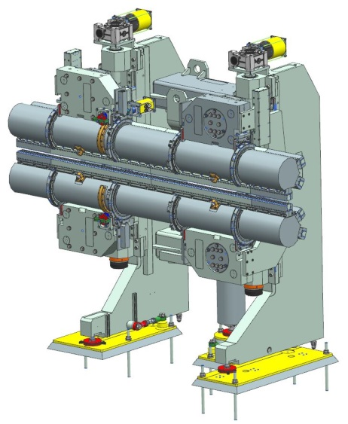
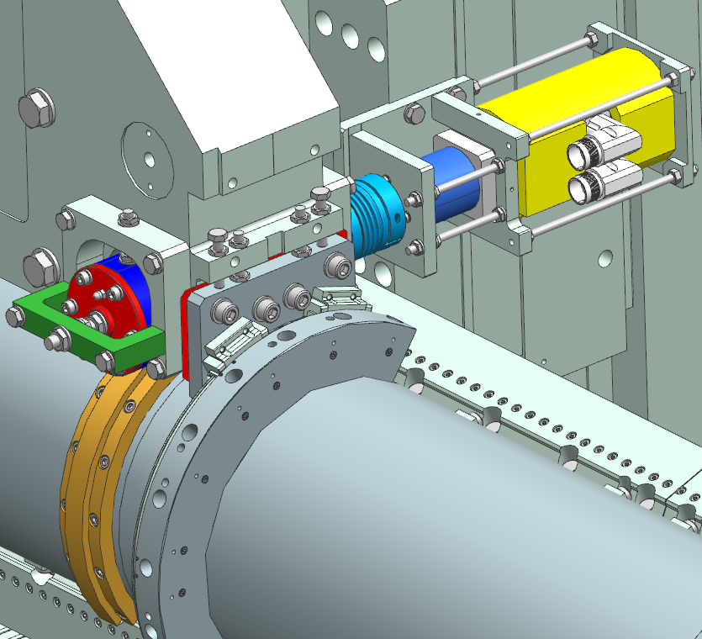
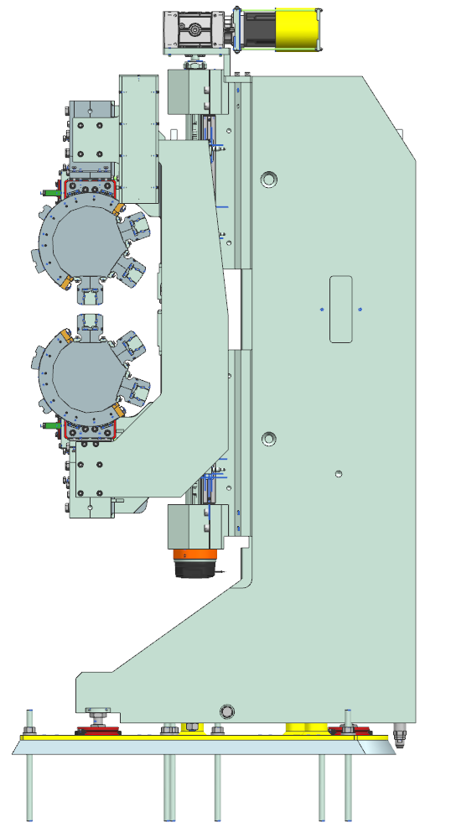
Planar Undulators
Planar Magnet Structures
Virtual shimming by 4 screws
Individual pole shift and tilt
Continuous adjustment (~2µm)
Fast tuning, 2m device ~1day per iteration
Magnet module design reworked
Support mechanics in different lengths
Revolver Mechanics
design completed (2.5m)
2 or 3 different magn. structures (sase, modulator or chicane)
(T. Ramm et al. Proc. MEDSI 2018)

Slide 5
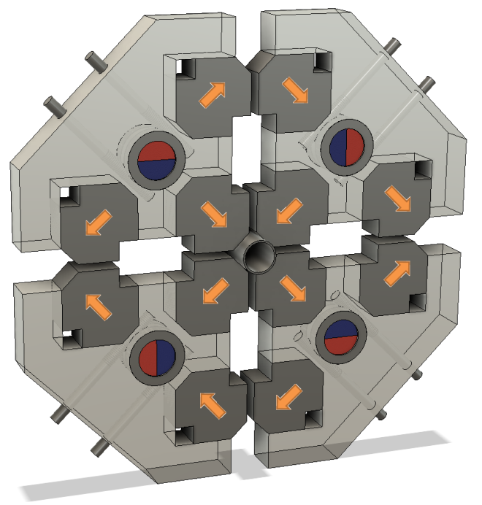
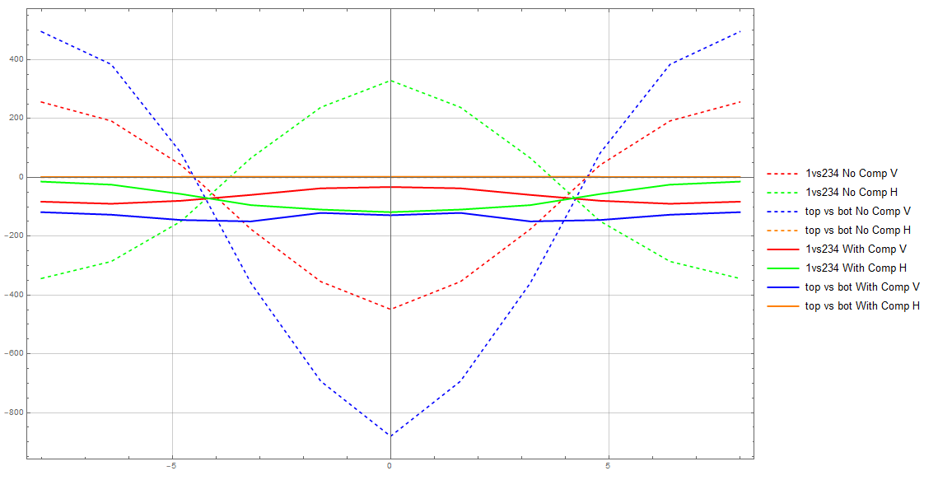
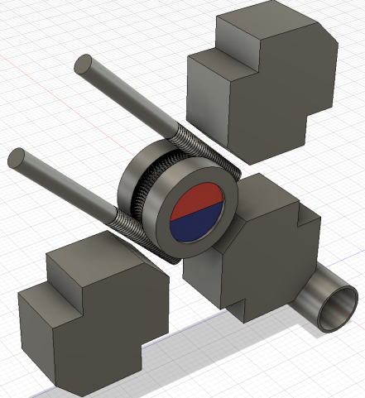
APPLE-III with Force Compensation
for FLASH2 Afterburner, FLASH2020+ and ~PETRA IV
400
0
-400
-800
Vert., Horiz. Force / period [N]
e⁻
solid: with compensation dashed: without comp.
-8 -5 0 5 8
Longitudinal Shift / mm
Force reduction up to factor of ~8
“Continuous” correction magnet signature ~1%
Same magnets for force compensation → improved sorting
Measurement with a normal bench through 1mm side gap
Customized Hall probe holder

Slide 6
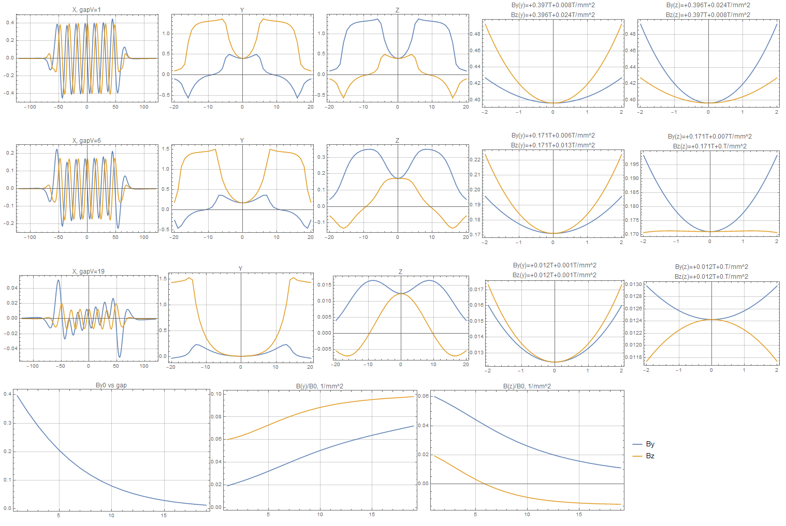
APPLE-III Transverse Field Dependence
Circular mode
By – vertical
Bz - horizontal
Symmetric configuration at minimum gap
Focusing effect of vertical field
for all gaps
De-/Focusing of horizontal field
depending on gap
gap=1
longitudinal
-10 0 10
-10 0 10
-1 0 1
-1 0 1
vertical
horizontal
vertical
horizontal position
gap=6
gap=19
B₀(gap)
horizontal
Curvature (~y²) vertical as function of gap
Curvature (~z²) horizontal as function of gap
1 5 10 15

Slide 7
APPLE-III Transverse Field Dependence
Circular mode
By – vertical
Bz - horizontal
zoomed in
Symmetric configuration at minimum gap
Focusing effect of vertical field
for all gaps
De-/Focusing of horizontal field
depending on gap
~”friendly” within the useful gap range
gap=1
longitudinal
-10 0 10
-10 0 10
-1 0 1
-1 0 1
vertical
horizontal
vertical
horizontal position
gap=6
gap=19
Curvature (~y²) vertical as function of gap
0.4 0.2
0
B₀(gap)
0
Curvature (~z²) horizontal as function of gap
1 5 10 15
0
1 5 10 15
1 5 10 15

Slide 8
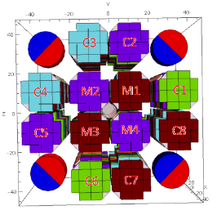
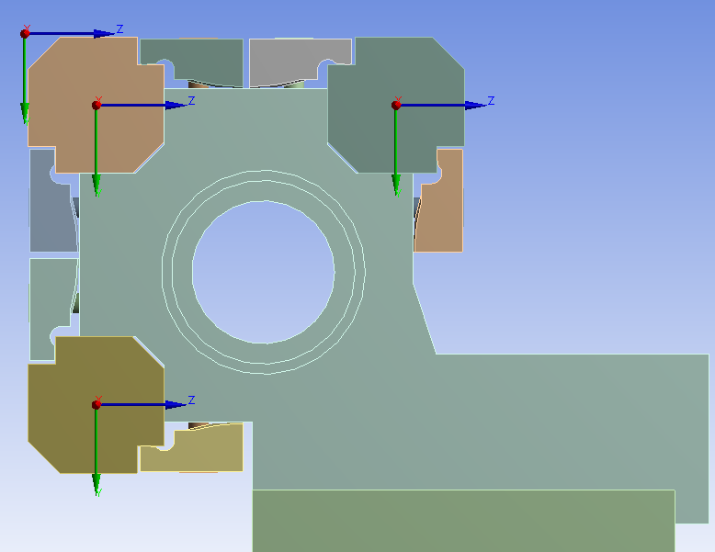
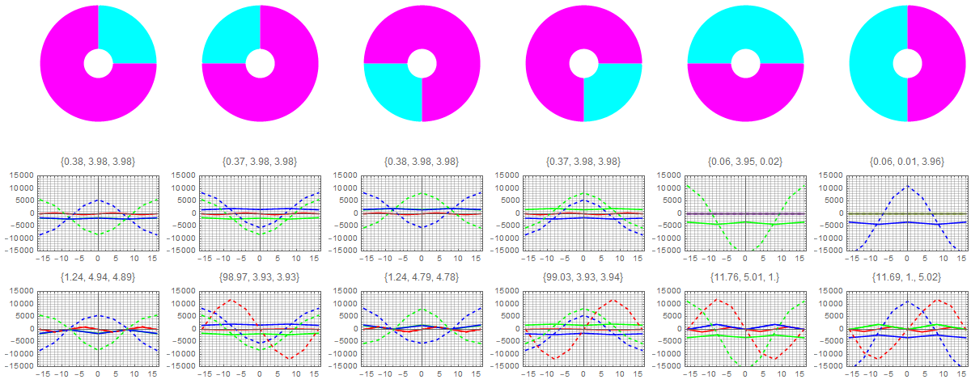
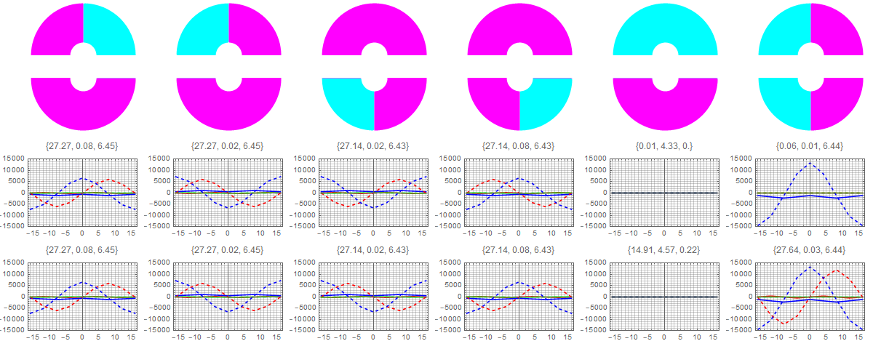
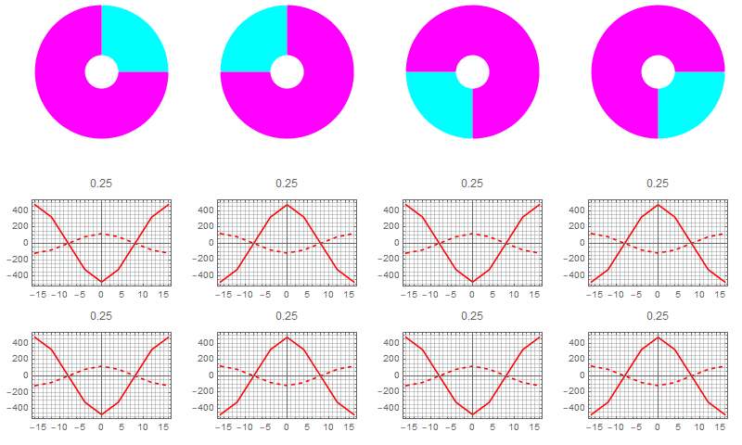
APPLE-III Forces
Forces on a single keeper
relevant for keeper and brackets
considered case: λ_{U} = 16mm
A+B magnet pair on 1 keeper
~85N / +-45N (long. / transversely)
Forces of a full row
relevant for design of shift drive
considered case: λ_{U} = 32mm
vertical/horiz. ~2100N per 1m
very small dependence on shift
long. ~900N per 1m (inclined mode)
Moments
considered case: λ_{U} = 32mm
a few ~100Nm per 1m on each quadrant (work in progress…)

Slide 9
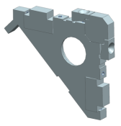
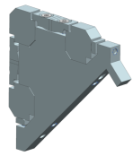
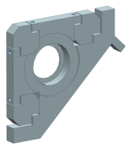
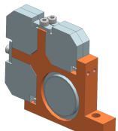
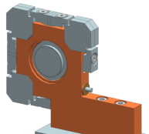
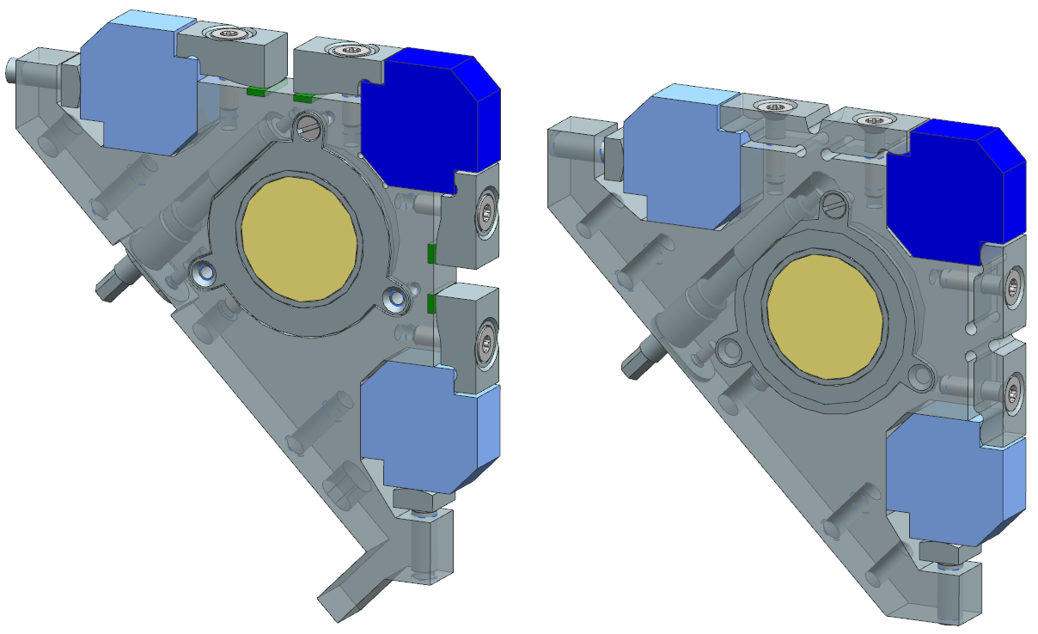
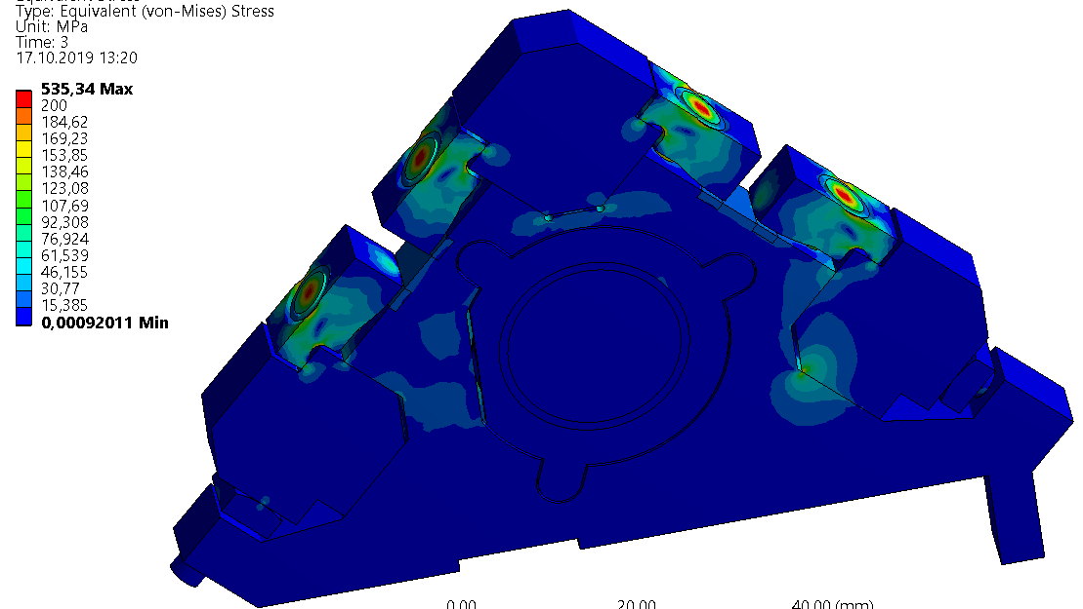
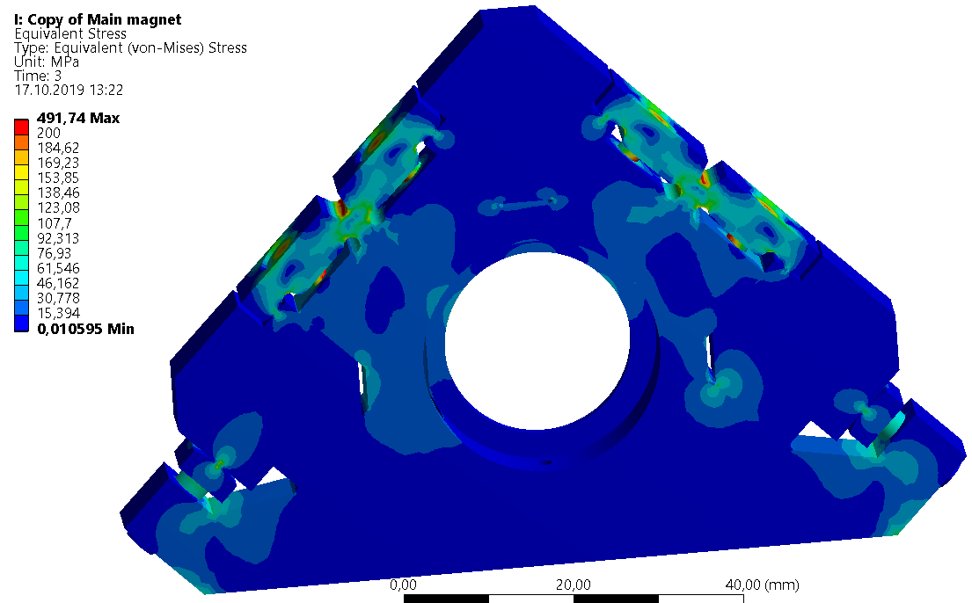
APPLE-III Keeper Design
Present design parameters (prelim.)
Period length 16mm, magn. gap Ø 8mm
Various design studies
Magnet clamping
Correction magnet rotation
Next steps:
Keeper prototypes
Verify stiffness, tuning, operability

Slide 10
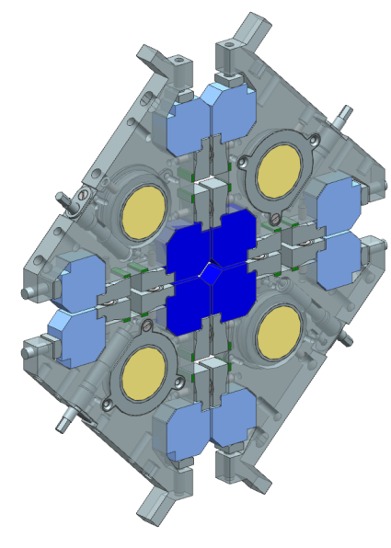
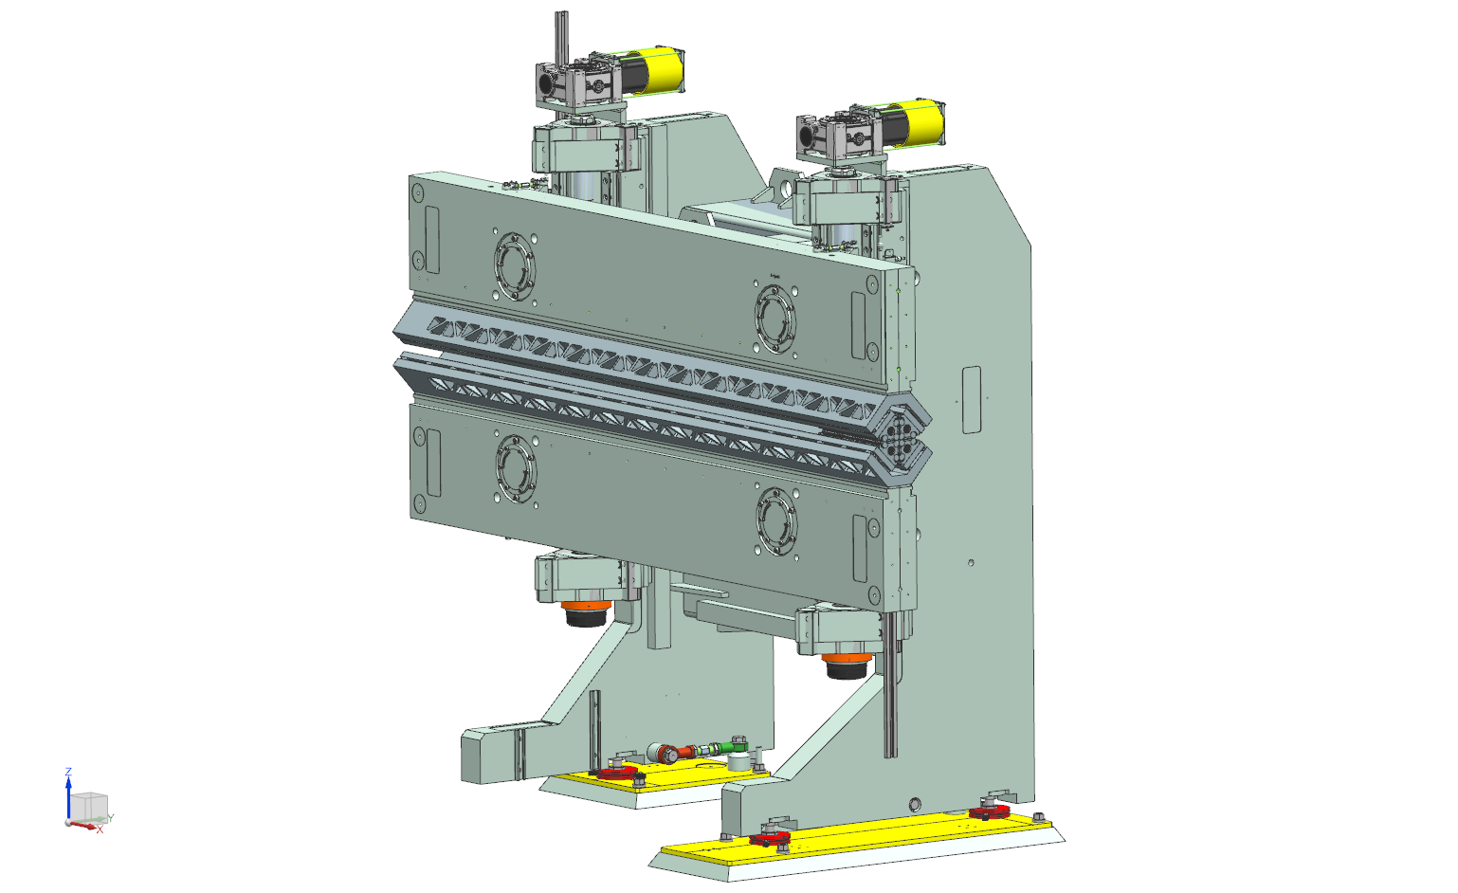
APPLE-III
Further development points:
Shift drive
Adaption to gap mechanics
Magnetic measurement tools, procedures
First full device:
FLASH2 Afterburner
Serves as full scale prototype for the FLASH2020 seeding IDs

Slide 11
Outline
1 Introduction
2 APPLE III Undulators
Design
Status
3 Variable Period Undulators
Concept
Design route, pre-prototype tests

Slide 12
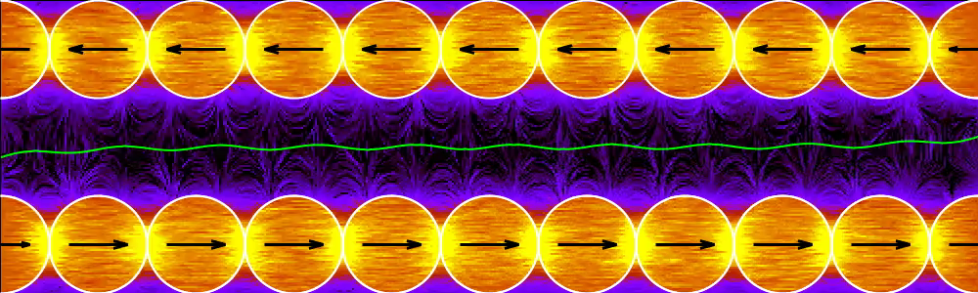
Variable Period Undulator
Present Developments – Variable Period Undulator
Ongoing DESY development
Concept : Arrangement of cylindrical magnets (Pavel Vagin)
Varying the angle between two neighbor magnets results in period change
Common rotation changes field amplitude or phase
Amplitude, phase or period adjustments are more or less orthogonal to each other
Synch. Rad. News 31:3 (2018) 48-52; SRI2018, AIP Conf. Proc. 2054, 030024 (2019)

Slide 13
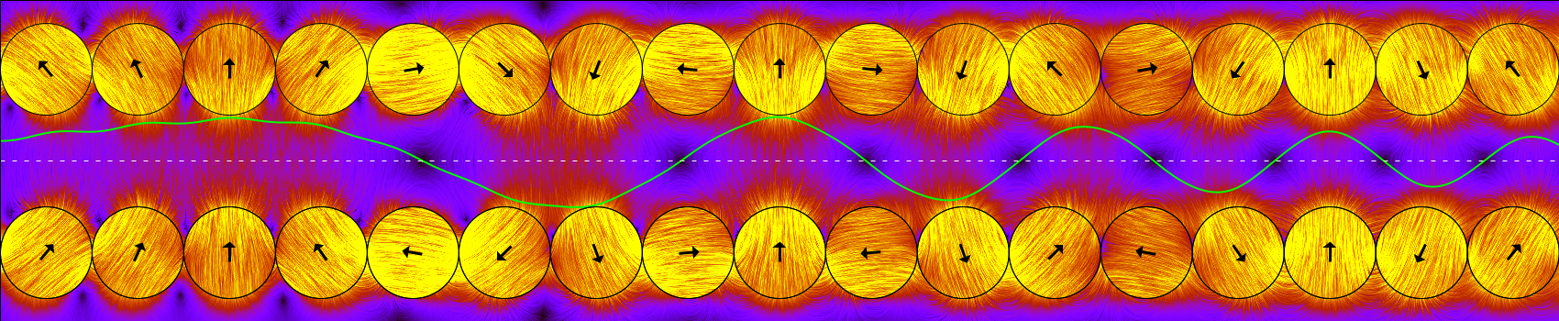
Variable Period Undulator
Present Developments – Variable Period Undulator
Ongoing DESY development
Concept : Arrangement of cylindrical magnets (Pavel Vagin)
Varying the angle between two neighbor magnets results in period change
Common rotation changes field amplitude or phase
Amplitude, phase or period adjustments are more or less orthogonal to each other
Synch. Rad. News 31:3 (2018) 48-52; SRI2018, AIP Conf. Proc. 2054, 030024 (2019)

Slide 14
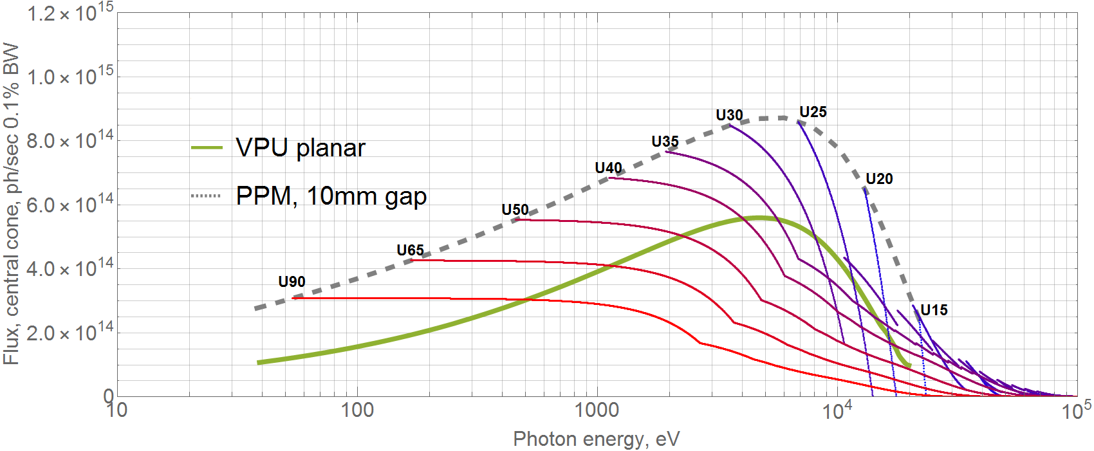
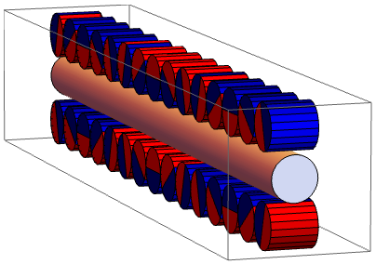
Spectral Performance
PETRA parameters
Halbach PPM, magnets 50mm x 50mm x λu/4
VPU, magnets ⌀10mm x 10mm
Same length, same 10mm gap, 6GeV

Slide 15
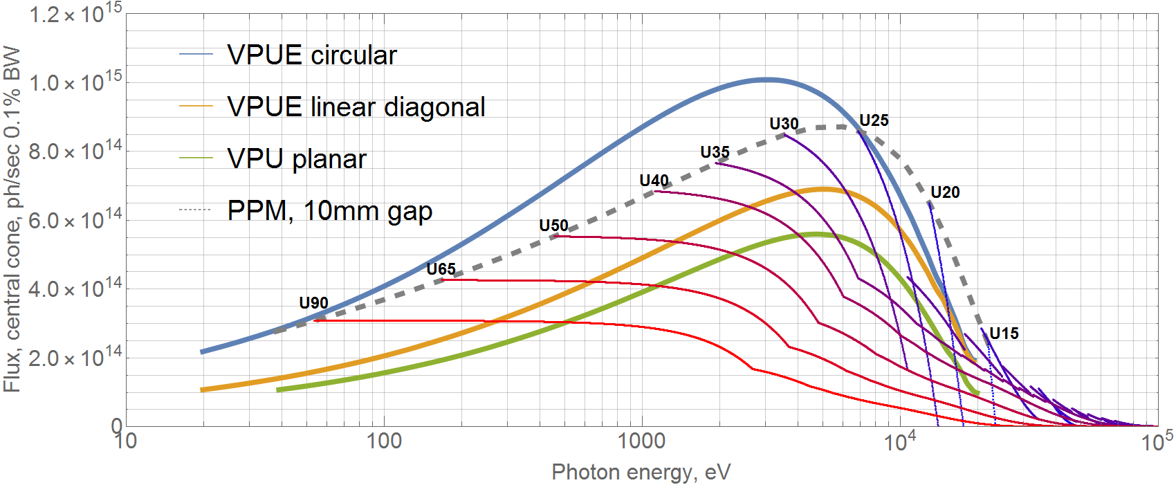
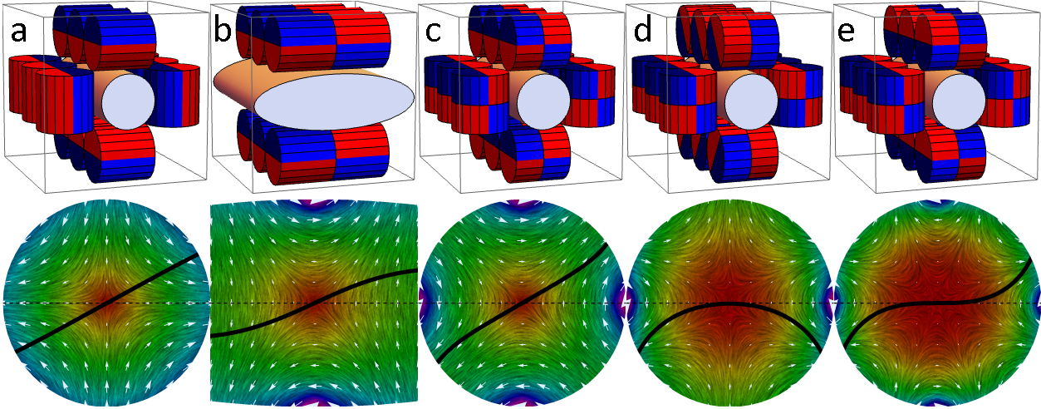
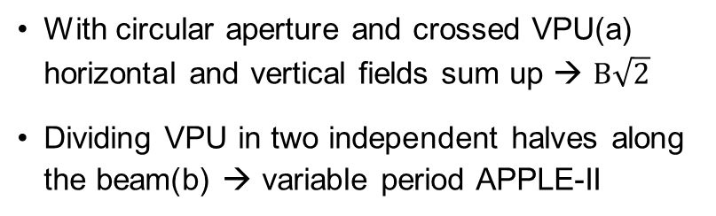
Spectral Performance
PETRA parameters
With circular aperture and crossed VPU(a) horizontal and vertical fields sum up → $B\sqrt{2}$
Dividing VPU in two independent halves along the beam(b) → variable period APPLE-II

Slide 16
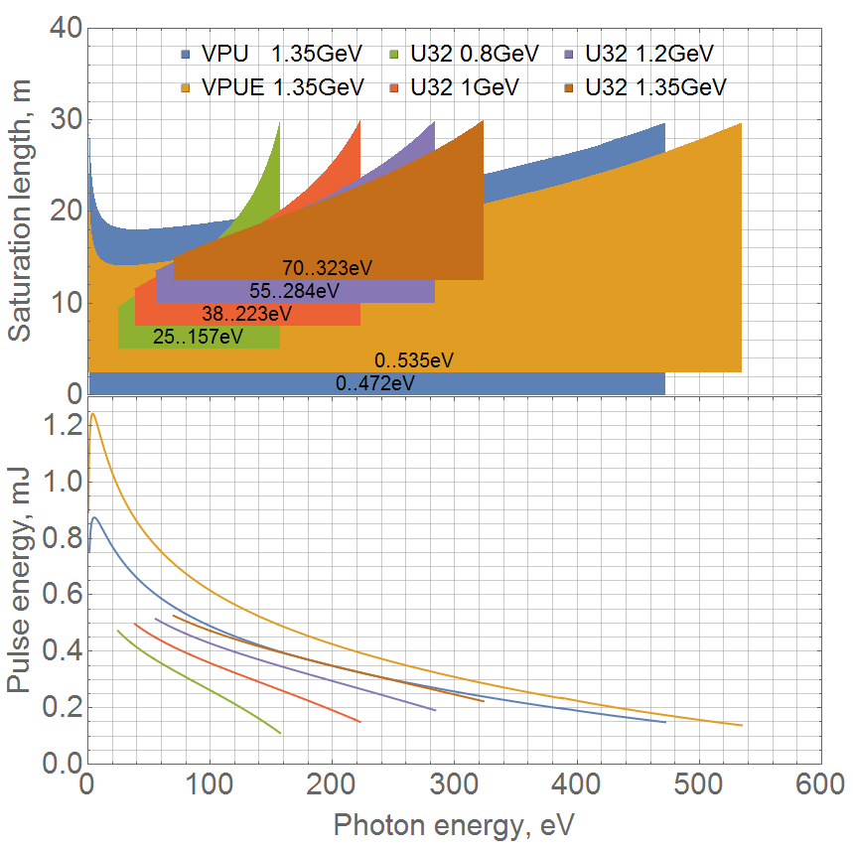
FEL SASE Performance
FLASH parameters

Slide 17
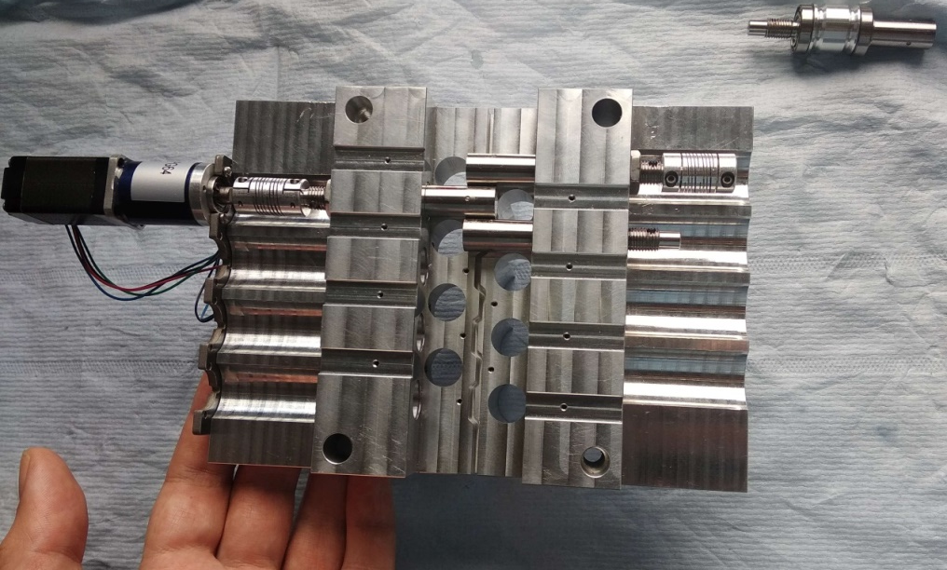
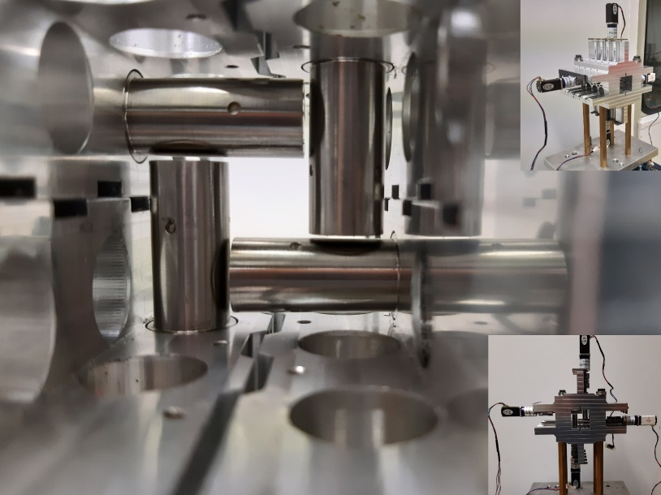
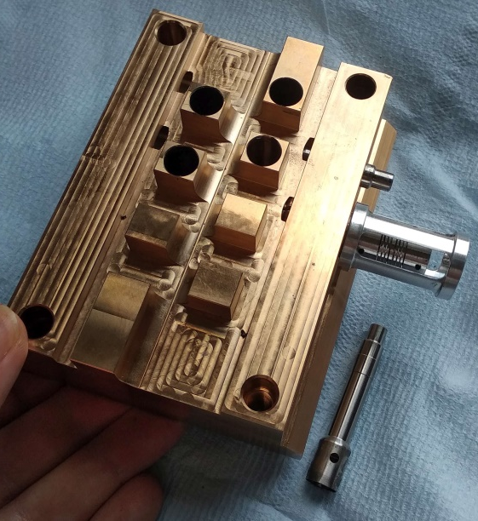
Mechanical Design
Ball bearing
Less friction and play
Smooth rotation
Friction bearing
Stiffer, less bending
Simpler, more economic
Harmonic drive
Direct mounting
Maybe just a test…
ball bearing
friction bearing
H. Bolat, P.Vagin

Slide 18
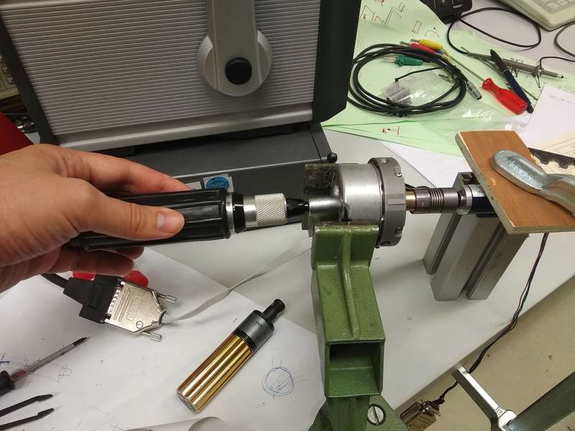
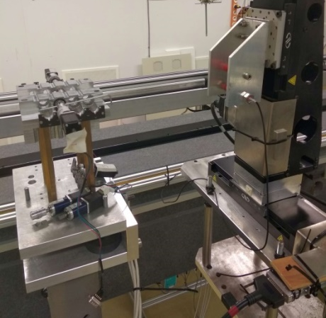
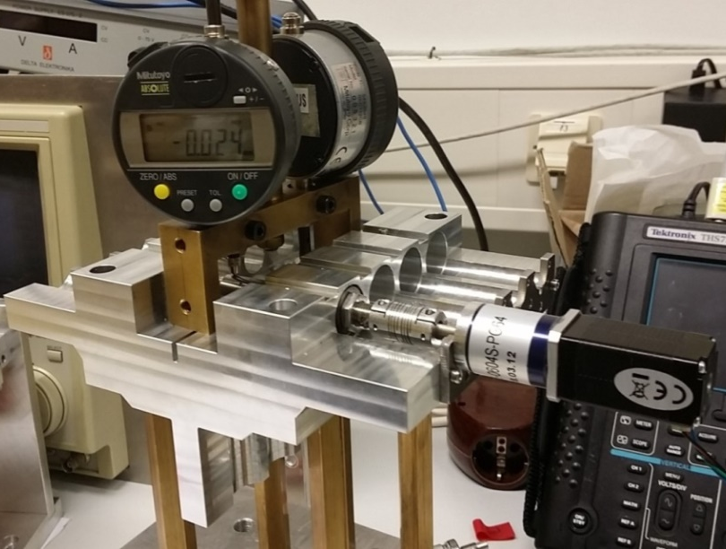
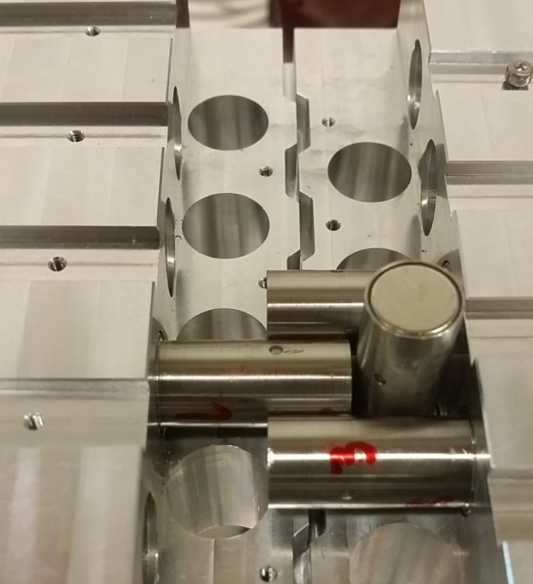
Mechanical Design
Various items to test or improve
Glueing of magnet to the shaft
Manufacturing tolerance of axis
Stiffness of coupling
Backlash or hysteresis
Integration of encoders
Small prototype
Stretched wire measurements of the individual magnets in the long structure

Slide 19
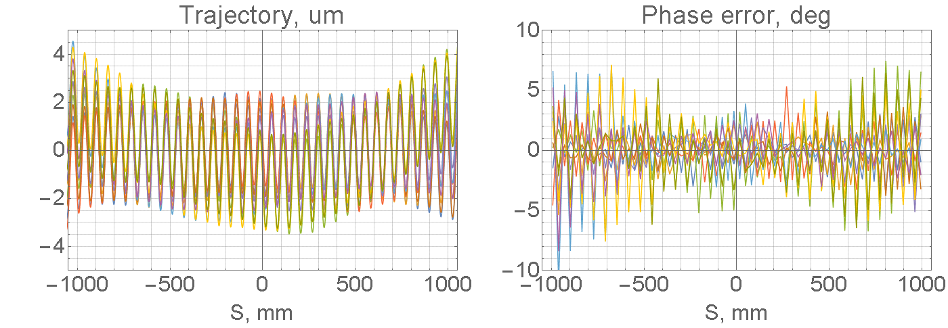
Angular Positioning Error
Assume: 2m VPU with 200 magnets of ⌀10mm, each randomly dispositioned by ±0.5̊
Random error of ±0.5̊ of each magnet results in phase error of less than 3̊ rms, for 2m device, and trajectory distortion is within the oscillation amplitude.
Single ⌀10x10mm magnet field integral is 1.3Tmm/rad, 0.5 degree angular error corresponds to 0.01Tmm = 10Gs*cm

Slide 20
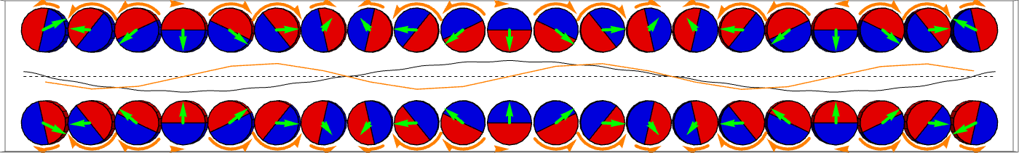
Angular Positioning Error
- Magnetic field - Force - Torque
Backlash error caused by magnetic forces is not random, but also periodic => much lower phase and field integral errors
Other ”static” errors like magnetization direction or mechanical positioning errors could be measured and compensated by software correction of the magnet angle.

Slide 21
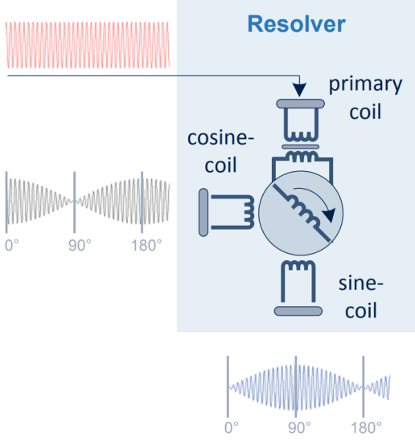
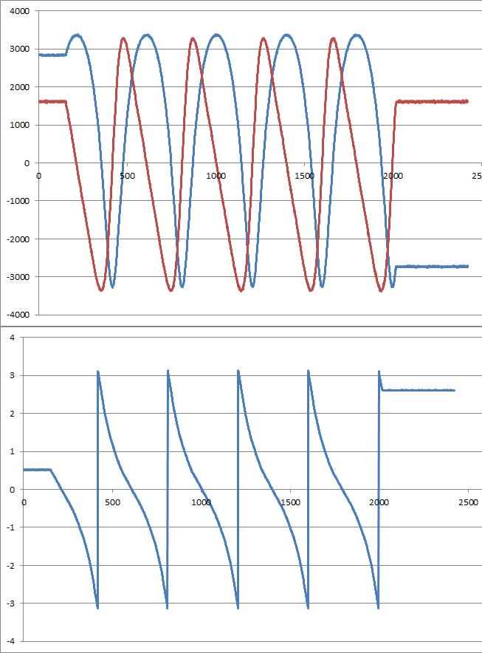
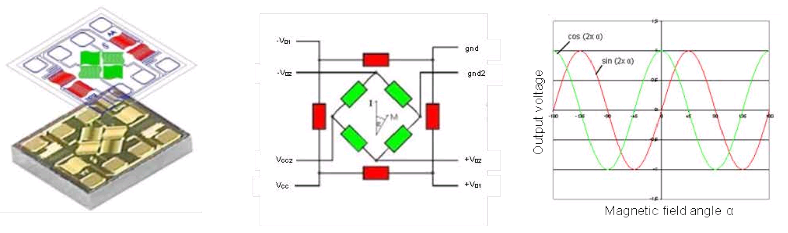
Rotary Encoder
Rotary transformer
AMR magnetic rotary encoder
First preliminary test:
Noise level ~2mrad (~0.1°)
strange nonlinearity probably due to misalignment of sensor vs magnet, but ratio shows a clean tan-signal
sin
cos

Slide 22







Inductive Rotary Encoder
Radial or axial arrangement
1 -
0 -
-1 -
Enhanced resolution
x 100
Noise level <0.1̊ deg (~1kHz)
4-channel inductive sensor for LDC1614
http://www.ti.com/sensing-products/inductive-sensing/overview.html

Slide 23
Variable Period Undulator – Conclusion
Software-defined magnetic field
Variable Period Undulators provide a wider wavelength range
Quasi-periodic, Figure-8, Transverse Gradient undulators, …
Arbitrarily shaped magnetic field: dipoles, phase shifters, multipoles, …
Lower magnetic field amplitude/K => lower intensity of high harmonics
Simpler support structure
Reliable operation of lots of drives
Complex control software
Integral magnetic measurement methods
Embedded automatic “shimming”

Slide 24
Thank you!

Slide 25

Multipoles
(a, b, c) Quadrupole up to 90T/m
(d) Sextupole up to 8kT/m^2
(e) Octupole up to 2MT/m^3

Slide 26




Transverse Gradient Undulator
Disabling only left (or right) part of structure produces transverse gradient undulator with dK/K/dx ~ 0.2/mm

Slide 27
Markus Tischer
DESY, FS-US
markus.tischer@desy.de
+49 40 8998 2923

Slide 28
Backups

Slide 29




Magnetic Measurement Equipment
Local field distribution
12m measurement bench
Hall probes (1D, 3D), pickup-coils
Pulsed wire
Field integral probes
Stretched wire
Moving coil
Calibration tools
NMR-probe in spectrometer magnet for calibration of Hall probes
Interferometer, Touch probe as a mechanical 3D-measurement probe
Touch probe measurement of
pole contour

Slide 30





Tuning
vert. dipole hor. quadrupole hor. dipole vert. quadrupole
Phase error < 1deg
Off-axis trajectory correction (remove quadrupoles)

Slide 31

Phase Shift Without Trajectory Offset
9th
3rd
1st harm.
Notes:
large figure: undulator radiation for different harmonics – emitted radiation
and how they are affected by an induced phase step due to a local field modification
no traj. offset

Slide 32






Mechanical Design of Local Phase Shifter
stepper motor with gearbox
coupling
cylindrical magnet
rotary encoder

Slide 33








Variable Period Undulators
Previous and recent developments
Variable period undulators as synchrotron radiation sources. G. Shenoy, J. Lewellen, D. Shua, N. Vinokurov,
J. Synchrotron Radiat. 10, 205 (2003).
Modeling and designing of variable period and variable pole number undulator.
I. Davidyuk, O. Shevchenko, V. Tcheskidov, N. Vinokurov, Phys. Rev. Accel. Beams 19, 2016
Variable period permanent magnet helical undulator. J. Mun, Y. Jeong, N. Vinokurov, K. Lee, K. Jang, S. Park, M. Jeon, S. Shin, Phys. Rev. ST Accel. Beams 17, 2014
The highly adjustable magnet undulator.
M. Hamberg, FEL2015, TUP057

