Slide 1
TRIBs at MAX IV
David K. Olsson, Jonas Breunlin, Francis Cullinan, David Olsson, Åke Andersson, Magnus Sjöström, Pedro Fernandes Tavares
ESLS19, 27-29/11-19, ALBA, Barcelona

Slide 2
TRIBs at MAX IV
Motivation
TRIBs on the 3 GeV storage ring
TRIBs on the 1.5 GeV storage ring
Issues and further development

Slide 3
Motivation
Neither storage ring was designed with single bunch operation in mind.
The FinEst beamline of the 1.5 GeV storage ring has requested single bunch delivery.
  First single bunch delivery on 22/10 2019. 22 mA.
  Minimum promised bunch purity of ~160, aimed to be improved in the future.
Beamline offices have to agree on whether or not to sacrifice time from continuous users for single bunch operation.
The goal is to allow both continuous and single bunch operation simultaneously, with no or few changes to the beamlines.

Slide 4
TRIBs in the 3 GeV Storage Ring
Experiments in February 2019 with Paul Goslawski, Felix Armborst, and Andreas Glassl
Tune was stepped to third order resonance using all quadrupole families and the dipole ‘pole face strip’.
The tune was fine-tuned using a defocusing quadrupole family.
The horizontal octupole family was reduced to almost zero.
The horizontal chromaticity eventually ended up at -0.6.
When exciting the beam horizontally TRIBs could be populated

Slide 5
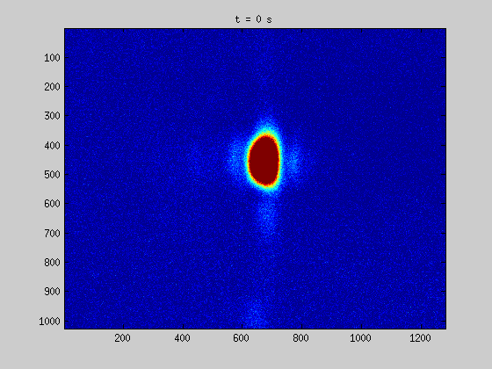
TRIBs populated by driving horizontally. Image is a projection of phase-space onto the xy-plane.

Slide 6
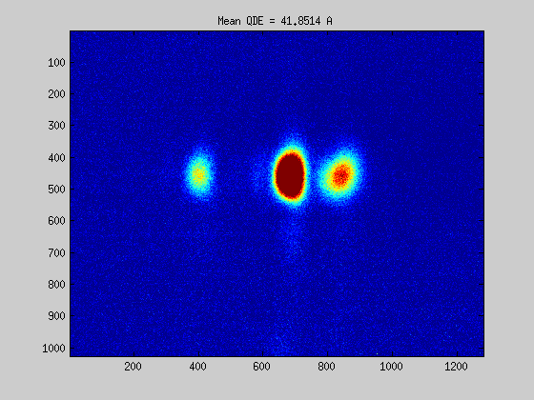
Moving TRIBs by shifting horizontal tune.

Slide 7
TRIBs in the 1.5 GeV Storage Ring
Since the interest of single bunch measurements has been greater in the 1.5 GeV storage ring, TRIBs studies were continued on this machine.
The horizontal tune was moved the third order resonance, and the horizontal chromaticity reduced to 0.20.
Secondary orbits found, which were populated through diffusion from the core, without driving.

Slide 8
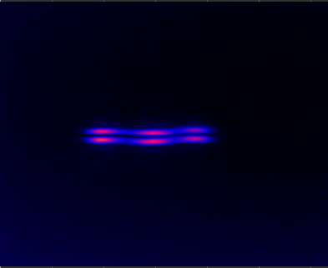

~ 1 mm in the beam pipe
Left: Driving the core. Right: Driving the islands. The double vertical spot is due to the pi-polarisation method of measuring the vertical beamsize.

Slide 9
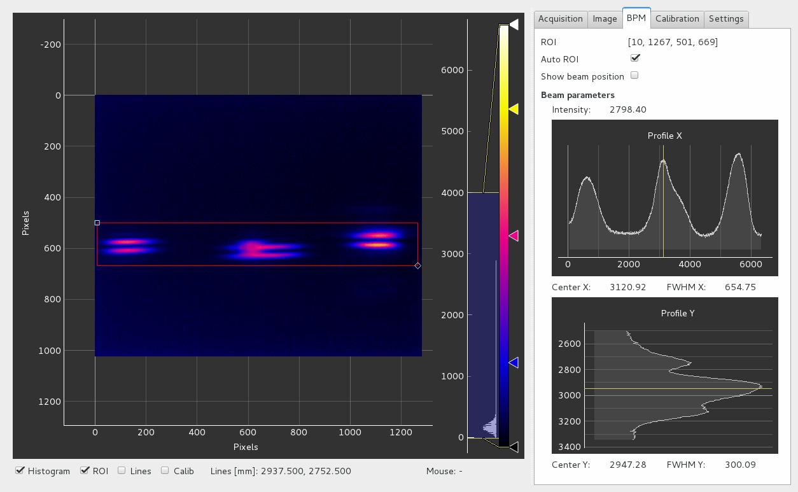
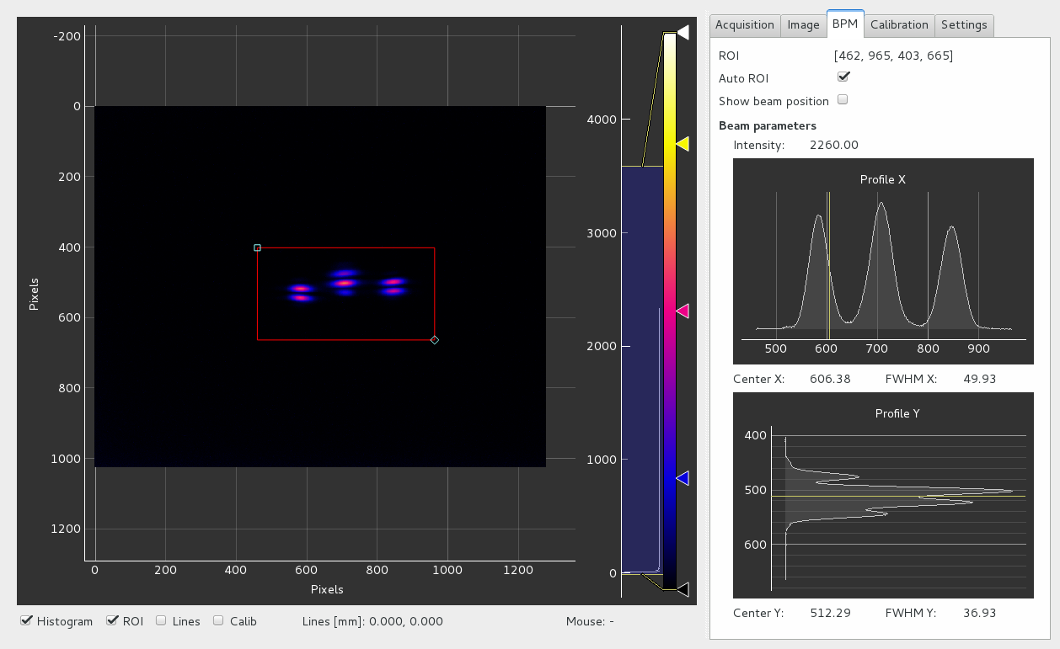
Horizontal chromaticity was reduced to zero.
With only slight trimming TRIBs were found. The core could be fully excited to the islands.
Injection rate was high on, above and below resonance.
Core tune: 11.3343
Island tune: 11.3317
~ 1 mm
TRIBs observed at the two cameras of the diagnostic beam line. The sources are separated by ~0.5 m. All beam has been excited to island orbits.
~ 1 mm

Slide 10
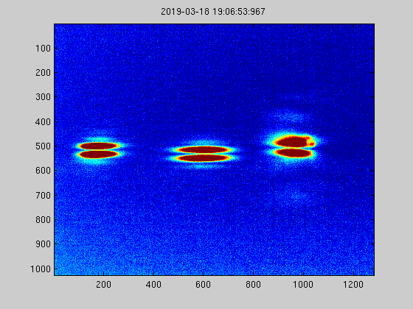
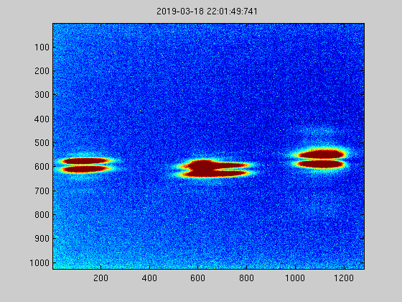
TRIBs lifetime could be increased trough sextupole trimming.
TRIBs lifetime was in the order of 30 minutes.
Each frame is ~0.2 s
Each frame is ~90 s. Distortion of middle island is due to dust on the camera.

Slide 11
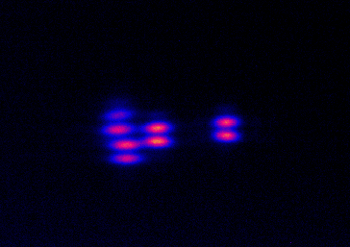
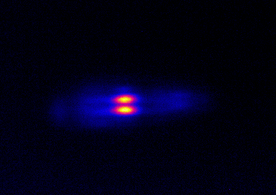
Injection
The 1.5 GeV storage ring uses a single dipole kicker for injection.
The injection kicker excited population to island buckets.
Driving at the island tune kept the islands from being populated during injection.
Injection rate unchanged from delivery optics.
A few ms after kick from injection kicker.
A few ms after kick from injection kicker, while driving at island tune.

Slide 12
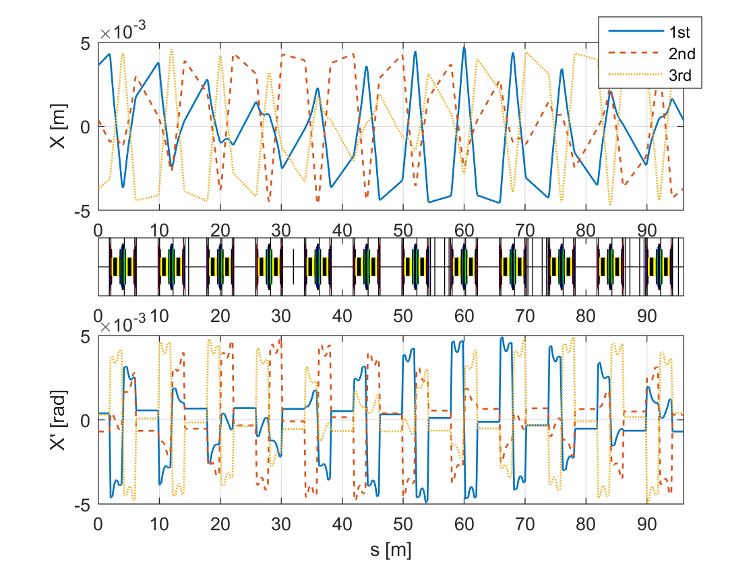
Optics Characterisation
LOCO measurement was done at TRIBs working point.
Chromaticity of model was corrected separately.

Slide 13
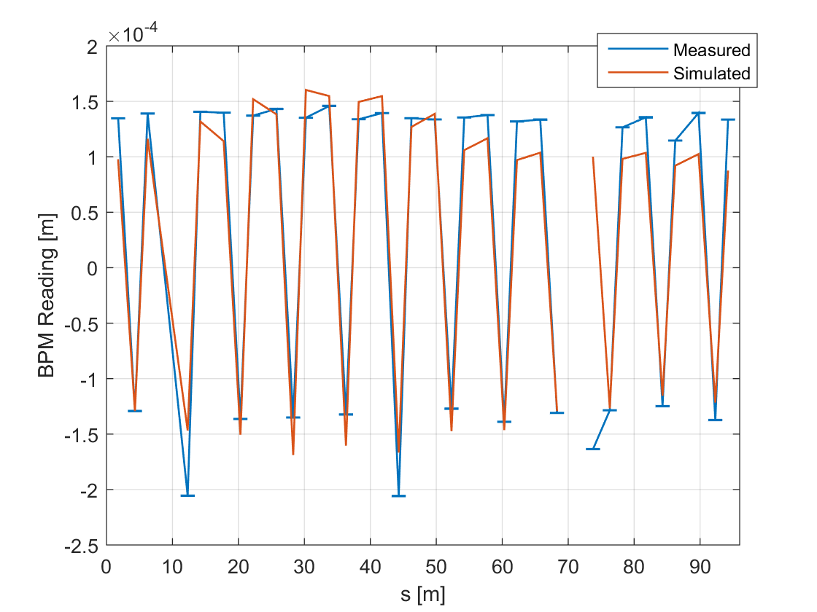
Optics Characterisation
Comparing the centre of charge of the simulated TRIBs orbit and the BPM readings when the core is empty.
TRIBs orbit from LOCO fit.
Actual and simulated BPM readings when the core is empty.

Slide 14
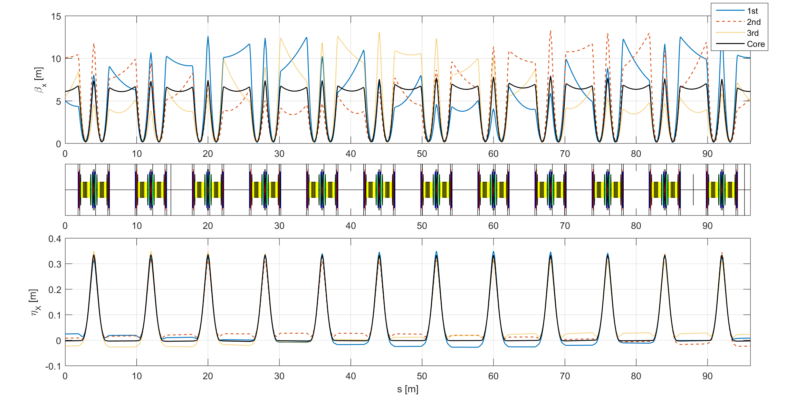
Optics Characterisation
Comparing the centre of charge of the simulated TRIBs orbit and the BPM readings when the core is empty.
Horizontal beta functions and dispersion functions of the TRIBs orbit.

Slide 15
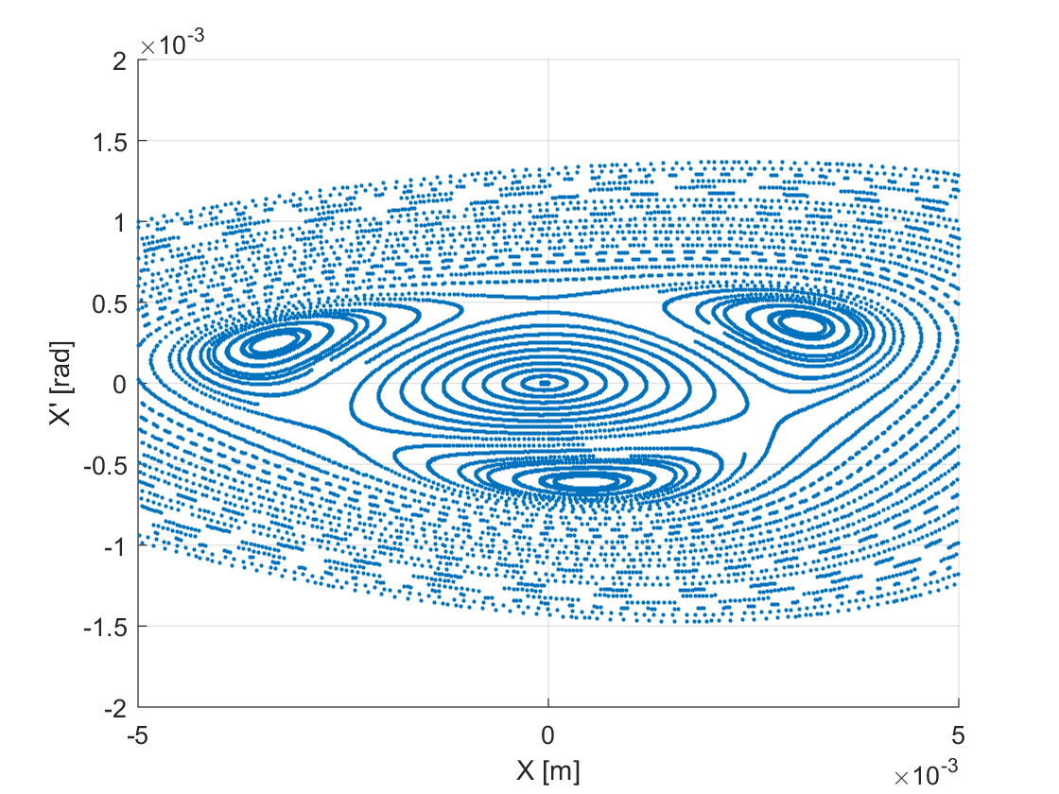
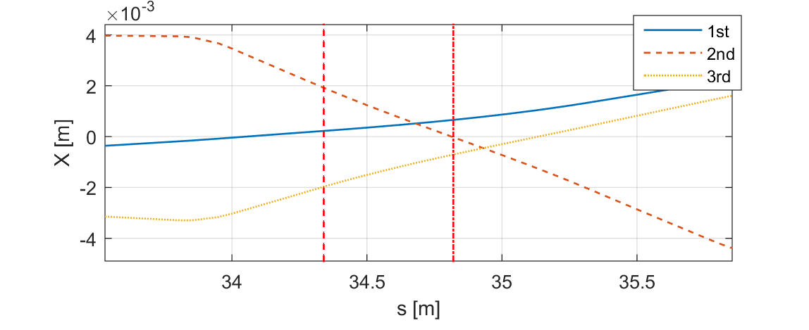
Optics Characterisation
The LOCO fit also corresponds well with what we see at the diagnostic beam lines.
Tracked island and core buckets at centre of first straight section (approximate position of BBB kicker).

Slide 16
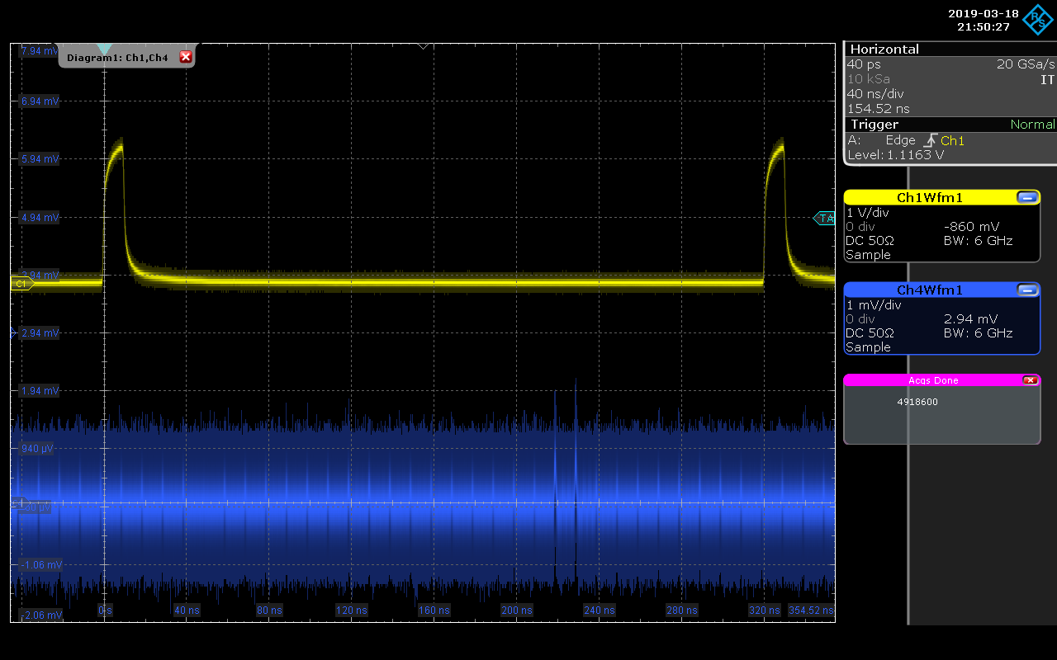

Using the BBB a single bunch could be selected and excited to its TRIBs orbit.
Individual bunches excited to the TRIBs orbit. Measured by diode looking at the light from the island.

Slide 17
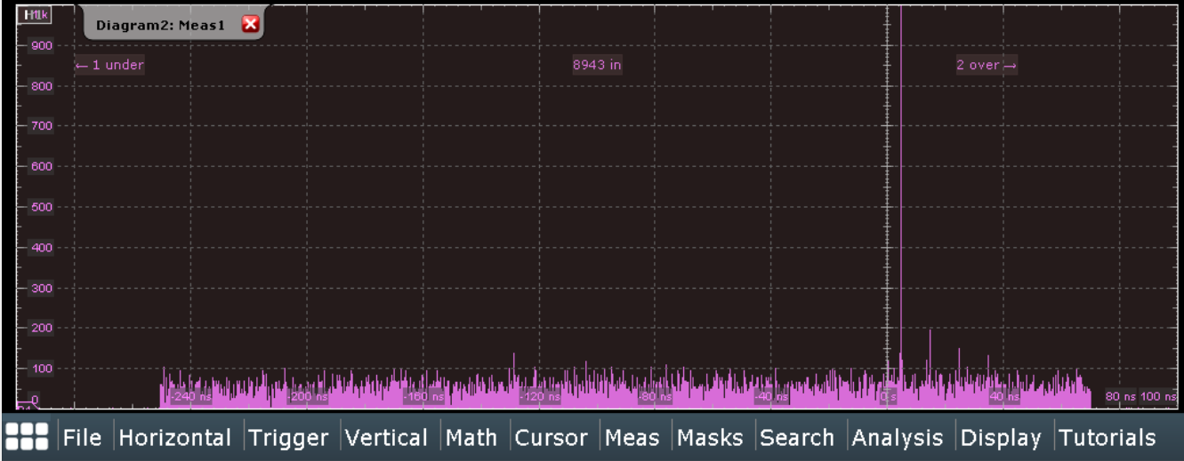
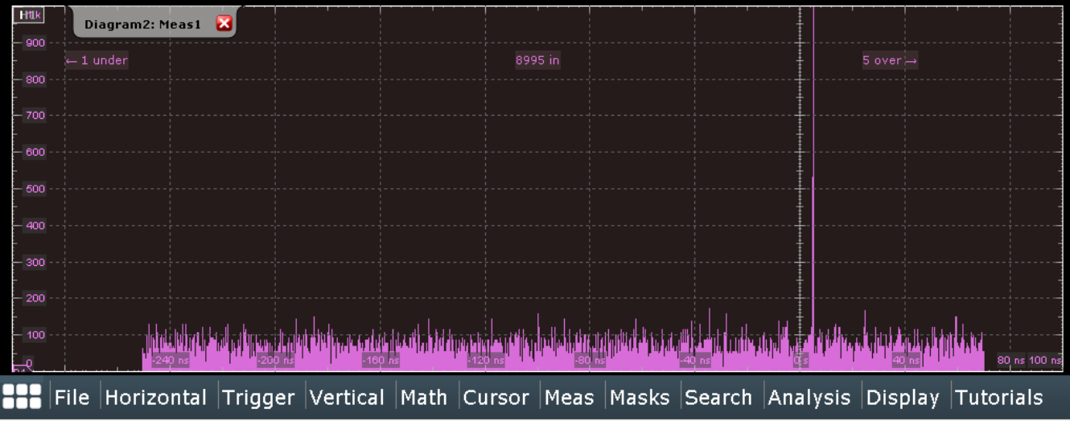
Using a photo multiplier tube a quick purity measurement was performed.
By driving one bunch out, and all other island triplets in, the purity was increased.
Higher current and/or longer integration time as well as better separation of island-core light needed for higher resolution
Top: Island purity when exciting one bunch. Bottom: Island purity when also driving all but one island triplet in.

Slide 18
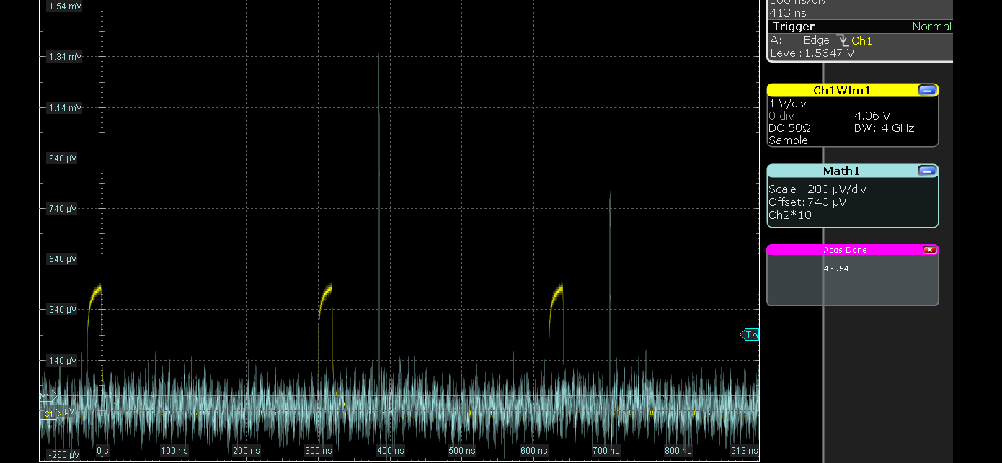
The BBB system was set up to a 96 bunch operation (instead of the usual 32), corresponding to the 96 island buckets.
A core bunch was driven at tune every third turn in an attempt to populate a single island.
Driving the core excited an uneven population to all islands. The drive was a 1 kHz span around the core tune.
Second Island
Third Island
First Island
Revolution Marker

Slide 19
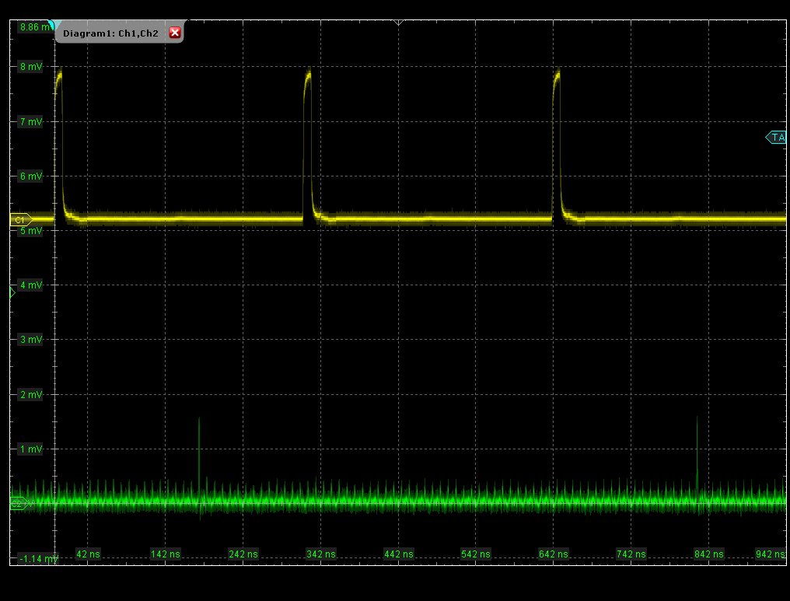
Kicking the core every third turns, instead of exciting at the tune, resulted in a slightly different island population.
Due to the BBB having a more limited amplitude when kicking the island buckets had to be brought closer to the core.
Revolution Marker
First Island
Third Island
Second Island

Slide 20
Issues and Future Development
Light separation at beamlines.
Achieve single island population.
Higher chromaticity TRIBs optics.

Slide 21
Thank you

