Slide 1
Collective Effects in Diamond-II
T. Olsson

Slide 2
Outline
Introduction
Status of impedance model
Instability measurements and benchmarking
Harmonic cavity → new fill patterns

Slide 3
Introduction
Design current 300 mA (as for Diamond-I).
Design includes space for ≈ 40 ID beamlines → damping times ≈ factor 2 shorter when all IDs at minimum gap.
Damping times are longer compared to Diamond-I for the bare lattice, but comparable when including the IDs.
Around 25 in-vacuum IDs, majority with 4 mm gap.
The IDs have significant effect not only on impedance and damping times, but also reduce emittance and increase energy spread.
However, large contributions from two SC wigglers so the variation during operation as the other IDs change gaps is smaller.

Slide 4
Impedance model
Vacuum chamber design in progress and choices might be still be revised.
Resistive wall – first design based on circular (10 mm radius) copper pipe with NEG coating (some sections in stainless steel).
Due to difficulty to NEG coat irregular chambers other design is currently under study: stainless steel + copper coating with antechambers for pumping.
BPMs – based on ESRF-style buttons used in DDBA cell.
Flanges – want another design than in current machine to provide zero gap, but no choice made yet.
Current design of pumping ports showed large contribution to the impedance so new design is under development.
We are also developing a new organisation of our impedance model based on putting all impedance elements into a structure similar to an AT lattice.

Slide 5
Instability measurements
We want to benchmark simulation tools to measurements to be able to estimate a safety margin for Diamond-II → working on improving our understanding of the collective effects in Diamond-I.
Currently mainly using two codes for instability studies (sbtrack + mbtrack).
Impedance calculations mainly done in CST.
This benchmarking also means further development of our methods and diagnostics for instability measurements.
So far started this work for transverse coupled-bunch instabilities → focus on resistive-wall effect.

Slide 6
Coupled-bunch measurements
Currently using two different methods for measurement of growth time and frequency shift of coupled-bunch modes.
 | Pros | Cons
Drive damp | Fast Good accuracy on growth time | Noisy frequency shift Decoherence when having chromaticity
Tune sweep | Good accuracy on frequency shift Can measure synchrotron sidebands No problems to measure with chromaticity | Slower Sometimes noisy growth time More difficult to standardise Need to measure under stable conditions

Slide 7
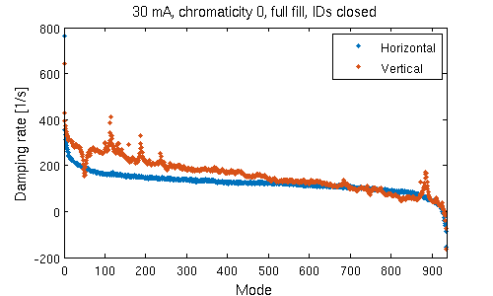
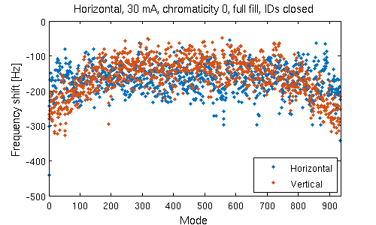
Drive damp measurements
Method: Drive the beam at each coupled-bunch frequency using transverse multibunch feedback, then let beam decay while recording beam oscillation.
Growth time and frequency shift can be determined by fit to amplitude and phase of IQ data.
The method has been standardised so we can measure all 934 modes in a few minutes.
IDs
Vertical collimator
Offset = radiation + chromatic damping (+ other effects?)
Why ID peaks not symmetric over the modes?

Slide 8
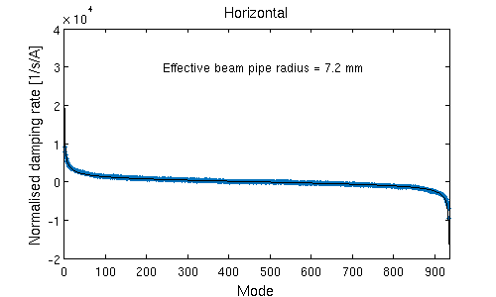
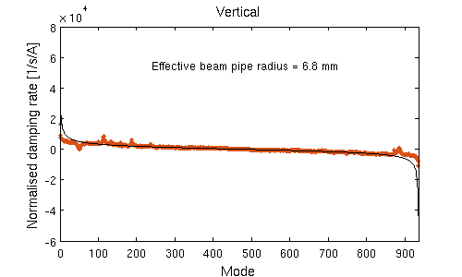
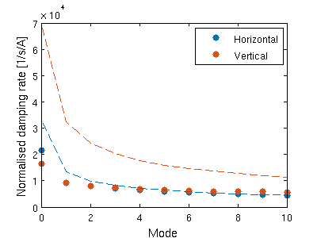
Drive damp measurements
Comparison to analytic formula to find measured effective beam pipe radius.
The overall shape agrees well to behaviour for
resistive wall.
However, the analytic model predicts significantly
higher damping/growth rates for low/high modes.
Need to improve impedance model to calculate
theoretical effective beam pipe radius.
Comparison to mbtrack simulations under progress.

Slide 9
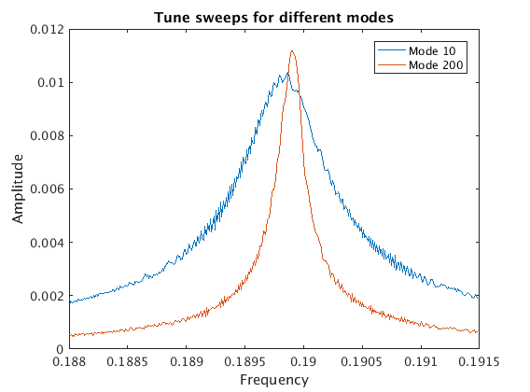
Tune sweep measurements
Method: Step driving frequency over a range of frequencies around the coupled-bunch frequency and measure equilibrium oscillation.
Growth time and frequency can be determined from fitting frequency and Q value of the resonator peak.
Same method is used for tune
measurement during operation →
same fitting algorithm used = can also
be used to fit the synchrotron sidebands.
Method is slower due to more measurement
points and need for waiting time between points.
Still all 934 modes can be measured in 10-30 minutes but manual setup time required.
Abbott and Rehm, “Tune Computation via Model Fitting to Swept Machine Response Measurement”, IBIC’19 (2019)

Slide 10
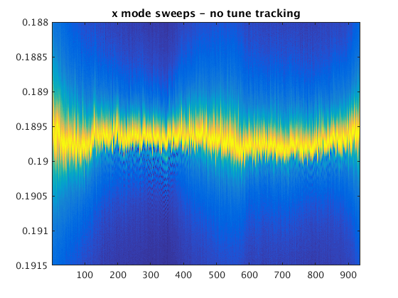
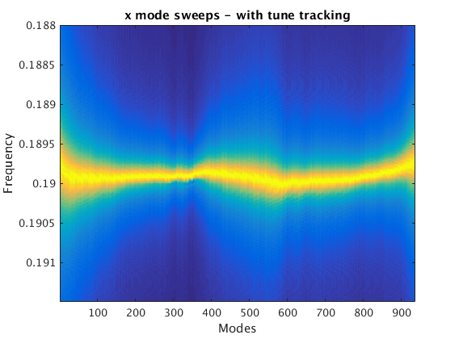
Tune sweep measurements
The measurement relies on using tune PLL → choose one bunch to track the tune and then as the tune of the machine moves excitation and measurements are done relative to that tune.
Consequence: need to exclude one bunch from excitation, but this effect is expected to be neglectable.
Without tune tracking
With tune tracking

Slide 11
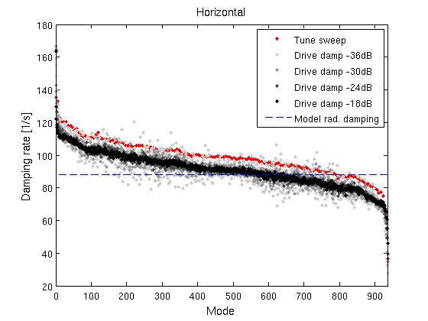
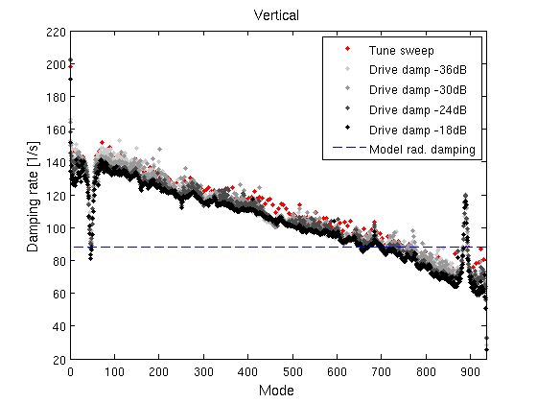
Comparison of methods
Measurement at ≈ 10 mA (0.011 mA/bunch), bare lattice, zero chromaticity, no feedback.
Shape of drive damp and tune sweep measurements agree, but difference in offset.
Also different offset compared to expected radiation damping.
Explanation for offset still under investigation.

Slide 12
Harmonic cavity
Diamond-II design includes a passive, 3rd order harmonic cavity.
Current choice: superconductive cavity of Elettra/SLS type.
So far lifetime main reason for the harmonic cavity, but also of importance for IBS, instability thresholds and heating.
Design also includes 8 normal conductive main cavities (EU HOM-damped).
Main cavities have a significant effect on the transient beam loading due to total R/Q.
Diamond-I is mostly operated with two fill patterns:
  Standard mode: 900 bunches (36 bunches gap)
  Hybrid mode: 686 bunches, 3 nC camshaft ( ≈ 500 ns gap)
Similar fill patterns were considered for Diamond-II, but studies show need for new fill patterns to reduce transient beam loading.

Slide 13
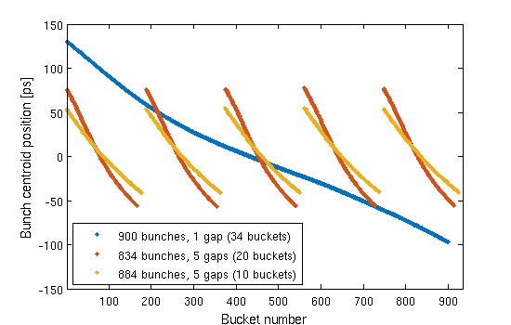
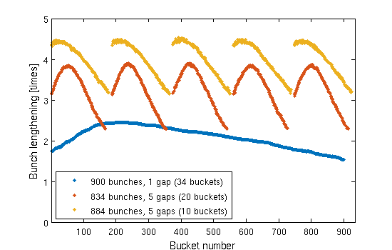
New fill patterns
So far started to study fill patterns with uniform charge distribution, but with several gaps instead of one
Gap requirements:
  Standard mode – requirement for ion and coupled-bunch instabilities
  Hybrid mode – requirement from timing users
 | Phase deviation | Bunch lengthening
900 bunches, 1 gap (34 buckets) | 6.5° | 2.08 times ± 0.26 times
834 bunches, 5 gaps (20 buckets) | 3.4° | 3.27 times ± 0.49 times
834 bunches, 5 gaps (10 buckets) | 2.8° | 3.86 times ± 0.59 times

Slide 14
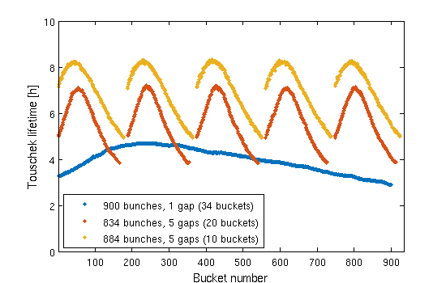

New fill patterns
The Toushcek lifetime increase can be estimated using
$\frac{τ_{HC}}{τ_{0}}=\frac{ε_{HC}^{2}}{ε_{0}^{2}}\frac{\int{ρ_{0}^{2}\left(z\right)dz}}{\int{ρ_{HC}^{2}\left(z\right)dz}}≈\frac{\int{ρ_{0}^{2}\left(z\right)dz}}{\int{ρ_{HC}^{2}\left(z\right)dz}}$
Open questions:
  Effect of non-uniform charge distribution from the gun
  How to maintain a fill pattern like this long-term together with multibunch injection? And how to simulate this long-term behaviour?
Byrd and Georgsson, PRAB 4:030701 (2001)
Effect on momentum acceptance neglected
Touschek lifetime assuming 2 h lifetime
for 300 mA in 934 bunches (0.6 nC/bunch)
Lifetime scaled to take into account greater bunch current for fill patterns with fewer bunches

Slide 15
Thank you!

