Slide 1
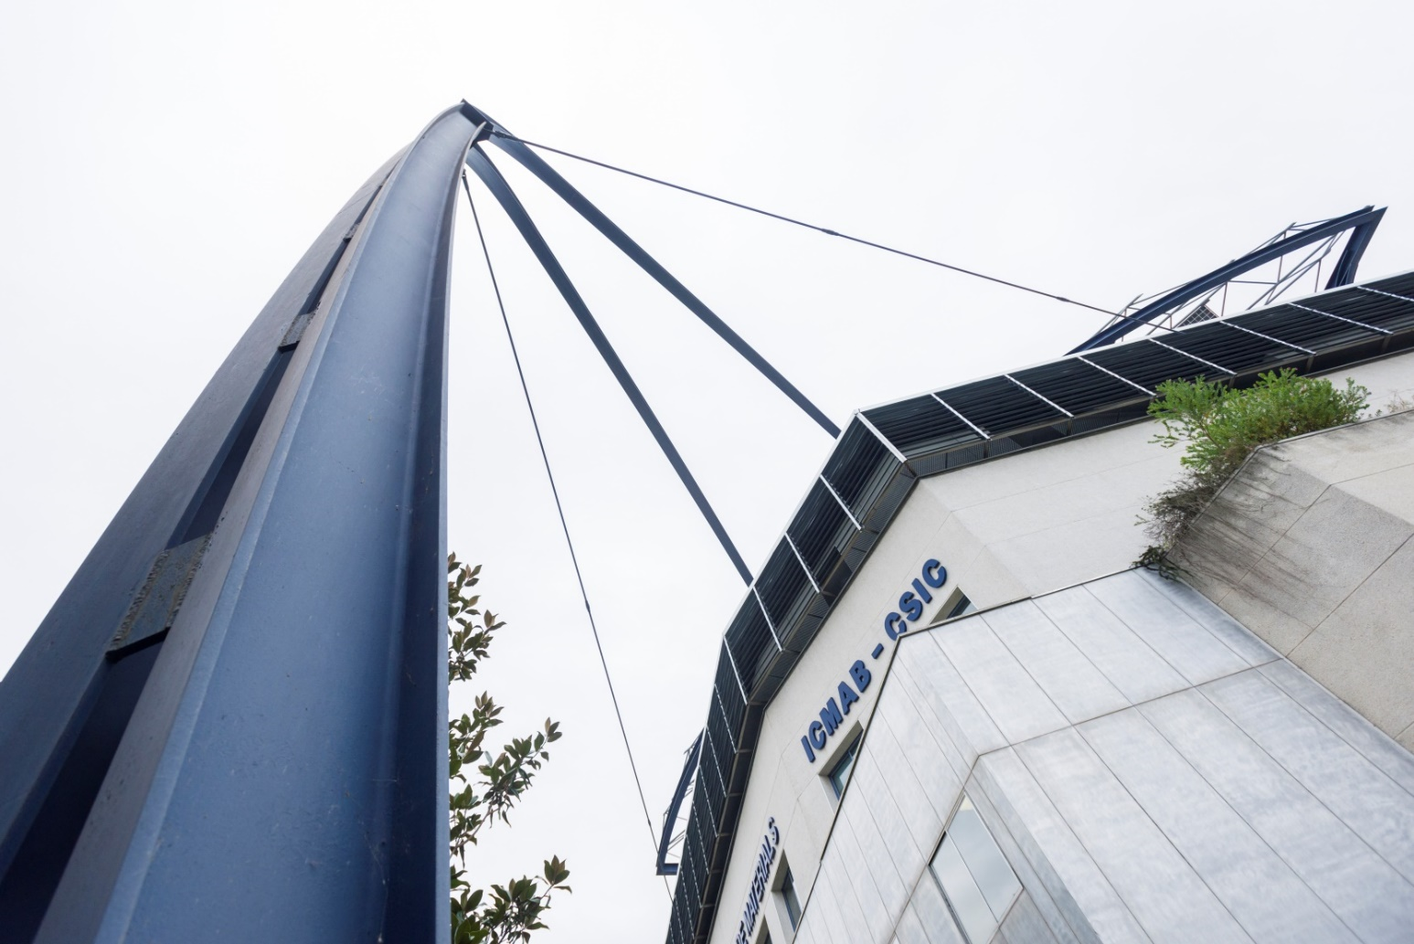

INSTITUT DE CIÈNCIA DE MATERIALS DE BARCELONA
Lifting the veil on the passivation layers in
Ca and Mg-metal anode based batteries:
A complementary FTIR (MIRAS) and
XPS (CIRCE) spectroscopies study
ALBA-ICMAB
Workshop
February 24th
Alexandre Ponrouch

Slide 2
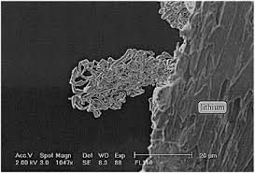
Beyond Li based technologies
Capacity
Abundance in crustal rocks (ppm)
Dendrite
Volumetric
(mAh/cm³)
Gravimetric
(mAh/g)
50000
Li Na Mg Ca
Cost of raw material ($/ton)
5000
Li Na Mg Ca
(Li-ion)
Voltage
Li⁺/Li
Na⁺/Na
NHE
E ˚
Ca²⁺/Ca
Mg²⁺/Mg
(…)
-3.04
-2.87
-2.71
-2.37
0
high energy density, low cost and safety (dendrite)

Slide 3
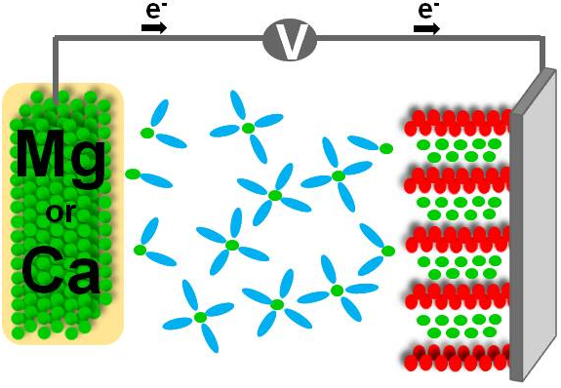
Interface and interphase
Ca
or
Mg
Interface
Passivation layer ?

Slide 4
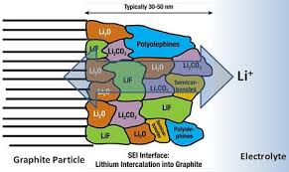
Multivalent Challenges
Lithium
Mg and Ca
Electrolyte
Passivation
Mg²⁺
Ca²⁺
M = Mg, Ca
Focus on electrolytes in which
no passivation occurs
(ethereal solutions)
Mg
Reversible plating and stripping
thought to be impossible !
Ca
Aurbach et al., J. Electrochem. Soc., (1991)

Slide 5
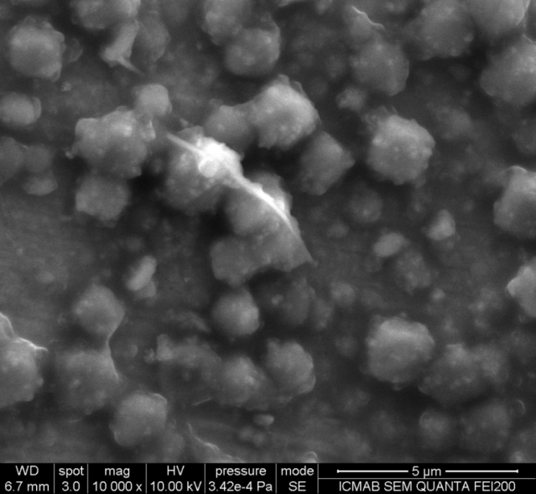
Ca plating with passivation layer (SEI)
TOYOTA
RoomT
75˚C
100˚C
FTIR
After stripping
After plating
Electrolyte stability > 4 V
100˚C; 0.2 mV/s
Ponrouch et al., Nat. Mater., 15 (2016) 169

Slide 6
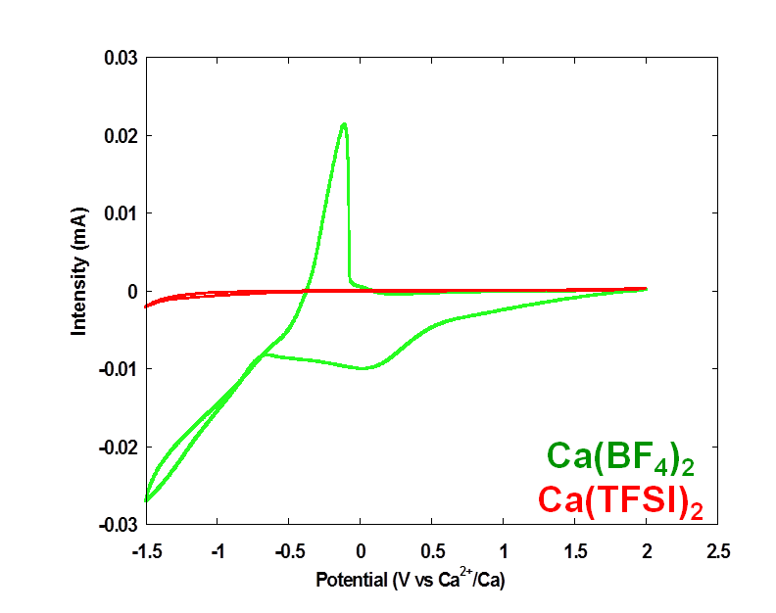
BF₄ vs TFSI based electrolytes
Why TFSI based electrolyte does not allow for Ca plating?

Slide 7
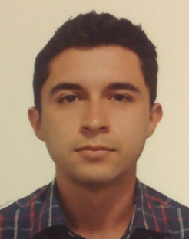
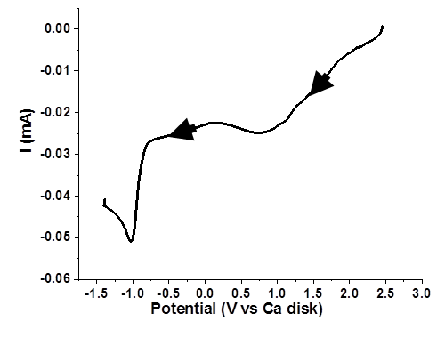
BF₄ vs TFSI based electrolytes
Ni particle
  Pristine Ni particle
J. Forero
Saboya
  Ca(BF₄)₂
  Ca(TFSI)₂
J. Forero Saboya, I. Yousef et al., in preparation

Slide 8
BF₄ vs TFSI based electrolytes
Ni particle
  Pristine Ni particle
  Ca(BF₄)₂
  Ca(TFSI)₂
Conformal passivation layers
Thinner film with TFSI
(yet fully blocking)
Ni
Ni
J. Forero Saboya, I. Yousef et al., in preparation

Slide 9
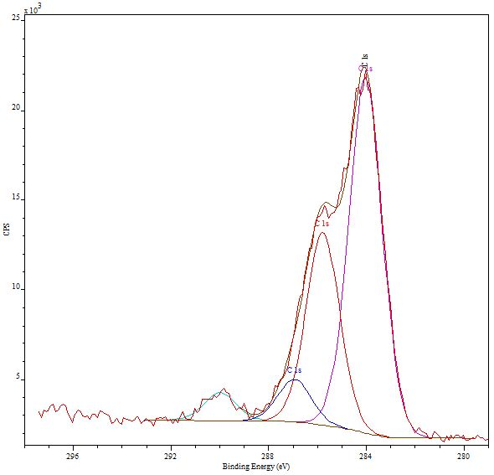
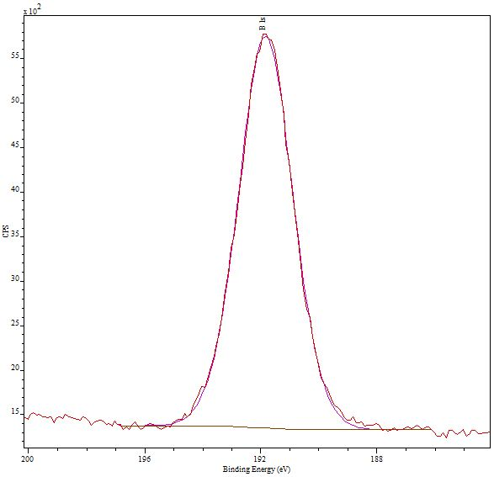
SEI component allowing for Ca plating
XPS
FTIR
C 1s
CH₂/CH₃
C-O
  Ca(BF₄)₂
CO₃
COO
B 1s
B_{x}O_{y}
  Ca(TFSI)₂
Presence of borate
J. Forero Saboya, I. Yousef et al., in preparation

Slide 10
BF₄ vs TFSI based electrolytes
Pre passivation in BF₄ based electrolyte
TFSI
vs.
BF₄
Good passivation is mandatory
Electrolyte significantly impact the plating / stripping kinetics
10
J. Forero Saboya, I. Yousef et al., in preparation

Slide 11
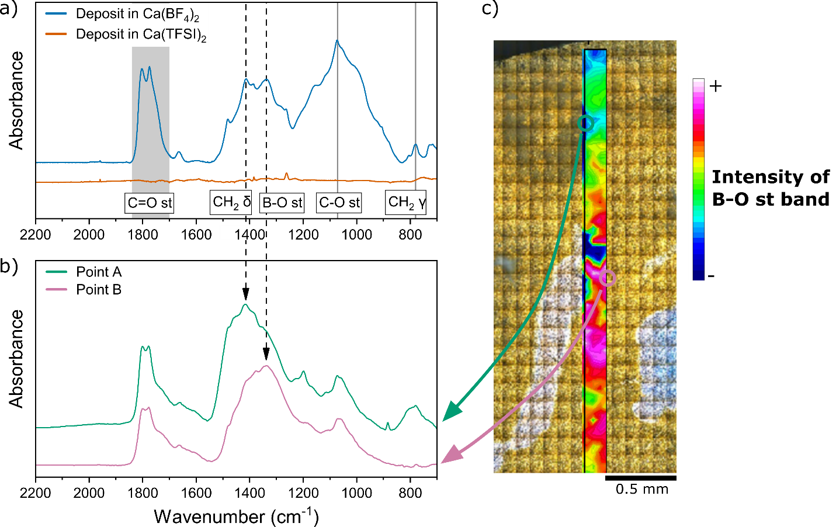
Preliminary work at MIRAS
FTIR-Microspectroscopy
J. Forero Saboya, I. Yousef et al., in preparation

Slide 12
Perspectives
MIRAS (FTIR)
Beamtime in June (proposal 2019083680)
Electrolyte formulation => SEI composition and homogeneity
Investigation on standard borate samples
Far IR (<700 cm⁻¹) study => cation coordination and ionic conductivity

Slide 13
Perspectives
CIRCE (XPS)
Apply for beamtime
Complementary to FTIR
SEI
Varying the photon energy (depth analysis)
Near ambient pressure photoemission (NAPP)
MIRAS (FTIR)
CIRCE (XPS)
Perfect combination for the characterization of passivation layer in batteries

Slide 14
THANK YOU FOR YOUR ATTENTION!

Slide 15
Multivalent Challenges
Battery operation window
0
Electrolyte electrochemical stability window (HOMO/LUMO)
Potential
Scale
(V vs M⁺/M)
Low voltage negative electrode
High voltage positive electrode
Kinetics limitation for electrolyte reduction
(SEI)
Kinetics limitation for electrolyte oxidation
(Surface layer)
SEI and surface layer needed for high voltage
(high energy density)

Slide 16

Interfaces and interphases
Electrochemical impedance spectroscopy: Ca//Ca symmetric cells
Influence of solvents
Influence of additives
No additive
1% additive
=> Power performances could be significantly enhanced!
R_{ct} + desolvation energy + R _{SEI}

Slide 17
Binding energy and plating kinetics
No ion pair
Pre passivation in BF₄ based electrolyte
TFSI (0.45M)
vs.
BF₄ (0.45M)
Improving kinetics by tuning the solvation shell
Forero Saboya et al., J. Phys Chem. C accepted

Slide 18
Ca plating
Ca²⁺ (Solvated)
①
Electrolyte
②
Ca²⁺ (Desolvated)
SEI
③
Ca (Nucleation and growth)
④
Substrate
① and ② Ca²⁺ diffusion/migration within the electrolyte and/or desolvation may be hindered
③ Ca²⁺ diffusion within the SEI may be hindered
④ Ca nucleation and growth may be hindered

Slide 19
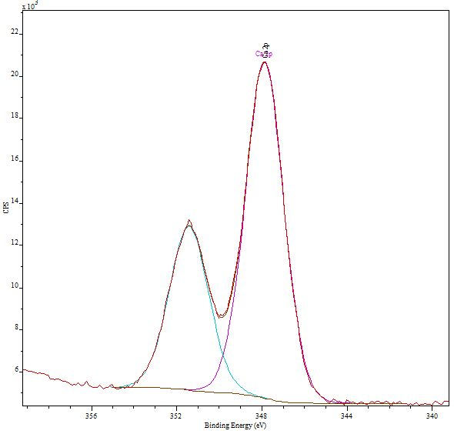
Ca plating !
Infrared and XPS of the calcium deposit
XPS
Ca 2p
XPS
FTIR
Ca 2p
2p_{3/2}
2p_{3/2}
2p_{1/2}
2p_{1/2}
After stripping
After plating
The SEI is stable upon cycling and fully covering!!!
Ca²⁺ cations seem to migrate through the SEI
Ponrouch et al., Nat. Mater., 15 (2016) 169
Forero Saboya et al., in preparation

Slide 20

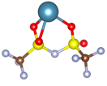


Solvation shell – Binding energy
Complex | Binding Energy (E_{b}) (kJ.mol⁻¹)
[Ca(EC)]²⁺ | 380
[Ca(TFSI)]⁺ | 1162
[Mg(EC)]²⁺ | 544
[Mg(TFSI)]⁺ | 1442
Improving kinetics by tuning the solvation shell
Forero Saboya et al., J. Phys Chem. C accepted

