Slide 1
Boron cluster presence in new materials for their use in polymers, biopolymers and medicine
Prof. Dr. Clara Viñas i Teixidor
Inorganic Materials & Catalysis Laboratory
T
ALBA-ICMAB workshop
Alba synchrotron
February 24th 2020

Slide 2
INTRODUCTION
Boron natural:
20% ¹⁰B
80% ¹¹B
R. Williams,
1964

Slide 3
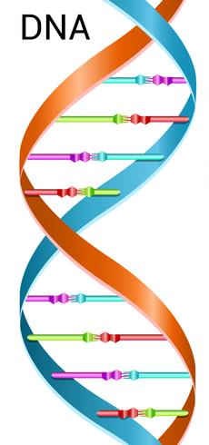
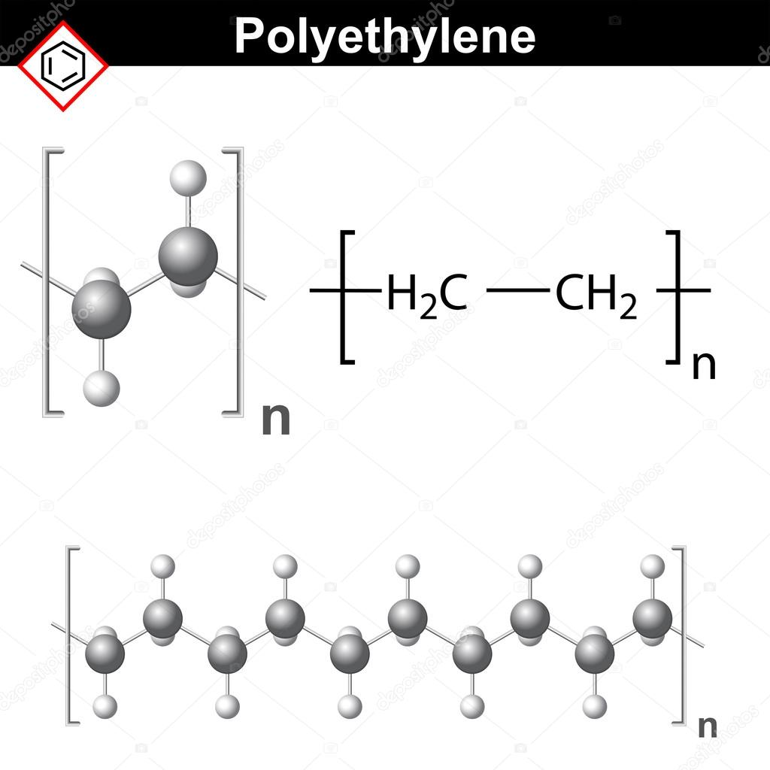
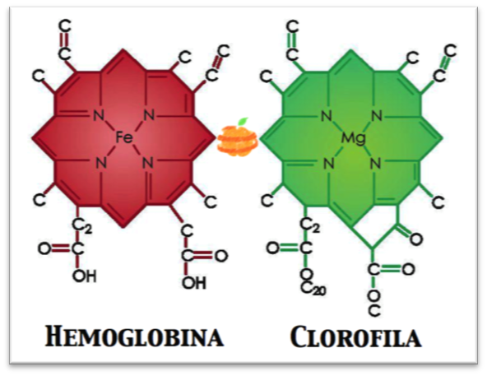
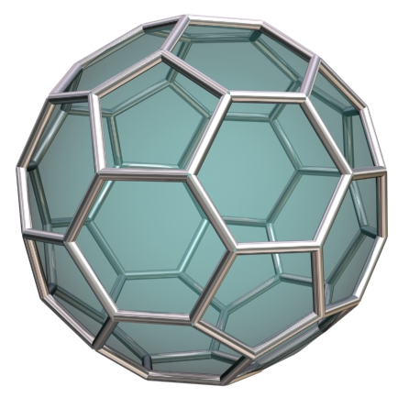
INTRODUCTION
Carbon Compounds
T
Fullerene C60:
Vertices only a C

Slide 4
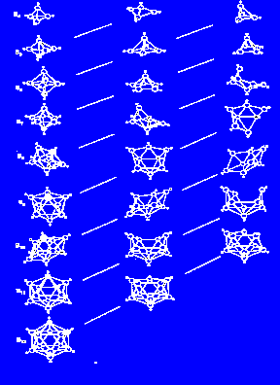
INTRODUCTION
Boron Compounds: boranes, carboranes
Vertices: B-H bond
R.W. Rudolph, W.R. Pretzer,
Inorg. Chem. 1972, 11, 1974.

Slide 5
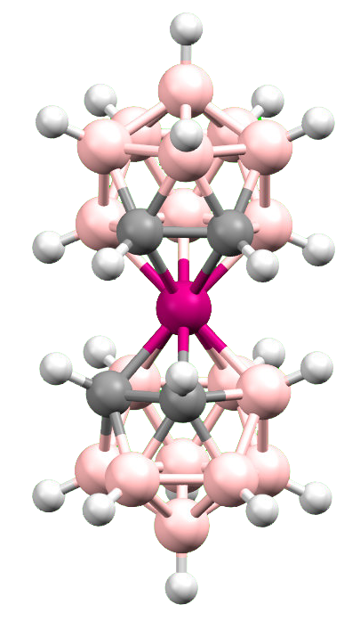
INTRODUCTION
Anionic metallabis(dicarborane)
M= Co³⁺, Fe³⁺
Neutral
dicarborane
Stable anions
Icosahedral geometry
3D Aromatic Structure
Photocatalysts
Non-localized negative charge
Soluble in water or organic solvents depending on the cation

Slide 6
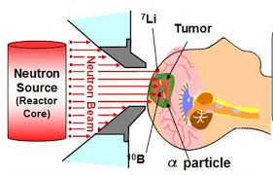
What is Boron Neutron Capture Therapy?
+
+
+ γ photon
¹⁰B ¹n ⁷Li ⁴He
¹⁰B
¹⁰B
¹⁰B
^{C}
^{C}
^{C}
^{C}
^{C}
^{C}
^{C}
^{C}
^{C}
Selective labeling
with ¹⁰B
Capture of slow
neutron
Tissue repair
Requirements:
∼20 μg of ¹⁰B / g tumor
Boron compound should be into the cells: “radiolabeling”
Notes:
But, what is Boron Neutron Capture Therapy?
BNCT is a bimodal cancer treatment based on the large neutron capture area of ¹⁰B nucleus. ¹⁰B captures slow neutrons core produces ⁷Li, a photon and α particle that can destroy cells (α particle has high kinetic energy, approximately 2.4 MeV).
The cancerous tissue, consisting of healthy and cancerous cells, is well irrigated so, tumor tissue gets more nutrients and more drugs. Irradiating the tissue with slow neutrons α particles are produced that can destroy cancer cells.
For the successful application of BNCT, a high concentration of boron should be delivered to the tumor cells. The amount of ¹⁰B needed for effective BNCT is more than 20 μg per gram of tumor.
Could these MNPs be suitable for BNCT radiation? It was prove that MNPs internalize cells and the amount of Boron 10 was of 26 20 μg per gram of tumor. It seems yes!!

Slide 7
COSAN: on the road to anticancer therapies
Requirements of suitable boron delivery agents for the highest therapeutic and cost efficiency in BNCT are:
Low toxicity
High selectivity for tumours
High uptake in tumours: ∼20 μg of ¹⁰B / g tumor
Accumulating the boron within the nucleous of cancer cells
Notes:
If COSAN accumulates within the nucleous, Does COSAN interact with DNS?

Slide 8
INTRODUCTION
Anionic metallabis(dicarborane)
M= Co³⁺ : CoSAN; Fe³⁺ : FeSAN
Neutral
dicarborane
Stable anions
Icosahedral geometry
3D Aromatic Structure
Non-localized negative charge
Soluble in water or organic solvents depending on the cation

Slide 9
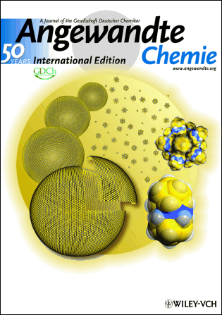
COSAN vesicles/micelles formation in water
Monolayer vesicles with polydisperse radius (aprox. 20 nm) and constant wall thickness (1.16 nm) in diluted water solution (1-13 mM).
Spherical micelles with of 1.16 nm radius and monolayer vesicles coexist at concentration higher than 13 mM.
Monolayer vesicles with polydisperse radius (80-890 nm) in saline solution.
B-H···H-C_{cluster}
P. Bauduin, S. Prevost, P. Farràs, F. Teixidor, O. Diat, T. Zemb, Angew. Chem. Int. Ed. 2011, 50, 5298 – 5300.
M. J. Hardie and C. L. Raston, Chem. Commun., 2001, 26, 905
Notes:
Our group reported in 2011 the unique property of the protonated salt of the cobaltabisdicarbollide to produce monolayer vesicles of about 20 nm of radius in diluted water solutions. When increasing the concentration, vesicles and micelles coexist. The radius of the vesicles increases to 80-890 nm in saline solution.
It is very important to emphasize that these vesicles are monolayer in contrast with liposomes and natural membranes that are bilayer.
Dihydrogen bond B-H ··· H-C are involved in both monolayers vesicles.

Slide 10

Interaction between CoSAN vesicles and membranes?
vs

Slide 11
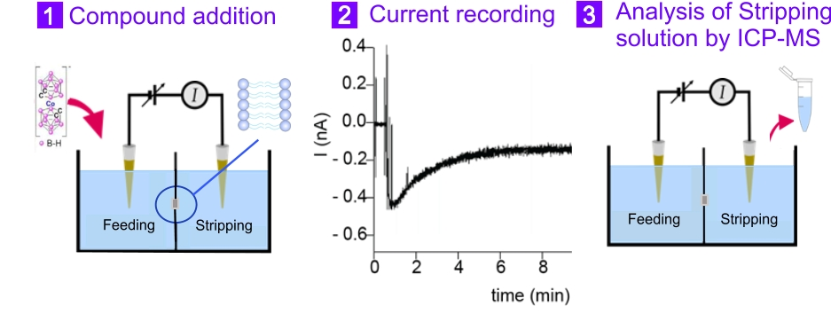
Interaction between COSAN vesicles and membranes
First focus: “in vitro” interaction between lipidic membrane and CoSAN
C. Verdiá-Báguena, A. Alcaraz, V. M. Aguilella, A. M. Cioran, S. Tachikawa, H. Nakamura, F. Teixidor and C. Viñas, Chem. Commun., 2014, 50, 6700-6703.

Slide 12
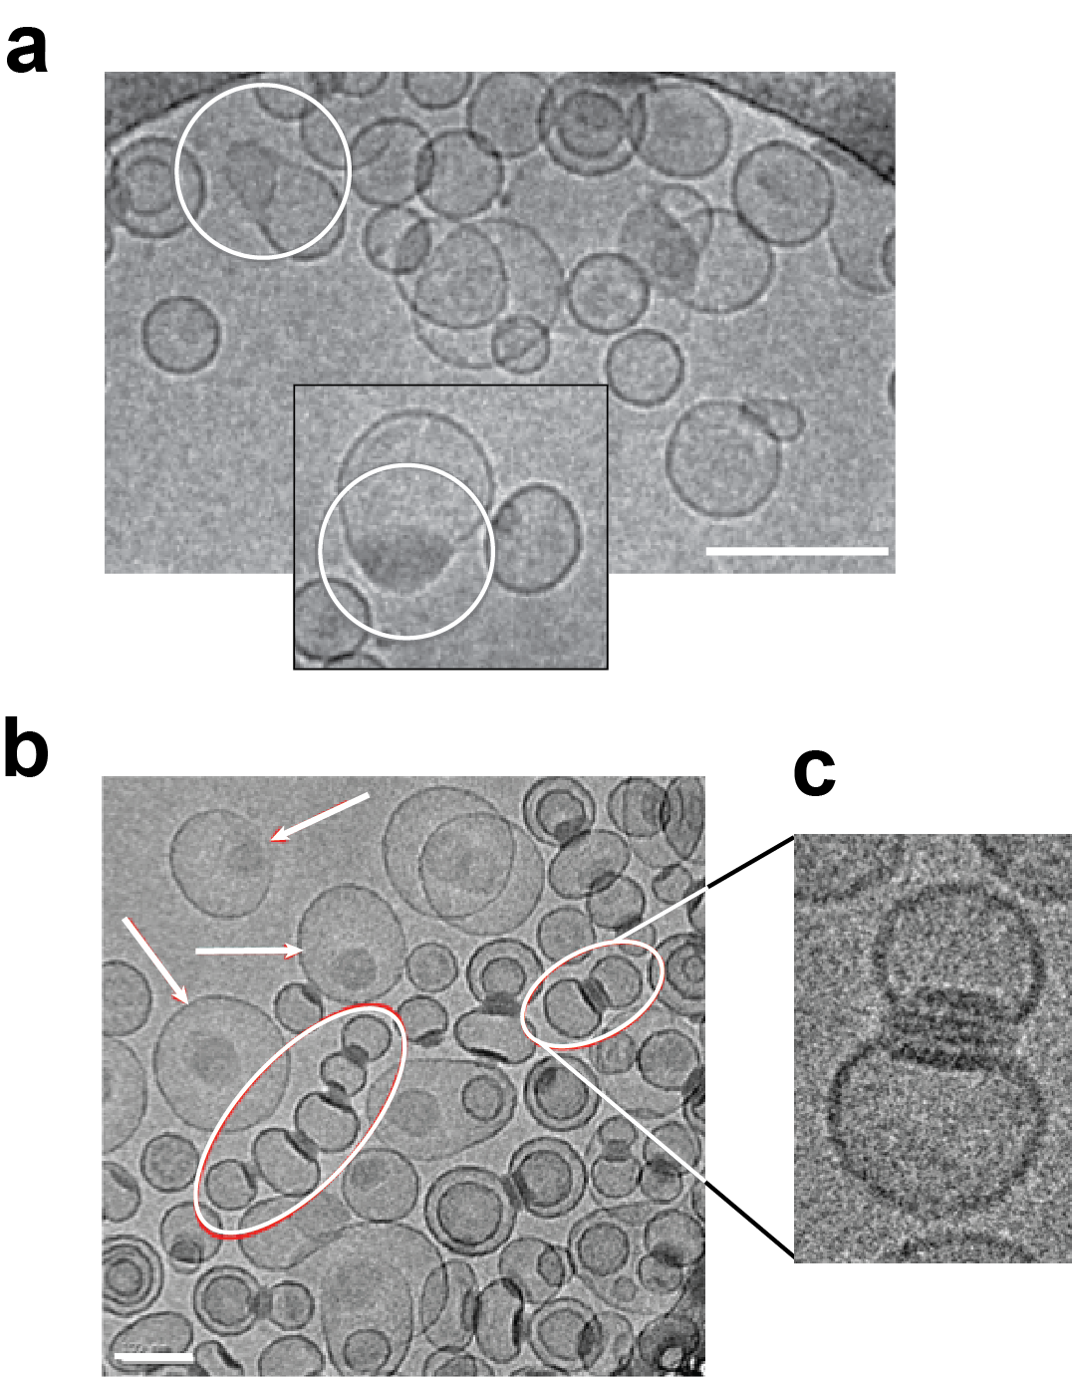
Visualisation of the interaction between COSAN vesicles and liposomes
CryoTEM
Images
C. Verdiá-Báguena, A. Alcaraz, V. M. Aguilella, A. M. Cioran, S. Tachikawa, H. Nakamura, F. Teixidor and C. Viñas, Chem. Commun., 2014, 50, 6700-6703.
Notes:
Our aim was to prepare high Boron content MNPs to act as anticancer drug for dual therapy: Hyperthermia therapy (by the core composition) + BNCT (by the capping molecules).

Slide 13
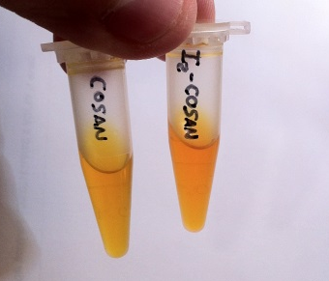
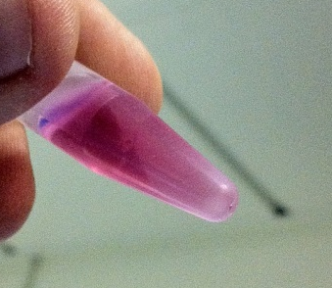
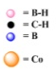


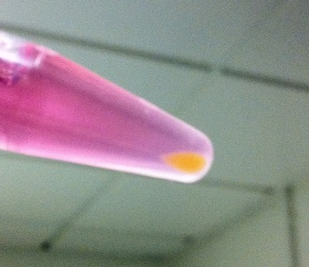
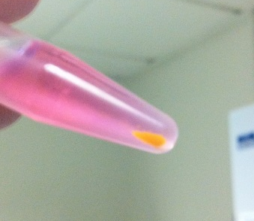
COSAN/Membranes interaction: Cell images
A
B
Alone cells
Cosan and
I₂-Cosan solution
C
D
M. Tarrés, E. Canetta, C. Viñas, F. Teixidor, A.J. Harwood, Chem. Commun., 2014, 50, 3370-3372.
Notes:
In 2011, we demonstrated that COSAN cluster crosses artificial bilayer organic membranes as well as cellular bilayer membranes.
We demonstrated that COSANE cluster accumulates into the cells and we visualized inside living cells by Raman Microscopy.

Slide 14
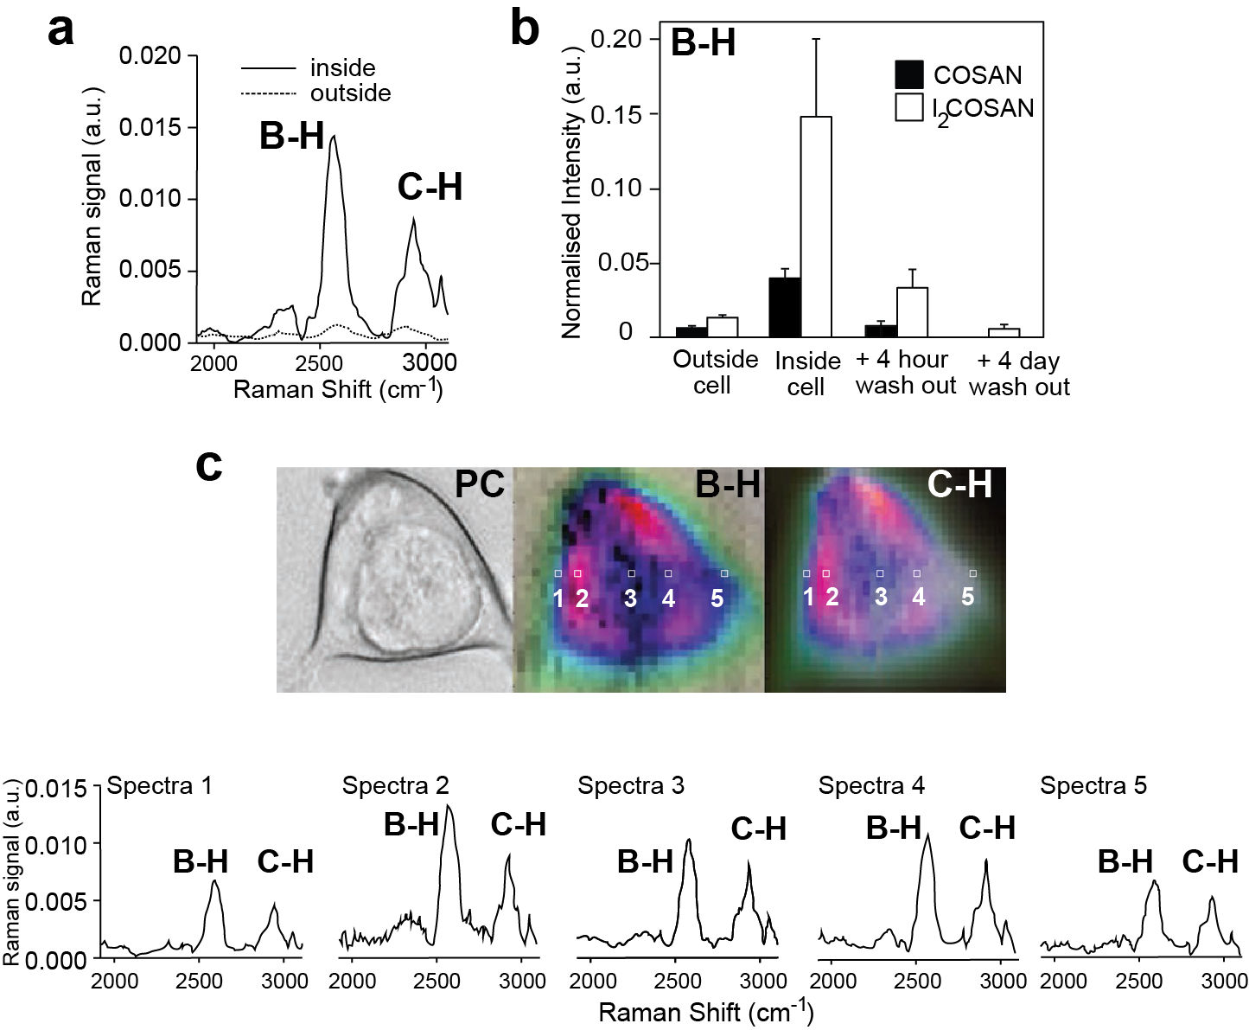
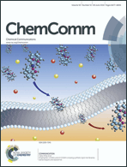
COSAN: Membranes interaction
Raman-Microscopy
Crossing artificial membranes
Accumulating / visualizing inside living cells
M. Tarrés, E. Canetta, C. Viñas, F. Teixidor, A.J. Harwood, Chem. Commun., 2014, 50, 3370-3372
C. Verdiá-Báguena, A. Alcaraz, V. M. Aguilella, A. M. Cioran, S. Tachikawa, H. Nakamura, F. Teixidor and C. Viñas, Chem. Commun., 2014, 50, 6700-6703.
Notes:
In 2011, we demonstrated that COSANE cluster crosses artificial bilayer organic membranes as well as cellular bilayer membranes.
We demonstrated that COSANE cluster accumulates into the cells and we visualized inside living cells by Raman Microscopy.

Slide 15
COSAN: on the road to anticancer therapies
Second focus: “in vitro” interaction between ds-DNA with CoSAN
Optical microscopy images
Na[CoSAN]
Nanohybrid
CT-dsDNA
I. Fuentes, T. García-Mendiola, S. Sato, M. Pita, H. Nakamura, E. Lorenzo, F. Teixidor,. F. Marques, C. Viñas, Chem. Eur. J. 2018, 24, 17239–17254.

Slide 16
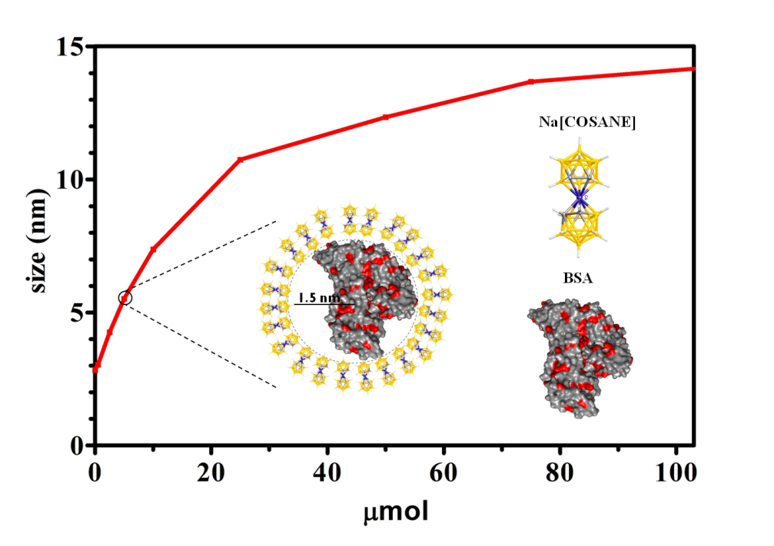
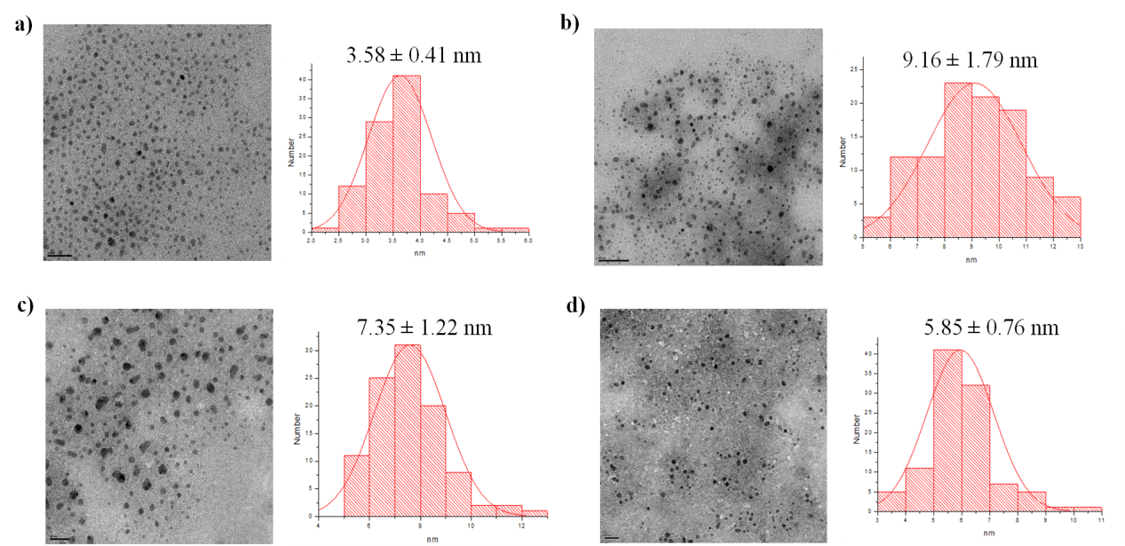
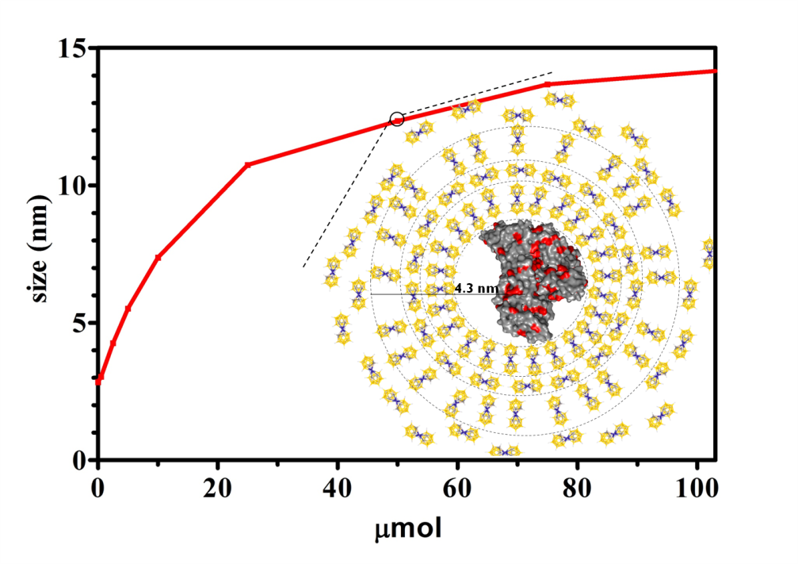
COSAN: on the road to anticancer therapies
Third focus: interaction between CoSAN and protein (BSA)
BSA-Na[CoSAN]
98 COSANE
1.1 nm
0.6 nm
100 COSANE
I. Fuentes, J. Pujols, C. Viñas, S. Ventura, F. Teixidor, Chem. Eur. J. 2019, 25, 12820 – 12829.

Slide 17
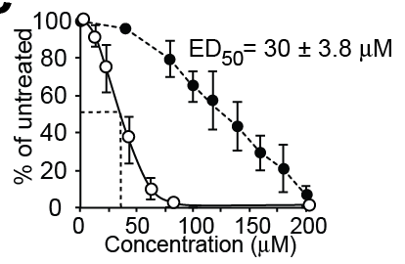
COSAN: “in vitro” cells study
 | ED₅₀ (mean ±SD, µM)
Cell type | COSAN | I₂-COSAN
Mammalian cells
HEK 293 | 121 ± 3.8 | 30 ± 3.8
HeLa | 157 ± 8.6 | 23 ± 2.5
THP-1 | 154 ± 8.9 | 44 ± 6.0
3T3 | 99 ± 5.5 | 29 ± 0.8
Amoeba cells
D. discoideum | 2.6 ± 0.3 | 1.8 ± 0.1
Bacteria
E. coli B/r | > 250 | 53 ± 5.4
Klebsiella Kneumonia | > 250 | 65 ± 4.1
COSAN is cytostatic
KK2 buffer: 6.5 mM KH₂PO₄, 3.8 mM K₂HPO₄, pH = 6.2
> 5 hours
M. Tarrés, E. Canetta, E. Paul, J. Forbes, K. Azzouni, F. Teixidor, C. Viñas, A.J. Harwood, Scientific Reports, 2015, 5, 7804
Notes:
In 2015, we proved that COSAN is cytostatic stopping the cellular division and its effective doses 50 were calculated for several Mammalian, ameba and bacteria cells.

Slide 18
CARBORANES: on the road to anticancer therapies
Gold nanoparticles
Fe₃O₄/ γ-Fe₂O₃
Magnetic nanoparticles (SPIONs)
A. M. Cioran, A. D. Musteti, F. Teixidor, Ž. Krpetić, I. A. Prior, Q. He, C. J. Kiely, M. Brust, C. Viñas, J. Am. Chem. Soc., 2012, 134, 212.
E. Oleshkevich, A. Rosell, A. Morancho, K. Galenkamp, J. Comella F. Teixidor, C. Viñas, Nanomedicine: NBM, 2019, 20, 101986.

Slide 19
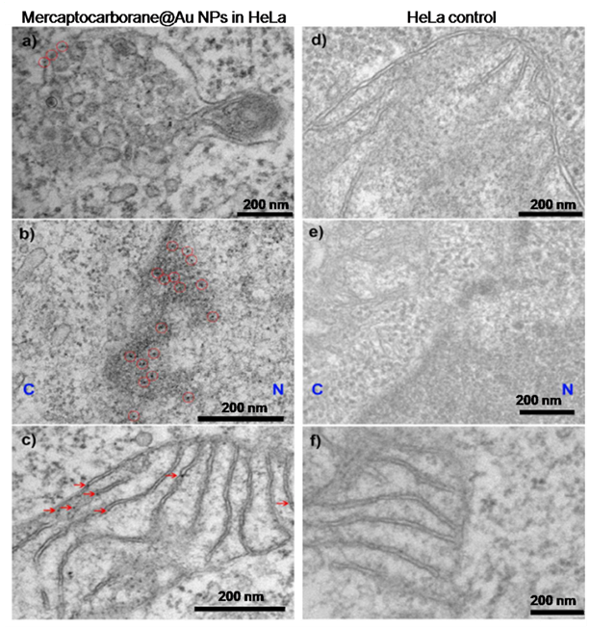
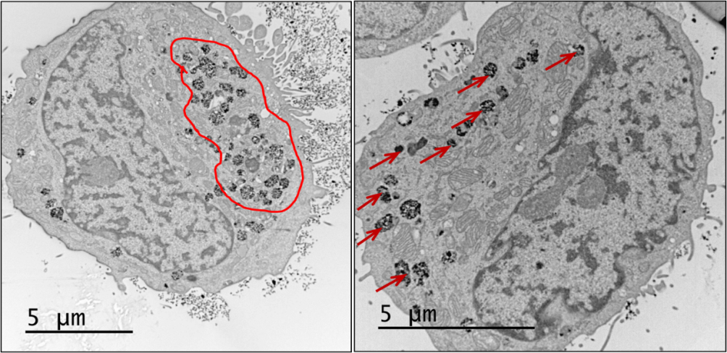
CARBORANES: on the road to anticancer therapies
Gold nanoparticles
A172 glioblastoma cells
Magnetic nanoparticles (SPIONs)
The core of the NPs were observed inside
the cells by HR-TEM and CryoTEM.
A. M. Cioran, A. D. Musteti, F. Teixidor, Ž. Krpetić, I. A. Prior, Q. He, C. J. Kiely, M. Brust, C. Viñas, J. Am. Chem. Soc., 2012, 134, 212.
E. Oleshkevich, A. Rosell, A. Morancho, K. Galenkamp, J. Comella F. Teixidor, C. Viñas, Nanomedicine: NBM, 2019, 20, 101986.

Slide 20
PROPOSALS
PROPOSALS at the MIRAS Beamline Fourier Transform Infrared (FTIR) spectroscopy and microscopy.
Boron clusters possess B-H bonds that appear in a peculiar region of the IR spectra in which no other bonds related to organic molecules appear.
- IR spectroscopy can support the presence of multifuctional Boron-containing agents inside cells for their use in multifuctional therapy (BNCT + thermotherapy + chemotherapy): decrease of the secondary effects while maintaining the efficiency.
- Presence of Boron clusters in biopolymers (DNA, gens, bone cements, ….) and polimers (COPs: Polypyrrole, PEDOT,….) …

Slide 21

New opportunities of boron clusters
in materials and medicine

Slide 22
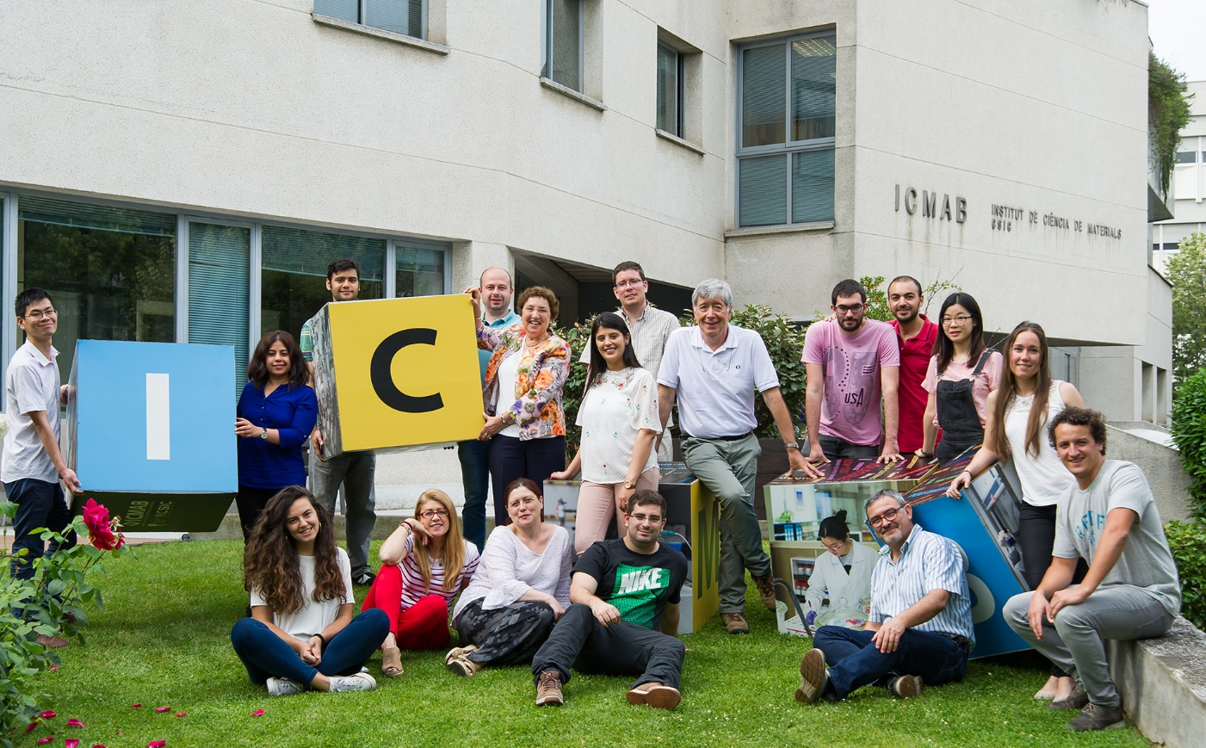

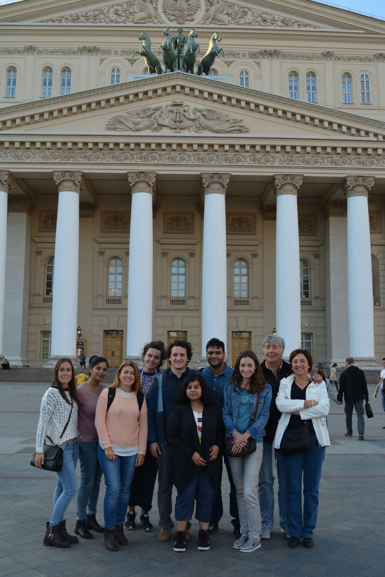





Prof. Francesc Teixidor
Dr. Elena Oleshkevich
Ms. Isabel Fuentes
Acknowledgements
Notes:
Thanks to all the group in Bellaterra but specially to Elena Oleshkevich, Ms. Isabel Fuentes and Francesc Teixidor.

Slide 23
COSAN: on the road to anticancer therapies
PROPOSALS at the MIRAS Beamline Fourier Transform Infrared (FTIR) spectroscopy and microscopy.
On Metallacarboranes (CoSAN and FeSAN):
After cellular uptake, would it be possible to discern by
Fourier Transform Infrared spectroscopy and microscopy on
the interaction between:
Metallacarbone and lipids?
Metallacarborane and proteins?
Metallacarborane and DNA?
If interaction was proven, would it be possible to quantify the amount of metallacarborane into the cell? Nucleus?
Notes:
If COSAN accumulates within the nucleous, Does COSAN interact with DNS?

Slide 24
CARBORANES: on the road to anticancer therapies
PROPOSAL at the MIRAS Beamline Fourier Transform Infrared (FTIR) spectroscopy and microscopy.
2) On Carboranes:
After cellular uptake, would it be possible to prove by FTIR that the carborane units at the NPs shell remains bonded to the core of the nanoparticles, either gold or magnetic ones?

