Slide 1

FTIR for polymers
and in-situ experiments
by Martin Kreuzer
- MIRAS-

Slide 2
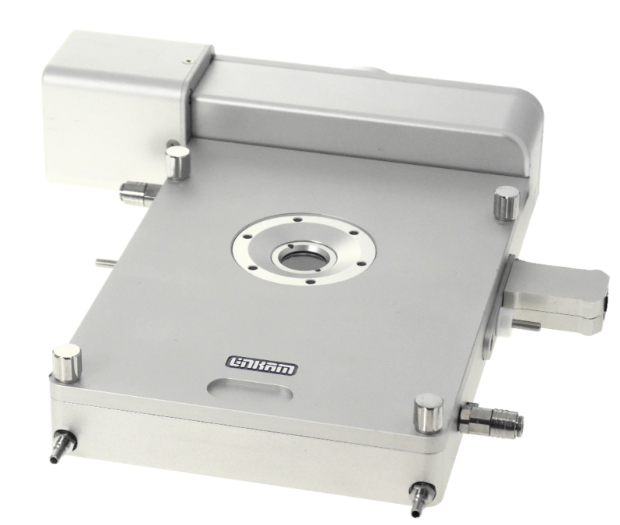
The Experiment
Setup:
Infrared microspectroscopy
Objective
Polarizer
Polymer film
Stretching stage
Stretching stage
Objective
*2019 L.S.Dilkes-Hoffman, S.Pratt, P.A.Lant and B.Laycock - The Role of Biodegradable Plastic in Solving Plastic Solid Waste Accumulation

Slide 3
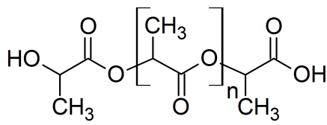
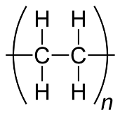

The Experiment
Setup:
Infrared microspectroscopy
Material: Polymer blend films
Objective
Poly lactic acid (PLA)
Polyethylene (PE)
Polarizer
Polymer film
Bioderived
and biodegradable
Well-known commodity polymer
Excellent mechanical properties
Stretching stage
Stretching stage
Fossil based and non-biodegradable
High brittleness
Objective
*2019 L.S.Dilkes-Hoffman, S.Pratt, P.A.Lant and B.Laycock - The Role of Biodegradable Plastic in Solving Plastic Solid Waste Accumulation

Slide 4
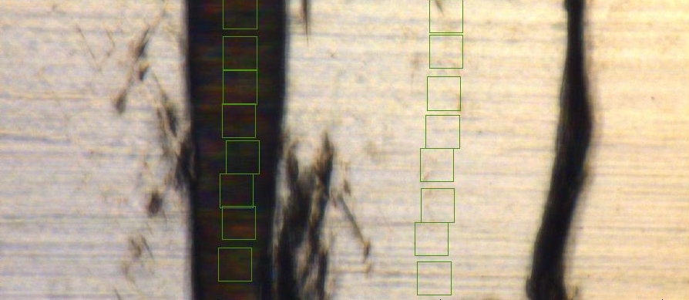
The Results
fractured
not-fractured
fractured
not-fractured
100 µm
100 µm

Slide 5
The Results
fractured
not-fractured
fractured
not-fractured
100 µm
100 µm
C=O
756 cm⁻¹
CH₂
719 cm⁻¹
C=O
756 cm⁻¹
CH₂
719 cm⁻¹

Slide 6
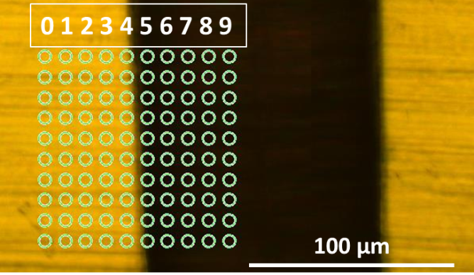
The Results
Mapping and principal component analysis (PCA)
Lines
Average spectra
(polarized light)

Slide 7
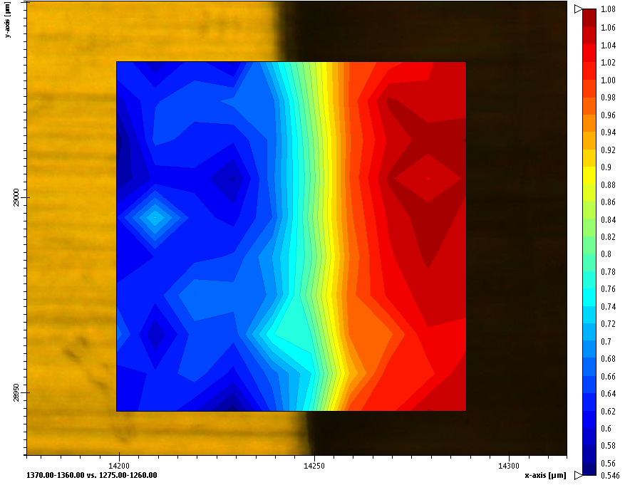
The Results
Mapping and principal component analysis (PCA)
Lines
Average spectra
(polarized light)
PCA – Scores plot

Slide 8
Optimum sample characteristics:
Infrared transparent sample (holder) for transmission measurements
Sample thickness between 0.2 and 20.0 µm
Change of orientation by a tuneable parameter (e.g. tensile force, temperature, voltage, light, humidity, …)
Results:
Maps with 5 µm spatial resolution
Measurement time per spectra is around 10 seconds
Martin Kreuzer - MIRAS

