Slide 1

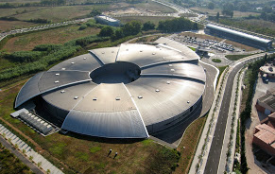
Synchrotron light - based
infrared micro-spectro (FTIR)
for the biomedical research
Tanja Ducic
MIRAS beamline

Slide 2
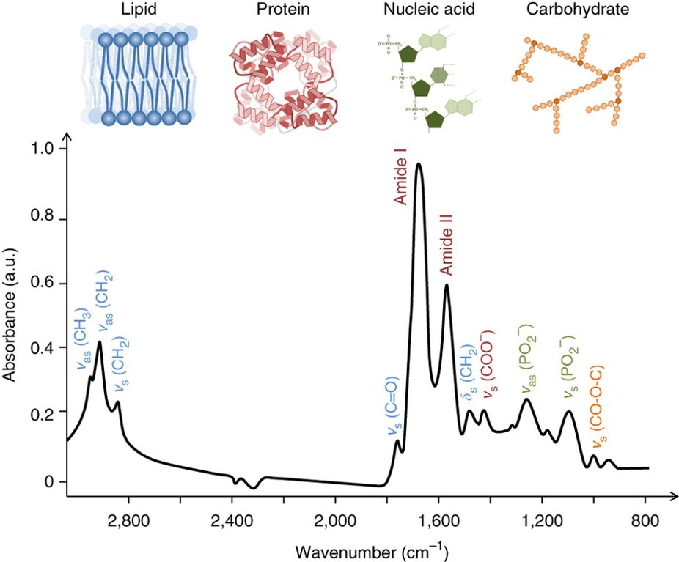
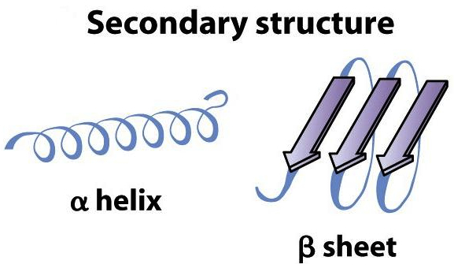
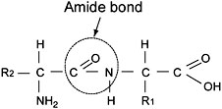
Synchrotron Radiation-FTIR microscope
FTIR Spectroscopy
Baker MJ et al. Using Fourier transform IR spectroscopy to analyze biological materials
Nature Protocols, 2014 (8):1771-91

Slide 3
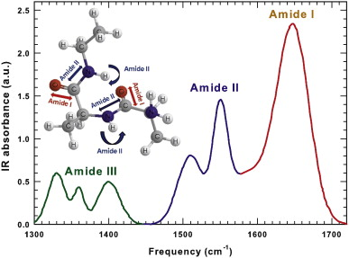
FTIR Spectroscopy
Secondary Structure | cm⁻¹
β-antiparalel | 1690-1680
β-turns | 1680-1670
α-helix | 1660-1650
random | 1650-1645
β-sheet intra | 1635-1630
β-sheet inter | 1625-1620
Ducic et al., Analytical chemistry 2019: 91: 1460−1471

Slide 4
FTIR microscopy
Evaluation of oxidative stress in NTg and mutant hSOD1 G93A rat astrocytes
10µm
10µm
Spatial distribution of peroxidized lipids-related absorptions by FTIR imaging of freeze-dried astrocytes.
C=O / (ν_{asym} CH₃ + ν_{as} CH₂).
ν_{as} CH₂ / ν_{as} CH₃
Ducic et al., Analytical chemistry 2019: 91: 1460−1471

Slide 5
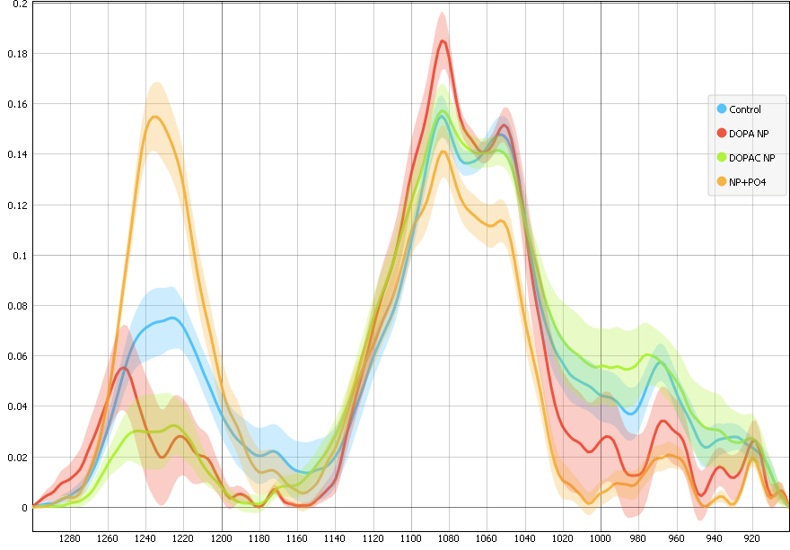
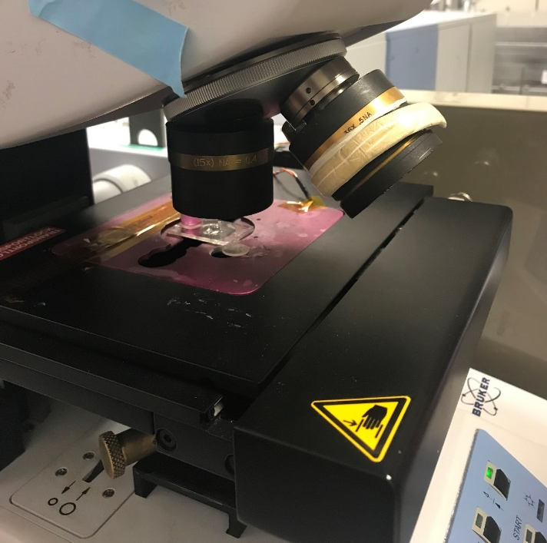
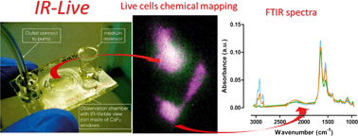
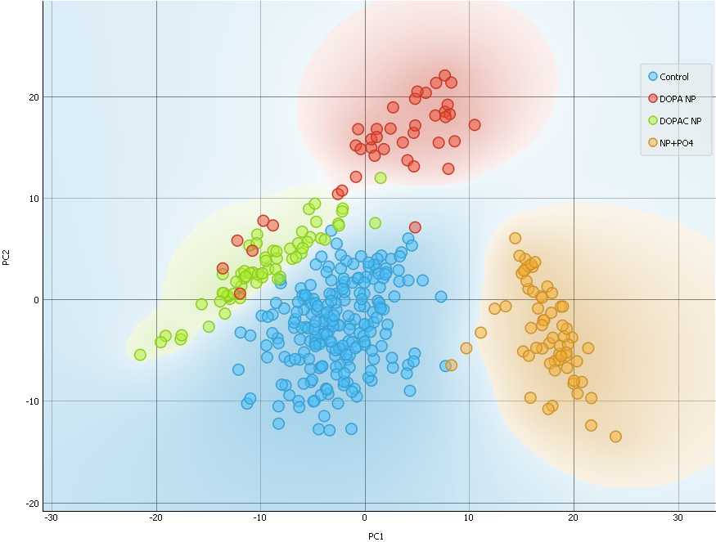
Potential new project
Live cells FTIR spectroscopy after treatment with targeted nanoparticles
Cells treated with NP
Technical development and application
Control
DOPA NP
DOPAC NP
NP + PO4
Finger print area
Birarda, et al. 2016. IR-Live: Fabrication of a Low-Cost Plastic Microfluidic Device for Infrared Spectromicroscopy of Living Cells. Lab on a Chip 16: 1644–1651.
Thank you!
Tanja Ducic tducic@cells.es
Ducic et al., in preparation; In collaboration with T. Paunesku & G. Woloschak, Northwestern University, Chicago, USA

Slide 6
Advantages of FTIR
Fourier transform infrared (FTIR) spectroscopy is a nondestructive, label-free, highly sensitive and specific technique that provides complete information on the chemical composition of biological samples.
The technique both can offer fundamental structural information and serve as a quantitative analysis tool.
It has many potential applications in different fields of clinical and biology sciences.
Notes:
Although considerable technological progress has been made to promote biomedical applications of this powerful analytical technique, most clinical laboratory analyses are based on spectroscopic measurements in the visible or ultraviolet (UV) spectrum and the potential role of FTIR spectroscopy still remains unexplored.

Slide 7
New challenges for synchrotron based bio-FTIR
Each microscopy and each technique has its own advantages and restrictions: the multimodal combination of all techniques enables to get a deeper understanding of molecular changes.
Combination of diverse techniques for a deeper cellular and molecular insight into modification on the structural/cellular level during the cellular misbalance. (Raman, HPLC, MS, fluorescence, EM…)
Correlative integrated imaging approach allow to elucidate subcellular structures, elemental distributions and/or densities at the nanometer scale which could be used for the investigation of e. g. protein aggregates in the entire intact cells in situ.
Go forward with pre-diagnostic studies using for example blood and other liquids prepared for the investigations.
More investigations on post mortem relevant tissues for neural diseases.

Slide 8

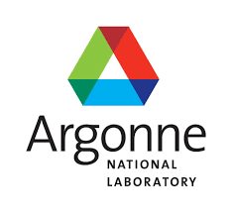

An example :
Protein aggregates in
single intact astrocytes in ALS
Amyotrophic lateral sclerosis (ALS), a fatal neurodegenerative disease, is the most common adult onset neurodegenerative disorder affecting motor neurons.
The pathological mechanisms are still poorly understood.
One of the familial ALS cases is caused by mutations in the metallo-enzyme copper-zinc superoxide dismutase (SOD1).
We employed multimodal cellular synchrotron radiation based spectro-microscopies to investigate the astrocytes of an ALS animal model: the rat hSOD1 G93A
Dučić et al., Analytical chemistry 2019
Notes:
This model overexpresses human mutated SOD1, which is known to increase the susceptibility of the SOD1 protein to form insoluble intracellular aggregates.

Slide 9
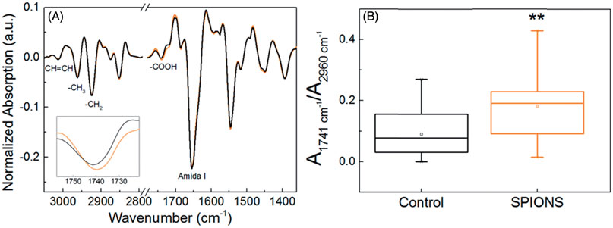
Iron oxide nanoparticles stress the cells
Toxicogenomics of iron oxide nanoparticles in the nematode C. elegans
Gonzalez-Moragas, et al., Nanotoxicology 2017
Derivative of the mean FTIR spectra of control (black) and Fe-oxide-treated (orange) C. elegans. The inset shows a zoom-in of the 1741 cm⁻¹ band.
(B) Box plot of the lipid oxidation ratio (1741 cm⁻¹/2960 cm⁻¹) of all spectra, for control and SPION-treated animals
Notes:
Nanoparticles present unique properties and offer very promising possibilities in
medicine but their use must be safe and tested.
Caenorhabditis elegans (C. elegans)
are 1-mm-long nematodes used as a model organism for genetic studies, given that
they have its whole genome sequenced. The advantageous characteristics of this worm,
such as its transparency, short life cycle (4-5 days), short life (2-3 weeks), ease of
operation and low cost of maintenance, among others, have been used by the authors
to evaluate the use of nanoparticles for applications in medicine.
it is possible to understand and predict their behavior,
and optimize their design to achieve low toxicity and
safer nanomaterials for humans.

Slide 10
Statistic: PCA analysis

Slide 11
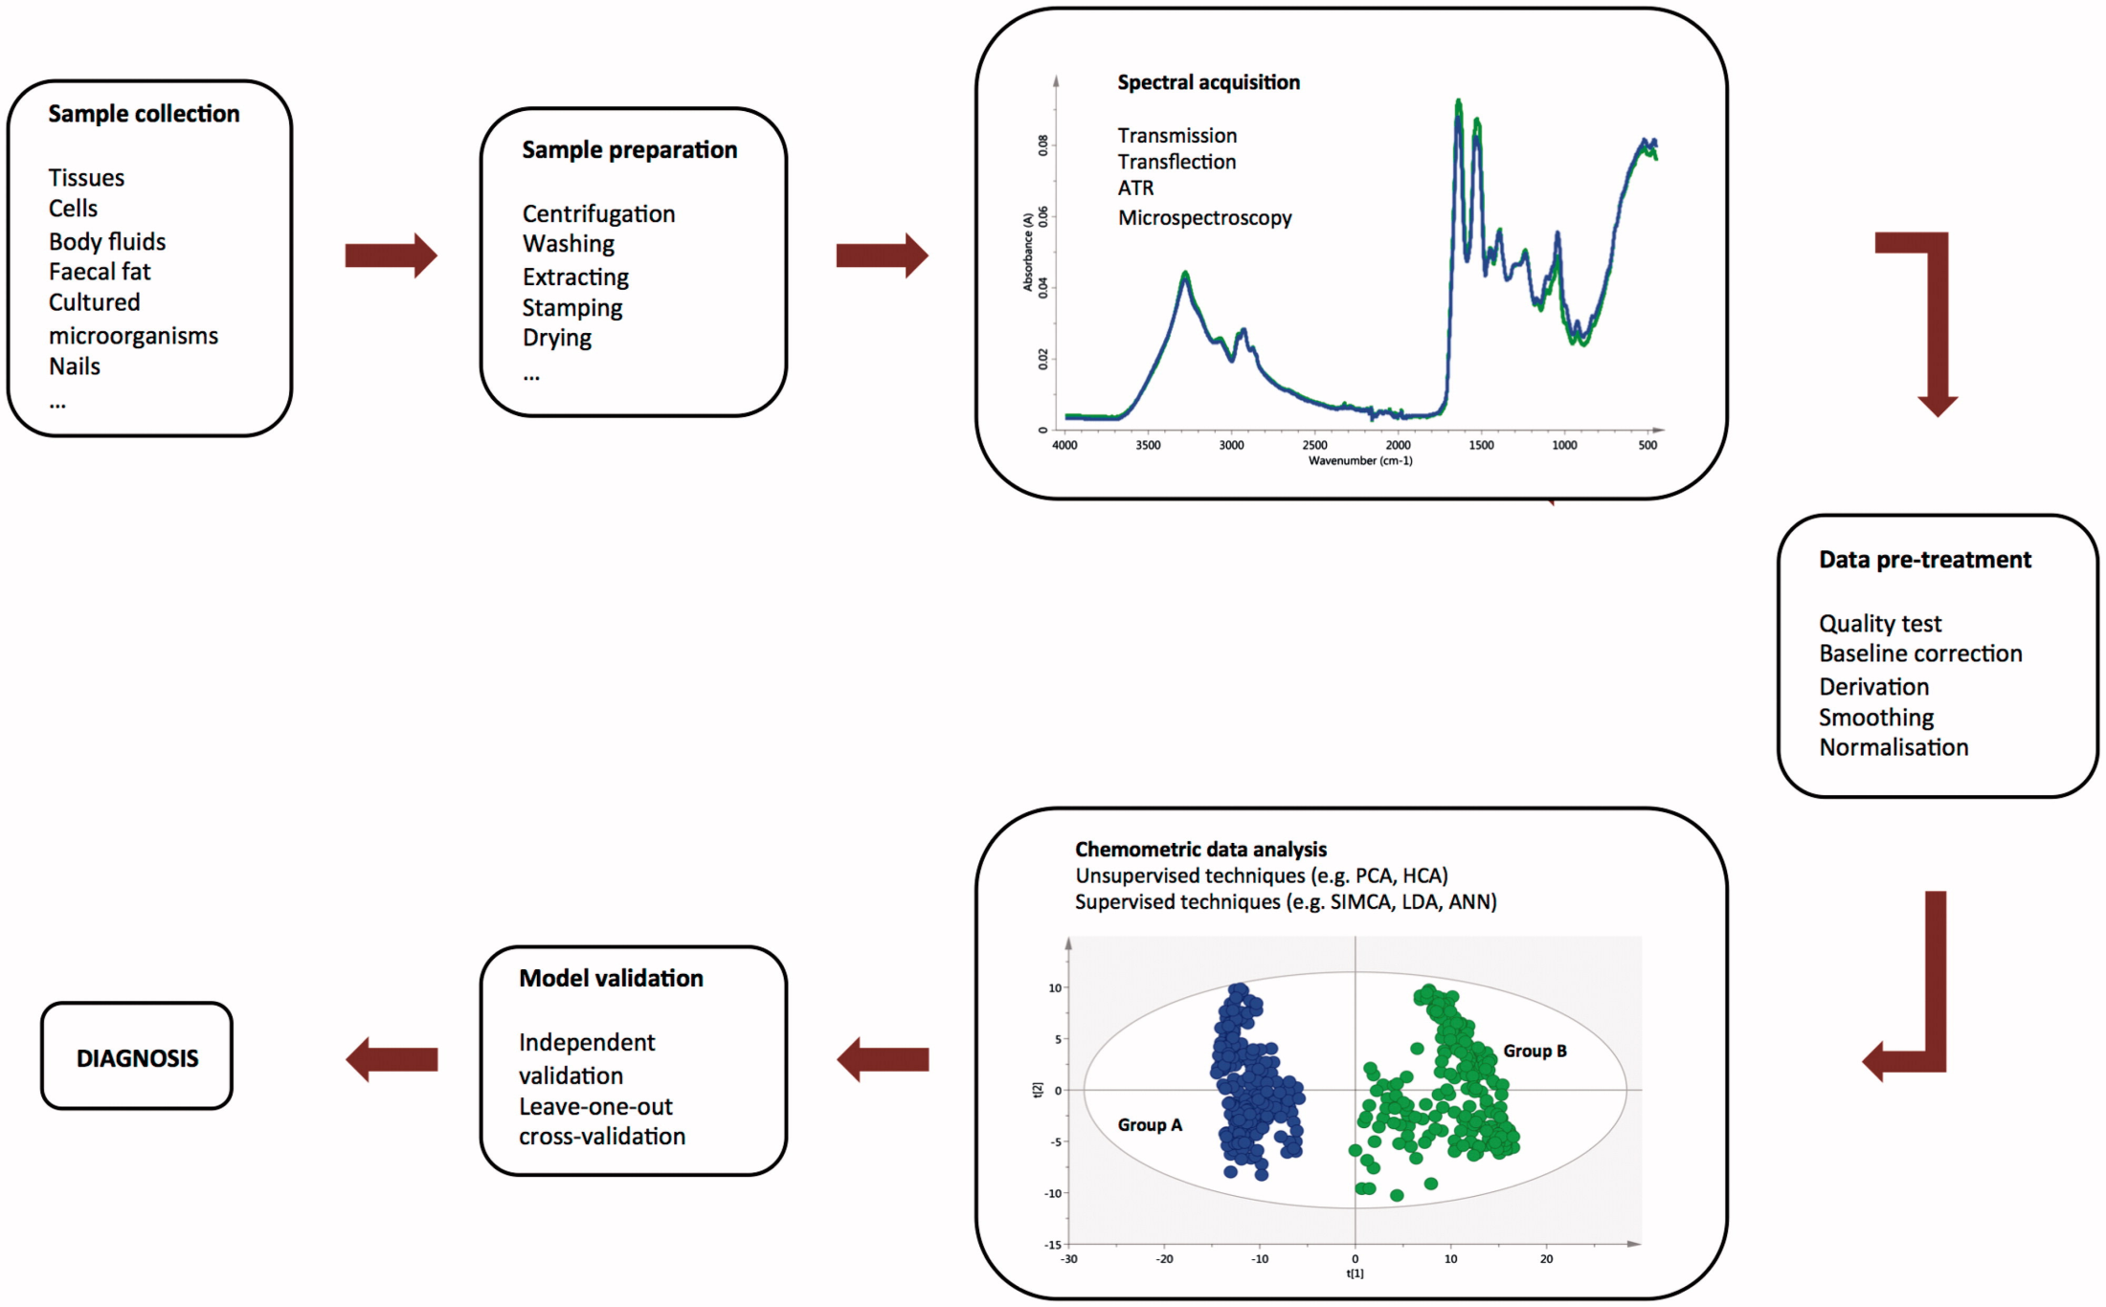
Work flow
Your lab
After data pretreatment, the choice of an appropriate chemometric technique (extracting information from chemical systems) for qualitative or quantitative data analysis is a crucial factor.
Synchrotron
Your lab and/or synchrotron
De Bruyne et al., 2017

