Slide 1
BOREAS for Multiferroics and +
Javier Herrero-Martín. BL29-BOREAS
General sample preparation/form Sintered pellets of policrystalline powder, single crystals (larger than ~100*100 um²), NPs(*), thin films, in-situ metals/molecules deposited onto substrates…
MFs - what can we learn? Chemically-selective quantitative details of the VB electronic structure, local symmetry and magnetization (orbital and spin separately) (HECTOR); CM/ICM AFM order analysis: element-selective magnetic moments orientation (MaRes)
ME coupling - what can we do? i) SHs ready to apply V-bias (or current) → magnetic response via XMLD-XMCD or ii) apply magnetic field in any direction (< 2 T or < 6 T) → electric response via XLD (HECTOR)
Three examples
Polycrystalline powder - MF like CMTO
Single crystal - Single-phase ME MF like MnCoWO4
Heterostructure - Composite ME MF system like PE STO + magnetostrictive substrate
Special thanks to: J.L.García (ICMAB-CSIC), L. Maurel (ETH-PSI), J. Ruiz-Fuertes (UNICAN), G. Subías (ICMA-UZ)

Slide 2
1. Polycrystalline powder - MF like CaMnTi₂O₆
x²-y²
Calculated XAS
1.00
x²-y²
x²-y²
0.20
0.50
xy
xy, xz, yz
xy
3z²-r²
0.30
0.09
0.50
3z²-r²
xy
0.15
0.36
1.30
X-ray absorption (arb. units)
x²-y², 3z²-r²
xz, yz
xz, yz
3z²-r²
Calculated XMCD
Mn L_{2,3}
0.40
PRB 97, 235129 (2018)
xz, yz
T_{d}
D_{4h} elong.
C_{4h} S.D.
C_{4h} L.D.
5 K, 6 T
Mn2 sites in D4h symmetry, not square planar (contrarily to as claimed) (E_{3z2-r2} > E_{xy})
Mn1 & Mn2 moments add up parallel in the AFM phase

Slide 3
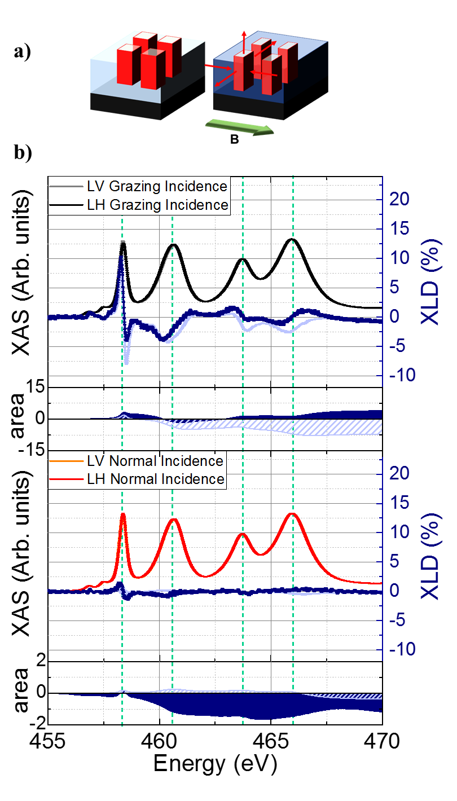
2. Heterostructure - Composite ME MF like PE STO + magnetostrictive substrate
(CMTO)
m_{S}=0.018, m_{L}=-0.013 → m_{TOT}=0.004
(a)
Ti L_{2,3}
*30
Experimental, 5 K
X-ray absorption (arb. units)
(b)
Calculated
*30
in preparation (2020)
B-field applied, electric response via charge redistribution seen in XLD

Slide 4
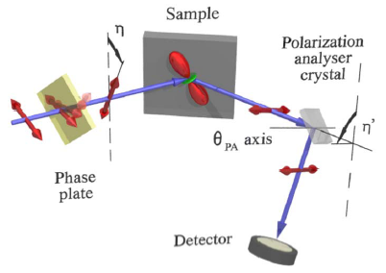
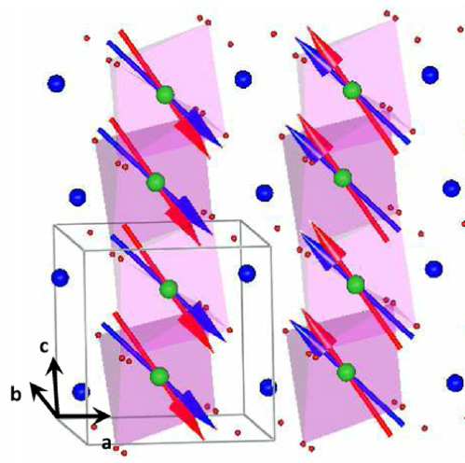
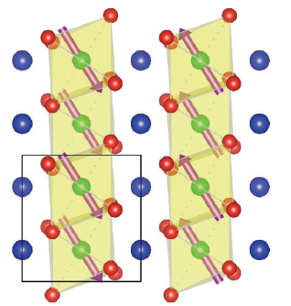
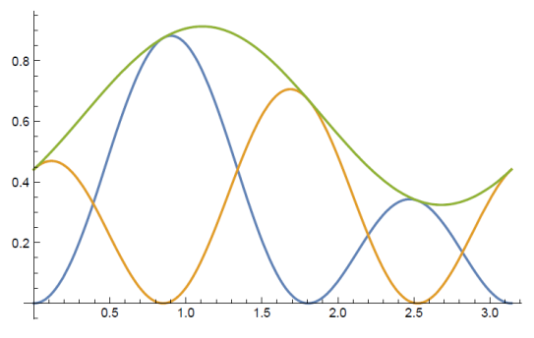
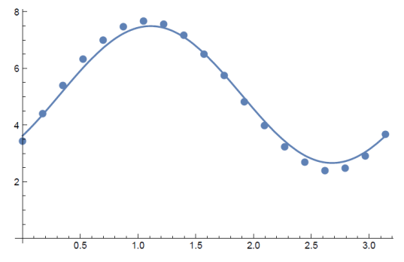
3. Single crystal - Single-phase ME MF like MnCoWO4
RMXS to complement Neutron Diffraction
χ
orbital, spin
actual AFM structure
η
As seen by ND
PRB 91, 220403(R) (2015)
calculated:
unrotated
rotated
sum
Small samples
High momentum space resolution (ICM structures)
Orbital / spin separation (non-res.)
More than one magnetic element (resonant)
experimental
Calc. sum
Element-selective (Mn, Co) magnetic structure unveiled thanks to RMXS

Slide 5
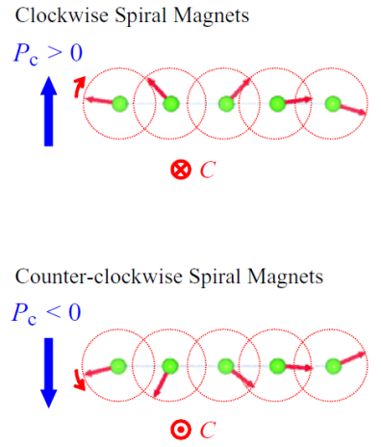
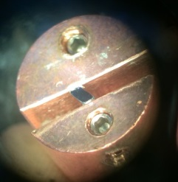
3. Single crystal - Single-phase ME MF like MnCoWO4
b
2
c
1
V
~ 10²-10³ V
ME coupling is due to Mn spins as demonstrated by RMXS

