Slide 1
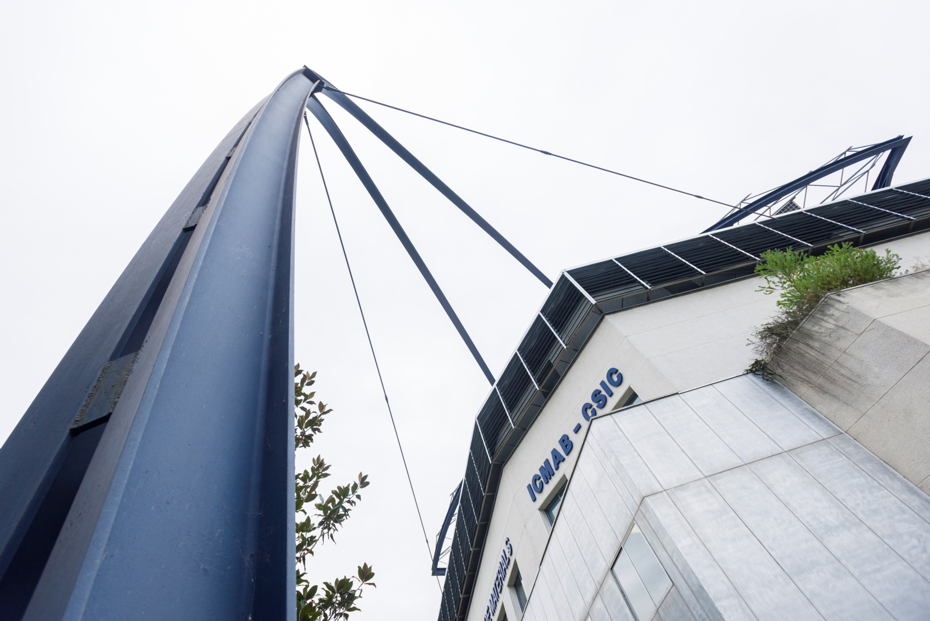

INSTITUT DE CIÈNCIA DE MATERIALS DE BARCELONA
ICMAB: a research Institute on advanced functional (nano)materials
Director: Xavier Obradors
Deputy Directors
Rosa Palacín & Riccardo Rurali

Slide 2
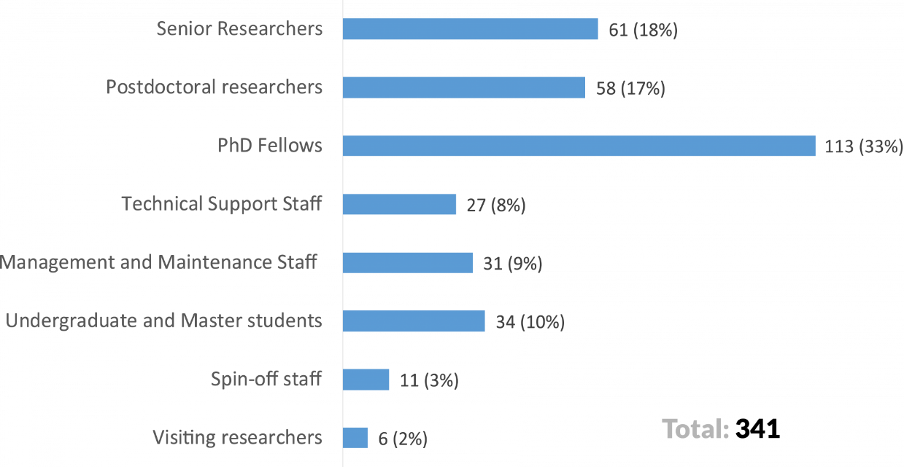
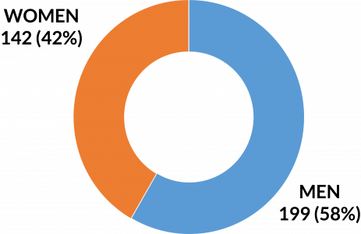
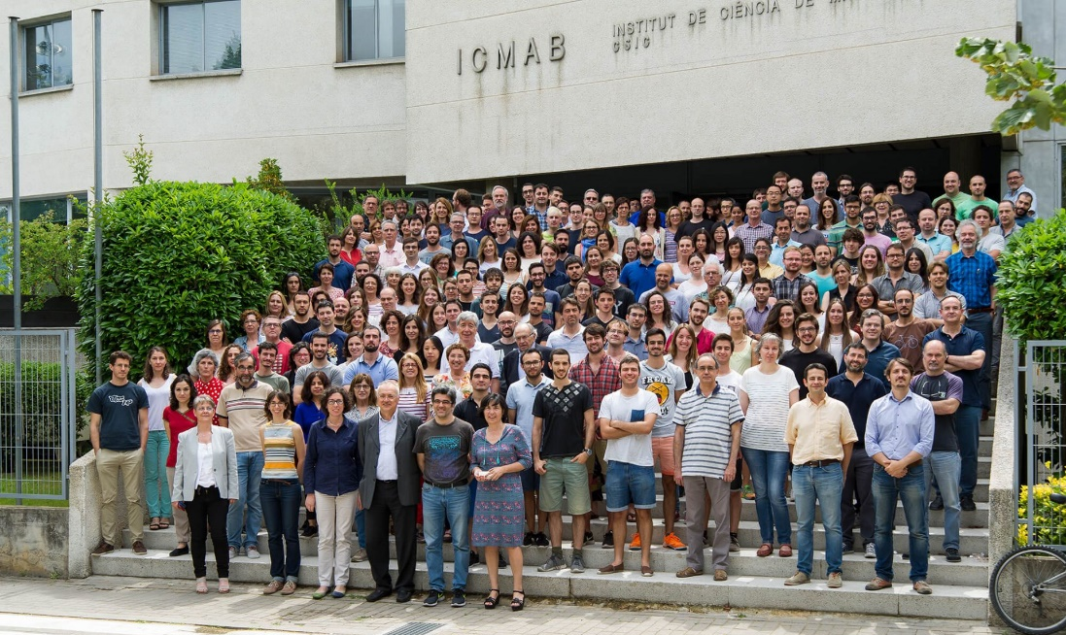
ICMAB

Slide 3
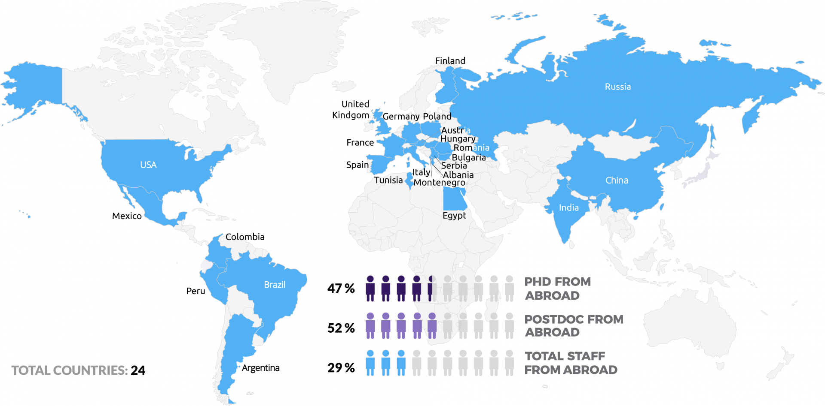
ICMAB
Internationality

Slide 4







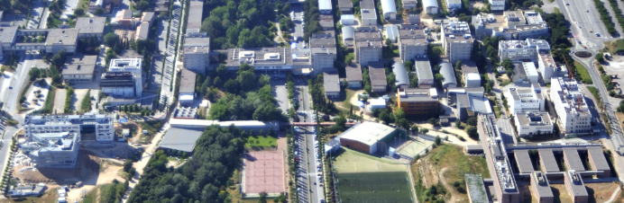

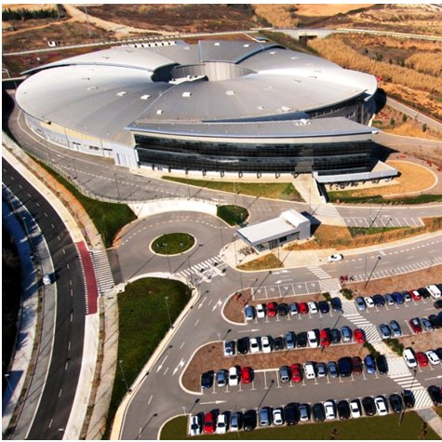

Barcelona Nanotechnology Cluster - Bellaterra
IFAE
ICMAB
IMB-CNM
UAB
CRAG
ALBA synchrotron
ICN2
BNC-b ~ 700 researchers
∼ 1000 people
The largest R+D N&N concentration in Spain
∼40-50 % Catalonia scientific production Mat&N&N

Slide 5
ICMAB R&D&i Activities
Discovery Research Use-inspired Basic Research
Applied Research
Technology Maturation
& Deployment
Industry
Spin-offs
Technological Centers
Polytechnic Universities
Hospitals
Society
Universities
Large scale facilities
Complem. research centers (Physics, Chemistry, Biology)
SCIENCE
TECHNOLOGY KNOW-HOW
Materials
Properties
Devices
The whole chain value is attended through strategic agreements at interfaces

Slide 6
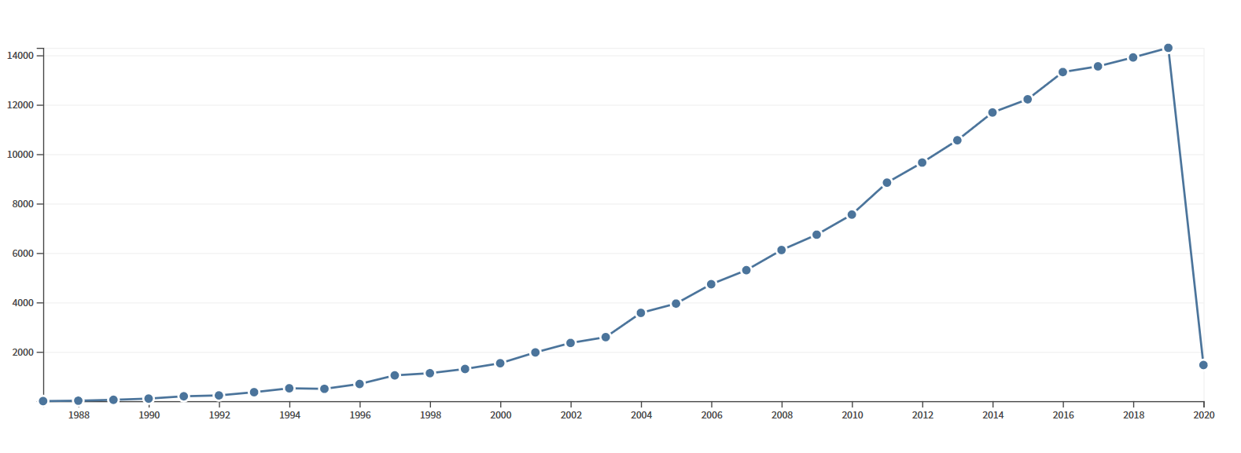
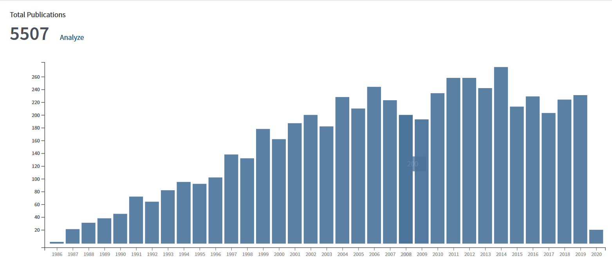
ICMAB: an excellent center in materials science (1986-2018)
Publications item in each year
Citations in each year
12.000
200
6.000
100
>162.000 citations
>5.500 art
>14.300 cit/yr
~200 art/yr
H= 145
29,4 cit/art
Mean I.F. = 5,68
2017
Total publications: 204
SJR
Q1: 91%
D1: 62%
2018
Total publications: 225
SJR
Q1: 95%
D1: 79%

Slide 7










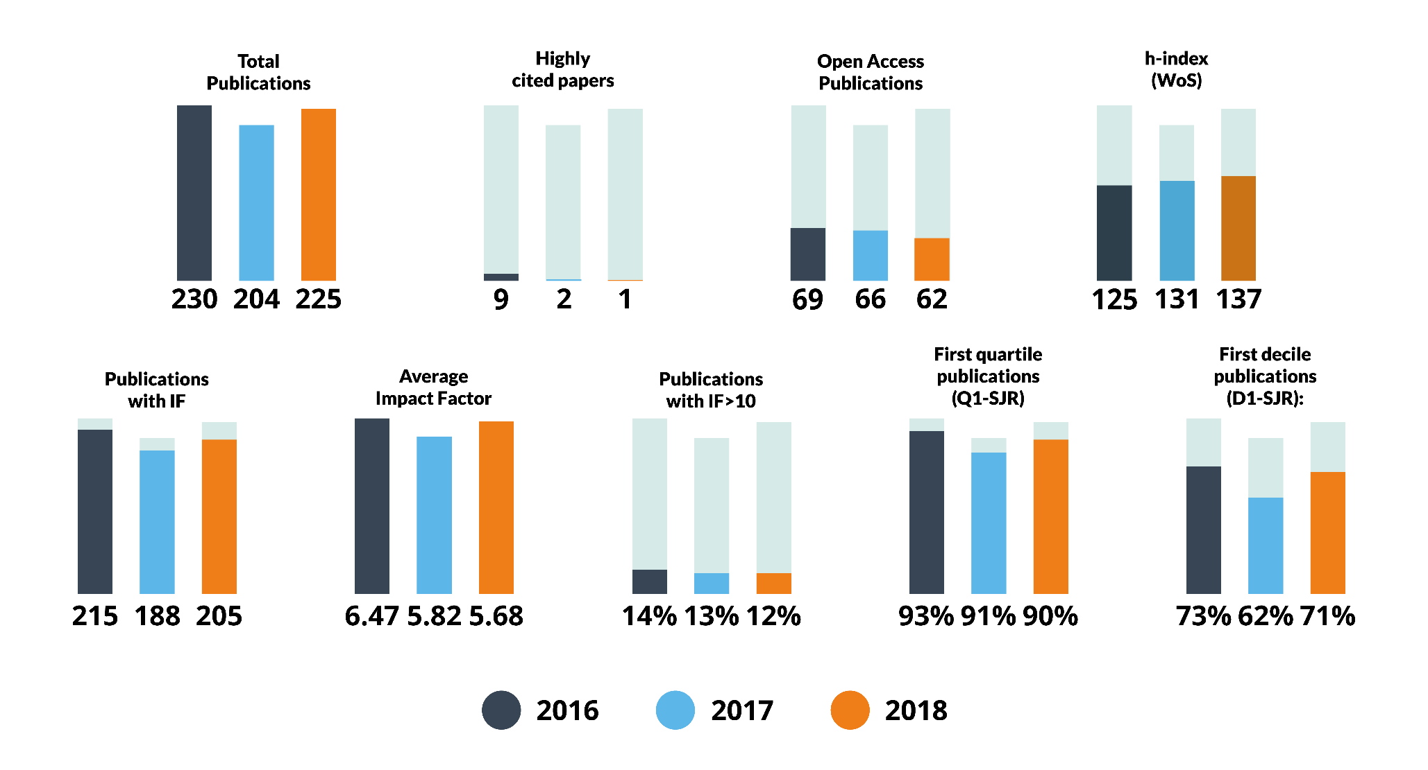

Publications 2016-2018

Slide 8
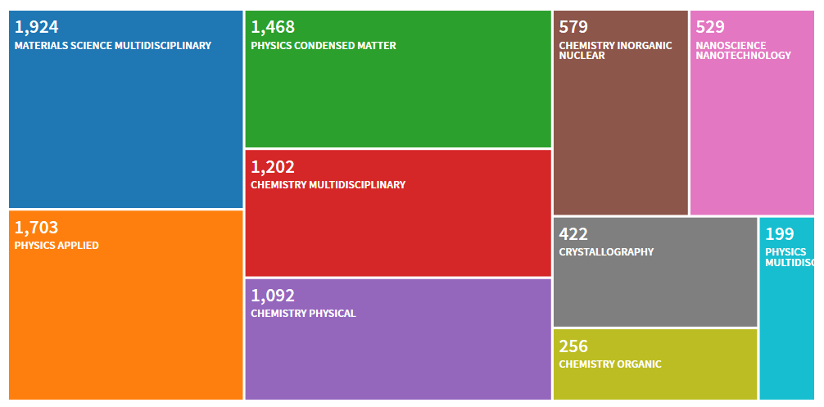
Interdisciplinary profile
̴ 5.500 articles: diversified areas

Slide 9
Research structure: push of emerging technologies and social challenges driven pull
Long term knowledge leadership combined with thematic focus
Oriented research
In-situ, in-operando, nanoscale and
hyperspectral characterization
Next generation electronics
Nanomaterials for clean Energy
Biomaterials for Nanomedicine
Blue-Sky Research
Sustainable multifunctional materials:
From synthesis to advanced manufacturing
Targeted design, theory and simulation
Notes:
Reptes comuns, nous breakthroughs, col.laboracions externes, Quantum electronic materials? (new electronics), Environment ?, Nanomaterials for clean energy ?, Nanomaterials for medicine ?

Slide 10
Research Lines - Social challenges
“Smart FUNctional materials for a better FUTURE” (FUNFUTURE)
Clean and secure energy
Smart and sustainable electronics
Smart nanomedecine
Energy conversion
RL1
RL1
Electrochemical Energy Storage
2 ERC
1 ERC
RL2
Superconductivity emerging technologies
Molecular Materials
Inorganic Materials
2 ERC
Oxide Electronics
Molecular electronics
RL4
RL3
2 ERC
3 ERC
RL5
Bioactive materials: therapy & diagnosis
RL5
1 ERC

Slide 11
RL 1: Sustainable energy conversion and storage systems
RL2: Superconductors for power applications
Energy harvesting
Solar cells
Energy storage
Supercapacitors
Environment
Conversion and electricity transport & use
Batteries
Thermoelectrics
Nanoparticles for metal sequestration
Superconductors
Superconductors
Piezoelectrics
Sensor for heavy metals
Lightining
Catalysis
Thermoelectrics
Superconductors
Notes:
Objective: build-up new ideas and breakthroughs and cooperate with other Institutes and entities to develop such new developments (IREC, LEITAT, UPC, MATGAS)

Slide 12
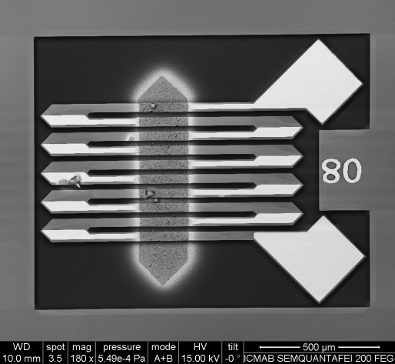
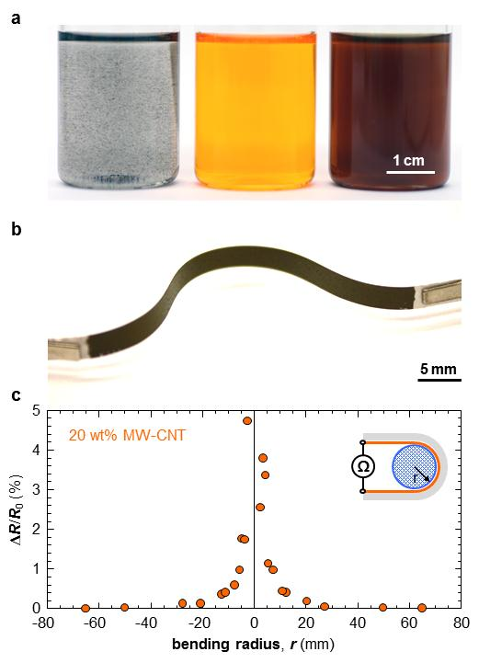
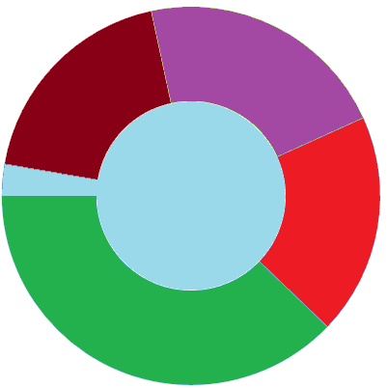
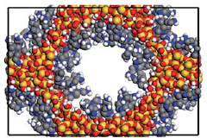
RL1: Sustainable Energy Conversion and Storage System
Inorganic TE:
M/air BAT:
Carbon allotropes
Organic TE
Nitrides & oxides
Ca, Na, Mg BAT
Porous/MOFs:
PV (organic, perovskite, oxide)
Molecular/polymeric materials
Batteries
Photonics for PV
TE
tools
Other appl.
PV
Theoretical tools
XRD and Synchrotron
Spectroscopy
Magneto-optical
AFM/SPM/TEM

Slide 13






RL2: Superconductors for power applications
1.- Acquire fundamental knowledge on the growth of epitaxial superconducting HTS films by low cost chemical solution deposition to reach theoretical properties limit for their device integration: CHEAPER AND BETTER!
2.- Develop new functionalities for energy-efficient superconducting electronic devices
3.- Understand and Customize Coated Conductors for energy, accelerators and fusion applications
Topics and Expertise
Fundamental Properties
U. Lleida
New
Physical Phenomena
Interdisciplinary:
Chemistry, physics, materials, engineering
Global approach:
from fundamental to applied and integration
Internationalization:
H2020 (NMBP & ERC), COST, CERN, EUROfusion
Superconducting Epitaxial Films
Advanced
Materials
Processing
Materials
Performance Customization
Process Understanding
Device Integration
Transfer of Knowledge
Applications

Slide 14
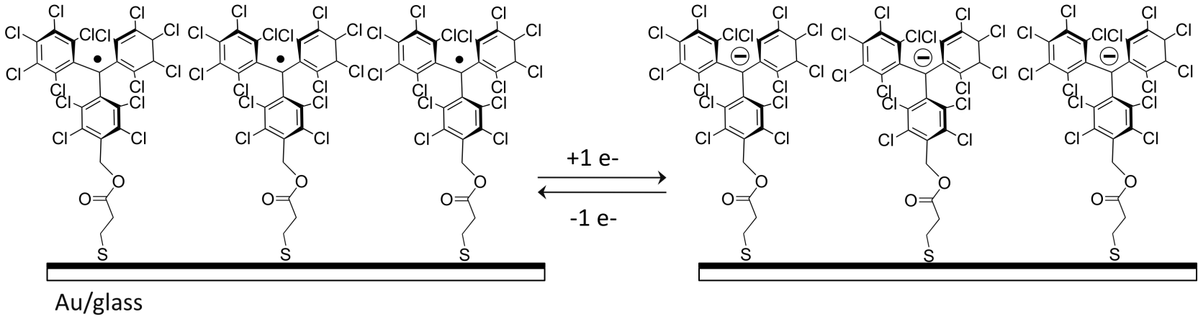
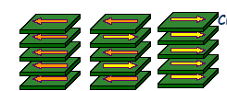
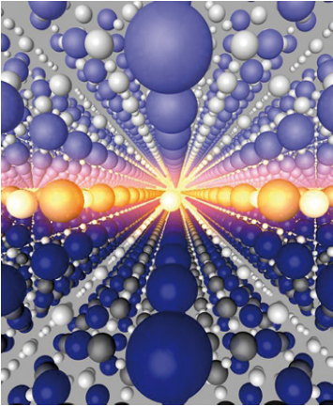
New electronics: RL3 and RL4
Quantum electronics
Spintronics
Semiconductor electronics
Oxide electronics
Molecular electronics
e⁻

Slide 15
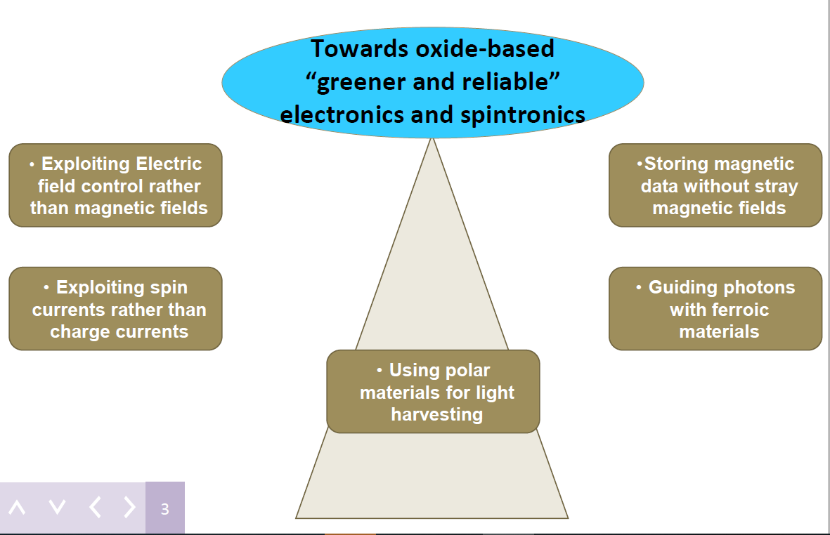
RL3: Oxide electronics

Slide 16
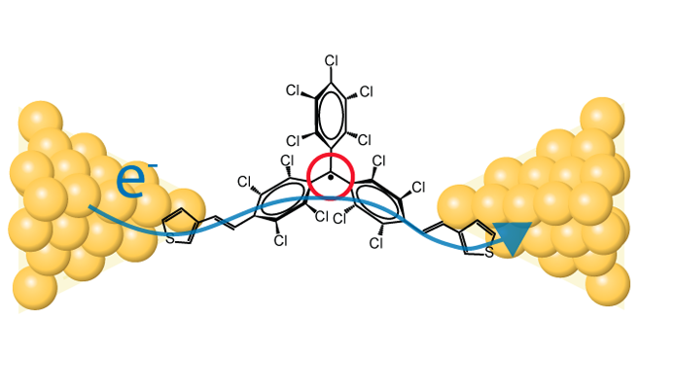
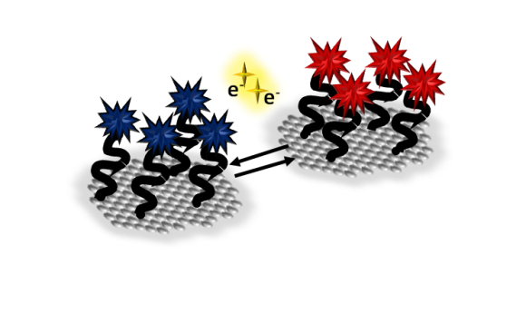
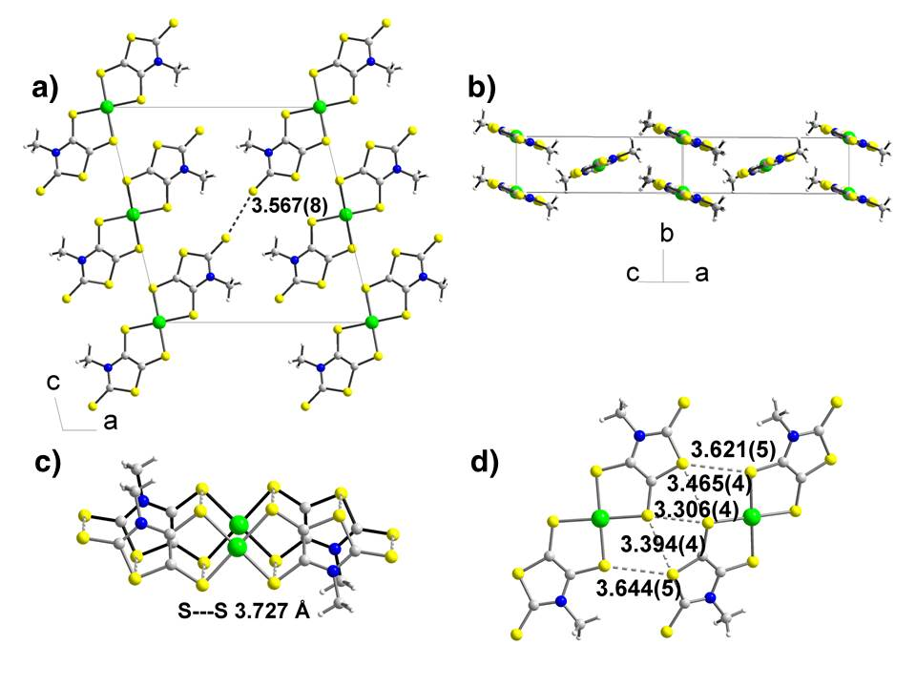
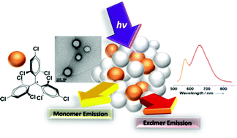
RL4: Molecular Electronics
Materials
Device Fabrication
Electroactive molecules in solution
Single molecule junctions
Single crystals with electrical properties
Hybrids materials: smart surfaces
Organic semiconductors-based devices: OFETs/EGOFETs, OPVs and Photodetectors
Functional nanoparticles
Advanced Characterization Tools
(SPM, Spectroscopy, Computational)

Slide 17
RL5:Multifunctional nanostructured biomaterials
Novel nanoobjects for therapy and diagnosis
Nanostructured materials for tissue repairing
In-vitro diagnostic
Sensors: nano (particles, wires, tubes, MEMS, …)
Detection biomarkers , virus, bacteria, tumoral cells
In-vivo imaging
Nanoprobes: magnetic Nps, quantum dots, Ntubes
Diagnosis illness evolution, therapy efficiency
Drug delivery
Nanocarriers: Nps, vessicles, dendrimers
Therapy
Biomaterials
Tissue engineering
Radiation, magnetic hyperthermia, plasmonics, antimicrobial
Biocompatibility: nanocoatings, interface bio
Biocompatible scaffolds: interface nano – bio
Max. Efficiency / Min. Adversity; new drugs, control
New therapies and materials: Nps Au, oxides , B compounds
Mechanical Properties, restauration, electrostimulation
Directed cellular growth, new tissues and organs
Notes:
11 ICMAB

Slide 18
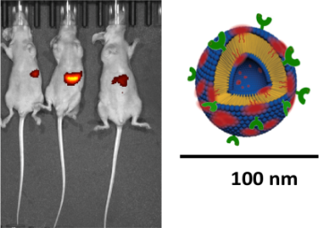
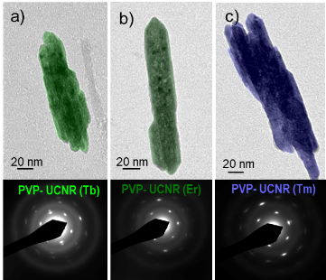
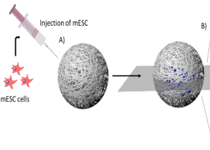
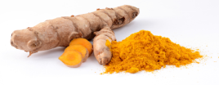
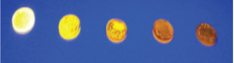
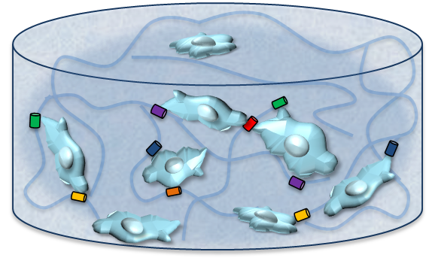
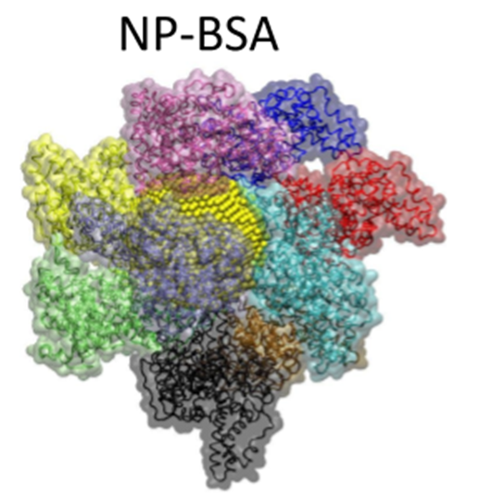
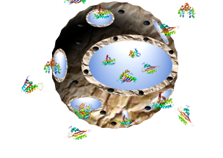
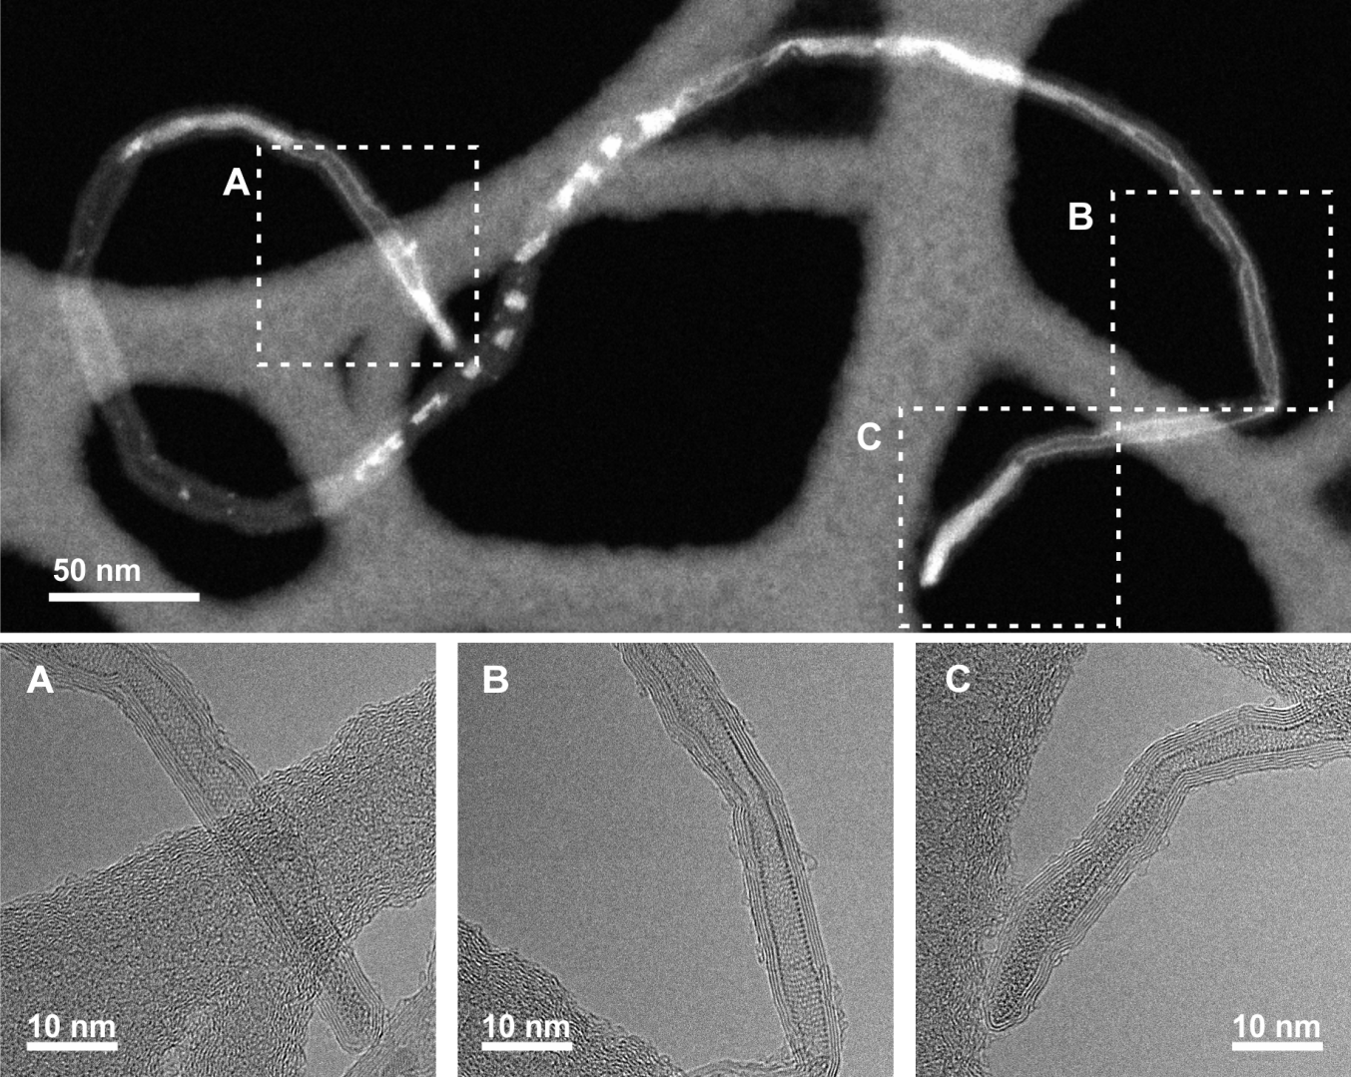
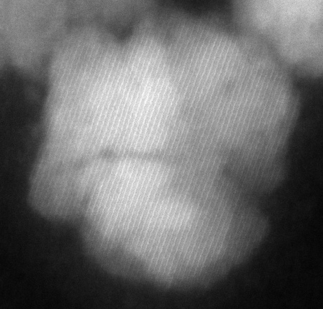
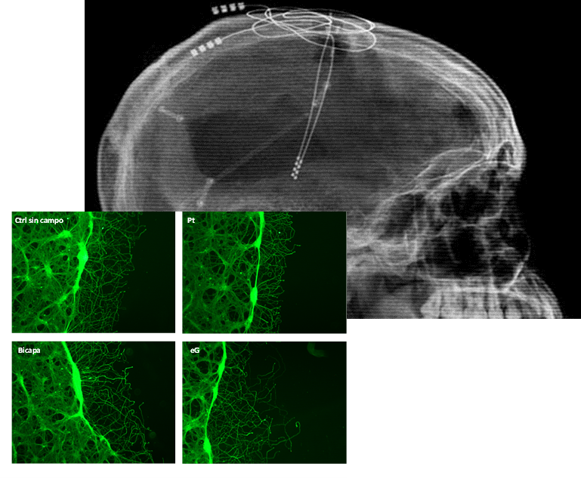
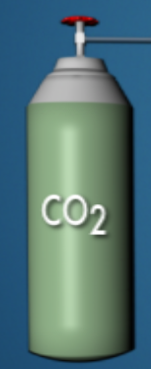
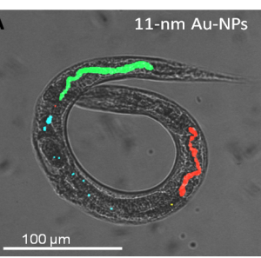

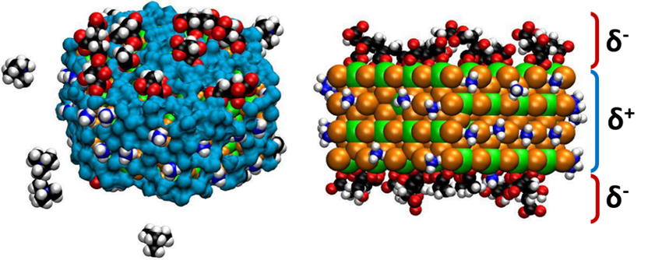
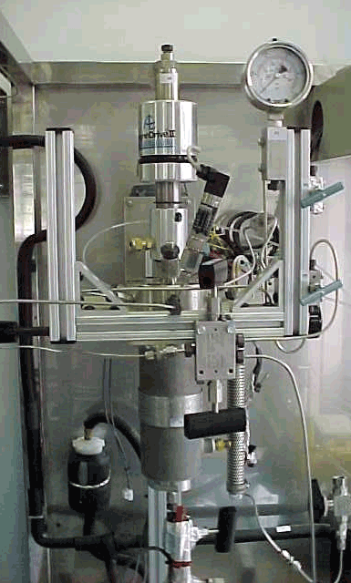
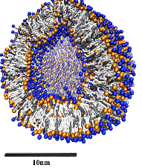
RL5: Multifunctional nanostructured biomaterials
Multifunctional nanovesicles for drug delivery and bioimaging
Radical dendrimer for DNP and MRI
Curcuminoid MOFs
Up-converting nanorods
Fluorescence boron enriched materials
ONPs for TPM
Bacterial cellulose hydrogel
Hydrogels for T cell activation
Filled carbon nanotubes
Magnetic hyperthermia and drug delivery
Diagnosis
Therapy
Magnetic PLGA for neurorepair
Theory
Tissue repairing
Bio eval.
Scale up
Nanostructured electroactive material coating for neural growth
Theoretical tools: Faraudo
Gradient of protein NP for cell motility
Biological evaluation of NP-C. Elegans
Spin off NanomolTech-scale up towards clinics

Slide 19
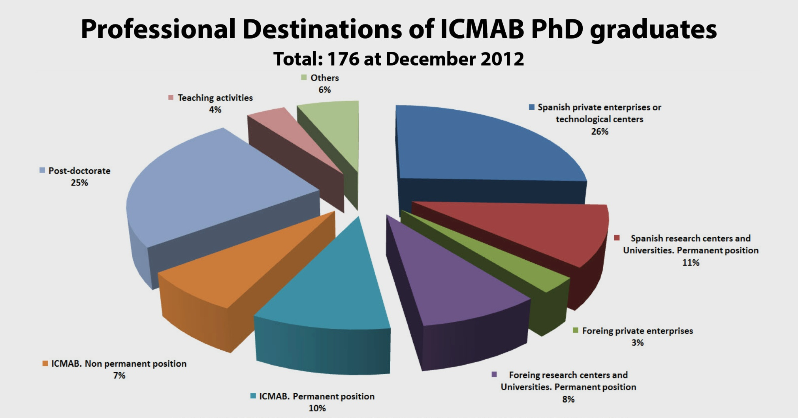
ICMAB training: PhDs
18/14/12/19 PhD thesis defended 2016/2017/2018/2019
∼ 30 % industry
269 at December 2019
< 70 PhD in the industry !
Notes:
Update ?

Slide 20
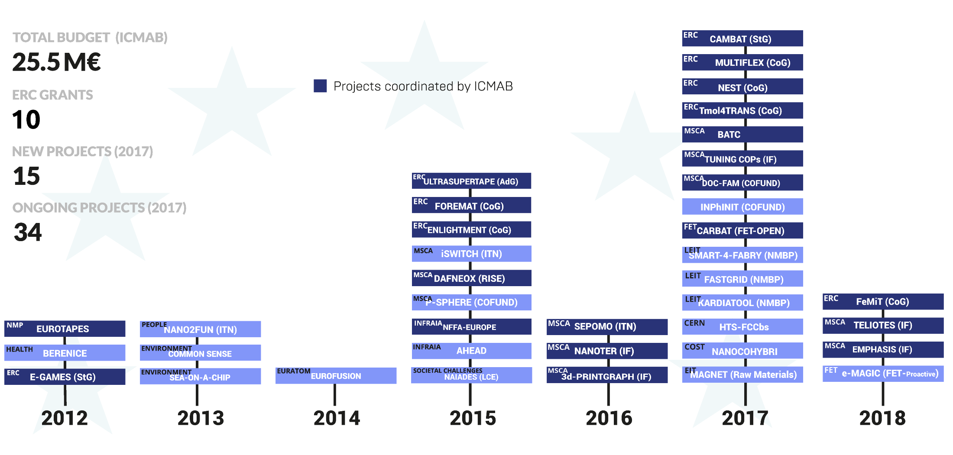
EU funded projects

Slide 21
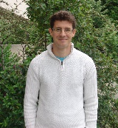
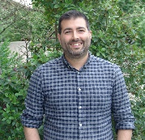
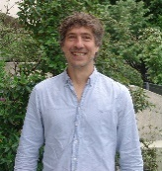
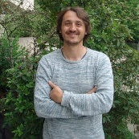
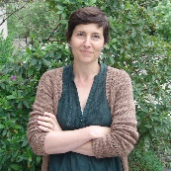
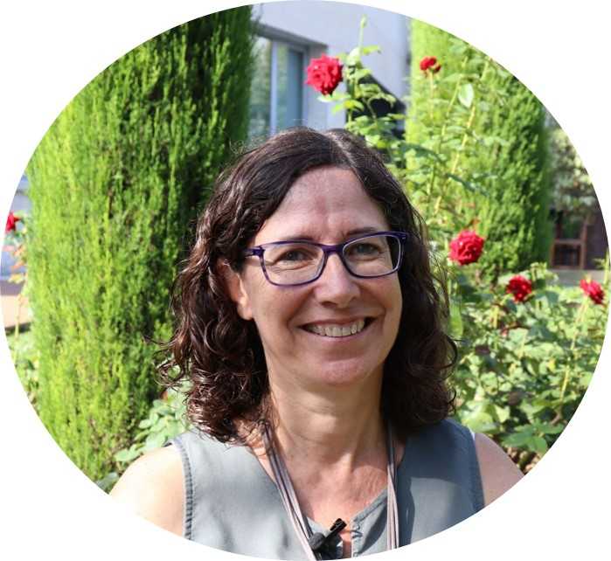
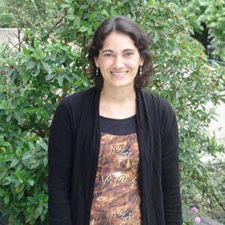
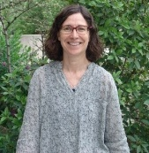
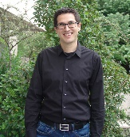

ERCs at ICMAB
ERC-StG
TOTAL ERC: 11 (5 W, 6 M)
ERC-AdG: 1
ERC-CoG: 5
ERC-StG: 3
ERC-PoC: 2
CAMBAT
8
ERC-StG
ERC-CoG
ENLIGHTMENT
MULTIFLEXO
EVALUATION PANEL:
PHYSICAL SCIENCES AND ENGINEERING
3: Condensed Matter Physics
5: Synthetic Chemistry and Materials
8: Products and Processes Engineering
8
3
ERC-CoG
ERC-CoG
ERC-PoC
FOREMAT
Tmol4TRANS
IMPACT
8
5
8
ERC-StG
ERC-PoC
ERC-AdG
ERC-CoG
ERC-CoG
e-GAMES
LAB-TECH
ULTRASUPERTAPE
NEST
FeMiT
5
5
8
8
8
2012
2013
2014
2015
2016
2017
2018
2019
Top 12 total in Spain / Top 6 in Research Institutes

Slide 22




Scientific-Equipment Platforms of ICMAB
Advanced Photolitography Facilities
Micro-contacts Facilities
Etching Systems
Thickness characterization Facilities
Deposition Systems
Chemical Synthesis
Rheological and wettability Characterization
Spectroscopic Characterization Facilities
Thermal processing equipment
Clean room facility (200 m²)
Low Temperature and Magnetometry
AFM
X-ray diffraction
Electron Microscopy
Thin film PLD growth
Thermal Analysis
MBE
Spectroscopy
Thermal Analysis
Soft materials
Managed by skilled technical staff (22 technitians)
Scientific Platforms: 610 m² (33 %)
RGs Laboratories: 1.315 m² (66%)
https://drive.google.com/file/d/0B2O_FzYhmMSxeFMwOE11OFBnSG8/view

Slide 23





Enhancing European competitiveness in nanoscience research and innovation (2016-2019)
TA1 - Lithography
TA2 - Growth and synthesis
TA4 - Characterization
Structural & Morphology
Electronic & Chemical
Magnetic & Optical & Electrical

Slide 24































  Industrial Liaision program (ILP)
Strong potential for an Industrial Liaison Program: : many final users sectors!

Slide 25


BUDGET
Budget evolution
Projects evolution

Slide 26
ALBA – ICMAB collaborations
Scientific collaborations
  97 co-authored articles (2014-2019)
  ICMAB co-authors in 11-20 % of scientific articles published by ALBA (2014-2019)
  ALBA co-authors in 4-12 % of scientific articles published by ICMAB (2014-2019)
  ICMAB users at least in 120 articles (97+22) (2014-2019)
  ICMAB experiments at ALBA: ~ 10 exp/year
  Majors users of ALBA from ICMAB
    C. Frontera, J.L. García-Muñoz, J. Rius, J. Fontcuberta, MR Palacín, C. Ocal, F. Sánchez, E. Barrena, C. Domingo, A. Fuertes, J. Gázquez, A. Goñi, F. Maciá, A. Ponrouch, T. Puig, X. Torrelles, I. Fina, A. López-Periago, E. Molins, X. Obradors, D. Tonti
Participation in proposal evaluation committees: C. Frontera, J.L. García-Muñoz, J. Rius

Slide 27
ALBA – ICMAB scientific collaborations
 | 2014 | 2015 | 2016 | 2017 | 2018 | 2019 | TOTAL 2014-2019
ALBA-ALBA Light Source (author) | 61 | 74 | 134 | 127 | 151 | 192 | 739
ICMAB (author) | 275 | 214 | 232 | 205 | 228 | 243 | 1397
ALBA + ICMAB | 8 | 8 | 18 | 25 | 17 | 21 | 97
% [ALBA + ICMAB] FOR ALBA | 13% | 11% | 13% | 20% | 11% | 11% | 13%
% [ALBA + ICMAB] FOR ICMAB | 3% | 4% | 8% | 12% | 7% | 9% | 7%
ICMAB (users only) | 0 | 4 | 5 | 3 | 7 | 3 | 22
% ICMAB ART WITH ALBA USE | 3% | 6% | 10% | 14% | 11% | 10% | 9%
A large percentage of articles published by ALBA or ICMAB are made in collaboration!
ICMAB is a strong user of ALBA Beamlines!
Main Beamlines: CIRCE-PEEM/NAPP, MISTRAL, MIRAS, MSPD, CLAESS, BOREAS
New Beamlines: ICMAB proposal “Surface diffraction” (X. Torrelles)

Slide 28



ALBA – ICMAB scientific collaborations

Slide 29



ALBA – ICMAB scientific collaborations

Slide 30




ALBA – ICMAB scientific collaborations

Slide 31





ALBA – ICMAB scientific collaborations

Slide 32



ALBA – ICMAB scientific collaborations

Slide 33


ALBA – ICMAB scientific collaborations

Slide 34



ALBA – ICMAB scientific collaborations

Slide 35
ALBA – ICMAB collaborations
Laboratories and equipment
  Contribution of ICMAB scientists to Beamlines design (MSPD)
  Ultra-high vacuum STM-AFM Laboratory at ALBA (C. Ocal, E. Barrena)
  ICMAB equipment at Beamlines: cryostats, potentiostat, cold finger, Crimper for coin cell assembly, ...
  Donation of He Dewar (500 l). Cooperation in He delivery.
  ICMAB participation in TEM Laboratory (ICN2, ICMAB, BIST, CSIC, UAB, ALBA)
  New ideas to be explored for Severo Ochoa 2020-2023
Personnel
  X. Turrillas (CSIC detachment), J. Rius (long term user)
  Former ICMAB scientists: S. Ferrer, J. Herrero, O. Vallcorba, F. Pérez, M. Foerster, E. Solano, J. Andreu
  PhDs under co-supervision: Raphaelle Houdeville (F. Fauth - M.R. Palacin)
  ALBA scientists in ICMAB projects: F. Fauth, O. Vallcorba

Slide 36
ALBA – ICMAB collaborations
Projects
  Nanofoundries for fine analysis (NFFA)
  EU-INFRA,
  PRUAB, ICMAB, ICN2, UAB, IMB, ALBA
  DOCtoral training programme in Functional Advanced Materials (DOC-FAM)
  EU-COFUND coordinated by ICMAB
  + ALBA, ICN2, IREC, IMB
  HTS coated conductors for FCC beam screen
  CERN project coordinated by ICMAB
  + ALBA, IFAE, UPC

Slide 37
ALBA – ICMAB collaborations
Outreach and communication activities and collaborations
  Visits to ALBA
  Common press release notes
Training activities
  Workshops organized by ICMAB or ALBA
  Workshop PhD students BNC-b
  DOC-FAM activities for PhD students: open to all PhDs
Industrial liaison program
  Envisaged collaborations to enhance attractiveness of industries
  Megadata handling initiatives

Slide 38






PROPOSED CASE EXAMPLE OF Private-Public Partnership COLLABoration
MASSIVE DATA ANALYTICS IN BIG SCIENCE EXPERIMENTS
- RATIONAL MACHINE SCIENTIST PRODUCT AND SERVICE DEVELOPMENT -
- A local company (deep CODAC expertise) and consolidated implantation in BS world (CERN, ITER, .., ALBA/LEAPS)
PROCON and UTT/ICMAB have identified a product/service development interest and discussed R&D
needs (In the field of IA/DML/NN/ NUMERICALS and ALGORITHMICS)
- UTT/ICMAB analyzed R&D-supporting Project´s funding instruments → PI+D/CDTI best option (1.5 M€/3y).
UTT/ICMAB configured the PPP Project under multi-WIN scheme (Public labs. under B2B collab. frame… 15% budget):
→ PROCONSYSTEMS (Company Project Owner, Manager and Integrator).
→ ICMAB (Dr. X. Torrelles) (Data case provider & non-AI (i.e. natural) scientific support and product QA qualifier).
→ ALBA (SARDANA´s Group /CODAC Data owner, support to data source management).
→ URV (Prof. Roger Guimerà´s Group; Numerics and Algorithmics for Rational (Bayesian) Scientist Machine).
→ BSC_CNS (MareNostrum-CPU and paralleling algoritmics, benchmarking against APACHE SPARC® Platforms).

Slide 39








(Nano)materials international leadership
fostered by synergy
ICMAB
ICN2
IMB
ALBA
UAB

Slide 40


THANK YOU FOR YOUR ATTENTION!
ICMAB acknowledges the Severo Ochoa
Program (MINECO, SEV- 2015-0496)
icmab.es
Notes:
11 ICMAB, 16 Energia, 28 nanociencia
55 transpes

