Slide 1
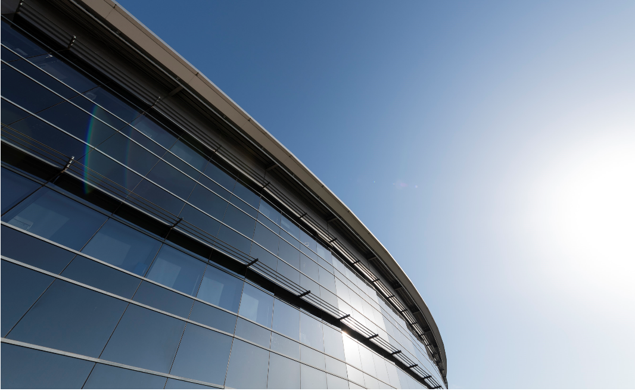


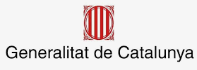


ALBA II – Strategy and Mission for Academic and Industrial Community
Klaus Attenkofer
30-06-2021
With major contributions of:
Judith Juanhuix I Gibert & entire section
Francois Fauth & entire section
Manuel Valvidares & entire section
Foto Sergio Ruiz

Slide 2
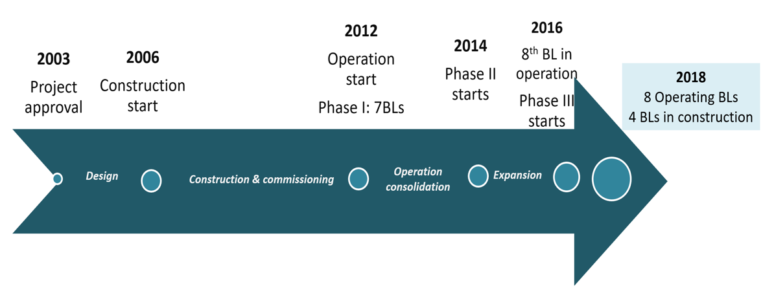
ALBA History and Future
Nineties: First proposal for building a synchrotron in Spain
10 years to obtain the approval
10 years for full operation
Your Input is needed!
2021
10 operating BL
3 under construction
ALBA II upgrade

Slide 3
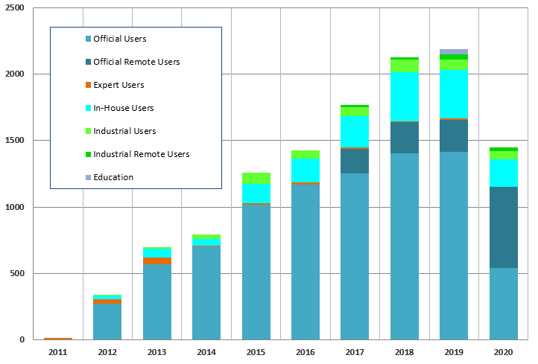
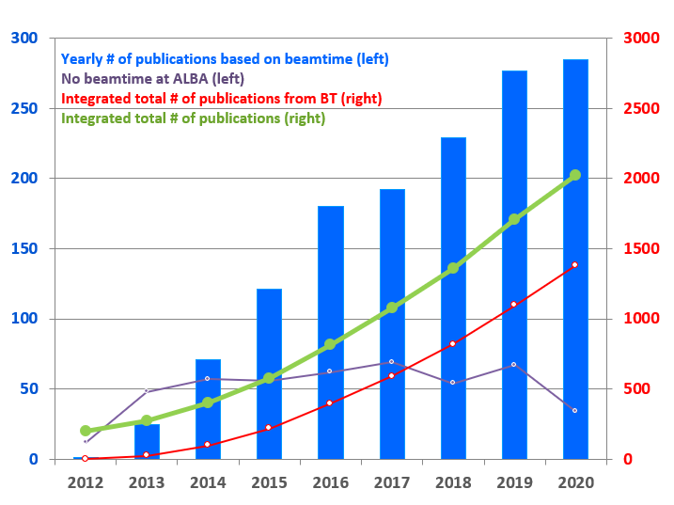
USER VISITS
PUBLICATIONS
+ 2200 yearly user visits
220 staff
+300 yearly experiments
3000 national users
ALBA in numbers
2/3 from Spain
1/3 international
300 Publications yearly
2100 international users
34% high impact factor ratio
10 operating Beamlines
+7500 yearly public visits
+200 trained students
3 GeV e- synchrotron
270 m circumference
300 mA operating current
> 98% availability
3 Beamlines
In construction

Slide 4
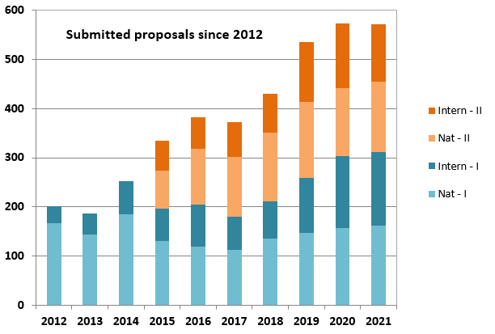
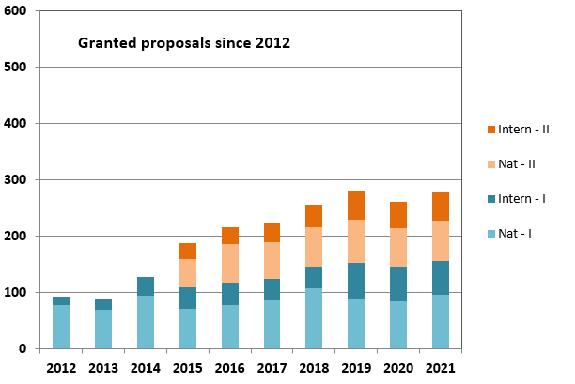
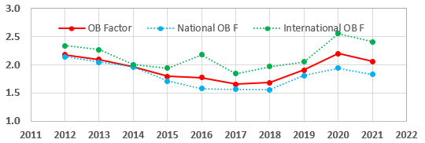
USERS
Submitted and granted Proposals
Oversubscription for all Beamlines
Joint academic and industrial
Private
Academic
ALBA
Direct access covering operational costs
Results can be confidential
Competitive and free access
Public results

Slide 5
Development of User Program over the Years
Comments:
Program (requested experiments) still grows.
Most of phase 1 beamlines have reached max capacity.
XALOC and BOREAS are still growing.
COVID seems to have relative minor impact.

Slide 6
The User Community
User community can be split in roughly three similar sized areas:
Life Science (MX and non MX).
Chemical and Material Sciences.
Electrical and Magnetic Structure.
User community:
Academic program has a strong applied character.
Community has a “healthy mix” between national and international users.

Slide 7
Alba’s Role in Science
In general, ALBA’s role is:
to provide to the existing user community in Spain state-of-the-art X-ray characterization tools.
to provide access to a vast international European network of specialists.
Specifically, for the 3 focus area:
to develop cutting edge characterization tools to address the socio-economical challenges in Spain and Europe. This includes:
Instrumentation.
Methodologies.
Data analysis strategies.
to make the tools available to a large user community which benefits from these.
Our tools:
Public and Proprietary User Program
Training and Outreach Program
In-house Research Program

Slide 8
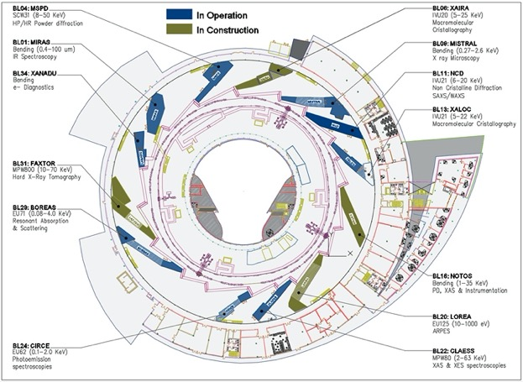
The Provided Techniques:
Alba’s organization: Three scientific sections support the user program:
Life Sciences Section.
Chemical and Materials Sciences Section.
Electronic and Magnetic Structure Section.
Alba is a 3. generation synchrotron source with 10 operating beamlines and 3 in construction.
10 operating beamlines:
MIRAS (IR)
MSPD (PD)
MISTRAL (soft X-ray microsc.)
NCD (SAXS/WAXS)
XALOC (MX)
NOTOS (XAFS + PD)
LOREA (ARPES)
CLAESS (XAFS)
CIRCE(NAPP/PEEM)
BOREAS (XMCD, soft X-ray scattering)

Slide 9
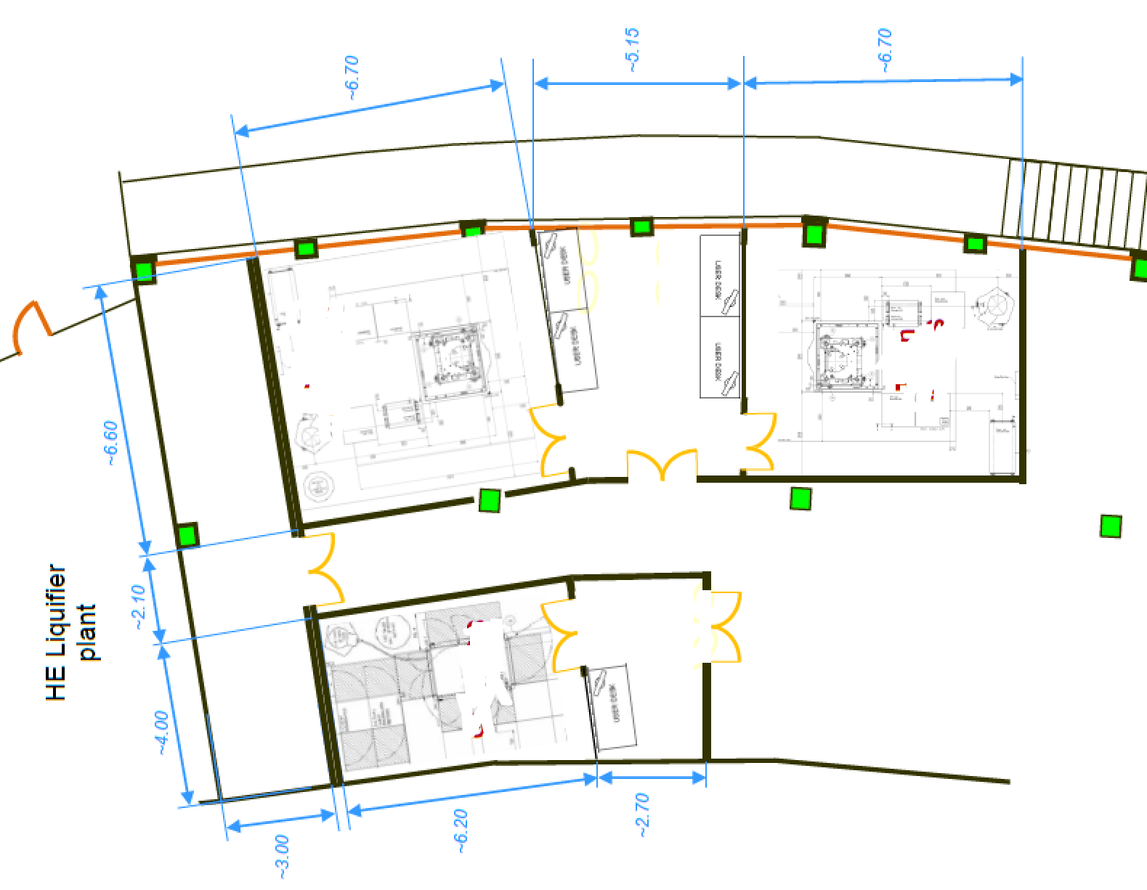
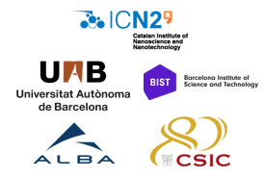
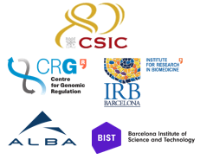
Advanced Microscope Platform Based on
Cooperative projects
TEM for Nano Science:
Aberration Corrected Monochromatic Transmission Electron Microscope.
Plus Focused Ion Beam (FIB) equipment.
Two of them co-funded and co-owned by different institutions to be placed at ALBA
Will have user program for public users
Call results to be published soon
Microscopes to be in operation in 2022
Cryo-EM for Life Sciences: (Single Particle Analysis & cryo-electron Tomography)
200 kV maximum acceleration voltage.
last generation direct electron detector.
automated sample load system.
Inside the approved Catalan proposal of ‘Area de Materiales’ of ‘Planes Complementarios’
To be developed in the period 2022-2025
Will have user program for public users
TEM for In-Situ and Operando experiments:
Aberration Corrected Monochromatic Transmission Electron Microscope.
Sample environments will be compatible with some beamlines.
Consortium of different institutions – being defined

Slide 10
The Context: ALBA II at a Glance
Beamlines at ALBA II:
13 ID BLs
8 BM BLs
1 IR BL
2 Straights for RF
1 Straight for injection

Slide 11
Mission of ALBA
2021-2024
ALBA
mission
Contribute to the improvement of well-being and progress of society as a whole through provision of scientific instruments dedicated to solving societal challenges such as health, environment, energy and communication.
Act as a catalyst for regional and national collaborations addressing overarching societal challenges.

Slide 12
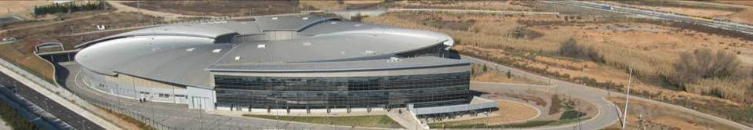
ALBA is Going a Step Further for the Three Focus Areas
The Spanish reseach infrastructure providing solutions for:
Health
Energy
Sustainable Information Technology
but also providing broad services to the Spanish X-ray user community from any field.

Slide 13
The Challenge of Multi-Length Scale Imaging
Alba’s role as a hub in for complex analysis problems:
Multimodal Imaging approach.
Big-Data and High Throughput
Providing External Expertise and Facilities.
The Grand Challenge:
Imaging from the smallest building unit to the functional unit. Interpreting the structural information.
Providing statistically relevant information.
Understanding the structure-function correlation.

Slide 14
Focus Area: Life Sciences More by Judith
Multi-length Scale Approach To Understand Behavior Of Biological Systems
using a suite of techniques and services enabling the catalytic role of ALBA
Focused on scientific fields:
Techniques
Services
Drug development
Membrane proteins
Structure-based enzymology
Crystallization
Specialized sample preparation
Nanobody production facility
MX
BioSAXS
CryoEM
Tailored to objectives
Tailored to the gap for accessing services
Proximity
From classical to new services
Notes:
This slide would be great if you can create. I suggest that you make a first go and we can iterate next week together.
Perhaps this will be the last slide which you should make.

Slide 15
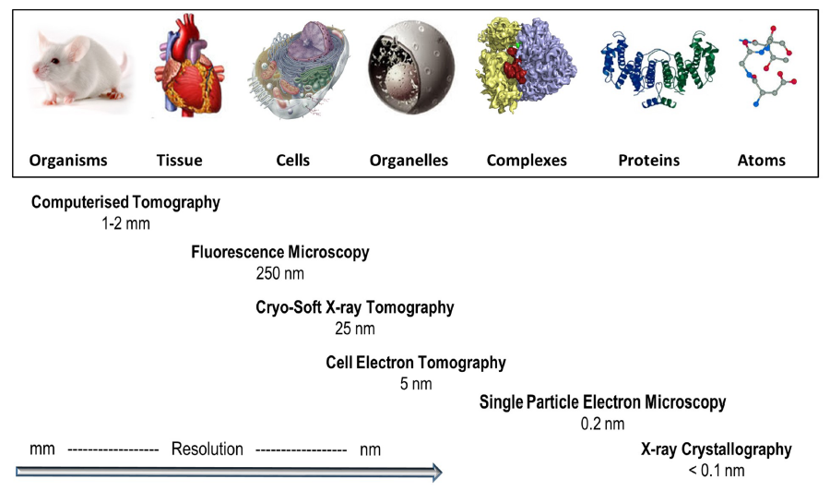
Health Strategy at a Glance
ALBA to provide the X-ray and electron- tools and the “missing links”
Aiming at a continuous path from genotype to fenotipe structural studies
ALBA embedded within their strategic partners provides leading capabilities
BioSAXS
FAXTOR
STXM
XALOC
MIRAS
MISTRAL
XAIRA
Computational
Biology
Cry-EM/SPA
BioSAXS
1 nm
Computational
Biology
From Harkiolaki et al. DOI:10.1042/ETLS20170086 ; CC BY 4.0 modified
Notes:
Smaller pic, answer to the mission statement
Put computational biology in the gap, al bionanoprobe. Prepare the ground for the vision, so put future tools
Genotype (molecular) to Fenotype (cellular)

Slide 16
Focus Area: Energy More by Francois
Tuning Electronic and Chemical Properties by Controlling Atomic Structure of Functional Materials.
using a suite of techniques and services enabling the catalytic role of ALBA
Focused on scientific fields:
Techniques
Services
Energy storage.
Hydrogen circular economy.
Carbon sequestration.
High throughput ensemble averaging probes including IR, XAFS, and diffraction.
X-ray microscopy in scanning and full field mode with absorption and phase contrast.
TEM.
Multi-modal approach combination of ex-situ, in-situ, and operando experiments.
Sample preparation tools allowing remote combinatorial approaches.
multi-modal pipelines and access modes for providing solutions for main focus area applications.
Big data gateway for data mining community.
data analytics tools to identify structure-function correlations in multi-modal experiments.
Notes:
This slide would be great if you can create. I suggest that you make a first go and we can iterate next week together.
Perhaps this will be the last slide which you should make.

Slide 17
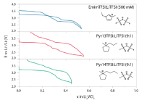
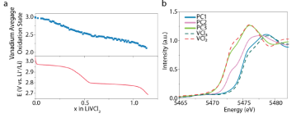
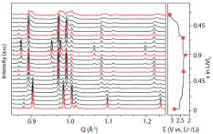
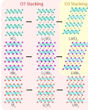
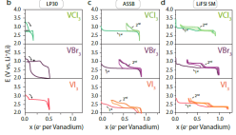
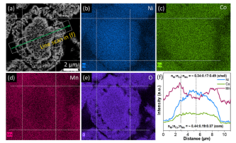
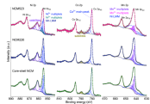
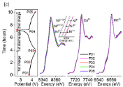
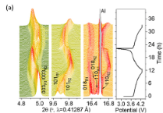
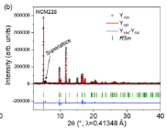
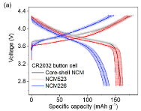
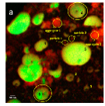
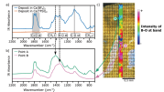
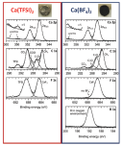
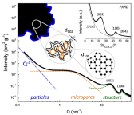
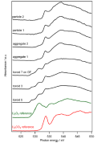
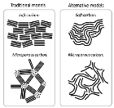
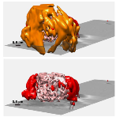
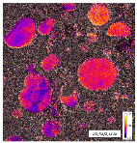
Energy Strategy at a Glance
Imaging, Tomography
Spectroscopy (molecule)
Spectroscopy (electronic configuration)
Diffraction (crystal structure)
Laboratory
(performance, discovery)
MIRAS
CLAESS, NOTOS-XAS
MSPD , NOTOS-PD
SEM and EDX
Electrolyte bulk
Computing
Dubouis et al Nat Mat , accepted
SEI
TEM
XPS
Wua et al Nat Mat , Nano Energy 78 (2020)
MISTRAL
CIRCE-NAPP
NCD-SWEET
Saurel et al Nat Mat , Energy Storage Materials 21 (2019)
Tchitchekoav et al Nat Mat , Chem Mat 30 (2018)
Olivares-Marin et al Nat Mat , Nano Lett 15 (2015)
Forero-Saboya et al Nat Mat , Energy Environ. Sci 13 (2020)
Notes:
It would be great if you can conclude this with a slide which graphically explains what is your branding and how the different tools contribute to this.
This is a very difficult slide but I think you really know what you want to say if you can make this one.
FF I have made something for battery example based on multitechniques . I do not feel competent producing the same for catalysis. I would hence supply Highlight of catalysis and gas sequestration examples This slide is pretty dense and long time will be spent on it
https://www.albasynchrotron.es/en/media/news/new-synthesis-procedure-to-optimize-the-catalytic-performance-of-platinum-based-materials
https://www.albasynchrotron.es/en/media/news/researchers-design-a-nanotechnology-based-system-that-can-transport-methane-at-lower-pressure-and-cost

Slide 18
Focus Area: Information Technology More by Manuel
Resolving and Manipulating the Electronic and Magnetic States, and its Spatial and Dynamic Characteristics in Quantum Materials.
using a suite of techniques and services enabling the catalytic role of ALBA
Focused on scientific fields:
Techniques
Services
Spintronics and Spinorbitronics.
Topological materials.
Materials discover.
Device physics.
Materials growth and device fabrication.
XAS, XMCD, XMLD, XLD, XRMS.
ARPES (including Spin-ARPES).
X-ray microscopy and coherent imaging with chemical, magnetic, spin/orbital- momentum contrast.
TEM.
Structural and functional characterization tools.
Sample preparation tools allowing remote combinatorial approaches.
multi-modal pipelines and access modes for providing solutions for main focus area applications.
Computational modeling tools for understanding impact of structure and environment on topological entanglement.
Notes:
This slide would be great if you can create. I suggest that you make a first go and we can iterate next week together.
Perhaps this will be the last slide which you should make.

Slide 19
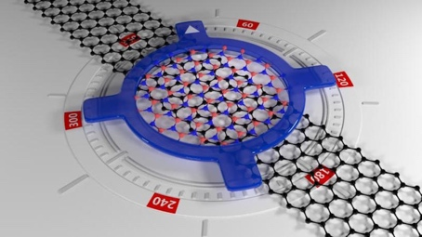
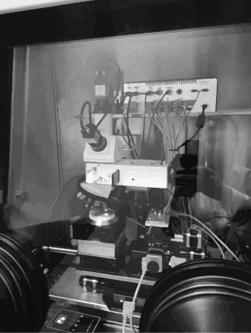
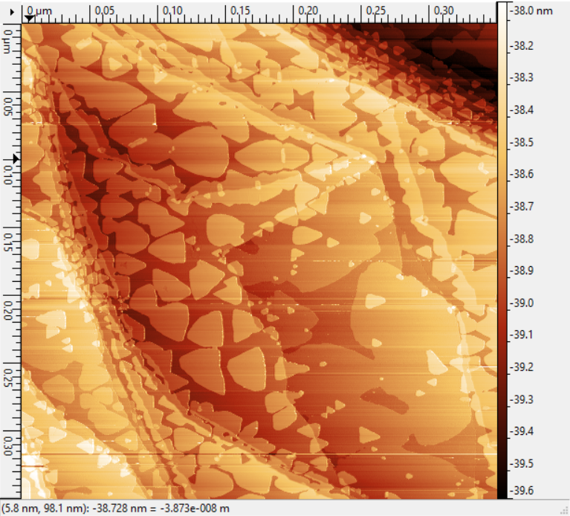
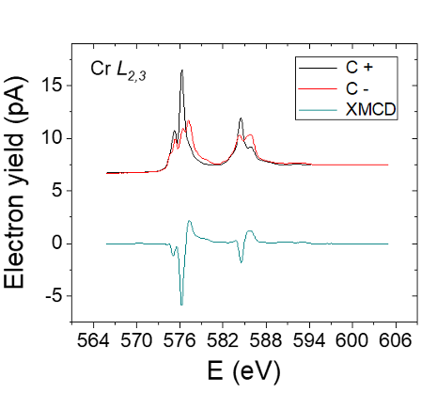
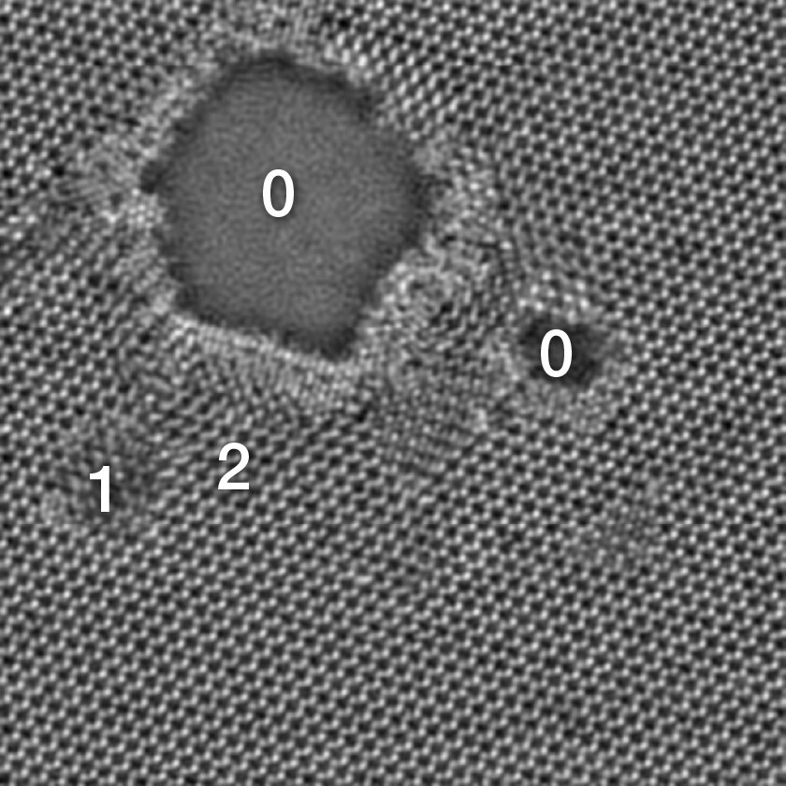
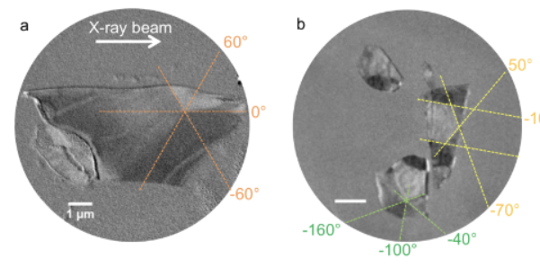
Our Goal at a Glance
example: 2D-VdW materials
MBE, 2D Materials and VdW Foundry at MS Lab, offline bl equipment, as a complement & bridge to user facilities
Challenges addressed and advantages:
air sensitive / short duration
repeatibility / efficiency / on-the-go experiment adjustments
Deeper partnership (projects, shared PhDs, short and mid term stays related to experiments and projects)
Raman
STM
twistronics
VdW transfer setup
-ALBA to provide the X-ray & electron- tools, enhanced sample preparation capabilities enabling pre-experiment preparation, mid-term visitor missions/collaborations and deeper partnerships
-Aiming at a multi-modal approach from meso to nanoscale, from surface to bulk-like
-ALBA embedded within their strategic partners provides leading capabilities
Microscale* averaged electronic & magnetic properties
Micro to nanoscale imaging
Atomic imaging
LOREA: ARPES
BOREAS - XMCD
CIRCE, MISTRAL & BOREAS
HR-(S)TEM
ARPES in twisted BLG,
Soleil, Sci Reports 2016
*Sub-micron to nano scale if a nano-focusing upgrade is considered
Defects in a MoS2
imaged with
high-resolution STEM
Spectra, ThermoFischer
Cr XMCD in CrCl3 sl,
ArXiv 2020
PEEM, Multilayer flakes of
CrTe2 VdW, ACS AMI 2020
 | Resolution | complementary x-ray + SPM, TEM imaging capabilities
XTM MISTRAL | 20-30 nm | fast ; 2D imaging ; 3D tomo ; bulk (only C+ BM)
PEEM CIRCE | 20-30 nm (<10nm possible) | fast; 2D; part 3D (shadow tech.) ; surface, mod. Field & LN temp
Coh. Imag. BOREAS | 25 nm (3-5 nm possible) | slow (reconst. or scanning) 2D ; 3D possible; LHe ; Hig field
Notes:
It would be great if you can conclude this with a slide which graphically explains what is your branding and how the different tools contribute to this.
This is a very difficult slide but I think you really know what you want to say if you can make this one.

Slide 20
Conclusion:
Existing User program:
Highly productive and mature program.
User program splits in 3 major areas:
Life Scineces.
Chemical and Material Sciences.
Electronic and Magnetic Structure.
Services in future:
Providing access to state-of-the-art X-ray and microscopy (including EM) characterization tools to the complete Spanish user community.
Providing system solutions for complex grand challenges in specific focus areas:
Health.
Energy.
Sustainable Information Technology.
Notes:
It would be great if you can conclude this with a slide which graphically explains what is your branding and how the different tools contribute to this.
This is a very difficult slide but I think you really know what you want to say if you can make this one.

Slide 21
Thank you for the attention!
Any questions?
Foto Sergio Ruiz

