Slide 1
ALBA II Accelerator Design Francis Perez (thanks to the ACE team)
ALBA II Day June, 30th, 2021

Slide 2
Present lattice

Slide 3
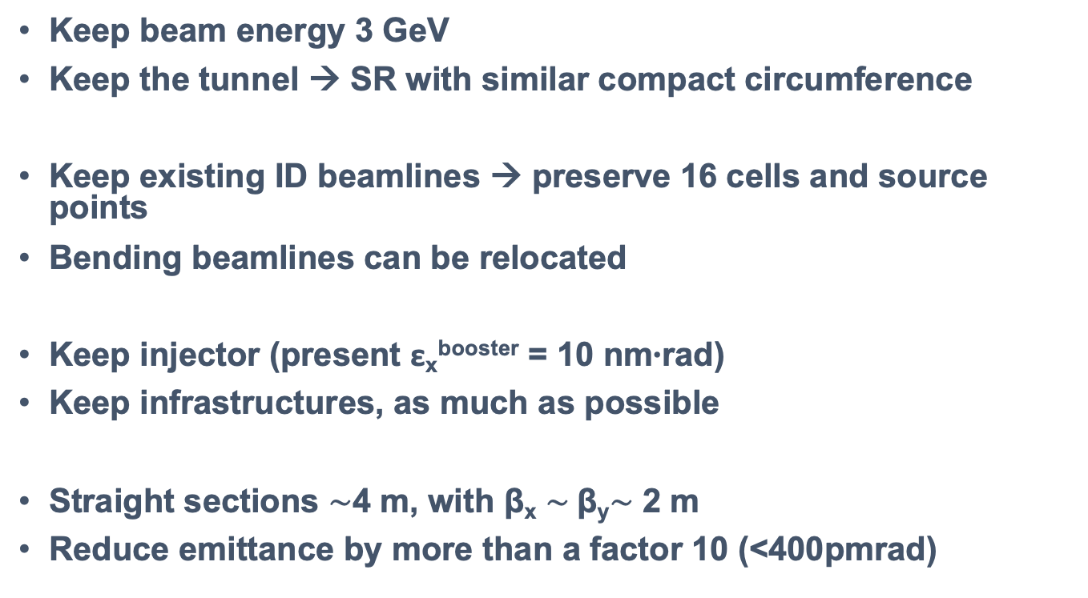
Constrains
Keep beam energy 3 GeV
Keep the tunnel → SR with similar compact circumference
Keep existing ID beamlines → preserve 16 cells and source points
Bending beamlines can be relocated
Keep injector (present ε_{x}^{booster} = 10 nm∙rad)
Keep infrastructures, as much as possible
Straight sections $\sim$4 m, with β_{x} $\sim$β_{y}$\sim$ 2 m
Reduce emittance by more than a factor 10 (<400pmrad)

Slide 4
Proposed solution
From 2 x 8 double-bend lattice (DBA)
To 1 x 16 multi-bend lattice (6BA)

Slide 5
Proposed solution
Main (preliminary) parameters

Slide 6
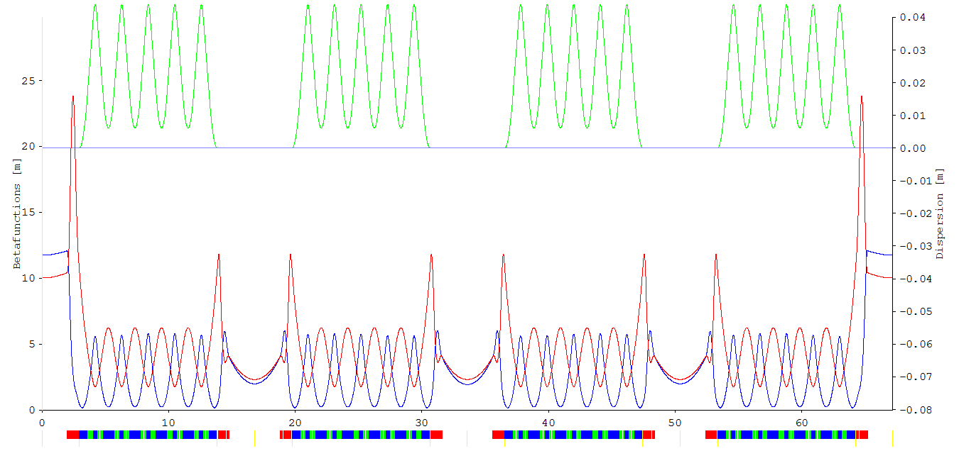
The 6BA lattice 4 fold symmetry
1/4
High beta required for Injection
At ID position, with 100% coupling, almost round beam:
σ_{x} = 14.0 um σ’_{x} = 7.1 urad
σ_{y} = 15.1 um σ’_{y} = 6,6 urad
At ID position, today:
σ_{x} = 127 um ; σ’_{x} = 47 urad
σ_{y} = 5.2 um ; σ’_{y} = 4,4 urad

Slide 7
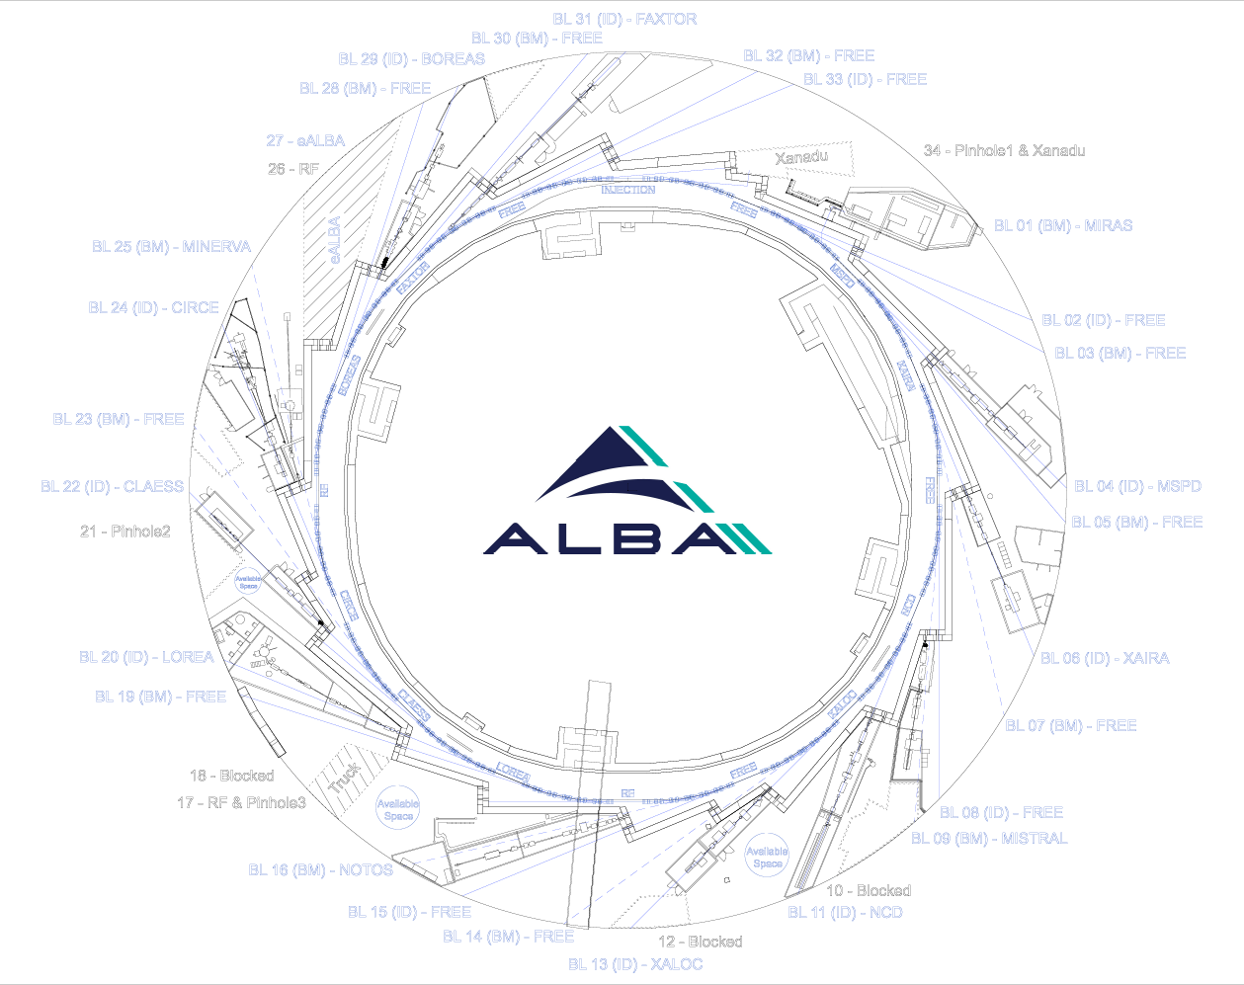
Implementation

Slide 8
Straigth sections for IDs
308 mm
308 mm
With high betas (β_{x}=11,7 ; β_{y}=10,0)
But 3 will be used for
the Accelerator:
1 for Injection
2 for RF
308 mm

Slide 9
ALBA2 - Straight Sections
Straight | BL |  | Comments
SR01 | 2 | FREE
SR02 | 4 | MSPD | 68mm displacement
SR03 | 6 | XAIRA
SR04 | 8 | FREE | 308mm displacement / Large Beta
SR05 | 11 | NCD
SR06 | 13 | XALOC | 68mm displacement
SR07 | 15 | FREE
SR08 | 17 | RF | & Pinhole3
SR09 | 20 | LOREA
SR10 | 22 | CLAESS | 68mm displacement
SR11 | 24 | CIRCE
SR12 | 26 | RF
SR13 | 29 | BOREAS
SR14 | 31 | FAXTOR | 68mm displacement
SR15 | 33 | FREE
SR16 | 0 | INJECTION
4x FREE
9x IN USE
3x MACHINE

Slide 10
Brilliance comparison for three relevant ALBA IDs
IVU XAIRA EPU LOREA SCW MSPD

Slide 11
Bending beamlines
1,02 T
1,02 T
1,02 T
1,02 T
0,73 T
0,73 T
The 6BA lattice has a lower bending field than ALBA (1,4 T)
We propose to replace
few of them by:
Brasilian
SIRIUS
Ligth Source
11

Slide 12
Superbend: 3.2 T combined permanent magnet
Influence in the emittance:
less than 10%
if high field peak is short and at the center.

Slide 13
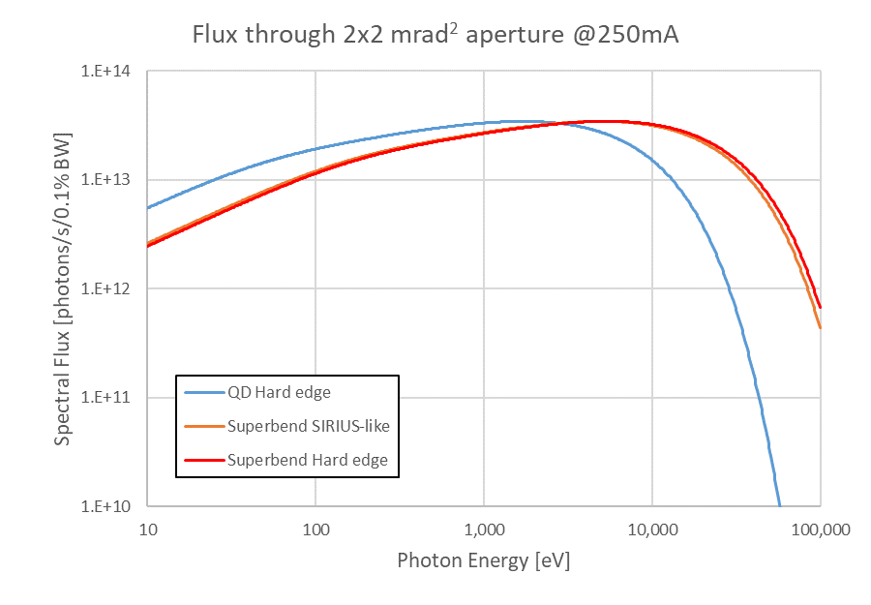
Bendings emission comparison
3,2 T
at middle
1,02 T
at middle
1,02 T
at end
1 T
3.2 T
For beamlines E_{ph} ≲ 4 keV
the 1T bending is more favorable

Slide 14
BM | BL |  | Super Bend | Comments
SR02_QD_3 ? | 1 | MIRAS
SR02_QD_1 | 3 | FREE | Ok
SR03_QD_1 | 5 | FREE |  | Limited space due to MSPD
SR04_QD_2 | 7 | FREE
SR05_QD_1 | 9 | MISTRAL
 | 10 | Blocked |  | NCD
 | 12 | Blocked |  | Xaloc
SR07_QD_2 | 14 | FREE
SR08_QD_2 | 16 | NOTOS | Ok (-2.5º) | Superbend requires to move BL 480mm
 | 18 | Blocked |  | Truck entrance
SR09_QD_4 | 19 | FREE | Ok
 | 21 | Blocked |  | CLAESS – Used for Pinhole2
SR11_QD_2 | 23 | FREE
SR12_QD_2 | 25 | MINERVA
 | 27 | Blocked |  | eALBA
SR13_QD_3 | 28 | FREE | Ok
SR14_QD_4 | 30 | FREE | Ok
SR15_QD_4 | 32 | FREE | Ok
 | 34 | Blocked |  | Pinhole1 + Xanadu
9x FREE
4x IN USE
6x BLOCKED
ALBA2 - BM beamlines

Slide 15
Possible sources
13 IDs
12 low betas
1 high betas
12 bendings
Keep the bending beamlines MISTRAL & MINERVA with 1T bending
Move NOTOS to a 3,2T bending
4 more possible with 1T bending
5 more possible with either 1T or 3,2T bending
MIRAS
Could be maintained in the same position, but the mechanical design of the extraction from the SR has to be investigated.

Slide 16
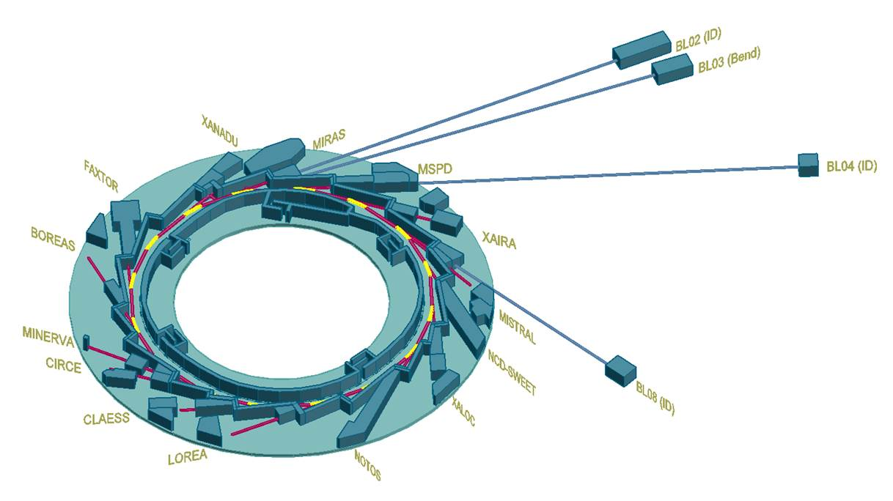
Possible long beamlines at BL02-ID , BL03-Bend, BL04-ID, BL08-ID

Slide 17
Some questions
Movement of BLs?
MSPD, XALOC, CLAESS and FAXTOR need to move 68mm.
NOTOS will need to move 480mm, with a 3,2T bending.
Beam current?
300 mA, 6 RF cavities, 2 straight needed → 13 IDs
400 mA, 8 RF cavities, 3 straights needed → 12 IDs
eALBA?
Space is reserved for the Electrons at ALBA proposal.
It takes Experimental Hall space, the space not used of the injection, plus one possible bending beamline.

Slide 18
Some (preliminary) conclusions
ALBA II seems feasible:
emittance ∼ 150 - 200 pmrad
betas X,Y ∼ 2.0 - 2.5 m
Up to 26 beamlines are feasible:
13 IDs
12 Bendings
Some of these bending positions can be used for 3,2T superbend.
1 IR (MIRAS)
The actual beamlines positions can be preserved, including the bending beamlines. But 4 x IDs and 1 x BM will need realignment.

Slide 19
Thanks

Slide 20
Beam sizes at emission points

