Slide 1
What does an ALBA-II beamline look like? - What source properties can it exploit? - What technical features must it have?
Josep Nicolas
30th june 2021

Slide 2
Size of the electron beam
ALBA
ALBA-2
 | Size (σ) | Divergence (σ’)
Horizontal | 132 µm | 48.5 µrad
Vertical | 7.7 µm | 5.9 µrad
 | Size (σ) | Divergence (σ’)
Horizontal | 14.0 µm | 7.1 µrad
Vertical | 15.1 µm | 6.5 µrad

Slide 3
Brilliance and Coherence
Comparison of the brilliance emitted at ALBA, ALBA-II and the diffraction limit for a SXR and a HXR undulator
For soft x-rays brilliance does not improve very much, because it is already very close to the diffraction limit.
The coherent fraction is large.
For hard x-rays brilliance improves a lot, but it is still far from the diffraction limit.
The coherent fraction is small.

Slide 4
The benefits of brilliance
Low brilliance: photon flux is distributed in a large/collimated or small/diverging beam
Sample
Detector
Optics
High brilliance: The same photon flux is are distributed in a small and collimated
Sample
Detector
Smaller spot
Higher flux density ( ~40 times)
More collimated
More intense
Smaller spot in detector (= Higher coherence distance on sample)
More beam accepted.
Lower aberrations
Optics

Slide 5
Brilliance impact on performance
Simulations of the beam on sample for XAIRA
ALBA
ALBA-2
1
x48
 |  |  | Flux | Fluxdens | Size | Brilliance | Brilliance factor at detector
ALBA |  |  | 4.5E+12 | 9.8E+11 | 2.9x1.4 | 2.3E+19 | 1
ALBA-2 |  |  | 1.6E+13 | 2.7E+13 | 0.6x0.7 | 1.1E+21 | 48

Slide 6
ALBA-2 advantages for photon science
ALBA-II
Super-BM
Low Emittance
High Energy for BMs
Coherence (mainly SXR)
Brilliance
(mainly HXR)
More ph/s on sample
“Wave” properties
smaller spot size
faster collection
Higher coherence, smaller spot size and higher photon flux density drive the development of usual and new experimental techniques.

Slide 7
ALBA-2 advantages for photon science
ALBA-II
Super-BM
Low Emittance
High Energy for BMs
Coherence (mainly SXR)
Brilliance
(mainly HXR)
More ph/s on sample
“Wave” properties
smaller spot size
faster collection
Ptychography
Coherent diffractions
STXM
Dynamics
Imaging
Hi-throughput
Big-Data methods
nanoprobes
Higher coherence, smaller spot size and higher photon flux density drive the development of usual and new experimental techniques.

Slide 8
ALBA-2 advantages for photon science
ALBA-II
Super-BM
Low Emittance
New generation Optics
High Energy for BMs
Coherence (mainly SXR)
Brilliance
(mainly HXR)
New generation Mechanics
IDs
More ph/s on sample
Controls technology
“Wave” properties
smaller spot size
Optics
Optics
Fast scan
Fast detectors
Data handling
faster collection
Ptychography
Coherent diffractions
STXM
Dynamics
Stability
Data infr.
Imaging
Accuracy
Hi-throughput
Big-Data methods
Only a few examples of enabling technologies are indicated
Fast scan
nanoprobes
Higher coherence, smaller spot size and higher photon flux density drive the development of usual and new experimental techniques.
Beamlines need to include new technologies to enable such development.

Slide 9
Optics
Simulations of the beam on sample for XAIRA, assuming perfect alignment and stability
ALBA
ALBA-2
ALBA-2
+Superpolished mirrors
ALBA-2
+Superpolished mirrors
+Adaptive Optics
1
x14
x36
x48
 | AXO | Super Polished | Flux | Fluxdens | Size | Brilliance | Brilliance factor
ALBA |  |  | 4.5E+12 | 9.8E+11 | 2.9x1.4 | 2.3E+19 | 1
ALBA-2 |  |  | 1.5E+13 | 8.3E+12 | 0.8x1.1 | 3.3E+20 | 14
ALBA-2 |  | YES | 1.5E+13 | 2.1E+13 | 0.4x0.7 | 8.4E+20 | 36
ALBA-2 | YES | YES | 1.6E+13 | 2.7E+13 | 0.6x0.7 | 1.1E+21 | 48

Slide 10
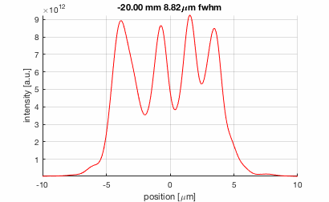
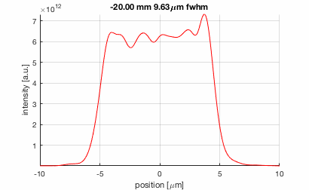
High Quality Optics
Effect of the slope errors near the focal plane. Even high quality optics generates strong heterogeneities on the beam.
Tight tolerancing of slope and figure errors is essential

Slide 11
Errors induced by Mechanics
Since the beam spot is very small, all optomechanical components must be very stable enough to preserve their position.
Motion systems must provide enough resolution, repeatability and accuracy to allow steering the beam without checking its position and size every time.
Photon density on sample is very high and scans can be very fast. Some motion systems at the beamline or at the endstation must allow for very fast scans.
Histogram of the spot size on sample of a 1 µm focus beamline, assuming perfect focusing optics, and BL misalignments with state-of-the-art stabilities.

Slide 12
Common feature are: Granite, high stiffness mechanics, close loop.
Additionally: Compact, in-vacuum mechanics, interferometer feedback, direct drive systems, servos, piezos.
Feedback is essential for top performance: Continuous scan, fast error correction, source-mono-detector synchronization.
Correction requires:
xBMP feedback
Interferometer feedback on some optical elements

Slide 13
ALBA-II
Low Emittance
Coherence (mainly SXR)
Brilliance
(mainly HXR)
New generation Optics
IDs
More ph/s on sample
New generation Mechanics
“Wave” properties
smaller spot size
Optics
Optics
Fast scan
Fast detectors
Controls technology
faster collection
Data handling
Ptychography
Coherent diffractions
STXM
Stability
Dynamics
Imaging
Accuracy
Hi-throughput
Data infr.
Fast scan
nanoprobes
Big-Data methods
Thank you for your attention !

Slide 14
Backup slides

Slide 15
Angular flux density (hard X-ray Undulator)
ALBA
ALBA-2
4.4E17
ph/s/mrad²@0.1%BW
ph/s/mrad²@0.1%BW
Simulation of the angular flux density emitted by IVU21 (XALOC)
0.9E17
For hard x-Rays BLs the emission cone is dominated by the electron beam size,
Although the integrated flux does not change, it is concentrated in a narrower cone.

Slide 16
Angular flux density (Soft X-ray undulator)
ALBA
ALBA-2
4.8E16
ph/s/mrad²@0.1%BW
3.1E16
ph/s/mrad²@0.1%BW
Simulation of the angular flux density emitted by EPU (LOREA)
Soft x-ray BLs are benefited, but brilliance is not improved so much, since they are already close to diffraction limit

Slide 17
Errors induced by optical elements
Some but very few companies can polish nanometer precision mirrors.
In any case, there are other sources of errors that appear on mirrors and gratings, which cause detrimental effects on the beam.
Ideal optics
Surface error (2 nm)
Bender error (cubic) – 20 nm/m
Gravity sag (4th order)
Grating line density error (10⁻⁵)
Thermal bump (20 W)

Slide 18
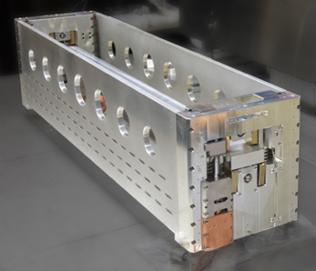
Optics for new generation BLs
Adaptive optics
The ‘nanobender’ system, developed by ALBA.
High bending accuracy, extrm
Optimized to minimize parasitic deformations
Adaptive optics correctors.
Gravity sag corrected by mirror width optimization.
Cooling compatibility
Bending feedback by strain gauges
Direct interferometer feedback
At-wavelength metrology
By using Hartmann Sensors, speckle tracking, or shearing interferometry, several techniques allow reconstructing the wavefront deformations of the x-ray beam.
Others
Cryogenic cooling
Carbon contamination cleaning
Deterministic polishing
Nanobender prototype

Slide 19
Mechanics for new generation BLs
Common features are: Granite, high stiffness mechanics, close loop, decoupled vacuum chambers.
Additionally: Compact, in-vacuum mechanics, interferometer feedback, direct drive systems, servos+piezos, (and they need to be controlled at high speed)
Feedback is essential for top performance: Continuous scan, Fast error correction, synchronization. So a lot of electronics integrated into high accuracy mechanics.
The Lorea monochromator
Example: The Lorea monochromator is a system with <100nrad resolution that can scan 38 mrad of pitch several times keeping the errors below ±2 µrad
A. Crisol et al.

