Slide 1
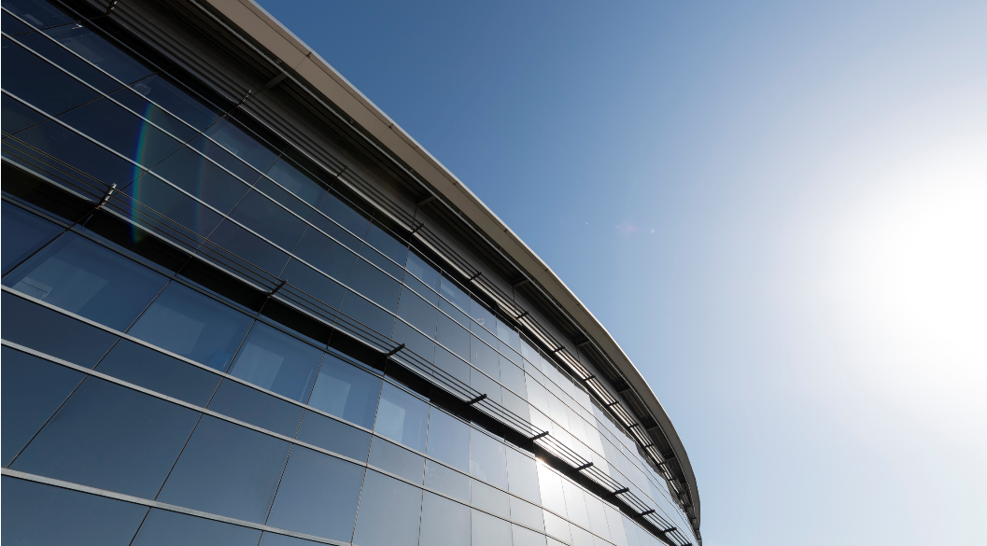


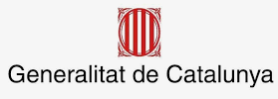


ALBA Partnerships
Caterina Biscari
30-06-2021
Foto Sergio Ruiz

Slide 2
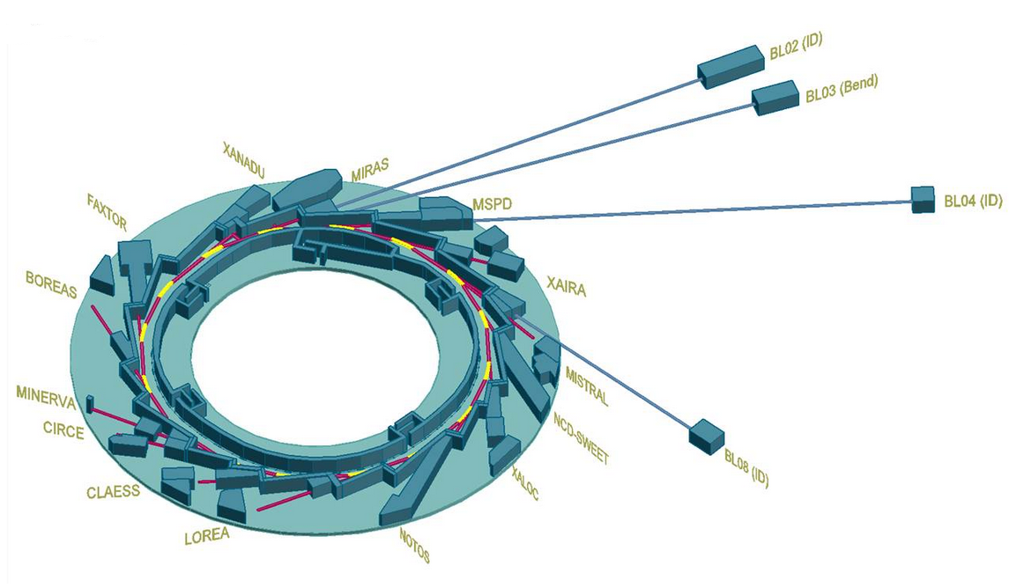
ALBA II in a nutshell
4th generation light source
Emittance 150 pm (30 times smaller than ALBA)
Current 300 mA (+ 20% with respect to ALBA)
Increase of brilliance by orders of magnitude
Increase of coherence
Same footprint of ALBA (C = 270m, same injector)
Present 13 BLs will be maintained and refurbished as needed
New BLs will be fully designed in view of ALBA II
Space for long BLs is available (three front ends + plots nearby ALBA)
Advanced Microscope Platform
Partnership with other institutions is welcome

Slide 3
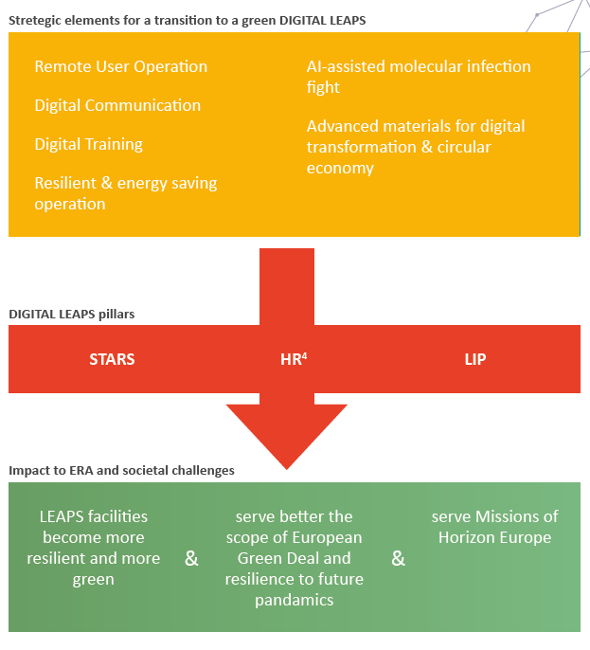
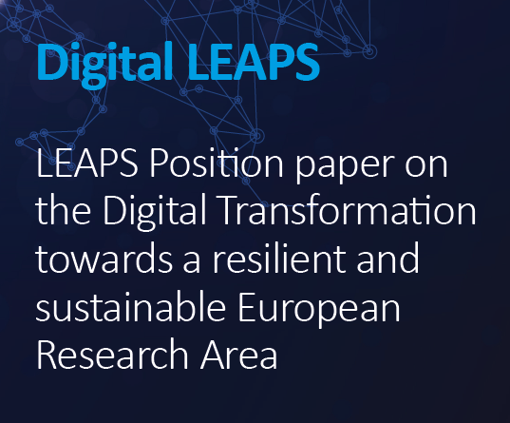

Slide 4
Strategic Partnerships are welcome
Research Institutes
Research Infrastructure
Goal:
develop and execute strong research program to tackle specific scientific or technological challenge.
Resources:
typically project oriented.
Goal:
Support the national and in a second priority the international research and innovation community to tackle specific scientific or technological challenge and give them a head start.
Resources:
typically long term commitment.

Slide 5
Conditions for Strategic Partnerships:
A strategic partnership understand the sensitivities and helps to achieve both sides:
Research Institutes
Research Infrastructure
Facility provides resources not available to the institute to produce a service (like engineering, beamtime, the ability to optimize an instrument)
Tools used by facilities experience a high degree of dissemination with generally high impact in the field
Facility research and political network offers additional playground for forming the research environment
Provided knowhow accelerates development of new services for user program
A good collaboration results in new services tuned to solve grand challenge-problems currently not available at other facilities
Institute’s research and political network offers additional playground for forming the research environment

Slide 6
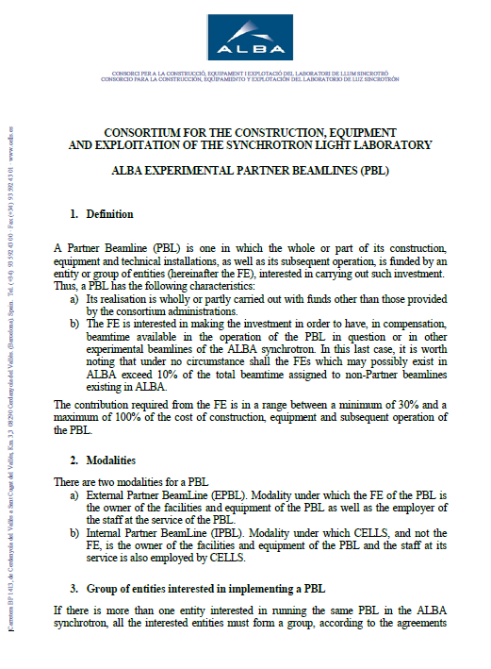
Partnerships rules approved in 2014 by ALBA Consejo Rector
ALBA can host instruments and BLs which are totally or partly owned by other institutions.
Any instrument at ALBA is open to all user community for a fraction which depends on the ownership rate.
As an example: 100 % ownership corresponds to 60% usage if staff is included, 50% if staff is not included
Agreements for distributing the use in different BLs can be considered
  Any instrument time has to be peer reviewed.
  Any partner can suggest a partnership
  Selection is performed by ALBA management under guidance of SAC

Slide 7
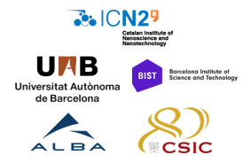
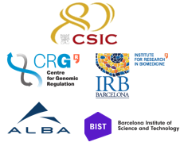
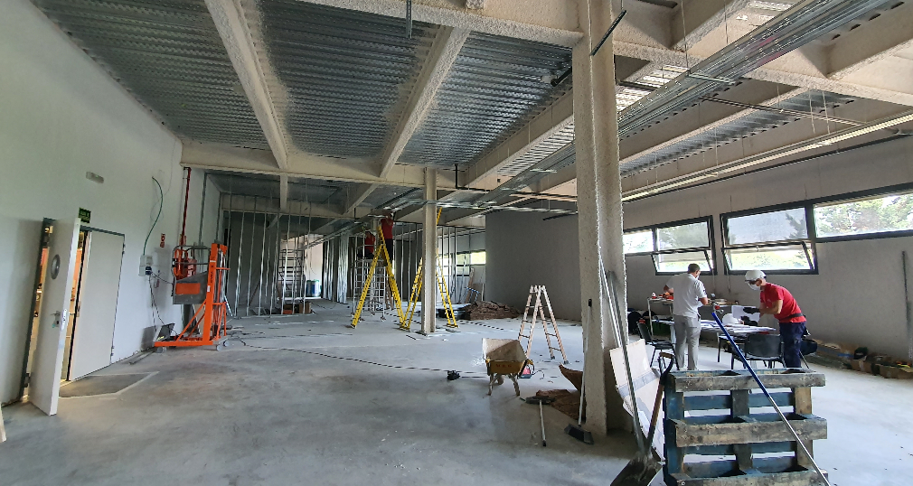


Advanced Microscope Platform
Based on cooperative projects
Construction on going
In operation in 2022
ERDF funds from the Departament d'Empresa i Coneixement of Generalitat de Catalunya assigned to the two new consortia
Call for tender for both micros published
Call for tender for infrastructure building at Alba published
Co-funded and co-owned by different institutions
Microscopes to be in operation in 2022
Aberration Corrected Monochromatic Transmission Electron Microscope,
Plus Focused Ion Beam equipment
for sample preparation
Nanoscience and Nanotechnology, Advanced Materials, Photonics
Specialized transmission cryo-electron microscope for structural biology applications
- 200 kV maximum acceleration voltage
- last generation direct electron detector
- automated sample load system
Single Particle Analysis & cryo-electron Tomography

Slide 8










Approved partnerships
  Complementary Plan in Area of Material (In-CAEM, correlative TEM): materials science environmental. Local Institutes and collaborations with several CCAA institutes. Project to be developed in 2022-2025
  Project is in preparation to be presented to the Ministry of Science in Oct 21
  CSIC (ICMAB, ITQ) – Battery, High TC SC, Catalysis - lab support infrastructure with initial staffing from CSIC researchers.
With CCAA
Aragon
Castilla y Leon
Madrid
Pais Vasco
Valencia

Slide 9

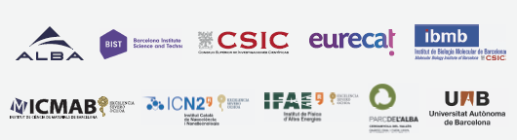
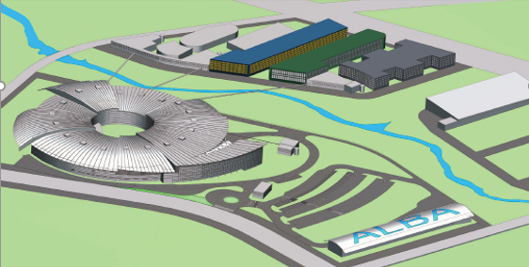
ASTIP: Opportunity for Scientific Development of the areas
Proposal presented to GenCAT in call of interest for NGEU future funds
ALBA is leaping from 3rd to 4th generation before fully completing the BL portfolio and will profit from the space for optimization
Develop ASTIP
Alba Science-Technology-Innovation Park
Space for new BLs in the experimental hall
+ Space available for long BLs
Cooperation with nearby institutions to develop a science hub. Advanced Microscope Platform on going – pilot test

Slide 10

ASTIP interdisciplinary hub based on 4 pillars – linking research, technology and innovation
Complex materials and technology developments
Large Research Infrastructure
ASTIP
AMBIC
Synchrotron light-based R&D towards new industrial Applications
Advanced Multiscale Bio Imaging Center

Slide 11
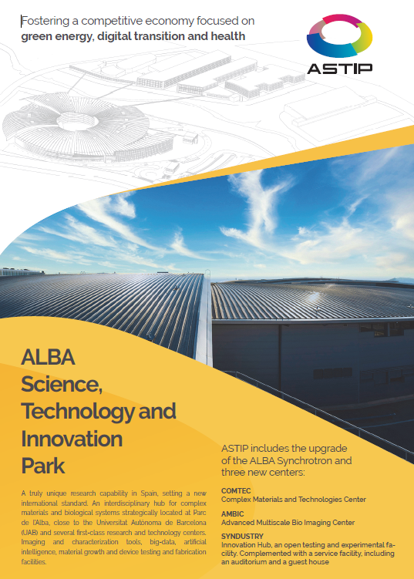
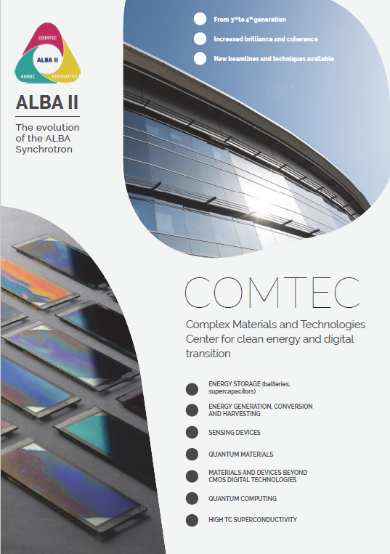

Slide 12
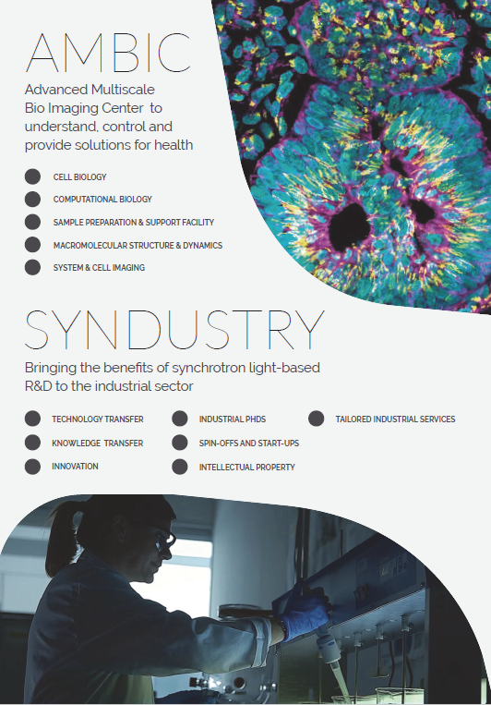
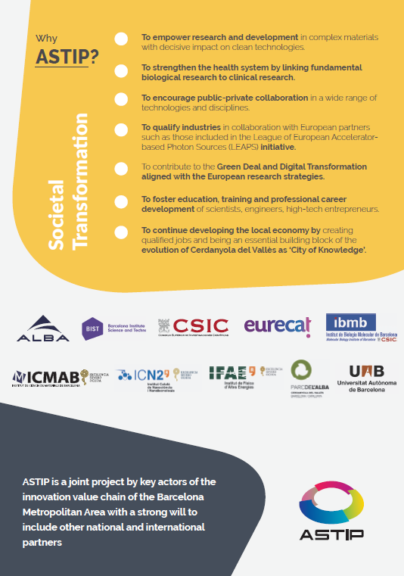

Slide 13
Examples of partnerships
Participation in a BL (investment, staff, operation)
Participation in instrumentation on existing BLs
Participation in setting up a laboratory
Participation in new instruments (as microscopes)
Association (for use of beamtime)

Slide 14
Thank you for your attention
Foto Sergio Ruiz

