Slide 1
Strategy Field: Health
Judith Juanhuix
30.6.2021

Slide 2
Life Sciences Mission, focus on solutions
2021-2024
Life Sci
mission
Make accessible effective, state-of-the-art scientific services and instruments dedicated to solving societal challenges related to life sciences such as health and environment.
Act as a catalyst for regional and national collaborations addressing societal challenges for which life sciences may provide solutions.
Multi-length Scale Approach To Understand Behavior Of Biological Systems
      using a suite of techniques and services enabling the catalytic role of ALBA
Focused on scientific fields:
Techniques
Services
Drug development
Membrane proteins
Structure-based enzymology
Specialized sample preparation
Crystallization
MX, BioSAXS
CryoEM
Full field TXM, phase contrast, STXM
Tailored to objectives
Tailored to the gap for accessing services
Proximity

Slide 3
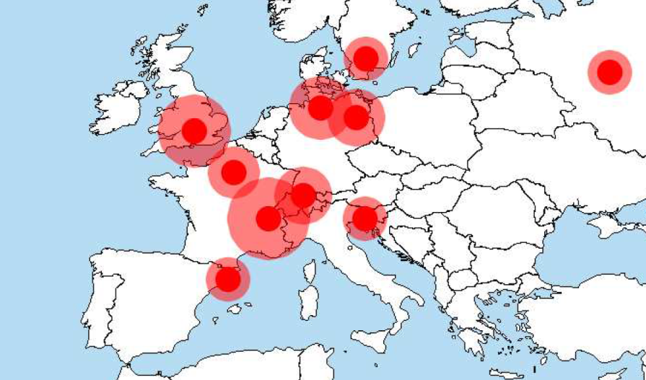



Environment
The Life Sciences community is well-connected to Europe (and worldwide) through programs, projects and human mobility
Strong push for tackling complex challenges/issues/problems in a multi-disciplinary approach
Many groups are specialized in particular techniques.
Gaps exist between communities and collaborative partners
ALBA is already collaborating. But need more.
Beamlines dedicated to MX in Europe

Slide 4
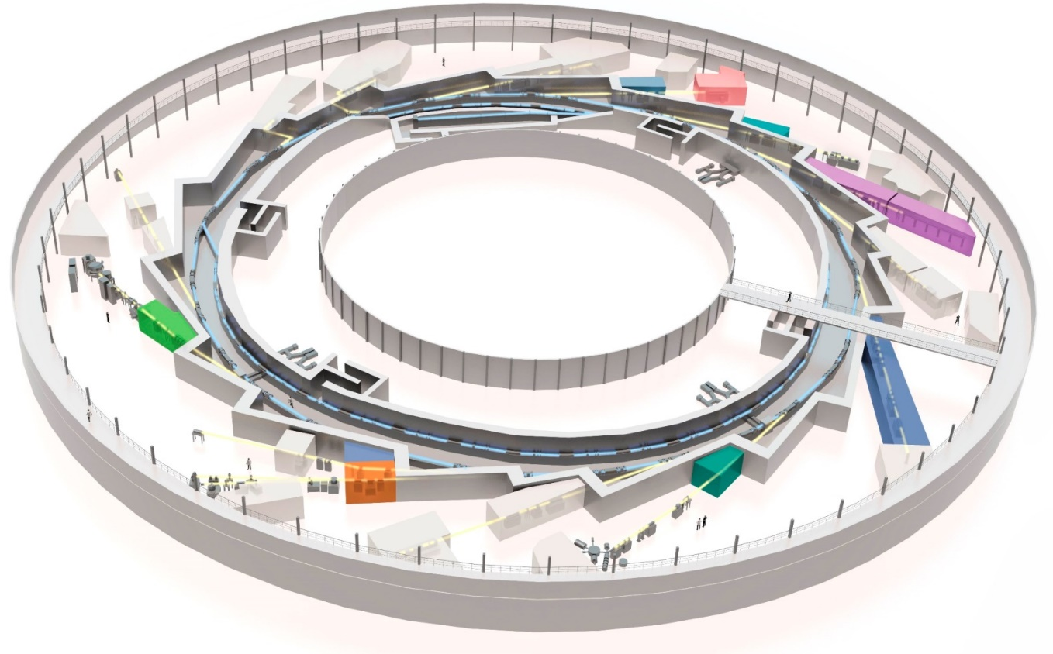
Existing tools in Structural Molecular Biology
Current facilities in Structural Molecular Biology:
1+1+1 BLs
Biolab
CryoEM
XAIRA (μMX)
CryoEM (Glacios)
BioLabs
Fully
dedicated
NCD-SWEET (SAXS)
Partially
dedicated
XALOC (MX)
In
construction

Slide 5
Existing tools in Structural Cell & Tissue Biology
Current facilities in Structural Cell & Tissue Biology:
MIRAS (IR bl)
MISTRAL (TXM, full field)
FAXTOR (HXTomo)
MIRAS (IR)
FAXTOR (HXT)
MISTRAL (TXM)
BioLabs
Fully
dedicated
Partially
dedicated
In
construction

Slide 6
The Roles of all Tools
Computing resources
Computational Biology
Beamlines
EM-tomo
SXTM
BioSAXS
Sample shipment
FAXTOR
XAIRA
cryoFIB-SEM
EM-spa
nMIRAS
pMISTRAL
uXALOC
Users
Biolab
Ligand screening
Sample prep
Correlative
microscopy
Services
Crystal farm
Sample manipulation
Crystallization facility
HT crystallization
HT sample harvesting
Notes:
This is a slide which needs to be made for all areas. So you will need one for catalysis and one for batteries.
This slide can also indicate external dependencies like databases which are hosted by others like the Battery 2030+
In other words, this slide can have lots of content or nearly nothing. This depends how far you are with you review planning.

Slide 7
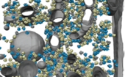


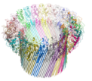






Correlations within Life Science programs
Phasing of MX data
Docking of crystal structures in higher order assemblies
SAXS cross-validation of cryoEM complexes
Computational modelling of missing regions
Characterisation of cryoEM sample
General sample visualisation
Fitting of SPA structures into cell tomogram reconstructions
XAIRA (μMX)
cryoET
cryoEM - SPA
XALOC (HT MX)
MISTRAL (full field TXM)
BioLab
Computational
modelling
BioSAXS
Notes:
I really like this slide from from Damia.
One can generalize it: take one of the standard characterization tools and show which other tool you use for getting the missing information. The text on the side makes it very clear.
Add as many slides of these kind as necessary to explain how the tools work together . I expect about 3 slides of this kind.

Slide 8
Correlation between soon-to-come program tools
XAIRA (μMX)
Cellular Biology
CryoEM (SPA)
XALOC
(High throughput MX)
BioLabs
Sample prep (P2)
BioLabs
Crystallization Facility
NCD-SWEET (SAXS)
MX beamlines have an integrated program with well defined roles.
Continued expansion of structural molecular biology to cellular biology program (TXM, Mistral BL)
MX program to be correlated with CryoEM – single particle projects
BioSAXS needs a new dedicated home: new BioSAXS BM beamline
Moderate growth of biolab equipment (Crystal farm) to complete a Crystallization Facility

Slide 9
Correlation between soon-to-come program tools
FAXTOR (HXR tomo)
MISTRAL
(full field TXM)
Molecular Biology
MIRAS
(FTIR)
BioLabs
Sample prep (P2)
CryoSIM
BioLabs
Continued integration of structural molecular biology to cellular biology program (TXM, Mistral BL)
FAXTOR program to be correlated with FTIR and SEM
Growth of biolab equipment to correlative microscopies (CryoSIM)
CryoEM-tomo, phase contrast techniques and nanofocus scanning missing

Slide 10
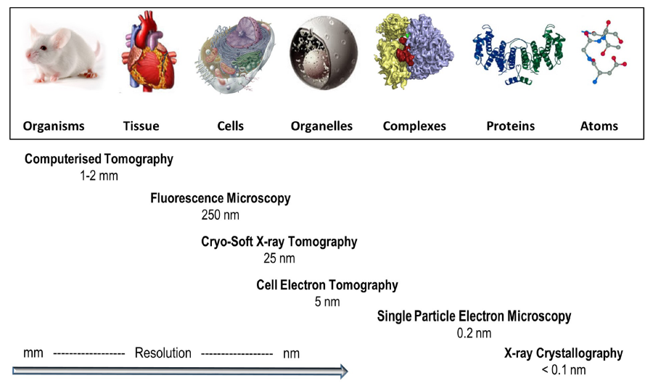
Our strategy at a glance
ALBA to provide the X-ray and electron- tools and the “missing links”
Aiming at a continuous path from genotype to fenotipe structural studies
ALBA embedded within their strategic partners provides leading capabilities
BioSAXS
FAXTOR
STXM
XALOC
MIRAS
MISTRAL
XAIRA
Computational
Biology
Cry-EM/SPA
BioSAXS
1 nm
Computational
Biology
From Harkiolaki et al. DOI:10.1042/ETLS20170086 ; CC BY 4.0 modified
Notes:
Smaller pic, answer to the mission statement
Put computational biology in the gap, al bionanoprobe. Prepare the ground for the vision, so put future tools
Genotype (molecular) to Fenotype (cellular)

Slide 11

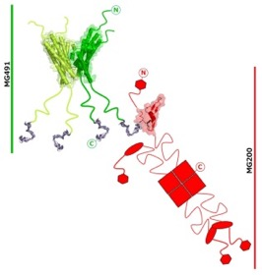
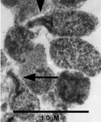
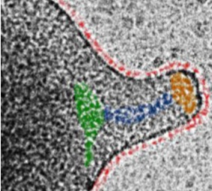
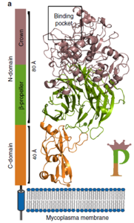
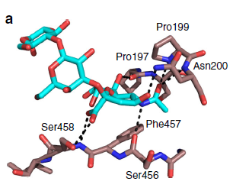
Multi-Scale Imaging Opportunities at ALBA
Understanding Mycoplasma Genitalium Disease
BACKGROUND
*Causative agent of infectious diseases in humans and cattle herds, with particular severity in immunosuppressed patients.
*Mycoplasma genitalium has a prevalence of 1-3 % in the general population.
*The increased emergence of antibiotic-resistant mycoplasma strains is a huge threat to public health.
DnaK (MG305)
GrpE (MG201)
MG491
MG200 EAGRb
(Calisto et al., Mol Microbiol 2012)
(Adell et al., Protein Sci. 2018)
(Martinelli et al., JBC 2015)
(Martinelli et al., PLoS Pathogens 2016)
P140 (MG191)
P110 (MG192)
XALOC, MX crystallography
MAIN MOTIVATIONS
* Decipher Mycoplasmas colonization and infectivity mechanisms.
* Identify targets for vaccines or drugs development for new and more effective therapeutics.
Cryo-Electron Tomography
(Aparicio, Fita et al., Nat. Comm 2018)
(Aparicio, Fita et al., 2877 (2020) Nat. Comm)
Notes:
Here I would make one example in which I show how a collaboration/IHR has alread. pushed in a direction and it is showing how things can work together. In this case you have 2 slides. In no cases longer.

Slide 12
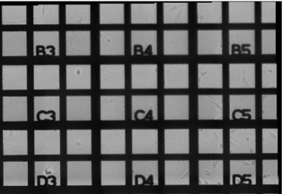
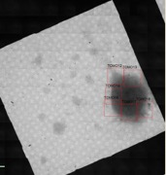
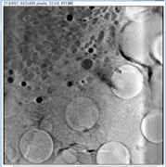
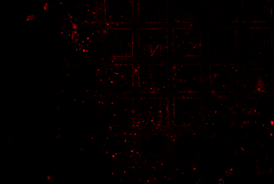
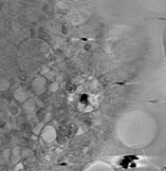
Multi-Scale Imaging Opportunities at ALBA
MISTRAL, cryo-Soft X-ray Tomography
Confocal Microscopy at UAB Microscopy Services
Mycoplasma genitalium cells
TEM
M. genitalium-infected human epithelial cells
COLLABORATORS
Piñol’s group (IBB-UAB)
Fita’s group (IBMB-CSIC)
Ana Pérez-Berná
(MISTRAL, ALBA)
Red fluorescence given by mCherry-labelled protein
Notes:
See previeous comment.

Slide 13
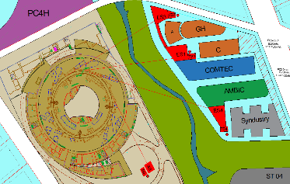

ASTIP: Examples for Strategic Partnerships
(in Pre-Proposal Stage)
Large partnership with local institutions and opening to other national institutions to form a hub of 4 pillars, being ALBA II in the center. The other three pillars will be:
  AMBIC (life sciences)
  COMTEC (material sciences)
  SYNDUSTRY (Innovation hub for industry)
The life sciences center AMBIC centers around:
  Macromolecular Structure & Dynamics
  System & Cell Imaging
  Cellular Biology
  Computational Biology
  Sample Preparation and Support Facility
AMBIC is required to provide full service building on the strength and expertise of local groups an
AMBIC provides users a network hub.
ASTIP is in the preproposal stage
Notes:
Here one should say something about strategig partnerships and what you do now and could be done with partnerships (like the battery lab).

Slide 14
New Opportunities for INDUSTRY at ALBA II:
ASTIP
TARGET COMPANIES: local spin-offs, SMEs and big companies
INDUSTRIAL SERVICE
Integrated, multiple-scaling STRUCTURAL MOLECULAR and CELL BIOLOGY studies
Notes:
Here I would put something which connects the area with industry. You can leave it out if there are no plans but I would contact Alejandro.

Slide 15
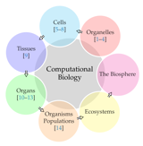
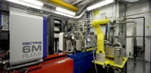
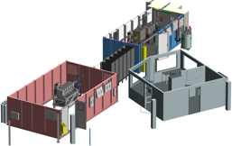
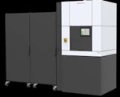
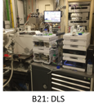
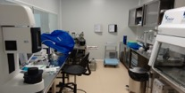

ALBA II
A Fourth Generation Source
Computational Biology
ALBA II will provide complete characterization solutions for the branding areas (Health) by combining:
Enhanced imaging tools allowing multimodal imaging.
Optimized high throughput instrumentation.
Data handling facilities consistent with big data (including theory, simulation and data analytics for branding areas).
Development and implementation of new methodologies.
ALBA II will form strategic partnerships and will be embedded into research supporting infrastructure which provides all non X-ray support to the users (example of the ASTIP proposal).
ALBA II will still provide all current services to all (Spanish) other users.
https://doi.org/10.3390/biology10050374
ALBA Core-Business
High throughput MX
SSX-MX
Soft X-ray full field microscope
Cryo-EM spa/tomo
*
IR-microscope
*nano-IR
Bio-SAXS
*
nanoprobe
The Labs
*: not yet approved
Notes:
I would follow this concept for the summarry: Blue box all core instruments which you think you will need (indicate to be approved if not yet in the process of being built). Red boxes are services for which we will do best effort but cannot guarantee to make it without partners.

Slide 16
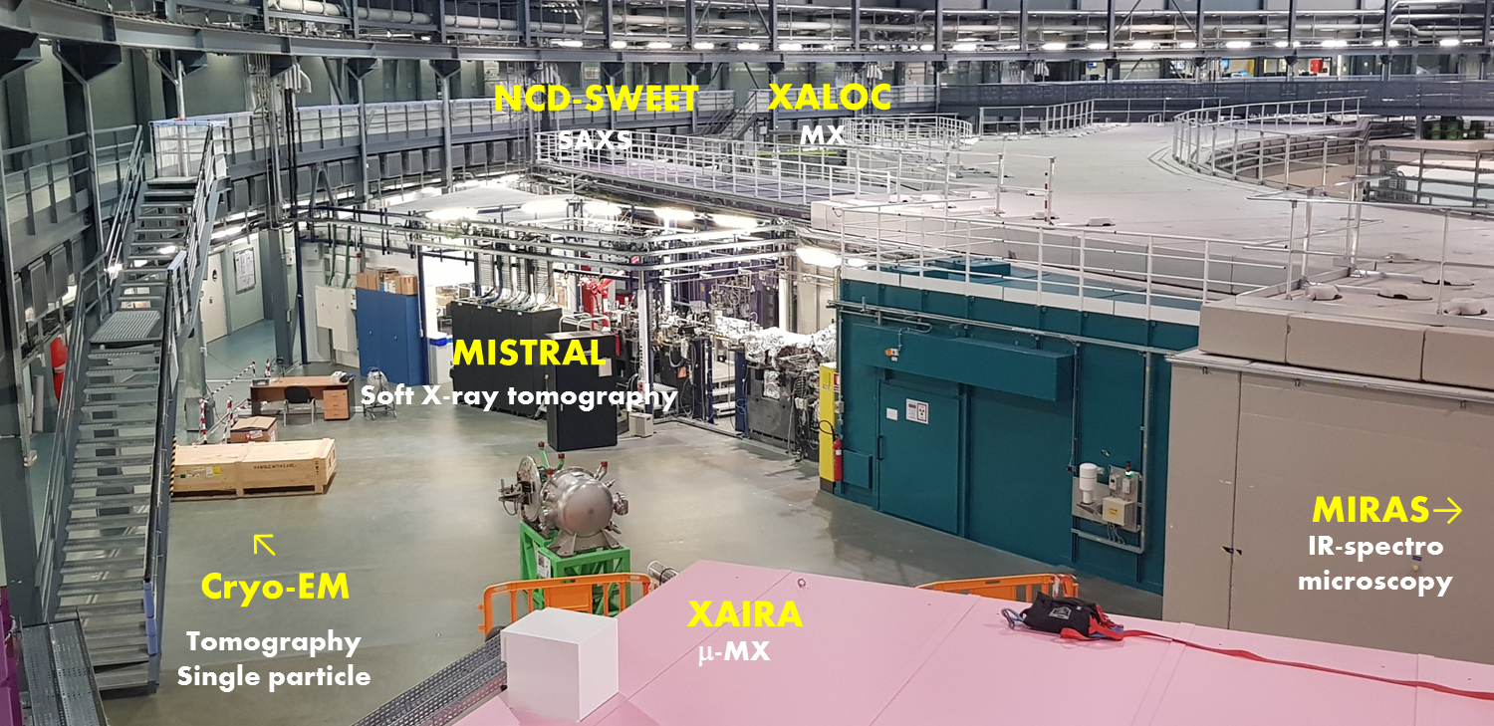
Questions
Questions welcome
Welcome

