Slide 1
Questionnaire Section E&MSM
30.6.2021
Notes:
Change section…. To section name

Slide 2
The Breakout Session: Overview.
Introduction
Overview of available (and planned) instrumentation.
Results from internal instrument call.
Template for community call.
The questionnaire:
Is the process to ALBA II inclusive?
What can ALBA II do for you?
Notes:
Add as many slides as you have topics within the branding area:
For example material sciences: Catalysis and Batteries
Don’t forget the TEM resources to be.

Slide 3
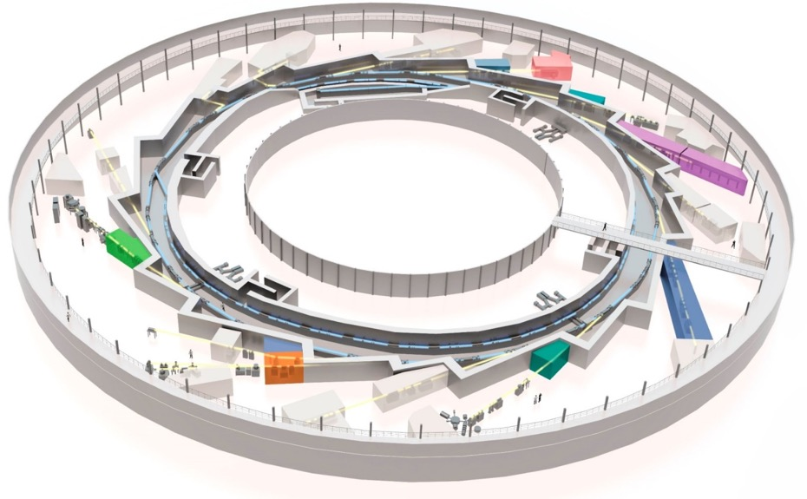
Existing tools IT & 2D/QMs at ALBA
Current facilities in Inf. Tech. / QMs:
2+2 BLs
Materials Science lab & Surf. Sci Lab
(S)TEM
MISTRAL
(TXM magnetic
microscopy/tomography)
Fully
dedicated
(S)TEM
Partially
dedicated
BOREAS
(XAS/XMCD, XRMS/
Coherent imaging)
In
construction
CIRCE
(X-PEEM
electronic and magnetic
microscopy)
LOREA (ARPES,SP-ARPES)
Electronic band structure mapping
MSLab
(sample prep, 2D+GB)
Surf.Sci. Lab (STM,AFM,ALD)
Notes:
Add as many slides as you have topics within the branding area:
For example material sciences: Catalysis and Batteries
Don’t forget the TEM resources to be.

Slide 4
The Internal “Instrument Call”
Goal:
Involving all employee into ALBA II process.
Collecting potential ideas for instruments to guide workshop program for ALBA II planning.
Test run for new call process.
The call itself:
Call for pre proposal
Should be easy and fast to suggest ideas.
Kind of abstract of the real proposal.

Slide 5
Results of Internal “Instrument Call”
Acronym | Name | Energy range [keV] | Beam size [μm²] | Branches | Techniques | Proposer
3SBar | Surface-Interface X ray Diffraction and Photoemission above one bar. | 3-20 | 5x5 | 2 | surface X ray diffraction and the second to ambient pressure (1 bar or more) photoemission | Eduardo Solano ,Enrique Ortega, Xavier Torrelles, Salvador Ferrer
ATTOMS | Attosecond Atomic and Materials Science x–ray & HHG hybrid beamline | 0,01-4 | 5-100 variable And 0,01-20 | 2 | time-resolved X-ray Absorption Spectroscopy, time-resolved, pump-probe Imaging holography, ptychography, xpcs | M. Valvidares (ALBA), Allan Johnson and Jens Biegert (ICFO), Wojciech Gawelda (IMDEA)
MiFun | Microscopy of functional materials | 0,250-4,1 | Main: 0,05 x 0,05 Side: 10 x10 | 2 (long beamline with short side branch) | Side-branch (full field) TXM, STXM with fluo & ptychography | Andrea Sorrentino, Eva Pereiro, Lucia Aballe, Sandra Ruiz Gómez
Batman | BAttery Tender x-rays Multitechnique Approach research eNvironment | 0,01-4 | 20x5 Up to 130x30 | 1 | Ambient Pressure XPS with tender X-rays | V. Pérez-Dieste, I. Villar-García
MATEC | MatterATExtremeConditions Beamline | 20-60 | 3-5 (round) | 2 | High energy Diffraction ( EH1: XRD in DAC main + complementary PDF in DAC as secondary technique) and in-situ synthesis XRD in Large Volume Cell (EH2 second stage) | Catalin Popescu (ALBA) Daniel Errandonea (UV) Juan Angel Sans (UPV)
CSXID | Coherent Soft X-Ray Imaging and Diffraction | 0,250-3 |  | 2 |  | Michael Foerster

Slide 6
Some Additional Obvious Beamlines.
Name | Energy range [keV] | Beam size [μm²] | Branches | Techniques
Hard/tender X-ray nano probe | 3-20 | 0,04x0,04 | 2 | Micro spectroscopy, micro diffraction, ptychography (can be optimized for life or material sciences) Second station can be freely chosen
Micro Spectroscopy beamline | 2-25 | 0,1x0,1 And 1x1 | 2 | Fast scanning microscope optimized for high quality spectroscopy (medium long)
Hard full field microscope | 5-20 | Resolution: ˜0,04 | 1 | Phase contrast, spectroscopy; typically used in materials sciences
Inelastic scattering beamline | 0,01-4 | 5x5 | 2-3 | Medium long beamline: RIXS (medium resolution), high resolution inelastic scattering, Raman
In-situ scattering/spectroscopy beamline | 5-25 | 1x1 | 1 | Optimize beamline for growth in-situ experiments with 0,5m working distance. Can also offer CTR
Hard X-ray time correlation spectroscopy | 2-12 (higher?) | 5x5 | 1 | XPCS, WAXS/SAXS
High Throughput hard X-ray spectroscopy beamline | 2-6 5-25 | 5x5 5x5 | 2 | Optimized sample handling (operado and sample changer) for 10s/spectrum
Soft X-ray Inelastic beamline | 0,1-2 | 1x1 | 1 | RIXS (resolution 1-5meV) medium long
High resolution full field imaging beamline | 10-40 (perhaps higher) | 5000x5000 And 20000x20000 | 2 | Tomography, absorption/phase contrast; long beamline
Coherent diffraction imaging beamline | 6-15 | 1x1 | 1 | CDI
Obvious other choices are:

Slide 7
Template for Community Call: The Process and Deadlines
Pre-Proposal Call:
Everybody from the community can participate and make suggestions (every proposal needs at least one external co-PI; it is highly encouraged the PI is not ALBA employed).
Pre-proposal should make minimum effort to proposer to encourage participation; all ideas are welcome.
All proposals will be peer-reviewed by committee; a limited number 3-4 will be encouraged for full proposal.
Deadline: 6.9.2021
Full Proposal:
External proposal team will be supported by ALBA optics experts and staff to develop full proposal with preliminary design and refined specifications.
Deadline will be 6.12.2021.
Preselection of beamline 13 end of December with start of project in February 2022.
Remaining proposals will form pool which will be added with additional call in 22. This pool of proposals will be used for deciding additional beamlines and upgrades of existing instruments.

Slide 8
Beamline/Instrument Title
Proposer team (names & institution/contact)

Slide 9
Beamline/Instrument Concept
Name of the beamline: Text
Beamline technique(s): Text
Short description of the program (less than 500 characters):
here text
Beamline type (short ID, BM, long ID): Text
Energy range (soft, tender, hard) : Text
(target energy range if available)
Beam size and specific conditions (polarization, coherence): Text

Slide 10
Beamline/Instrument Concept
Name of the beamline: Text
Expected benefit from ALBA II:
Add bullet list.
Which scientific or community need will be addressed:
Add here text
Potential or existing user community (communities or also institutes):
Add here text
International competition (at which other sources there are similar instruments):
Add here text

Slide 11
Questionnaire: Is the process to ALBA II inclusive?
Is the Information provided enough? Which information is missing?

Slide 12
Questionnaire: Is the process to ALBA II inclusive?
Is the Information easy to find? Can we improve the dissemination process?

Slide 13
Questionnaire: Is the process to ALBA II inclusive?
Is the process clear and transparent?

Slide 14
Questionnaire: What can ALBA II do for you?
What do you see in your field as the grand challenge to be solved in the future?

Slide 15
Questionnaire: What can ALBA II do for you?
Which instrumentation is missing for your research?

Slide 16
Questionnaire: What can ALBA II do for you?
Which instrumental performance upgrade do you need (microscope resolution, high throughput, data management…etc)?

Slide 17
Questionnaire: What can ALBA II do for you?
Which services are missing for your research at ALBA?

Slide 18
Questionnaire: What can ALBA II do for you?
How can ALBA improve services and access mode for fostering innovation?

Slide 19
Questionnaire: What can ALBA II do for you?
Do you have suggestions for strategic partnerships and their goals?

