Slide 1
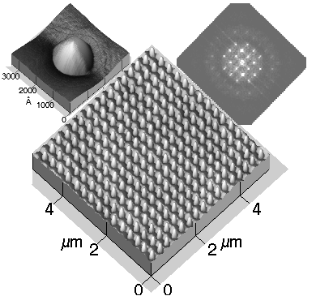

ALBA Beamline Proposal: Near-Surface X-ray Diffraction under Controlled Sample Environment
A proposal prepared for the pre-screening of ALBA phase-III beamlines
10 April 2014
Pre-screening ALBA phase-III beamline proposals
10 April 2014

Slide 2
Near-Surface X-ray Diffraction under Controlled Sample Environment
This proposal was promoted by:
Dr. M.J. Capitán Aranda IEM-CSIC
Dr. X. Torrelles Albareda ICMAB-CSIC
Dr. J. Álvarez Alonso Dpto. FMC-UAM
With contributions of:
Dr. J. J. de Miguel Llorente Dpto. FMC-UAM
Dr. José Santiso López CIN2-CSIC
Dr. Enrique Herrero Dpto. QF-Univ. Alicante
Prof. Juan M. Feliú Dpto. QF-Univ. Alicante
Dr. Alfonso Cebollada IMM-CSIC
Dr. Jorge M. Martínez García IMM-CSIC
Dr. Rafael Andreu Fondacabe Dpto. QF-Univ. Sevilla
Dr. Maria Alonso ICMM-CSIC
Dr. Miguel A. Rodriguez Perez Dpto. FMC-Univ. Valladolid
Prof. José A. de Saja Sáenz Dpto. FMC-Univ. Valladolid
Dr. Miguel Clemente León ICM-Univ. Valencia
Dr. Mercedes Perez-Mendez ICTyP-CSIC
Pre-screening ALBA phase-III beamline proposals
10 April 2014

Slide 3
Outline:
Beamline objectives
Scattering geometry
Scattering techniques & sample environments
Scientific cases. Examples:
Surface structure (Z-checking): C60/metals
Molecular self-assembling. Chiral systems (symmetry checking).
Adenine / Au(111) & heptahelicene / Cu(111)
Surface structure and catalysis: CO+O₂ → CO₂ / [Rh(111) & Pd(100)] surfaces
Reciprocal space mapping: 3D quantum dots superlattices
GISAX: Rh nanoparticles
List of supporting scientists
Scientific cases and priority lines of Horizon 2020
Synergies between the surface beamline and ALBA
Conclusions
Pre-screening ALBA phase-III beamline proposals
10 April 2014

Slide 4
Beamline aims:
To build a high resolution x-ray diffraction beamline on an in vacuum undulator source, to investigate the structure of surfaces, films and nanostructures. Both wide angle and small angle scattering will be accessible for a complete characterization of the atomic and the nanostructure order.
Different types of studies under a wide range of well defined and controllable environments, covering both hard and soft condensed matter.
Incorporate the exciting potential of coherent scattering, microbeam diffraction and magnetic scattering.
Possibility to use the white beam for strain analysis of microcrystals.
Pre-screening ALBA phase-III beamline proposals
10 April 2014

Slide 5
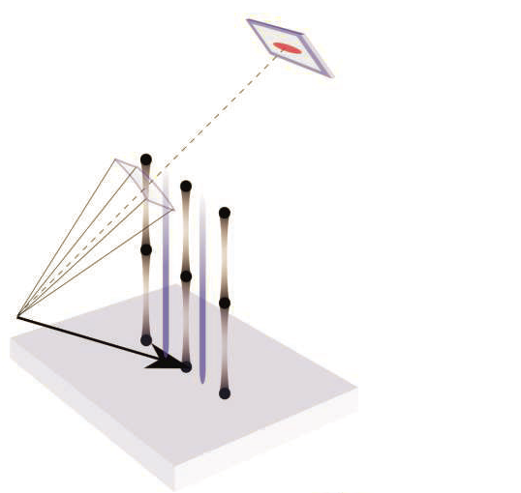
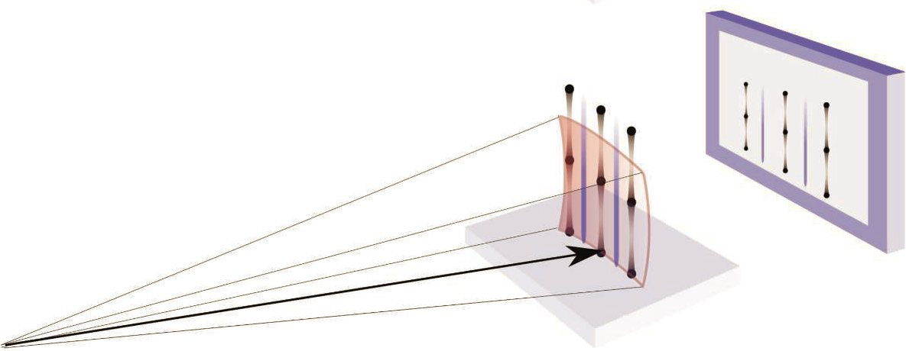
Surface and Interface Scattering geometry:
Conventional surface x-ray diffraction
Small area detector
E ∼ 20 keV
Ewald sphere
Superstructure rod
Bragg peak
Crystal Truncation rod
Incident x-ray beam
Static large area detector
Novel surface x-ray diffraction
E ∼ 80 keV
Ewald sphere
Incident x-ray beam
Pre-screening ALBA phase-III beamline proposals
10 April 2014

Slide 6
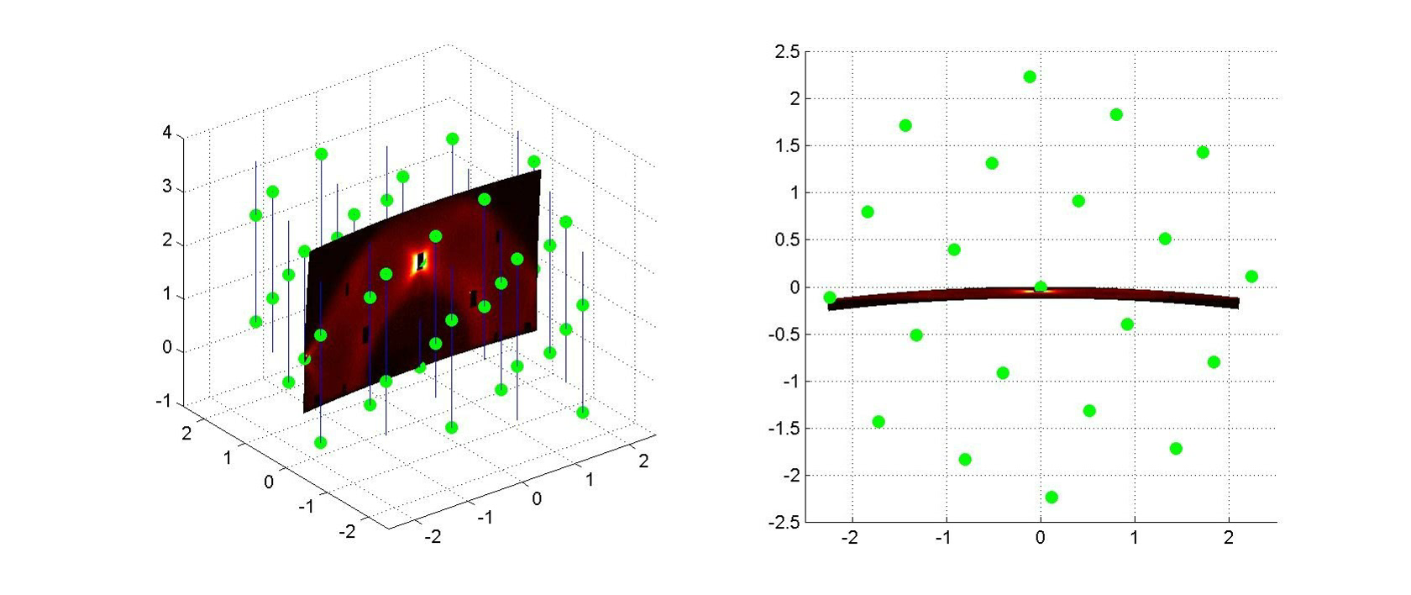
Surface and interface scattering geometry:
Pre-screening ALBA phase-III beamline proposals
10 April 2014

Slide 7
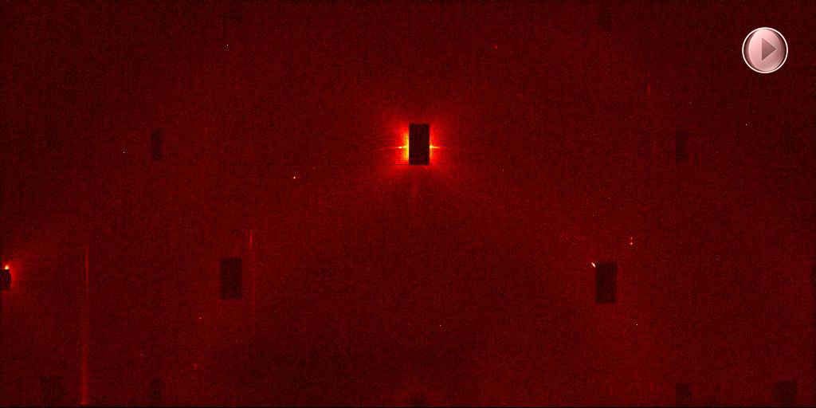
Surface and interface scattering geometry:
Pre-screening ALBA phase-III beamline proposals
10 April 2014

Slide 8
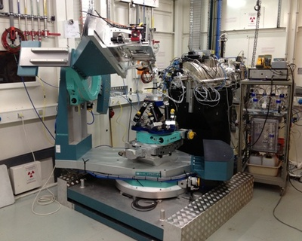
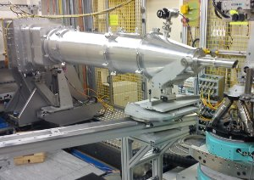
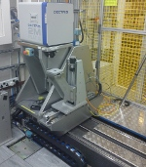
Surface and interface scattering techniques:
GISAX side
2D -CCD
2D -CCD
Flight tube
Sample support
GIXRD side
Reflectivity (specular and diffuse). Grazing Incidence Small Angle X-ray Scattering.
Grazing-incidence Wide Angle Scattering (diffraction).
Coherent scattering-dynamics and 'imaging'.
Magnetic / Resonant scattering .
Microbeam-disordered samples and nano-particles (strain distribution in μ-Xtals: white beam experiments).
Pre-screening ALBA phase-III beamline proposals
10 April 2014

Slide 9
The new science:
Nanostructures
Quantum Dots.
Soft-Condensed Matter Self-Organized Systems
Soft-Condensed Matter: Chiral Systems
Thin films
Magnetic materials
Buried Interfaces
Polymers
Biomolecules
Surface and Interfaces
Surface in UHV
Harsh environments / catalysis
Solid-Liquid interfaces: Electrochemistry
Langmuir Blodgett films
Soft-Condensed Matter
Magnetism
Pre-screening ALBA phase-III beamline proposals
10 April 2014

Slide 10
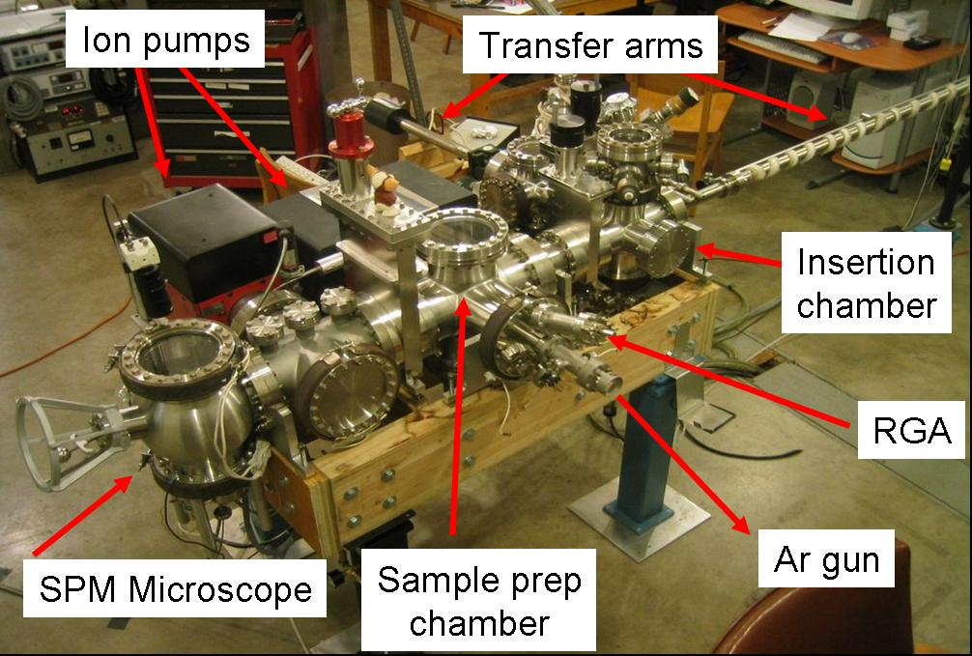
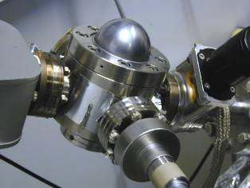
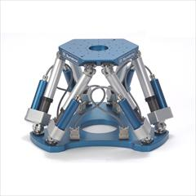
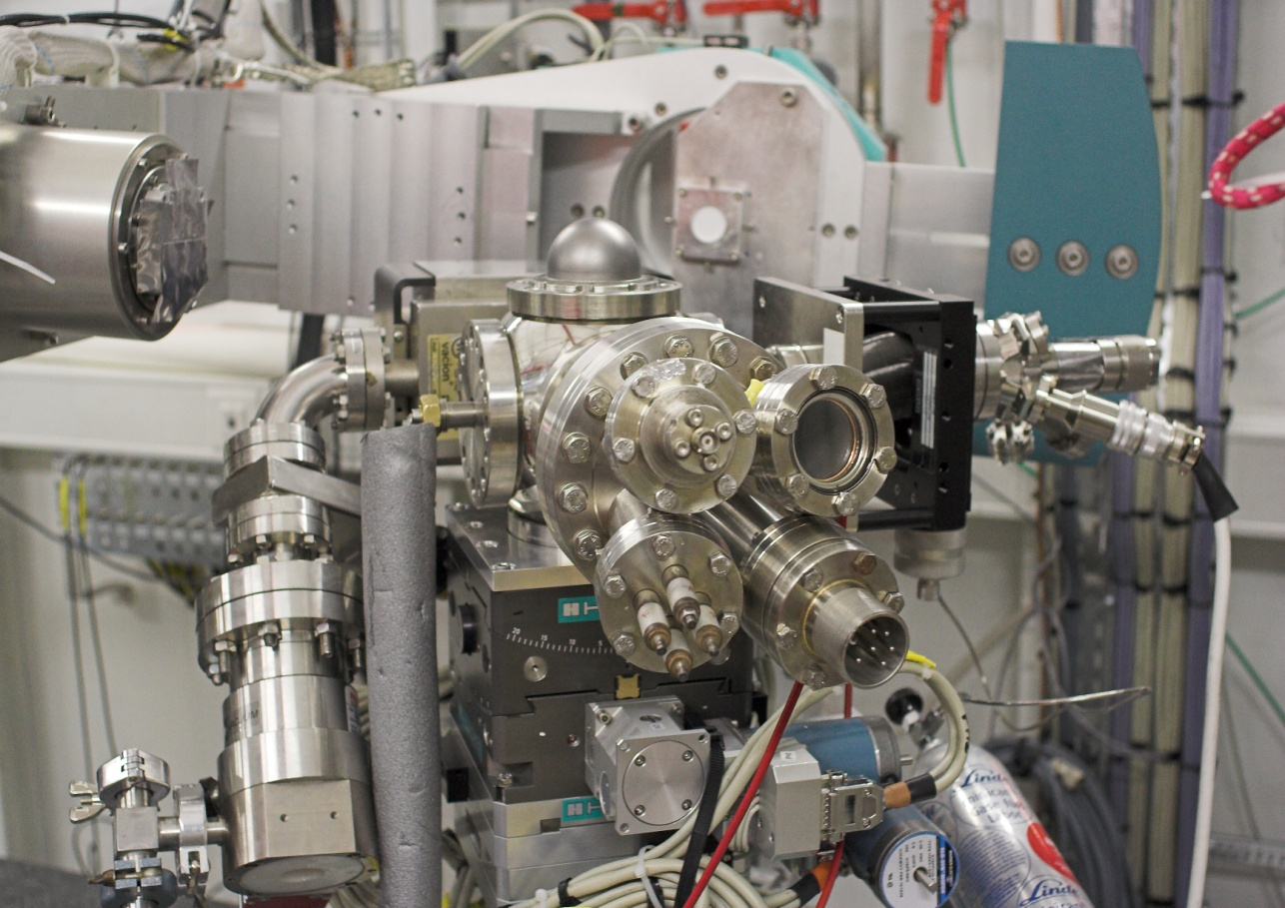
Surface Preparation Laboratory
Sample environments: surface preparation
HV environment
Hexapod sample support
“In situ” preparation minichamber
Pre-screening ALBA phase-III beamline proposals
10 April 2014

Slide 11
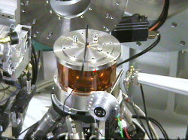
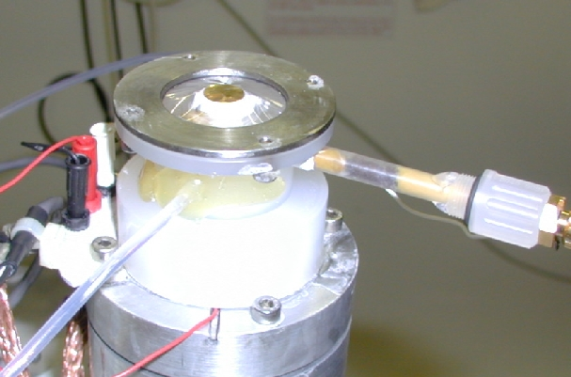
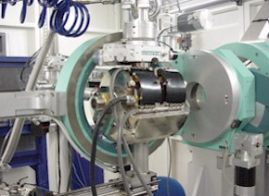
Sample environments
Harsh reactor
Leak valve for gas introduction (HCl, H2S)
- O₂ rich: 800K
- UHV: 1400K
- HCl trap (gas exhaust pipe)
Flow reactor with UHV section
Mass flow controllers (gas inlet)
Batch reactor
Controlled environment gas
Electrochemical Cell
Magnetic field
Pre-screening ALBA phase-III beamline proposals
10 April 2014

Slide 12
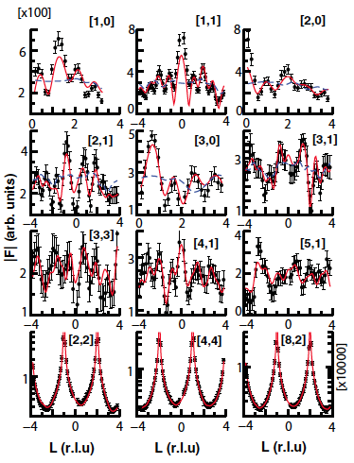
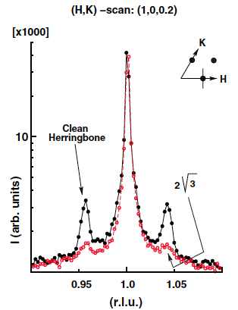
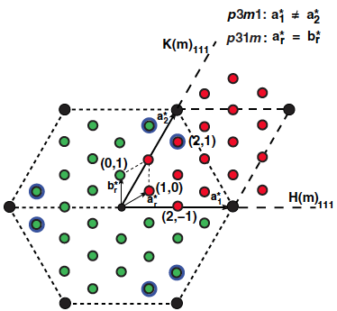
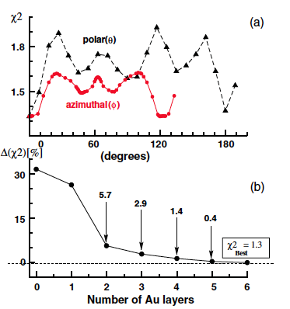
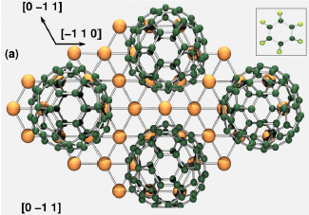
Scientific cases. Molecular systems: C60/Au(111)
Sensitivity of X-rays to systems with low scattering factor: molecules (organic / inorganic)
In-situ sample preparation: i) minichamber ii) SPL + babychamber
Clean Au(111): herringbone – 22x√3
C60/Au(111)-(2√3x2√3)-R30º
Experimental data + guest model
+ (I_{exp} – I_{calc})
Model refining
C60
ρ(e⁻)
- Vacancies
- Molecular &
substrate order
30º
Au
C60/Au(111)(2√3x2√3)R30º
guest model

Slide 13
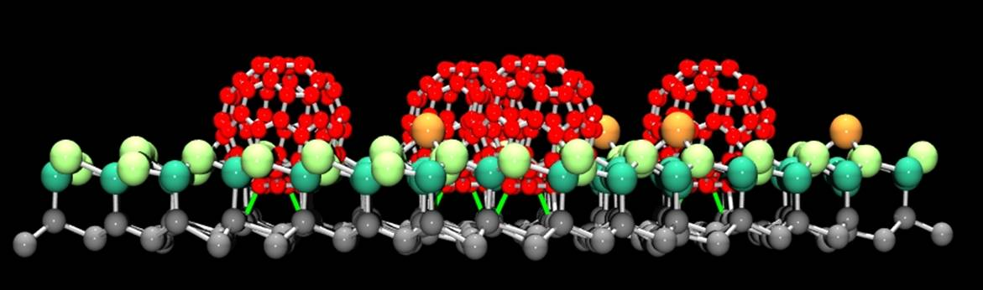
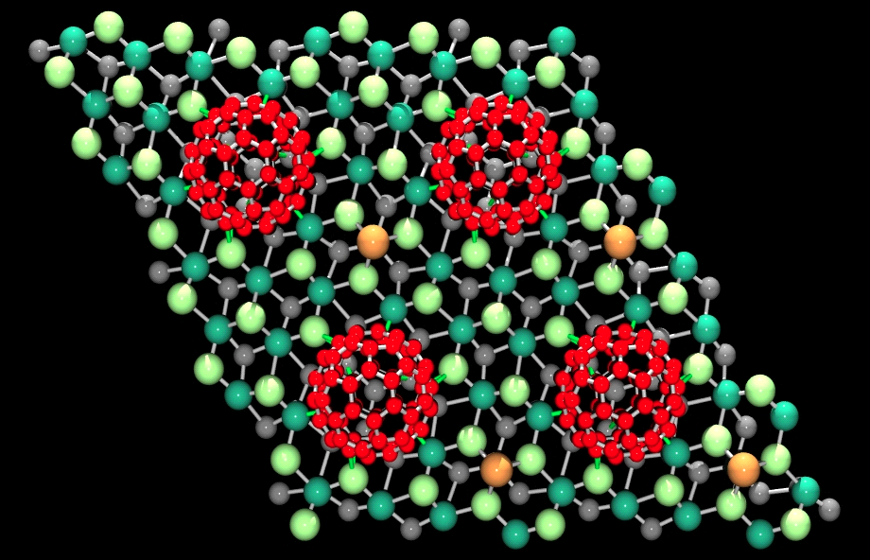
Scientific cases. Molecular systems: C60
C60/Au(110)
C60/Au(111)
C60/Pt(110)
C60/Ge(111)
1
2
3
4
Phys. Rev. B 77 (2008) 153412
Phys. Rev. B 86 (2012) 075471
Phys. Rev. B 81 (2010) 041404R
ESRF Newsletter 39 (2004) 1718
Reconstruction Vacancies C-Atom_{Subst} Bond character
1: (6x5) -9 ∼3 Å ionic
2: (2√3x2√3)R30º -1 ∼2.5 Å ionic / covalent
3: c(4x4) +4 ∼2.2 Å covalent
4: (√13x√13)R14º -6 ∼2.0 Å covalent
Pre-screening ALBA phase-III beamline proposals
10 April 2014

Slide 14
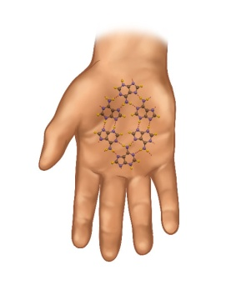

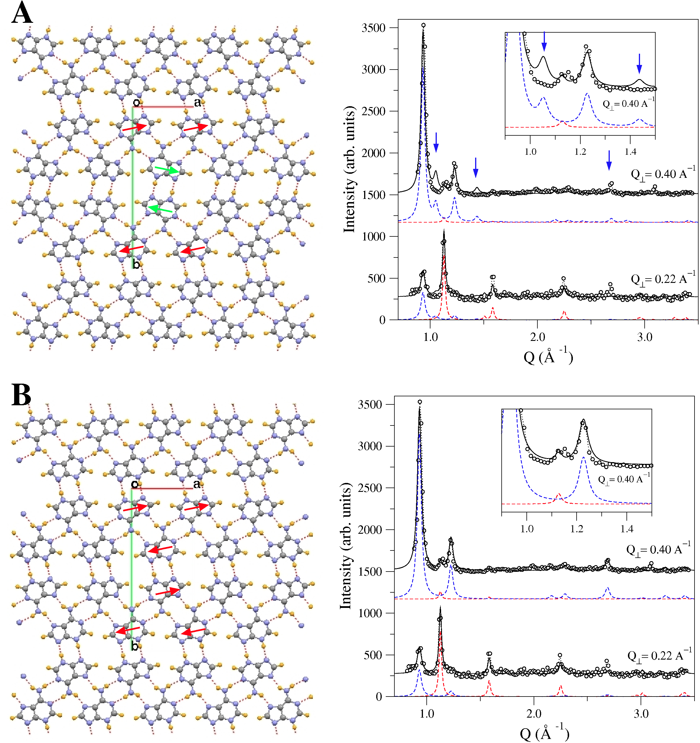
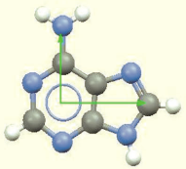
Scientific cases (Soft. Cond. Matt.). Organic films and chirality: Adenine/Au(111)
Sensitivity of X-rays to symmetry in systems with low scattering factor
Chirality
m
: p2gg
Adenine/Au(111)
Bragg_{FWHM} ∼ 15 nm (grain size).
Two perpendicular stacking. models:
α (p2gg) & β (p2)
Textured growth along z-direction.
I_{Q} = (I_{Q||},I_{Qz})
Radial scans at different Q_{z}
(I_{exp}–I_{calc}) permits identify the grown phase.
DFT confirms the higher stability of
β-phase.
: p2
R(180º)
Flip (E>>)
Capitán et al., CHEMPHYSCHEM 12 (2011), 14 (2013)
Pre-screening ALBA phase-III beamline proposals
10 April 2014

Slide 15
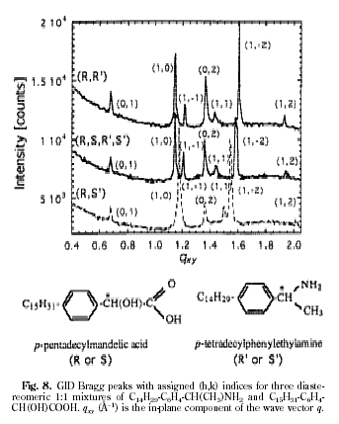
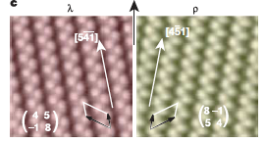
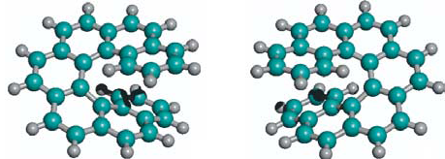
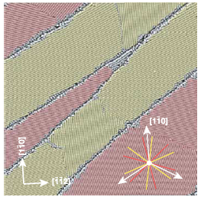
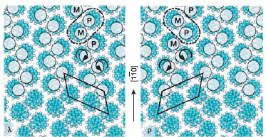
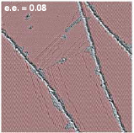
Soft Condensed Matter: Amplification of chirality in 2D lattices
i) Spontaeneous separation of enantiomers in Langmuir films
ii) Enantiomeric separation in 2D: Some bulk symmetries excluded, so, chiral interactions enhanced (microscopic scale). Pharmacological interest
i)
C₁₄H₂₉ & C₁₅H₃₁
ii) Heptahelicene / Cu(111)
m
p
C₃₀H₁₈
m
p
I. Kuzmenko et al., Chirality 10 (1998) 415
- The unit cell of the films contains one pair of molecules with different configuration. R-R’, R-S’...
- GID can distinguish between the structure of the different types of films (enantiomer ordering).
- Chiral domains show enantiomer disorder.
Racemic domains (μm)
STM (200x200) μm
With enantiomeric excess
only one domain is formed
ee = (m-p)/(m+p) = 008
Pre-screening ALBA phase-III beamline proposals
10 April 2014
Homochirality
R. Fasel, Nature 439 (2006) 449

Slide 16
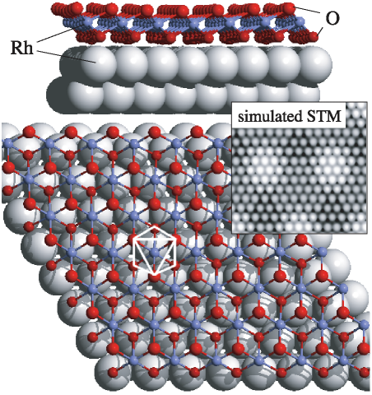
Surface structure & catalysis: CO oxidation reaction on Rh(111)
STM & SXRD:
Bulk and surface oxide cell (9x9):
PO₂ ∼ 2x10⁻³ mbar @ 800 K
Side and top views of the most stable Rh surface oxide as calculated by DFT (octahedrally coordinated Rh atom is indicated).
The inset shows the STM simulation.
a _{Rh111} = 2.72 Å
a_{Rh2O3} = 3.02 Å
a_{O-Rh-O} = 3.10 Å
J. Gustafson et al., Phys. Rev. Lett. 92 (2004) 126102
Pre-screening ALBA phase-III beamline proposals
10 April 2014
Rh₂O₃

Slide 17
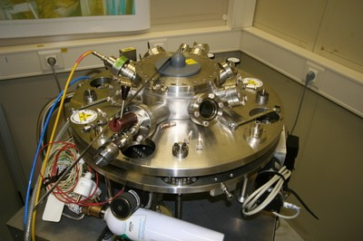
Surface structure & catalysis: CO oxidation reaction on Rh(111)
I
II
III
IV
I) O₂: Oxide formation
II) CO introduction: the reaction 2CO + O₂ ➔2CO₂ and the surface is reduced
III) O₂/CO partial pressure progressively increases.
IV) At this point the gas mixture again becomes oxidizing: the surface oxide returns.
Surface structure evolution while monitoring the reaction productos.
J. Gustafson et al., Phys. Rev B 78, (2008) 045423
Pre-screening ALBA phase-III beamline proposals
10 April 2014

Slide 18
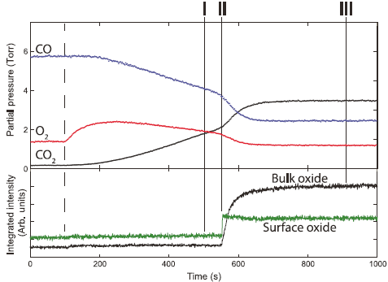
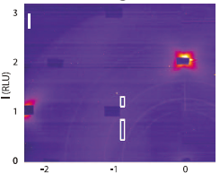
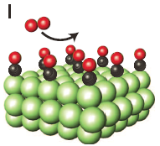
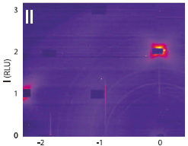
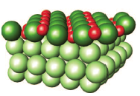
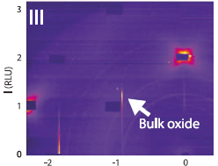
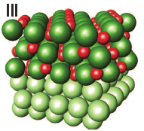
Surface structure & catalysis: CO oxidation on Pd(100)
P-T phase diagrams; surf. structures identification; real time experiments operando conditions
CO oxidation reaction in stoichiometric conditions [CO:O2 = 2:1] @ 57 5K with a Pd(100) catalyst.
I) Reaction starts from the clean surface (metallic)
II) A 3 layer active surface oxide is formed (O-Pd-O). Bulk oxide starts to form (not active)
Surf. oxide: (√5x√5)R27º
J. Gustafson et al., Science 343 (2014) 758
Pre-screening ALBA phase-III beamline proposals
10 April 2014

Slide 19
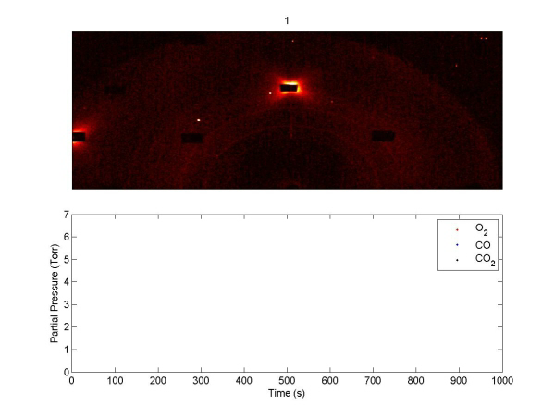
Surface structure & catalysis: CO oxidation on Pd(100)
Pre-screening ALBA phase-III beamline proposals
10 April 2014

Slide 20
Investigation of nanostructures
Order, composition, strain
x-ray diffraction to measure reciprocal space mappings.
Observation the intensity distribution in the surrounding area of
a reflection: surface and/or substrate (Bragg reflection).
- Chemical distribution / composition in particles (anomalous scattering),
structural ordering,
- 2D ordered arrays of quantum dots and 3D ordered superlattices,
- 3D ordering and strain distribution in quantum dots, nanoislands, thin films..
size, shape, and positional correlation
x-ray reflectivity, GISAXS (sensitive to mean electron density)
Pre-screening ALBA phase-III beamline proposals
10 April 2014

Slide 21
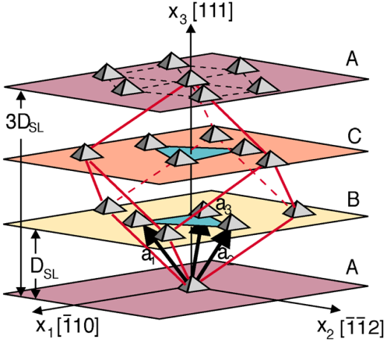
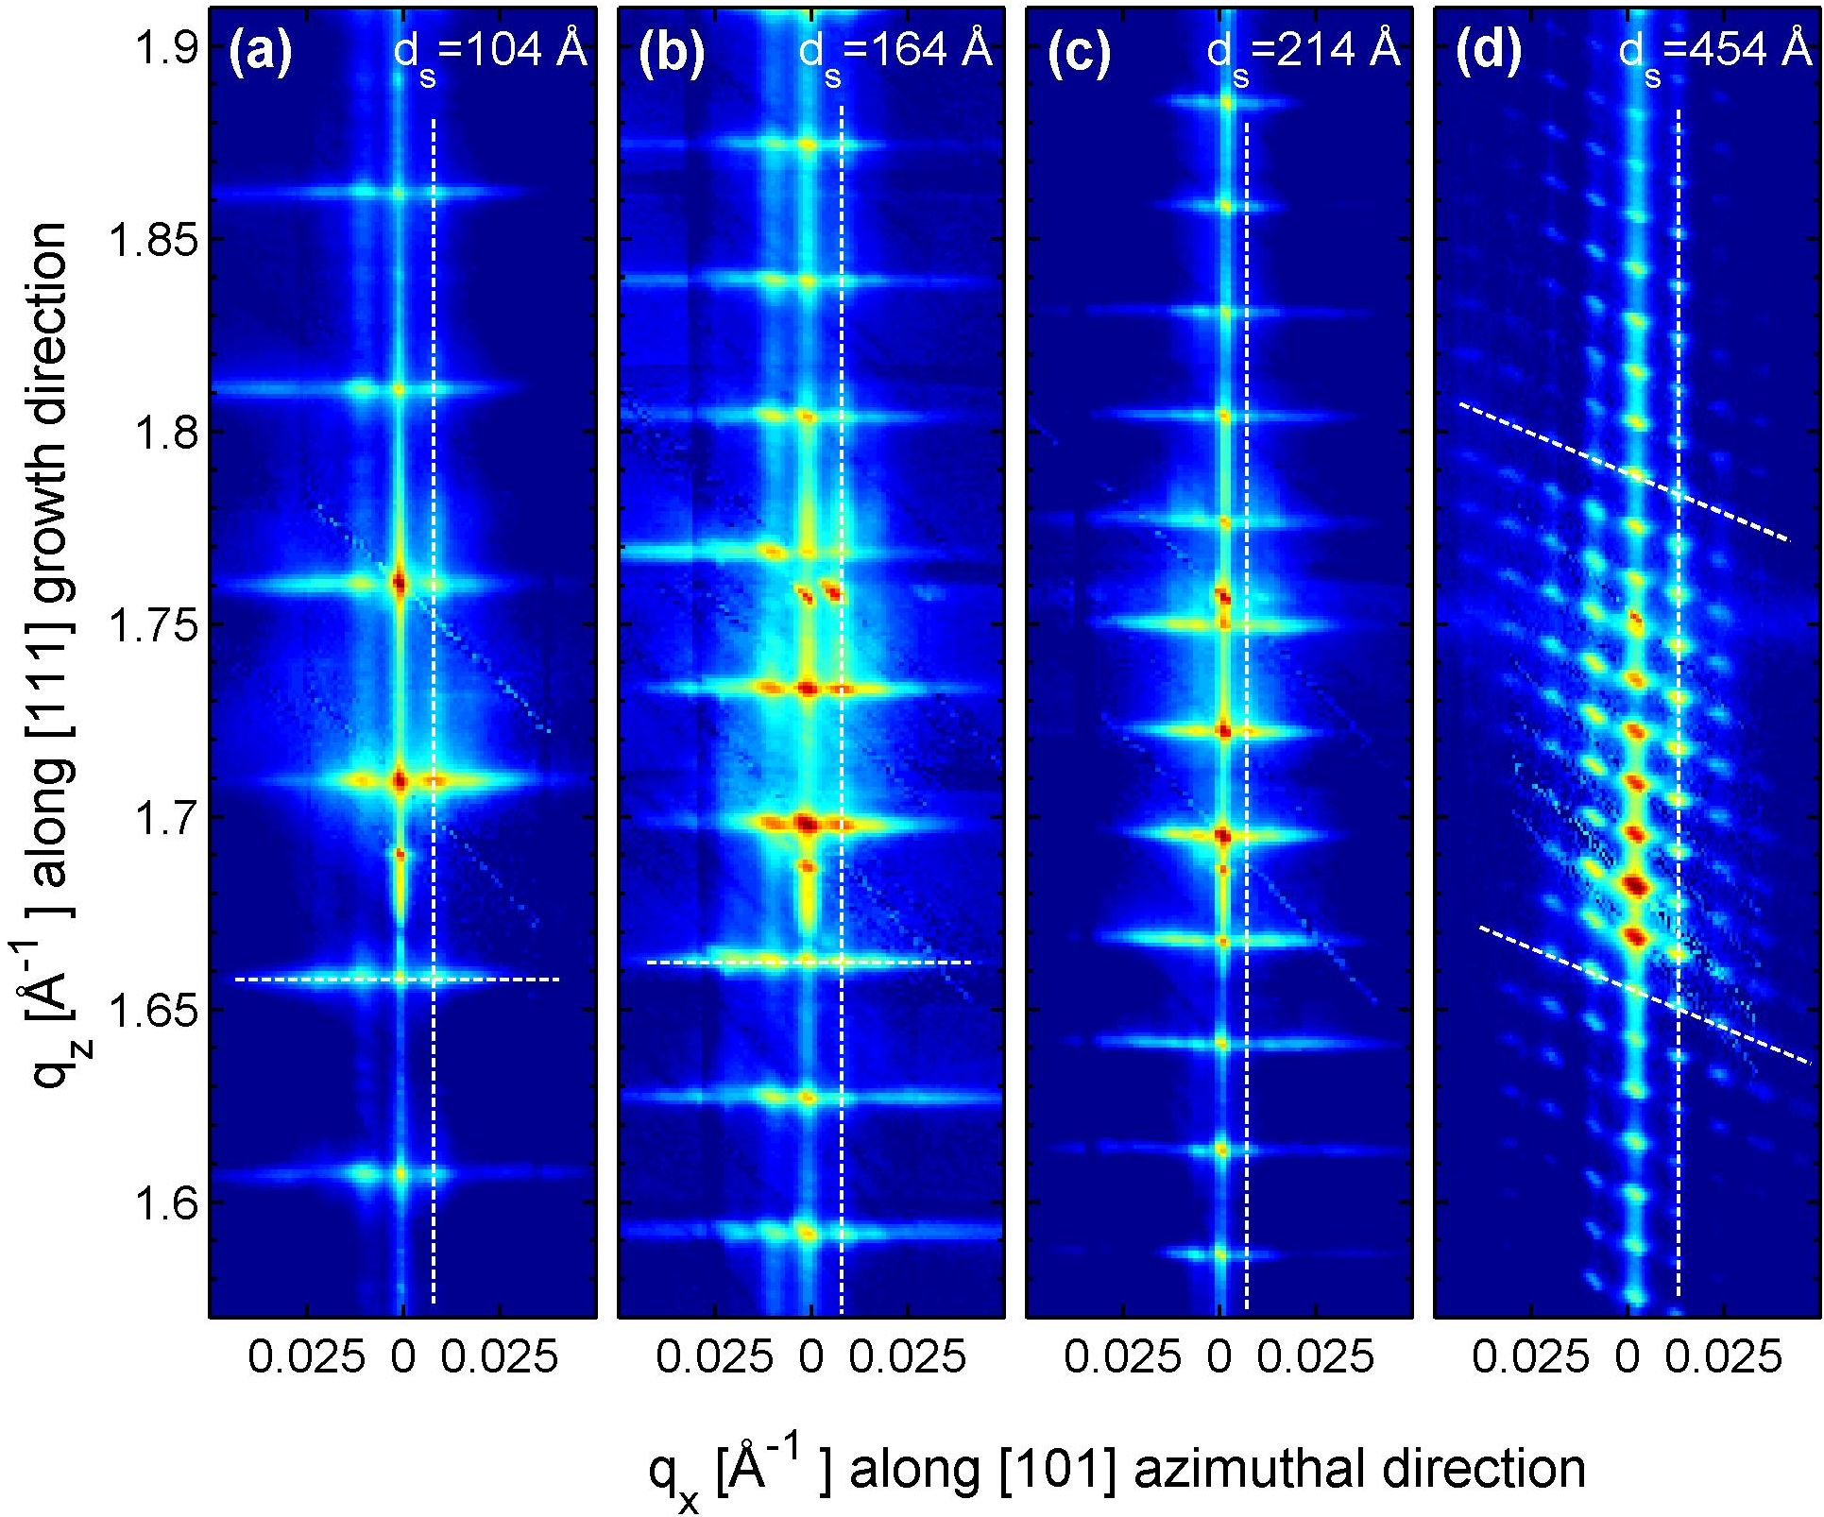
Nanostructures: 3D quantum dots: PbSe/Pb_{1-x}Eu_{x}Te (0.05<x<0.1)
1)
1) Substrate: BaF₂(111)
PbSe arranged dots in a single layer (MBE growth)
2) Dots arranged in trigonal lattice with ABCABC stacking (fcc)
The elementary dot cell (red) is nearly cubic. Periodcity = 3D_{SL} (p3m)
3) AFM image of the topmost single layer (60 period dot superlattice). Inset: Fourier Transform of the image.
2)
(111) Reciprocal space mapping
fcc-stacked
dot SLs:
inclined row
of satellites
long-range 3D trigonal
ordering
Vertically aligned
dot SLs:
Broader
lateral
satellites
short-range
ordering
3)
Δq_{x}, Δq_{z} width evolution related with vertical and lateral ordering parameters on 3D dots distribution.
to (c) 3D hexagonal; (d) 3D trigonal.
R.T.Lechner et al.,
Appl. Phys. Lett. 84 (2004) 885

Slide 22
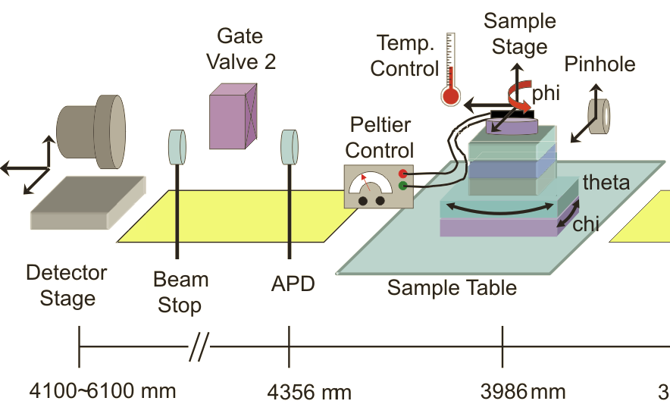
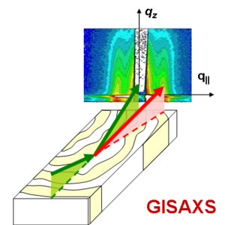
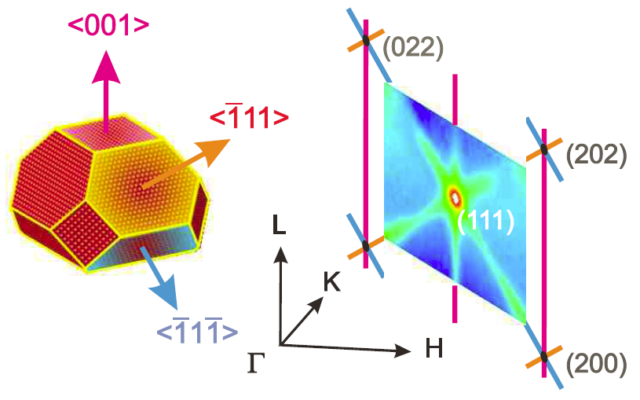
Nanostructures: GISAXS
XRR: Normal density profile
SAXS:Lateral structure inf.
α_{f}
2θ_{f}
I = f(α_{f},2θ_{f})
α_{i}
Film
Long range ordering og block copolimers (dense data storage)
Composite membranes (artificial photosynthesis)
Inorganic nanocomposites (electrochromic windows)
Batteries & fuel cells
OPB-BHJ (organic photovolt. /bulk heterojunction) materials
Lithographic patterning
Self assembly of nanoparticles
Virus nanofiber tissue (enginnering materials)
Diluted systems / catalysis in operando conditions, ….
Pre-screening ALBA phase-III beamline proposals
10 April 2014

Slide 23
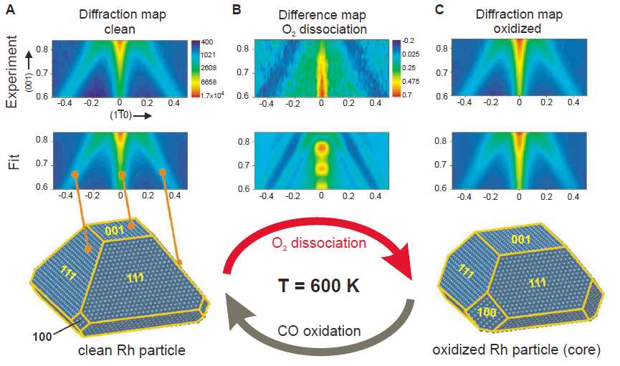
GISAXS: shape profile changes in catalyst Rh NP
PO₂ = 3x10⁻⁵ mbar
PCO = 10⁻⁵ mbar
JP. Nolte et al., Science 321 (2008) 1654
Oxidation: 001 facet increas at cost of decreasing 111 facets
Reducing the NP (CO oxidation) makes recover its original shape
Pre-screening ALBA phase-III beamline proposals
10 April 2014

Slide 24
Supporting scientist
Dr M.J. Capitán Aranda IEM-CSIC
Dr. J. Álvarez Alonso Dpto. FMC-UAM
Dr. X. Torrelles Albareda ICMAB-CSIC
Dr. J. J. de MiguelLlorente Dpto. FMC-UAM
Dr. Oier BikondoaXMAS (UK beamline) @ ESRF, UK
Dr. José Santiso ICN2-CSIC
Prof. José Luis García Muñoz ICMAB-CSIC
Dr. Enrique Herrero Dpto. QF-Univ. Alicante
Prof. Juan M. Feliú Dpto. QF-Univ. Alicante
Dr. Alfonso Cebollada IMM-CSIC
Dr. Jorge M. Martínez García IMM-CSIC
Dr. Miguel A. Rodríguez Pérez Dpto. FMC-Univ. Valladolid
Prof. José A. de Saja Sáenz Dpto. FMC-Univ. Valladolid
Dr. Rafael Andreu Fondacabe Dpto. QF-Univ. Sevilla
Dr. Juan J. Calvente Pacheco Dpto. QF-Univ. Sevilla
Prof. Enrique Fatás Dpto. QF-UAM
Dr. Concepción Alonso Dpto. QF-UAM
Dr. Miguel Clemente León ICM-Univ. Valencia
Dr. Javier Díaz Dpto. FMC-Univ. Oviedo
Prof. Fausto Sanz Dpto. QF-Univ. Barcelona
Dr. Mercedes Perez-Mendez ICyTP-CSIC
Dr. Julio Camarero de Diego Dpto. FMC-UAM
Dr. Germán Castro ICMM(SPLINE)-CSIC (ESRF)
Dr. Jose A. Martín Gago ICMM-CSIC
Dr. Maria F. Lopez ICMM-CSIC
Dr. Julio Camarero de Diego Dpto. FMC-UAM
Dr. Germán Castro ICMM(SPLINE)-CSIC (ESRF)
Dr. Jose A. Martín Gago ICMM-CSIC
Dr. Maria F. Lopez ICMM-CSIC
Dr. Maria Alonso ICMM-CSIC
Dr. F. Pigazo ICMM-CSIC
Dr. F. Javier Palomares ICMM-CSIC
Dr. Carlos Prieto ICMM-CSIC
Dr. Alicia de Andrés ICMM-CSIC
Dr. Esther Barrena MPIM-Stuttgart
Dr. Carmen Ocal García ICMM-CSIC
Prof. Federico Soria ICMM-CSIC
Dr. M. Eugenia Dávila Benítez ICMM-CSIC
Dr. Juan de la Figuera Ballón Dpto. FMC-UAM
Prof. Rodolfo Miranda Soriano Dpto. FMC-UAM
Dr. Amadeo L.V. de Parga Dpto. FMC-UAM
Dr. Leonardo Soriano Dpto. FA-UAM
Dr. Juan José Hinarejos Murillo Dpto. FMC-UAM
Prof. Clara Conde Dpto. FMC-Univ. Sevilla
Dr. Mª Ángeles Gómez Rodríg. IcyTP-CSIC
Dra. Mª Esperanza Cagiao IEM-CSIC
Pre-screening ALBA phase-III beamline proposals
10 April 2014

Slide 25
Supporting scientist
NANOMOL Group ICMAB-CSIC
- Prof. Jaume Veciana
- Prof. Concepció Rovira
- Dr. Inma Ratera
- Dr. Marta Mas Torrent
- Dr. Evelyn Moreno
Dr. Pilar Ferrer Escorihuela DIAMOND Light Source, UK
Pr. Mohamed Larbi Merroun Dpto. Microbiología, Universidad Granada
Prof. Alejandro Fernández-Martínez CNRS & Univerity Grenoble Alpes, Francia
Prof. Enrique Rodríguez Castellón Dpto. Química Inorganica, Universidad de Málaga
Dr. Miguel A. Ciria Inst. Cienc. Mat. Aragón, CSIC-Universidad de Zaragoza
Prof. Fernando Rey García Inst. Tecnología Química, UPV-CSIC
Prof. Leonardo Soriano de Arpe Dpto. Física Aplicada, UAM
Dr. Carlos Quirós Fernández Dpto. Física. Universidad de Oviedo
Grupo de Caracterización de Materiales Universitat Politécnica de Catalunya (UPC)
Dpto. Física I Enginyeria Nuclear
- Prof. Josep Lluis Tamarit Mur
Dr. Juan J. de Miguel Dpto. FMC-UAM
Prof. Enrique García Michel Dpto. FMC-UAM
Dpto. Química Inorgánica e Instituto de Materiales Universidad de Alicante
- Prof. Emilia Morallón Núñez
- Prof. Diego Cazorla-Amorós
Pre-screening ALBA phase-III beamline proposals
10 April 2014

Slide 26
Scientific cases and priority lines of Horizon 2020
Horizon 2020: contents compatible with the Surface beamline:
I) Excellent Science
Future and emergent technologies: Promote new ideas to develop technological research, risky, to explore new bases for future technologies.
Attractive opportunities for training and mobility. Promote the cross-link knowledgment between different disciplines, countries and highly qualified personnel.
II) Industrial opportunities
- Sensors, organic electronic compounds.
- New generation of nanomaterials providing sustainable solutions: functional materials, biocompatibility.
Development of the social dimension of the nanotechnology: To cover the needs of human and physical infrastructures.
Development of techniques, measurement methods and equipments susceptible to develop the research capabilities.
Surface and Inerface beamline
III) Social challenges
Health: development of new type of targeted drugs .
Energy: New types of renewable energy and reuse, i.e.,CH₄ to H₂. Hydrogen technology.
Storage and capture of CO₂.
Cross-link between multi-disciplinar research (fields: nanoscience, materials science, solid state physics, bioscience,...) to promote new developments in technology.
Pre-screening ALBA phase-III beamline proposals
10 April 2014

Slide 27
Synergies between the surface beamline and ALBA
UHV: “Surf. Prep. Lab.”
Prof. C. Ocal & Dr. E. Barrena
Surfaces & Interfaces beamline
CIRCE (PEEM and NAPP) (microscopy and spectroscopy)
MSPD (powder diffraction)
UHV/instrumentation: qualified staff
BOREAS (absorption and dichroism
NCD (SAXS)
Nanotechnology, catalysis
Electronic structure ←→ complementary with structural in surfaces and interfaces
Pre-screening ALBA phase-III beamline proposals
10 April 2014

Slide 28
Conclusions
Scientific areas covered:
- High number of different types of experiments:
- Soft / hard condensed matter: surface - thin films –
microscale
- Biology/Physics/Chemistry: GISAX
- Integrate Physics and Chemistry phenomena in single
experiments: catalysis, electrochemistry,... : (GIXRD)
- A high number of relevant technological areas promoted by European Community (H2020) related with the development of new materials and techniques are well justified in this proposal.
- The beamline is compatible with coherence type of experiments.
- A second station could integrate LAUE micro-diffraction and Xtal micro-diffraction or other compatible possibilities, mixing more than one technique.
Pre-screening ALBA phase-III beamline proposals
10 April 2014

Slide 30
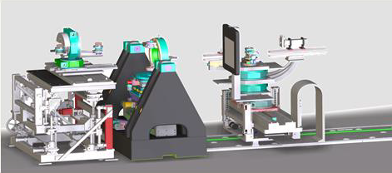
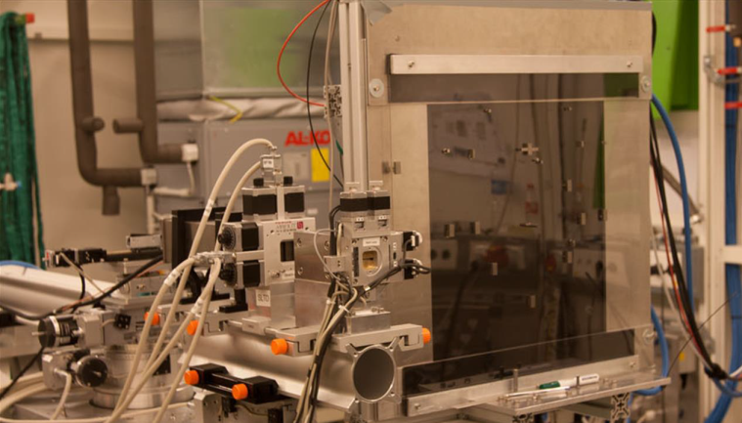
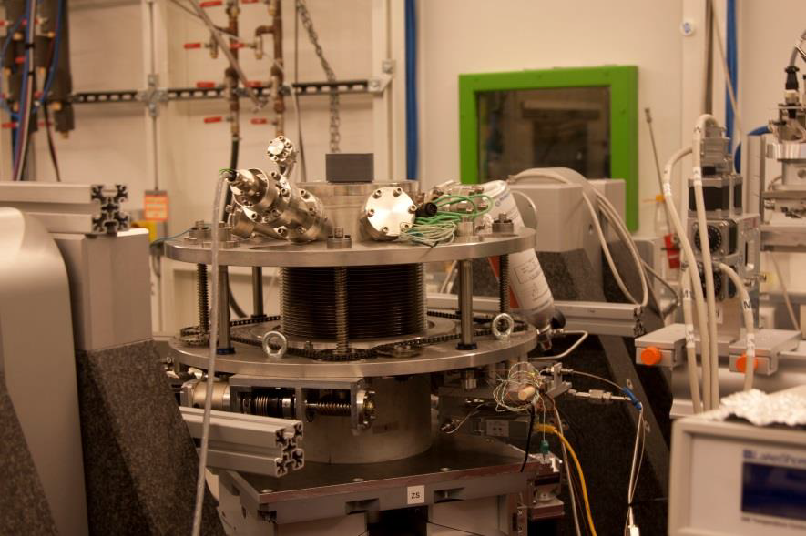
EH2 at the P07 beamline at PETRA III
Si(111) and tuneable in a photon energy range from 35 to 200 keV
The 2D area detector is a CsI scintillator on amorphous silicon photodiodes.
Active area is 400 × 400 mm2 and the pixel size is 0.2 × 0.2 mm2
α= 0.04º (∼ α_{c} -Pd); E_{in} = 85 keV; Sample-detector distance: 1.75m
Table for optics, slits…
2D detector
Sample stage
NaI point detector
2D detector: W-pieces at the position of Pd Bulk bragg peaks
Flow reactor chamber. The bellow is up whilst sample cleaning (UHV)
Pre-screening ALBA phase-III beamline proposals
10 April 2014

Slide 31

Coherent – Incoherent X-rays
Incoherent radiation: Yields the average spacing d of a collection of scatterers.
The speckles, each having an angular width λ/a, arise from the interferences between the wavefronts scattered from the different particles. If the position of a single particle is changed, all interferences are affected, and the complete speckle pattern changes. The pattern therefore contains information on the positions of all particles.
Pre-screening ALBA phase-III beamline proposals
10 April 2014

Slide 32






Lensless coherence imaging
Plane-wave CDI: 3D representation of single objects (shape and 3D- distribution of ρ(r))
GaN nano-particles {GaN-Ga₂O₃ core shell}; 600 μm
E = 5 keV; green GaN (high ρ)/ blue Ga2O3 (low ρ);
J. Miao et al., Phys. Rev. Lett. 97 (2006) 215503
Bragg CDI: mapping a Bragg reflection. Rotating sample.
- Need of phase retrieval procedures to get information in real space .
Gold nanoclusters (1 x 3 μm); reflection (1,1,1)
- Techniques can measure the full strain tensor in nanocristals and nanomeer scale [PRL 87 (2001) 195505]
G.J. Williams et al., Phys. Rev. Lett. 90 (2003) 175501
Reflection geometry CDI: Holography by using a screen containing object and reference holes for phasing the pattern (object obtained by FT of the image): single shot imaging
Placing a pinhole before the sample: XPCS
Time correlation experiments, dynamics,
Fluctuations, dislocations, domain walls, CDW/SPW defects, biologic membranes,...
Pre-screening ALBA phase-III beamline proposals
10 April 2014

Slide 33




LAUE μ-diffraction
Objectives:
- Submicron spatial resolution in 2D.
- Fast mapping of crystal orientation and strain fields in polycrystals: local deviatoric (on b/a, c/a, α, β, γ [shape changes]) & hydrostatic part (volume changes) of the strain tensor (Δa/a) (measuring the energy profiles of Laue spots).
Submicron accuracy: sample position and raster scan.
Sample Laue pattern
Diamond Laue pattern
45º
O. Robach et al., Acta Cryst. A 69 (2013) 164
The filter created well-defined dips in the E-spectrum of the white incident beam. These dips shift in E with the
rotation, ans succesively attenuate the various Laue spots of the sample. The dips permit calibrate the real energy
of the beam with that scattered by the sample which is affected by strain.
- The system can also be used for μ-diffraction crystal structure determination.
Pre-screening ALBA phase-III beamline proposals
10 April 2014

