Slide 1
Round Table: open questions
Alba II High Pressure Workshop
28.10.2021

Slide 2
synchrotron techniques to address challenges in HP instrumentation and research
strategies and methods for synchrotron techniques: sample environments, complementary techniques
data collection and analysis strategy: time resolved experiments,
data science (machine learning, etc)
HP Alba program: present and future
other relevant issues for HP program @ ALBA II

Slide 3

Support services
HP X-ray diffraction @MSPD
high productivity | driving force HP program
large beam for HP: 25x25 µm² (wiggler source)
upgrade detector (obsolete)
automate data collection
High Pressure laboratory
limiting supporting infrastructure
Sample environment pool shared between BLs
IR spectroscopy @MIRAS
vertical geometry & working distance limiting SE
automate data collection (automate pneumatic drive)
X-ray absorption @CLAESS
flux, missing focusing optics
nano polycrystalline (glitch free)

Slide 4
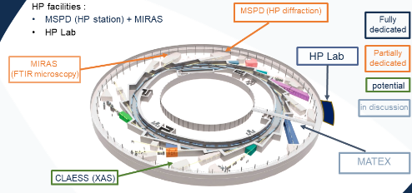
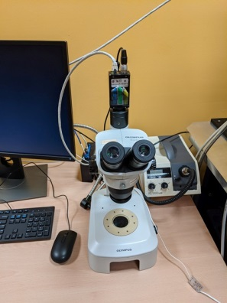
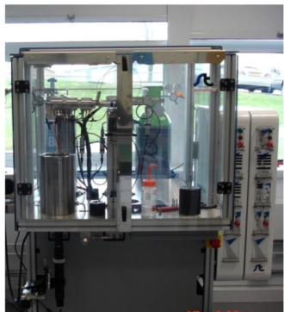
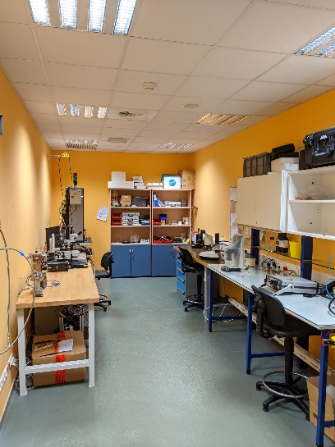
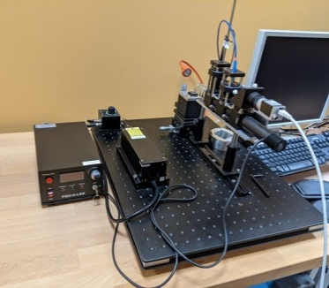
HP laboratory
HP Lab role:
Service HP BLs| loan pool and development
size of HP lab: limit factor of the HP program (1pers)
Adjust staffing!
dedicated technician +
beamline scientist
HP Lab equipment:
Microscopes for DAC loading
Indentation ‘stage’
offline PRL for ruby fluorescence
Instrumental development
Laser drilling machine (soon)
HP Lab extension:
gas loading machine
inert atmosphere DAC handling
off-line characterization

Slide 5
Future perspective HP techniques
Beamline
spatial resolution (3-5μm) for HP X-ray diffraction
Undulator source at HP-MSPD (20-40 keV)
Upgrade detector (high energy efficiency)
Complementing with dynamic compression (piezo actuators DAC) & multichannel collimator (low Z elements)
High Pressure laboratory
Sample environment shared between BLs
Laser heating (pulsed/flash 6000K)
resistive heaters (2000 K)
gas loading machine
Far-IR spectroscopy program (5μm)
develop home made Cassegrain microscope to move to horizontal geometry
X-ray Emission Spectroscopy
Evaluate dedicated beamline or mini XES spectrometer for existing BL
Multiple analyzers to increase solid angle coverage (resolution 1-2 eV)
spatial resolution (5μm) for HP X-ray absorption
Undulator source at CLAESS (5-30 keV)
KB mirrors as focusing optics
nano polycrystalline (glitch free)
X-ray Imaging
Evaluate tomography in large volume cell for existing BL (Faxtor 20-70 keV)
Computing
data analysis
Online visualization
Data base access

Slide 6
HP microXRD @ALBA
Beam size limitation for XRD at MSPD
MSPD upgrade
Undulator source at HP-MSPD (20-40 keV)
Upgrade detector
Scenario 1
Microfocus PD BL: HP program + microXRD (5μm)
Undulator source (15-40 keV)
High energy detector
Scenario 2
MATEX beamline (3μm) for HP XRD
Undulator source (20-40 keV)
KB mirrors as focusing optics
High energy detector
Scenario 3

Slide 7
Matter AT EXtremes (MATEX) beamline
• A1 - new beamline feasible within time, budget and administrative conditions, for construction in the period 2022-2025, to be operative in ALBA and in ALBA II
• A2 - new beamline to be operative only in ALBA II, not to considered for starting in 2022
• Upgrade BL - possible upgrade of existing beamline, not to be considered for starting in 2022
• Others - beamlines or instruments not using synchrotron light
Juan Ángel Sans (UPV, SP), Jose Antonio Alonso (ICMM-CSIC, SU), Vera Cuartero (UNIZAR, SU), Daniel Errandonea (UV, PI), Virginia Monteseguro (UCAN, SU), Miriam Peña-Álvarez (U. Edinburgh, SU), Catalin Popescu (ALBA, PI)
MALTA-Team (20 Spanish groups), EHPRG (European HP community) and AIRAPT (International HP community) support this proposal

Slide 8

Thank you for your participation!
contact: feedback & suggestions
cpopescu@cells.es

