Slide 1
Welcome & Introduction to: ALBA II High Pressure Workshop on Scientific and Instrumental Advances in High Pressure Techniques
By Klaus Attenkofer
28.10.2021

Slide 2
The Context: ALBA II
ALBA upgrade decision to a 4th generation synchrotron was granted in December 2020; the goal of the upgrade is:
Bringing all facilities of ALBA to a modern, state-of-the-art standard guaranteeing stable and effective operation for the next 20-25 years.
Significantly strengthening the microscopic capabilities.
Providing high throughput capabilities and integrating big data approaches in the research portfolio.
Strengthening the operando and in-situ capabilities.
Preliminary ALBA II timeline:
Providing a scientific case and defining key parameters for the upgrade (including first 2 additional instruments): January 2022.
Preliminary design of accelerator complex and instrumentation: Mid 2022.
Operation until 2028; large shutdown is currently planned for 2029 with commissioning and start of operation in 2030.

Slide 3
The Context: ALBA’s Mission
ALBA is committed to provide robust highly productive user operation for all national and international user communities. In addition, we will develop enhanced capabilities in the areas of:
Health.
Energy.
Information technology.
The enhanced capabilities of the focus areas will:
Provide all synchrotron characterization tools to study structure and electronic states and their roles in the functions of materials and devices.
Add additional characterization tools (mainly microscopic tools like Electron Microscopy) to reach atomic and subatomic resolution or add additional contrast mechanisms.
Provide all sample preparation and computational tools necessary to enable the user to answer key questions and grand challenges of the field.
And develop methodologies using multimodal approaches.

Slide 4
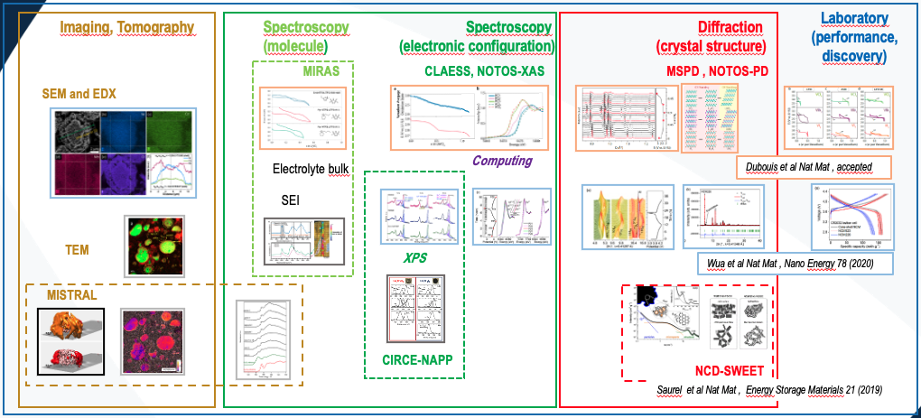
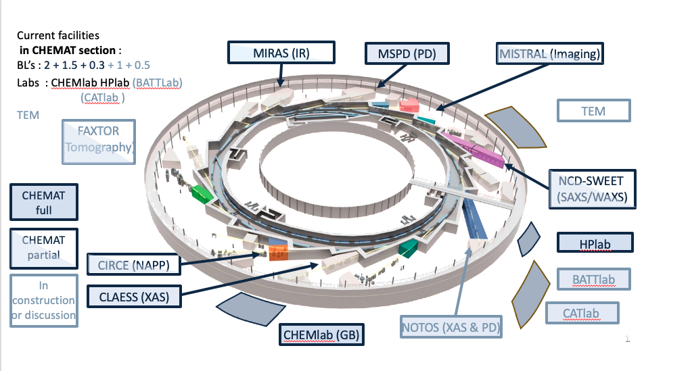
Chemistry and Material Science Section
Tuning Electronic and Chemical Properties by Controlling Atomic Structure of Functional Materials.
Battery case:
Focused on scientific fields:
Energy storage.
Hydrogen circular economy.
Gas (Carbon) sequestration.
Tchitchekova et al Nat Mat , Chem Mat 30 (2018)
Olivares-Marin et al Nat Mat , Nano Lett 15 (2015)
Forero-Saboya et al Nat Mat , Energy Environ. Sci 13 (2020)

Slide 5
The Context of the Workshops
The Section Reviews
Workshops & Colloquium
Call for New Instruments
Goal:
Mission verification.
Strategy review.
Gap Analysis.
Service review.
Stakeholders:
International experts.
National user community representatives.
SAC expert.
Goal:
Identification of grand challenges.
Identification of needs.
Creating awareness in community.
Organizing community.
Stakeholders:
Spanish community.
International experts.
ALBA employees.
AUSE.
Goal:
Identification of instruments and services
Grouping key-players around proposed instruments.
Stakeholders:
Spanish and international community.
ALBA employees.
AUSE.

Slide 6
The Context: ALBA II at a Glance
Beamlines at ALBA II:
13 ID BLs
8 super bend BLs
4 (?) BM Bls
1 IR BL (?)
2 Straights for RF
1 Straight for injection
Beamlines at ALBA: currenly committed or operated ports:
Potential for new beamlines at ALBA II:
9 ID BLs
3 BM Bls
1 IR BL
2 ID BLs (long; low beta-function)
1 ID BLs (long; high beta-function)
1 ID BL (short; low beta-function)
8 super bend BLs

Slide 7
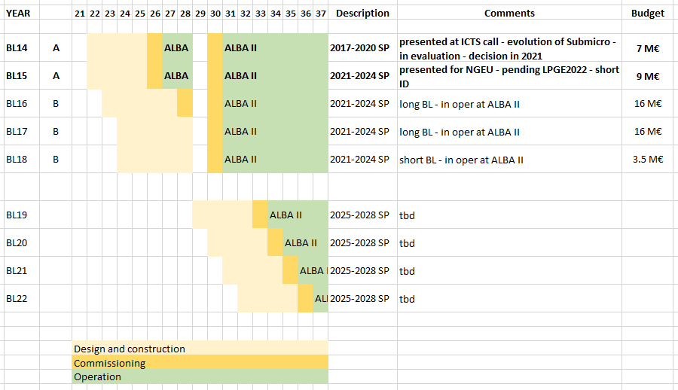
Long Term New Beamline Development Program (As spelt out in strategic plan & current funding expectations)
Operational at ALBA
And to be decided in 2021
Operational at ALBA II
And to be decided in 2022+

Slide 8
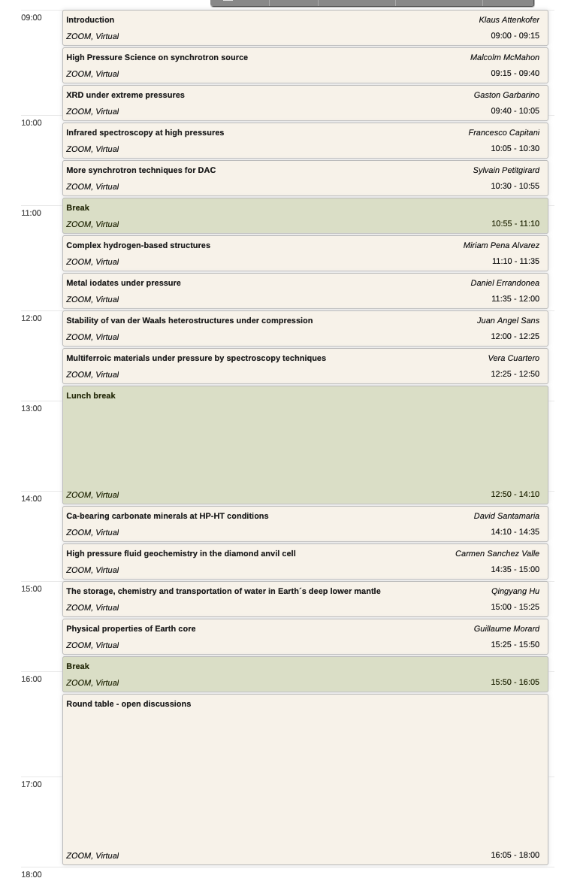
The Workshop: ALBA II – Workshop on APXPS
Goal of Round Table Discussion:
Giving every participant a voice.
Agreeing on grant challenges and
Collecting first characterization(and other) needs.
Defining final workshop report topics which will be used for the science case of ALBA II.

Slide 9
Questions and Answers
Any Questions or Suggestions?

Slide 10
ALBA II process during 2021
Scientific case
ON GOING
Workshops
ALBA II Colloquia
ON GOING
- Section Reviews
BL proposals
FINISHED
From ALBA staff
ALBA II Day (30.6.21)
ON GOING
From ALBA Users
Workshops in preparation:
Catalysis I (grand challenges)
Battery
SAC
Mai
June
July
August
September
October
November
December
January
February
SructuralCellular and Tissue Biology Review
2D Materials WS
Spintronics WS
Magnetism and Electronic Material
and Device Review
Time resolved WS
Material Science and Chemistry Review
First version of science case
With gap analysis
Catalysis II
Catalysis III
Coherence
Macromolecular stractural biology Review
Science case
SAC evaluation of
Science case and beamline
selection
Start of Beamline 14
ALBA II Day (workshop)
Definition of proposal
and preselection for
projects compatible with BL14
Selected proposal development
External review and rating
Internal Call for BL Concepts
Internal presentation of call results
User Community Call for BL Concepts
User Community Call for BL Concepts Deadline
BL proposal

Slide 11
ALBA II process during 2022
Scientific case
PLANNED
Workshops
ALBA II Colloquia
BL proposals
PLANNED
- From ALBA Users
SAC
March
April
May
June
July
August
September
October
November
December
Science case
SAC evaluation of
Science case and beamline
selection
External review and rating
Definition of ALBA II BLs
Analysis of BL concepts
(by ALBA) –
choice of # of them
User Community Call for BL Proposals
ALBA II Day (workshop)
Definition of proposal
and preselection for
Projects for ALBA II BLs
Selected proposal development
BL proposal

